Slide 1




Improving the Intensity of Tropical Cyclones for the AIGFS
Linlin Cui¹*, Jun Wang², Jianjun Liu³, Xiao Luo¹, Wei Li⁴, Jiayi Peng³, Zhan Zhang², Bin Liu¹, Lin Zhu⁴, Qi Shi¹, Alicia Bentley², Jacob R. Carley²
¹Lynker, ³Axiom, ⁴SAIC @NWS/NCEP/EMC
²NWS/NCEP/EMC
U.S. Department of Commerce
National Oceanic and Atmospheric Administration
National Weather Service

Slide 2
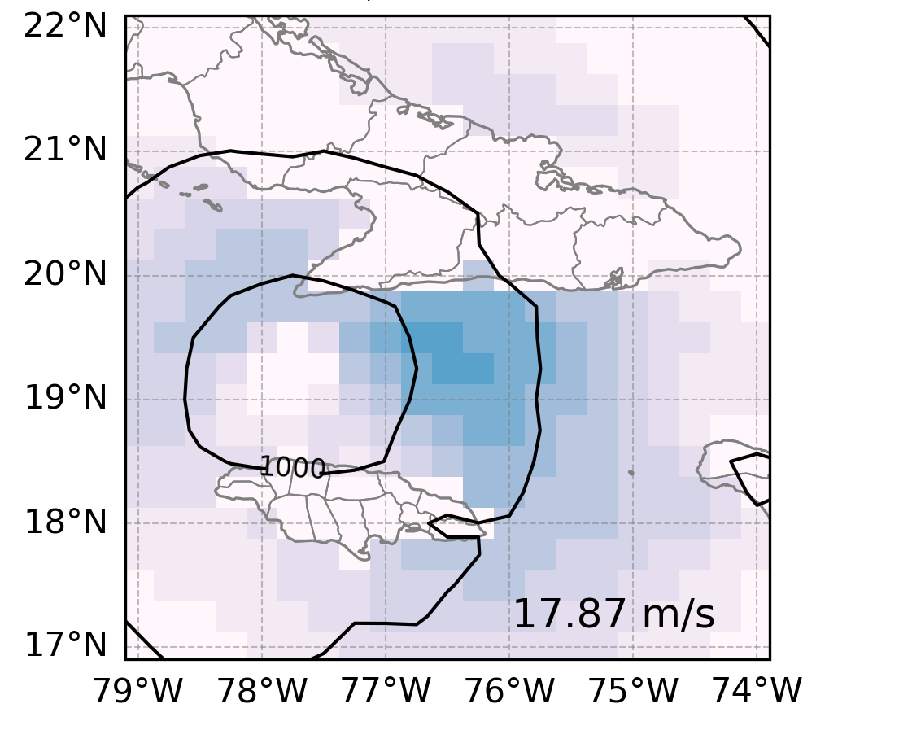

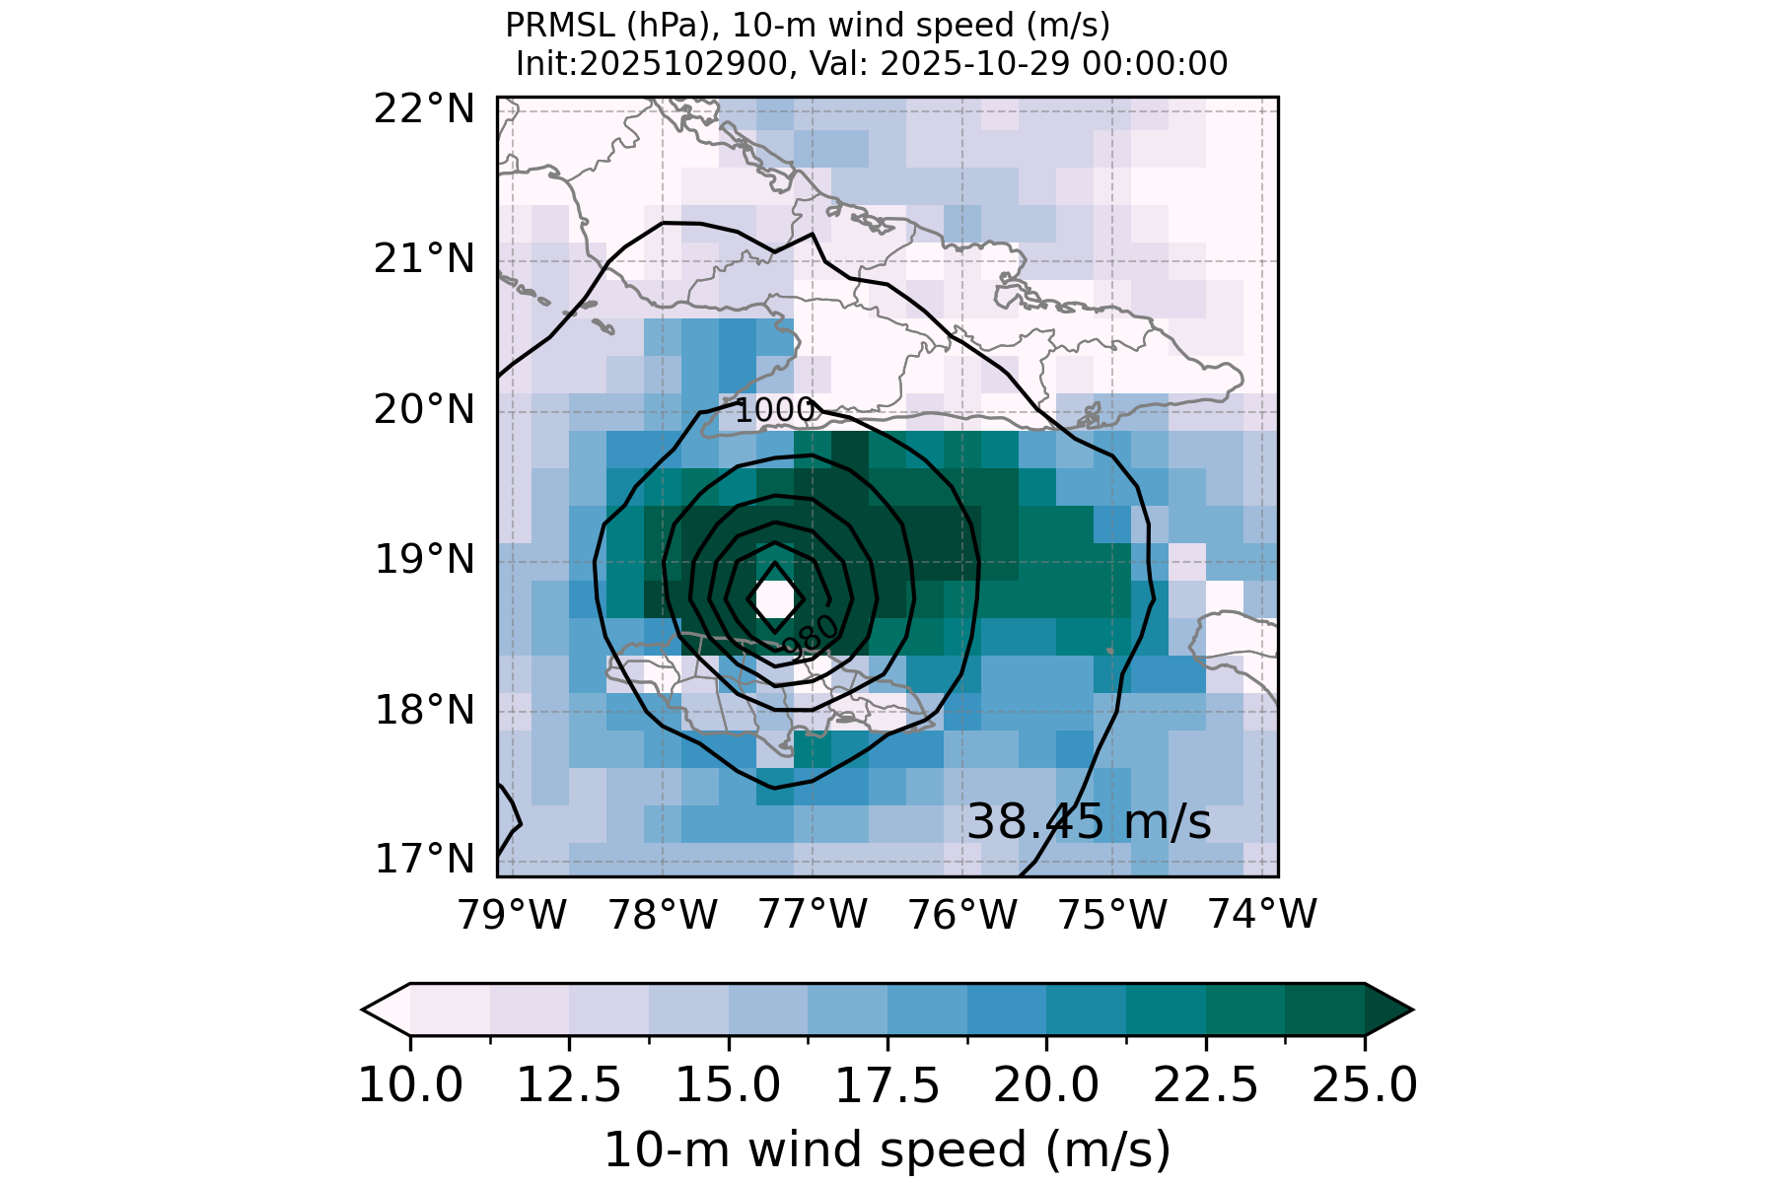

Motivation & Objective
Example: Hurricane Melissia
Improving Storm Structures in AIGFS with Spectral Loss
day 5 AIGFSv1.0
Motivation
Conventional MSE loss tends to oversmooth high-frequency features.
Tropical cyclones (TCs) and other small-scale systems are not well captured.
GFS analysis
Objective
Use spectral-based adjusted MSE (AMSE) loss to better recover small-scale structures, especially TC intensity.
Reduce oversmooth forecast issues at the longer lead times.

Slide 3




Method & Experimental Setup
Model
Google DeepMind’s GraphCast
Graph Neural Network (message passing)
Icosahedral mesh graph
Loss Function: AMSE (Spectral Space)
Data
NOAA GDAS analysis
0.25 resolution
13 pressure levels
April 2021 to March 2025
Penalize errors by spherical harmonic wavenumber
Preserve realistic energy across scales
Reduce over-smoothing at high wavenumbers
Training Setup
Fine-tune from 1 autoregressive (AR) step to 12 ARs
Apply cosine decay scheduler at each AR step
Subich et al., 2025

Slide 4
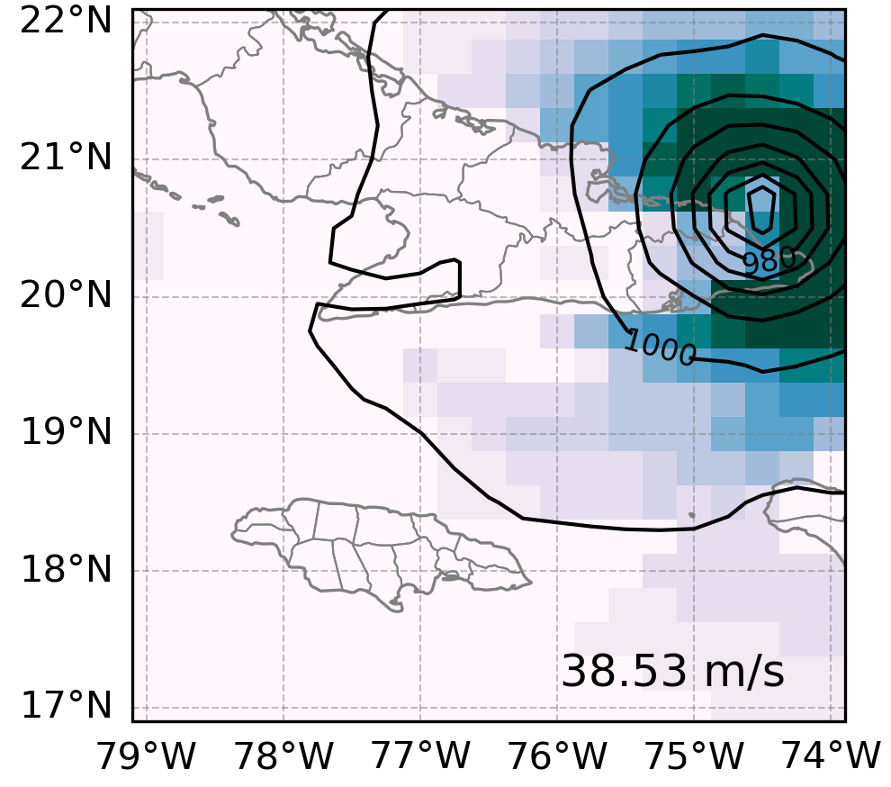
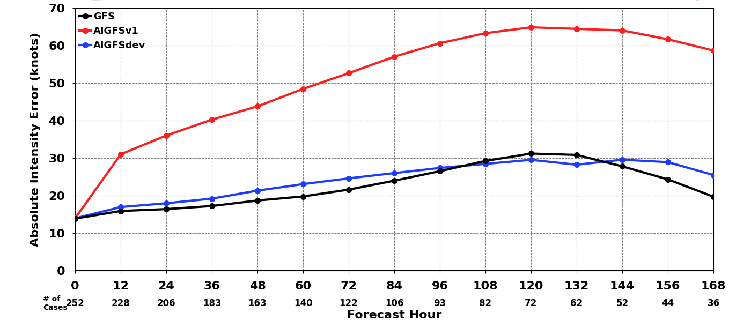
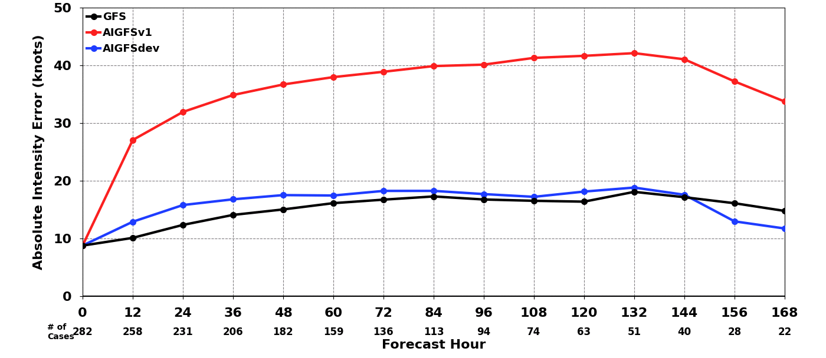
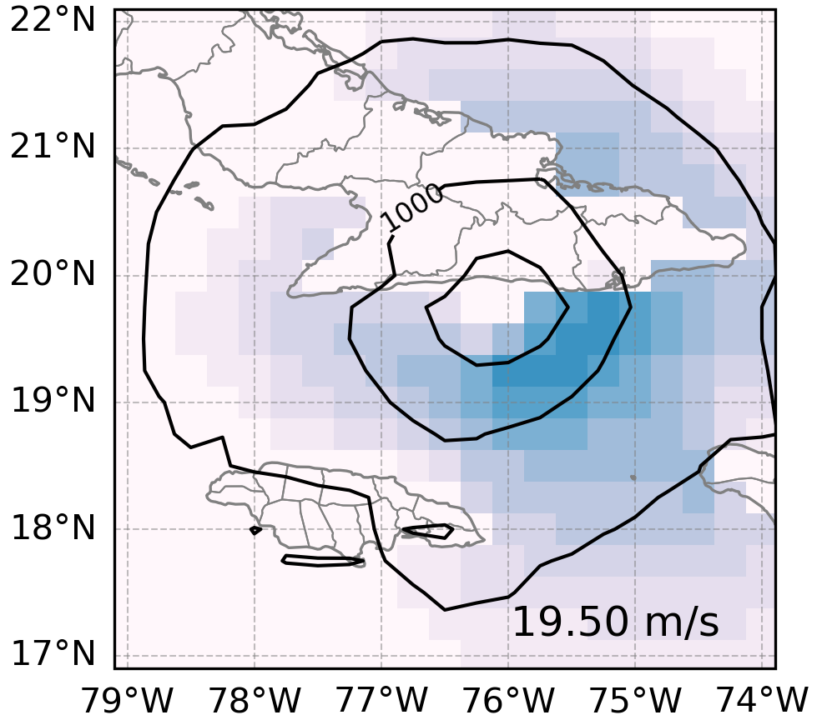
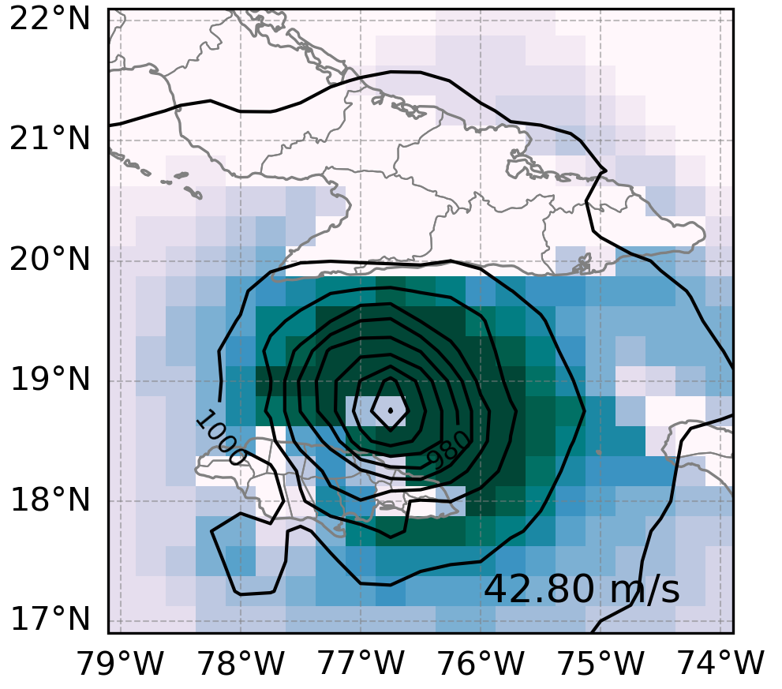
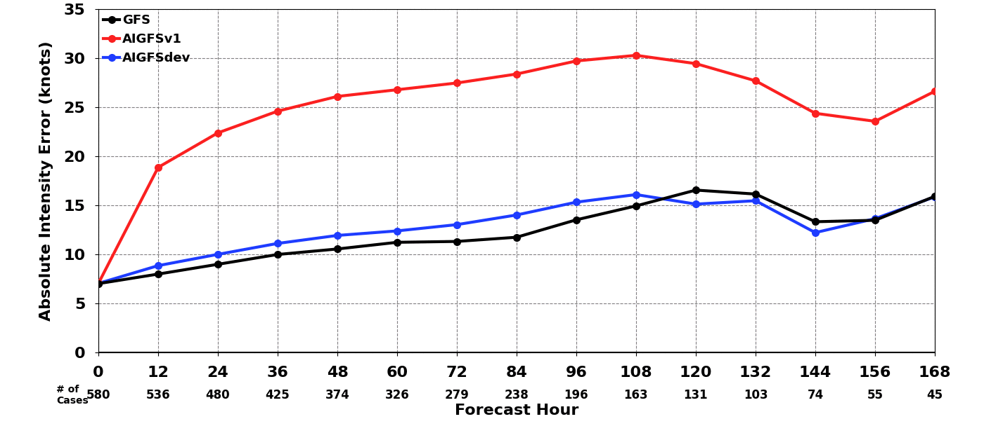
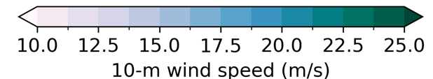
Key Results
Hurricane Melissa day 3 forecast
Absolute Intensity Error (knots) 2025
GFS analysis
GFS forecast
Atlantic
AIGFS v1.0 (MSE)
AIGFS v1.1 (AMSE)
East Pacific
West Pacific

Slide 5
Take-Home Message & Future Work
Take-Home Message
Future Work
AIGFS v1.1 effectively enhanced small-structures, especially intensity of tropical cyclones.
AIGFS v1.1 improved performance for heavy rain events (see extra slides).
AIGFS v1.1 reduced the blurriness at the longer lead times (see extra slides).
AIGFS v1.1 improved the performance of synoptic scales at short lead times (see scorecard on extra slides).
✔
Transition to Anemoi Framework.
1
2
Add more products.
Resolve cold biases of 2-m and low level temperature when using GDAS as training data.
3
Develop a hybrid loss (grid + spectral) with tunable weights.
!
AIGFS v1.1 had larger cold bias in low-level temperature over CONUS than AIGFS v1.0 (see extra slides).
AIGFSv 1.1 had larger RMSE for vector wind than AIGFS v1.0 (see extra slides).
4
Explore TC-focused spectral weighting (e.g., higher weights near TC regions).
5

Slide 6

Questions?
Linlin Cui (linlin.cui@noaa.gov)

Slide 7

Extra slides

Slide 8
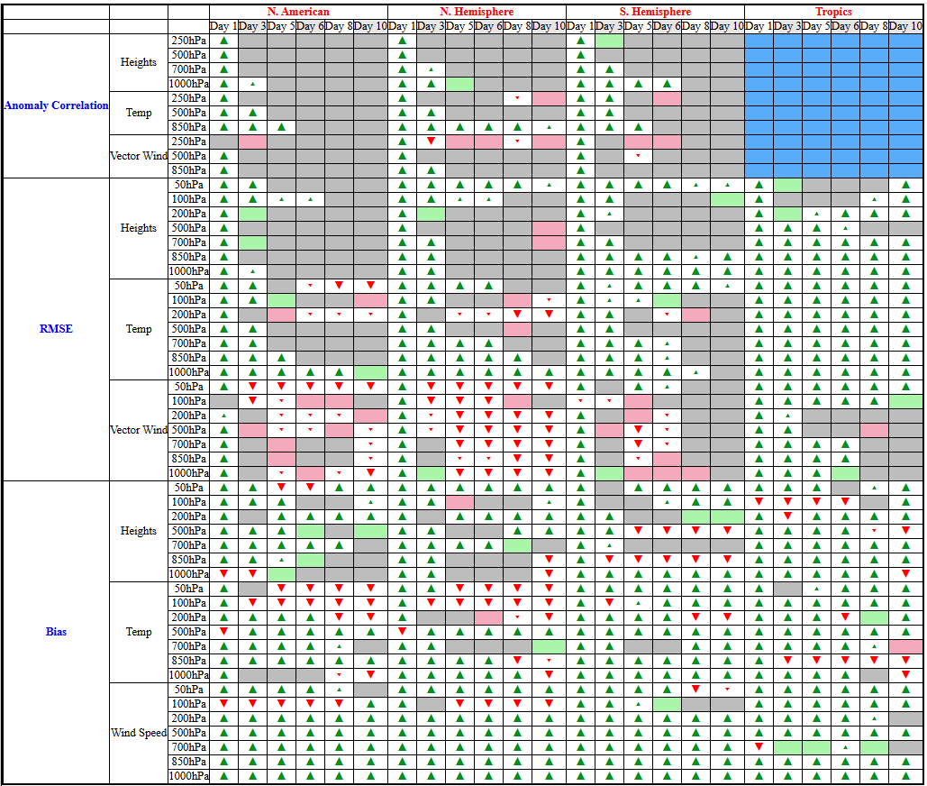
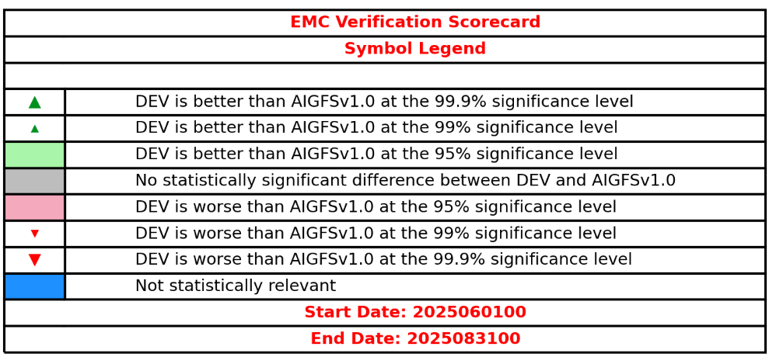
Evaluation: Scorecard (grid-grid)
2025 Summer
ACC - AIGFSdev had statistically significant improvement over North America, the Northern Hemisphere, and the Southern Hemisphere at lead time day 1 at all pressure levels for Geo. Height and temperature, and most pressure levels for vector wind.
RMSE - AIGFSdev had statistically significant improvement over Tropics for temperature at all pressure levels and lead times, for Geo. Height and vector wind at most lead times and pressure levels. Some significant degradation for vector wind over North America and Northern Hemisphere.
Bias - Overall, AIGFSdev had much more improvement, but some degradation in upper-level temperature over North America and the Northern Hemisphere.

Slide 9
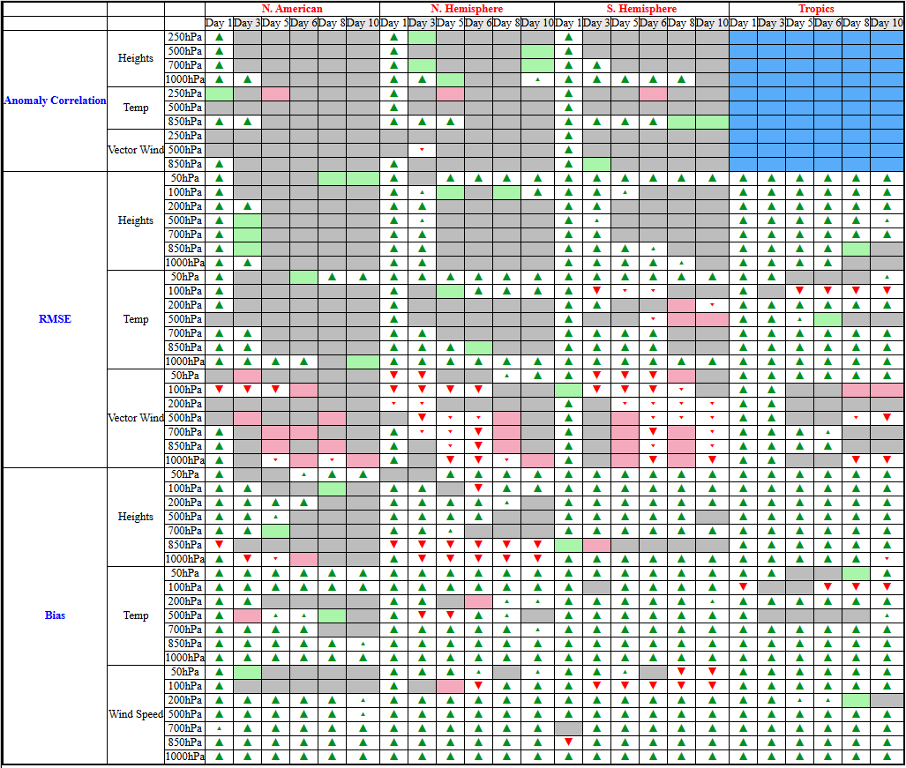
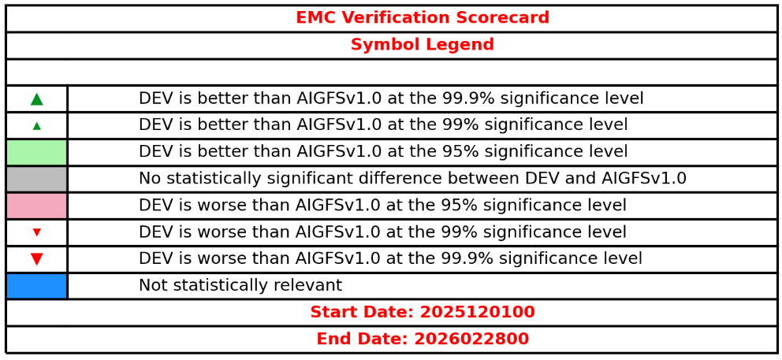
Evaluation: Scorecard (grid-grid)
2025 Winter
Overall similar pattern with Summer performance:
Statistically significant improvement for short lead time.
Statistically significant improvement over Tropics
Much more improvement for bias
Bias of the upper-level temperature degradation in the summer doesn’t exist in the winter season
Some degradation of bias for low-level Geo. Height over the Northern Hemisphere
Some degradation of RMSE for vector wind

Slide 10
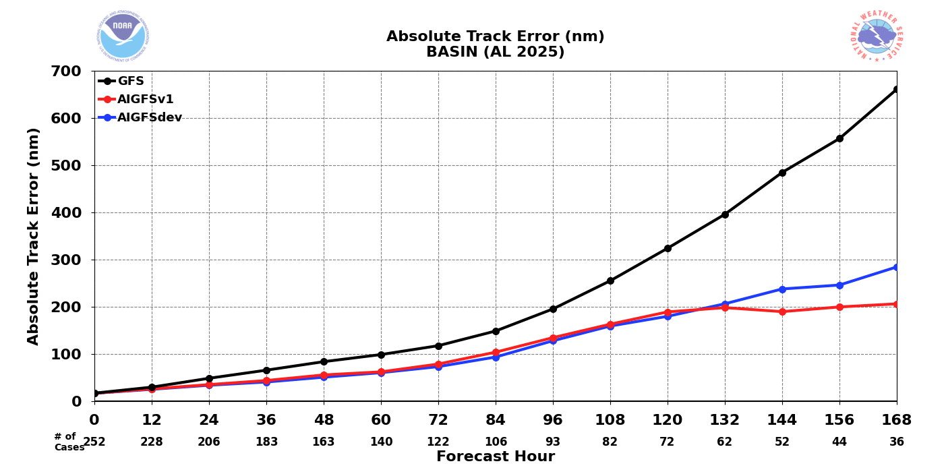
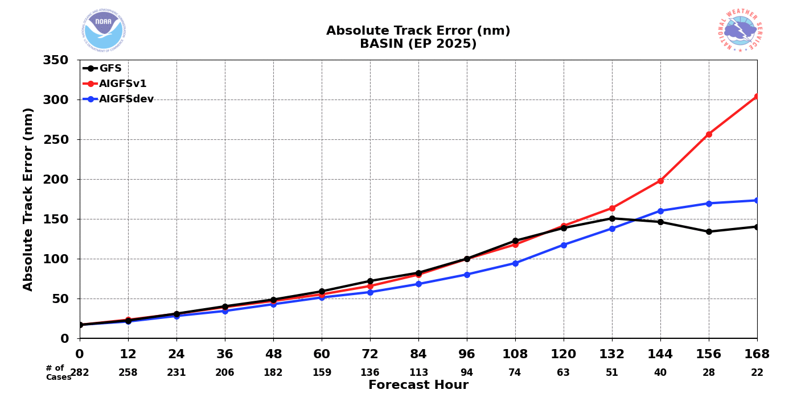
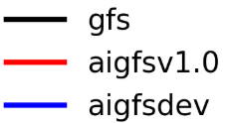
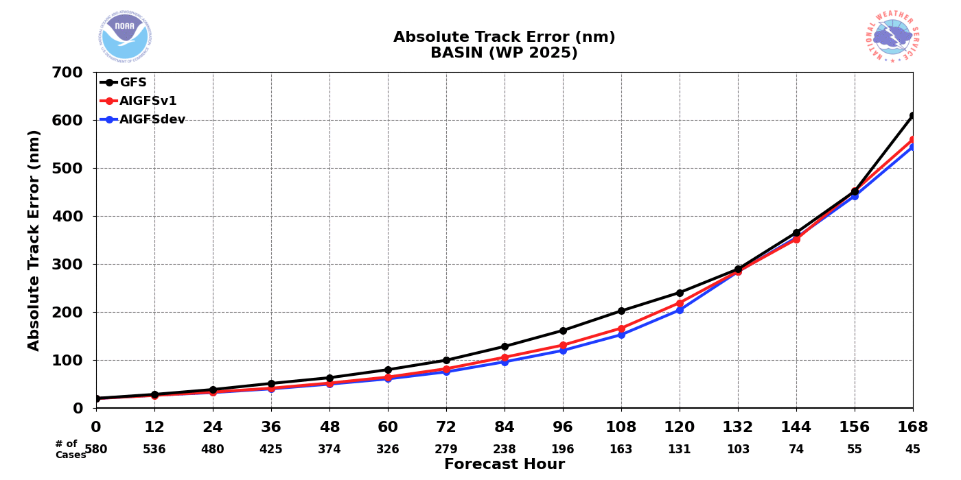
Tropical Cyclone Track Error 2025
Atlantic
East Pacific
West Pacific
AIGFSdev had a slightly smaller absolute bias than AIGFSv1.0 over WP and EP
AIGFSdev had a slightly larger absolute bias over Atlantic at day 6 and 7

Slide 11
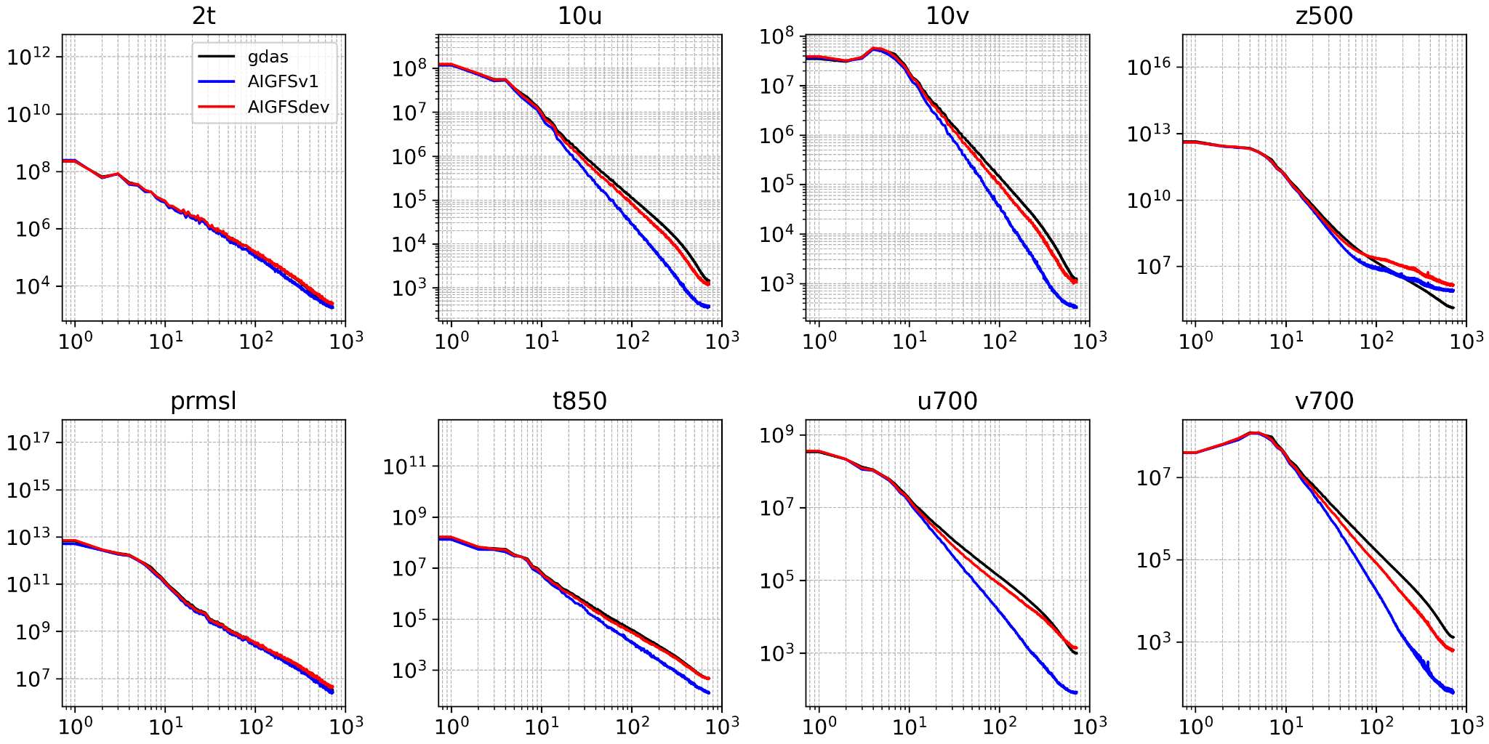
Spectra at FH120 - Blurry issues
Power
Power
Wavenumber
Wavenumber
Wavenumber
Wavenumber

Slide 12
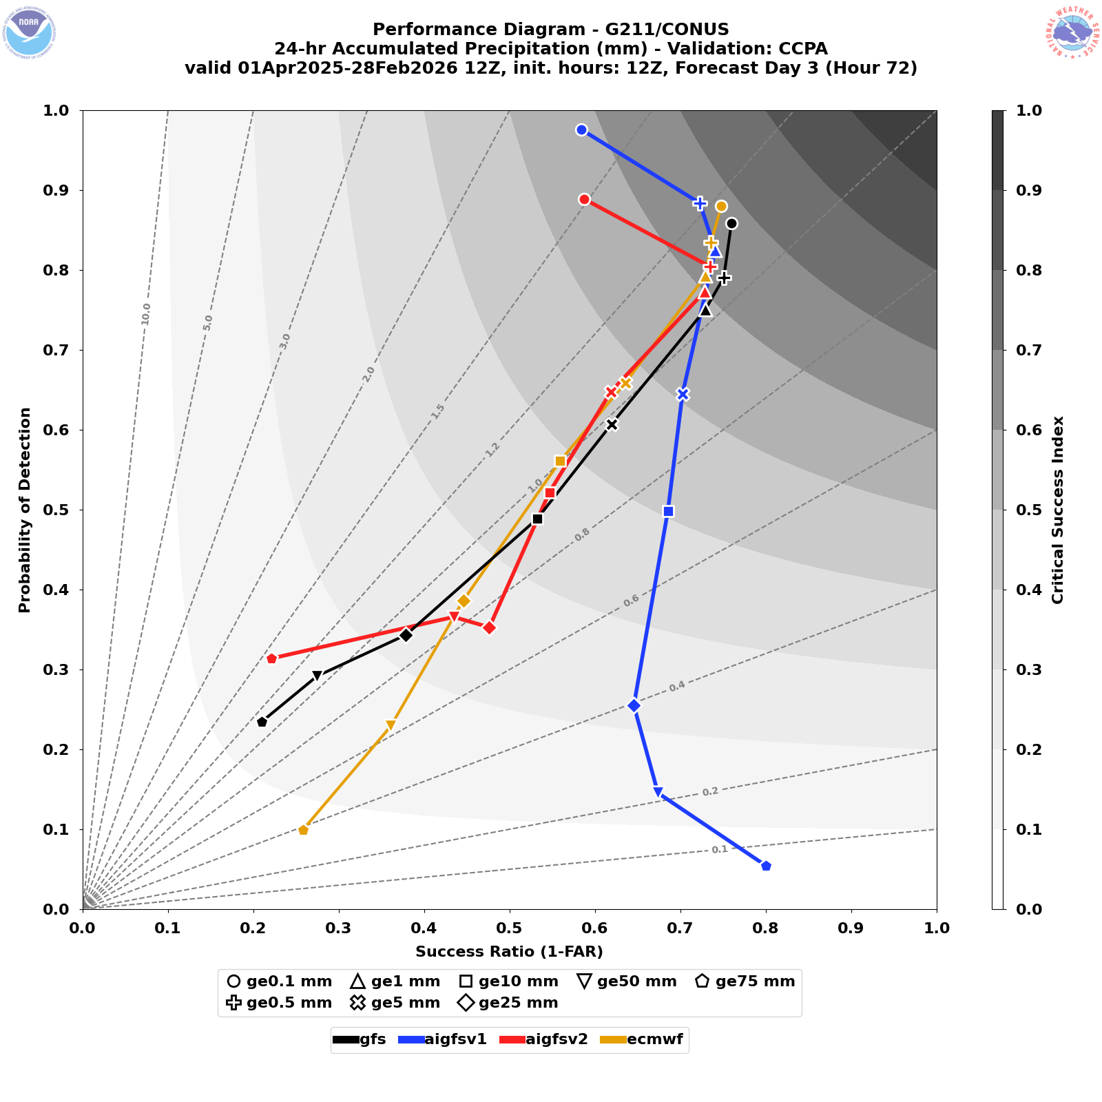
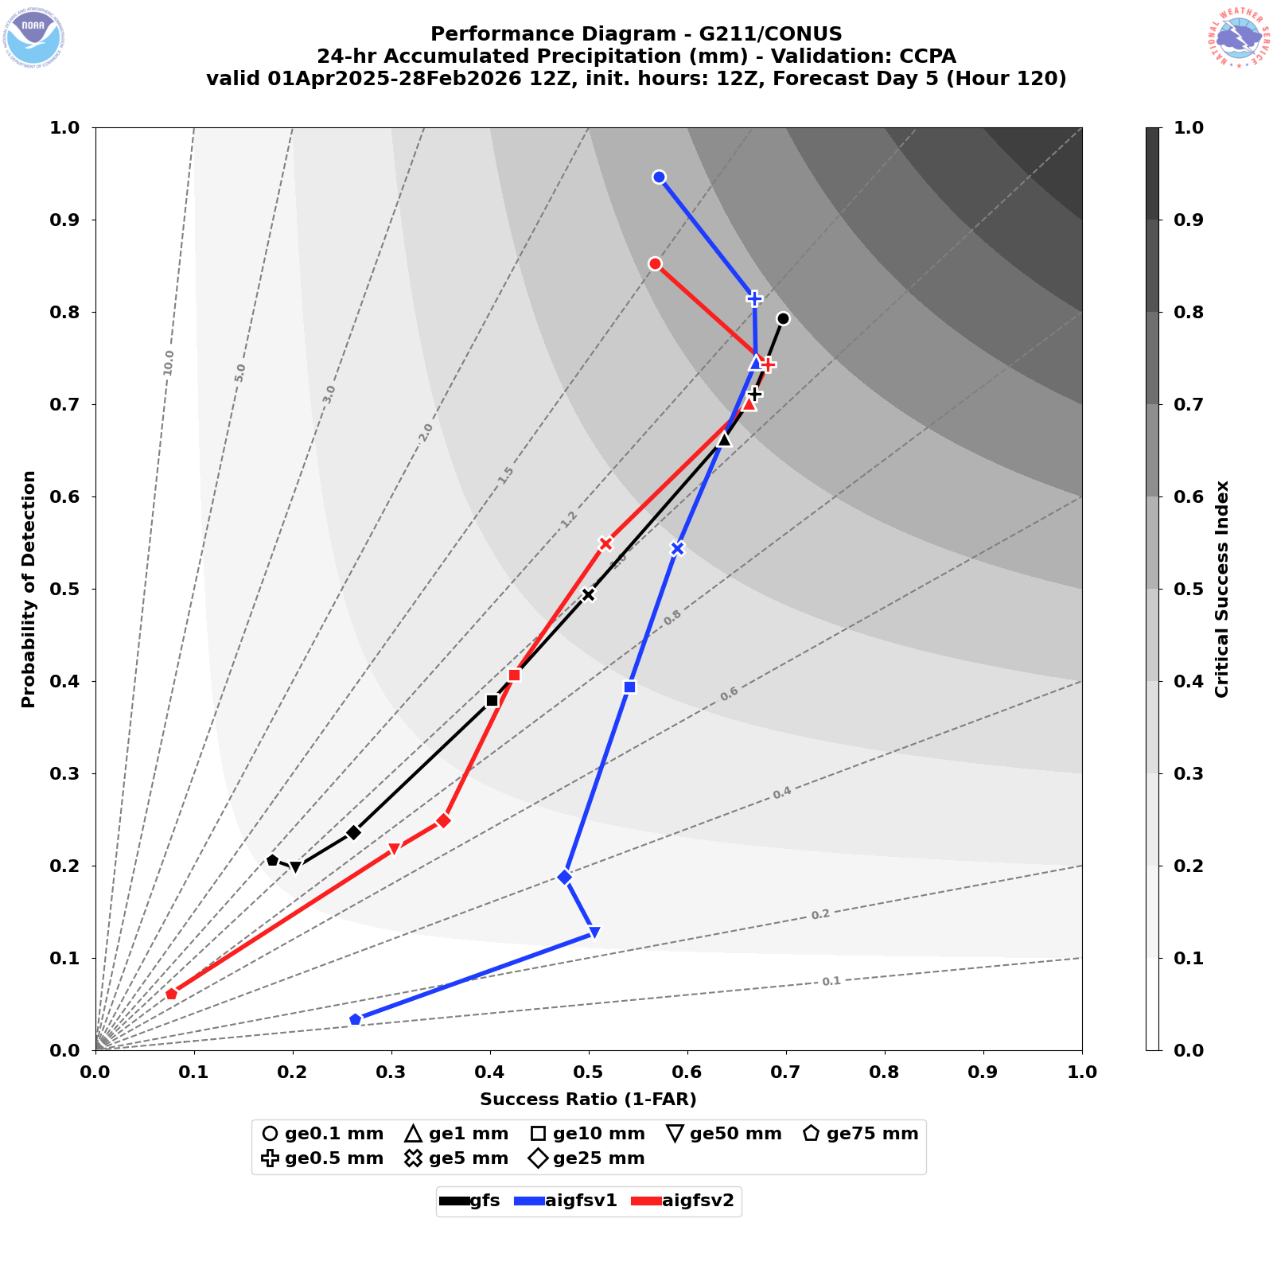
24-h Accumulated Precipitation
DAY 3
CONUS
DAY 5
CONUS

Slide 13
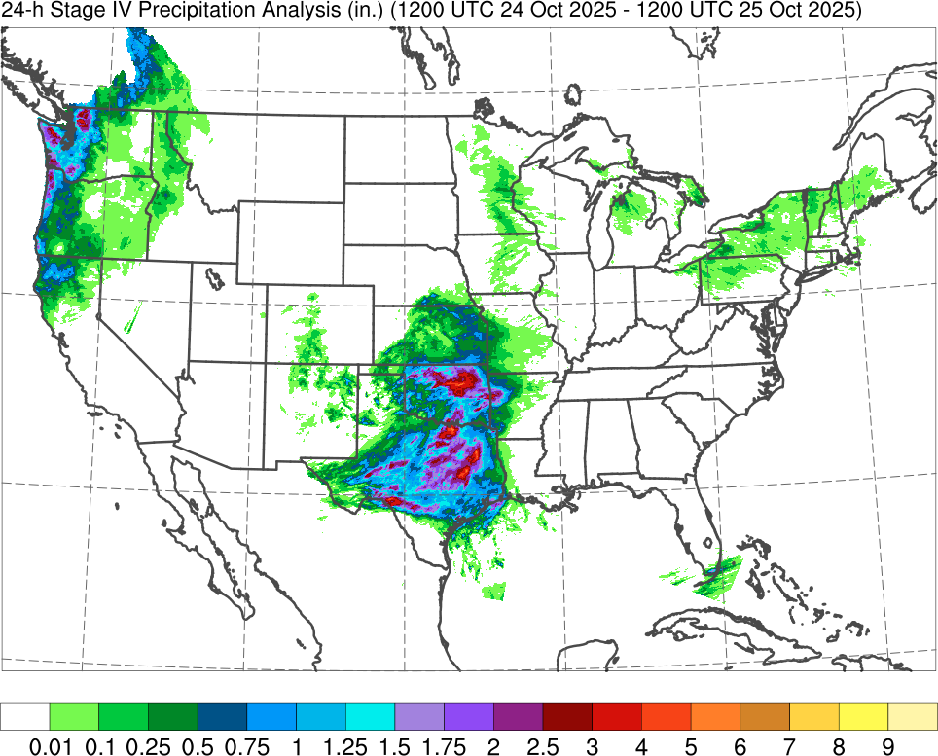
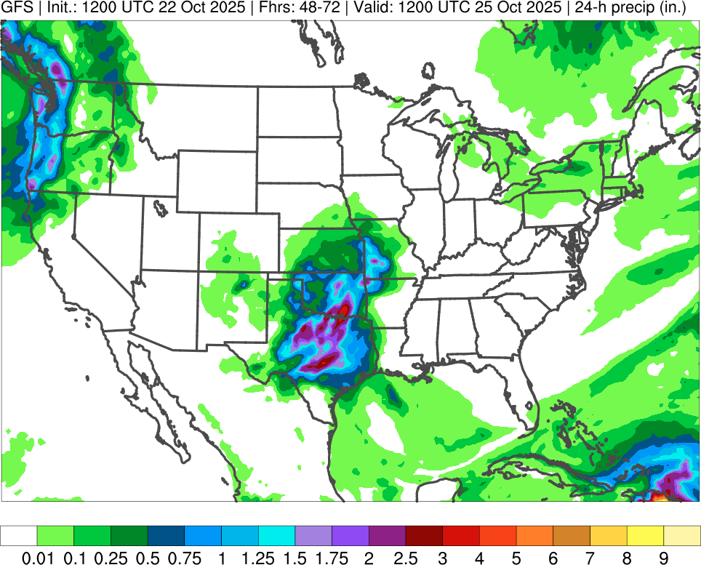
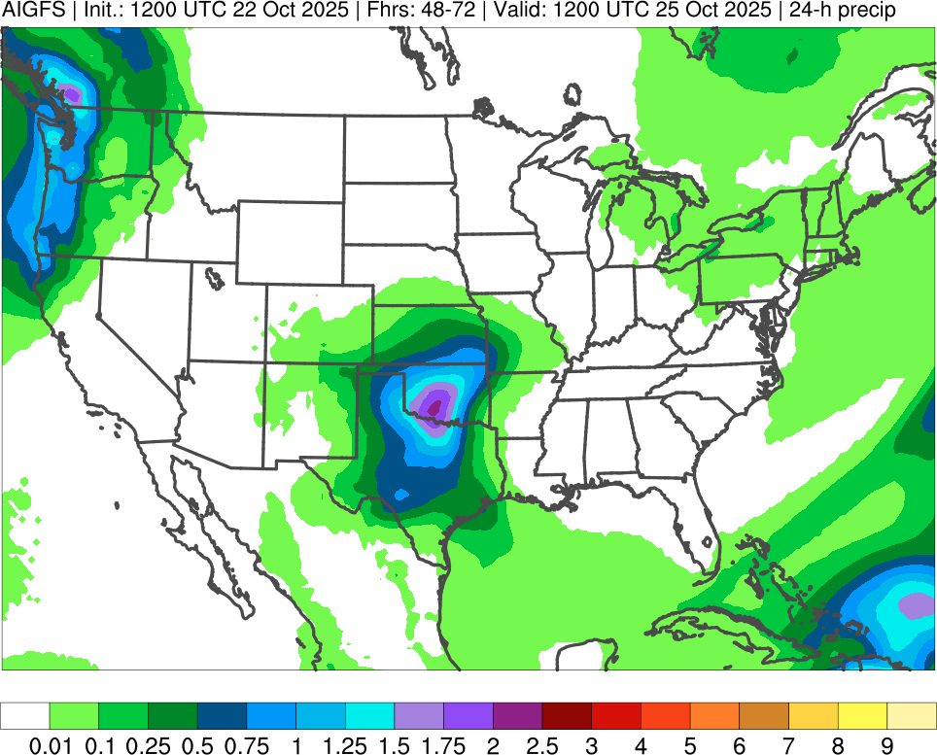
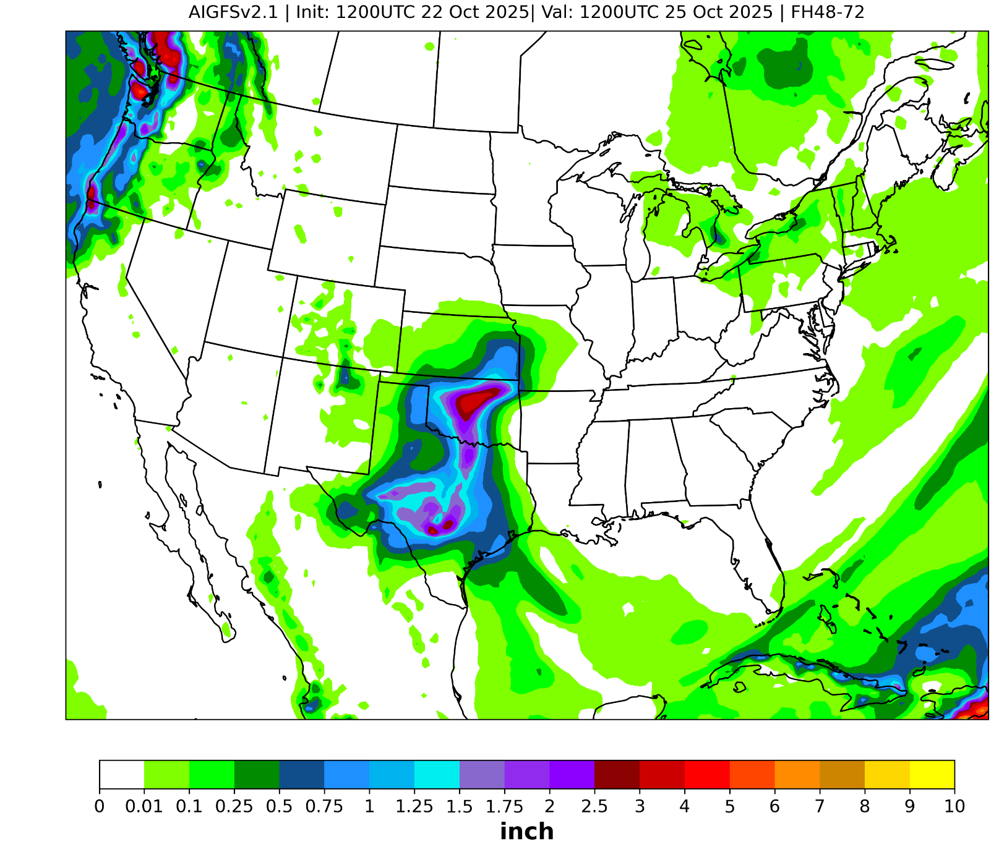
24-h Accumulated Precipitation (F048-072)
Initialized: 1200 UTC 22 October 2025
Valid: 1200 UTC 25 October 2025
Stage IV
GFS
AIGFSv1.0
AIGFSdev

Slide 14
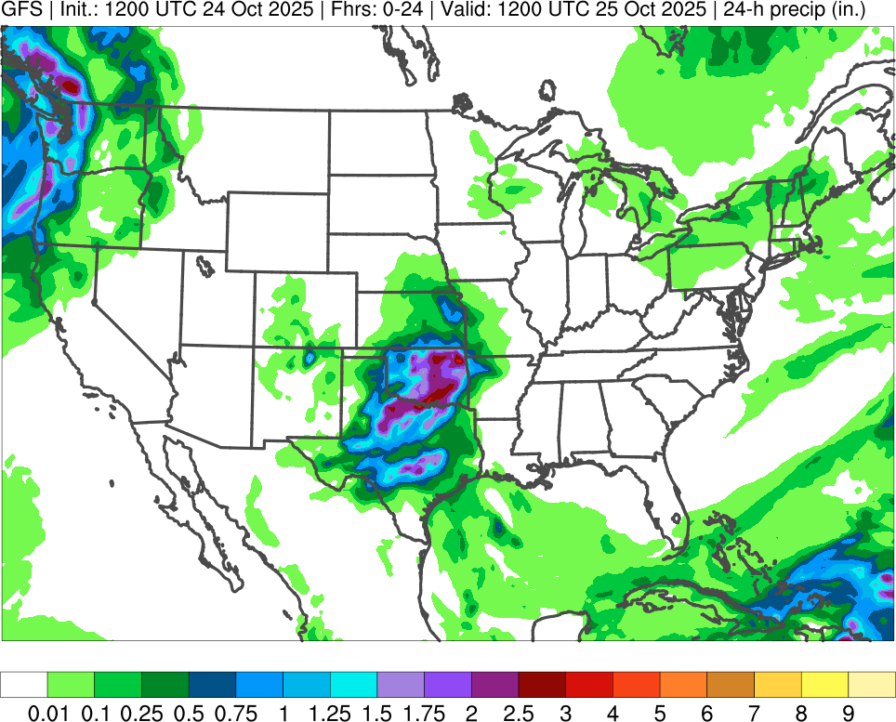
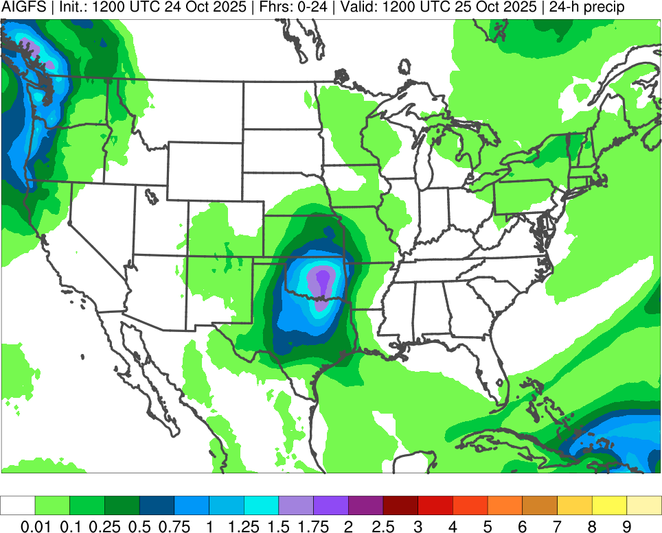
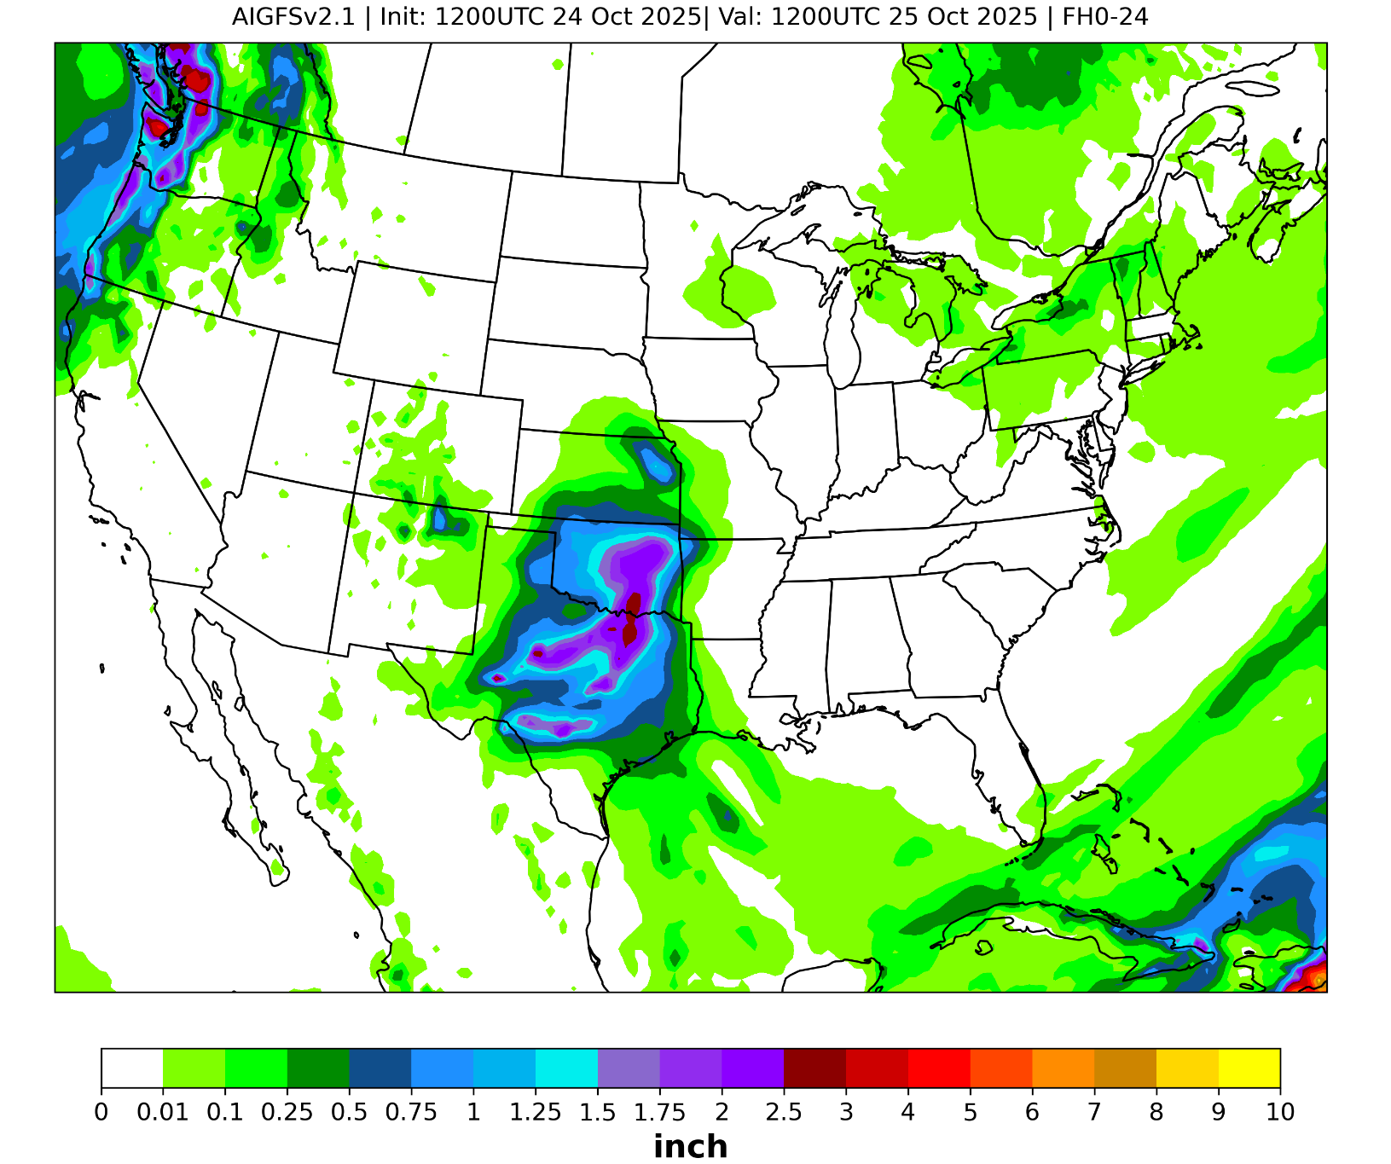
24-h Accumulated Precipitation (F000-024)
Initialized: 1200 UTC 24 October 2025
Valid: 1200 UTC 25 October 2025
Stage IV
GFS
AIGFSv1.0
AIGFSdev

Slide 15
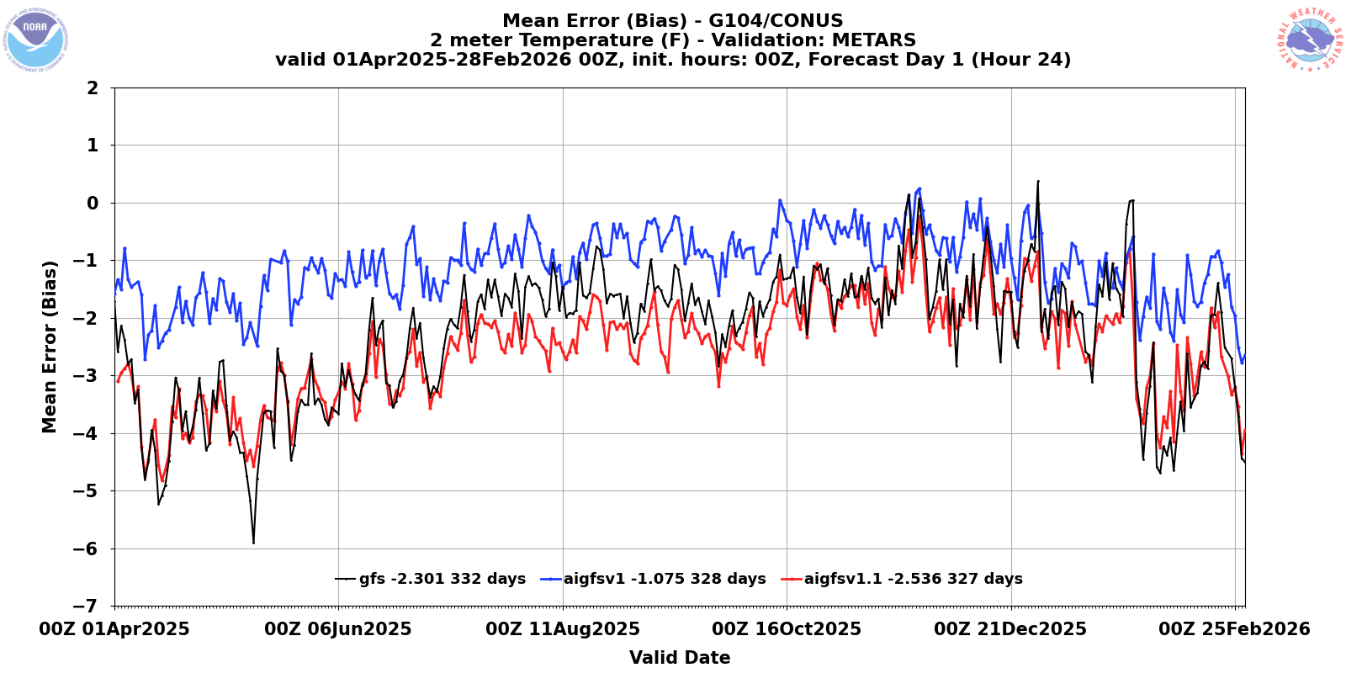
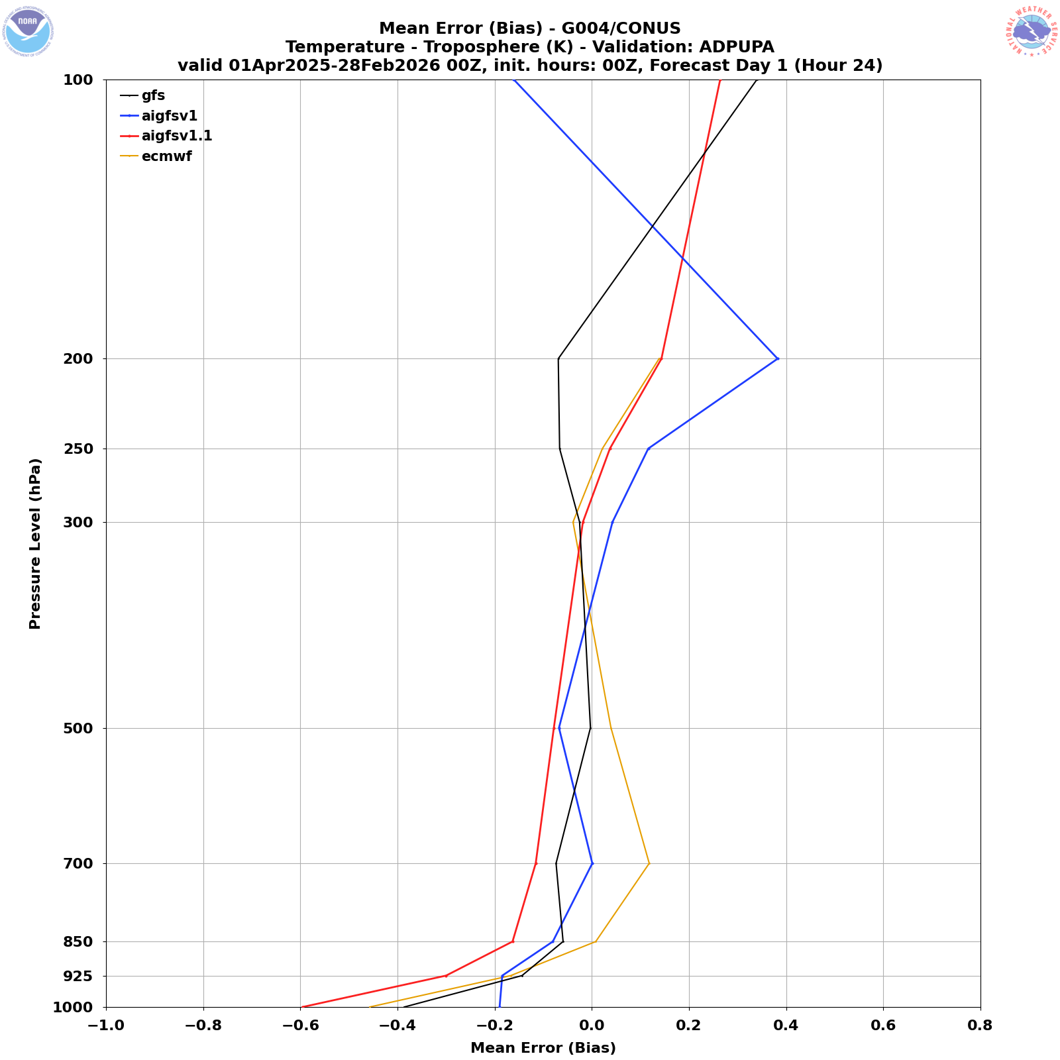
Things to improve: T2m
AIGFSv1.1 showed large cold bias in 2-m temperature and low-level surface temperature over CONUS due to the usage of training data set change
Risk: Users who are using AIGFS v1.0 T2m field will be impacted.
Mitigation: 1) Add a post-process job to bias-correct T2m. 2) Train the model with GFSv17 3) Bias-correct T2m in the training data set before conduct training

Slide 16
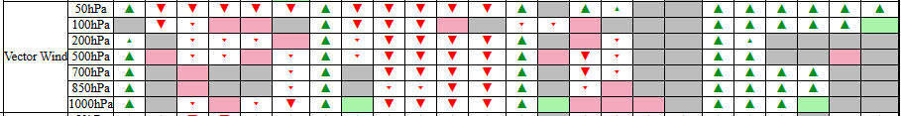
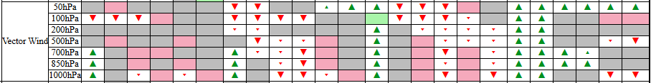
Things to improve: vector wind
AIGFSv1.1 had increased RMSE for vector wind
Summer 2025
Winter 2025
Mitigation: 1) Add a horizontal gradient term to the loss function. 2) Apply per-variable-level weights that scale by the inverse variance of the time differences

