Slide 1


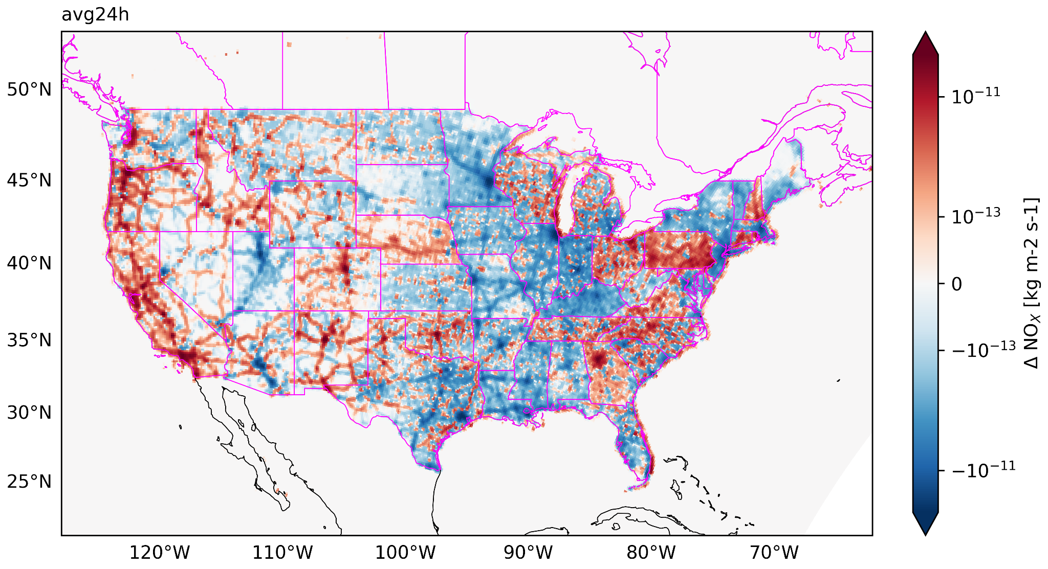
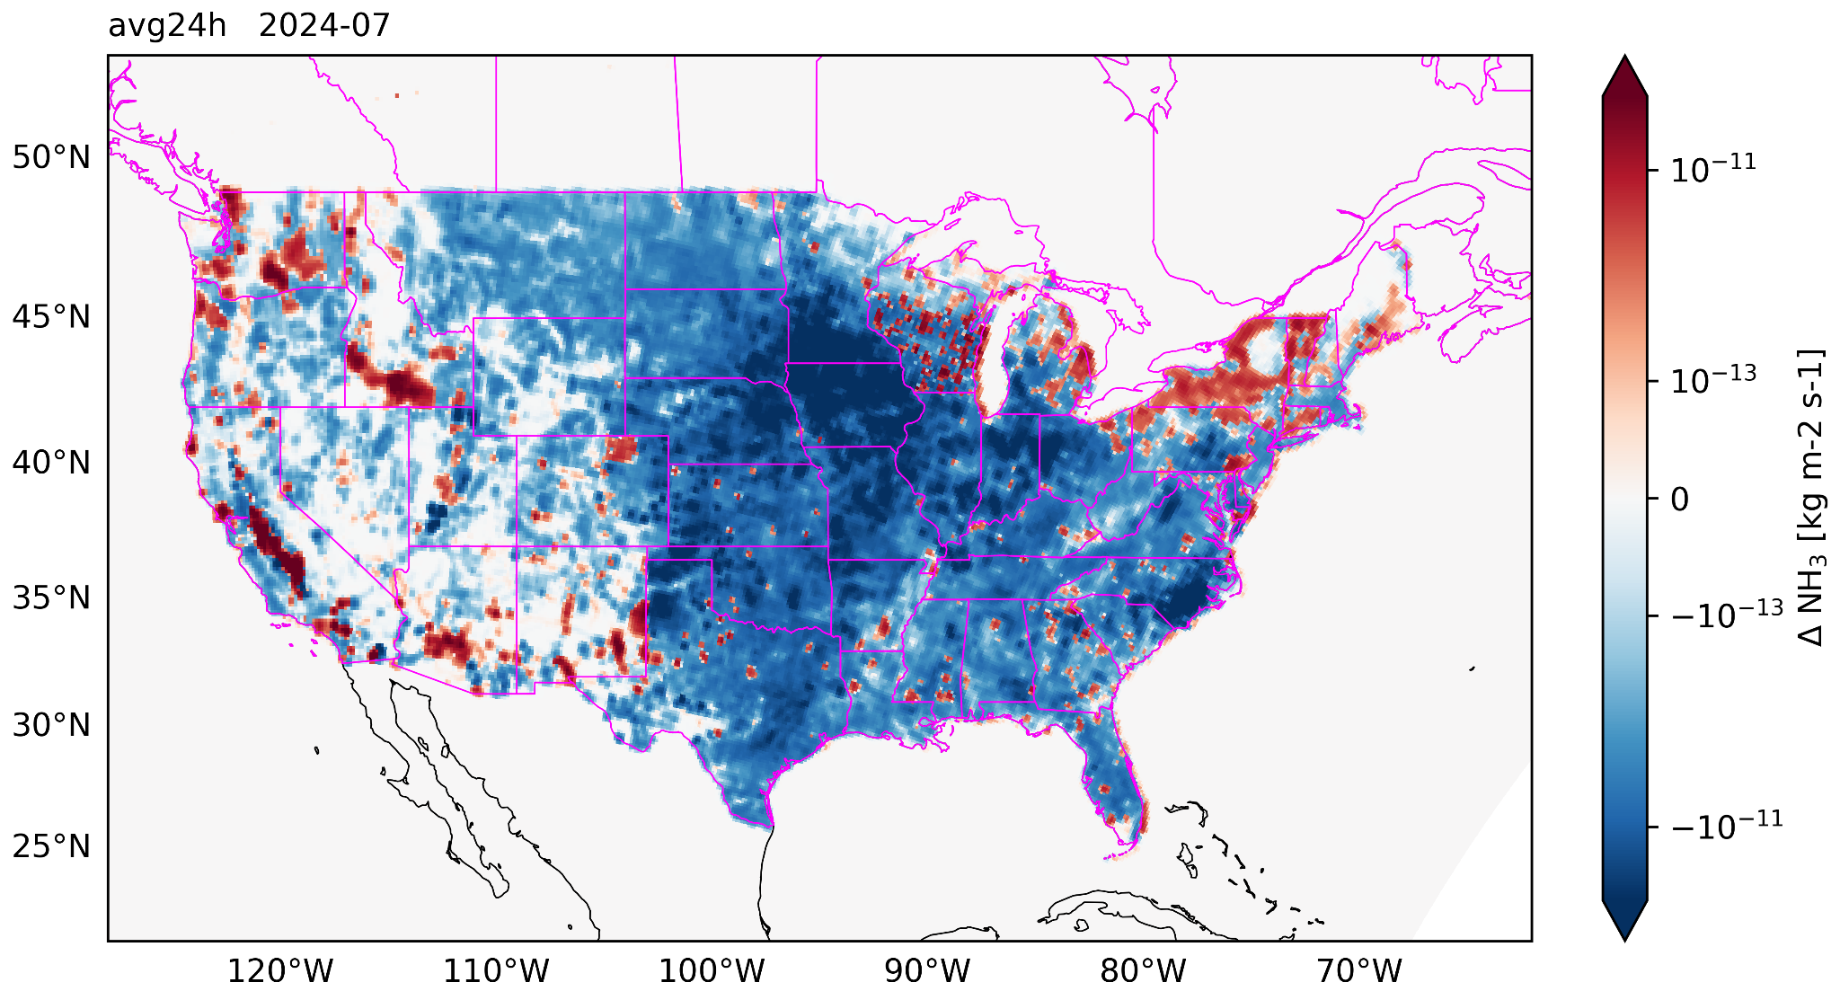
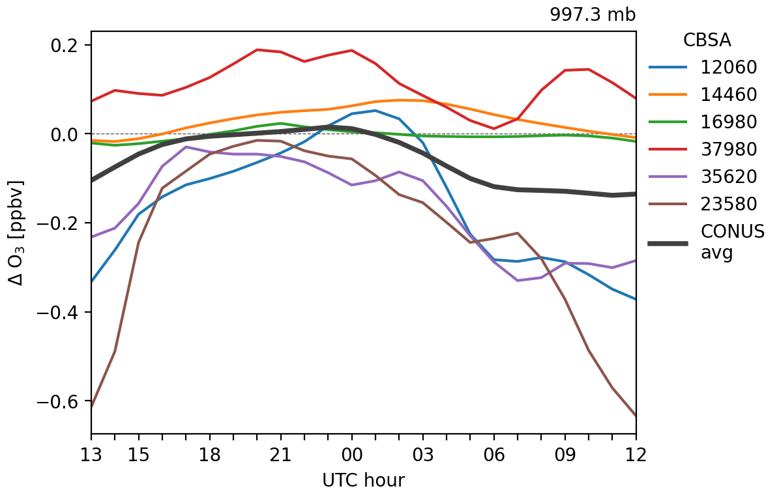
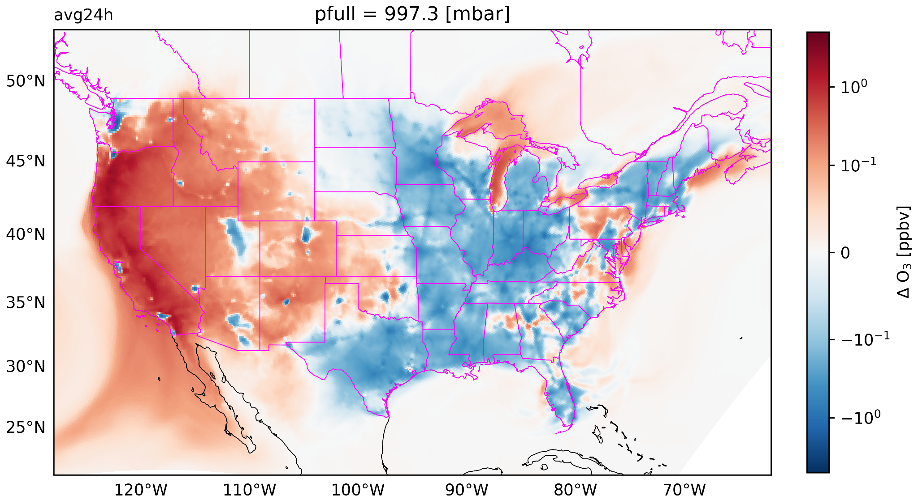
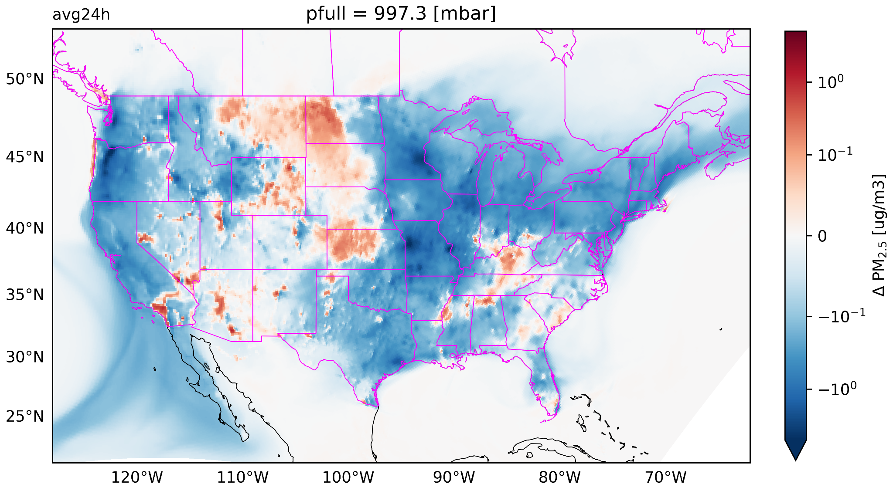



Dynamic Meteorology-Aware Emissions to Improve NOAA’s UFS Air Quality Model Predictions
Model Impacts (July 2024)
NH₃ Emission Changes
Key Highlights
MetEmis dynamic coupler adapted from U.S. EPA SMOKE-CMAQ.
R2O transition for NOAA Unified Forecast System-Air Quality Model (UFS-AQM) and the community.
Improved ozone and PM_{2.5} predictions compared to static NEI.
Methodology
Online-coupled emissions system using ESMF/NEXUS interface.
HEMCO submodule in NEXUS for anthropogenic and biogenic extensions.
Meteorology-dependent extensions for onroad, livestock, residential heating, and fugitive dust emissions.
NO_{x} Emission Changes
Ozone Changes
PM_{2.5} Changes
Metro-Level Ozone Changes
Patrick C. Campbell
Bok Haeng Baek, Siqi Ma, Chi-Tsan Wang, Irena Ivanova, Zachary Moon, Youhua Tang, Kai Wang, and Barry Baker
Presented for UIFCW 2026| NOAA Affiliate | George Mason University
Contact: Patrick Campbell (pcampbe8@gmu.edu)
MetEmis Branch: https://github.com/GMU-CSER/HEMCO/tree/feature/metemis
SCIENCE.GMU.EDU
Notes:
Emissions are arguably the most important input to any atmospheric composition model or air quality model, including the operational UFS-AQM, which forms the National Air Quality Forecasting Capability (NAQFC). However, emissions representation remain a key limitation in air quality models and the UFS-AQM.
Static anthropogenic offline inventories have limited sensitivity to land/meteorological variability in real-time air quality forecasting applications.
Specific emissions sectors have known sensitivity to land/meteorological conditions (e.g., temperature, humidity, wind speed, precipitation, and snow cover).

