Slide 1
WELCOME
Unifying Innovations in Forecasting Capabilities Workshop 2026
July 21st, 2026

Slide 2
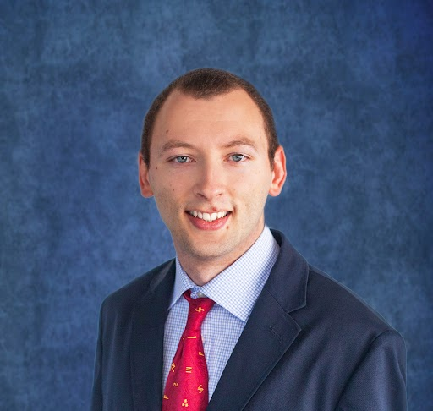
Today’s Master of Ceremonies
Jan Ising
EPIC Program DA and HPC Lead
/NOAA/Weather Program Office

Slide 3
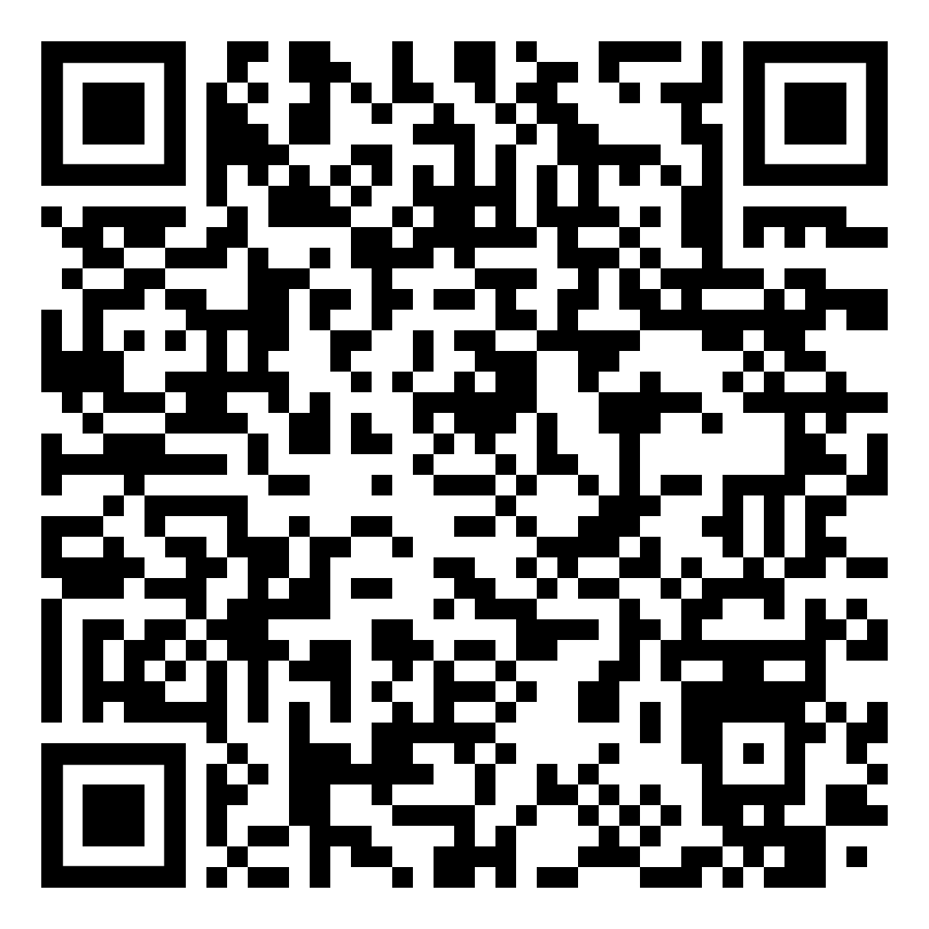
Transcription Announcement
The UIFCW is an open event that will be held via Google Meet and will be transcribed. By staying in the room (and online), you understand that your image, in video or still, and any sound recorded alongside it, will be streamed over Google Meet. The information that you provide may be used for websites, agenda's, and event descriptions.
For more information on NOAA's Privacy policy,
scan to read more:

Slide 4
Tuesday, July 21st
09:00 AM - 09:10 AM Welcome (General Vessey Ballroom)
09:10 AM - 09:40 AM Keynote Presentation from the NOAA Administrator,
Dr. Neil Jacobs
09:40 AM - 10:40 AM NOAA Leadership Panel (NOS, NWS, OAR)
10:40 AM - 11:10 AM Morning Break
11:10 AM - 11:30 AM Six Years of the UFS-R2O Project
11:30 AM - 12:00 PM EPIC: Retrospective + Goals Moving Forward
12:00 PM - 01:00 PM LUNCH

Slide 5
Tuesday, July 21st
01:00 PM - 01:30 PM American Meteorological Society (AMS) Community
Modeling Committee Updates (General Vessey Ballroom)
01:30 PM - 02:00 PM NOAA’s High Performance Computing and Communications
(HPCC) Program Overview
02:00 PM - 03:30 PM Model for Prediction Across Scales (MPAS) Integration
03:30 PM - 03:45 PM Group Picture
03:45 PM - 04:15 PM Afternoon Break
04:15 PM - 05:15 PM Poster Session I (Chesapeake Ballroom)
05:15 PM - 07:00 PM Networking Mixer (Patuxent Room & Patio)

Slide 6
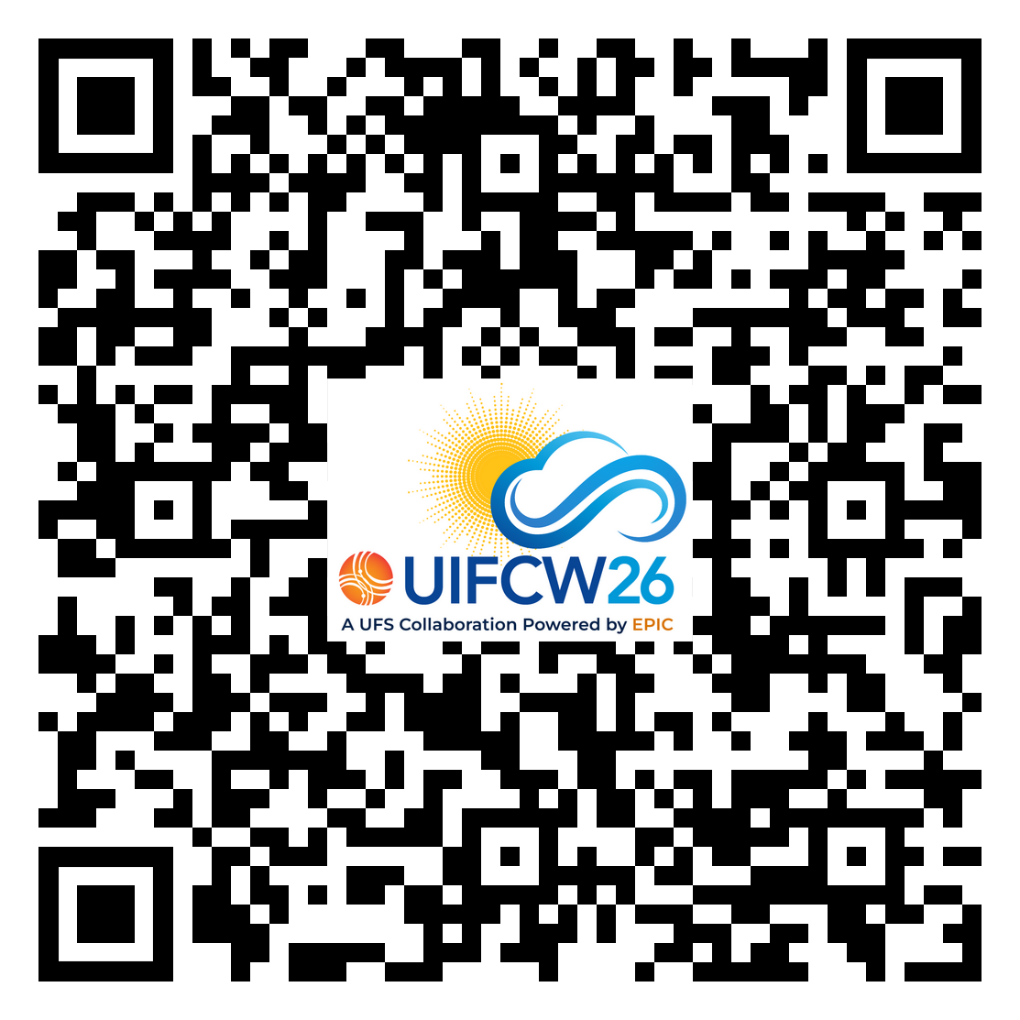




Connect With Us!
Event Guide
Use Google Meet Q&A to connect with speakers and other attendees.
Find us on:
@NOAAEPIC
NOAAEPIC
#NOAAEPIC
NOAAEPIC
Wi-Fi: UMUC-Guest Network
No password is required.

