Slide 1
NOAA Leadership Panel
Jennifer Mahoney, Michelle Mainelli, Stephan Smith

Slide 2

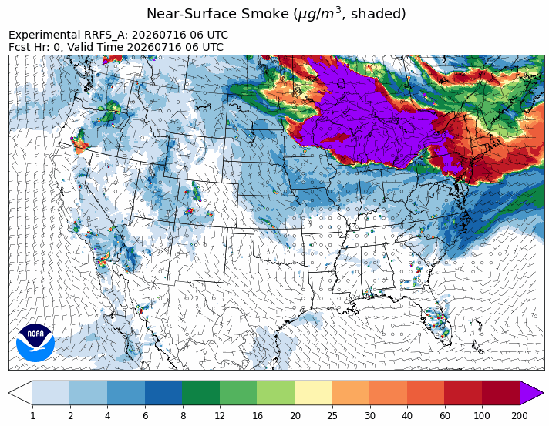
Jennifer Mahoney
Deputy Assistant Administrator for Science, OAR (Acting)
FY25 OAR Transitions
177 - Total transitions reported by OAR
labs and programs, including:
54 - Research to Operation
82 - Research to Application
2 - Research to Commercialization
39 - Research to Other Use
Smoke plume from Canadian wildfires -
Rapid Refresh Forecast System (RRFS), July 16-19, 2026

Slide 3
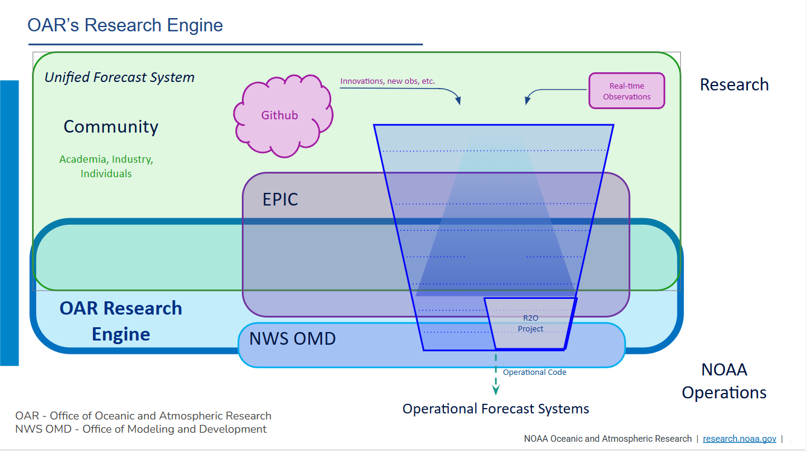

Slide 4
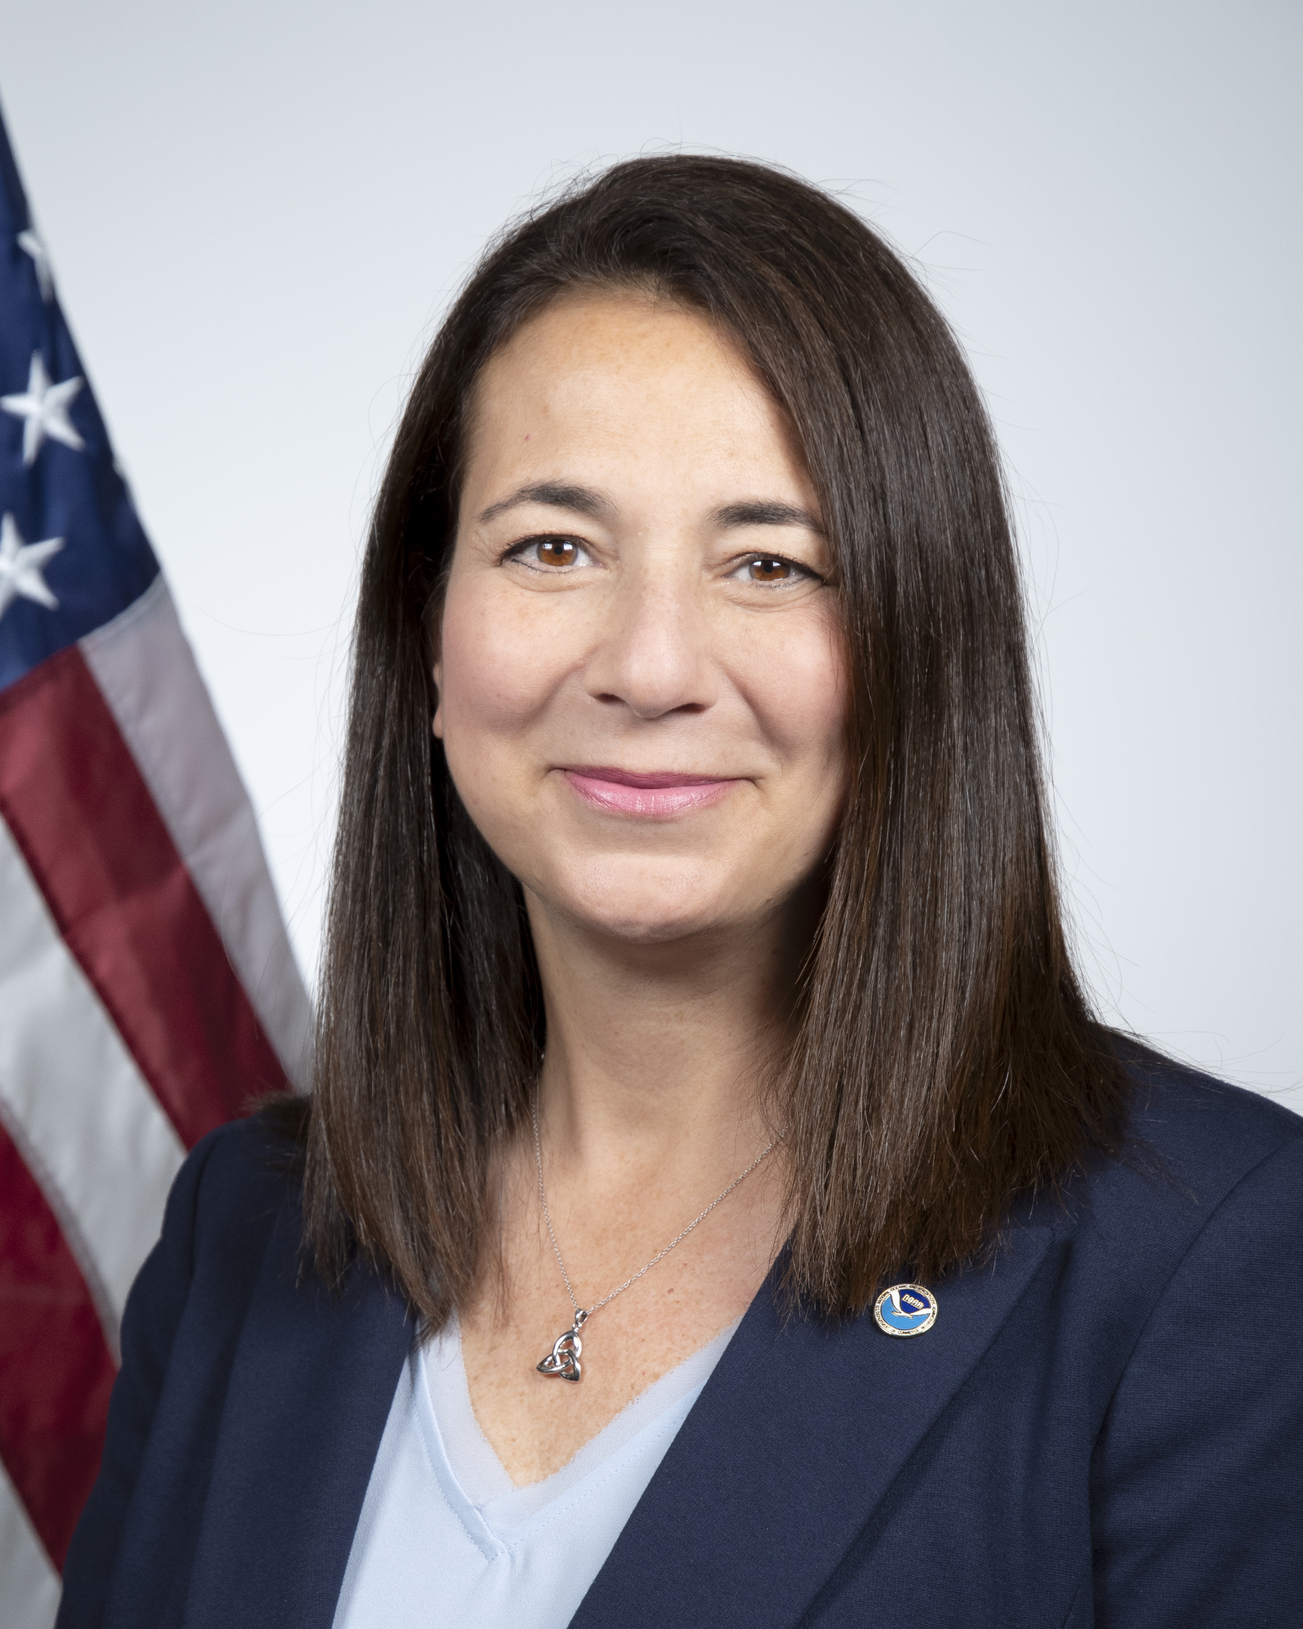
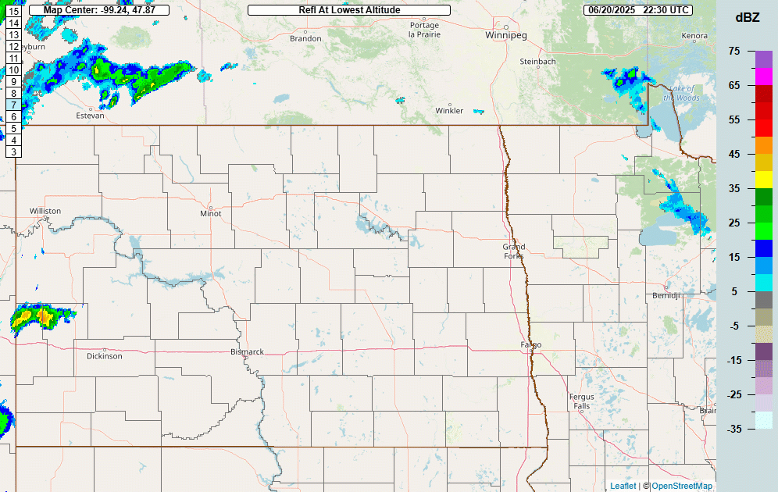
Michelle Mainelli
Deputy Assistant Administrator, NWS
2025 Watch/Warning Stats
23,434 Severe Thunderstorm Warnings
643 Tornado / Severe Thunderstorm Watches
3,014 Tornado Warnings
5,230 Flash Flood Warnings
2,787 River Flood Warnings
35,610 Spot Forecasts (Record breaking!)
141 IMET Missions
June 20-21, 2025
North Dakota derecho radar loop.

Slide 5
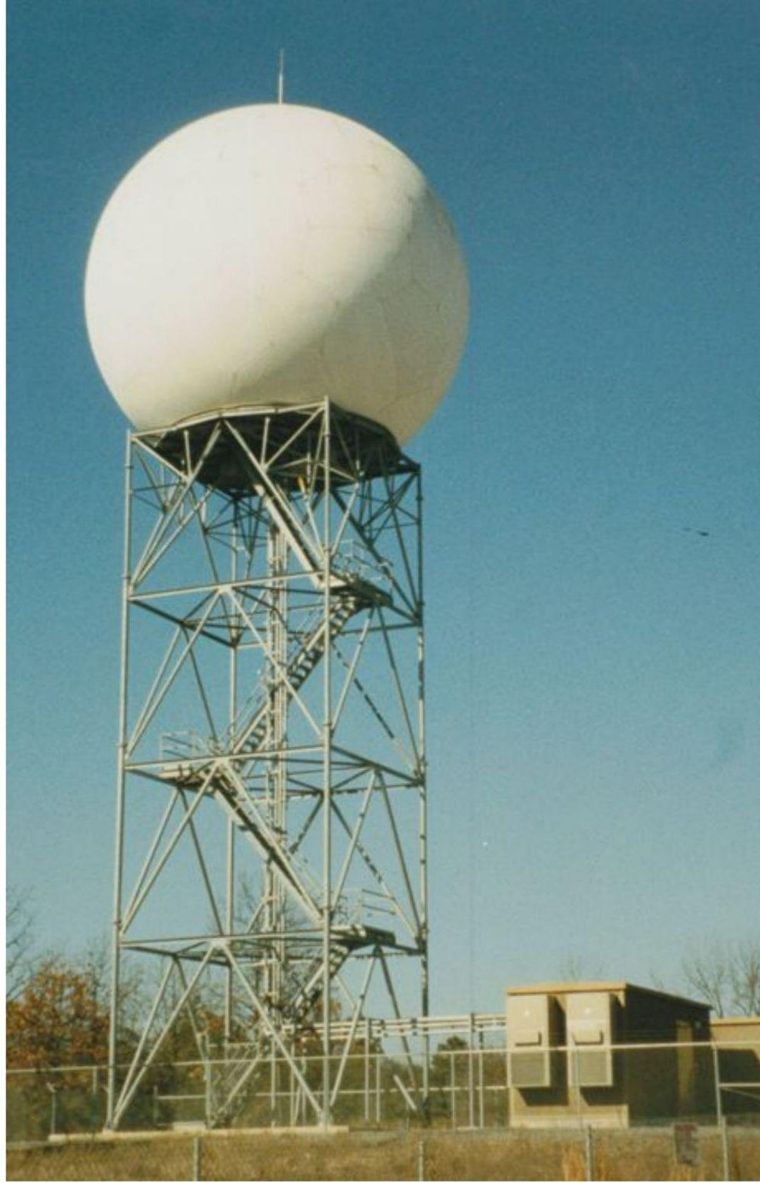
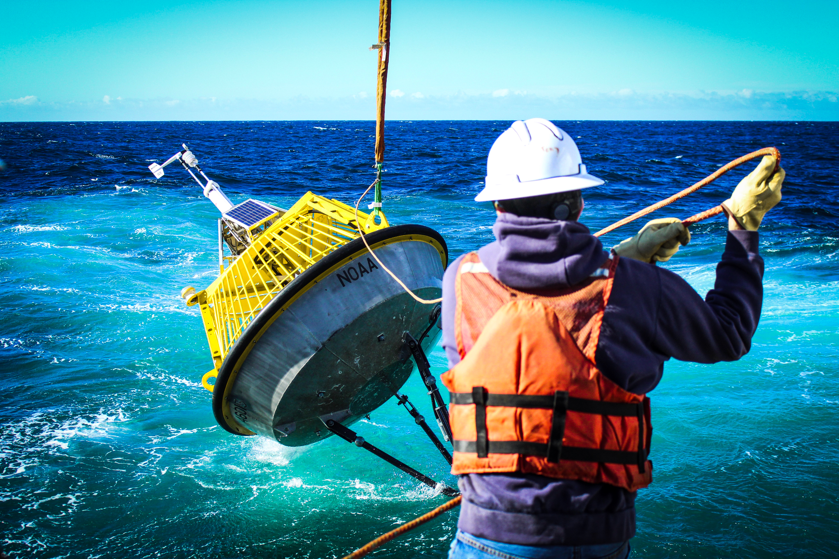
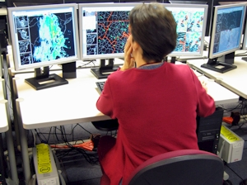
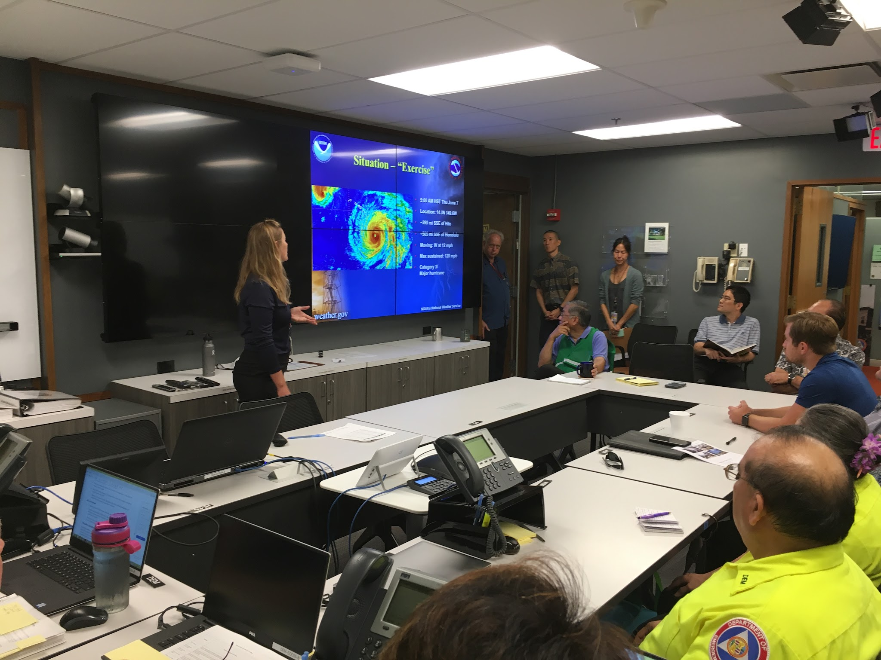

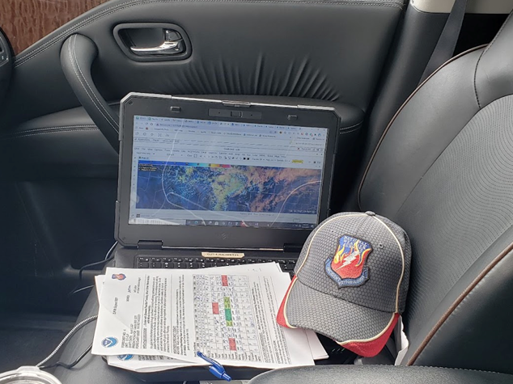
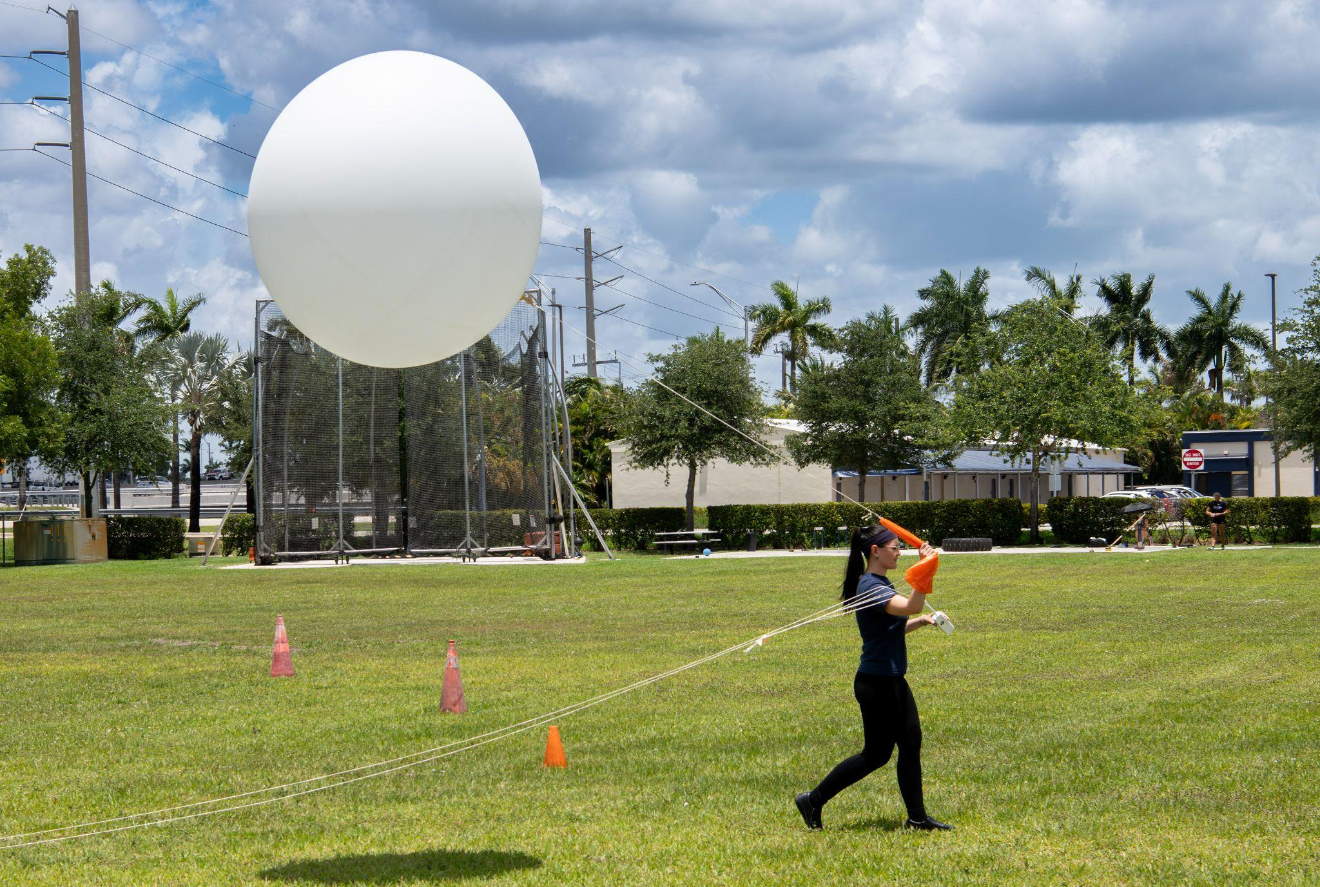
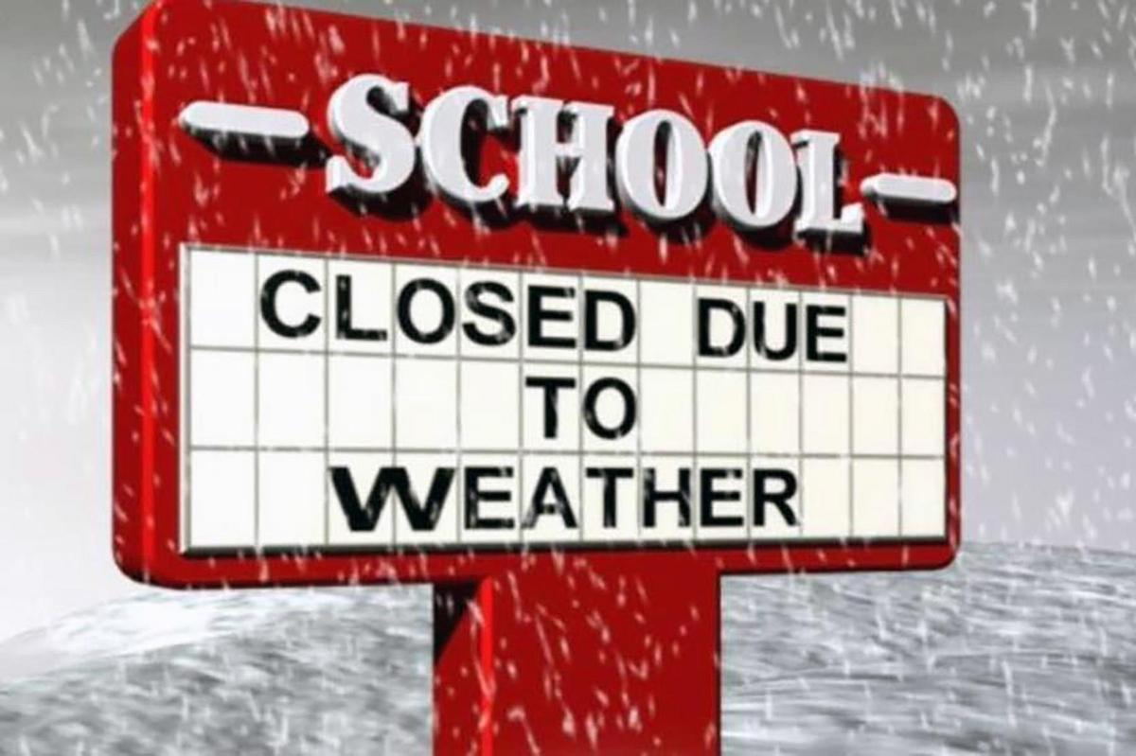
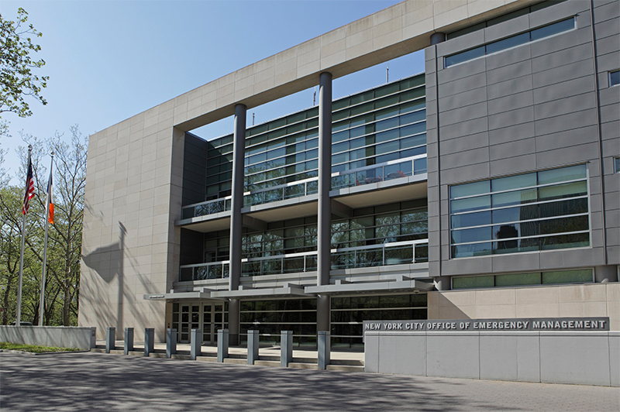
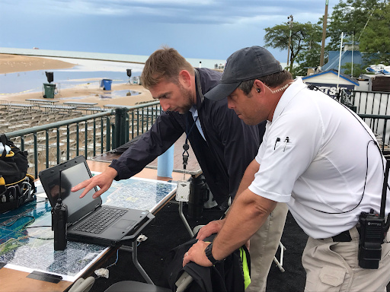
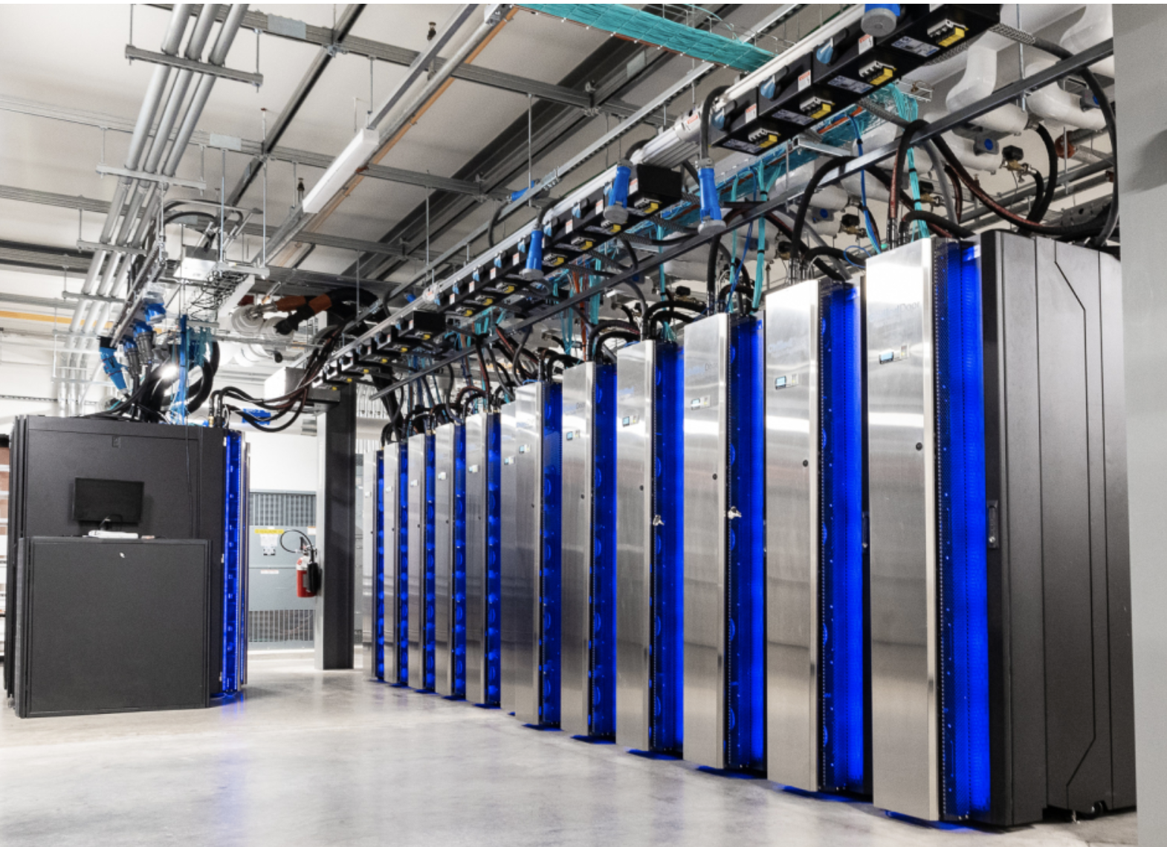
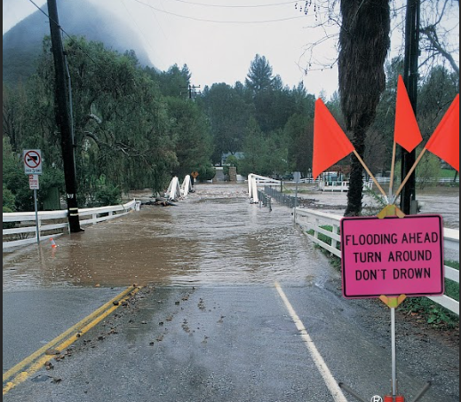
NWS Value Chain
Operational Execution of its Mission: Begins with robust observational platforms & a modernized operational NWP suite
Observations/Data => Models/Guidance =>
Forecasts / Services => IDSS
Enable Prepared, Weather Ready, and Responsive Communities
Notes:
School Closed picture: https://www.shorewood.k12.wi.us/apps/news/article/1736955
Over the next 10 years, the NWS will thoroughly modernize its operational modeling suite and production schedule through a transformation to advanced software and HPC architectures, investments in high resolution reanalyses, expansion of data-driven ensemble prediction systems (AI), and adoption of the Model for Prediction Across Scales (MPAS) atmospheric dynamical core.
Implementing the vision will result in meeting stakeholder requirements for more accurate, timely, and actionable information tailored to the local level, increasing lead times and trust in forecasts, and realizing significant cost savings across multiple economic sectors.
The future advanced modeling suite will provide decision makers with more accurate probabilistic-based tailored forecast guidance with improved identification of extreme events, and support stakeholders who rely on hyperlocal data to inform better business decisions.
Rapid translation of weather variables into actionable thresholds using modern decision support tools optimizes emergency resource allocation.

Slide 6


Stephan Smith
Coastal Modeling Science and Services Lead, NOS
NOS Value Chain across Mission Services
Hazardous Spill Response / Search and Rescue
Safe, Efficient Marine Navigation
Observations
Core Hydrodynamic Models
Applications / Tools
Protecting Human Health
Coastal Resilience and Risk Reduction

Slide 7
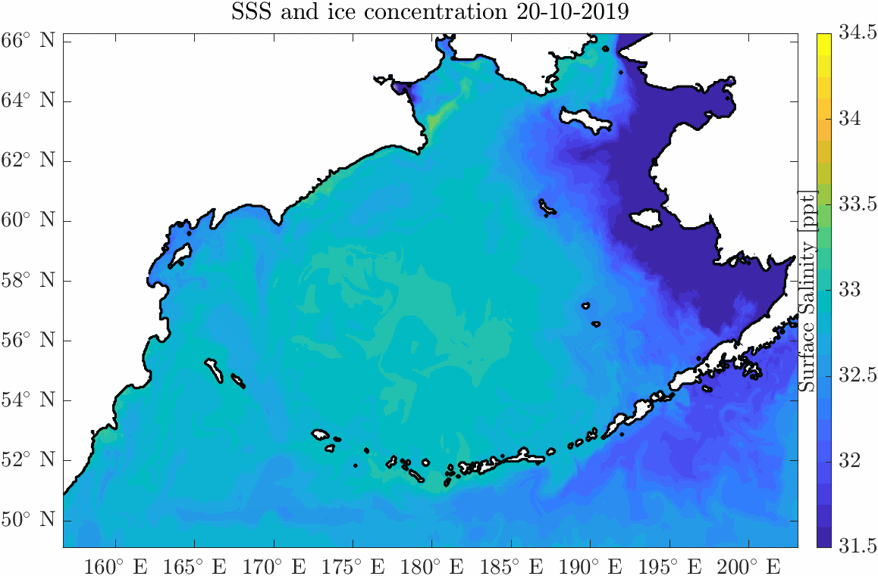
UFS-Coastal Application: A Success Story
NUOPC Cap
Sea Ice
(CICE)
CMEPS
Mediator
NUOPC Cap
CDEPS
(DATM)
NUOPC Cap
Waves
(WW3)
NUOPC Cap
OCEAN
(SCHISM)
Surge and Tide Operational Forecast System (STOFS) 3D-Alaska
Community Partners: NOS, EPIC, OSU, NCAR and VIMS
Notes:
Talking points:
What it shows: Alaska's Bering Sea and coastal regions
Colors = surface salinity, white = sea ice coverage (the whiter the thicker the ice).
Fresher (bluer) water hugs the coast where ice melts, saltier water sits offshore.
Sea ice and salinity are tightly linked as ice formation and melt directly reshape ocean saltiness (ice formation release salt and ice melt release freshwater).
Ice peaks in Feb–Mar and melts out by June, matching the natural yearly cycle.
Why it matters: Our UFS coupled application closely matches satellite data, proving we can reliably forecast Alaskan coastal conditions.

Slide 8
Q&A Period

