Slide 1
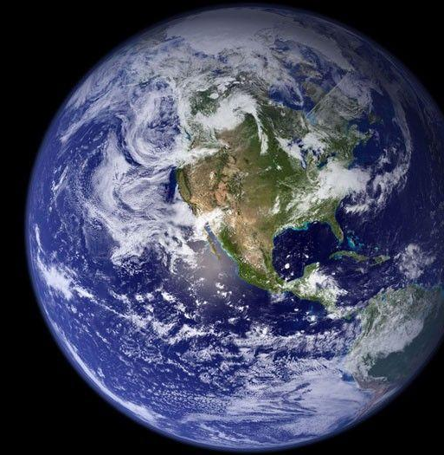
AMS Ad Hoc
Community Modeling Committee
Updates
21 July 2026
Frederick H. Carr, Co-Chair
University of Oklahoma, fcarr@ou.edu
Jim Kinter, Co-Chair
George Mason University, ikinter@gmu.edu
Alison Gregory, Executive Manager, agregory@ucar.edu

Slide 2
Uccellini, Spinrad, Koch, McLean, and Lapenta; BAMS, 2022
To complement the NMB and to ensure flow of communication between NOAA and the rest of the UFS community, EPIC is facilitating the establishment of a Community Modeling Board (CMB). The CMB will provide oversight to the UFS and will represent community perspectives and priorities. The CMB will include representation from the NMB to ensure effective communication and alignment. NOAA and community modeling boards will co-exist to sustain the flow of information between R&D and operations and applications (operations/applications to research, X2R, as well as R2X). The specific mechanism of that collaboration will be co-developed with the community with support from EPIC (Figure 6). The tightly-coupled NMB/CMB system aims to provide transparent, two-way visibility and mutual understanding of environmental modeling priorities, helping converge efforts across governmental and non-governmental modeling communities towards outcomes that benefit all.

Slide 3
The CMC Selection Committee chose 15 individuals representing academia, NOAA, other Federal agencies, private sector, and student/early career sectors
Terms of Reference drafted and approved by the WWCE Commission leadership
Regular monthly meetings and Working Groups formed
Fall 2025
Winter 2025
Spring 2026
Summer 2026
CMC Membership Selection Committee formed and begins receiving nominations for CMC Membership
First CMC meeting held in-person at AMS in New Orleans (January 2026)
In-Person meeting at UIFCW26 (July 2026)

Slide 4
Terms of Reference for the CMC
Can be found online at:https://www.ametsoc.org/cwwce/committees/ad-hoc-community-modeling-committee/
Purpose
The Community Modeling Committee (CMC) is an ad hoc committee in the American Meteorological Society (AMS) Weather, Water & Climate Enterprise (WWCE) Commission. Its purpose is to promote the advancement of U.S. Earth system prediction models for research, operations, and applications. Its primary activities are to:
Increase private, public, and academic participation in research and development of Earth system prediction modeling;
Enhance coordination among U.S. modeling centers, with a focus on advancement and community use of the Unified Forecast System (UFS); [The UFS is a framework for research and development, used by all members of the weather enterprise community, comprised of a suite of Earth system prediction models on all scales to advance NOAA’s operational forecast capabilities.]
Serve as a catalyst for leveraging community expertise on modeling innovations and advancements to benefit the UFS;
Identify best practices and innovations to the UFS and assess how to best facilitate community use of the UFS.

Slide 5
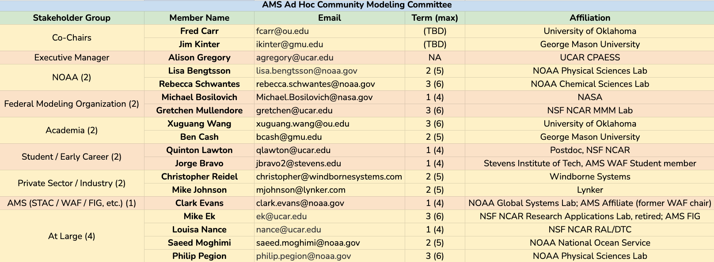
AMS Ad Hoc CMC Members

Slide 6
AMS Ad Hoc CMC Liaisons - 2026
AMS Ad Hoc Community Modeling Committee (CMC) Liaisons 2026
Name | Affiliation | Email
Vijay Tallapragada | NOAA/NWS/OSTI/EMC | vijay.tallapragada@noaa.gov
Jim Doyle | Naval Research Laboratory (NRL) | james.doyle.civ@us.navy.mil
Ligia Bernardet | NOAA GSL | ligia.bernardet@noaa.gov
Jacob Carley | NOAA/NWS/OSTI/EMC | jacob.carley@noaa.gov
Whit Anderson | NOAA GFDL | whit.anderson@noaa.gov
Tom Auligne | Joint Center for Satellite Data Assimilation | auligne@ucar.edu
Adam Clark | NOAA NSSL | adam.clark@noaa.gov
Kevin Garrett | NOAA/NWS/OSTI/EMC | kevin.garrett@noaa.gov
Ruby Leung | Pacific Northwest National Lab (PNNL) | Ruby.Leung@pnl.gov
Marty Ralph | Scripps (EISWG co-chair) | mralph@ucsd.edu
Jen Vogt | NOAA OAR/WPO/EPIC | jennifer.vogt@noaa.gov

Slide 7
What will CMC Do?
Actions? Products?
Still a work in progress
Discussions with leaders and other groups (NOAA & NWS HQ, EMC (MDC), UFS SC, NMT, EISWG, DTC, NOAA Labs and CIs, etc.)
Working Groups for specific topics
Reports or white papers (No response required but intent is that they would be of value and would be welcome)
Bring suggestions, best practices, concerns, etc. on important issues to NOAA/UFS leaders
Suggestions on possible roles of CMC welcome from audience/community

Slide 8
Attention Areas
Accessibility and Usability
Research-to-Operations Pipeline
Technical Infrastructure & Integration
Funding and Investment
Workforce Development
Collaboration & Coordination

Slide 9
CMC Working Groups
UFS Ease of Use
To understand and document barriers to adoption and use of the UFS by the broader scientific community. For the UFS to be a community model, the community must be able to build it, run it, and analyze it using resources the community can access. All of these steps must be not just possible but simple and seamless if we want adoption to increase.
Working Group Lead:
Ben Cash, George Mason University bcash@gmu.edu

Slide 10
CMC Working Groups
R2O/O2R
Evaluate what is needed for successful U.S. Weather Enterprise modeling in support of research, operations and applications.
Gather information around community modeling as it relates to…
  What are the major roadblocks for R2O/O2R?
  What is working great for R2O/O2R?
  What partnerships are needed at each stage in the R2O/O2R process?
  How do we define success?
Next step: Engage social scientist(s) to design the information gathering activities!
Working Group Leads:
Louisa Nance, NSF NCAR Developmental Testbed Center (DTC) nance@ucar.edu | Clark Evans, NOAA Global Systems Laboratory (GSL) clark.evans@noaa.gov

Slide 11
Next steps
Finalize Working Group Roles/Responsibilities
Produce Reports/White papers
Solicit feedback, follow up, etc.
Decide on next Working Groups

Slide 12
Questions / Comments?
For example, what issues do you think the CMC should address? How can we best help advance NOAA modeling?
Frederick H. Carr, Co-Chair
University of Oklahoma, fcarr@ou.edu
Jim Kinter, Co-Chair
George Mason University, ikinter@gmu.edu
Alison Gregory, Executive Manager, agregory@ucar.edu

Slide 13
Supplemental Slides

Slide 14
Terms of Reference for the CMC
Purpose
The Community Modeling Committee (CMC) is an ad hoc committee in the American Meteorological Society (AMS) Weather, Water & Climate Enterprise (WWCE) Commission. Its purpose is to promote the advancement of U.S. Earth system prediction models for research, operations, and applications. Its primary activities are to:
Increase private, public, and academic participation in research and development of Earth system prediction modeling;
Enhance coordination among U.S. modeling centers, with a focus on advancement and community use of the Unified Forecast System (UFS); [The UFS is a framework for research and development, used by all members of the weather enterprise community, of a suite of Earth system prediction models on all scales to advance NOAA’s operational forecast capabilities.]
Serve as a catalyst for leveraging community expertise on modeling innovations and advancements to benefit the UFS;
Identify best practices and innovations to the UFS and assess how to best facilitate community use of the UFS.

Slide 15
Terms of Reference for the CMC (cont.)
Membership
The CMC will consist of 13 to 17 members, approved by the WWCE Commissioner, with representation across various stakeholder categories. Liaisons, who are ex officio, non-voting members, may be appointed by the leads from relevant modeling organizations
Members of the Community Modeling Committee are to serve a term of three years, rotating off 1/3 of the members each year. At the onset, 1/3 of members will be appointed for 1 year, 1/3 of members will be appointed for 2 years, and 1/3 of members will be appointed for 3 years. At the end of each term, there is an option for members to renew for one additional three-year term.

Slide 16
Terms of Reference for the CMC (cont.)
Membership will include:
A Chair or Co-Chairs, nominated by CMC members and approved by the Commissioner
One member from Weather Analysis and Forecasting STAC Committee
Two members from NOAA modeling organizations
Two members from other Federal modeling organizations
Two members from the academic community
Two members from private sector modeling community
One to two student or early-career members
Two to four at-large members
Liaisons (non-voting, ex-officio) members (as needed)

Slide 17
Terms of Reference for the CMC (cont.)
Responsibilities
Help advance the UFS for the mutual benefit of the broader Earth system prediction modeling community. This includes prioritizing model improvement needs, and identifying gaps and barriers that impede progress.
Identify innovative ideas and high impact initiatives to advance the UFS.
Promote partnerships, coordination and collaborations that will benefit the UFS.
Promote community engagement by incentivizing community use of UFS systems, conducting open meetings, soliciting advice on community modeling needs and UFS improvement, and evaluating the responses of those responsible for the UFS to community input.

Slide 18
Terms of Reference for the CMC (cont.)
Responsibilities (cont.)
Conduct meetings as necessary to accomplish these responsibilities. Working groups may be formed to complete specific tasks, and expertise outside the CMC can be solicited as needed.
Provide recommendations to achieve the above goals to the Commissioner. Share these recommendations with the wider research and operational forecasting community.
Sustain community values of collaboration, transparency, accountability, integrity, trust, inclusion, engagement, skill, and attribution.

