Slide 1
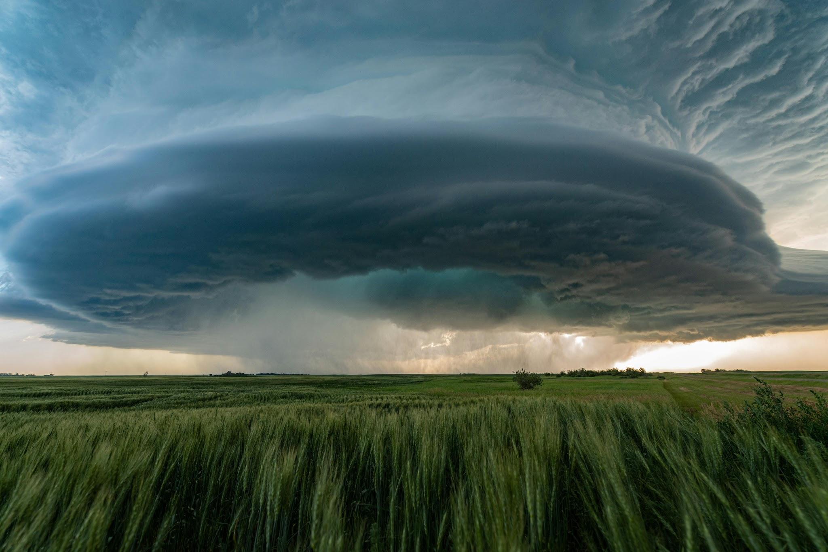
July 21, 2026
The NCAR MPAS Program
Gretchen Mullendore & Kate Fossell
NSF NCAR Associate Director/MMM Lab Director
Contributions from across NSF NCAR

Slide 2

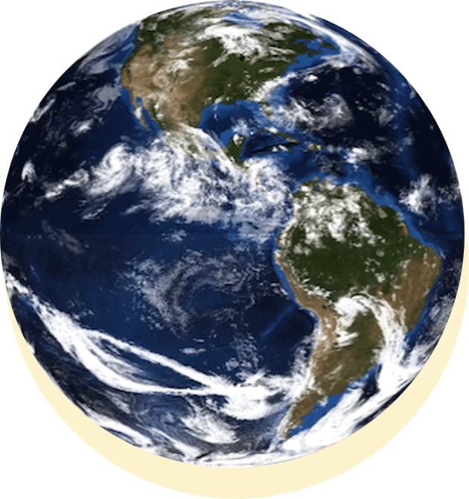
 | MPAS: Model for Prediction Across Scales
Next-generation community modeling system with development led by NSF NCAR
Applicable from regional cloud-scale processes to global climate applications
Uptick in broader community use and adoption, development, and support requests in recent years
Jan. 2026 NOAA adopts MPAS for next decade of research and operations
www.mmm.ucar.edu/models/mpas

Slide 3
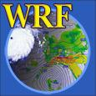
Strategic ramp down of WRF support and resources to meet our mission to innovate and deliver the next state-of-the-art modeling system (MPAS)
Anticipate a community-wide announcement of a 1-year transition period culminating in a final feature release of NSF NCAR WRF (WRF 4.9)
What this means for the community:
  WRF is not going away
  NSF NCAR will freeze WRF development at the end of the 1-year transition, i.e., NSF NCAR will no longer accept WRF contributions from the broader community
 | WRF Transition Plan

Slide 4
Ownership: NSF NCAR/MMM owns the entire WRF system – it resides entirely within in an NSF NCAR repository. MPAS-A is moving towards including major components from developers’ repositories outside of NSF-NCAR.
Examples: DA (JEDI, DART), physics, chemistry.
This places more responsibilities on external component developers for the MPAS-A Community release and support. Developers become co-owners of MPAS-A.
Decision making: While WRF had many working groups, most were inactive, and most major decisions were made by MMM WRF developers. With MPAS-A, we are moving towards a governance structure and decision making that includes external co-developers.
This necessarily follows from increased ownership.
 | MPAS Community Development
Community Development: How does MPAS-A differ from WRF?

Slide 5
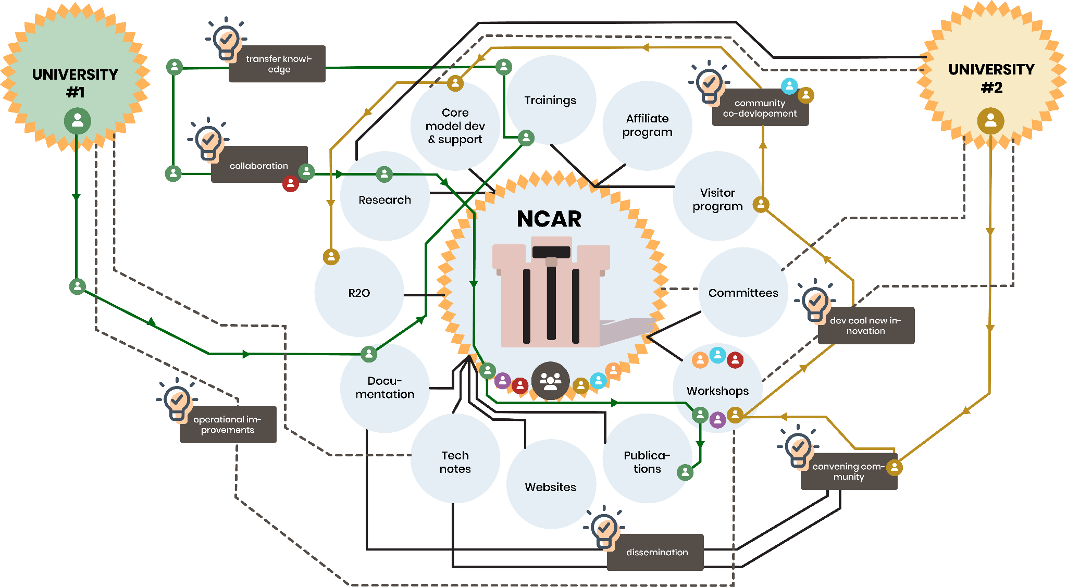
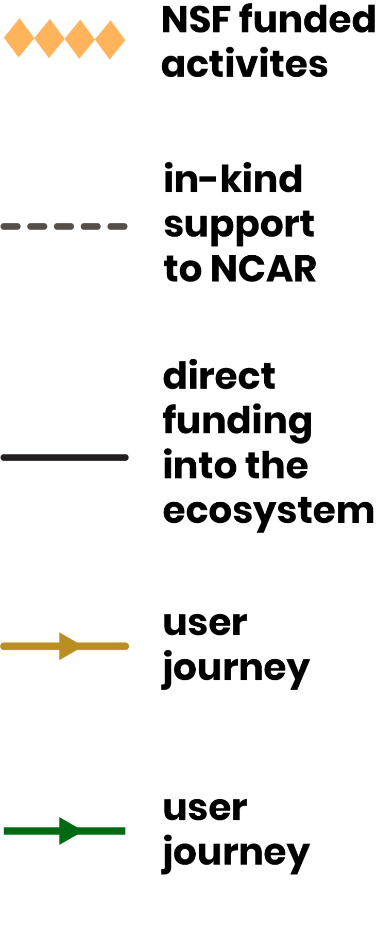


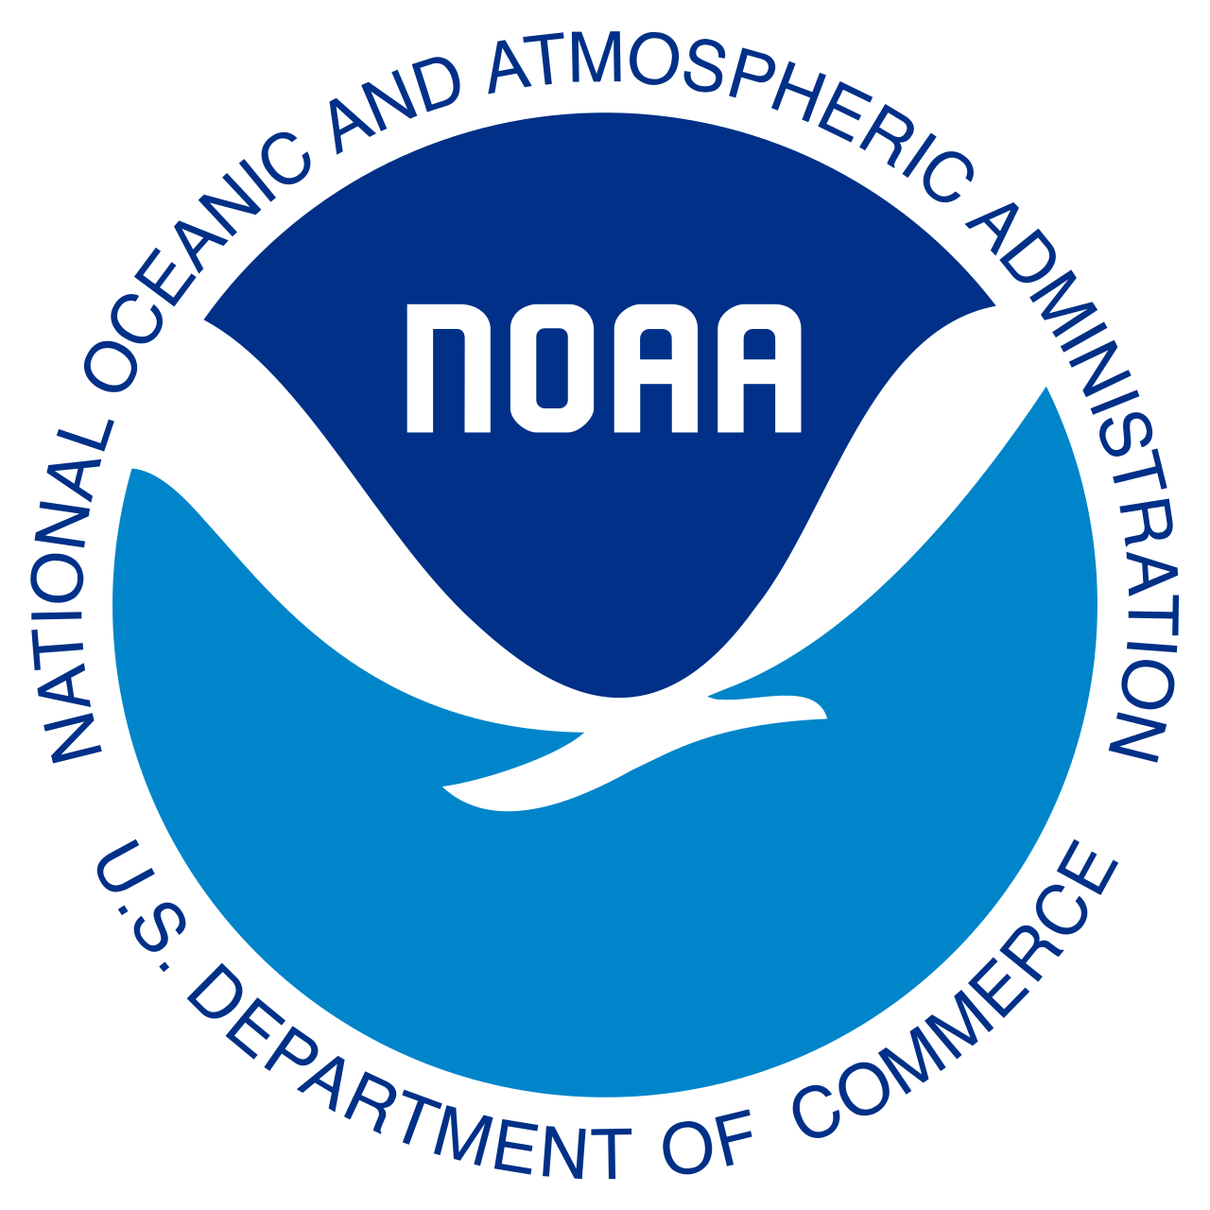

MPAS Ecosystem
R2X
Funding and in-kind support from Partners further supports MPAS development
Weather Enterprise R2X
Operations: NOAA, USAF
Commercialization: The Weather Company
Applications: Hazard risk mgmt (e.g. reinsurance), Hydro, Fire
Other uses
Notes:
*joke about NCAR-centric :)

Slide 6
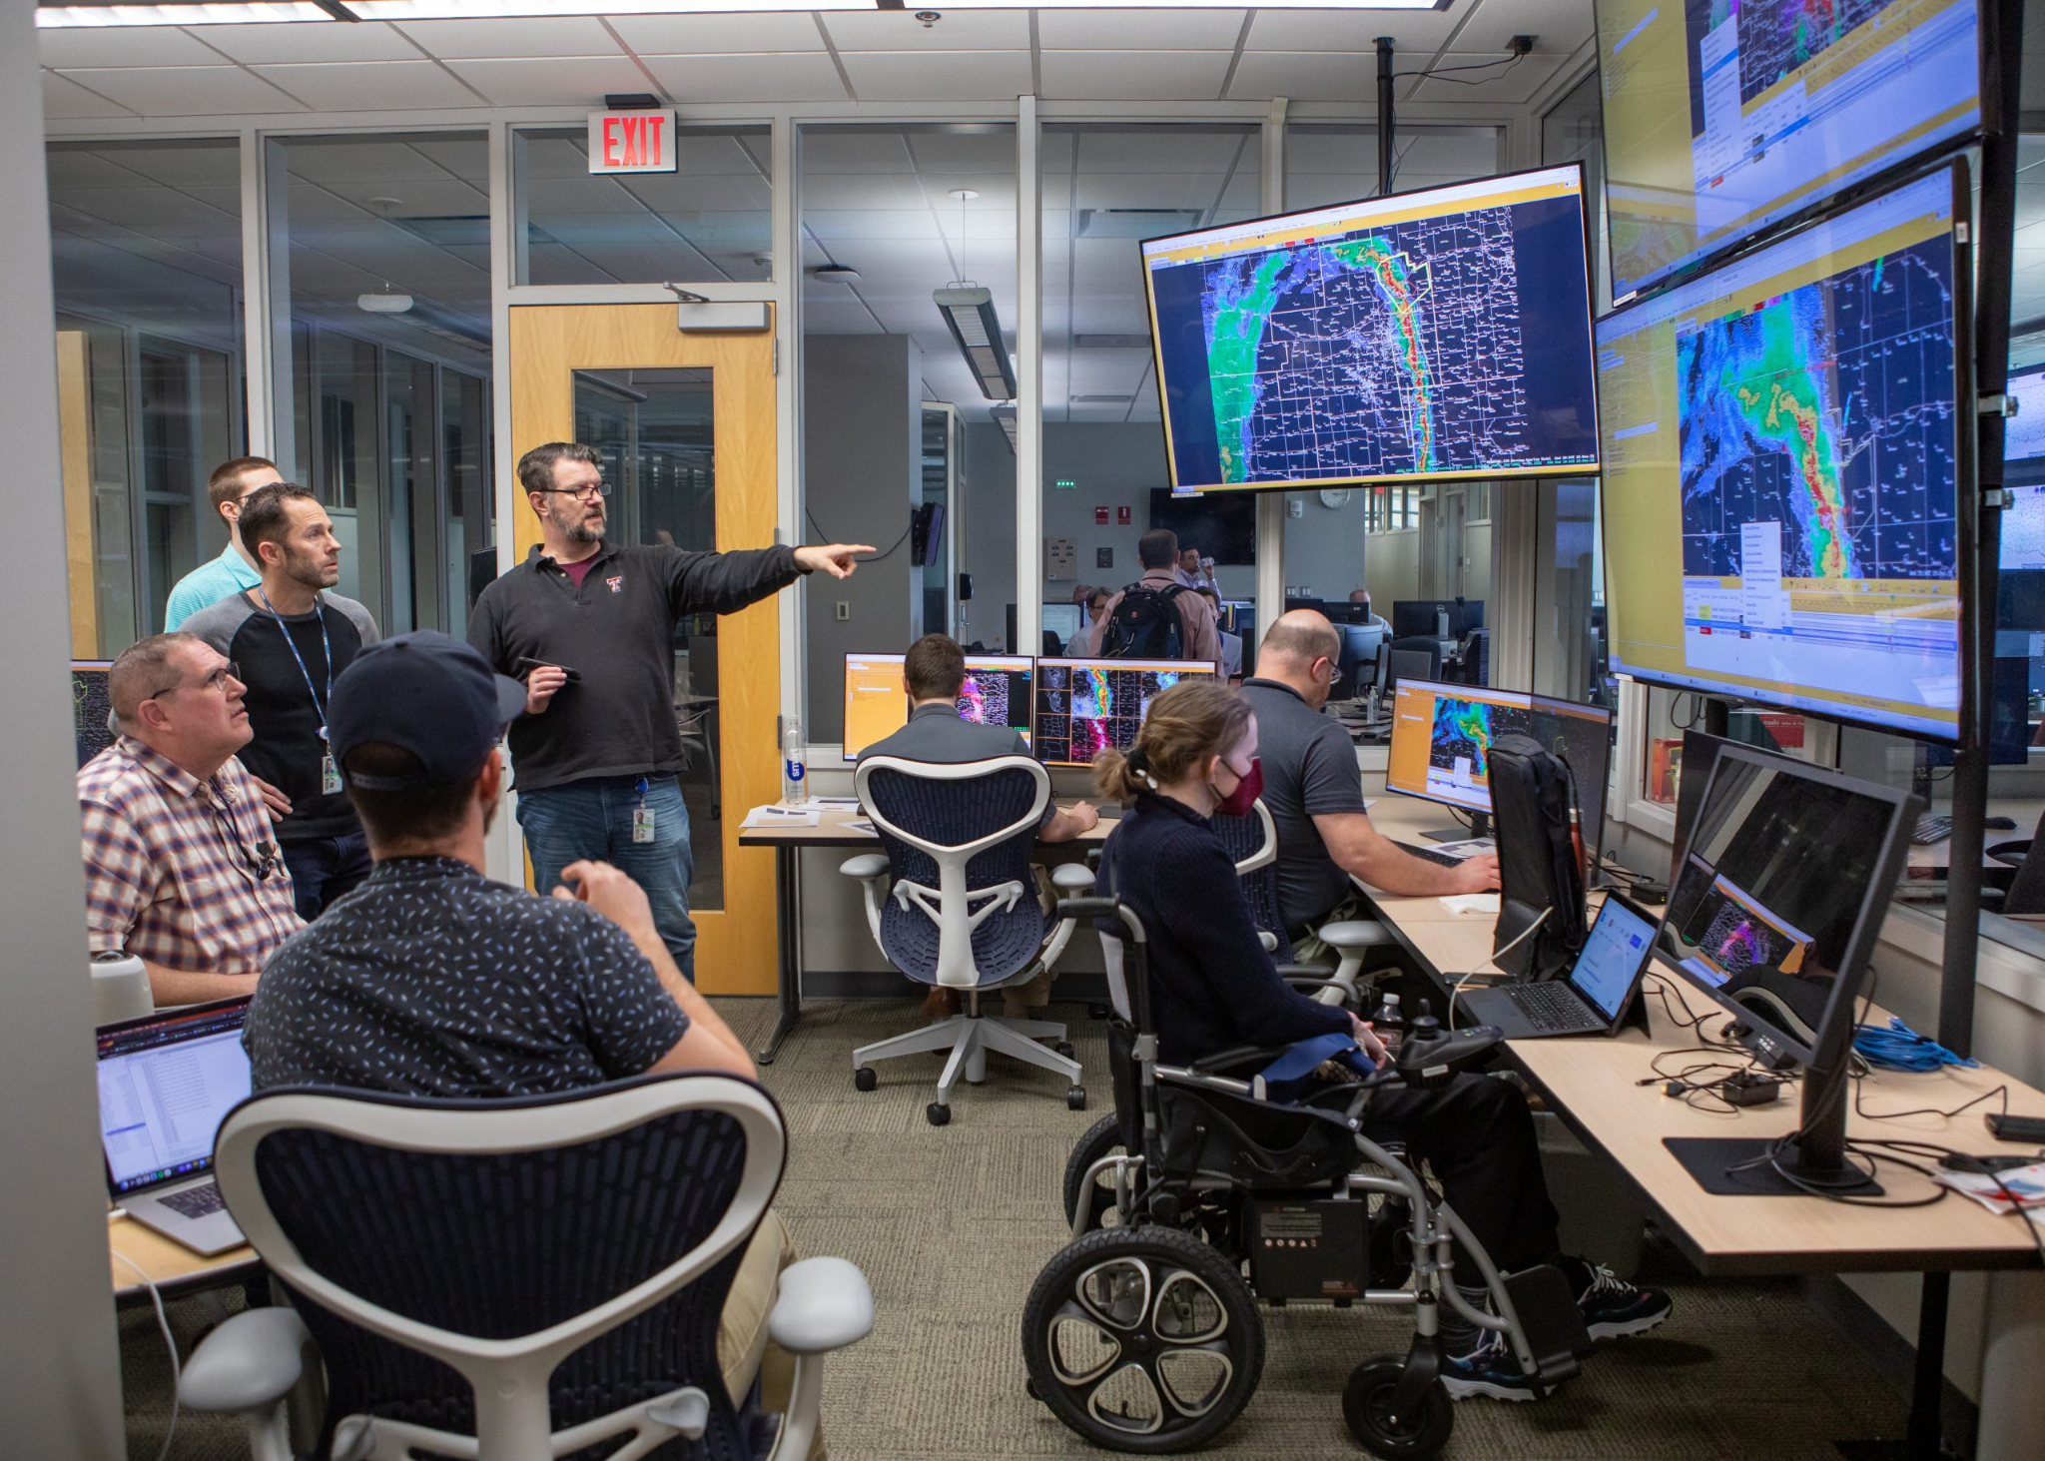
NCAR and NOAA continue to strengthen our decades long collaboration
NOAA and NCAR lead critical components of the the R2O continuum for the US Weather Enterprise
Many examples of success (e.g., HRRR, HRRRE)
We have formalized the value our partnership in the NOAA/NCAR MOU
  Facilitate sharing of research, tools, and data to advance weather and Earth system science
  A framework for strategic exploration of scientific understanding and solutions to accelerate advancement of the U.S. weather enterprise
Excited to continue our partnership and strengthen communication and process to further improve our collaboration
 | NCAR-NOAA Partnership
Credit: NOAA NSSL

Slide 7




 | NCAR MPAS Program
Structure, governance, and communications in support of all NCAR MPAS activities.
Enables NCAR to effectively convene community and collaborate with partners to facilitate critical developments
Serve MPAS
Users & Developers
Recognize & Support valuable work
NCAR MPAS Program
Align shared resources
Foster open dialogue & knowledge exchange

Slide 8
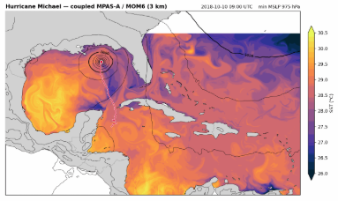
Released June 2026
GPU optimization of MPAS-A dycore
Initial LES capabilities
Mesh partitioning “online”
Chemistry – GOCART2G
GSL Physics *
MPAS Urban (collab w/ HKUST)
Noah-MP
LES full terrain
GPU physics (multi-org collab)
Ocean Coupling
CheMPAS full release
Spectral Nudging
 | Looking Ahead: New MPAS Capabilities
MPAS Release V8.4
Coming soon
In the pipeline
* co-developing community contribution framework to facilitate future community innovation into NOAA applications and UFS

Slide 9
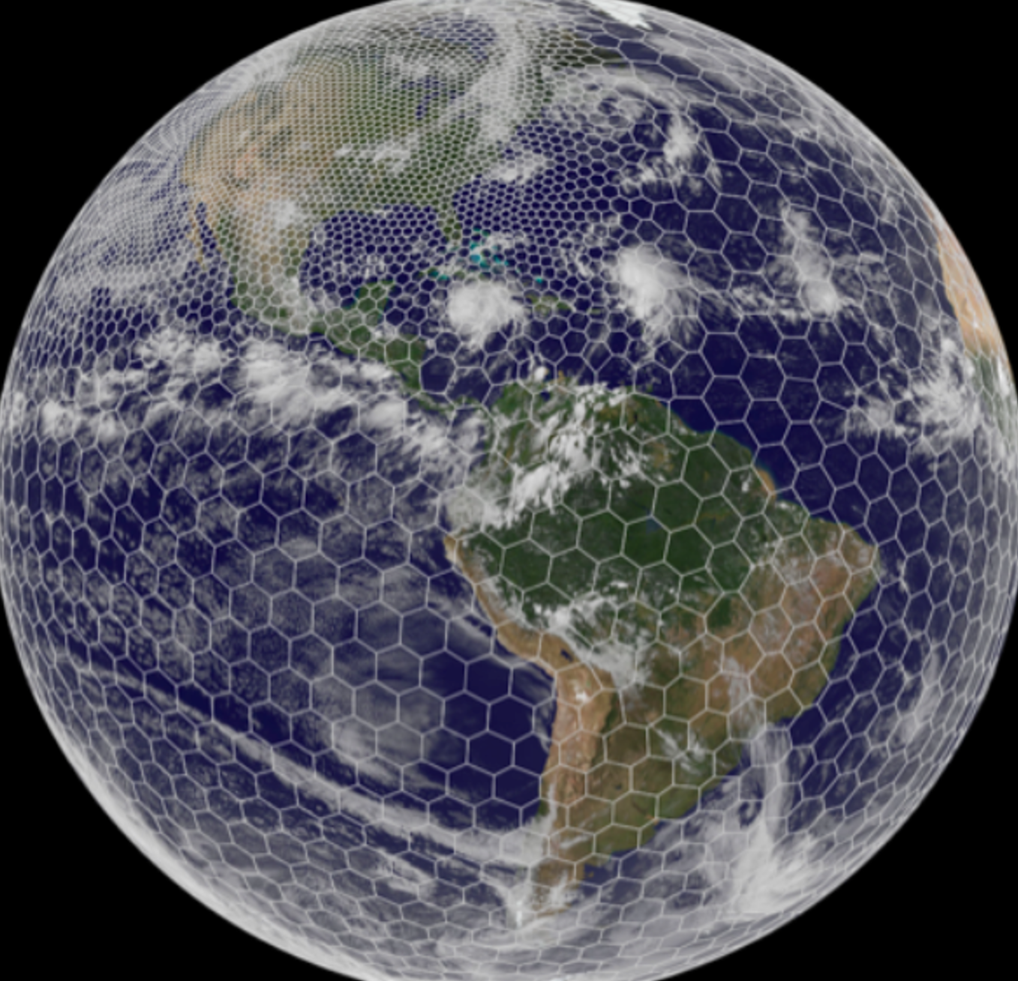
 | Stay engaged with MPAS!
AMS Summit: Aug 2-7, 2026 – Madison, WI
MPAS Tutorial: Aug 10-14, 2026 – Boulder, CO (website)
MPAS website & repository
  https://www2.mmm.ucar.edu/projects/mpas/site/index.html
  https://github.com/MPAS-Dev/MPAS-Model

Slide 10
Thank You!

