Slide 1

EPIC’s Role in Facilitating the Integration of MPAS into UFS
Eric Aligo1,2, Ben Koziol1,3, Jong Kim1,2, Jennifer Vogt1, Maoyi Huang1,
Youngsun Jung4, Ligia Bernardet5,6,Jacob Carley4, Gillian Petro1,7, and Kate Fossell8
1 NOAA/OAR/WPO/EPIC 2 Science and Technology Corporation
3 RedLine Performance Solutions, LLC 4 NOAA/NWS/OMD
5 NOAA/OAR/GSL 6 DTC 7 Element 84, Inc. 8 National Center for Atmospheric Research

Slide 2

Why MPAS Integration into UFS Matters
Supports NOAA’s Vision for Next-Generation Modeling
01
Global high-resolution prediction system
Unified Forecast System (UFS) Community Infrastructure
EPIC, in partnership with NOAA modeling laboratories, operational centers and NCAR — is enhancing the UFS community infrastructure to incorporate MPAS capabilities.
02
Fully coupled Earth-modeling system
03
Community-driven model development
04
Improved operational forecasting capabilities
05
Faster research-to-operations transition

Slide 3
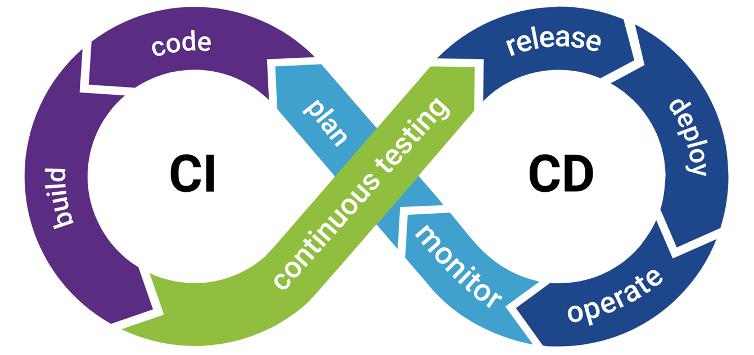

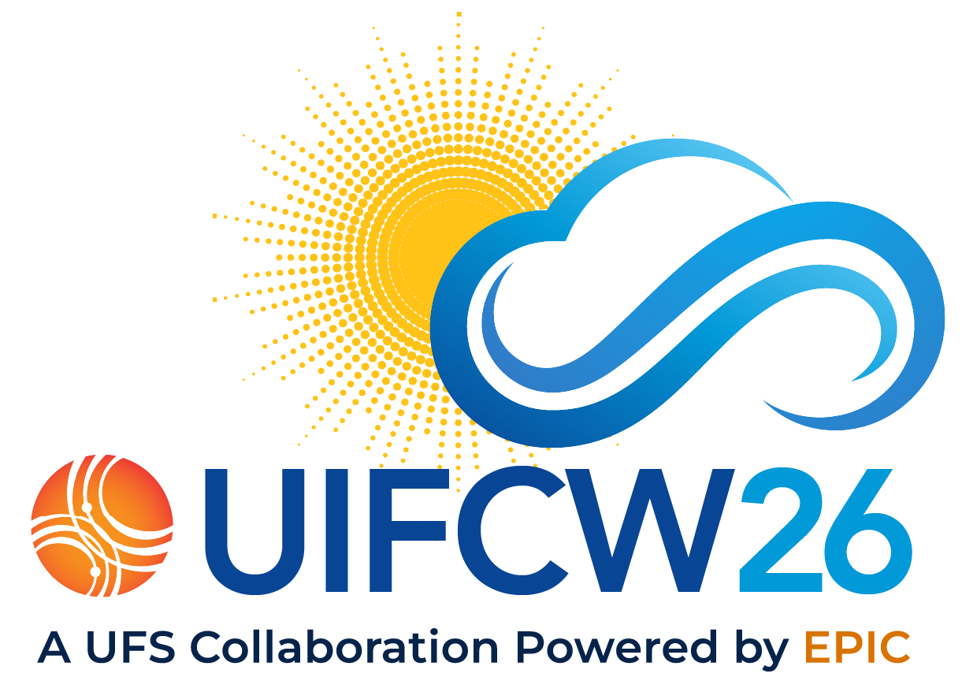
Key EPIC Activities for MPAS-UFS
01
CI/CD & Infrastructure
Establishing robust Continuous Integration and Development pipelines to accelerate software delivery and maintain system reliability.
Coupling Infrastructure: Enhancing and modernizing coupling capabilities utilizing the ESMF framework.
03
UFS Optimization
Refining system architecture and removing redundancies to make the Unified Forecast System (UFS) more lean and efficient.
04
Expansion/modification of testing and development environments
Ongoing Reliability Testing (ORT), regression testing trimming, unit testing.
UFS Side Meeting on Integration/Testing
Convened this week at UIFCW with key collaborators from EPIC, NOAA labs, and NWS!
02

Slide 4
MPAS-UFS & MPAS Standalone
Challenges with Synchronization
Synchronization Benefits
Seamless Integration: Code management framework ensures the seamless integration of standalone development with MPAS-UFS.
Community Access: Access to latest developments while enjoying a well-tested, supported system with enhanced capabilities.
Enhanced R2O: A close collaboration directly accelerates the transition of research standalone efforts to operations.
01
Duplicate Infrastructure
Avoiding duplicate testing infrastructure
02
Dycore Consistency
Ensuring development in one dycore does not break the code in other dycores (FV3 and MPAS)
03
Code Convergence
Converging standalone and UFS-based development

Slide 5

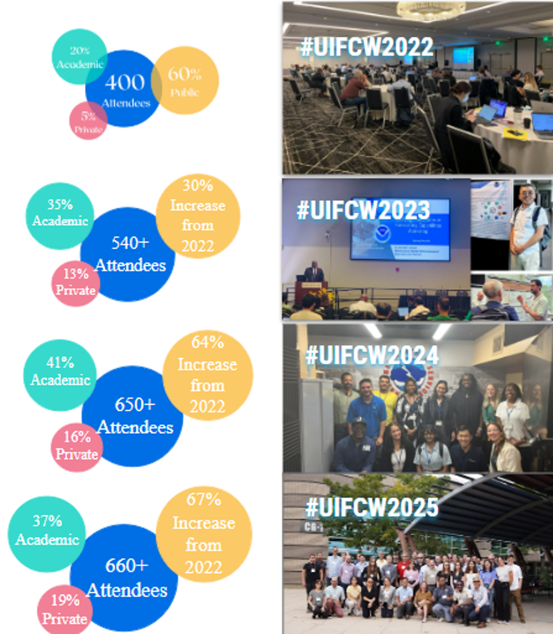

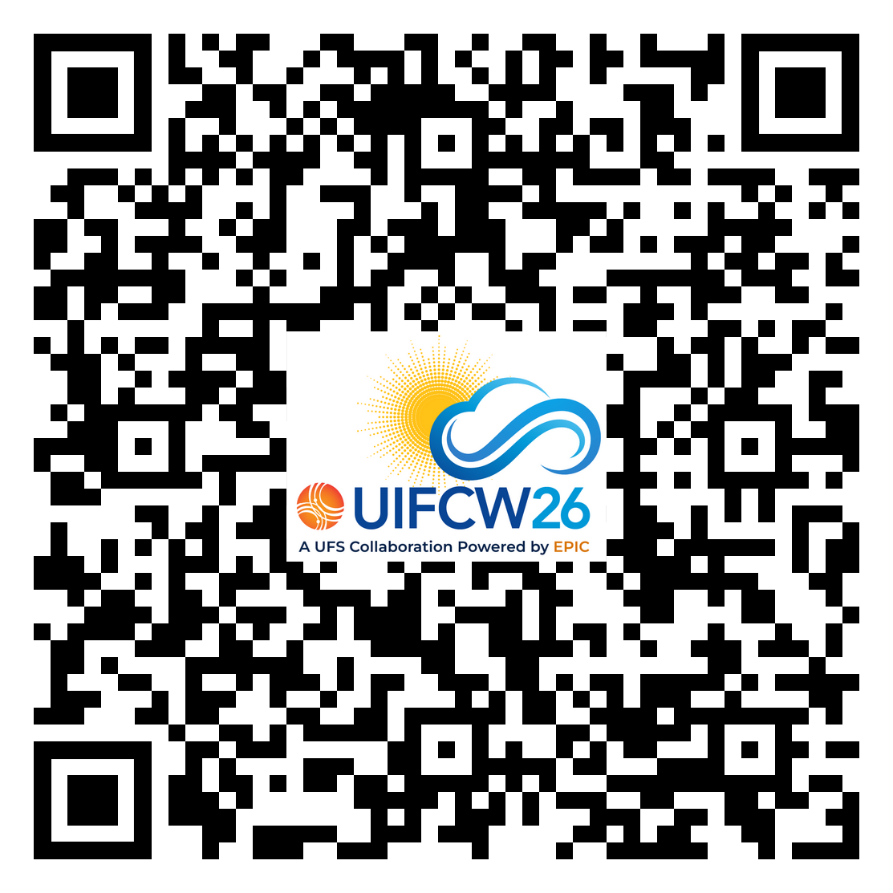
Community Support for MPAS-UFS
Key Initiatives
Expanded documentation and tutorials
User support resources
Community workshops and training events
Increased collaboration opportunities
Growing Engagement
UIFCW26
Side Meetings*
GPU-UFS Integration
EPICs Role in
MPAS Testing
Scan for UIFCW26 Participation Guide
*By invitation only

Slide 6
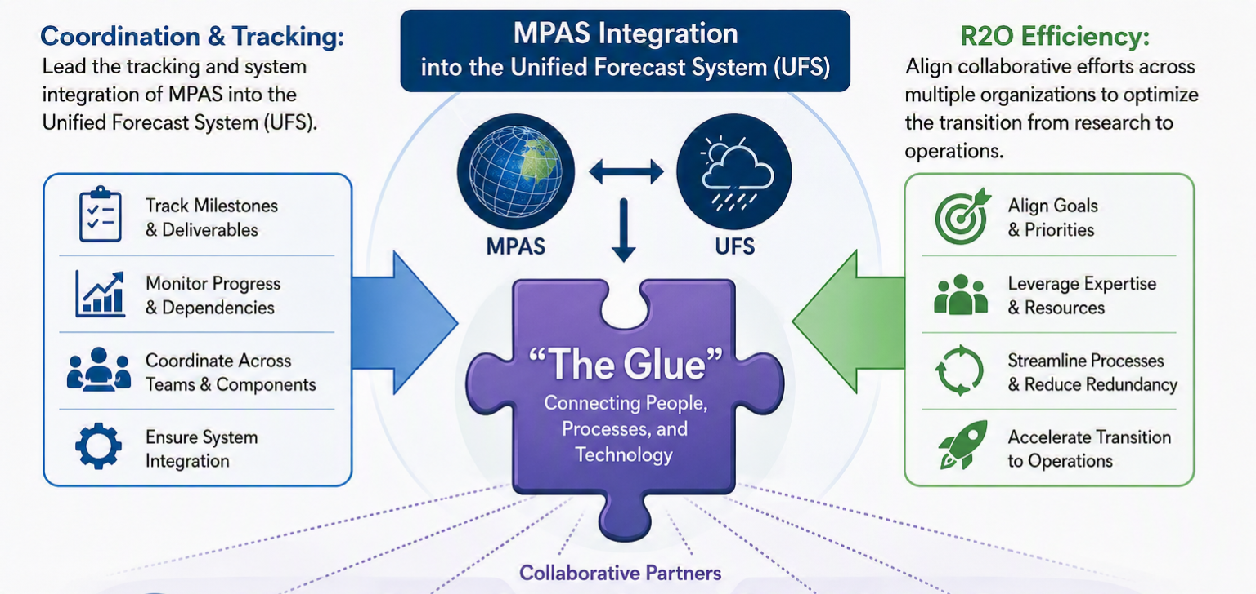
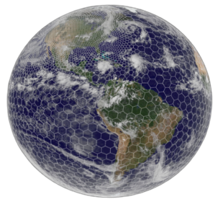








EPIC Program Support
Project Engineer Role
EPIC Chief Scientist/Program Coordinator = Project Engineer

Slide 7
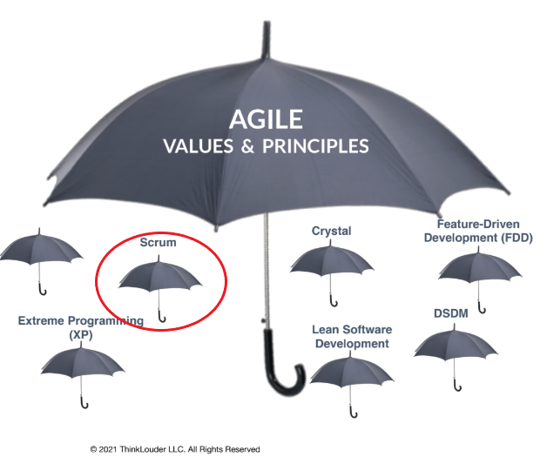
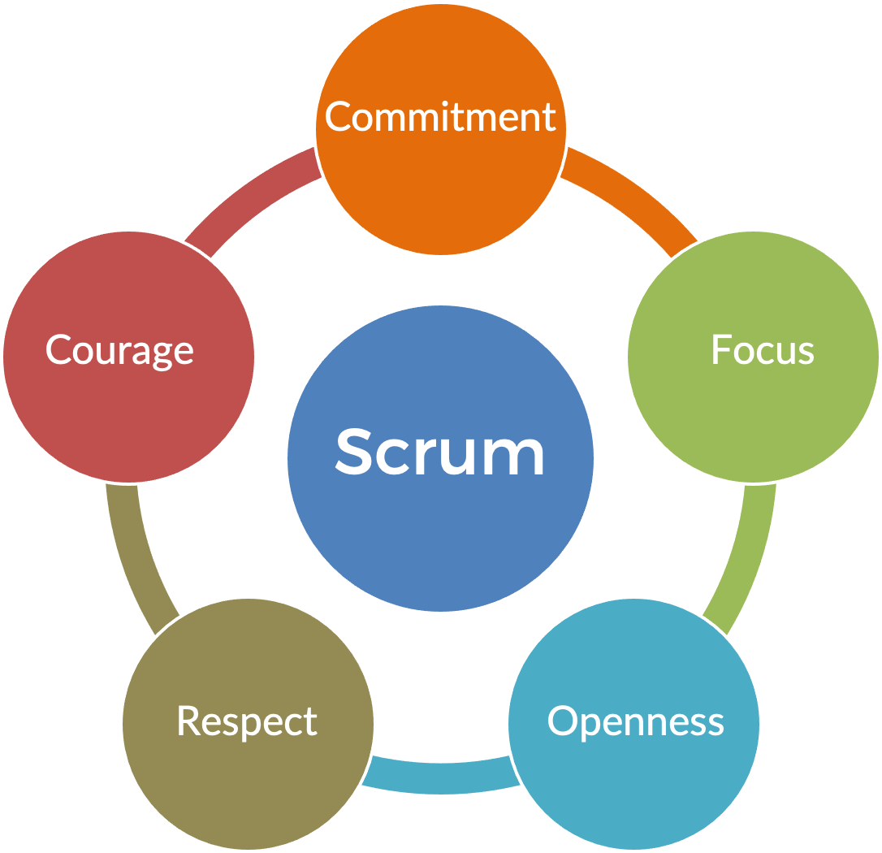

EPIC Program Support
NWS, OAR, NCAR Collaboration
Project Plan & Funding: Identify strategic funding needs to support moonshot initiatives.
  Funding Sources: JTTI, UFS-R2O, STI, Water in the West, GSL/EMC Base, IIJA / BIL, Testbed Program
Project Charter: Drive collaboration and team coordination under a unified charter.
Agile/Scrum Approach: EPIC contract teams use the Agile/Scrum methodology. Apply a similar approach to support NOAA and the community in achieving the moonshot initiatives by eliminating impediments and improve efficiency while improving transparency and visibility.
Scrum Values
scrum.org

Slide 8
Draft MPAS-UFS Project Plan
Infrastructure
Key Priorities:
UFS infrastructure integrating MPAS into UFS
Code Management
CCPP-compliant physics/stochastic physics
Ensemble infrastructure
Coupling
Atmospheric Composition
Pre-/Post-processing/IO
Performance tuning/optimization
Team Members
Project Engineer
Eric Aligo
Program Managers
Maoyi Huang
Youngsun Jung
Chandra Kondragunta/
Aaron Pratt
Project Managers
Ligia Bernardet
Jacob Carley
Program Sponsors
John Ten Hoeve
Kevin Garrett

Slide 9
Draft Project Charter
Roles
Project Managers (PjMs):
Identify gaps.
Provide technical direction.
Ensure progress towards all milestones and deliverables.
Communicates with Program Managers (PMs) and principal investigators.
Project Engineer:
Provides overall project coordination and reporting.
Helps find solutions to roadblocks.
Tracks milestones.
Organizes Sprint meetings/Sprint Reviews.
Progress Tracking
Meeting Cadence:
Once per month in Routine Sprints and Sprint Reviews
Quarterly meeting with PjMs and PMs.
Annual progress report to stakeholders.
Tools: Jira/Confluence/GitHub project boards

Slide 10

Summary
EPIC provides the community infrastructure, development environment, training resources, and collaborative framework necessary to facilitate integration of MPAS into the UFS.
The development of an infrastructure Project Plan and Charter puts us on the path to achieve NOAA’s moonshot vision of a global, fully-coupled, MPAS-based, high-resolution Earth-system model.
Community engagement through workshops, tutorials, etc. together with adopting a form of the Agile/Scrum methodology will lead to improved efficiencies and a faster R2O process.

Slide 11
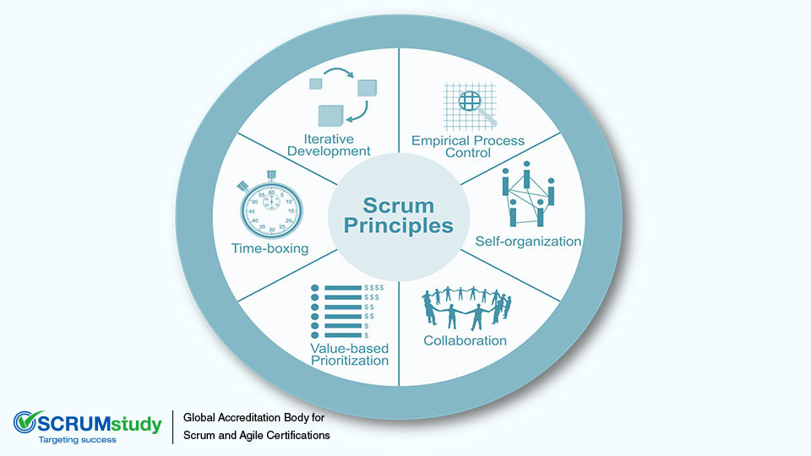
EPIC Program Support
Project Engineer Role
Coordination & Tracking: Lead the tracking and system integration of MPAS into the Unified Forecast System (UFS).
R2O Efficiency: Align collaborative efforts across multiple organizations to optimize the transition from research to operations.
“The Glue”
NWS, OAR, NCAR Collaboration
Project Plan & Funding: Identify strategic funding needs to support moonshot initiatives.
Project Charter: Drive collaboration and team coordination under a unified charter.
Scrum/Agile Approach: Meet regularly to eliminate impediments, while improving transparency and visibility.
Funding & Partners
Funding Sources
JTTI, UFS-R2O, STI, Water in the West, GSL/EMC Base, IIJA / BIL, Testbed Program
Partners
WPO, GSL, EMC, DTC, NSF NCAR, PSL

Slide 12
MPAS-UFS & MPAS Standalone
Challenges with MPAS and Synchronization
01
Duplicate Infrastructure
Avoiding duplicate testing infrastructure
Synchronization Benefits
Seamless Integration: Code management framework ensures the seamless integration of standalone development with MPAS-UFS.
Community Access: Access to latest developments while enjoying a well-tested, supported system with enhanced capabilities.
Enhanced R2O: A close collaboration directly accelerates the transition of research standalone efforts to operations.
02
Dycore Consistency
Ensuring development in one dycore does not break the code in other dycores (FV3 and MPAS)
03
Global Scale-Up
Scaling MPAS to global operational resolutions
04
Code Convergence
Converging standalone and UFS-based development

