Slide 1


Transitioning to an
MPAS-JEDI based Warn-on-Forecast System (WoFSv2):
Next-Generation Storm-Scale Probabilistic Guidance
Nusrat Yussouf, Craig schwartz, Soyoung Ha, Yunheng Wang, Kent Knopfmeier, Thomas Jones, Joshua Martin, Brian Matilla, Louis Wicker, Patrick Skinner, Ted Mansell, Miranda Silcott, Holly Obermeier, Derek Stratman, Christopher Kerr, Chengsi Liu, Adam Clark, Corey Potvin, Patrick Burke, Israel Jirak, Jim Nelson

Slide 2

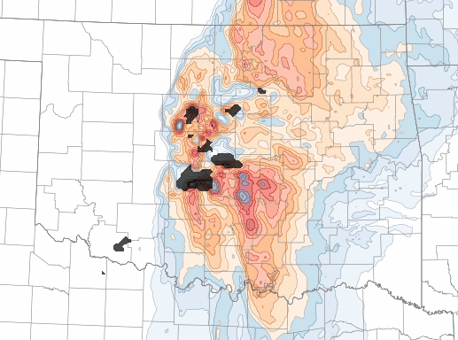
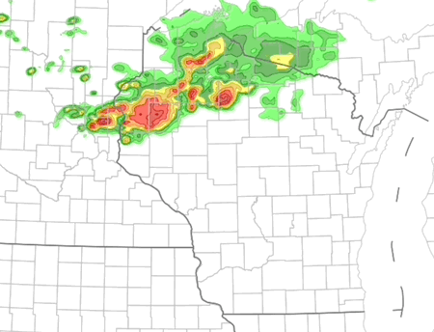
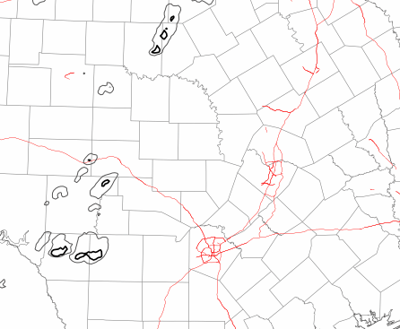
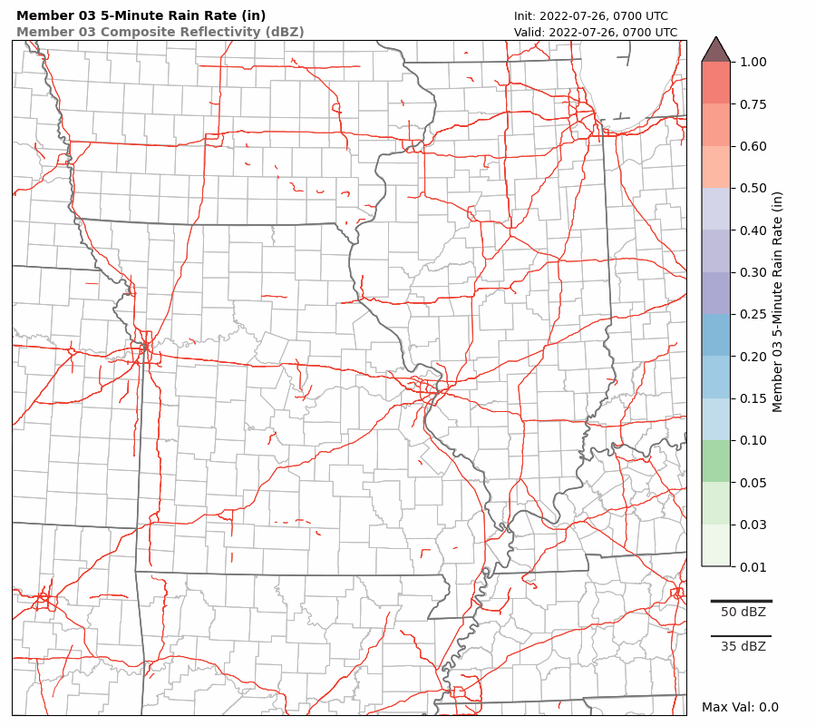
CURRENT CAPABILITIES
WoFSv1: Frequently cycled ensemble DA enables probabilistic prediction of individual storms
Storm producing largest hail stone in Texas history
Flash Flooding
Area where significant flash flooding occurred
Tornado hot spots…
1-4 hour lead time
Derecho Path
3 km horizonal grid spacing 36 analysis members 18 forecast members 6 h ensemble forecast
WRF model and GSI-EnKF Data Assimilation System
Relocatable regional domain focused on active high-impact weather
Low-latency probabilistic output for local and national forecast operations
Analysis cycling is key: new observations continually correct storm position, intensity, and environment.

Slide 3
FROM OBSERVATIONS TO PROBABILISTIC HAZARDS
Data assimilation workflow in WoFSv1
Observations
Quality control / preprocessing
Ensemble DA analysis
Forecast ensemble
Hazard guidance
Radar, satellite, surface, radiosonde, acars
0–6 h prediction of individual storms
Observation thinning
Update model state and uncertainty
Probabilities, percentiles, ML products
Repeated every 15 minutes
New forecast run every 30 minutes
When storms are continuously assimilated, WoFS can sharpen guidance toward storm-scale corridors.
The forecast ensemble must retain enough spread to represent multiple plausible storm evolutions.
Goal: Accurately initialize storms and surrounding environment in the ensemble initial condition fast enough for watch-to-warning decisions.

Slide 4
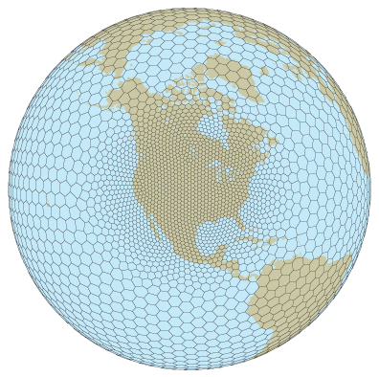
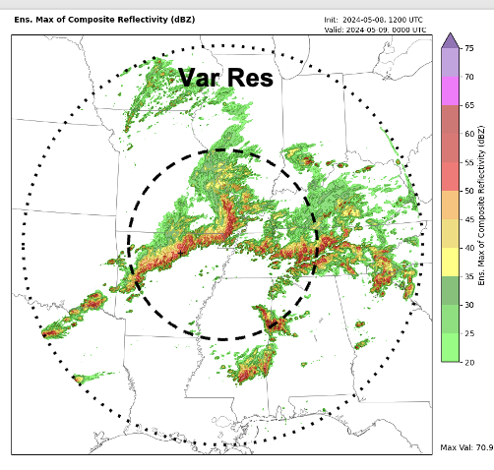
Move toward MPAS–JEDI for WoFSv2
Full integration to NWS operations and meet NOAA’s Unified Forecast System (UFS) infrastructure
Year: 2026-2028
NWS JTTI and Testbed Proposals
Advance RL 8 WoFS within the MPAS-JEDI framework.
Vet MPAS-WoFS performance through 3 years of evaluation in two NOAA testbeds.
WoFSv2 objective: Improve WoFS operational value while modernizing and advancing the core system.

Slide 5
Initial WoFSv2 configuration
36-member single physics ensemble
Microphysics: NSSL 2M microphysics, PBL: MYNN, LSM: RUC and
LW and SW radiation: RRTMG
Horizontal cell spacing = 3km, 60 vertical levels in MPAS
LETKF Solver (LGETKF was evaluated but not adopted because WoFS require flexibility in vertical localization.)
What MPAS–JEDI WoFSv2 assimilates
  MRMS Reflectivity and WSR-88D Radial Velocity
  GOES Cloud Water Path
  Conventional Observations from Prepbufr
6 Spring 2026 Cases ran on URSA

Slide 6
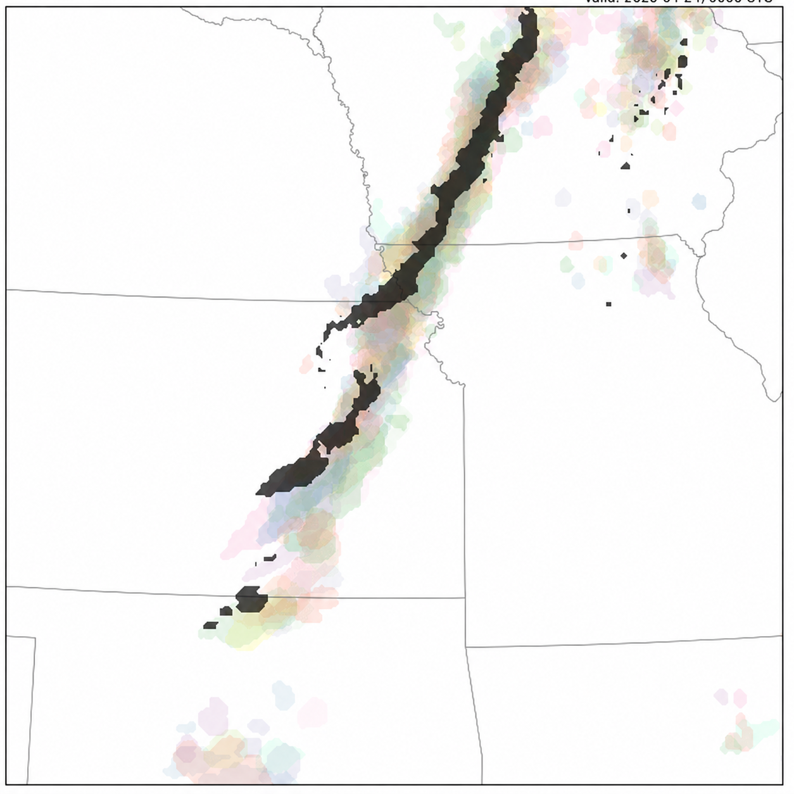
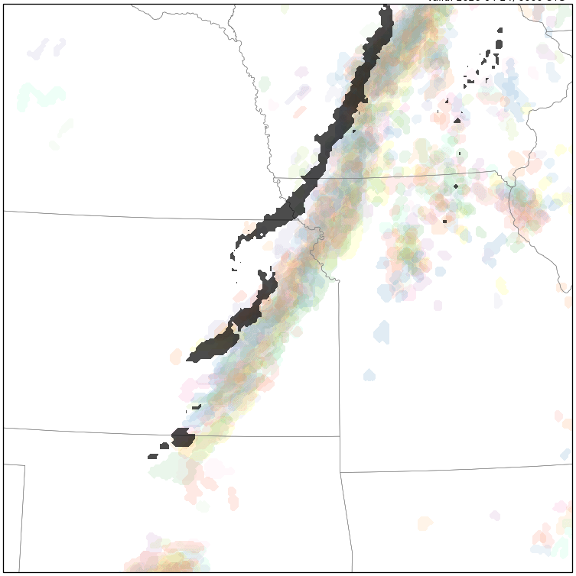
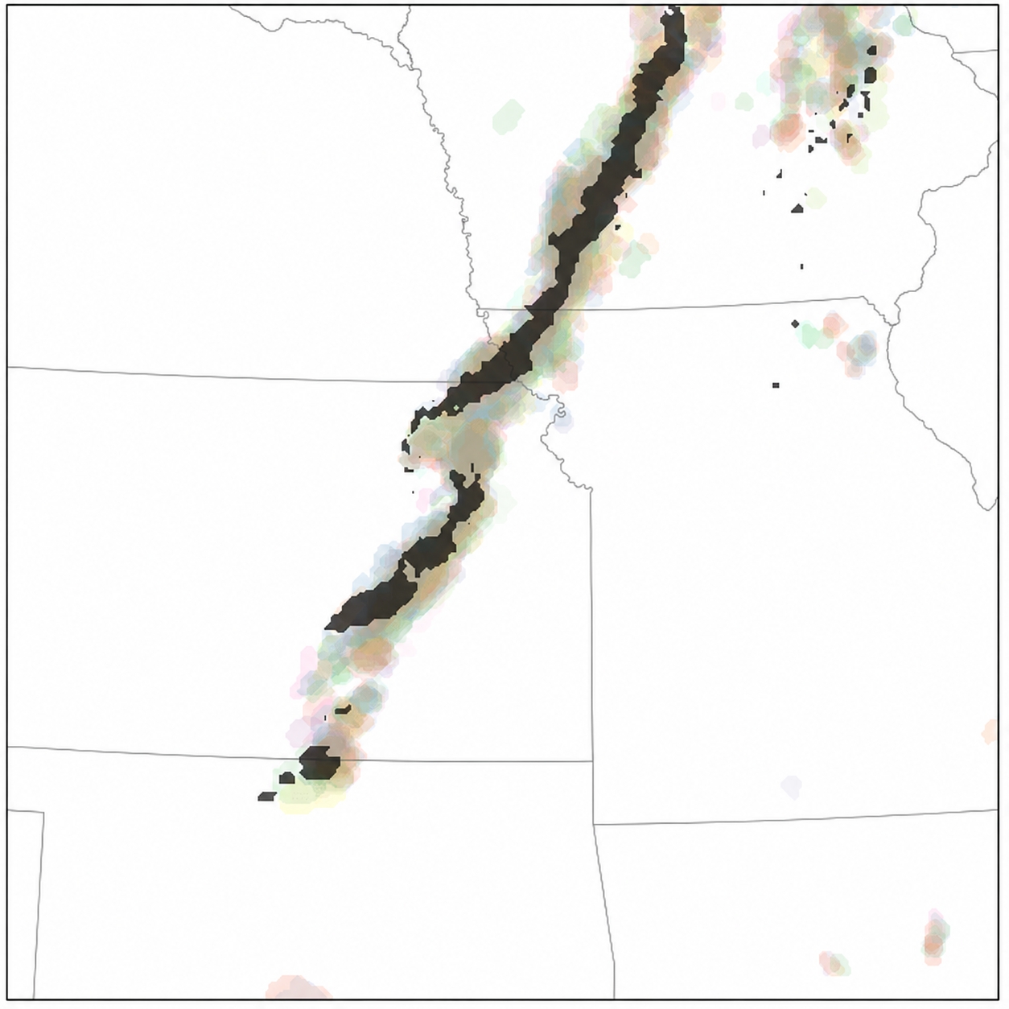
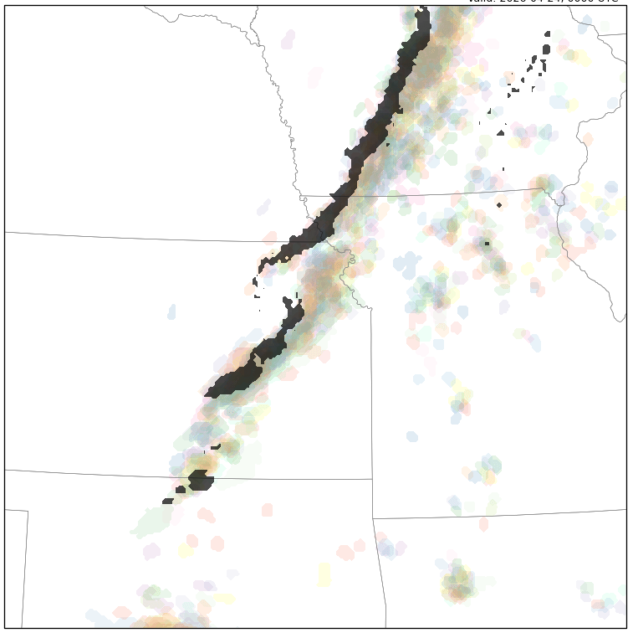
Preliminary Results: WoFSv2 versus WoFSv1
Composite Reflectivity Paintballs > 40 dBZ Valid: 24 April 2026 at 0000 UTC
VLAB-WoFS (WoFSv1) MAPS-JEDI-WoFS (WoFSv2)
Both systems capture the observed squall line structure, but MAPS-JEDI-WoFSv2 shows a faster eastward progression than the observations.
After 3 hours of DA cycling, the 2300 UTC initialized forecast shows improved squall-line placement.
MAPS-JEDI-WoFSv2 has more spurious echoes, especially east of the main convective line.
Init. 2000 UTC
（4 hour fcst.)
Init. 2300 UTC
(1 hour fcst.)
Black shading: observed reflectivity > 40 dBZ

Slide 7
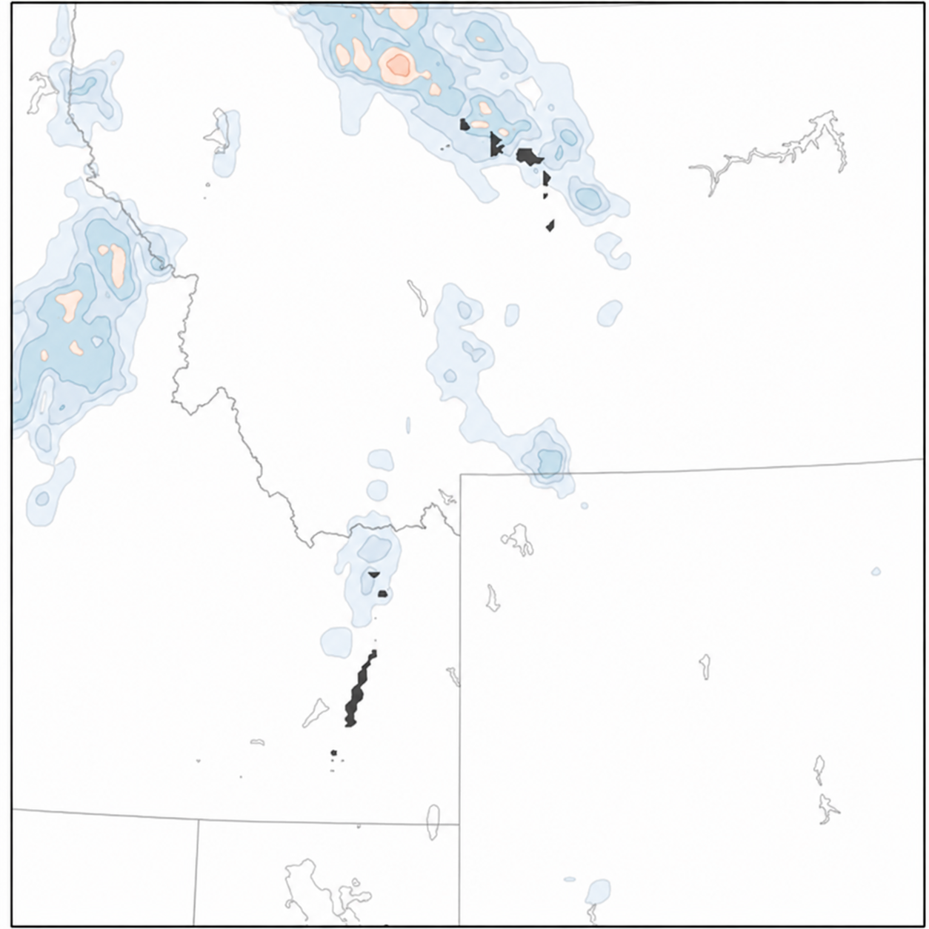
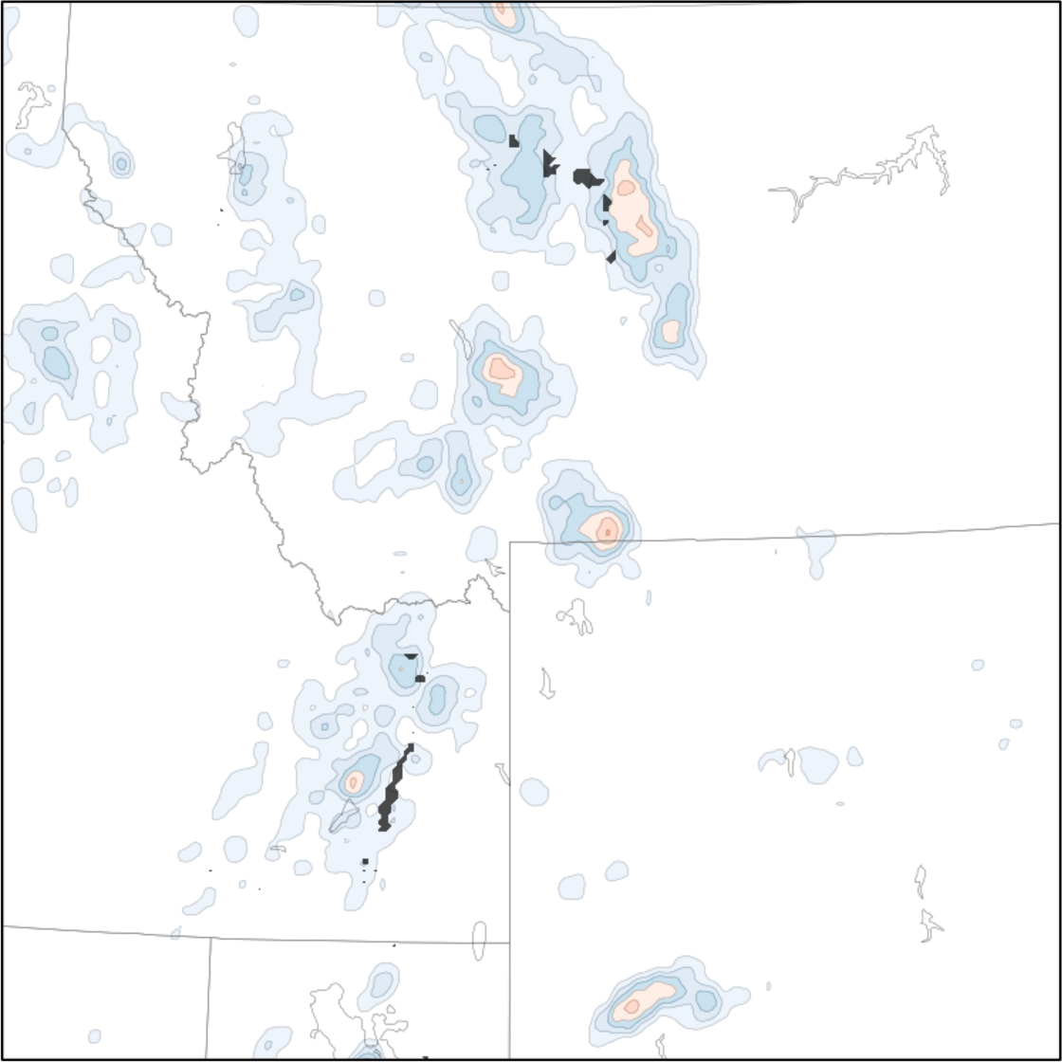

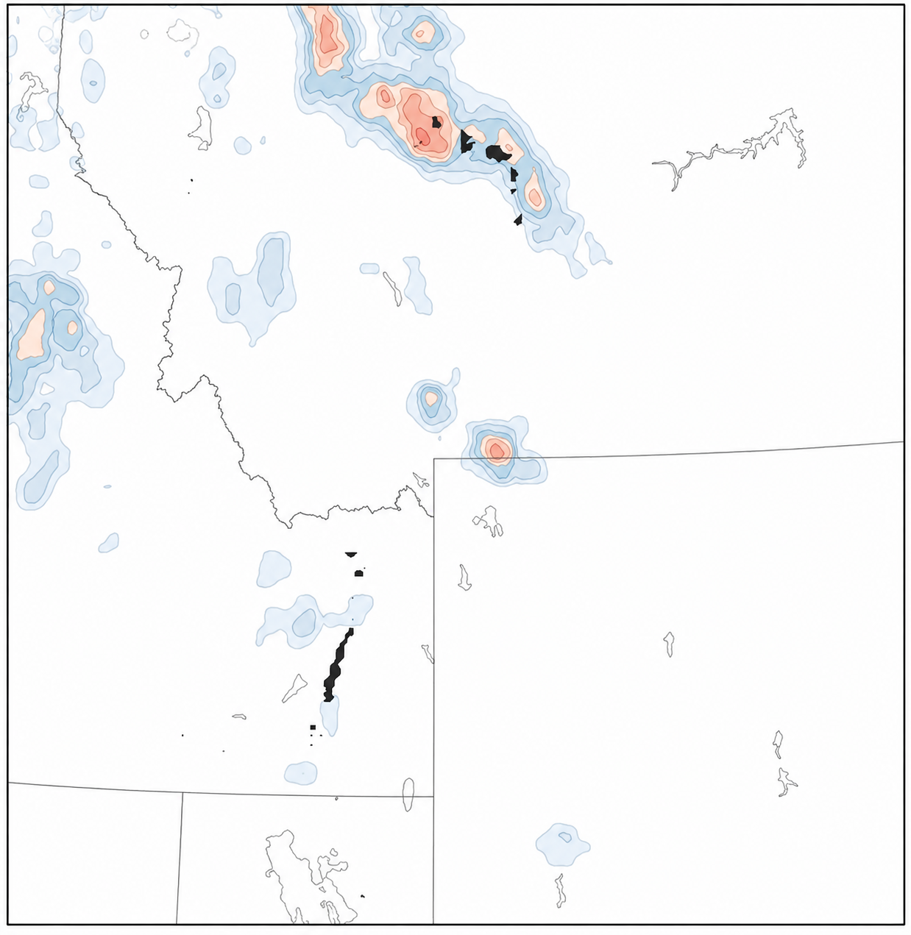
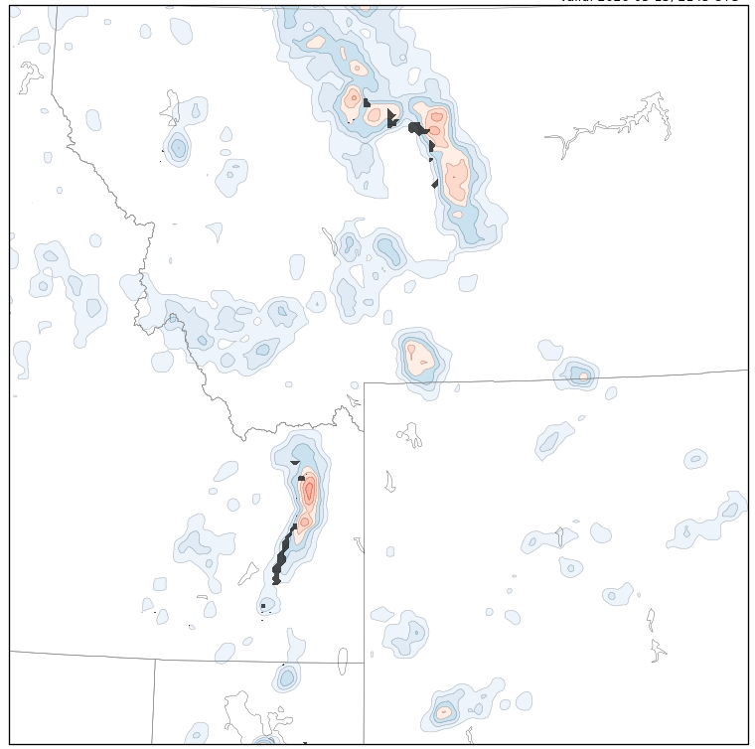
Preliminary Results: WoFSv2 versus WoFSv1
Ens. Prob. Of Composite Reflectivity > 40 dBZ Valid: 13 May 2026 at 2145 UTC
VLAB-WoFS (WoFSv1) MAPS-JEDI-WoFS (WoFSv2)
WoFSv1 fails to predict the southern observed convection in both the 1800 and 2000 UTC initialized forecasts.
WoFSv2 provides a more focused and better-aligned probability forecast for the southern storm.
Initialized at 1800 UTC
Initialized at 2000 UTC
Black shading: observed reflectivity > 40 dBZ

Slide 8


2026 HWT Spring Forecasting Experiment
2026 SFE Evaluation: WoFSv2 (DART based) vs. WoFSv1
Thunderstorm object identification and matching is performed for composite reflectivity against MRMS using the methodology of Skinner et al. (2025)
Only forecasts that were completed for each experiments are considered, results in 136 total forecasts.

Slide 9
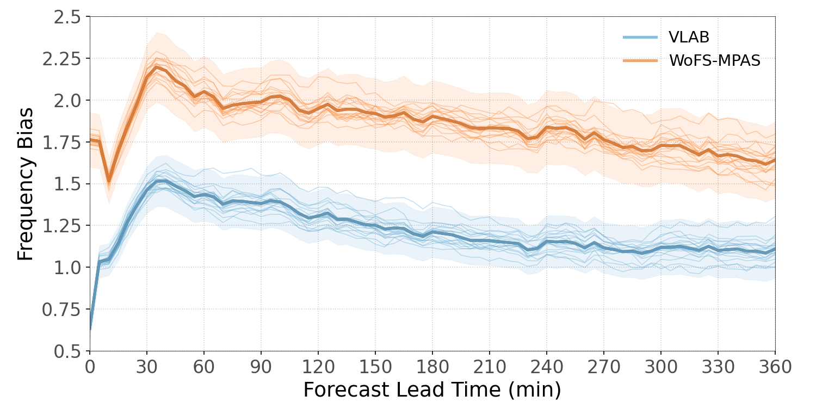
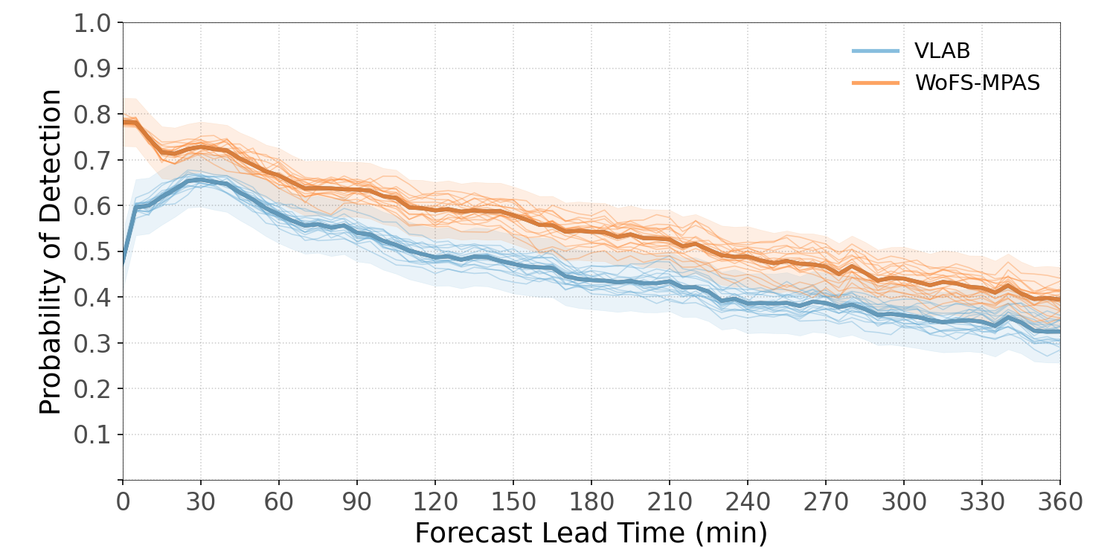
Frequency Bias and Probability of Detection: Composite Reflectivity
WoFSv1
WoFSv2
WoFSv1
WoFSv2
WoFSv2 maintains a higher POD throughout the forecast period.
WoFSv1 has a lower frequency bias.
The lower bias in WoFSv1 is associated with the lowest POD.

Slide 10
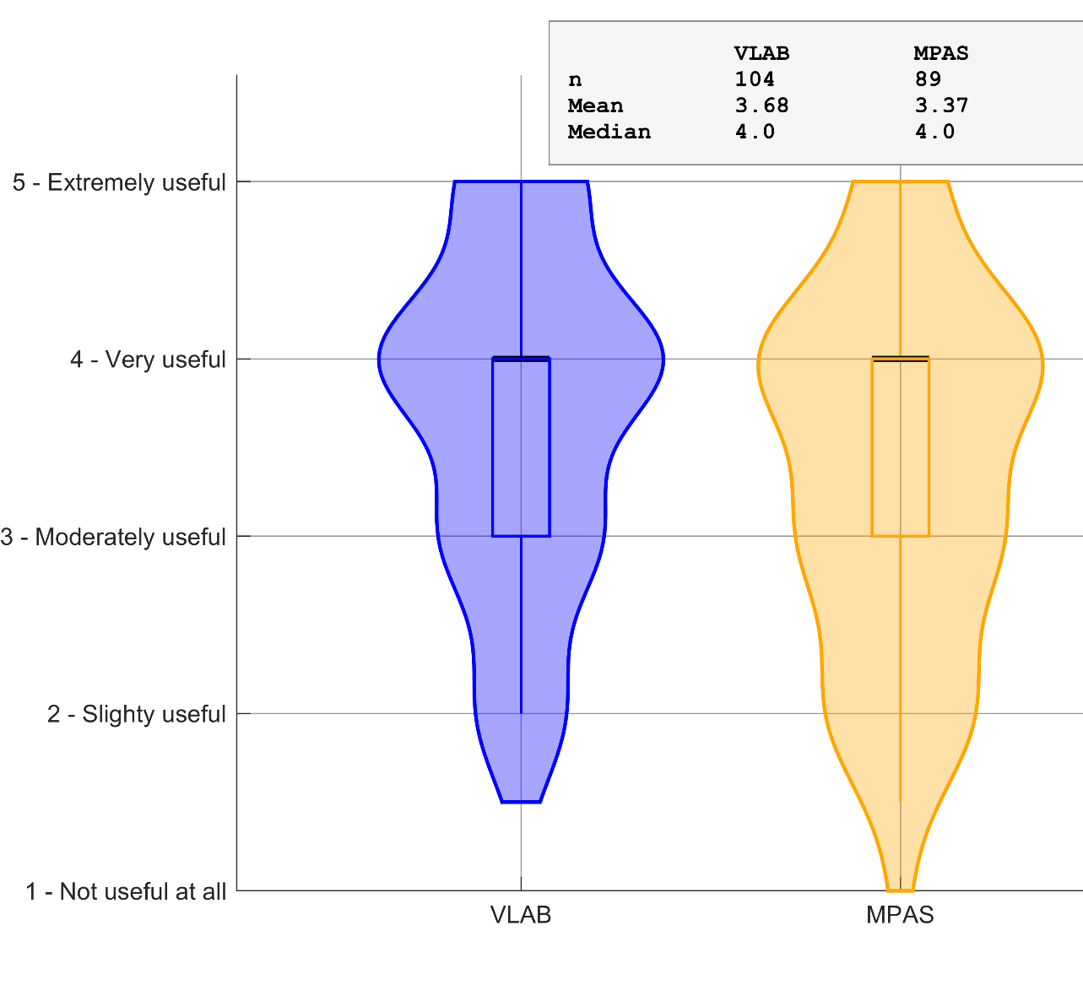
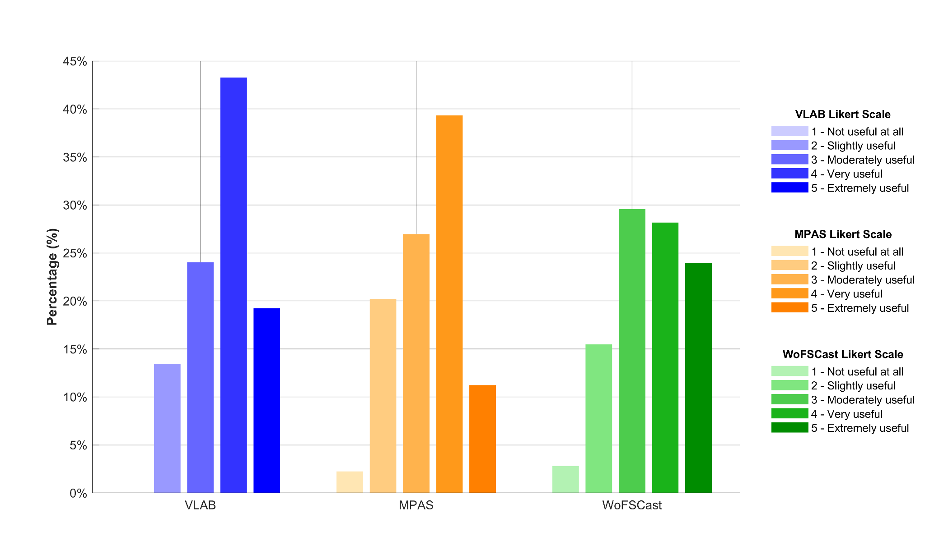
How would you rate the usefulness of the composite reflectivity paintball in informing your forecast for today's activity? (1 = Not useful at all; 5 = Extremely useful). Consider factors such as the number of storms, intensity, location and coverage, convective mode, evolution, and timing of convective initiation.
WoFS Afternoon MD Activity: Early Survey Results

Slide 11
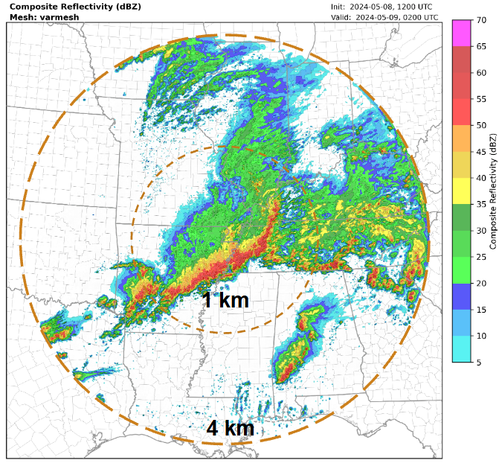
Variable-Resolution ~4 to ~1 km Mesh
Experiment Design
Case: 8 May 2024
Cold start from the 12 UTC HRRR analysis
24-hour deterministic forecast
Full domain: approximately 1,400 km in diameter
Inner 1-km region: approximately 700 km in diameter
Benefits
Expands the modeled area by ~300% with only 36% more grid cells
Inner 1-km region: 453,329 cells covering ~385,000 km²
Full domain: 617,113 cells covering ~1.54 million km²
Reduces the influence of lateral boundary conditions within the high-resolution area of interest.

Slide 12


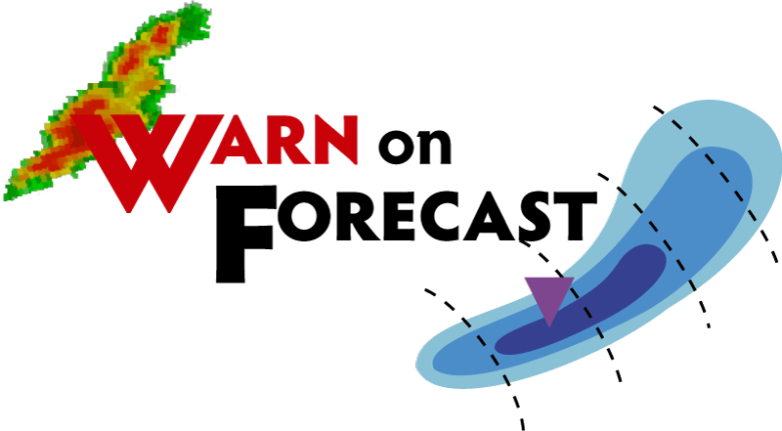
Thank You

