Slide 1
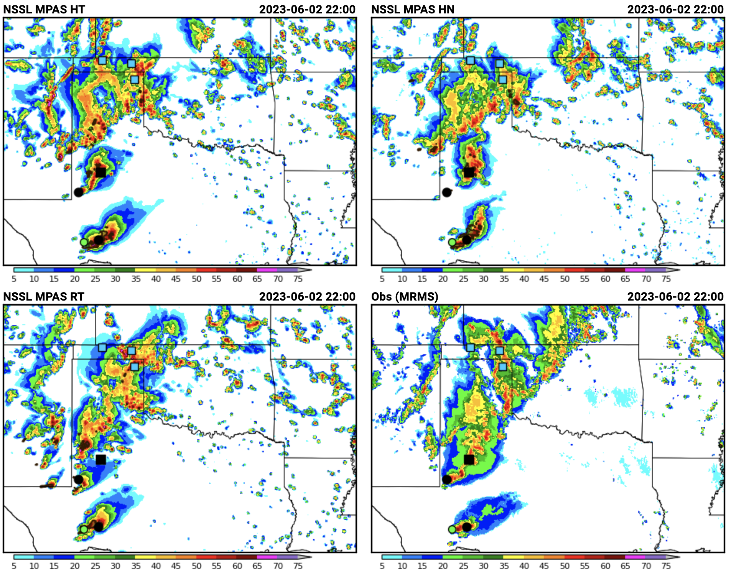
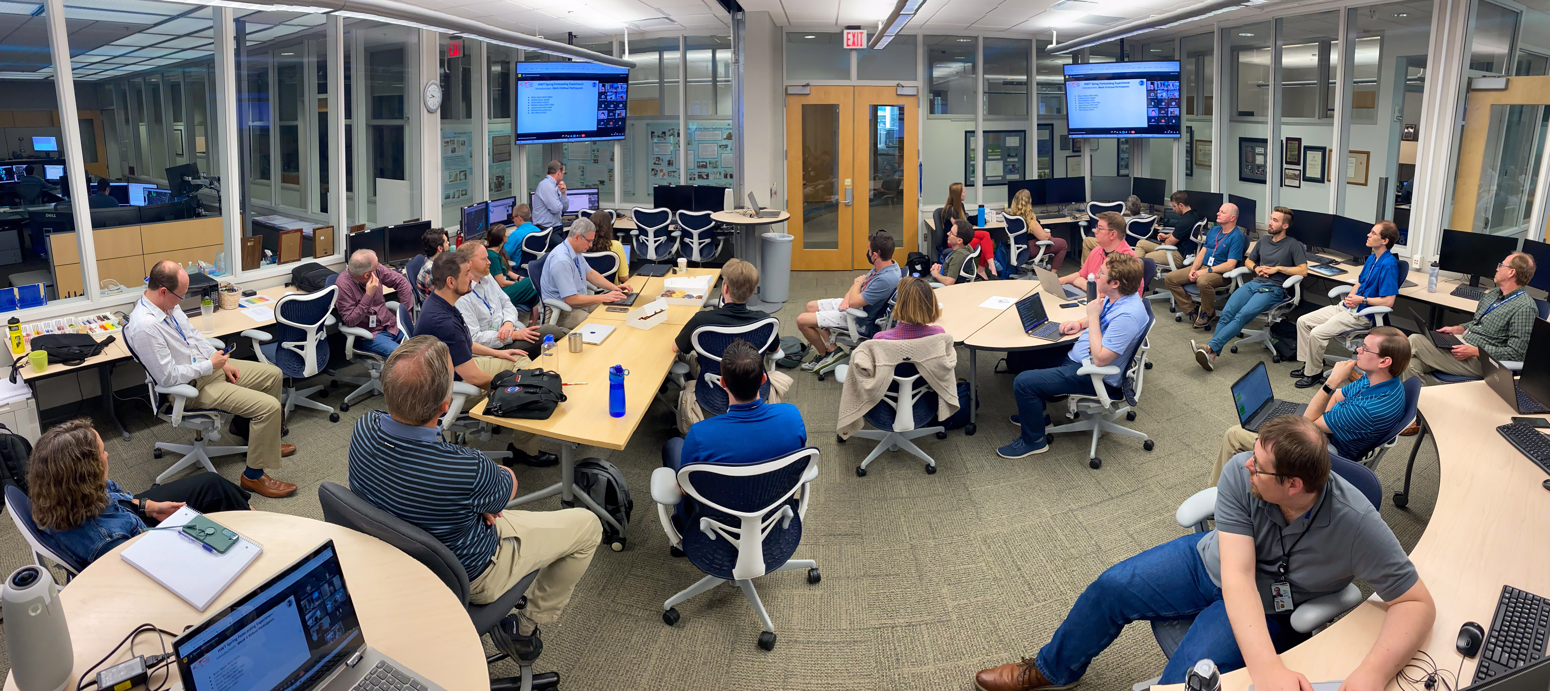
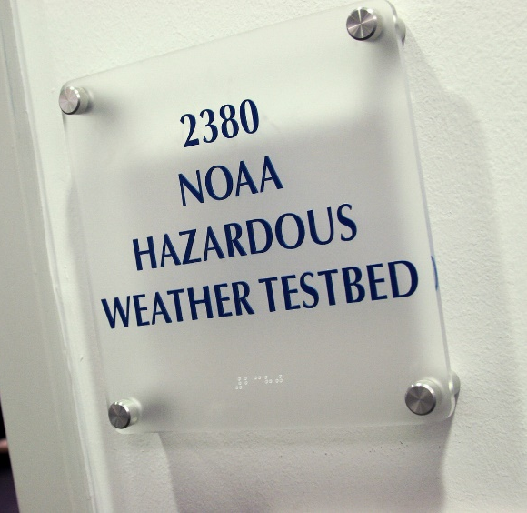
MPAS Evaluations During the 2026 NOAA/Hazardous Weather Testbed Spring Forecasting Experiment
Adam J. Clark^{2,4}, Kent Knopfmeier^{2,3}, Yunheng Wang^{2,3}, Nusrat Yussouf^{2,3}, Israel Jirak¹, Louis Wicker^{2,4}, Clark Evans⁵, Terra Ladwig⁵, Ming Hu⁵, David Dowell⁵, Craig Schwartz⁶, and Soyoung Ha⁶
¹NOAA/NWS/NCEP Storm Prediction Center, Norman, Oklahoma
²NOAA/OAR National Severe Storms Laboratory, Norman, Oklahoma
³Cooperative Institute for Severe and High-Impact Weather Research and Operations, University of Oklahoma, Norman, Oklahoma
⁴School of Meteorology, University of Oklahoma, Norman, Oklahoma
⁵NOAA/OAR Global Systems Laboratory, Boulder, Colorado
⁶National Center for Atmospheric Research, Boulder, Colorado

Slide 2


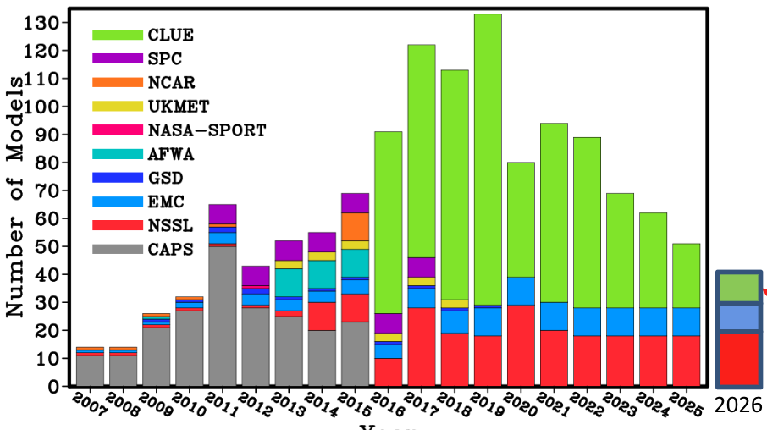
2026 NOAA/HWT Spring Forecasting Experiment
SFEs are five-week experiments jointly organized and facilitated by SPC and NSSL
The 2026 SFE was hybrid with 75 in-person and 58 remote participants.
SFE Goals include:
Testing & evaluation of emerging technologies for severe weather prediction
Accelerating R2O; developing & strengthening O2R pathways
Facilitating experiments to: inform Unified Forecast System Development.
HWT SFE Model Contributions
Model for Prediction Across Scales (MPAS)
SFE 2026 included MPAS configurations from NSSL & GSL.
Motivation: MPAS is NOAA’s next generation models for global and regional applications.
SFE 2026 marks the fourth year of MPAS evaluations. Building on success of previous years.
Notes:
This slide is pretty self explanatory. Focus for this talk is on evaluations to inform UFS development (highlighted in red).

Slide 3
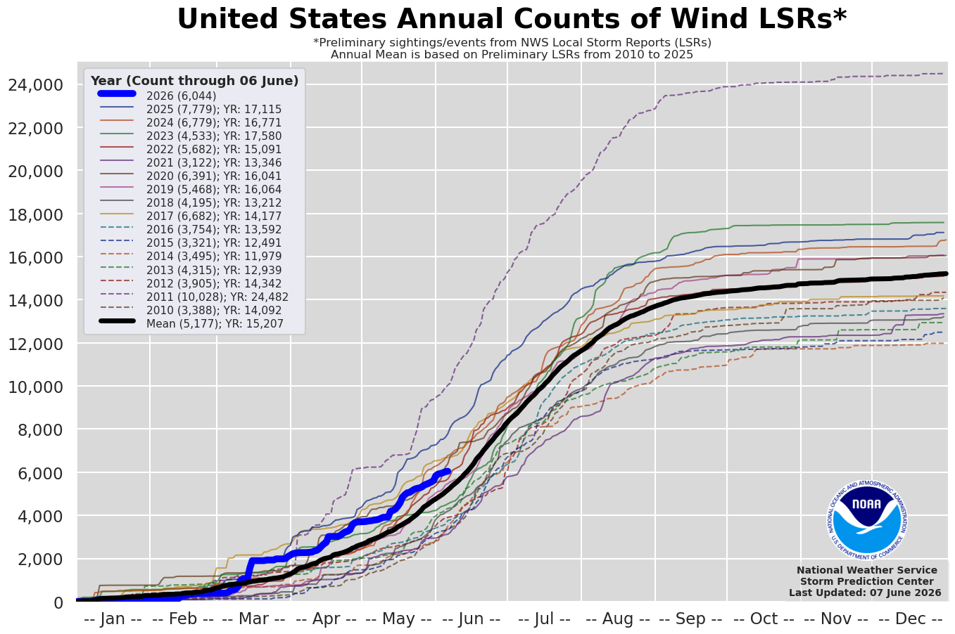
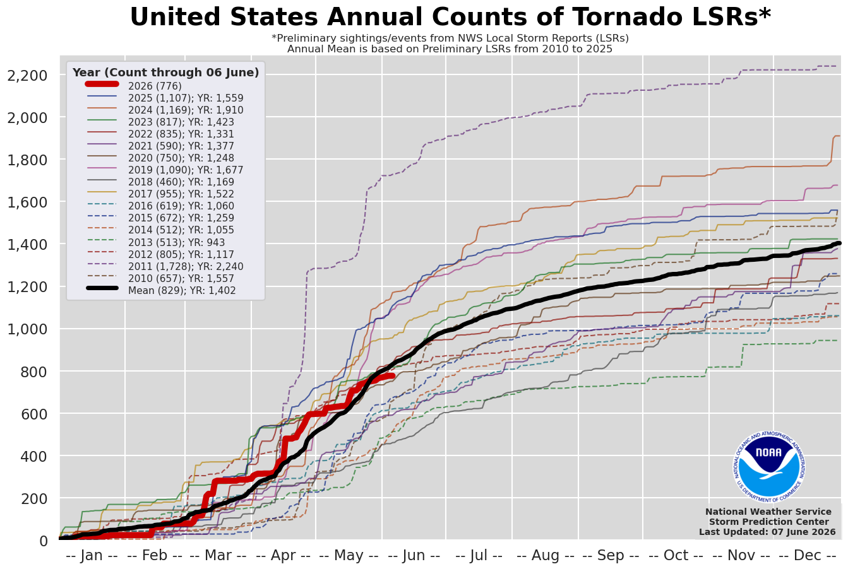
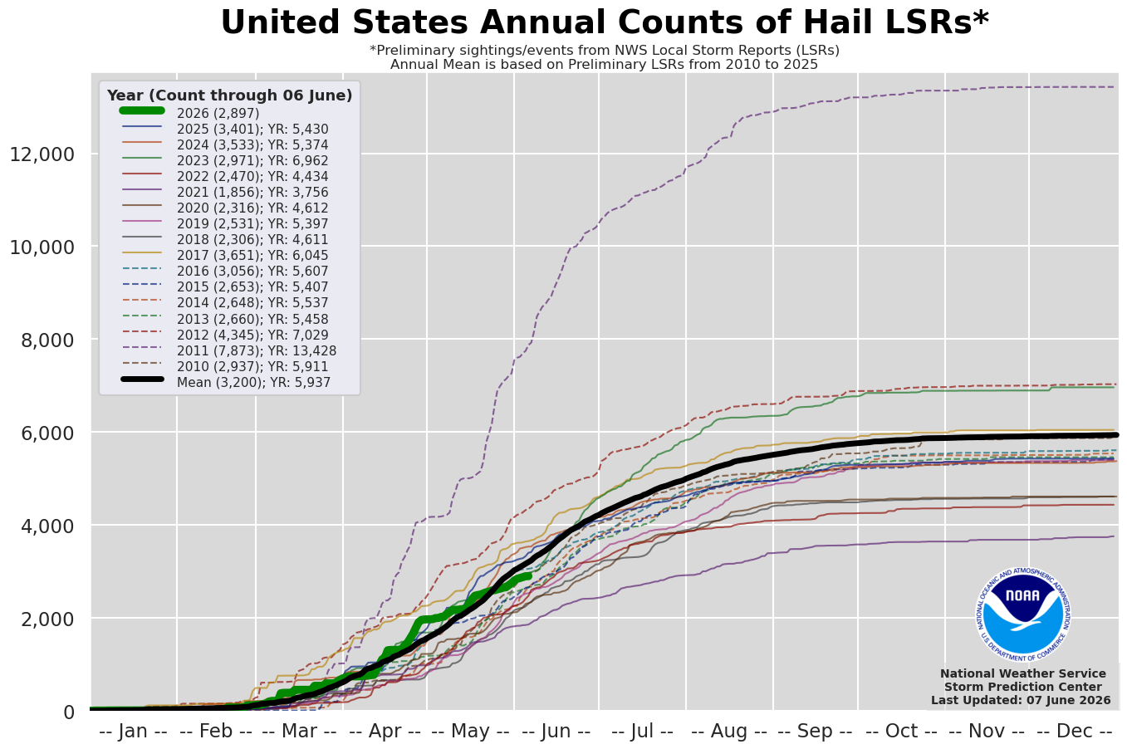
SFE 2026 featured slightly below average severe weather activity
SFE
SFE
SFE
Cumulative severe weather reports
Box around SFE period.
Near average activity for the year, with two active tornado periods in March and April.
SFE period was below average.
Notes:
SFE 2026 featured slightly below normal severe weather activity.

Slide 4
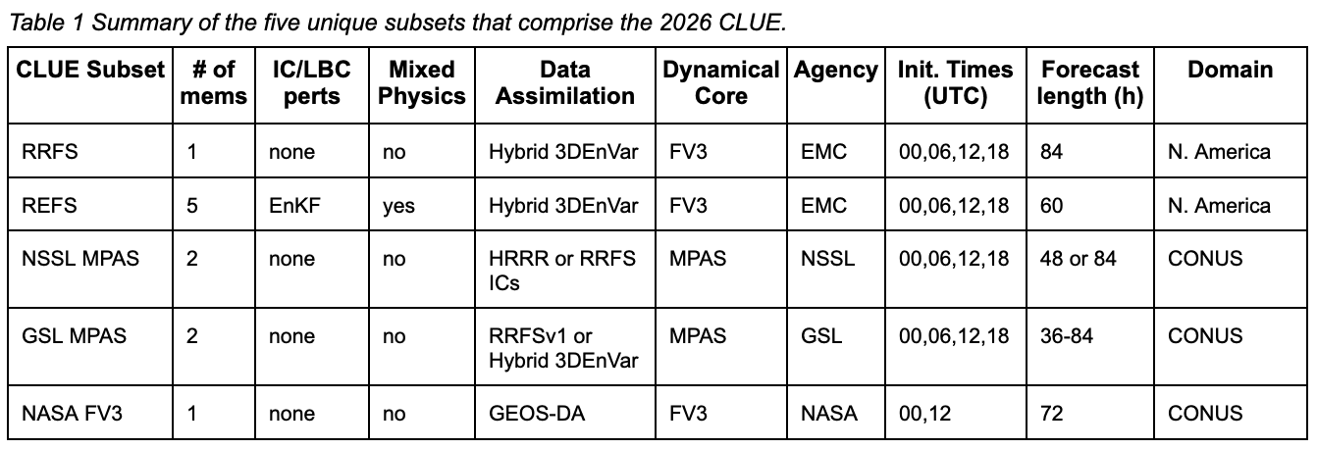
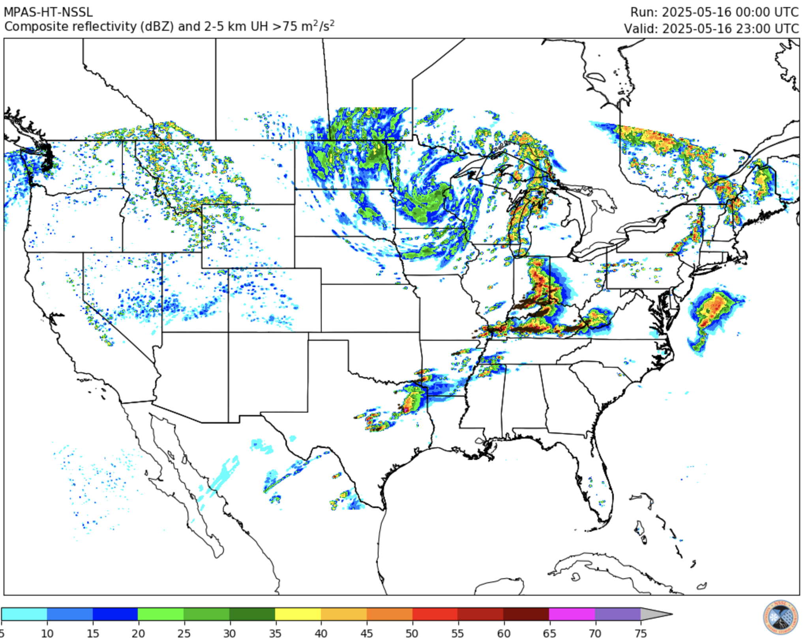
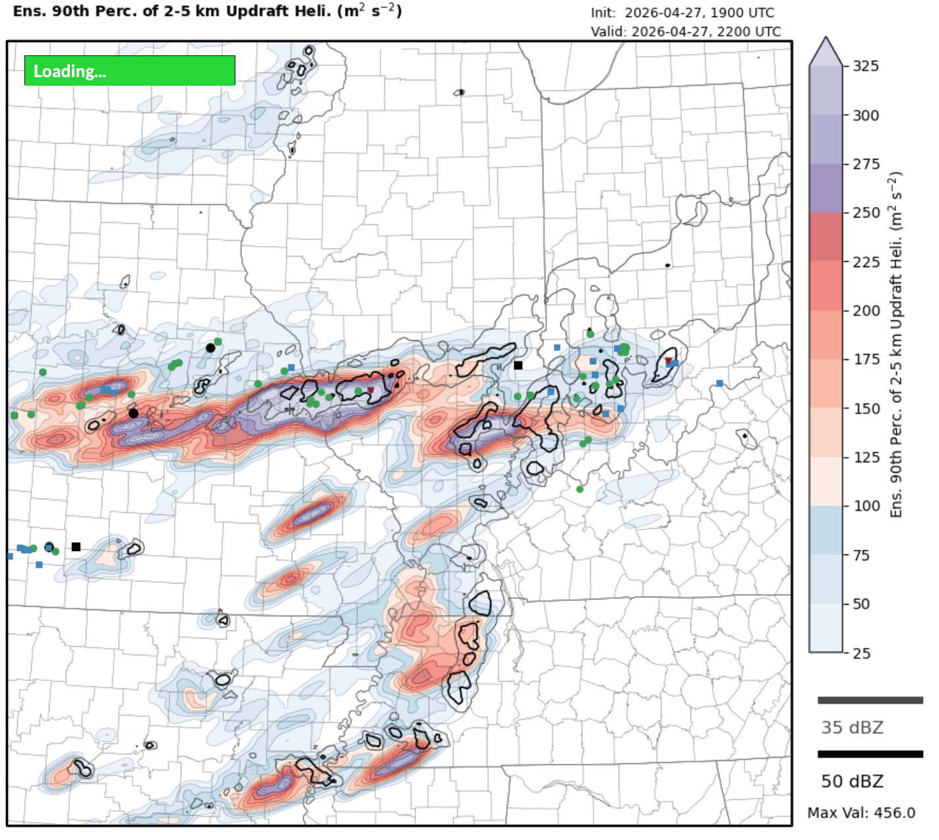
SFE 2026 MPAS configurations
MPAS configurations
cams.nssl.noaa.gov
NSSL: Two unique regional configurations initialized at 00 & 12Z, and WoFS MPAS.
NSSL MPAS HT: HRRR-initialized with TEMPO microphysics
NSSL MPAS RN: RRFS-initialized with NSSL 2-moment microphysics
Warn-on-Forecast version 2
  18-member, targeted domain, 3-km ensemble
  Azure cloud, DART-based DA (transitioning to JEDI)
GSL: Two unique regional configurations at 00 & 12Z
GSL MPAS RT: RRFS-initialized with TEMPO microphysics
GSL MPAS JEDI: RRFSv2 prototype; hourly-cycled, JEDI-based convective scale DA
cbwofs.nssl.noaa.gov/mpas
Notes:
Summary of MPAS configurations in SFE 2026. The table shows ALL the CONUS scale models examined and yellow highlighted ones denote MPAS configurations. NSSL had the two CONUS runs plus the WoFS MPAS configurations. GSL had the RRFS-initialized run, as well as the MPAS JEDI, which is the RRFSv2 prototype with hourly cycled, JEDI-based convective scale DA.

Slide 5
SFE 2026 Evaluations
MPAS-related evaluations
Evaluations presented herein
(D)eterministic CAMS | CAM (E)nsembles | (C)alibrated Guidance | (A)nalyses | (A)rtificial (I)ntelligence
D1: 00Z Day 1 Deterministic Flagships | E1: Day 1 Ensemble Flagships | C1: Medium-Range Severe ML guidance | A1: Mesoscale Analysis Background | AI1: Global AIWP Models: GFS ICs
D2: 12Z Day 2 Deterministic Flagships | E2: Day 2 Ensemble Flagships | C2: Day 1 00Z Tornado ML Guidance | A2: Upscaled Mesoscale Analysis Background | AI2: Global AIWP Models: EC ICs
D3: 00Z Day 3 Deterministic Flagships | E3: Short-term Ensembles | C3: Day 1 00Z Hail ML Guidance | A3. Storm-Scale Analysis | AI3: Global AIWP Models: IC Comparison
D4: Day 1 MPAS ICs |  | C4: Day 1 00Z Wind ML Guidance |  | AI4: Global AIWP Ensembles
D5: Data Assimilation Comparisons |  |  |  | AI5: WoFS Deterministic Comparisons
 |  |  |  | AI6: WoFS Ensemble Comparisons
 |  |  |  | AI7: 00Z Day 1 HRRRCast vs. HRRR & REFS
 |  |  |  | AI8: Short-term AIWP
 |  |  |  | AI9: MD Peak Intensity Bin Guidance
Major Themes
Warn-on-Forecast
RRFSv2 (MPAS) Development
AIWP
Medium-range severe hazards
Notes:
Table shows ALL of the SFE evaluations. Red outlines are all the MPAS-related ones and yellow highlighted indicates the ones presented herein. MPAS is one of several major themes in the SFE.

Slide 6
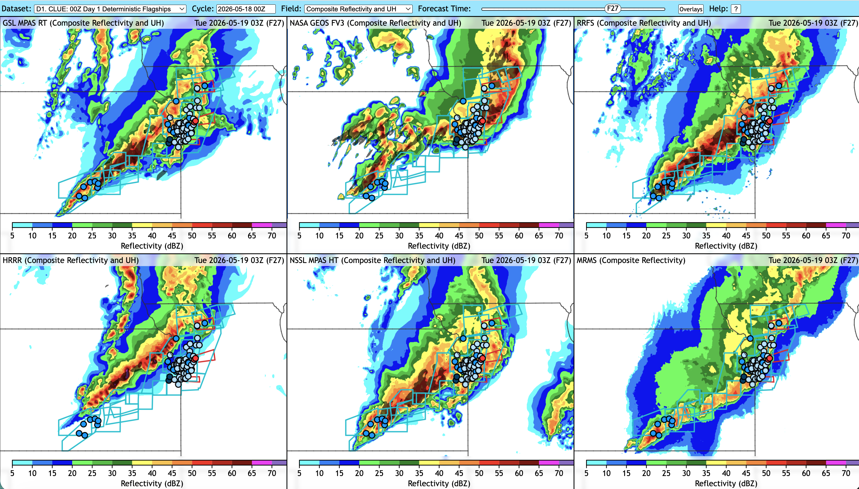
00Z Day 1 & 2 Deterministic Flagships
Goal: Gauge progress for severe weather predictions for a single deterministic model from each SFE contributor relative to HRRRv4.
New interactive viewer! Retains resolution when zooming in & out.
UH & composite reflectivity evaluated over forecast hours 12-36. Consider timing of CI, convective mode, displacement errors, etc.
Comparisons were blinded, and models revealed after ratings were assigned.
NSSL MPAS HT & GSL MPAS RT were compared to HRRR, RRFS, and NASA GEOS.
GSL MPAS RT
NASA GEOS
RRFS
Accurate placement and mode
Wrong evolution
Storms too intense
HRRR
NSSL MPAS HT
MRMS OBS
Line too slow
Spurious storms
Accurate placement and mode
Notes:
Day 1 & 2 Deterministic Flagships evaluation. Graphic shows an example forecast (mention new interactive viewer!). Issues noted by participants for this case are noted in each panel. Just an example of how things get evaluated. Make sure to hit all the bullet points on the right.

Slide 7
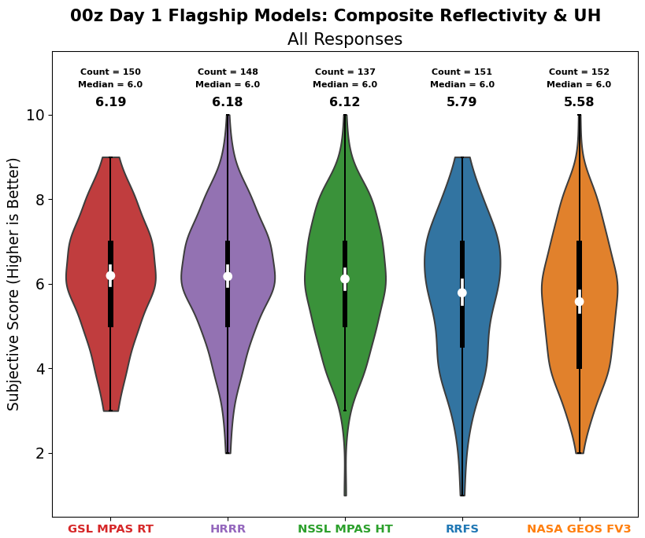
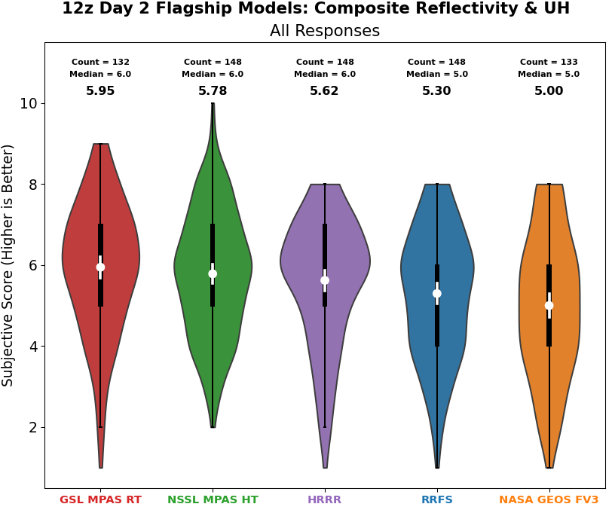
Deterministic Flagships: Composite Reflectivity & UH
Performance tightly clustered, but GSL MPAS RT had highest average ratings for Day 1 & Day 2.
FV3-based models performed worst
Similar to SFE 2025: Weekly results that were reviewed Fridays showed large week-to-week variability. Need multiple weeks for robust performance measures.
Interesting note: GSL MPAS RT was not top performer any single week, but was best in aggregate.
Day 1
Day 2
Best
Worst
Best
Worst
Notes:
These are the main results for Days 1 & 2. I always explain that these are violins plots which visualize the distributions of subjective ratings (y-axis). Models are ordered (left to right) from best to worst. Main result: GSL MPAS RT (RRFS-initialized) had best results. *Note, the comparison did not include the MPAS JEDI results (those are shown in a separate evaluation on one of next slides). Feel free to repeat the other bullet points on the right.

Slide 8
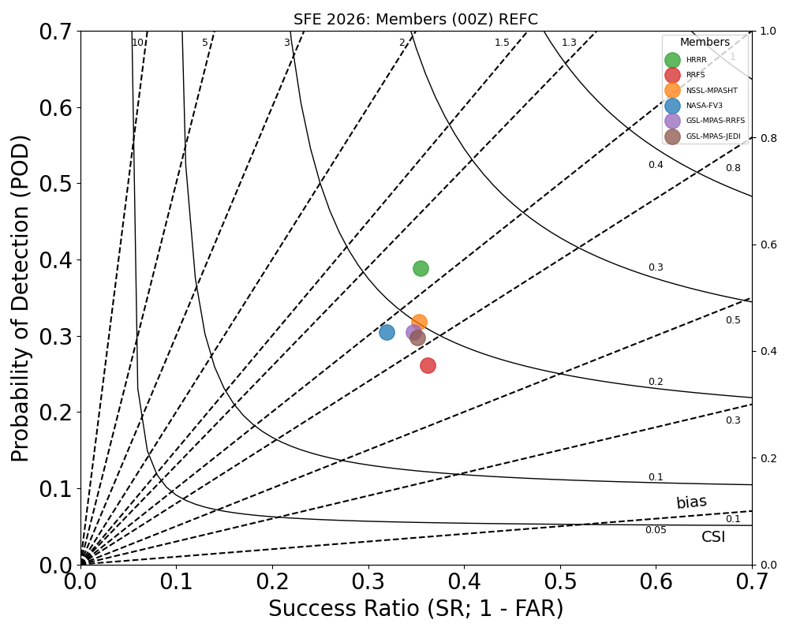
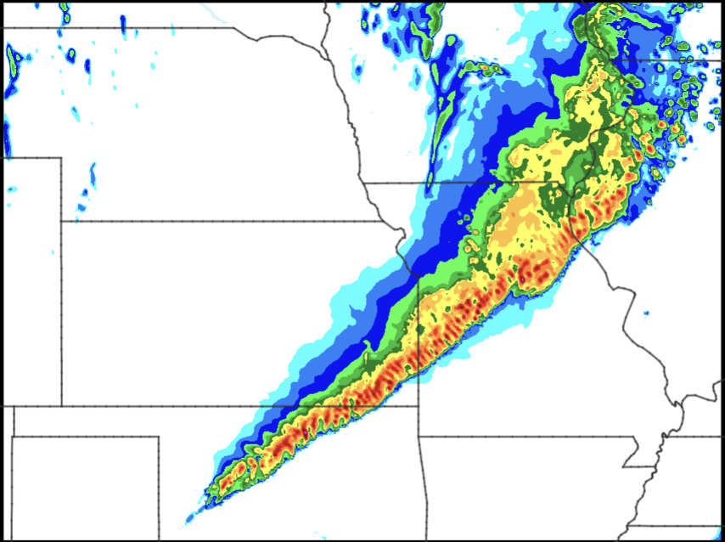
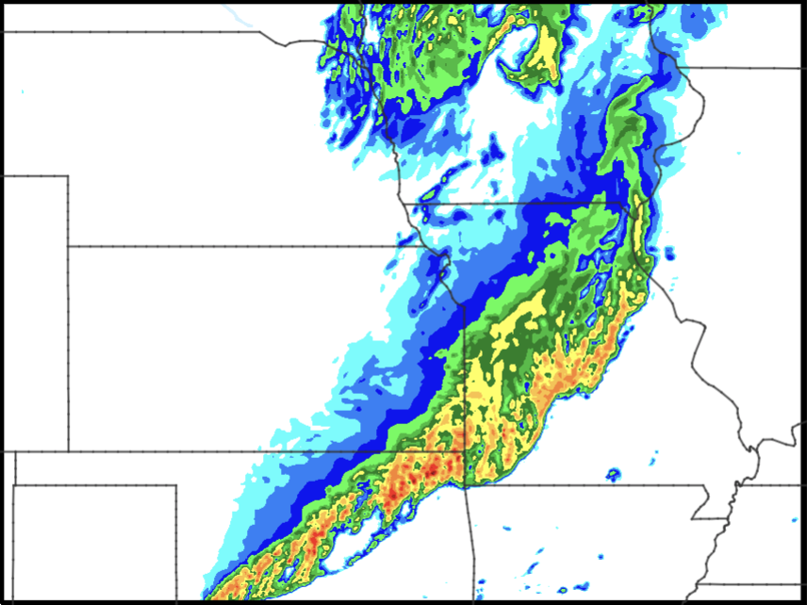
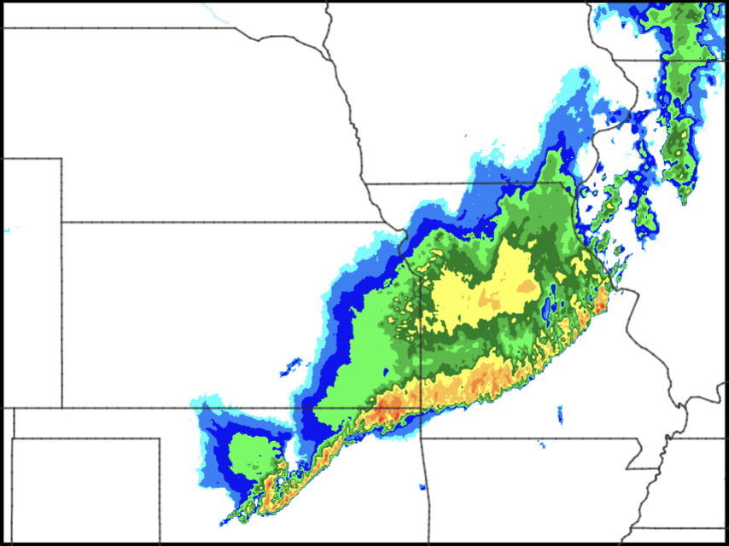
Deterministic Flagships: Composite Reflectivity & UH
Objective results – Performance diagram (40 dBZ)
HRRR overprediction likely inflating verification metrics. Percentile correction brings MPAS scores much closer to HRRR (not shown).
Example case
HRRR
GSL MPAS RT
HRRR
Best depiction of stratiform and convective core intensity
MPAS
High biases in cores and stratiform.
FV3
MRMS
18 May 2026
Notes:
Objective results show HRRR performing best, with MPAS runs clustered behind and FV3 runs worst. High bias in HRRR likely inflating metrics. The example case illustrates more intense cores in HRRR and more intense stratiform region.

Slide 9
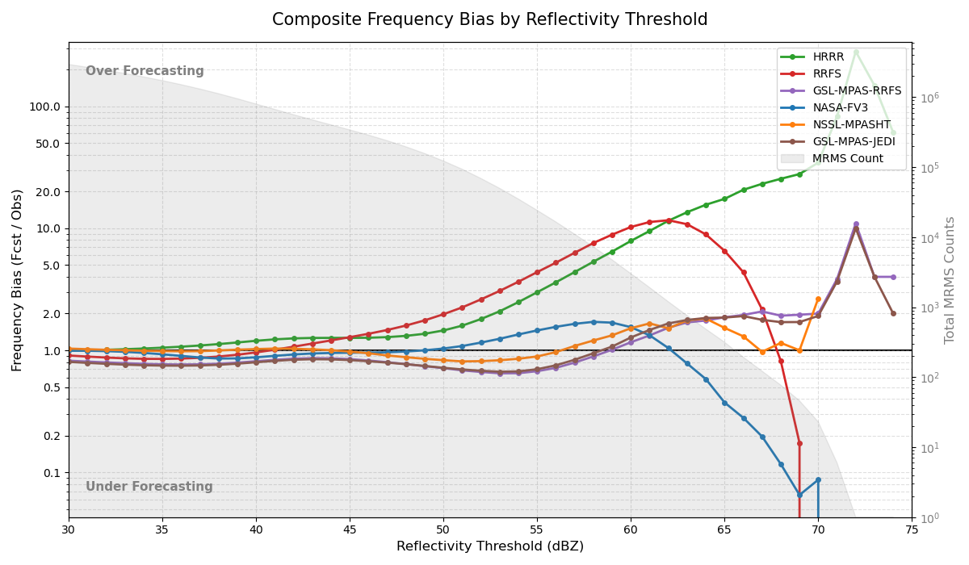
Deterministic Flagships: Composite Reflectivity & UH
Objective results – frequency biases
MPAS configurations best calibrated across all reflectivity values (brown, orange, & purple lines).
Notes:
Frequency bias as a function of reflectivity threshold. Notice that the MPAS runs (orange, brown, and purple lines) are best calibrated across the range of reflectivity values.

Slide 10
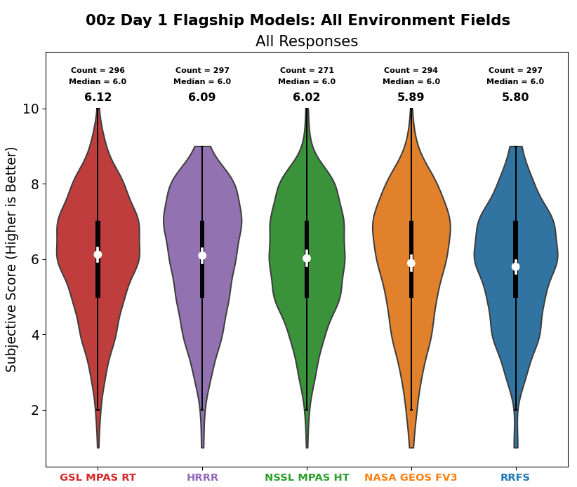
Day 1 Deterministic Flagships: Environment Fields
GSL MPAS RT runs slightly better than HRRR for all environment fields – temperature, dewpoint, and SBCAPE.
Notes:
Environment fields in GSL MPAS RT also rated highest.

Slide 11
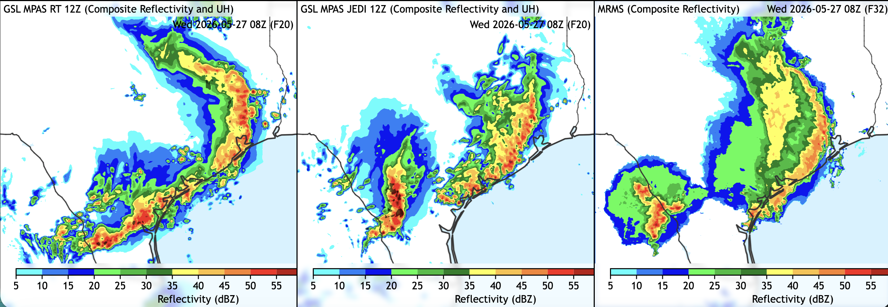
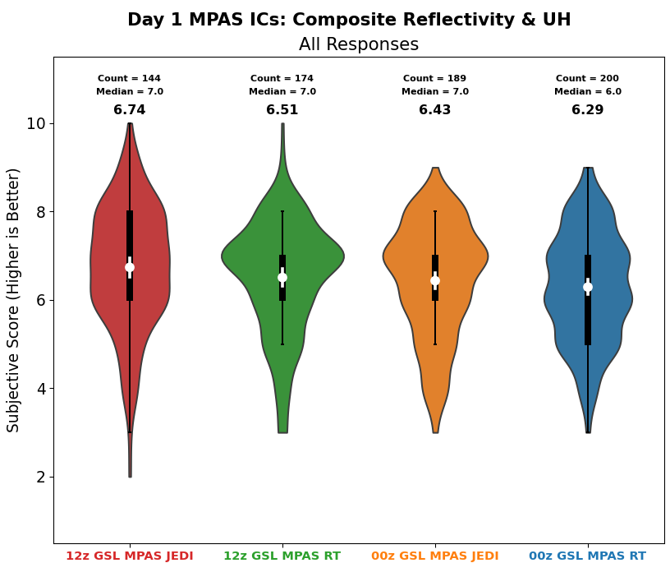
Day 1 MPAS ICs
Goal: Assess the impacts of using JEDI-based, hourly-cycled, convective scale data assimilation with MPAS, focused on 12-36h lead times. MPAS initialized with RRFS compared to MPAS JEDI.
MPAS JEDI
MPAS RRFS
Two separate lines depicted very well in MPAS JEDI.
MPAS RRFS not as good with convection organized in one large complex.
1200 UTC
0000 UTC
Best
Worst
Notes:
Hourly cycled, JEDI-base DA improves performance at 12-36 h lead times relative to RRFS-initialized MPAS. Great result because the RRFS-initialized MPAS runs were already rated the best performing!

Slide 12
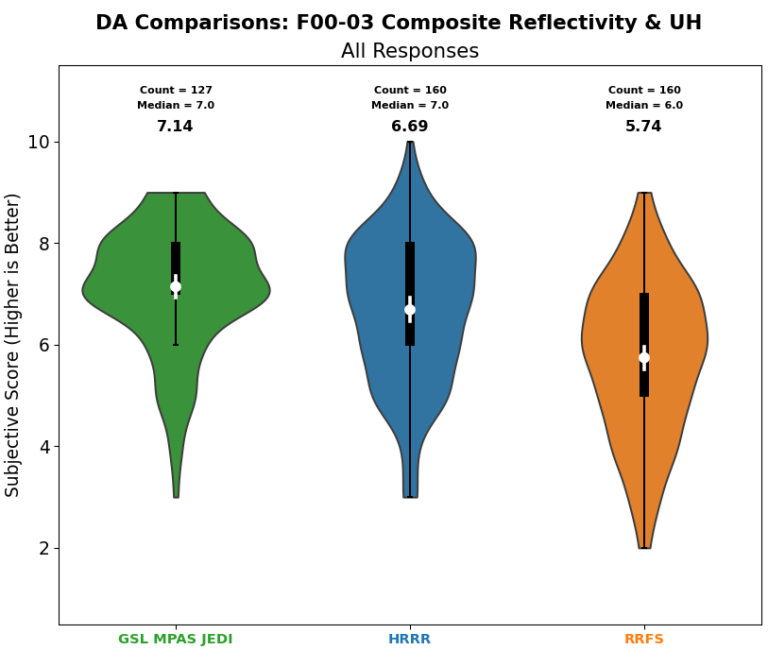
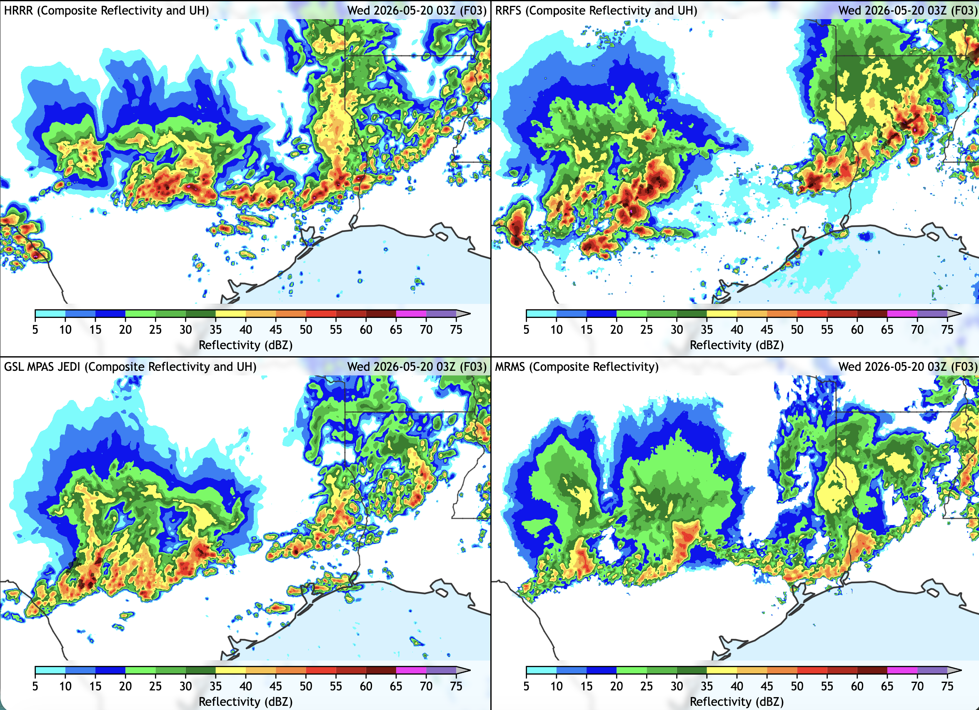
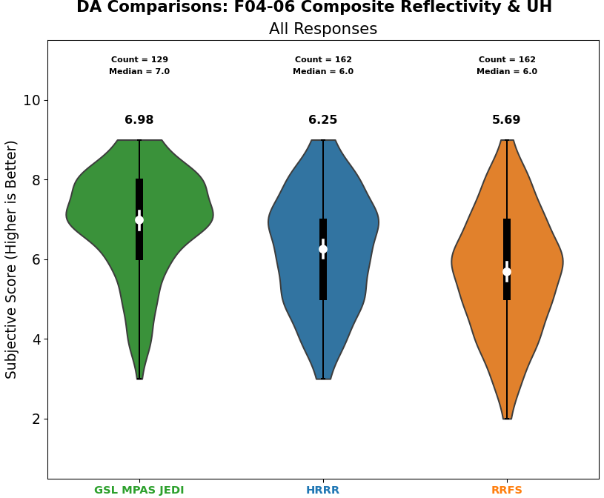
Data Assimilation Comparisons
Goal: Assess the impacts of using JEDI-based, hourly-cycled, convective scale data assimilation with MPAS, focused on 0-6 h lead times.
HRRR
RRFS
Result: MPAS JEDI was clearly superior to HRRR and RRFS
Too intense, northward displacement
Storms too intense and cellular
MPAS JEDI
MRMS
Most accurate placement, intensity, and evolution
Notes:
Even more dramatic improvement for JEDI runs when assessing 0-6 h lead times! Another VERY encouraging result from RRFSv2 prototype.

Slide 13
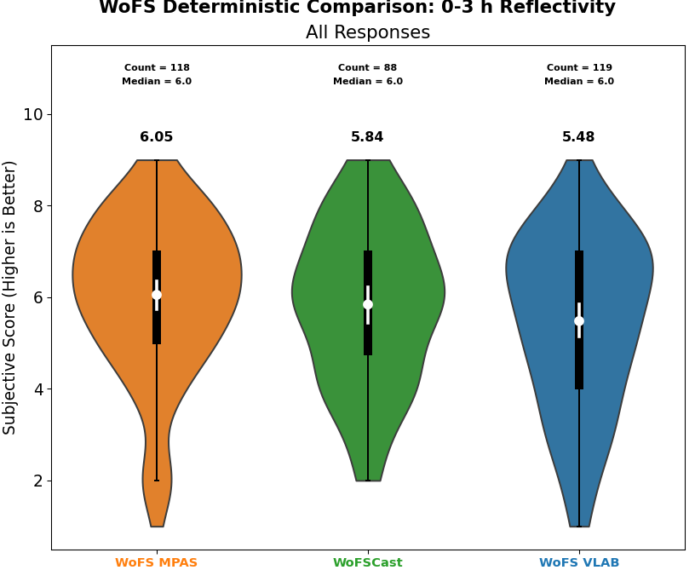
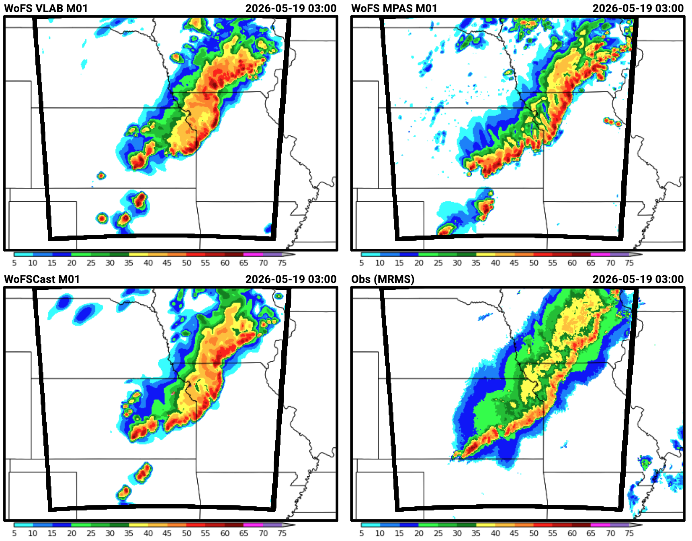
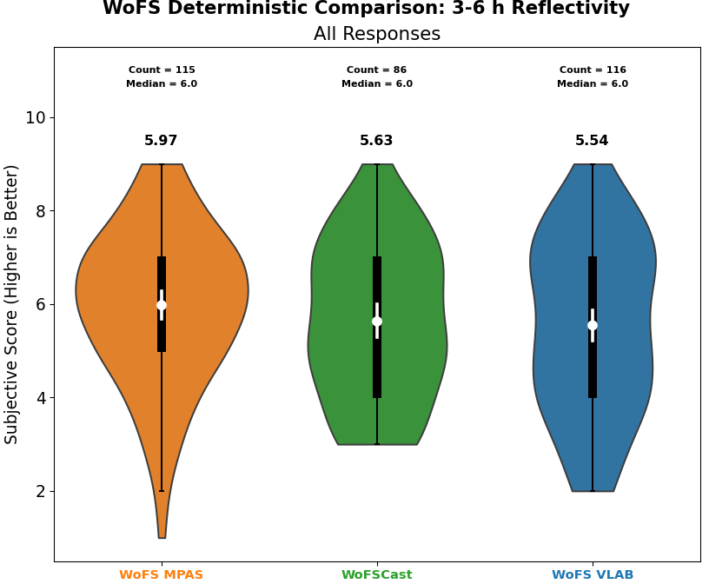
WoFS Determinstic Comparisons
Goal: Assess the quality of deterministic reflectivity forecasts from different configurations of WoFS.
Result: WoFS MPAS rated highest. Higher effective resolution and more realistic storms. Still significant issues with spurious convection.
More realistic structures (e.g., stratiform region better defined).
Notes:
MPAS WoFS also performed very well. Highlight that we’re still dealing with the spurious storms issue.

Slide 14
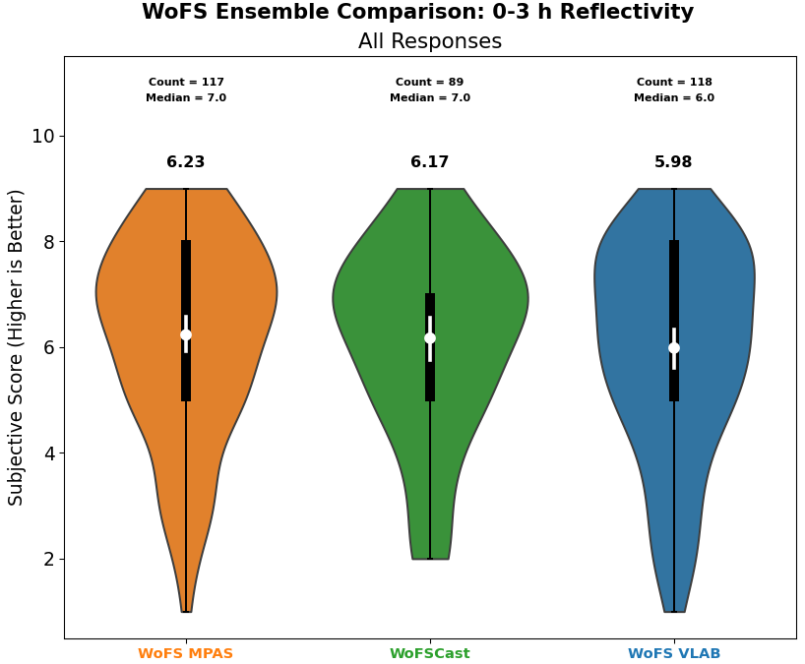
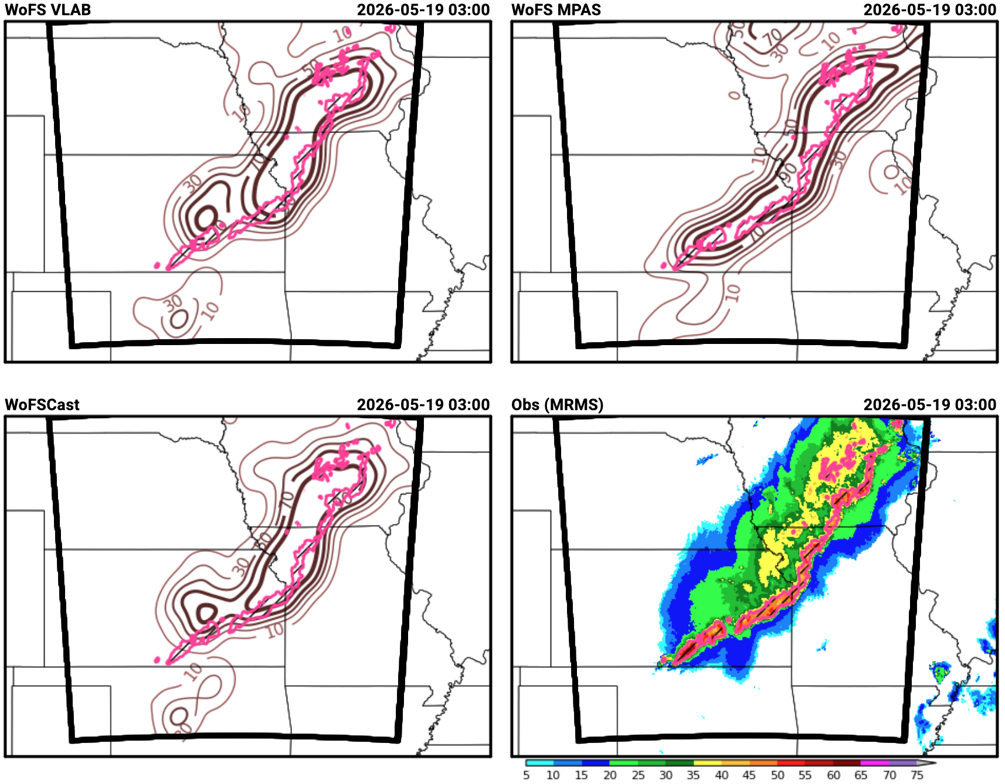
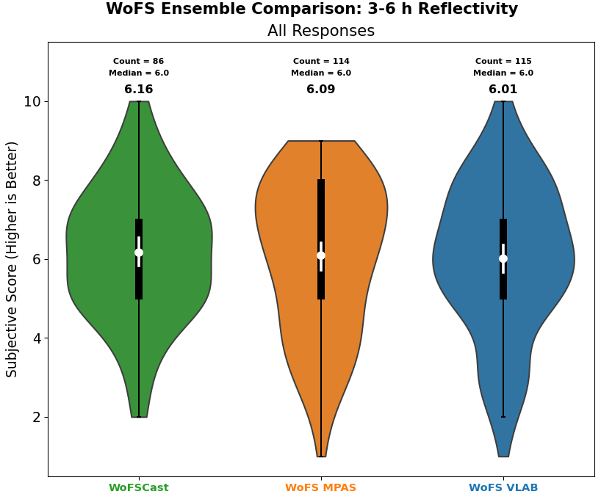
WoFS Ensemble Comparisons
Goal: Assess the quality of probabilistic reflectivity forecasts from different configurations of WoFS.
Highest probabilities encompass observations more tightly
Result: WoFS MPAS rated highest for 0-3 h & second highest for 3-6 h. Interesting, the AI version of WoFS performed best at 3-6 h leads.
Notes:
Ensemble WoFS MPAS results also very good.

Slide 15


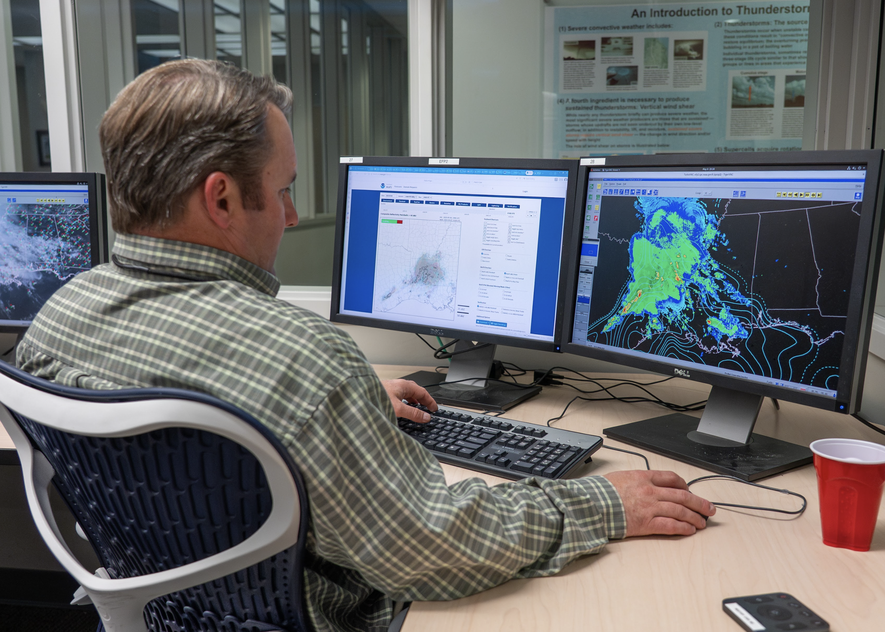
SFE 2026 Takeaways
SFE 2026 marked the fourth year of MPAS evaluations, which included deterministic and ensemble products.
Very encouraging results for RRFSv2 prototype (MPAS JEDI). Forecast quality especially impressive compared to the HRRR and RRFS at 0-6 h lead times.
Encouraging first-year evaluations for WoFS MPAS. SFE 2027 will feature JEDI-based WoFS-MPAS and tentative plans to drive WoFS-MPAS with RRFSv2, rather than HRRR.
Questions?

