Slide 1
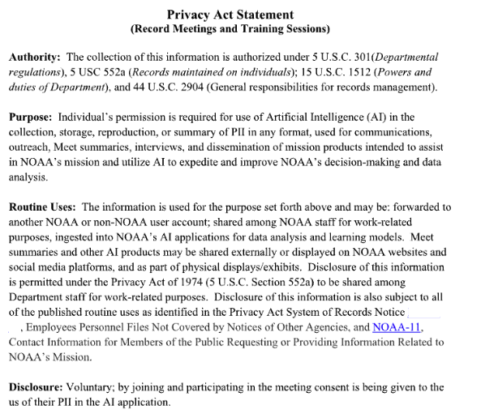

Privacy Act Statement for Recording

Slide 2
Global Workflow Tutorial
Walter Kolczynski
RedLine Performance Solutions/EPIC

Slide 3
Let’s Get Started!

Slide 4
Some steps in this tutorial will take the computer a while to complete.
We will be starting the process without explanation, then explaining while processing completes.
All commands shown have been pinned in this training’s Slack channel and the presentation speaker notes.

Slide 5
Logging Into the AWS Tutorial Sandbox

Slide 6
Logging into the AWS Sandbox
Use ssh to connect to the AWS bastion, which will automatically forward you to your head instance.
> ssh -Y first.last@jump1.epic.noaa.gov
Each person will have their own head instance, but you will share a lustre disk system with other users. You have admin permissions on your instance (so be careful) and your username there will be ubuntu, not first.last.
Notes:
Commands:
ssh -Y first.last@jump1.epic.noaa.gov

Slide 7
Cloning and Building Global Workflow

Slide 8
Cloning and Building Global Workflow
First, let’s define and create a few locations where we will be working:
> ME=first.last
> MY_SAVE=/lustre/users/$ME/save/gw
> MY_NOSCRUB=/lustre/users/$ME/noscrub/gw
> MY_STMP=/lustre/users/$ME/stmp
> mkdir -p $MY_SAVE $MY_NOSCRUB $MY_STMP
Then, move into the save directory you just created:
> cd $MY_SAVE
Notes:
If you are using an on-prem machine, create directories in the appropriate spaces for your account
Commands:
ME=first.last
MY_SAVE=/lustre/users/$ME/save/gw
MY_NOSCRUB=/lustre/users/$ME/noscrub/gw
MY_STMP=/lustre/users/$ME/stmp
mkdir -p $MY_SAVE $MY_NOSCRUB $MY_STMP
cd $MY_SAVE

Slide 9
Cloning and Building Global Workflow
Now, clone global workflow:
> git clone https://github.com/NOAA-EMC/global-workflow.git tutorial --recursive --jobs=8
After the clone is complete, move to the source code directory and build for GFS forecast-only:
> cd tutorial/sorc
> ./build_all.sh -cA aws gfs
Notes:
Commands:
git clone https://github.com/NOAA-EMC/global-workflow.git tutorial --recursive --jobs=8
cd tutorial/sorc
./build_all.sh -cA aws gfs

Slide 10
Cloning and Building Global Workflow
That command will take about 25 minutes to complete, so let’s go over what we’ve actually done and the structure of global workflow.

Slide 11
Cloning and Building Global Workflow
So, what did we just do?
First, we set up the three directories where all of the global workflow will reside:
  The first, $MY_SAVE, is where the source code will live
  The second, $MY_NOSCRUB, is where the experiment directories and output will live
  The third, $MY_STMP, will be used for run directories
Notes:
While on AWS we placed these in the same directory, on other machines it often makes sense to separate these.

Slide 12
Cloning and Building Global Workflow
After moving to $MY_SAVE, we then copied the GW repository from GitHub:
> git clone https://github.com/NOAA-EMC/global-workflow.git tutorial --recursive --jobs=8
  https://github.com/NOAA-EMC/global-workflow.git is the path to the repository
  tutorial set the directory name
  --recursive told git to also checkout all submodules
  --jobs=8 told git to use 8 threads to retrieve everything faster

Slide 13
Cloning and Building Global Workflow
After moving into the sorc directory of the clone we just created, we then built the global workflow executables necessary to run forecast-only GFS:
> ./build_all.sh -cA aws gfs
  -c uses compute nodes to build
  -A aws specifies the HPC account to use
  gfs says to build the executables necessary for forecast-only GFS
Notes:
The HPC account name is irrelevant on AWS, so we could’ve used anything here. On other machines, use whichever compute accounts you have access to.

Slide 14
Cloning and Building Global Workflow
We only built build_all.sh for forecast-only GFS, but it can take multiple arguments to build for multiple configurations:
Build | Description
gfs | components for GFS (no data assimilation)
gsi | components for “old” DA (GSI; atmosphere-only)
gdas | components for “new” DA (JEDI-based)
gefs | components for medium-range global ensemble
sfs | components for seasonal forecast system
gcafs | components for global chemistry & aerosol forecast system
all | build everything

Slide 15
Cloning and Building Global Workflow
Multiple options can be built at once by specifying multiple options:
To build for GSI-based ATM-only cycled GFS:
> ./build_all -cA <account> gfs gsi
To build for coupled cycled GFS:
> ./build_all -cA <account> gfs gsi gdas
To build for forecast-only GFS and GEFS:
> ./build_all -cA <account> gfs gefs
Notes:
Commands:
./build_all -cA <account> gfs gsi
./build_all -cA <account> gfs gsi gdas
./build_all -cA <account> gfs gefs

Slide 16
Cloning and Building Global Workflow
 | Build Option (multiple allowed)
⬇Component ⬇ | gfs | gsi | gdas | gefs | sfs | gcafs | all
gdas |  |  | X
gsi_enkf |  | X
gsi_monitor |  | X | X
gsi_utils |  | X | X |  |  | X
nexus |  |  |  | X |  | X
ufs_model | gfs |  |  | gefs | sfs | gcafs | all 4
ww3_prepost | X |  |  | X
gfs_utils, ufs_utils, and upp are always built

Slide 17
Cloning and Building Global Workflow
UFS model configurations (built with FV3/MOM6/CICE6/WW3 unless noted)
GFS Model | Non-hydrostatic with unstructured wave grid (PDLIB=ON)
GEFS model | Non-hydrostatic with structured wave grid (PDLIB=OFF)
SFS model | Hydrostatic (built with waves, but waves not used)
GCAFS | Non-hydrostatic FV3/GOCART

Slide 18
Structure of Global Workflow

Slide 19
What Is a Workflow, Anyway?
The term “workflow” has two different meanings around GW
The strict definition, which you’ll see in software development in general, is the workflow is the portion of the software that is responsible for determining when jobs are ready to be run and submitting them to the job scheduler
  Generally, this is done via a “workflow manager”, an external program that provides a language for defining a workflow and then manages the job submission. Examples include ecFlow, Rocoto, and Cylc. GW uses ecFlow in operations and Rocoto in development.

Slide 20
What Is a Workflow, Anyway?
More generally, we refer to “workflow” as both the above definition and the whole collection of scripts that are needed to run executables. The workflow is responsible for all of the following:
  Building/installing executables and otherwise preparing to run the system
  Determining when jobs are ready to run and submitting them to the scheduler
  Configuring job and program settings
  Staging all of the data and configuration files necessary to run an executable
  Storing output for use by later jobs or publication
  Deleting data when it is no longer needed

Slide 21
Workflow Structure
Global workflow has a complex structure. Much of the structure and terminology are the result of NCO requirements and/or legacy hold-overs.
Workflow contains a bunch of other components that provide all the programs needed for the global systems. These are incorporated into the workflow via submodules within the sorc/ directory.
All of global workflow itself is written in either bash or python.

Slide 22
Workflow Structure
Job scripts are located in several different directories that have a certain hierarchy in which they operate:
Workflow manager & Job Scheduler
└> entry script (dev/job_cards/rocoto/ or ecf/…)
└> j-job (dev/jobs/)
└> ex-script (dev/scripts/)
└> ush-script (ush/)
└> [additional levels also in ush/]
workflow manager
job scheduler (system)
dev
🕔
ops
rocoto sh
ecf
j-job
ex-script
ush
ush

Slide 23
Workflow Structure
The workflow manager submits a specific script as the entry point for the job. This job only loads modules and sets the job name, then calls the “j-job”
  In development, these are located in dev/jobs_cards/rocoto/
  In operations, these are in ecf/
The “j-job” is located in dev/jobs/. They are called j-jobs because they all begin with ‘J’. These scripts load config files, set paths and other basic settings, and then calls the “ex-script”
The “ex-script” is located in dev/scripts/. They all begin with ‘ex’. This is where work actually starts to get done.
The ex-script may then call one or more scripts. These are known as “ush scripts”, as they are placed in ush/.

Slide 24
Workflow Structure
Most settings are contained within “config” files. This includes settings for workflow control (whether to run certain portions), general experiment settings (what dates to run, how long the forecast is for, etc.), and specific namelist settings.
The source version of these live in dev/parm/config/${NET}/. Each forecast system has their own set. ($NET is gfs, gefs, gcafs, or sfs)
config.base is sourced by every job and provides general settings and those needed by multiple jobs. Jobs then also have their own individual config(s).
Variables marked by @var_name@ get replaced at experiment creation.

Slide 25
Workflow Structure
Generating a development workflow is a two-step process:
Generate an experiment directory
This step creates a new directory and copies all of the config files there. Certain variables are substituted in based on inputs or defaults. These config files can be edited further before proceeding to the next step.
Generate workflow definition
This step reads the config files in the experiment directory and generates a Rocoto workflow definition (XML).
There are also a number of canned cases from the CI system that can be run in a single step. This is the method we will be using today.

Slide 26
Workflow Structure
Other key workflow directories:
fix/
  Contains all of the large data files that do not change based on forecast period.
  These are kept in a centralized place on each machine and linked to HOMEglobal at build time.
dev/
  Files used by developers in development mode
dev/ci/
  CI testing system, including cases that can also be used manually
    We will be using one of these cases today
parm/ and dev/parm/
  Contain smaller static files with settings such as namelists, tables, and aforementioned config directories

Slide 27
Workflow Structure
Other key workflow directories (cont.):
docs/
  Source files for documentation
env/
  Sets certain machine-specific parameters based on the job
modulefiles/
  Contains the modulefiles listing the modules to be loaded at runtime
versions/
  Defines the module and fix versions to be used by the workflow during build and run time
gempak/
  Contains many of the scripts needed to produce gempak files required by operations. Rarely run in development. (These break the normal j-job/exscript/ush paradigm.)

Slide 28
Workflow Structure
The GFS runs in different phases: an “early” phase run soon after the analysis time, and a “late” phase that allows more observations to be assimilated. The forecast ensemble for EnKF is also placed in separate phases.
These phases are designated by $RUN,:
  gfs: “early” analysis and full forecast
  enkfgfs: “early” ensemble for EnKF (for GEFS initial conditions) [v17]
  gdas: “late” analysis
  enkfgdas: “late” ensemble for EnKF (background for next cycle)
The GCAFS system also has two phases, a gcafs and a gcdas.
GEFS and SFS only have one phase (gefs/sfs)
Notes:
The early enkfgfs phase will be new with GFS v17.

Slide 29
Workflow Structure
Job names will be prefixed by their $RUN, since many jobs will be executed in multiple runs. e.g. gfs_fcst, gdas_fcst, enkfgdas_fcst
Not all experiments will have every phase
 | forecast-only | cycled
⬇ $RUN ⬇ |  | nens=0 | nens>0
gfs | YES | if INTERVAL_GFS > 0
enkfgfs | NO | NO | if EUPD_CYC = “BOTH”
gdas | NO | YES | YES
enkfgdas | NO | NO | YES

Slide 30
Finishing the Build Process

Slide 31
Finishing the Build Process
Now that all the components have (hopefully) finished compiling, there is one last step to complete the build process: running the linking script (while still in sorc/):
> ./link_workflow.sh
This scripts creates a bunch of links for:
  executables we just built (in exec/)
  fix files that are stored on disk (in fix/)
  some source directories farther down the tree (in sorc/)
  scripts and configs that GW expects in certain places
Notes:
Commands:
./link_workflow.sh

Slide 32
Setting Up Your First Case

Slide 33
Setting Up Your First Case
Now that you have completed the build process, it is time to set up your first test case.
Create a $HOME/.gwrc file and fill it with the following:
user:
STMP: '/lustre/users/first.last/stmp'
PTMP: '/lustre/users/first.last/stmp'
This overrides the default temporary directory settings
  The default is usually good enough on most machines, but with the tutorial setup, may cause collisions with others
  The .gwrc only needs to be set once on a machine and will be used for all GW experiments until deleted
Notes:
~/.gwrc file:
user:
STMP: '/lustre/users/first.last/stmp'
PTMP: '/lustre/users/first.last/stmp'

Slide 34
Setting Up Your First Case
Exit the source code directory and move to the workflow directory:
> cd ../dev/workflow
  This directory has all the scripts necessary to set up and run an experiment directory
Notes:
Commands:
cd ../dev/workflow

Slide 35
Setting Up Your First Case
Set up the C48 atm-only GFS test case:
> ./generate_workflows.sh -A aws -y C48_ATM "${MY_NOSCRUB}/tutorial"
  generate_workflows.sh combines two steps:
    Experiment creation (setup_expt.py)
    Workflow (Rocoto) creation (setup_workflow.py)
  We’ll explain this command in more detail once we get the workflow started
If this succeeds, it should give you a crontab line to run the workflow. Copy it; we will be using it in the next step.
Notes:
“tutorial” can be any name you want to give this set of experiments
Commands:
./generate_workflows.sh -A aws -y C48_ATM "${MY_NOSCRUB}/tutorial"

Slide 36
Setting Up Your First Case
Now we need to schedule Rocoto to run the experiment directory
Enter the crontab editor
> crontab -e
  You can specify the editor you wish to use by setting EDITOR first
Paste the block from the previous step into the crontab
Delete the /5 (but not the *) at the beginning of the line
  This changes the frequency from every five minutes to every minute
  Do NOT do this on any shared computer resource (like on-prem HPC)
Save and exit; you should get the message:
crontab: installing new crontab
Notes:
For on-prem machines, you may need to be on a specific node to edit crontab. Consult system documentation.
On Gaea C6, you need to use scrontab instead. See https://global-workflow.readthedocs.io/en/latest/user_guide/start.html#set-up-your-experiment-cron-or-scron for more information.
Commands:
crontab -e

Slide 37
Monitoring Your Experiment (Prelude)

Slide 38
Monitoring Your Experiment
Your workflow should now be set up to run. Let’s confirm it is running.
Before we leave the code directory, let’s source a bash script to make sure the environment is set up correctly for GW:
> source ../ush/gw_setup.sh
  This loads modules and defines a couple utility functions
    This will reset any modules you currently have loaded
And also make an alias for the OMD Rocoto Viewer tool, which we will be using later:
> alias rv=”TERM=xterm $MY_SAVE/tutorial/dev/workflow/rocoto_viewer.py”
Notes:
Commands:
source ../ush/gw_setup.sh
alias rv=”TERM=xterm $MY_SAVE/tutorial/dev/workflow/rocoto_viewer.py”

Slide 39
Monitoring Your Experiment
You should have two directories in $MY_NOSCRUB/tutorial:
    EXPDIR, holding the experiment directory
      config files and Rocoto files
    COMROOT, holding the output directory
  Each directory should have a C48_ATM directory
    If we were running multiple cases, each would have its own directory under EXPDIR and COMROOT
Let’s move to that experiment directory now so we can check on the Rocoto workflow:
> cd $MY_NOSCRUB/tutorial/EXPDIR/C48_ATM
Notes:
Commands:
cd $MY_NOSCRUB/tutorial/EXPDIR/C48_ATM

Slide 40
Monitoring Your Experiment
The Rocoto workflow for this experiment is made up of two files:
  A workflow definition, in XML format (here, C48_ATM.xml)
  A SQL database (C48_ATM.db)
If you do not have a database, that means Rocoto hasn’t run yet. Either wait a minute for crontab or run Rocoto manually:
> rocotorun -w C48_ATM.xml -d C48_ATM.db
Once the database has been created, we can check the status:
> rocotostat -w C48_ATM.xml -d C48_ATM.db
Notes:
Commands:
rocotorun -w C48_ATM.xml -d C48_ATM.db
rocotostat -w C48_ATM.xml -d C48_ATM.db

Slide 41
Monitoring Your Experiment
We’ll cover everything in more detail later, but for now just focus on the state of the first job, stage_ic. It should be in one of four states: SUBMITTING, QUEUED, RUNNING, or SUCCEEDED.
Repeat the rocotorun and rocotostat commands every few seconds until the state changes to RUNNING or SUCCEEDED.
  If your job is stuck on SUBMITTING, or is FAILED or DEAD, please ask for assistance
Once the first job is running, start Rocoto Viewer using the alias we defined earlier:
> rv -w C48_ATM.xml -d C48_ATM.db
Once you have started Rocoto Viewer, go on break
Notes:
Commands:
rv -w C48_ATM.xml -d C48_ATM.db

Slide 42
BREAK - Will Resume at 10:55

Slide 43
Setting Up Experiments

Slide 44
Setting Up Experiments
Running the experiment will take much of the remaining time. You can keep an eye on the progress with Rocoto Viewer (which we go over in depth later) while we review what we just did to set up the case.
If one of your jobs fails, flag down one of the EPIC team members to help.

Slide 45
Setting Up Experiments
We created the experiment with the following command:
./generate_workflows.sh -A aws -y C48_ATM "${MY_NOSCRUB}/tutorial"
  -A aws specifies the HPC account to use
  -y C48_ATM specifies the test case to run
  ${MY_NOSCRUB}/tutorial is the location to use for the cases
Under the hood, this is running two different scripts for each experiment:
  setup_expt.py
  setup_workflow.py
Notes:
As with the build, the HPC account is irrelevant on AWS. For on-prem machines, use the appropriate value for your account.

Slide 46
Setting Up Experiments
By default, generate_experiments.py looks in the dev/ci/cases/pr directory for test cases
  This location can be changed by specifying another path with the -Y option
Cases can be listed with or without the .yaml suffix on the file
You can specify multiple cases by separating each case with a space and enclosing the whole list with quotation marks:
> ./generate_workflows.sh -A aws -y "C48_ATM C48_S2SW C96_atm3DVar.yaml" "${MY_NOSCRUB}/tutorial"
Notes:
Commands:
./generate_workflows.sh -A aws -y "C48_ATM C48_S2SW C96_atm3DVar.yaml" "${MY_NOSCRUB}/tutorial"

Slide 47
Setting Up Experiments
Instead of using -y, you can also run all tests for a forecast system valid on the current machine:
  -G: Run all GFS tests
  -E: Run all GEFS tests
  -C: Run all GCAFS tests
  -S: Run all SFS tests
You can also combine two or more of these. Using -GECS will run all tests valid on the current machine.
When running multiple tests, each test will have a directory matching its name in both EXPDIR and COMROOT

Slide 48
Setting Up Experiments
Other common options:
  -D: Delete existing directories without prompting
  -c: Append the tests to your crontab automatically
    Must be on a node where it is permitted to edit crontab
  -t <tag>: Add a “tag” to the experiment names
    Useful to distinguish and avoid name collisions when running the same test in multiple versions of GW
A full list of options can be viewed using -h

Slide 49
Setting Up Experiments - Case Files
Each case file is actually a succession of four yaml files:
  The main one provided, which has basic experiment settings like resolution, paths, start and end dates. It also specifies the next file…
  The second file contains overrides to the system default values. For the cases in the ci system, these are contained in dev/ci/cases/yaml. These can be pretty short, and also specify the next file…
  The third file contains all the defaults for a particular forecast system. These files are the respective one for the system: dev/parm/config/<system>/yaml/defaults.yaml.
  The fourth file is not defined by the experiment at all, but instead is determined by the platform. These contain a bunch of machine-dependent settings and reside in dev/workflow/hosts.

Slide 50
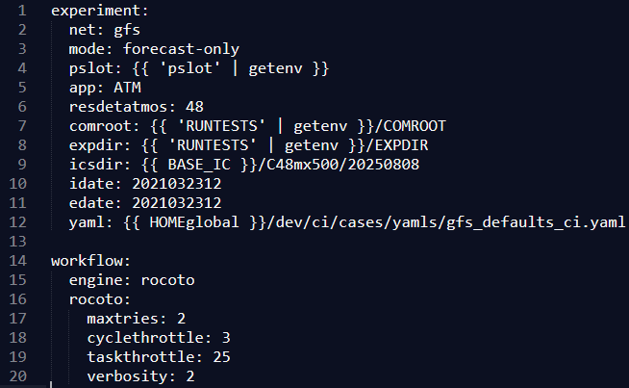
Setting Up Experiments - Case Files
C48_ATM.yaml

Slide 51
Setting Up Experiments - Case Files
These settings are the arguments provided to setup_expt.py and setup_workflow.py.

Slide 52
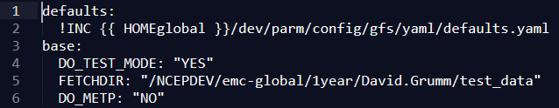
Setting Up Experiments - Case Files
gfs_defaults_ci.yaml

Slide 53
Setting Up Experiments - Case Files
As noted earlier, these are just overrides to the file listed in the defaults sections.
Other sections are named after the config file the setting appears in (here, only config.base).
If you want to make your own test case, copy and modify these first two files for the case closest to your new one.

Slide 54
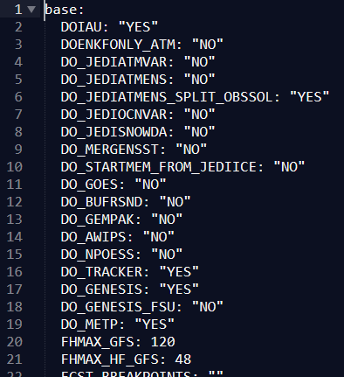
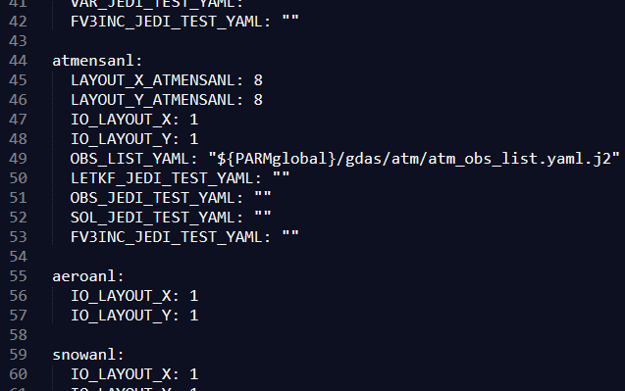
Setting Up Experiments - Case Files
defaults.yaml

Slide 55
Setting Up Experiments - Case Files
These files are organized the same way, with each section corresponding to the config files the settings are in.
You should not be modifying these. Change any settings by making additions to the previous file (or, rather, your copy of the previous file).

Slide 56
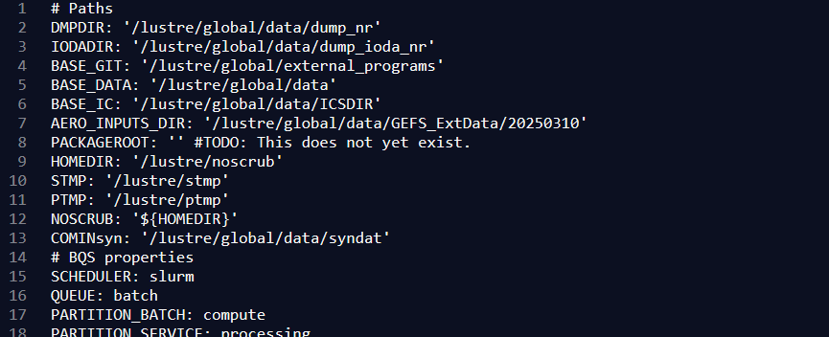
Setting Up Experiments - Case Files
aws-ec2.yaml

Slide 57
Setting Up Experiments - Case Files
The hosts file specifies a bunch of machine-related paths and capabilities.
Like with the defaults file, avoid altering this one. Any settings you need to change can be done in either in the main case file (for experiment-specific changes), or in your .gwrc (like we did with PTMP and STMP).

Slide 58
Monitoring and Managing Your Experiment

Slide 59
Monitoring and Managing Your Experiment
As mentioned previously, GW uses Rocoto for the workflow manager for development workflows.
Rocoto is designed to not need any setup from a sysadmin. Instead of using a daemon/client model like ecFlow, Rocoto works by intermittently updating from a user account.
Since it requires repeatedly calling an executable, we put that command in the crontab to run regularly.
  Could also do it with a loop in the terminal, but crontab will continue running even if we disconnect.
    If there is too big a gap between Rocoto executions, job info may age off the job scheduler.

Slide 60
Monitoring and Managing Your Experiment
Rocoto consists of three pieces:
An XML file defining the workflow
A SQL database to store job status information
A collection of executables that read the XML, take actions, and update the database
Global workflow generates the XML for you, and the SQL database is handled entirely by the Rocoto executables, so you really only need to worry about the executables.

Slide 61
Monitoring and Managing Your Experiment
The Rocoto workflow is defined as a series of tasks (jobs) and metatasks (collections of tasks that are variations of the same job).
Each task or metatask has a set of dependencies that must be met before starting.
  Dependencies are often another job finishing and/or certain files existing.
Each time rocotorun is executed, it does the following:
  Polls the status of any jobs previously submitted
  Updates the database
  Submits any jobs that now has its prerequisites met
Notes:
Example metatasks in global workflow:
Product generation at each output time
Different segments of a long forecast
Any job that has to be run for multiple ensemble members

Slide 62
Monitoring and Managing Your Experiment
Primary Rocoto commands:
rocotorun: Main Rocoto command to read the XML and database, query the status of any running jobs, and then submit additional jobs if appropriate.
rocotostat: Displays the current status of the Rocoto workflow
rocotocheck: Queries the database about a job’s status, including the status of prerequisites that the job is waiting on.
rocotorewind: Resets a job back to the unrun state so it will run again. Usually used when a job fails and you think you’ve fixed the problem without needing to rerun all the jobs leading up to it.
rocotoboot: Forces a job to be submitted, ignoring normal prerequisites.

Slide 63
Monitoring and Managing Your Experiment
All Rocoto commands require an XML workflow (specified with -w) database (specified with -d). Some command allow or require additional settings for cycle and task:
Examples:
  Run Rocoto (update job statuses and launch new jobs)
  > rocotorun -w ${pslot}.xml -d ${pslot}.db
    You can also add -v 10 for a more verbose option that will display job cards submitted
  Rewind the gfsfcst job for the 20211221 06z cycle:
  > rocotorewind -w ${pslot}.xml -d ${pslot}.db
  -c 202112210600 -t gfs_fcst
Notes:
Commands:
rocotorun -w ${pslot}.xml -d ${pslot}.db
rocotorewind -w ${pslot}.xml -d ${pslot}.db -c 202112210600 -t gfsfcst

Slide 64
Monitoring and Managing Your Experiment
Manipulating the Rocoto commands on the command line can be cumbersome. Luckily, we have a GUI tool: rocoto_viewer.py
This is NOT an official part of Rocoto. Terry McGuinness of OMD wrote it many years ago. It is supplied in GW in the dev/workflow/ directory.
Uses curses to run right in the terminal window, so no need for X windows.
Rocoto Viewer is picky about the terminal setting. You should set TERM to 'xterm' before using (you can change it back afterwards).

Slide 65
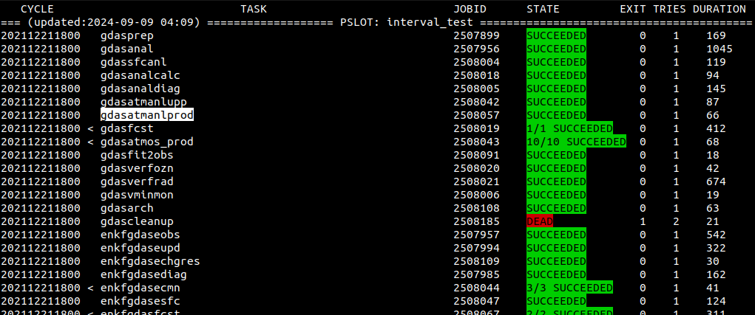
Monitoring and Managing Your Experiment
Experiment Name
Selected task
Metatask indicator
Cycle
Tasks
Task Status
Notes:
This is an older slide for a different experiment, so your job names will not match, but rocoto viewer hasn’t changed.

Slide 66
Monitoring and Managing Your Experiment
A < next to a job indicates a collapsed metatask (group of tasks)
A > indicates an expanded metatask
Key Controls
  ◀️▶️ Change cycle
  🔼🔽 or Click: Select job
  x: Expand/Collapse metatask
  c: Run rocotocheck on selected job(s) and display
  r: Run rocotorewind on selected job(s)
  SHIFT+R: Run rocotorun
  ENTER: Add/remove job to selection
  h: Display help with all commands
  q: Quit

Slide 67
Monitoring and Managing Your Experiment
(Interactive Rocoto Viewer demo)

Slide 68
Output and Logs

Slide 69
Output and Logs
Logs (STDOUT) for your jobs will be placed in ${MY_NOSCRUB}/COMROOT/${pslot}/logs/${PDY}${cyc}
  $pslot is the experiment name
  $PDY is the initialization date in YYYYMMDD format
  $cyc is the two-digit initialization time (cycle)
If a job is rerun, any previous log will be renamed to have a .0 at the end. If a log ending in .0 exists it will be renamed .1, etc.
Bash scripts are generally run with trace on (set -t), so every line will print before it is executed.

Slide 70
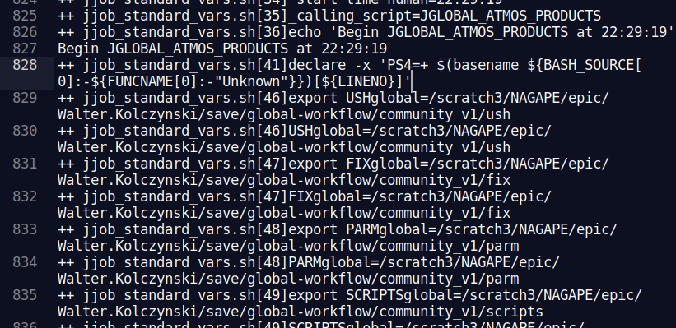
Output and Logs
Beginning of script
Script name
Line number
Command being executed

Slide 71
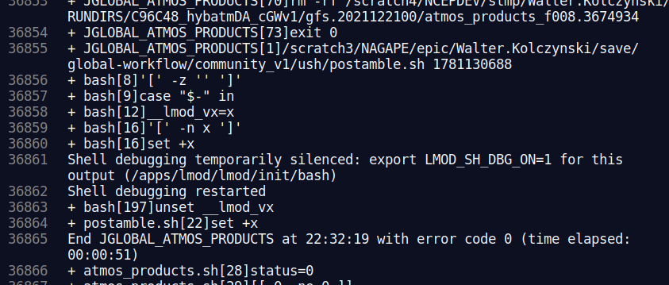
Output and Logs
Script end, with elapsed time

Slide 72
Output and Logs
Output will be placed in ${MY_NOSCRUB}/COMROOT/${pslot} under ${RUN}.${PDY}/${cyc} directories.
Output is sorted hierarchically in the following manner:
  ${RUN}.${PDY}/${cyc}
    Member (if any)
      Data category (conf/analysis/bmatrix/model/obs/products)
        Component (atmos/chem/ice/ocean/wave)
          Data type
            Grid/domain (if any)

Slide 73
Output and Logs
gfs.20210323
└── 12
├── conf
├── model
│ └── atmos
│ ├── history
│ ├── input
│ └── master
└── products
└── atmos
├── cyclone
│ ├── genesis_vital
│ └── tracks
└── grib2
├── 0p25
├── 0p50
└── 1p00
C48_ATM Output Tree

Slide 74
Output and Logs
conf: holds a few namelists and other input configuration files
model
  atmos|chem|ice|ocean|wave
    history: native model output (format varies by component)
  atmos|chem
    restart: restart files used by DA in next cycle
  atmos
    master: all variables on Gaussian grid (grib2)

Slide 75
Output and Logs
products
  atmos
    cyclone
      genesis_vital: first pass of tropical cyclone tracks
      tracks: final tropical cyclone tracks
  ice|ocean
    netcdf/native: output on native grid (NetCDF)
  wave
    gridded: wave output on various grids (grib2)
    station: wave output at points (tar’d bulletins)

Slide 76
Output and Logs
gdas.20211221/00
├── analysis
│ ├── atmos
│ ├── ice
│ ├── ocean
│ │ ├── bump
│ │ └── diags
│ └── snow
├── bmatrix
│ ├── ice
│ └── ocean
├── conf
├── model
│ ├── atmos
│ │ ├── history
│ │ ├── master
│ │ └── restart
│ ├── ice
│ │ ├── history
│ │ └── restart
│ ├── med
│ │ └── restart
│ ├── ocean
│ │ ├── history
│ │ └── restart
│ └── wave
│ ├── history
│ ├── prep
│ └── restart
├── obs
└── products
├── atmos
│ ├── grib2
│ │ ├── 0p25
│ │ ├── 0p50
│ │ └── 1p00
│ ├── minmon
│ ├── oznmon
│ │ ├── horiz
│ │ └── time
│ └── radmon
├── snow
│ └── anlmon
└── wave
├── gridded
│ ├── arctic.9km
│ ├── atlocn.0p16
│ ├── epacif.0p16
│ ├── global.0p16
│ ├── global.0p50
│ ├── gsouth.0p25
│ └── wcoast.0p16
└── station
Cycled Output Tree — gdas

Slide 77
Output and Logs
enkfgdas.20211221/00
├── conf
├── ensstat
│ ├── analysis
│ │ ├── atmos
│ │ ├── ice
│ │ ├── ocean
│ │ └── snow
│ ├── conf
│ └── model
│ └── atmos
│ └── history
├── mem001
│ ├── analysis
│ │ ├── atmos
│ │ ├── ice
│ │ ├── ocean
│ │ └── snow
│ ├── conf
│ └── model
│ ├── atmos
│ │ ├── history
│ │ └── restart
│ ├── ice
│ │ ├── history
│ │ └── restart
│ ├── med
│ │ └── restart
│ └── ocean
│ ├── history
│ └── restart
└── mem002
├── analysis
…
Cycled Output Tree — enkfgdas

Slide 78
Output and Logs
gfs.20211221/00
├── analysis
│ ├── atmos
│ ├── ice
│ ├── ocean
│ │ ├── bump
│ │ └── diags
│ └── snow
├── bmatrix
│ ├── ice
│ └── ocean
├── conf
├── model
│ ├── atmos
│ │ ├── history
│ │ ├── master
│ │ └── restart
│ └── minmon
├── ice
│ └── netcdf
│ └── native
├── ocean
│ └── netcdf
│ └── native
└── wave
├── gridded
│ ├── arctic.9km
│ ├── atlocn.0p16
│ ├── epacif.0p16
│ ├── global.0p16
│ ├── global.0p50
│ ├── gsouth.0p25
│ └── wcoast.0p16
└── station
│ ├── ice
│ │ └── history
│ ├── ocean
│ │ └── history
│ └── wave
│ ├── history
│ └── prep
├── obs
└── products
├── atmos
│ ├── cyclone
│ │ ├── genesis_vital
│ │ └── tracks
│ ├── grib2
│ │ ├── 0p25
│ │ ├── 0p50
│ │ └── 1p00
Cycled Output Tree — gfs

Slide 79
Output and Logs
analysis
  atmos|ice|ocean|snow
    Analysis, increments, bias estimation from data assimilation
bmatrix
  ice|ocean: background error covariance estimates
obs: copy of observations used this data assimilation cycle
Ensembles only (contents underneath generally the same as above):
ensstat: ensemble mean
mem001, mem002, …: individual ensemble members

Slide 80
Wrap Up

Slide 81
Wrap Up
By now, hopefully your test case is complete or nearly so.
We will try to leave the training clusters up until tomorrow. Please continue to explore your output, and maybe run another test case.
Please limit yourself to the low-resolution cases in dev/ci/cases/pr
We have a limited AWS budget for training, please be responsible
  We may need to shut it down early if the costs get too high
The EPIC team will be around all week if you have any questions, or you can email me directly at Walter.Kolczynski@noaa.gov

Slide 82
Resources

Slide 83
Resources
Authoritative GW Repository:
https://github.com/NOAA-EMC/global-workflow
Quick-Start Guide:
https://global-workflow.readthedocs.io/en/latest/quick_start.html
GW Documentation:
https://global-workflow.readthedocs.io/en/latest/index.html
Rocoto Documentation:
christopherwharrop.github.io/rocoto/
Discussion Board (for help):
https://github.com/NOAA-EMC/global-workflow/discussions

