Slide 1
WELCOME
Unifying Innovations in Forecasting Capabilities Workshop 2026
July 22nd, 2026

Slide 2
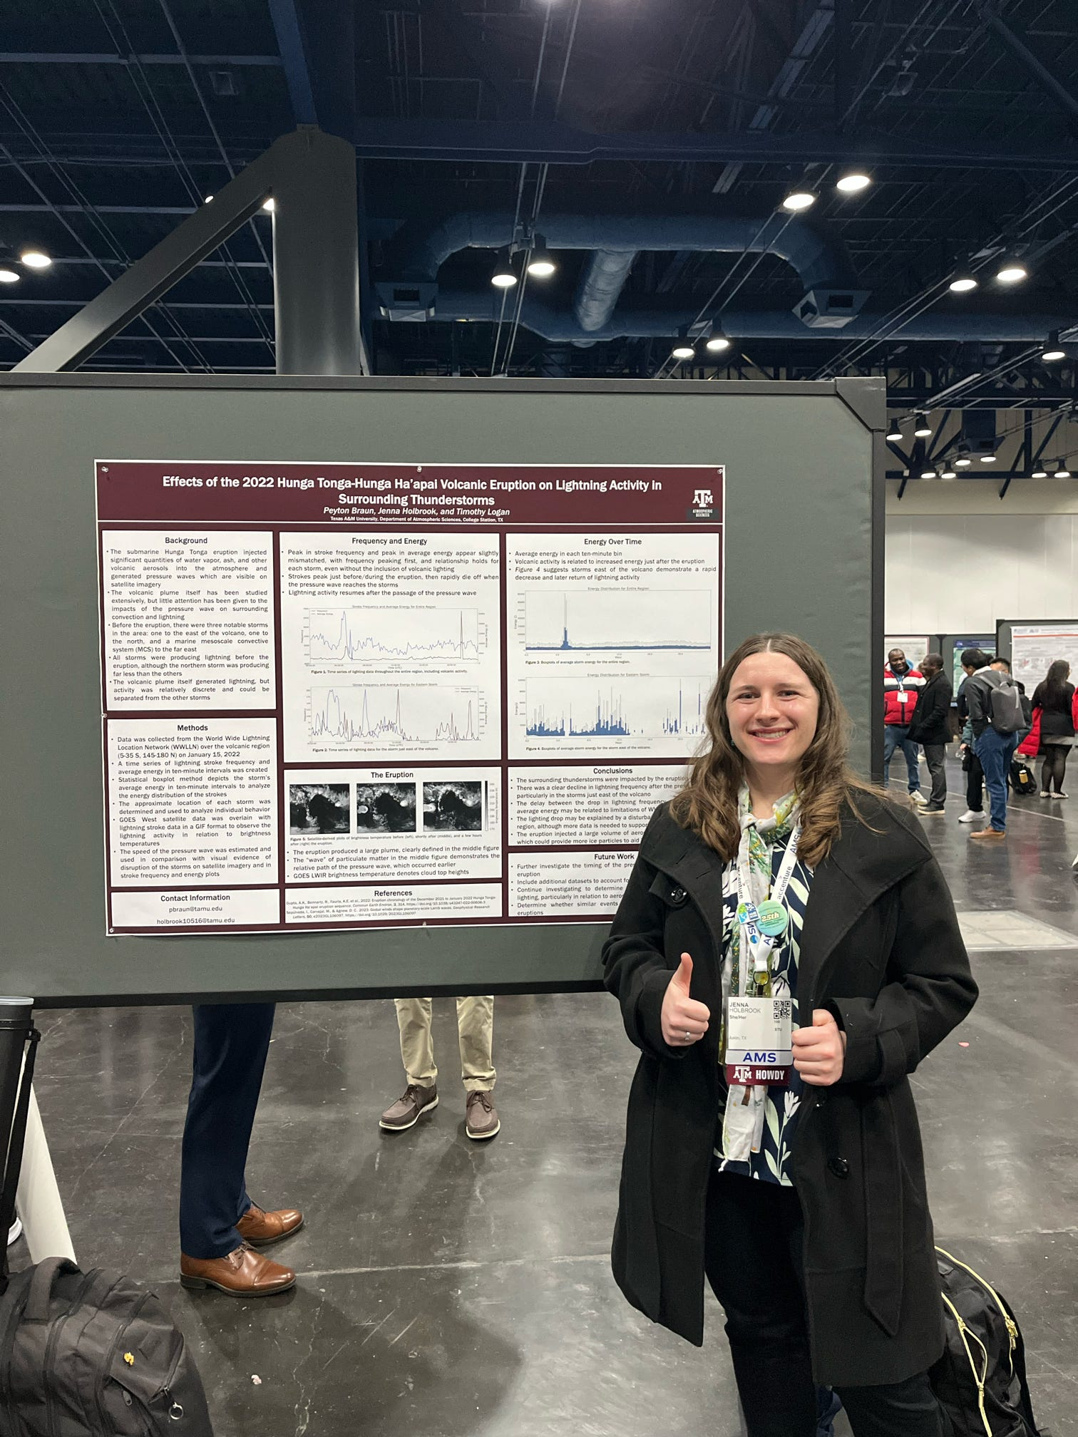
Today’s Master of Ceremonies
Jenna Holbrook
WPO/EPIC Lapenta Intern
Texas A&M University

Slide 3
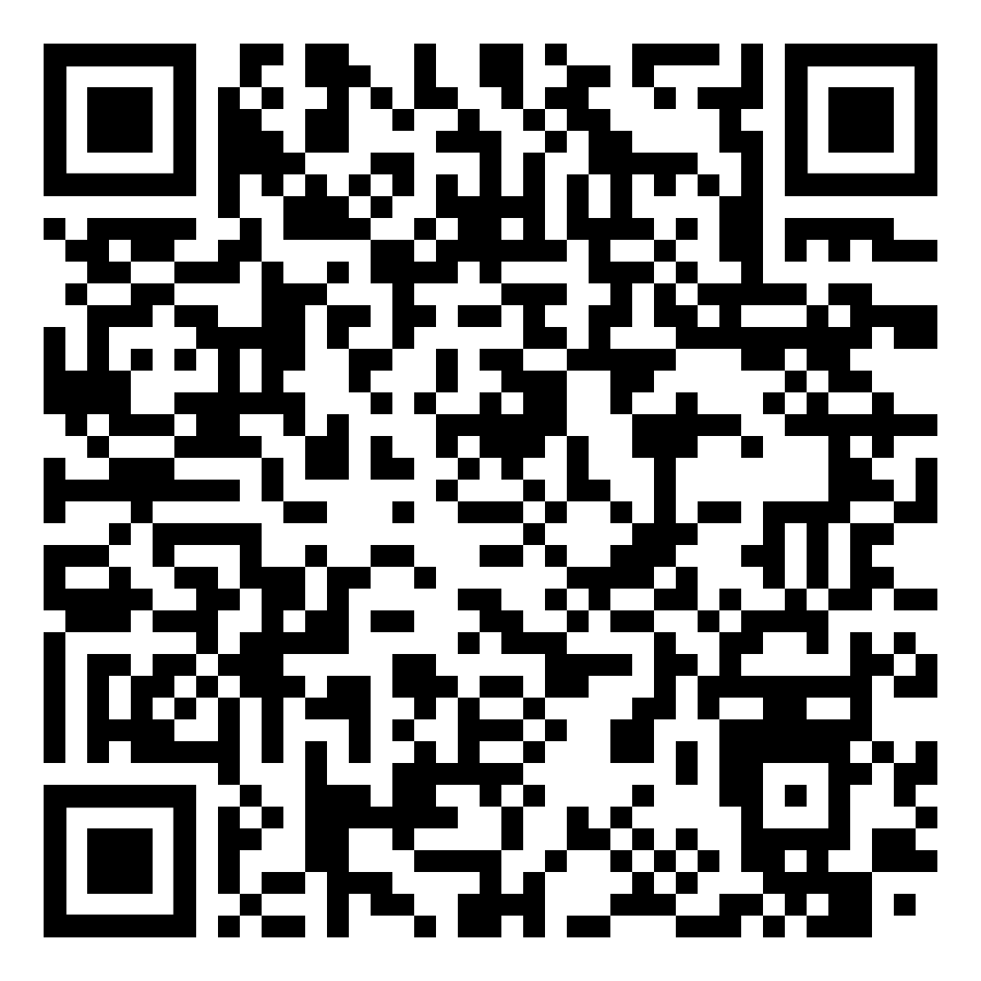
Transcription Announcement
The UIFCW is an open event that will be held via Google Meet and will be transcribed. By staying in the room (and online), you understand that your image, in video or still, and any sound recorded alongside it, will be streamed over Google Meet. The information that you provide may be used for websites, agenda's, and event descriptions.
For more information on NOAA's Privacy policy,
scan to read more:

Slide 4
Wednesday, July 22nd
09:30 AM - 09:40 AM Welcome (Rm 1101/1102)
09:40 AM - 09:50 AM Introduction to UFS: A Video Overview
09:50 AM - 10:30 AM UFS Applications Overview
10:30 AM - 11:00 AM Morning Break
11:00 AM - 12:00 PM Student Career Panel: Careers in the Weather Enterprise
12:00 PM - 01:00 PM LUNCH

Slide 5
Wednesday, July 22nd
01:00 PM - 01:45 PM Career Building Workshop (Interactive Session)
01:45 PM - 03:00 PM HANDS-ON-SESSION:
JEDI-Edu Tutorial: Introducing Data Assimilation Methods
in JEDI Using a Simple Two-Layer QG Model
03:00 PM - 03:30 PM Afternoon Break
03:30 PM - 04:15 PM HANDS-ON-SESSION Cont…
JEDI-Edu Tutorial: Introducing Data Assimilation Methods
in JEDI Using a Simple Two-Layer QG Model
04:15 PM - TBD (Weather-Themed) Movie Viewing
05:15 PM Adjourn

Slide 6
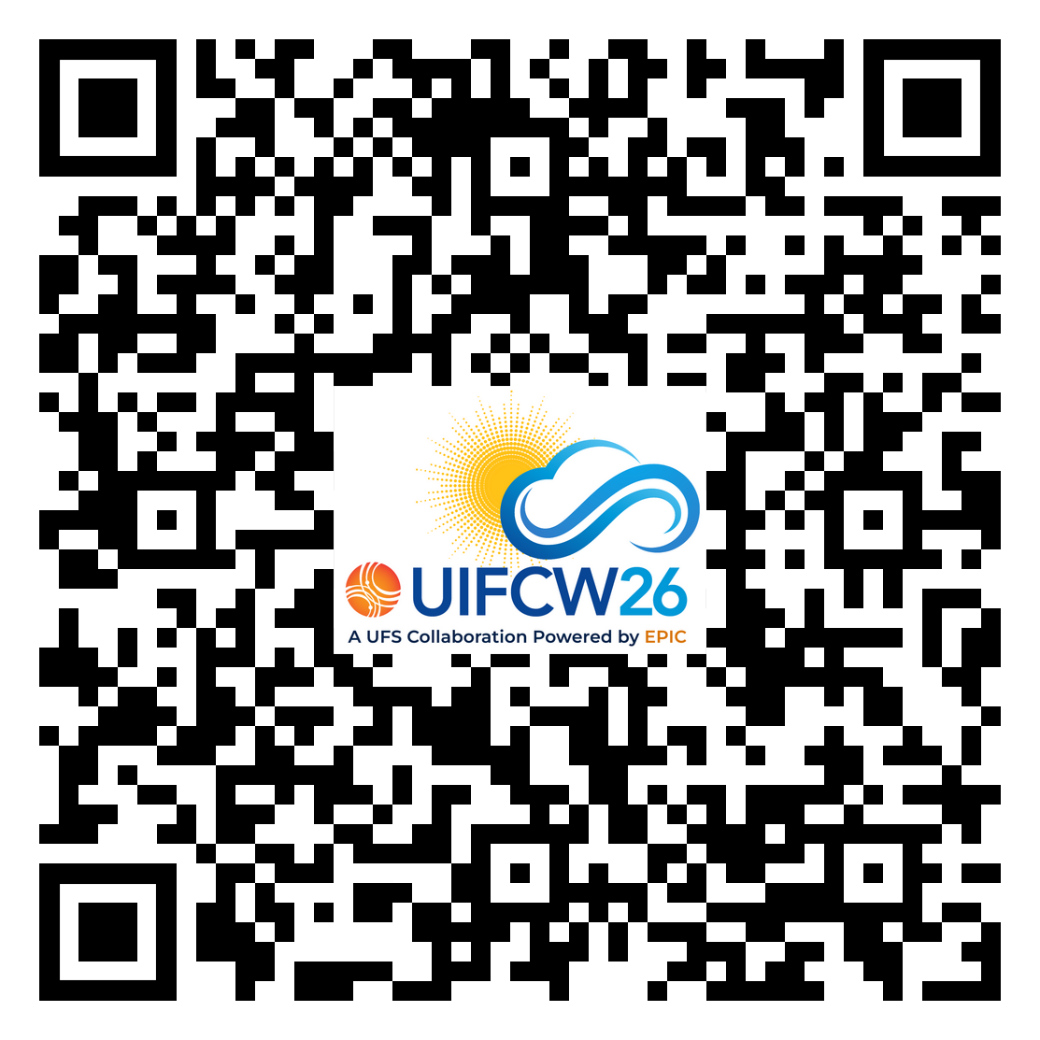


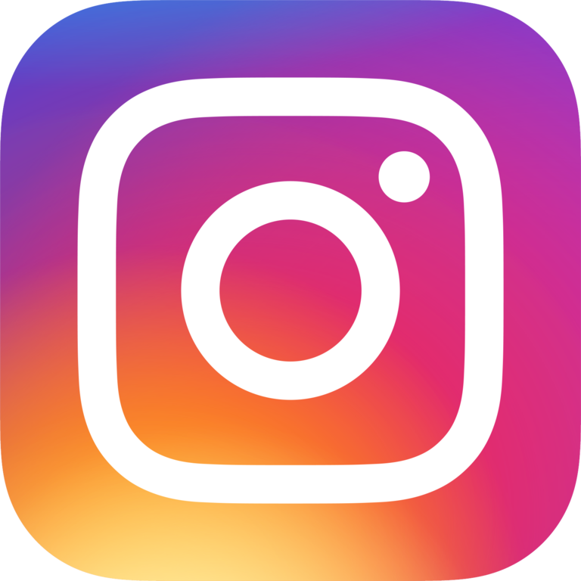

Connect With Us!
Detailed Agenda
Use Google Meet Q&A to connect with speakers and other attendees.
Find us on:
@NOAAEPIC
NOAAEPIC
#NOAAEPIC
NOAAEPIC
Wi-Fi: UMUC-Guest Network
No password is required.

