Slide 1
Accelerating Rapid Innovation
EPIC’s Pre-Configured Public Cloud HPC Environments
Contributors: Kristopher Booker, Wei Huang, Walter Kolczynski, Cameron Book, Keven Blackman, Natalie Perlin

Slide 2

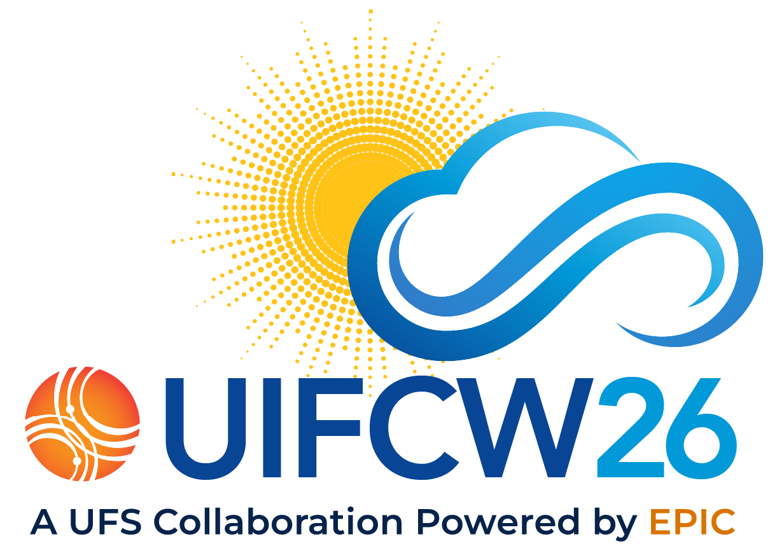
Problem
dns
The HPC Access Gap
Interested user:
"I want to participate in the UFS community but I don’t have access to a High Performance Computing environment."

Slide 3

Problem
construction
Library Build Complexity
Cumbersome & Slow: Building the UFS basic application (spack-stack) libraries is highly complex and time-consuming.
Restricted Support: Only officially supported on NOAA R&D HPC platforms (Tier-1), creating a high barrier to entry.

Slide 4

EPIC Community Involvement
groups
Lowering the Barrier to Entry
Community Mandate:
EPIC has been tasked with lowering the barrier to entry for working with NOAA’s software stack.

Slide 5

I just want to run the model!

Slide 6

Building on the public cloud
Easy Access
Easy to gain access immediately without barriers.
login
No Background Check
No long and tedious background check required.
verified
Frictionless Billing
All you need is a credit card to get started.
credit_card

Slide 7
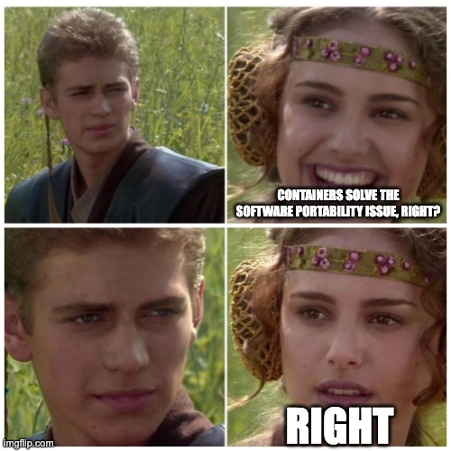
Containerization?
The Portability Promise
inventory_2
Containers are designed to encapsulate programs and dependencies, promising seamless portability across diverse computing environments...
...right?

Slide 8

Challenges of containerization
Increased network latency and MPI integration
Performance overhead (increased I/O)
Scalability
Library Portability (compilation on different architectures)

Slide 9

Challenges of containerization
error_outline
Strategic Decision
EPIC’s spack-stack containerization plan
EPIC has suspended its plan to use containers for the UFS base package libraries (spack-stack) deployment within the NOAA R&D HPC ecosystem due to these persistent challenges.

Slide 10

Pre-configured HPC environments
psychology
Too much abstraction?
What if instead of providing a container we couple the software stack directly to the HPC environment?

Slide 11

Building a pre-configured software stack
Take an existing AWS Parallel Cluster machine image (AMI) and build the basic software package libraries (spack-stack) using HashiCorp Packer.
The entire process is fully reproducible and easily shared, allowing others in the community to deploy identical stacks.
sync

Slide 12
Building a pre-configured software stack
cloud
school
swap_horiz
Cloud Integration
The entire application is now available on public cloud HPC platforms, requiring minimal inner workings knowledge.
Proven Turnkey
Demonstrated repeatedly across workshops, leveraging public cloud to deploy turnkey HPC environments seamlessly.
External Portability
Porting applications to non-NOAA R&D HPC environments, expanding capabilities outside the NOAA ecosystem.

Slide 13
Training Workshops
cloud_queue
replay
code
Cloud Portability
EPIC has demonstrated the capability to port the UFS base software library stack (spack-stack) and applications to the public cloud for workshops.
Reproducible Stack
Participants have often requested having the capability of reproducing these full-stack environments after the workshop has concluded.
Open Recipes
EPIC has posted these automation recipes to public GitHub repositories for easy access and community reuse.

Slide 14
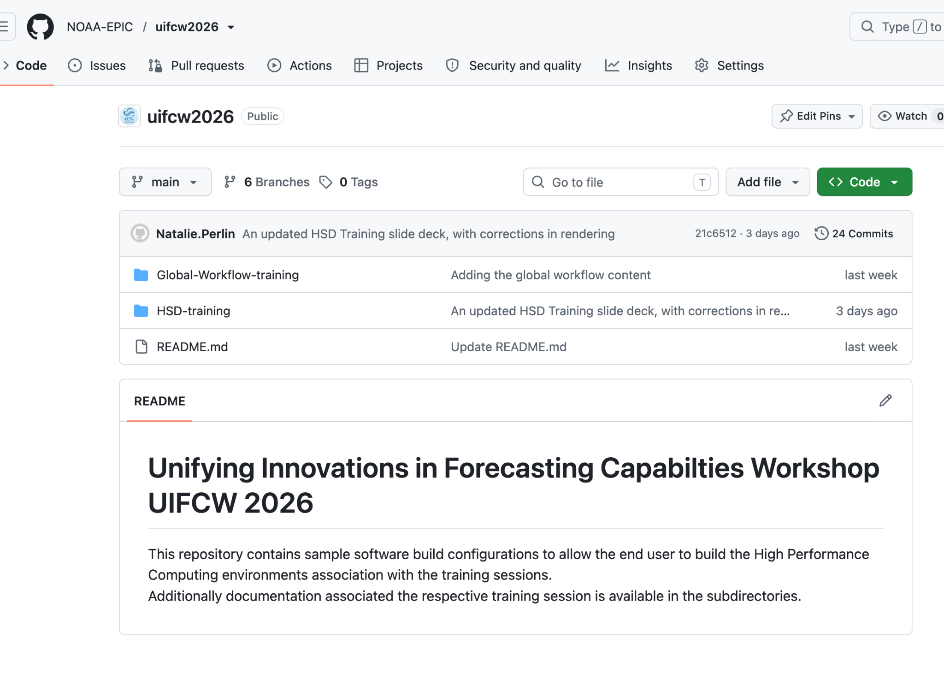
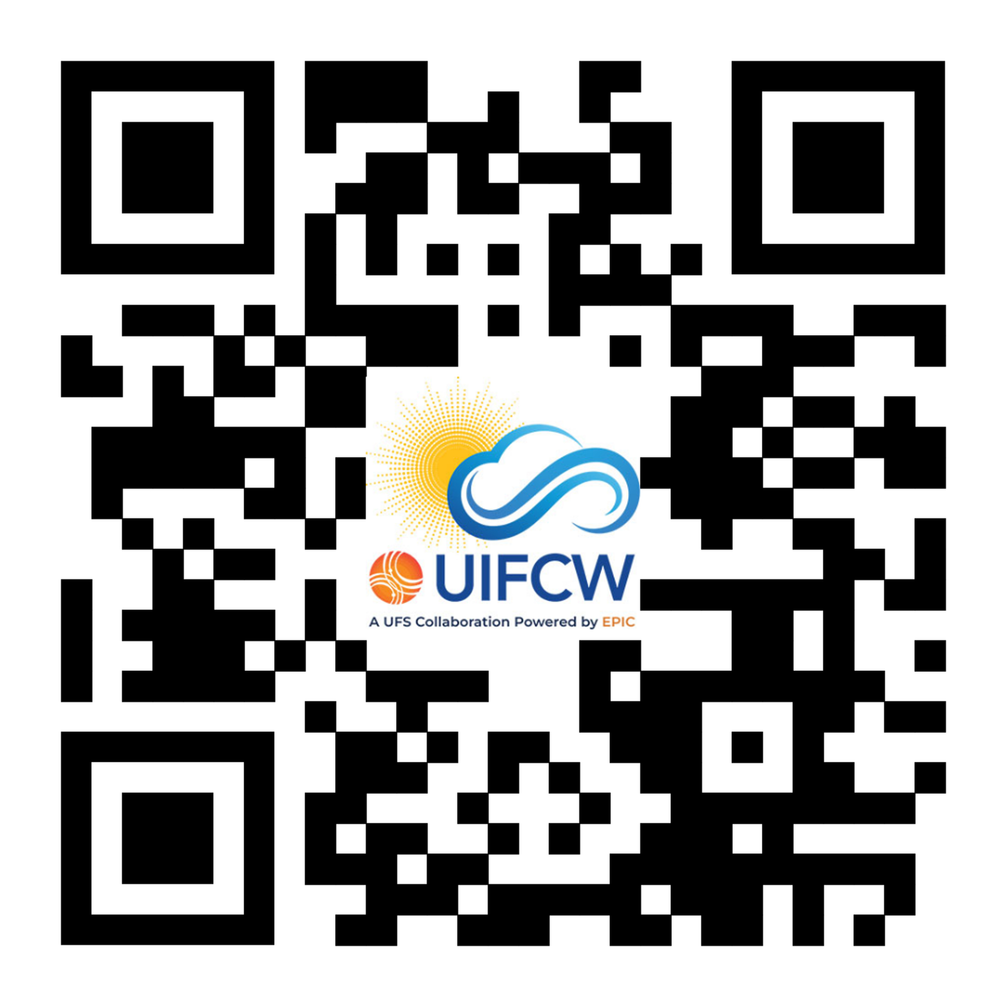
UIFCW 2026
UIFCW 2026 GitHub Repository
https://github.com/NOAA-EPIC/uifcw2026
code

Slide 15
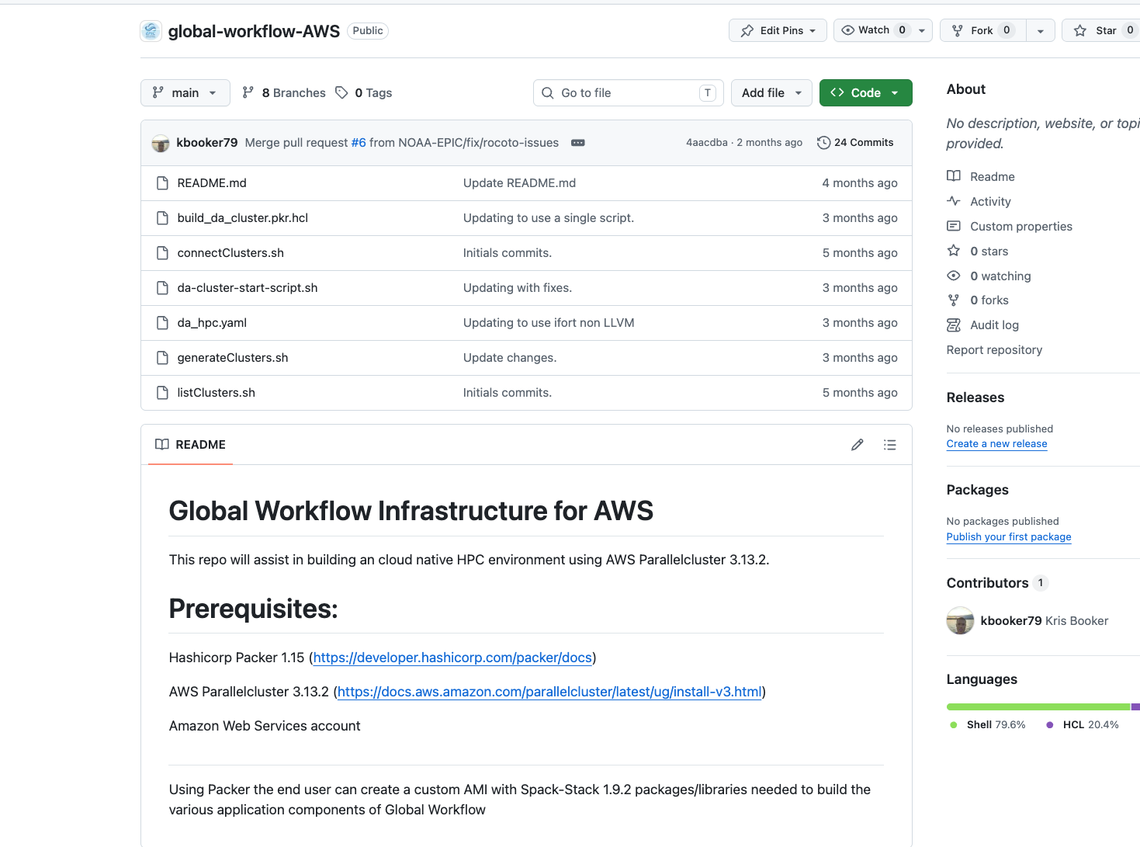
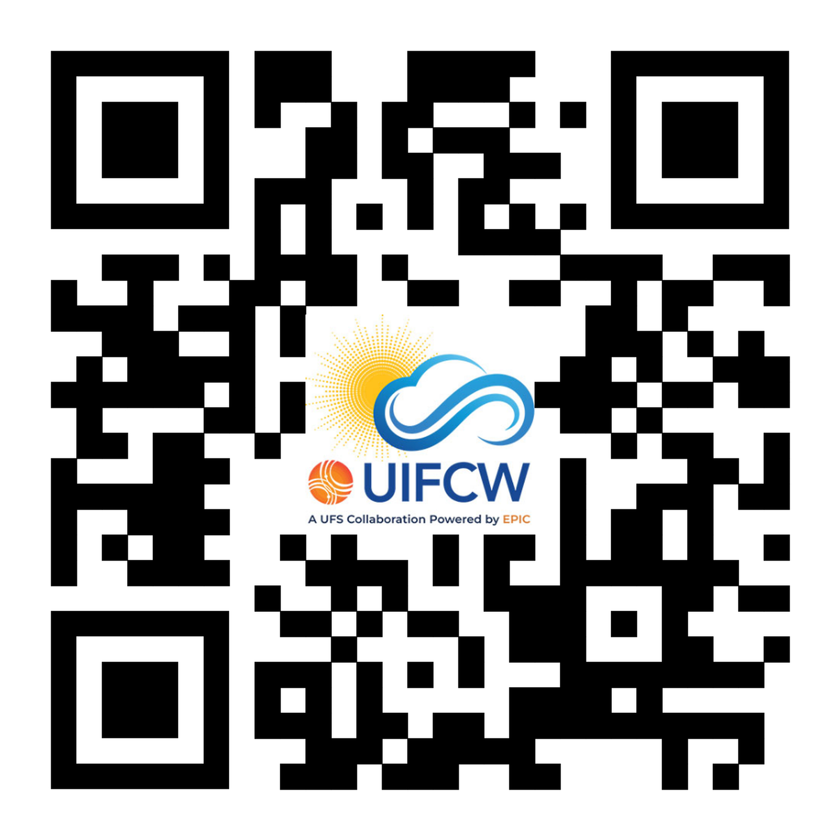
Global Workflow
EPIC GitHub Repository
https://github.com/NOAA-EPIC/global-workflow-AWS
code
In-Depth Presentations
Wei Huang: Running Global Workflow on Native AWS
Walter Kolczynski: Public Release of NWS Global Workflow
co_present

Slide 16

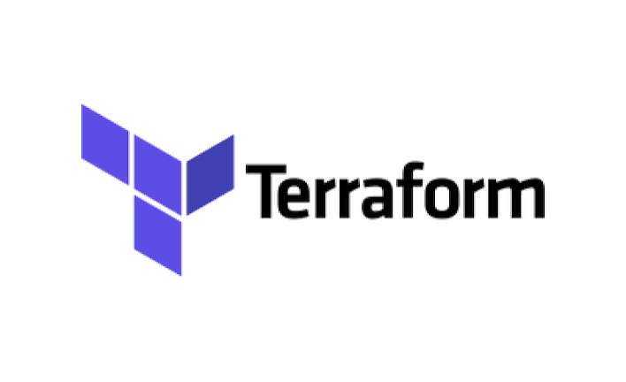
Future Considerations
AWS Marketplace Release
Making the Amazon Machine Images (AMIs) available to the user community through the AWS Marketplace.
Infrastructure Automation
Creation of AWS CloudFormation or HashiCorp Terraform automation templates to allow easy HPC environment creation including all required requirements.

Slide 17

Questions

