Slide 1
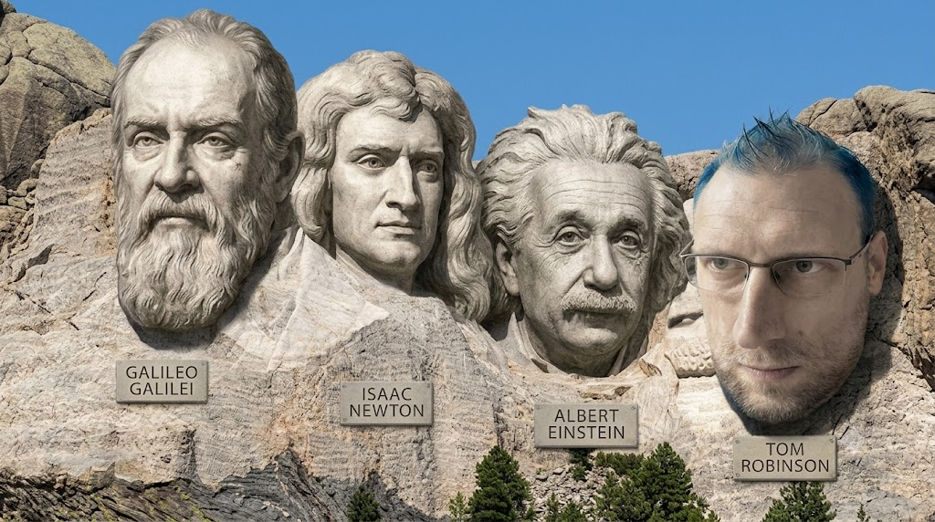
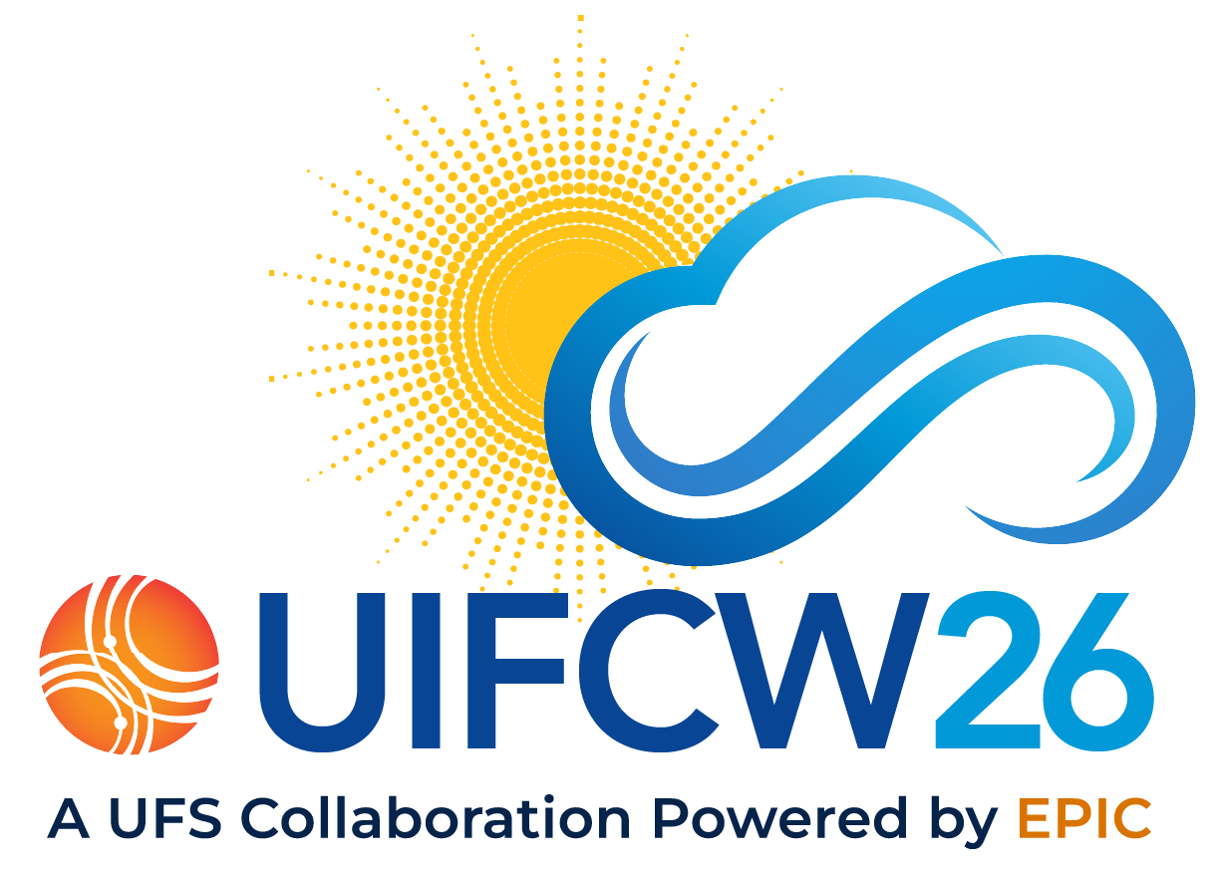
ESM4.5 Container Case Study
Thomas Robinson
Dana Singh, Niki Zadeh, Eric Stofferahn, Elijah Mccarthy, Subil Abraham, Uriel Ramirez

Slide 2
Outline
Motivation
Container Description
Model Environment Base (HPC-ME)
ESM4.5 build
ESM4.5 container performance
Sharing ESM4.5

Slide 3
Problem
public
The Sharing Mandate
report_problem
Traditional Barriers
Journal Requirements: Model description papers published in journals require models to be shared publicly.
ESM4.5: Run in production for hundreds of years to study long-term effects of the earth system, it must be shared publicly.
Lack of Support: Previous models were shared via GitHub without support on building and running the code.
Reproducibility Issues: External users faced difficulty running models, hindering scientific discovery and reproduction.

Slide 4
Solution
settings_suggest
The Core Workflow
layers
What is a Container?
Key Objective: Enable portable, reproducible, and easy-to-use execution environments across different high-performance and cloud computing platforms.
Workflow Goal: Create a workflow that allows scientists to build and run containers.
Image-like: A self-contained package that encapsulates everything needed to run:
OS & core system libraries
Application & dependencies
Executable: Instantly runnable using some sort of container launcher.
https://doi.org/10.1002/cpe.7966

Slide 5
Containers
construction Build Recipe
Dockerfile Base
User-defined build with a base container of minimal software/OS.
Uses a structured recipe to build the target application.
Keep it highly optimized and remove any unnecessary files.
layers Build Engines
Docker & Podman
Docker is standard for building on cloud or personal systems.
Podman is preferred on shared high-performance computing systems (RDHPCS).
launch Deployment
Launch Platforms
Can be built and launched with different programs.
Apptainer is made for running containers on HPC systems.
Easily convert Docker format (OCI) to Apptainer format (SIF).

Slide 6
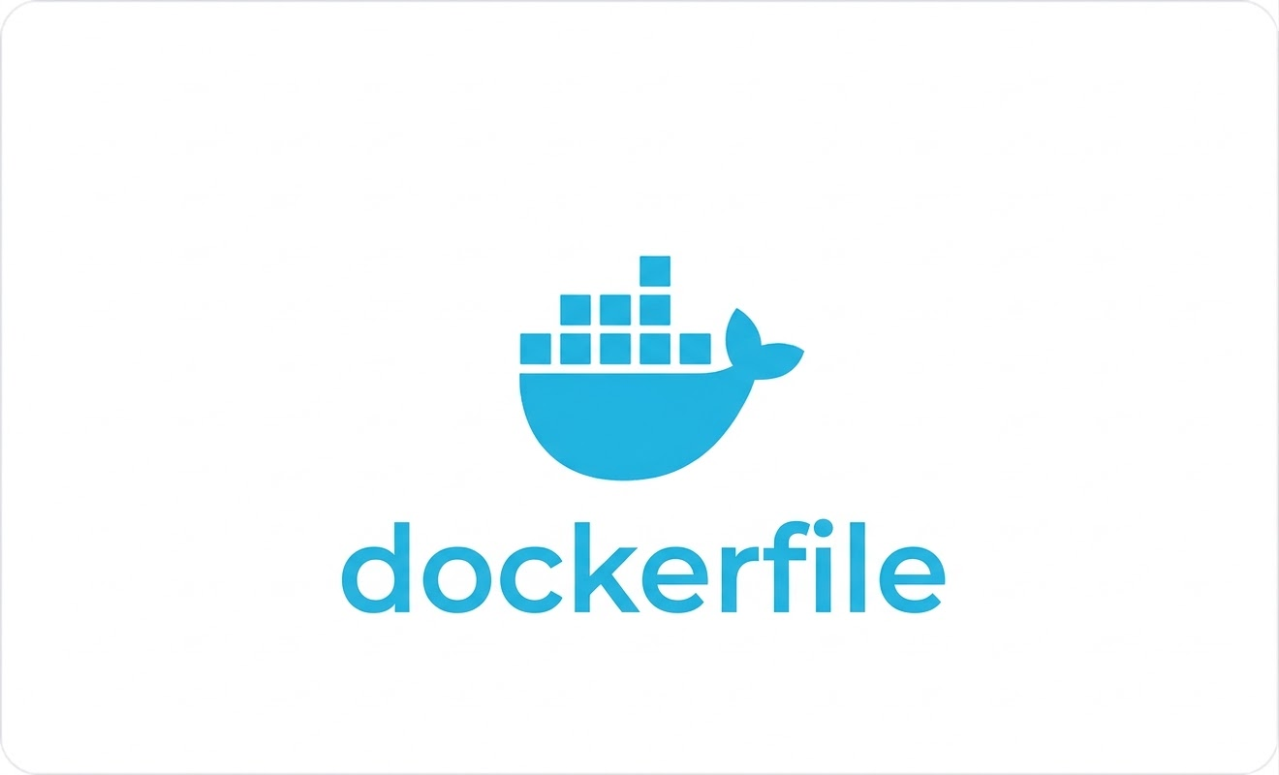

Base Containers
computer Compilers
Model Environment
Starting containers specifically configured for the model environment.
Supports both Intel and NVHPC compiler/runtime setups.
widgets Dependencies
Built via Spack
All critical stack dependencies are systematically built using Spack.
Includes libyaml, hdf5, netcdf, and nceplibs.
publish Dockerfiles
Sharing & Licensing
Dockerfiles and application containers are shared publicly.
Containers with commercial compilers are stored internally for licensing.
HPC Portable Containers - Model Environments (HPC-ME)

Slide 7

Building ESM4.5
FRE-CLI
settings FRE Workflow
Core Build Engine
Models at GFDL are systematically built using the FRE-CLI.
FRE updated to run and build executables seamlessly on both host systems and in containers.
code Code & Build
YAML Configuration
Build specifications are cleanly defined in a central YAML configuration file.
* FRE parses these repositories to automatically generate the Dockerfile.
layers Optimization
Container Strategy
Leverages reliable HPC-ME base containers for environments.
Employs efficient 2-stage builds to make the final model highly shareable.
* Eliminates the need for Docker expertise, lowering the barrier to adoption.

Slide 8
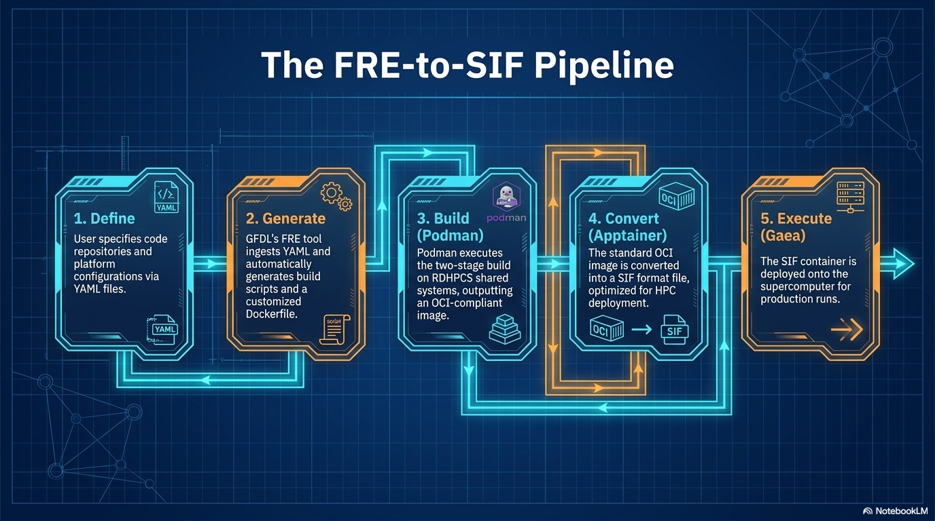

Slide 9

Binding System MPI
The MPI Challenge
The MPI inside the container used to build ESM4.5 cannot handle communication during execution.
GAEA HPC SYSTEM
dns
System MPI
Wrapped in a module from sys admins
Runtime Binding Solution
Apptainer variables and Gaea wrapper scripts inject the host system MPI into the container at runtime.
bind mount
layersApptainer
settings_applications
ESM4.5
Model Container
Automated FRE Workflow
FRE automatically loads the MPI bind modules and issues the correct srun apptainer execution commands.

Slide 10
ESM4.5 Performance
100 runs bare metal and container, 1 year run
MAIN LOOP | bare metal (s) | container (s) | bare-cont (s) | %diff
max | 10318.64563 | 10471.1064 | -152.460767
min | 9674.657974 | 9618.948526 | 55.709448
average | 9772.803198 | 9768.303332 | 4.499865783 | 0.05%
std dev | 76.06617559 | 107.4541827 | -31.38800709
median | 9762.12145 | 9748.263047 | 13.858403 | 0.14%

Slide 11
Sharing ESM4.5
layersESM4.5 Container
The container is publicly available to pull
codePublic Dockerfile
FRE-generated Dockerfile has been fully adapted and structured for public sharing.
View GitHub Repository →
terminal — Apptainer Pull
$ apptainer pull docker://ghcr.io/thomas-robinson/esm4:latest
buildDependency Resolution
Because HPC-ME containers are not available publicly, this Dockerfile automatically builds all necessary dependencies from scratch.
infoAvailability Status
Currently in the process of finalizing for official release, but fully accessible and available for deployment immediately.

Slide 12
Key Points
01
Containers fulfill open science mandates by journals by providing reproducibility and portability
02
Containers provide an easy pathway to running across diverse platforms such as on-prem HPC and the cloud
03
Base containers provide a way to reduce container build time
04
Integrating containers into the workflow eases the pathway to adoption
05
Bare metal runtime performance is achievable by working with sys admins to bind MPI into containers in a user-firendly way

Slide 13
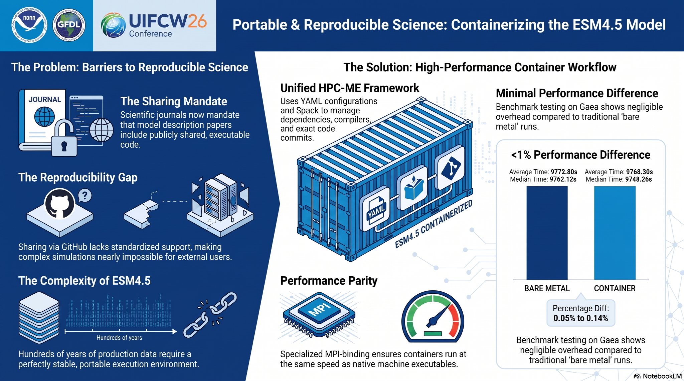
Acknowledgement: This work was funded by the Software Engineering for Novel Architectures (SENA)

Slide 14
Supplement slides

Slide 15
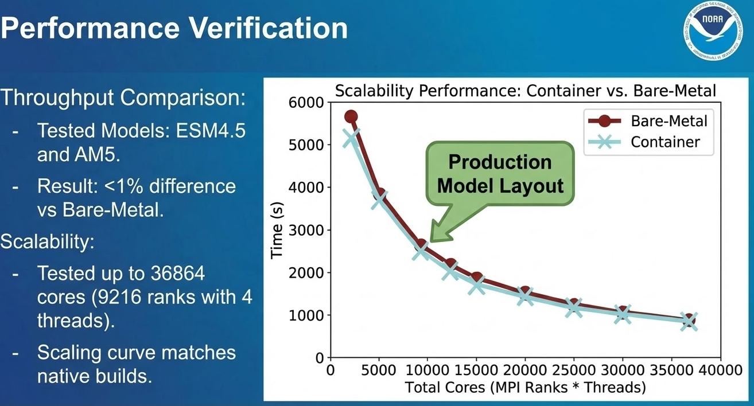

Slide 16
CI Testing on RDHPCS PW Cloud
Cloud Infrastructure: Always-On Instances
Spinning up on PRs was time consuming and unreliable; Intel HPC-ME .sif containers reside on the cloud.
GitHub Runner: Build Phase
singularity exec -B /contrib ${container} ${container_env_script} "./COMPILE..."
Models built in container environment
Executables stored on host file system for persistence
GitHub Runner: Run Phase
./${testname} "--partition=compute --mpi=pmi2... singularity exec..."
Hybrid MPI launching for small/short runs
Execution via singularity within compute partitions
Testing AM5 for FMS and SHiELD for SHiELD_build and fv3 code

Slide 17

Other Use Cases at GFDL
Portable Post Processing
Cylc engine in a container
GFDL software environment on gaea for easy porting from PPAN (42x speedup)
GitHub Free Testing
Latest software updates used for testing with FMS code
Support for expanding the compiler set
Ollama
NOAA Generative AI pilot project
Distributed and easily installed via container
HPC Enabling
Ursa GH200 Nemotron - open source LLM from Nvidia (relies on cuda)
Cray Program Environment containers for continuity

Slide 18
“Gotcha”s
MPI Flavors
Must match exactly (e.g., mpich vs openMPI) to ensure compatibility.
glib-c Versioning
Incompatibility between system (e.g. SLES) and container (e.g. Ubuntu) causes crashes.
LD_LIBRARY_PATH
MPI bind overwrites this. Use \${LD_LIBRARY_PATH} to preserve container paths.
Architecture (ARM/x86)
- Containers must be explicitly built for the target runtime architecture.
- Older chips not supporting avx instructions may not be compatible
Podman Deployment
Users must be added individually; no simple method for general deployment yet.
Podman Storage
Hidden caches consume massive space and require regular manual cleanup.
Directory Binding
- Work directories must use --bind. Watch for soft links in input paths.
- Updates to the host system may require updates to bind paths for MPI
Apptainer Cache
Default $HOME fills quotas quickly. Recommend reconfiguring to larger storage.
The cache is hidden which can leave to mysterious issues

