Slide 1
Using containers to run UFS Weather Model regression tests on HPC platforms or cloud environments
Natalie Perlin^{(1,2)}, Eddie Snyder^{(1,3)}, Cameron Book ^{(1,4)}
¹- NOAA EPIC Software Integration Team
²- RedLine Performance Solutions
³- RTX
⁴- Science and Technology Corp
24 July 2026 (College Park, MD)

Slide 2
UFS: Why Community Matters
UFS goal is to be a community-driven modeling framework
Success depends on broad participation in development, evaluation, feedback
Open-source (GitHub-hosted) code helps
  …if it runs on contributors' platforms!
Contributors span many institutions, systems, and compute environments
NOAA EPIC works to remove technical barriers to entry
UFS Weather Model may be of top interest to the community
A consistent, portable software environment is one way to bridge that gap
Notes:
"Let's start with why this work matters. UFS — the Unified Forecast System — was designed to be a community-driven modeling framework. Its success depends on broad participation — people contributing to development, testing, evaluating performance, and eventually giving feedback.
Now, UFS is actually made up of several components, but among them, the UFS Weather Model tends to draw particularly strong interest from the community — which is why it's the focus of what I'll be presenting today.
Open-source code hosted on GitHub is a great enabler of that — but only if it actually runs on the platforms contributors are using. Having the code open isn't enough on its own.
That matters because contributors span many institutions, systems, and compute environments — different HPC centers, different clouds, different default toolchains.
That's where NOAA-EPIC comes in — working to remove the technical barriers that keep people from contributing in the first place.
And one idea at the core of that effort: a consistent, portable software environment could help bridge the gap between these different compute environments."
(transition: "So let's look at where that gap actually comes from.")

Slide 3
UFS Weather Model: Things Get Complicated
Each compute platform requires coordinating a variety of compilers, host environments and modules, MPI implementations, job schedulers, and workflow managers
At the core of the UFS WM requirements: a large software stack, now ~300 packages (incl. Python)
  installed natively on all NOAA Tier 1(*) RDHPC platforms
    installation details tailored uniquely to each Tier 1 platform
Regression tests (RTs)
  A chosen set of tests confirming consistent results (baseline) after code changes
  Run on all NOAA Tier 1 platforms for every pull request
    RT framework in UFS WM targets exclusively NOAA Tier 1 systems
Contributors on other platforms:
  running RTs simply confirms the UFS model was ported successfully to their platform
  a full baseline comparison capability, as maintained on Tier 1, is not the goal
Replicating UFS requirements and testing steps by hand: a heavy lift for individual contributors!
(*) NOAA Tier 1 RDHPC platforms: chosen to support UFS development and testing, including Ursa, Gaea, Orion, Hercules, Derecho, and NOAA Cloud (AWS, Azure).
Notes:
"So where does that gap actually come from?
On each platform, you're coordinating a variety of compilers, MPI implementations, job schedulers, and workflow managers — and they all have to work together correctly.
At the core of the UFS Weather Model's requirements is something even bigger: a large software stack — currently around 300 packages, including Python — installed natively on all NOAA Tier 1 platforms. And this isn't one-size-fits-all — the stack's details, build flags, and installation steps are tailored uniquely to each Tier 1 platform.
Now, a quick clarification — regression tests are a chosen set of tests that confirm the model still produces consistent, expected results after code changes are made. Right now, these regression tests run automatically on all NOAA RDHPC platforms for every pull request into the source code — but that automated coverage exclusively targets Tier 1 systems.
That said, it's worth noting why a contributor on a different platform might still want to run these tests. It's not necessarily to maintain a full baseline comparison capability, the way it's done for Tier 1 systems — that's a heavier, ongoing infrastructure commitment. Instead, for most contributors, simply running the regression tests successfully is enough to confirm that the model has been ported correctly to their machine and appears to be working.
Put simply: replicating this entire environment by hand — matching the right compilers, the right MPI library, all ~300 packages, configured exactly right for your platform — is a very heavy lift for an individual contributor."
(transition into next slide: "And that's exactly the problem containers are designed to solve.")

Slide 4
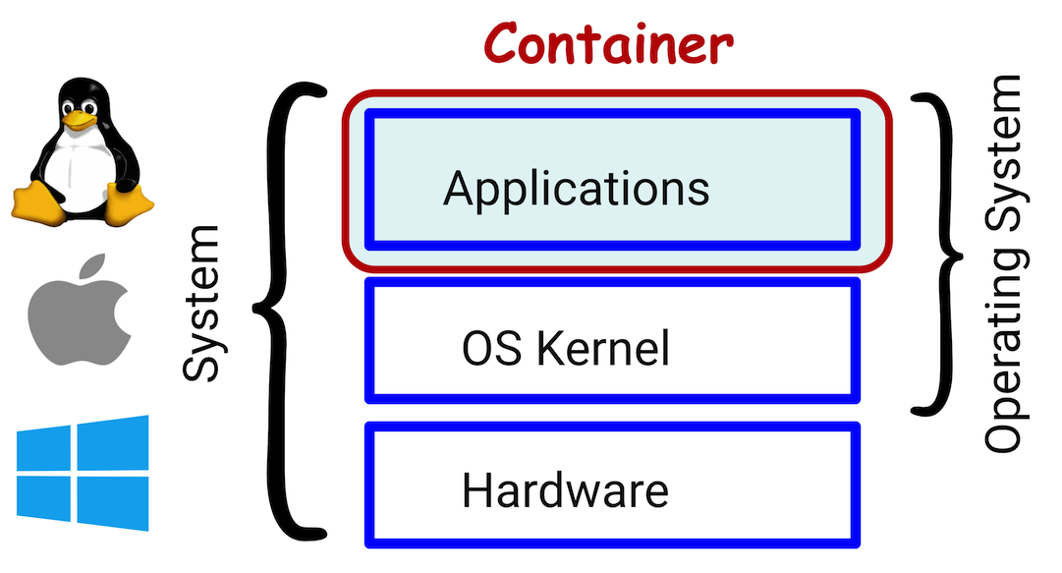
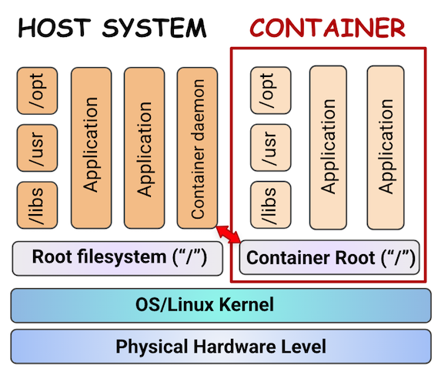
Software Containers as a Possible Solution
A software container packages an application (libraries) and all its dependencies into a self-contained, standardized runtime environment
Highly portable: runs consistently across different systems and cloud platforms
Highly reproducible: the same image behaves the same way everywhere, improving confidence in results
Lightweight compared to VM: shares the host's OS kernel rather than emulating separate hardware - isolation with less overhead
Docker is the dominant container software across the broader ecosystem:
  requires root/elevated privileges — a security concern on shared HPC systems
  targets lightweight microservices (e.g., handles one specific function, runs independently)
Singularity/Apptainer software developed to address HPC system needs:
  runs without requiring elevated (root) privileges — viable for shared HPC systems
  demonstrated stronger success integrating with multi-node host environments
Notes:
Spoken Material
So how does NOAA-EPIC address this? The answer is containers.
So what exactly is a container? At its core, a software container packages an application — or a set of libraries — and all of its dependencies into a self-contained, standardized runtime environment.
This gives you two major properties. First, portability: the same container image runs consistently across different systems and cloud platforms. Second, reproducibility: that same image behaves the same way everywhere it runs, which improves confidence that your results are consistent no matter where the job executes.
Containers are also lightweight compared to full virtual machines. Instead of emulating separate hardware and running an entirely separate operating system, a container shares the host system's OS kernel — so you still get isolation at the application level, just with a lot less overhead.
Docker — it's the dominant container software across the broader industry ecosystem. But Docker comes with two things worth flagging here.
First, it typically requires root, or elevated, privileges to build and run — which raises real security concerns on shared HPC systems, where you don't want individual users operating with that level of access.
Second, Docker is designed around lightweight microservices — think of an application broken into many small pieces, each handling one specific function and running independently. That model fits web and cloud-native applications well, but it's a poor match for a large, tightly-coupled scientific application like the UFS Weather Model.
That's exactly why Singularity and Apptainer were developed — purpose-built to address HPC system needs. They run without requiring elevated privileges, which makes them viable for shared, multi-user HPC systems. And in practice, they've demonstrated stronger success integrating into multi-node environments — which, as we'll see next, matters a lot once MPI enters the picture.
NOAA-EPIC has built two parallel container tracks to support this. The first is based on GNU compilers and the Open MPI library, with all the pre-built spack-stack dependencies needed to run the UFS Weather Model and its applications already baked in. Because everything here is fully open-source, these containers can be publicly distributed — anyone, anywhere, can pull them down and start running the model.
In parallel, EPIC has also built container environments using Intel compilers and Intel MPI — which offer performance characteristics that are especially familiar and valuable to many Tier 1 HPC users.
But this Intel track comes with an important constraint, which I want to walk through next."
(transition into next slide: licensing restrictions on Intel-based containers)

Slide 5
A Container Strategy: GNU and Intel Builds
Two container sets built by EPIC, both supporting the version of the current UFS WM
Built as Docker images, hosted on DockerHub (noaaepic)
Convert seamlessly to Singularity/Apptainer
spack-stack (v 1.9.2) pre-built inside — ready to build/run UFS WM pulled from the authoritative repo
1. GNU-based containers (open-source)
GNU compiler suite + Open MPI
  GNU 13.3.1 + Open MPI 4.1.6
  GNU 13.3.1 + Open MPI 5.0.7
GNU version is chosen to align with the currently supported version in UFS WM
Open MPI versions chosen to address different host MPI/scheduler environments
2. Intel-based containers
Intel OneAPI 2024.2.1 + bundled MPI, from Intel's public Docker repo (intel/hpckit:2024.2.1-0-devel-rockylinux9)
Constraint: Intel EULA prohibits redistributing containers with Intel compilers/MPI. Solutions:
  NOAA RDHPCs with licensed Intel compilers: stage fully capable containers with compilers locally
  Community platforms: alternative workaround suggested to build the fully capable spack-stack container with the compilers/MPI for community use
Notes:
NOAA-EPIC has built two container sets, both supporting the current version of UFS WM. Both are Docker images hosted on DockerHub under noaaepic, and both convert seamlessly to Singularity or Apptainer. spack-stack — version 1.9.2 — is pre-built inside, so users can use the container to build and run UFS WM pulled from the authoritative repo.
The first set is GNU-based and fully open-source: GNU compiler suite plus Open MPI. We've built two versions — GNU 13.3.1 with Open MPI 4.1.6, and with 5.0.7. GNU matches the version currently supported in UFS WM; the two Open MPI versions address different host MPI and scheduler environments.
The second set is Intel-based: OneAPI 2024.2.1 with its bundled MPI, built from Intel's own public Docker repository.

Slide 6
Community Workaround:
Rebuilding with Intel Compilers/MPI
Concept: Layer Intel's public runtime onto the spack-stack container, built locally by the user — no Intel software ever redistributed by EPIC. Steps:
Build a writable sandbox from NOAA-EPIC Docker Intel-based spack-stack (--fix-perms, --fakeroot)
NOTE: Helper scripts for the next steps are included in the EPIC spack-stack container
Build a separate sandbox with Intel OneAPI compilers/MPI, pulled from Intel's public Docker repo
Copy the Intel software (compilers, MPI, MKL, other libraries) from the Intel sandbox into the EPIC’s spack-stack sandbox
Convert the combined sandbox back into a *.sif image (--fix-perms) for production use
Result: A fully capable Intel-based container, assembled locally — compliant with Intel's EULA since EPIC never redistributes Intel software.
Notes:
How does the community get a fully capable Intel container despite the licensing constraint? The approach: assemble it locally from two independently-pulled pieces.
The user pulls EPIC's Intel-based spack-stack container — optional, since they could start from scratch — and builds a writable sandbox from it, using --fix-perms and --fakeroot, no root needed.
Separately, they build a second sandbox with Intel's OneAPI compilers and MPI, pulled from Intel's own public Docker repo.
The key step: Intel software — compilers, MPI, MKL, other libraries — gets copied from that sandbox into the EPIC writable spack-stack sandbox.
Finally, the combined sandbox converts back into a .sif image for production use.
Result: a fully capable Intel container, assembled locally. EPIC never redistributes Intel software directly — which keeps this compliant with Intel's EULA."

Slide 7
Intel Container: The Workaround in Practice
# Step 1 — Build a writable sandbox from the spack-stack container (Docker noaaepic repo, or locally present image)
singularity build --sandbox --fix-perms --fakeroot spackstack_sandbox/ docker://noaaepic/rocky9-oneapi2024.2-spack-stack:v19.2-ufs-wm-env
# Step 2— Build a separate sandbox with Intel OneAPI compilers/MPI from a Docker repository
singularity build --sandbox --fix-perms --fakeroot intel_sandbox/ docker://intel/hpckit:2024.2.1-0-devel-rockylinux9
# Step 3 — Copy Intel software (compilers, MPI, MKL, libs) into the spack-stack sandbox
# stage locally a helper script that copies necessary directories with Intel software:
singularity exec spackstack_sandbox/ cp /opt/compilers_cp.sh .
./compilers_cp.sh intel-sandbox spackstack_sandbox
# Step 4— Convert the combined sandbox back into a production .sif image
singularity build <-B -bind-dir> --fix-perms rocky9-oneapi2024.2-ss192.sif spackstack_sandbox/
Notes:
Let's walk through the actual commands.
Step one: build a writable sandbox directly from the spack-stack container in the NOAA-EPIC Docker repo — or from a locally present image — using --fix-perms and --fakeroot, so no root privileges are needed.
Step two: build a separate sandbox from Intel's own public Docker repository, containing the OneAPI compilers and MPI.
Step three is the key step: shell into the spack-stack sandbox in writable mode, binding in the directories needed, and copy the Intel software — compilers, MPI, MKL, and other libraries — from the Intel sandbox into it.
Step four: convert the combined sandbox back into a standard .sif image, ready for production use.
The result: a fully capable Intel-based container, assembled locally from software pulled directly from EPIC and from Intel.

Slide 8
Pulling the EPIC Container Images from Docker Repos
# GNU-based container — GNU 13.3.1 + Open MPI 4.1.6
singularity build rocky9-gnu13-ompi416.sif docker://noaaepic/rocky9-gnu:13.3.1-ompi416
# GNU-based container — GNU 13.3.1 + Open MPI 5.0.7
singularity build rocky9-gnu13-ompi507.sif docker://noaaepic/rocky9-gnu:13.3.1-ompi507
# Intel-based container — OneAPI 2024.2 + spack-stack v1.9.2
singularity build rocky9-oneapi2024.2-ss192.sif docker://noaaepic/rocky9-oneapi2024.2-spack-stack:v19.2-ufs-wm-env
Notes:
Here are the actual commands to pull EPIC's container images, using singularity build / pull, which converts the Docker image directly into a production-ready .sif file.
Two GNU-based containers — one with Open MPI 4.1.6, one with Open MPI 5.0.7 — both from the noaaepic Docker repo. And the Intel-based container, built on OneAPI 2024.2 with spack-stack version 1.9.2, from that same repo.
Each of these is ready to use immediately — spack-stack is already built inside, so a user can pull one of these images and go straight to building and running UFS WM.

Slide 9
A Cleaner Path for Community Testing and Debugging
Production CI/CD (PR-triggered) runs through rt.sh + rt.conf + supporting tests/ scripts
community.sh follows the same workflow, with its own community.conf (custom container/community platform configurations, machine-specific data paths, etc.)
Kept separate — rt.sh remains insulated from container/community-platform complexity
Still reuses some supporting scripts in tests/ and fv3_conf (e.g., job templates)
Containers require two separate sets of modulefiles:
  host-side (to start the container instance)
  inside-container (spack-stack libraries, used once running)
Runs sequentially: compile all required configs → run tests consecutively (no Rocoto/ECFlow)
Result: simpler script for community debugging and portability testing
PR currently open for review (so still work-in-progress, feel free to comment!):
https://github.com/ufs-community/ufs-weather-model/pull/3268
Notes:
So how does this fit into the existing UFS WM testing framework?
Production CI/CD — triggered on every pull request — runs through rt.sh, rt.conf, and supporting scripts in tests.
community.sh follows that same overall workflow, but uses its own community.conf — where users specify custom container or community-platform configurations, along with machine-specific data paths.
Importantly, the two are kept separate: rt.sh remains insulated from container and community-platform complexity. That said, community.sh isn't built from scratch — it still reuses some of the same supporting scripts in tests and fv3_conf, like job templates.
One important wrinkle specific to containers: they require two separate sets of modulefiles — one on the host side, to start the container instance itself, and another inside the container, for the spack-stack libraries used once it's actually running.
The workflow runs sequentially: it compiles all the required configurations, then runs their tests one after another — no Rocoto or ECFlow involved.
The result is a simpler script — well suited for community debugging and platform-portability testing.
This work is captured in an open pull request, currently under review, linked here for anyone who wants to follow along or try it out.

Slide 10




Container testing for UFS WM standard tests (from RTs)
Container testing has been done on all the NOAA Tier 1 RDHPC platforms(*) with the following containers (Intel-based or/and GNU-based):
  Ursa
  Gaea-c6
  Hercules
  Orion
  NOAA Cloud AWS
  NOAA Cloud Azure
  Derecho (**)
Tested 25 built UFS WM configurations and ~51 tests (specified in community.conf)
Intel containers: all tests successful
GNU containers:
  fail to build for the following configs (untested compiler pairing):
  atmaero, datm_cdeps_land, hafsw, hafs_mom6w
  failing at runtime for the following tests (untested compiler for the tests?)
  cpld_debug_gefs, cpld_dcp_gefs, cpld_control_gefs
(*) (hosen for availability, serving as a proxy for community (non-Tier 1) platforms
(**) Derecho - more work on PBS scheduler integration is needed; currently not included in the PR https://github.com/ufs-community/ufs-weather-model/pull/3268
Notes:
Let's look at actual testing results.
Container testing has been carried out on all NOAA Tier 1 RDHPC platforms — Ursa, Gaea-C6, Hercules, Orion, and both NOAA Cloud AWS and Azure — using both Intel-based and GNU-based containers. These Tier 1 systems were chosen partly for their availability, and they serve as a useful proxy for how community, non-Tier 1 platforms might behave.
Derecho is the one exception — tested only with the GNU container so far. Integrating with Derecho's PBS scheduler needs more work, so it isn't included in the current pull request yet.
In terms of scope: we've tested 25 built UFS WM configurations, covering roughly 51 individual tests, all specified in community.conf.
Now, it's not all successful yet — and it's important to be transparent about that. On the GNU side, four configurations currently fail to build: atmaero, datm_cdeps_land, hafsw, and hafs_mom6w. And three additional tests fail at runtime, even though their executable — fv3.exe — builds successfully: cpld_debug_gefs_gnu, cpld_dcp_gefs_gnu, and cpld_control_gefs_gnu.
These remaining issues are actively being worked, and the goal is to close this gap as the pull request matures

Slide 11
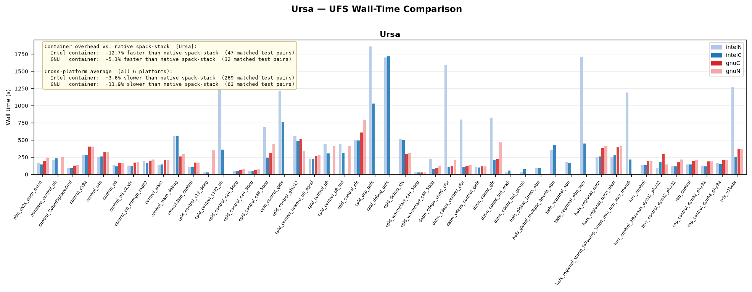
Container Testing on Different Platforms: Ursa

Slide 12
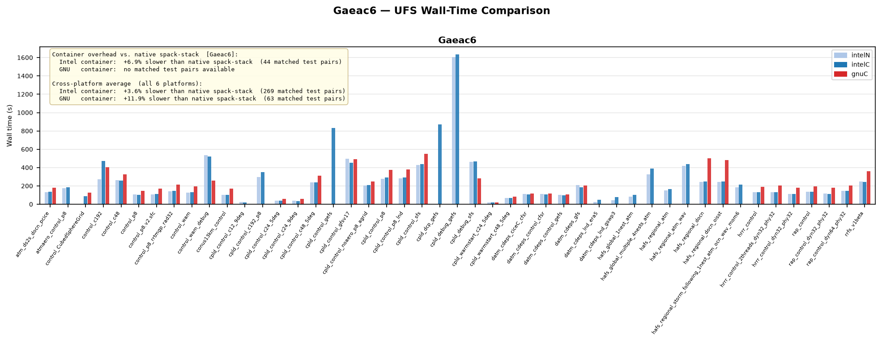
Container Testing on Different Platforms: Gaea c6 (GFDL)

Slide 13
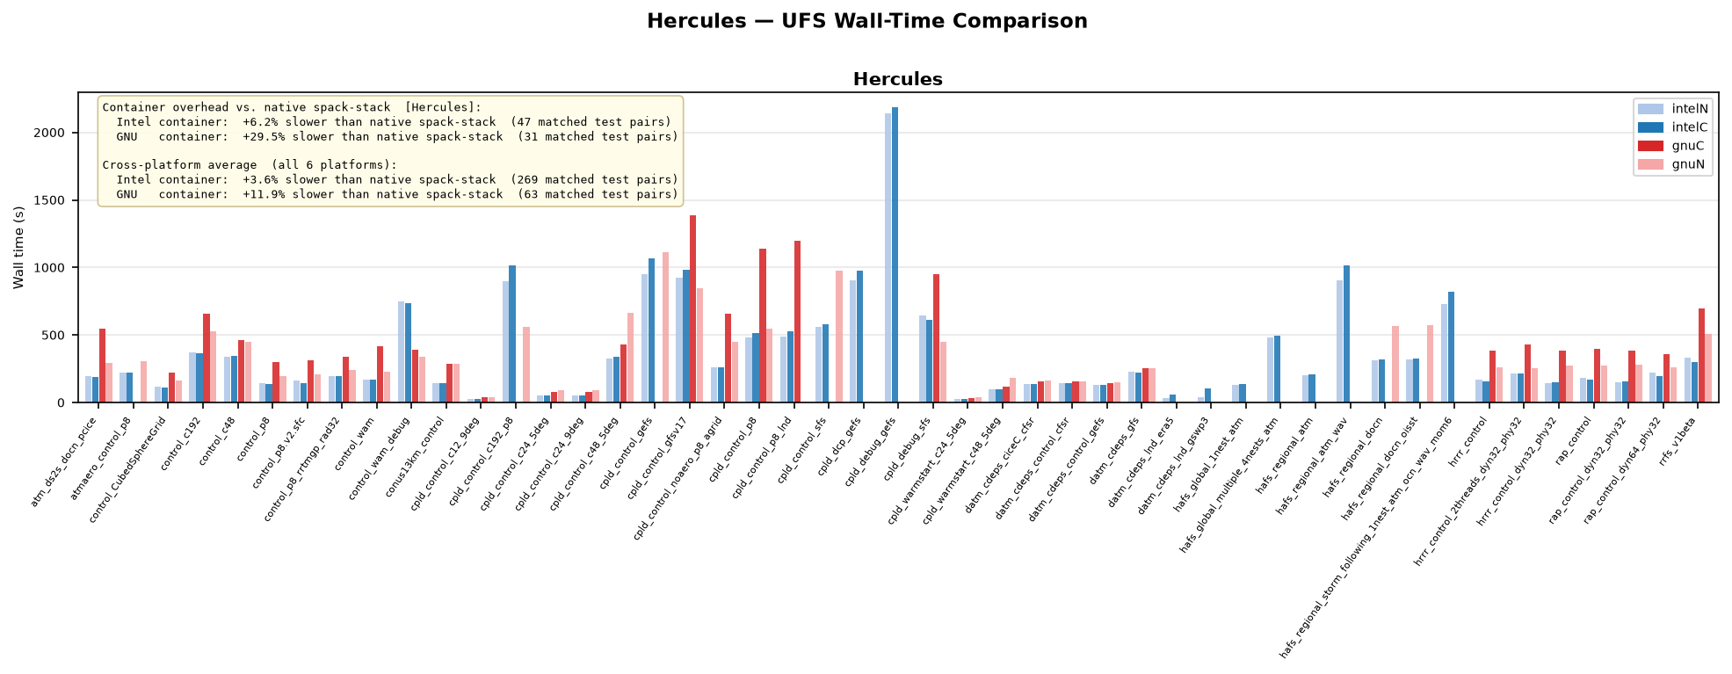
Container Testing on Different Platforms: Hercules (MSU)

Slide 14
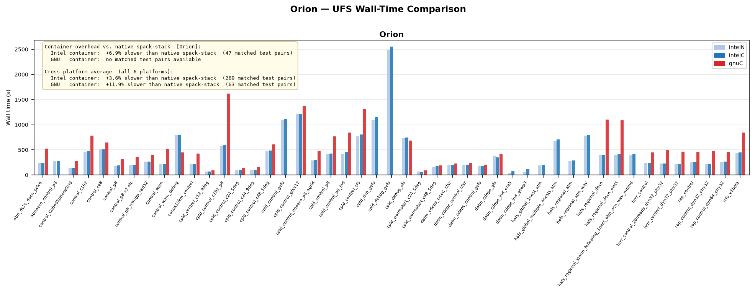
Container Testing on Different Platforms: Orion (MSU)

Slide 15
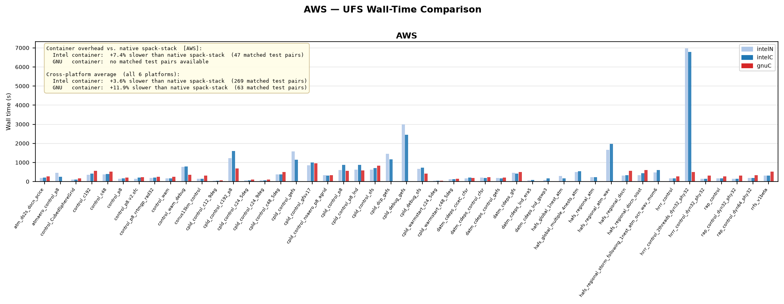
Container Testing on Different Platforms: NOAA Cloud AWS

Slide 16
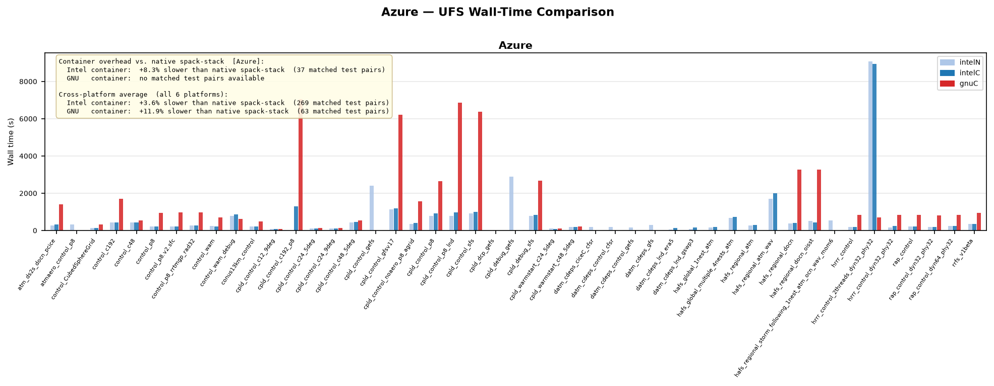
Container Testing on Different Platforms: NOAA Cloud Azure

Slide 17
Summary & Path Forward
Containers make the UFS Weather Model portable across HPC and cloud platforms — GNU-based images are fully open and ready today
Intel-based containers offer performance benefits, but licensing constraints require either native RDHPC staging or a locally-assembled workaround
community.sh gives contributors a simpler, self-contained path to build/run/debug — without burdening the production rt.sh CI/CD pipeline. PR is still open for the comments!!
https://github.com/ufs-community/ufs-weather-model/pull/3268
Testing across all Tier 1 platforms (as proxy to community platforms) shows strong results: Intel containers fully passing; a small set of GNU issues remain and are being addressed
Wall-time comparisons show containerized runs performing competitively with native software stacks
Net result: a practical, lower-barrier path for the broader community to build, test, and contribute to UFS WM — advancing the project's core community-driven mission

Slide 18
Containerized MPI Hello-World Example
Build and run a simple MPI “hello-world” test program from a noaaepic Docker test container, on systems with Slurm job manager built with PMI2 support(*). Singularity or Apptainer is needed on the host.
1. Create the container image (Singularity of Apptainer software needed on t:
singularity pull rocky9-gnu13-ompi416.sif docker://noaaepic/rocky9-gnu:13.3.1-ompi416
2. Copy the test directory from the image
singularity exec rocky9-gnu13-ompi416.sif cp -r /opt/mpi-tests .
3. Follow the local instructions in
./mpi-tests/README.md
(*) PMI2 check, verify that pmi2 appears in the list:
srun --mpi=list

Slide 19
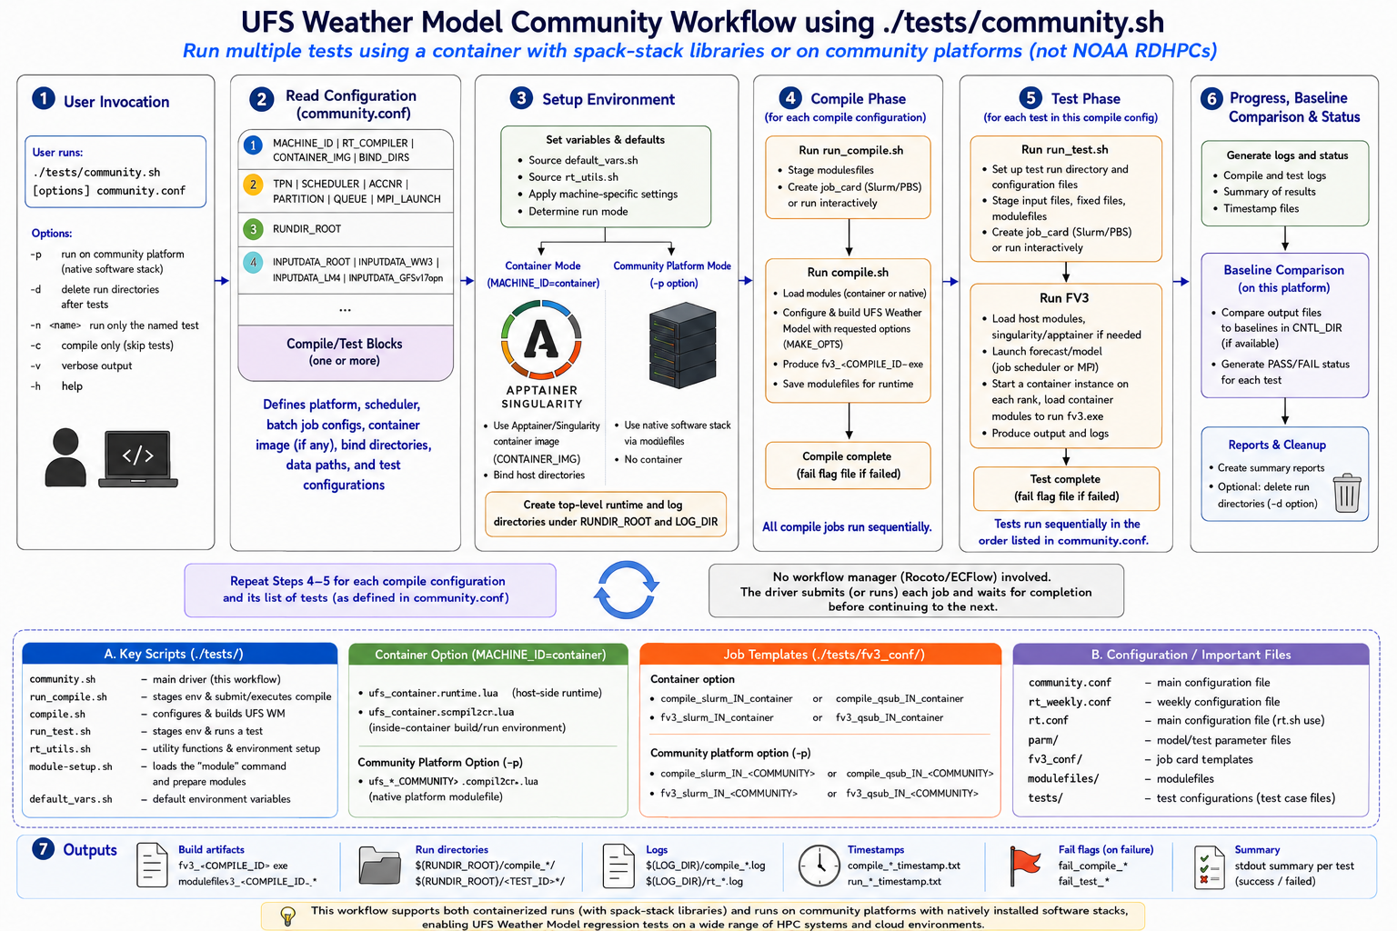

Slide 20
