Slide 1


Developing WAVEWATCH IV TM to enable exascale wind wave modeling
Dr. Ir. Hendrik L. Tolman
NOAA / National Weather Service

Slide 2

Where it started …
Experience with community modeling (based on WAVEATCH III)
Tolman, H. L., 2026: What makes a successful community model for research and operations? Lessons learned from WAVEWATCH III ®. BAMS, 107, E932-E954, DOI: 10.1175/BAMS-D-24-0223.1
2

Slide 3


Where it started …
The need for software modernization
Tolman, H. L., 2025: Software modernization for the UFS: A position paper. NOAA report, DOI: 10.25923/gfbx-pk53.
Tolman, H. L., and J. Meixner, 2025: Integrated Wind Wave Modeling at NWS, NOAA NCEP Office Note 524, 32 pp. + Appendices, DOI: 10.25923/jzks-6g74.
3

Slide 4


Focus on wind waves
Applying this to WAVEWATCH
Tolman, H. L., 2025: The WAVEWATCH III ® Software Modernization Project: Phase I report, NOAA NCEP Office Note 525, 30 pp. + Appendices, DOI: 10.25923/h7j3-1h25.
Tolman, H. L., 2026: The WAVEWATCH IV TM Project: Phase II report, NOAA NCEP Office Note 528, scheduled to be published end of May, DOI: 10.25923/0wyp-9f39
.
4

Slide 5
Phases and team
Member | Representing | Role / Expertise
Hendrik Tolman | NOAA / STI | Lead (NWS)
Jessica Meixner | NOAA / EMC | Wave team lead
Jacob Carley | NOAA / EMC | Chief, Engineering & Implementation Branch
Steven Earle | NOAA / NCO | Sanity check for operational viability at NOAA
Andrew ‘Kit’ Stokes | UK Met Office | Wave modeling lead, WW3 in operations
Fabrice Ardhuin | IFREMER | Long time WW3 team member, IOWEGA
Arun Chawla | tomorrow.io | User/developer/code manager with a history in government and industry.
Aron Roland | Oceanwaves Technology j.d.o.o. | Unstructured grid development for WAM/WWM/WW3, C++ wave model development TRITON-C. SCHISM-WWM coupling
Pieter Smit | SoFar Ocean | US WW3 user/developer (industry)
Erick Rogers | US Navy / NRL | Long time WW3 contributor
Chris Massey | USACE | Leading software modernization efforts
Steven Brus | DoE | Wave modeling focus in DOE
Alexander Babanin | Univ. Mebourne | Long time WW3 contributor.
Phase |  | Topic | Developer | open-source | Open Science | Notes
I |  | Initial choices | Core team | N/A | No | Phase I report
II | a | First language test | Tolman | No | No | Phase II report
 | b | Set up governance | NOAA | Yes | N/A
 | c | Core code design | Core team | N/A
III |  | Core code dev. / design | Tolman → Core Team | Yes | starting | Started
IV |  | Initial Model Capability | community | Yes | Yes | May be adjusted
V |  | Initial Operational Capability | community | Yes | Yes
VI |  | Complete first “full” code | community | Yes | Yes
5

Slide 6
Phase I big Picture
Develop WAVEWATCH IV (WW4) instead of modernizing WAVEWATCH III
Community buy-in from core co-developers
Clean up obsolescent code and fragmented tools
Focus of discussion:
Choosing the language (from Fortran to C++ for now)
Setting up the environment (initial discussions on repository)
6

Slide 7


Phase II big Picture
Not just a focus on writing code
IP protection in a community modeling effort
    https://github.com/NOAA-EMC/WW4, intent.md, license.md, contributors.md, and trademark.md
Set up ”governance” from the start
    Using wiki, discussions, projects GitHub features
    Define ownership (see wiki), CMB still TBD
    linting, coding standards, unit testing in GitHub workflow
    Start Doxygen documentation (tagging only or now)
7

Slide 8
Phase II big Picture
Design Principles: modular software, low coupling and high cohesion functions, separation of the core code from the solvers
Domain Focus: WW4 will be based on domain decomposition
Spatial Grids: Adopt the NetCDF-UGRID standard for grid representation
Data structures: Explore Kokkos for data abstraction to enable performance portability (CPU, GPU etc.)
Simplification:
    Reduce number of tools and options (no more switches)
    Reduce number of file types (NetCDF, YAML, Zarr only?)
8

Slide 9
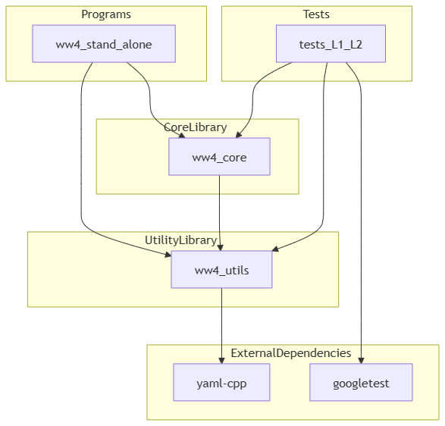
Phase III progress
WW3 inventory
250K lines of code and documentation
16 (!) programs
Only need 5 or even less!
Tentative core WW4 design
Clean decoupled code
YAML user input
100% unit testing (130+ so far)
.
Type of code: | 1K Lines
Total number of lines (just over 40% code, rest is documentation) | 245
Core model code (logic, timestepping, in- and output) | 55
Code that could be dropped (e.g., duplication, Fortran specific) | 80
Numerical solvers and physics | 70
Coupling code and institute specific code | 40
9

Slide 10
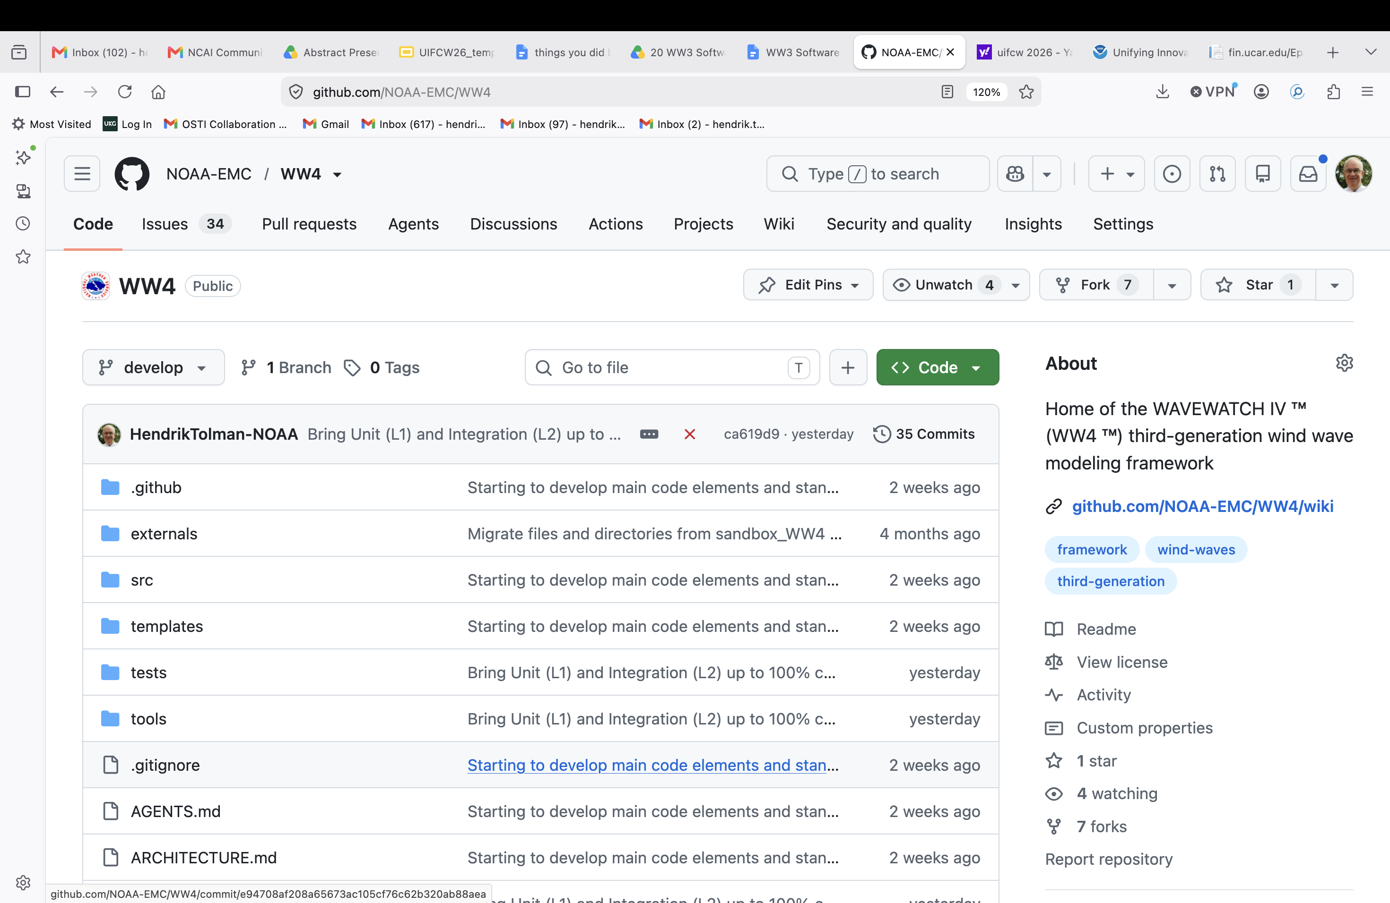
.
10

Slide 11

XXXXXX
Questions?
11

