Slide 1
NOAA’s Seasonal Forecast System (SFS) Project:
Progress, Challenges, and Stakeholder Engagement
Yan Xue¹, Neil Barton¹, Phil Pegion², Xiaqiong (Kate) Zhou¹, Wanqiu Wang³4, Fanglin Yang¹, Steven Simon^{1,5}, Kevin Garrett¹, Daryl Kleist¹, Sergey Frolov², Mark Olsen⁴, John Ten Hoeve⁴
1 NWS/Office of Modeling and Development (OMD)
2 OAR/PSL
3 NWS/NCEP/WPC
4 OAR/WPO
5 IBSS Corporation

Slide 2
Project Overview & Goals
Building the future of NOAA’s Seasonal Forecasting

Slide 3
Mission: Replacing the Legacy CFSv2
CFSv2
The Solution: SFSv1
Operational since 2011
Aging software architecture
Model deficiencies:
  Poor MJO propagation
  False ENSO alarms
  SST trend biases
  Poor precipitation skill
Fully coupled UFS
Modern physics
Cloud-ready
AI-ready
Operation future: Implementation on Cloud-based WCOSS3 by Dec 2027

Slide 4
SFS Project
Task Teams
Four-way coupled Earth system model:
  FV3/CCPP (50km)
  Noah-MP land (50km)
  MOM6 ocean (25km)
  CICE6 sea ice (25km)
Atmos physics
Infrastructure & coupling
DA & reanalysis
Evaluation & products
Sponsors: NWS and OAR
Budget: $6.5M in FY23-24, $3M in FY25
SFS Application Team (AT): OMD, PSL, GSL, WPC, DTC, Academia partners
SFS AT Co-Leads:
Neil Barton (NWS)
Phil Pegion (OAR)
Xiaqiong Zhou (NWS)

Slide 5
Current Progress: SFS Beta

Slide 6

SFS Beta v1.0 Launch (Mar 2026)
SFS Beta consistently outperforms CFSv2 for
Near Real-Time deployment (6th day of each month)
Monthly forecasts to 12 months
On-the-fly reforecasts (1991–2025)
Data available on AWS/NODD
Used experimentally by NCEP/WPC
see details in Wanqiu Wang’s presentation
SFS Beta Data Here
User feedback and collaboration are welcome!

Slide 7
Remaining Challenges
Operation Timeline
Initial Condition Development
Target implementation on WCOSS3 in FY28 Q1
Completion of 35 years (1991-2025) reforecast
Development of initial conditions
Refinement of physics
Refinement of individual model component (land, sea ice, ocean)
Refinement of ensemble spread
SFS coupled reanalysis not ready for implementation
35 years replay to ERA5 atmosphere, GLORe ocean and sea ice, land spin-up → reforecast I.C.
Replay to GFSv17 operational analysis → real-time I.C.
Adjust climatology
as needed

Slide 8
SFS Coupled Reanalysis & SFS v1.x
Goal: Generate NOAA first coupled reanalysis that ensures reforecast to be more consistent with operational forecast and therefore improve forecast consistency and accuracy
DA Method:
  Atmosphere: 3DVar (compare to hybrid 4DEnVar for GFSv17)
  Ocean/Sea ice: JEDI-based Sea-ice Ocean and Coupled Analysis (SOCA)
  Land: JEDI 2DVar snow
Observations: NOAA NASA Joint Archive (NNJA)
Reanalysis & reforecast: 35 years (1991-2025)
Operation potential: Contribution to SFS v1.x upgrade

Slide 9
Stakeholder Impacts

Slide 10
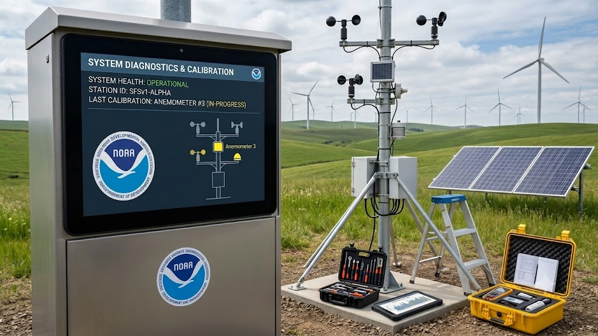
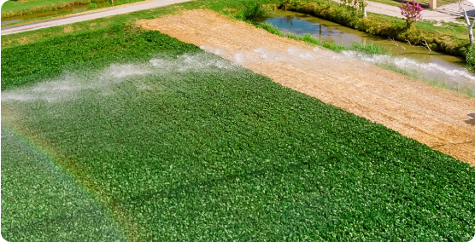

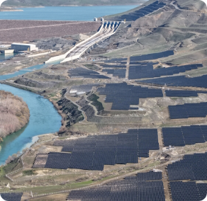
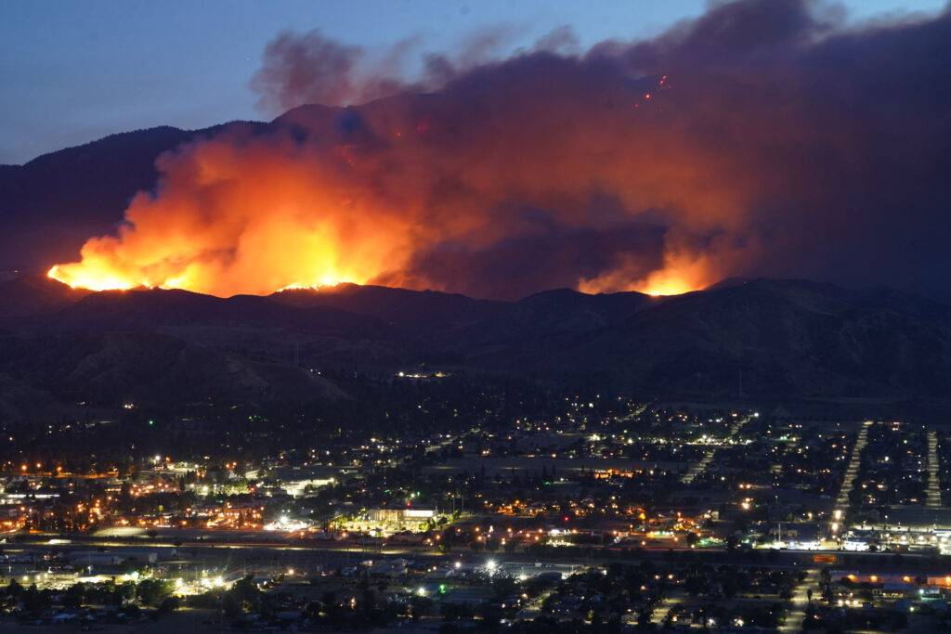
Active End-Users
Sector | Applications & Data Use
Energy | Offshore winds, wind/solar resource, heating/cooling degree days.
Agriculture | Crop yield forecasting, soil moisture monitoring (gridMET).
Water Management | USACE FIRO, reservoir operations, NWS river forecast centers.
Emergency Mgmt | Hurricane and wildfire risk pre-positioning.

Slide 11
Addressing CFSv2/CFSR Retirement
Cadence Shift: CFSv2 (16x/day) → SFSv1 (Monthly) Subseasonal users must migrate to GEFSv12.
Migration Pathways: Directing CFSR users to ERA5-T (5-day latency) or JRA-3Q for climate applications and GFSv17 operational analysis for real-time applications
Open Access: Data available via AWS (NOAA NODD) to ensure technical debt reduction.
Support: Structured transition window for NWS centers, NIDIS, FEWS NET, USACE, and Bureau of Reclamation mid-term modeling.
Replacing CFSv2 requires coordinated transition of an entire ecosystem of operational and research applications!

Slide 12
Summary
SFSv1 is NOAA's next-generation seasonal prediction system, as replacement of the legacy model CFSv2.
SFS Beta in near real-time, launched in Mar 2026, demonstrates encouraging forecast improvements over CFSv2.
Transition from CFSv2 requires coordination across many operational users.
Community evaluation and feedback are critical!

Slide 13

Questions?
Yan.Xue@noaa.gov
Visit the SFS Project Webpage
for more updates

