Slide 1
Practical Strategies for Initialization of the Seasonal Forecast System
Philip Pegion - NOAA/Physical Science Laboratory
Shan Sun - Global Systems Laboratory
Neil Barton - Office of Modeling and Development
Wanqiu Wang - Weather Prediction Center
Fanglin Yang-- Office of Modeling and Development

Slide 2
Introduction
Due to model errors and small signals at timescales beyond weather, a set of retrospective forecasts (re-forecasts) are necessary to bias-correct and calibrate the raw model output in order to make forecasts useful.
The challenge is to create a suite of reforecasts that are consistent with the operational system.
The current operational seasonal system, CFSv2, took the approach of implementing a real time component of the CFS-Reanalysis. This has faced its own challenges due to the longevity of the operational system.

Slide 3
The challenge
The Seasonal Forecast system will be initialized off of the GFSv17 operational analysis when it is implemented in 2027.
35 years of retrospective forecasts must begin this fall.
Currently, there are 2 methods to initialize reforecasts with for the SFS
A 3rd method will be introduced in this talk.

Slide 4
Comparison of initial conditions
 | GEFS replay | CPC initial conditions | GFSv17
Atmosphere resolution | 25 km/127 levels | 75 km/64 levels | 9 km/127 levels
Ocean Resolution | 0.25 degree | 1.0 degree | 0.25 degree
Atmosphere analysis | Replay to ERA5 | Conventional Observation Enkf | Full observing system hybrid 4D-En-Var
Ocean analysis | Replay to ORAS5 | JEDI 3D-var | JEDI 3D-var

Slide 5
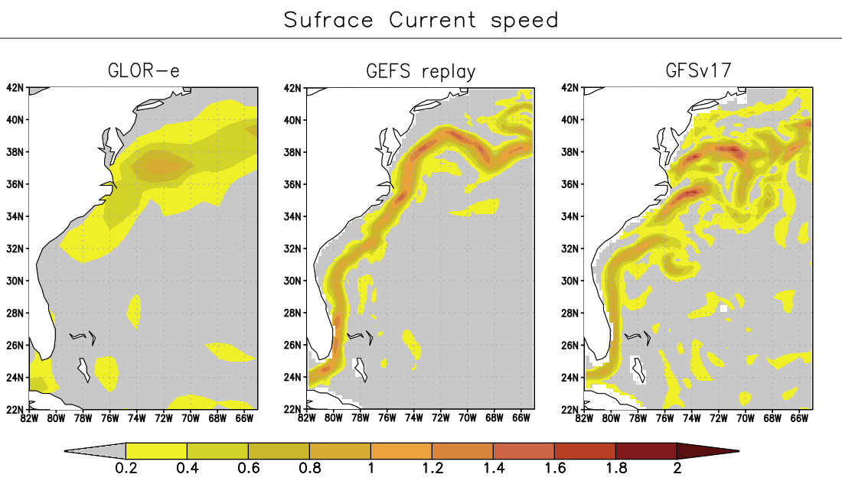
Speed of surface currents
The 1-degree GLORe analysis is missing the Gulf Stream

Slide 6
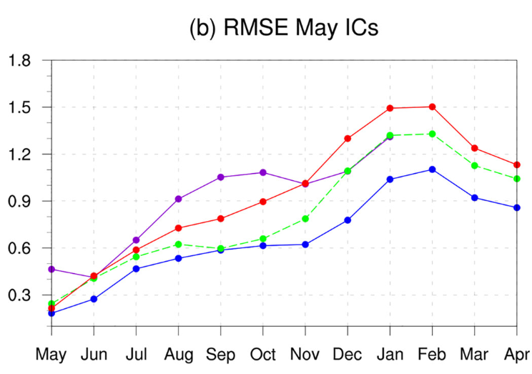
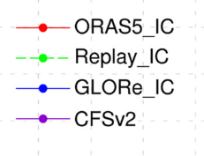
Motivation for new replay
Key finding in Importance of Ocean Initialization in ENSO Predictions: Accuracy Versus Consistency (Sun et. al 2025) is that the ENSO skill is highest when the forecast model is initialized with data that is consistent with the model’s own physics, even if the initial conditions are not as accurate.
These results were carried out with a 1-degree version of the SFS. Will these results hold at 0.25-degrees?

Slide 7
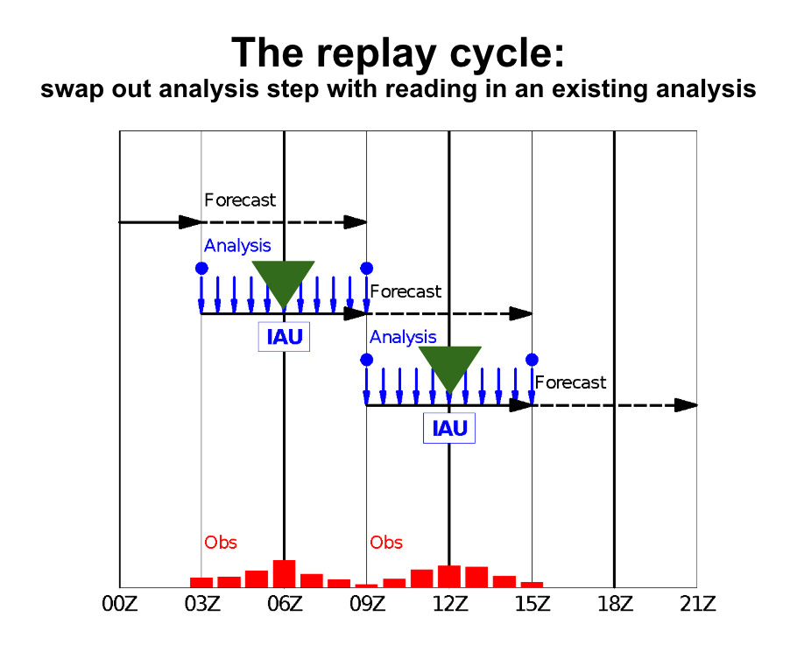
SFS replay for May 1st initial conditions
Start cycling with GEFS replay restart file at 6z on the 27th of April for each Year.
Replay temperature and salinity to GLORe, increment is calculated at 1-degree then interpolated to the 0.25-degree grid
Ocean currents are not constrained by GLORe
25% of the increment is applied every 6-hour cycle
Atmosphere is replayed to 1-degree ERA5 data.

Slide 8
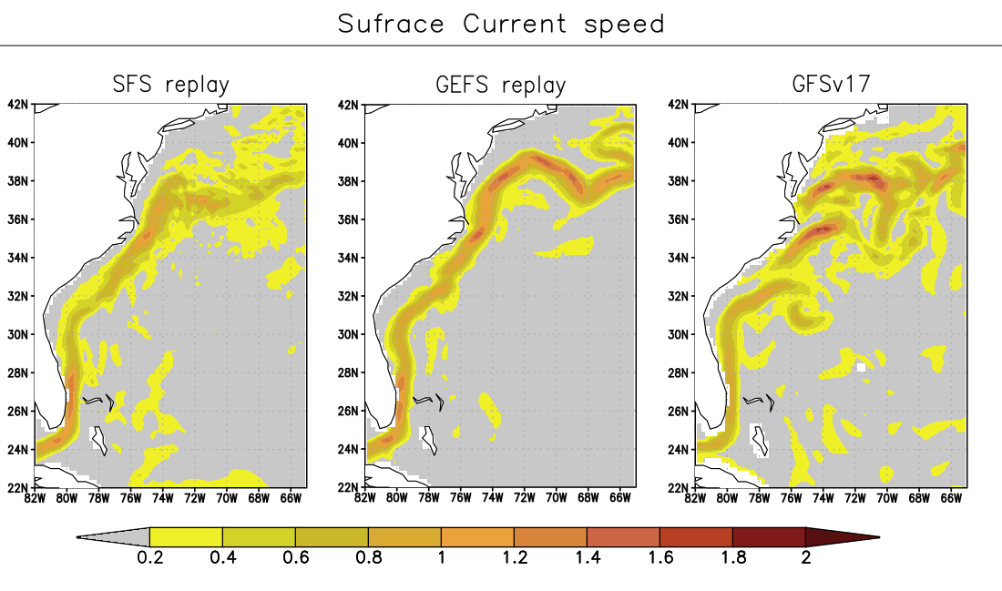
Speed of surface currents
The replay method preserved the currents from the higher resolution model

Slide 9
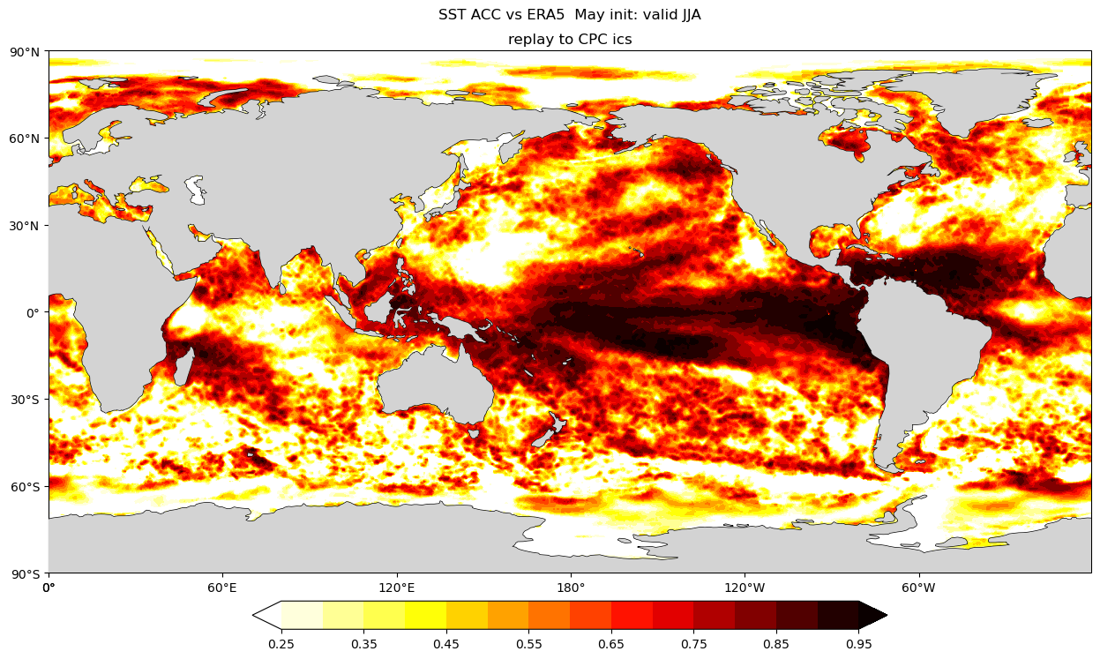
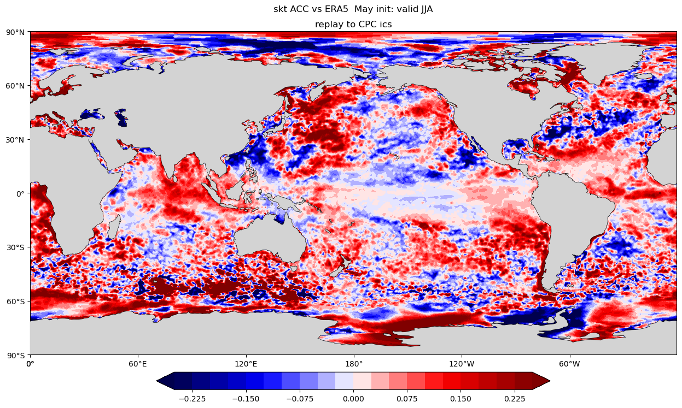
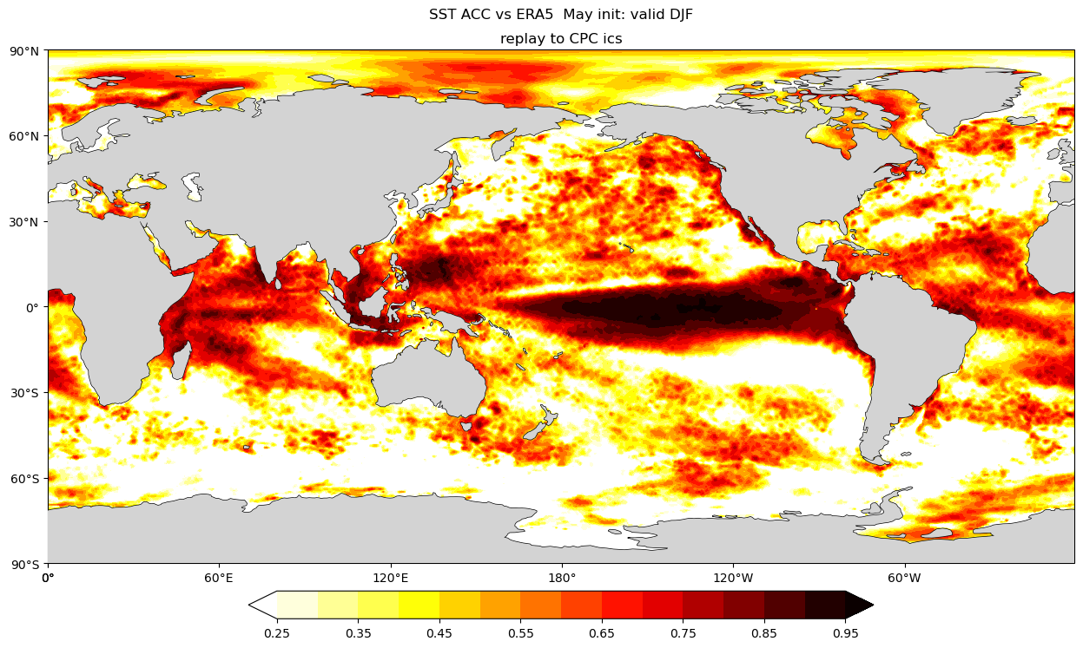
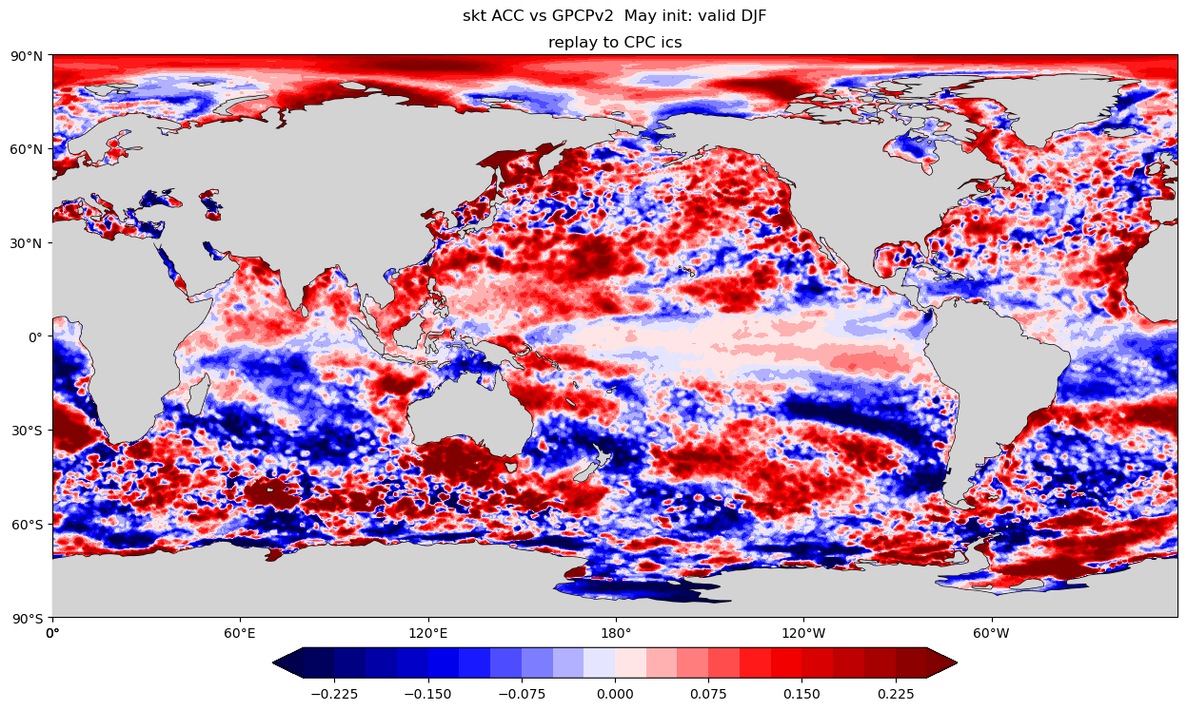
Reforecast Results
May 1st initializations
Seasonal Mean Anomaly Correlation
Change in anomaly correlation from SFS beta1
JJA
DJF

Slide 10
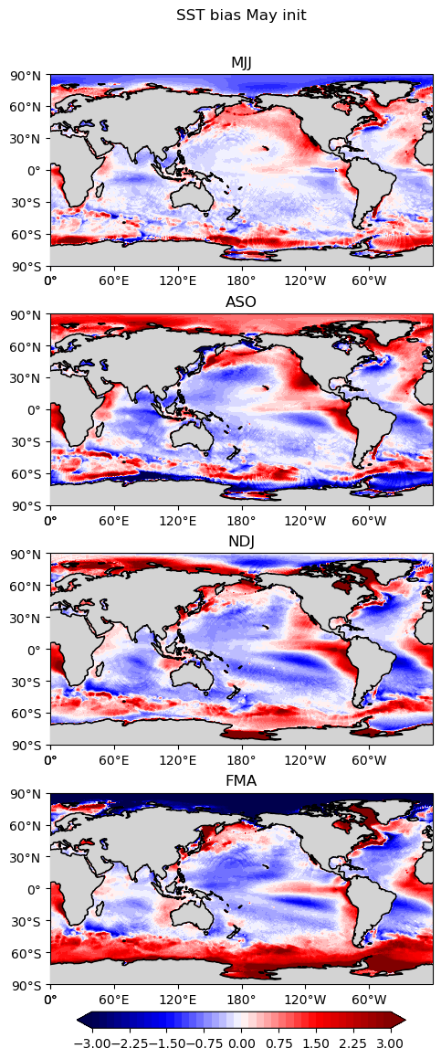
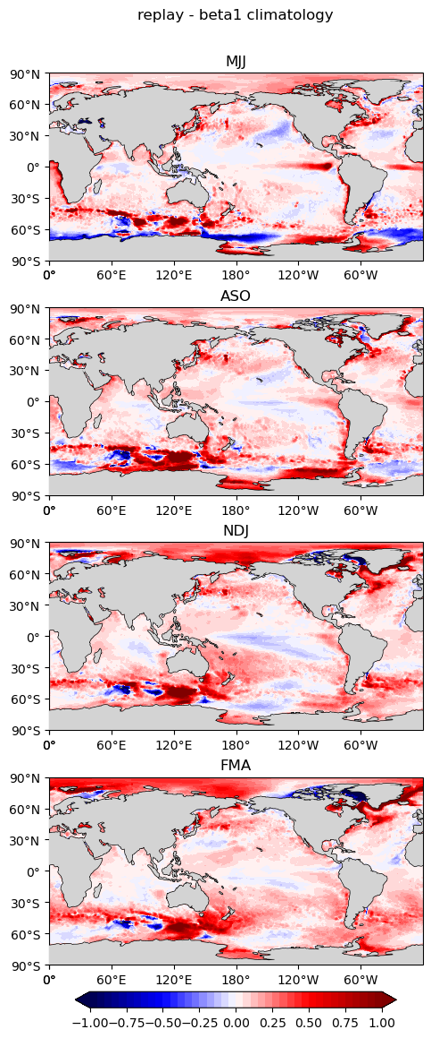
SST climatology
Beta1 - ERA5 Bias
Replay - Beta 1
Lead 0-2
SFS replay initialization has a different bias in the tropical eastern pacific in the early lead.
Overall, the reforecasts are warmer at longer leads
Lead 3-5
Lead 6-8
Lead 9-11

Slide 11
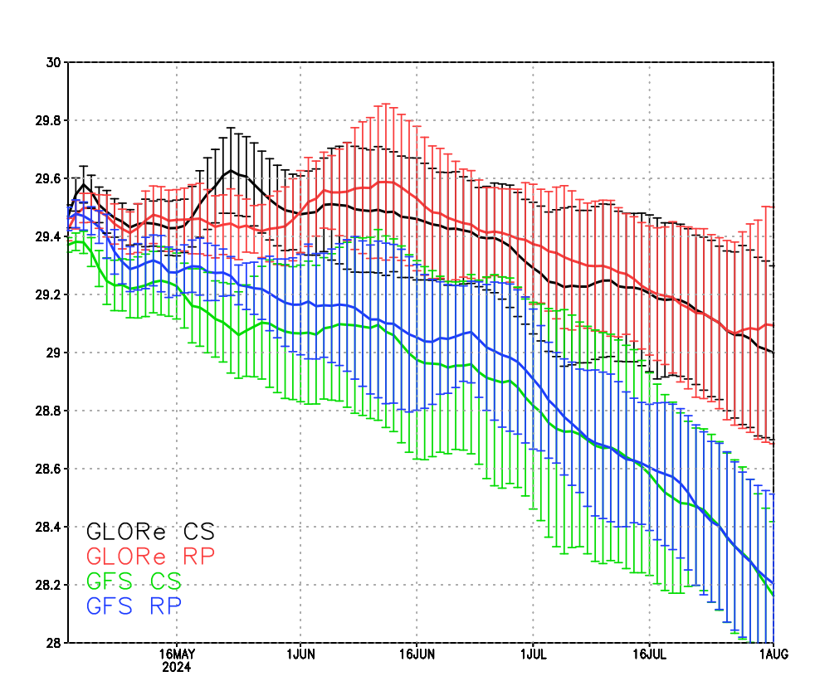
Next Steps
Building off the success of the SFS replay, we are now experimenting with replaying the SFS model to the GFSv17 analysis.
Initial tests show that the replay does not change the character of the forecasts much and more is needed to address the difference between the CPC analysis and the GFSv17 analysis.
We are extending the GFSv17 analysis back in time so we can compute a correction to the GFSv17 initial conditions that will make then more consistent with the reforecast initial conditions.
Daily NINO3.4 SST values

Slide 12
Conclusions
S2S forecasts face the challenge of generating a suite of retrospective reforecasts that are consistent with the real-time, operational forecasts
The replay methodology allows for an external analysis to gently nudge the forecast model, which reduces initialization shock/spin up.
Further testing with the GFSv17 analysis is needed to address the inconsistency of the CORe/GLORe reanalyses and the operational analysis.

