Slide 1



Improving land-atmosphere background error covariance estimation toward RRFS strongly coupled data assimilation
Aaron Johnson and Xuguang Wang
University of Oklahoma and Consortium for Advanced Data Assimilation Research and Education (CADRE)

Slide 2
Background and Motivation
Strongly Coupled Data Assimilation (SCDA) is expected to provide:
  Greater consistency between soil and atmosphere increments
  Improved analyses due to properly leveraging information from observations across both components.
Past SCDA efforts
Most widely studied for ocean-atmosphere:
Generally small cross-component correlations (e.g., Smith et al. 2017), stronger coupling in localized processes (e.g., Frolov et al. 2021)
Large ensemble sizes may be needed, and Gaspari-Cohn function may not be optimal for vertical localization (e.g., Stanley et al. 2024)
Mesoscale land-atmosphere SCDA has also been demonstrated with promising results (Lin and Pu 2018)
Issues related to sampling error have received much less attention than in ocean-atmosphere context
Convective-scale land-atmosphere SCDA has its own unique challenges
Short time scales of land-atmosphere interaction
Magnitudes and spatial structures of the coupled correlations at convective scales are not known
Localization parameters and ensemble size requirements are not known

Slide 3
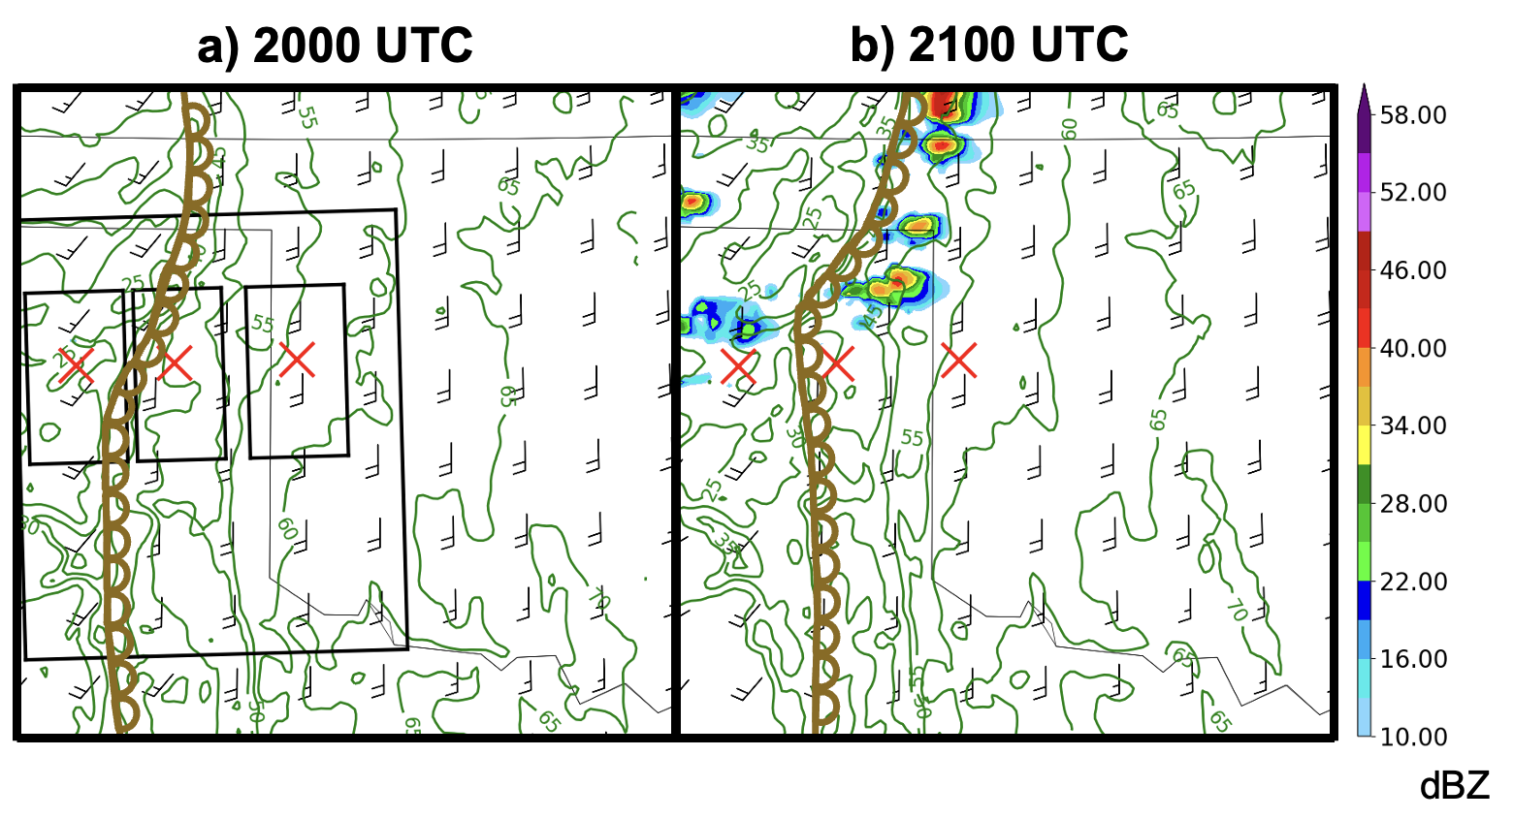
Case study overview and goals
MPAS forecast initialized from RAP analysis at 1200 UTC
Forecast Configuration
NOAA GSL MPAS version 8.2, 3 km grid spacing, RUC land surface model, TEMPO microphysics, MYNN-EDMF PBL
Initialized 1200 UTC 19 May 2024 from RAP analysis
Mesoscale environment, including 2m dewpoint gradient associated with dryline, is well simulated.
Note locations of later-used hypothetical observations (red markers) and averaging regions (black boxes)
Dryline CI case study goals
Understand the part of the coupled correlation originating from land surface uncertainty on scale of dryline CI
Guide improved treatments of sampling error in the context of convective-scale land-atmosphere SCDA

Slide 4
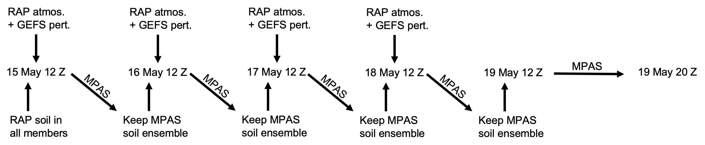
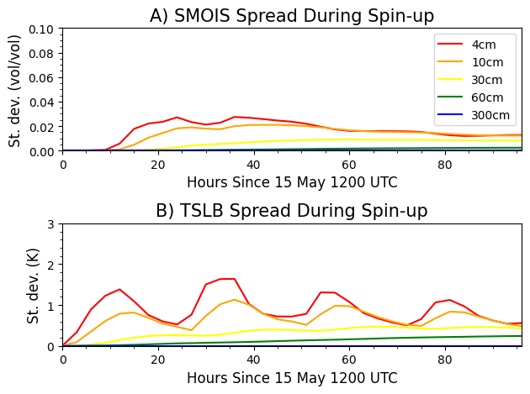
Experiment Design
4-day cycling period is used to spin up ensemble of soil states.
8-hour 30-member forecast ensemble from 1200 UTC 19 May 2024 spins up the coupled ensemble perturbations
Top 10 cm have stabilized (even decreasing) spread during the spin-up period
Deeper layers likely need longer spin-up period

Slide 5
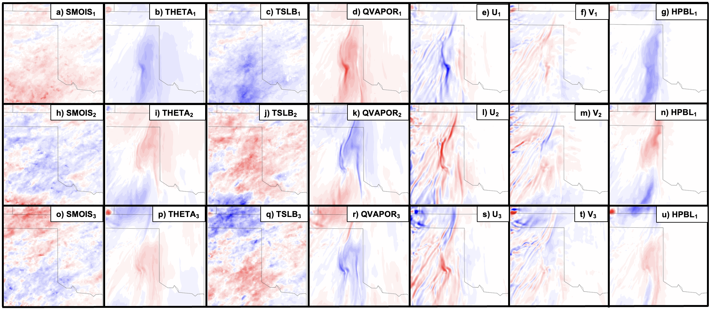
Expand ensemble size for sampling error considerations
Leading Modes of Forecast Variability (Eigenvectors)
4cm soil variables (moisture and temperature), model level 5 atmospheric variables (potential temperature, water vapor mixing ratio, U/V winds), and boundary layer height in leading eigenvectors of 8-hr lead time ensemble forecast
Approx. dryline location
SMOIS/TSLB variability related to precipitation variability during spin up
QVAPOR (THETA) anomalies roughly downstream of SMOIS anomalies of same (opposite) sign
Strongest atmosphere anomalies are concentrated along and ahead of dryline.
Ensemble dressing method is adopted to generate 1000 ensemble members (Wang and Bishop 2005)

Slide 6
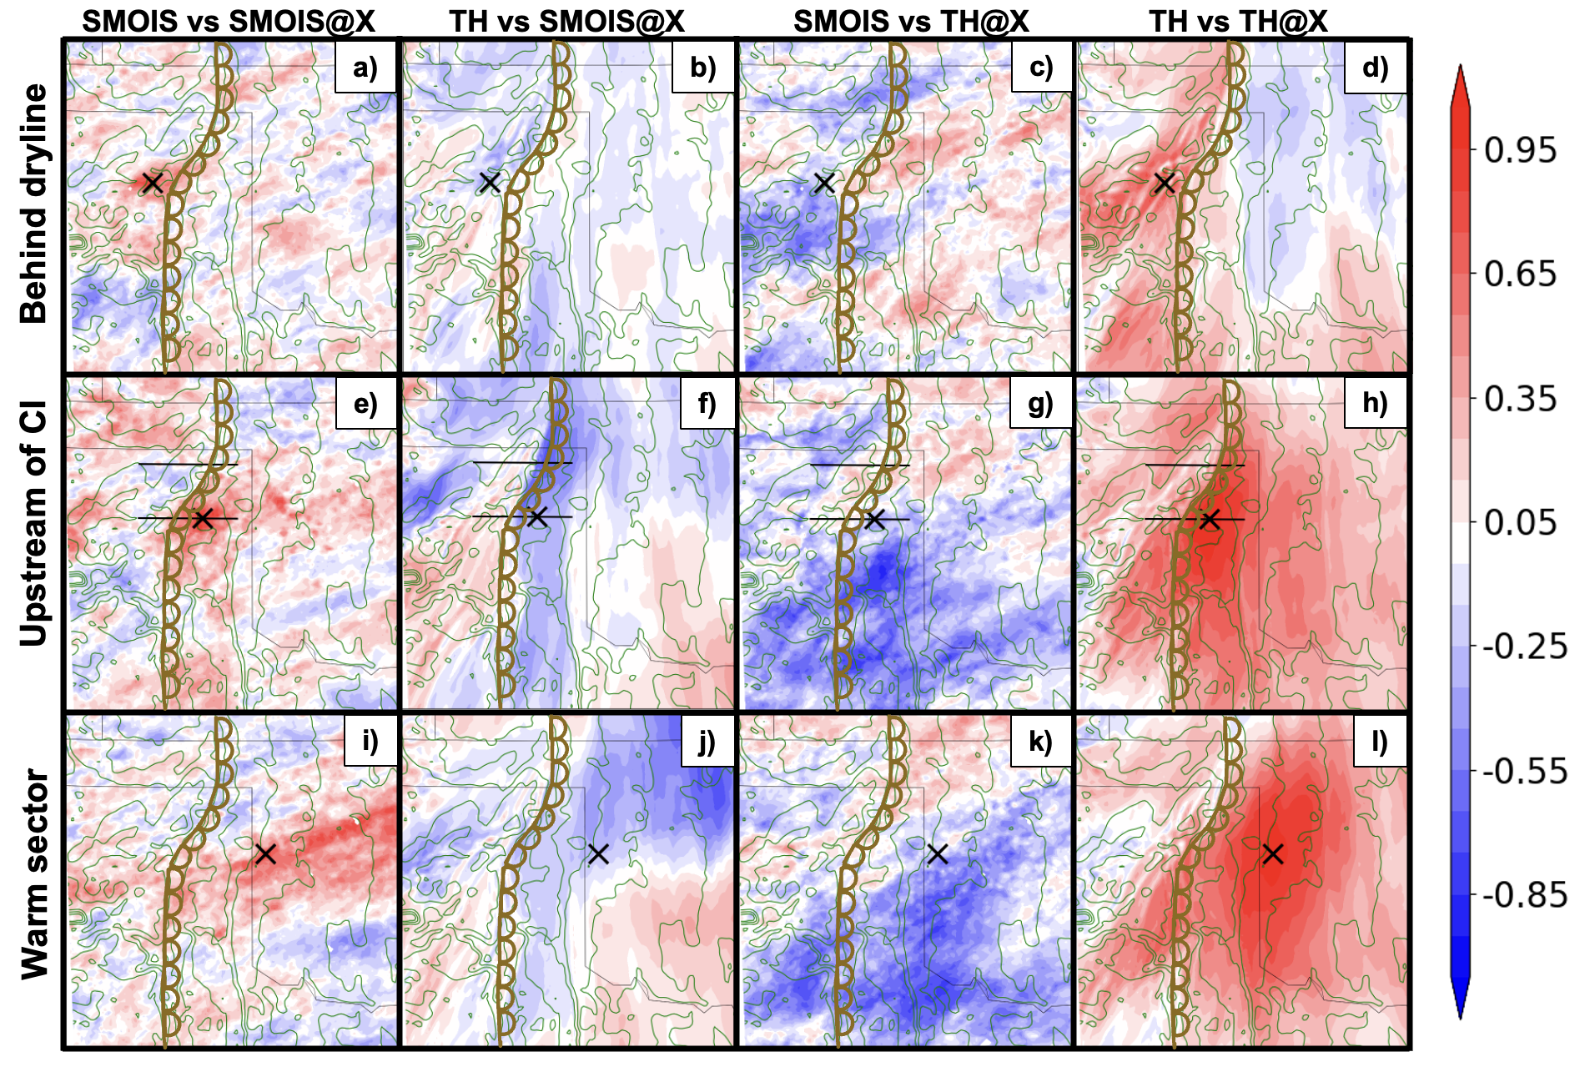
Coupled correlation relative to hypothetical observations
1000-member ensemble correlation to hypothetical observation at the “x”
TH observation is correlated to TH in surrounding area, especially east of dryline (4th column)
Shape of SMOIS autocorrelation corresponds to upscale growing MCS variability during spin up (1st column)
SMOIS observation contains more information about TH downstream from the observation (e.g., panel f) than at the observation.
Similarly, TH observations are most strongly correlated to SMOIS well upstream of the TH observation (3rd column)
Potential temperature (TH) is at model level 5
Soil moisture (SMOIS) is at 4cm depth

Slide 7
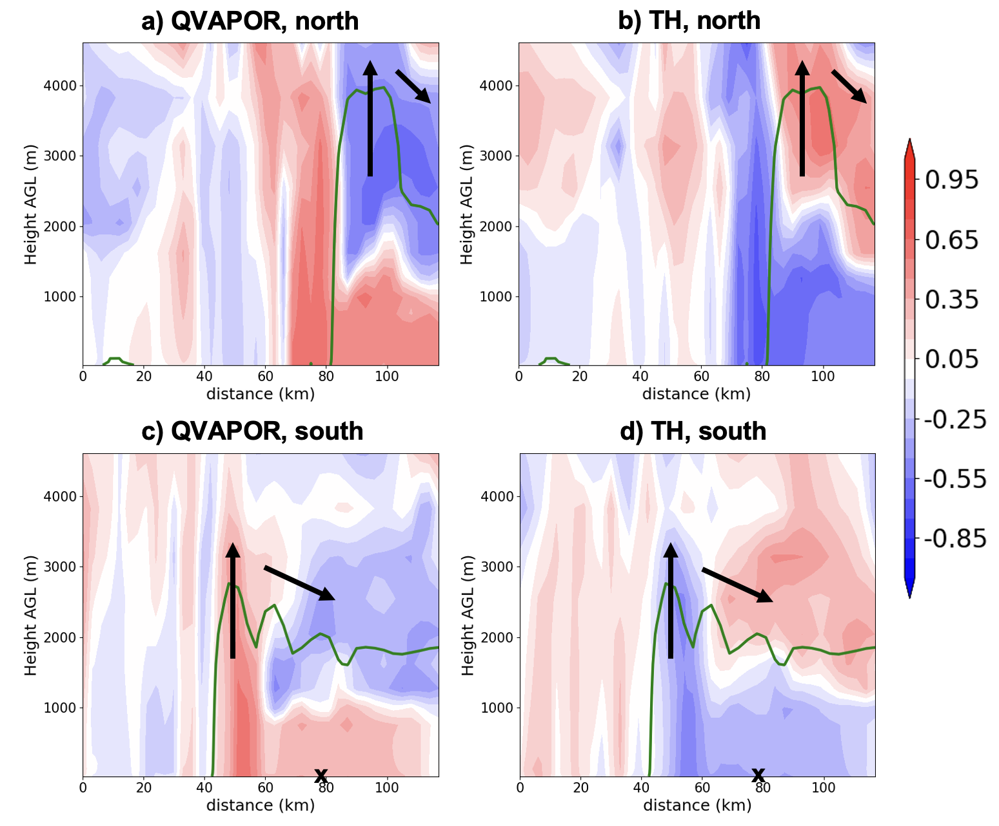
Vertical cross-section of coupled correlation structure
SMOIS observation is positively correlated to moisture in the lower boundary layer and along/west of the vertically lofted moisture (left column)
Negatively correlated with moisture in the upper PBL and subsiding branch of dryline circulation (left column)
Potential temperature correlations have similar structure, opposite sign (right column)
Correlations are qualitatively similar along the downstream cross-section, but with greater magnitude, even several km above the surface (a,b)
Northern cross-section
(downstream from “x”)
Southern cross-section
(in plane of “x”)
Green line is 5 g/kg QVAPOR contour in ensemble mean forecast
Correlation is relative to an SMOIS observation

Slide 8
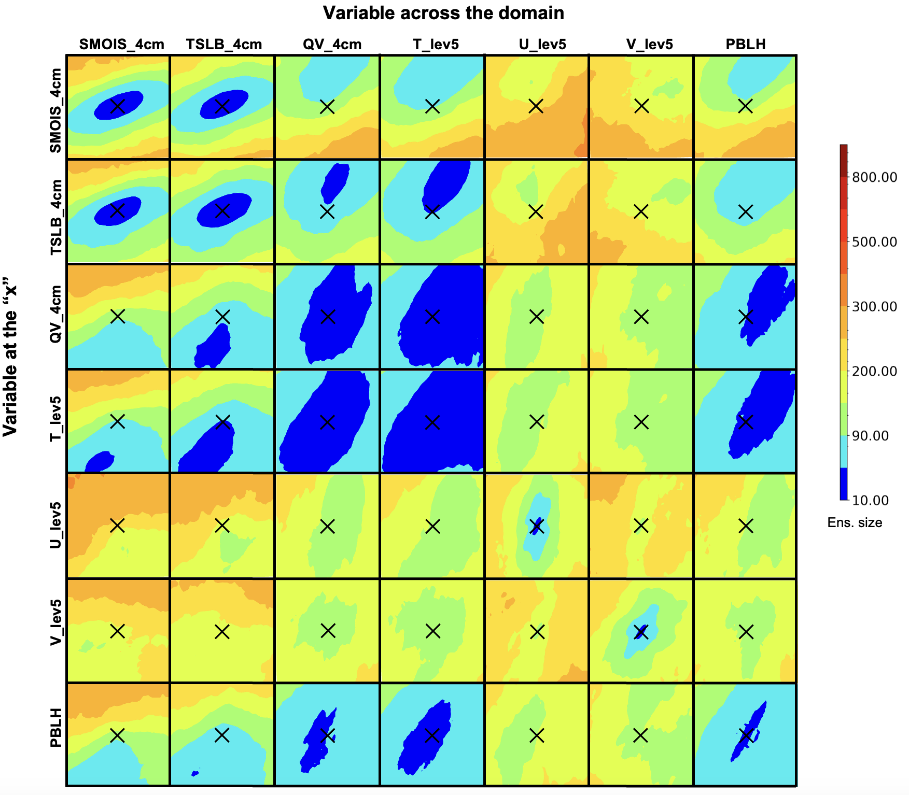
Sampling error characteristics averaged over “large” region
Minimum ensemble size at which the sign of the correlation is estimated with p-value < 0.05 (via bootstrap resampling)
THETA/QVAPOR in atmosphere:
Correlation to surrounding area is reliably estimated with <90 ensemble members
Correlation is more reliably estimated in the along-dryline direction than the cross-dryline direction
SMOIS/TSLB in soil
Smaller spatial scale over which correlation is reliably estimated
Correlation is most reliably estimated along the track of MCS’s from during the spin-up period (i.e., more east-west orientation)
Cross-component correlations
90+ ensemble members needed for reliable correlation at the observation location for some variables
Atm. obs are most reliably correlated to soil ~30-60km upstream
Soil state obs are most reliably correlated to atm.~30-60km downstream
U/V wind fields
More strongly affected by sampling error than other variables
PBLH
Similar to T, but slightly larger ensemble sizes needed
Each box is about 70km by 70km

Slide 9
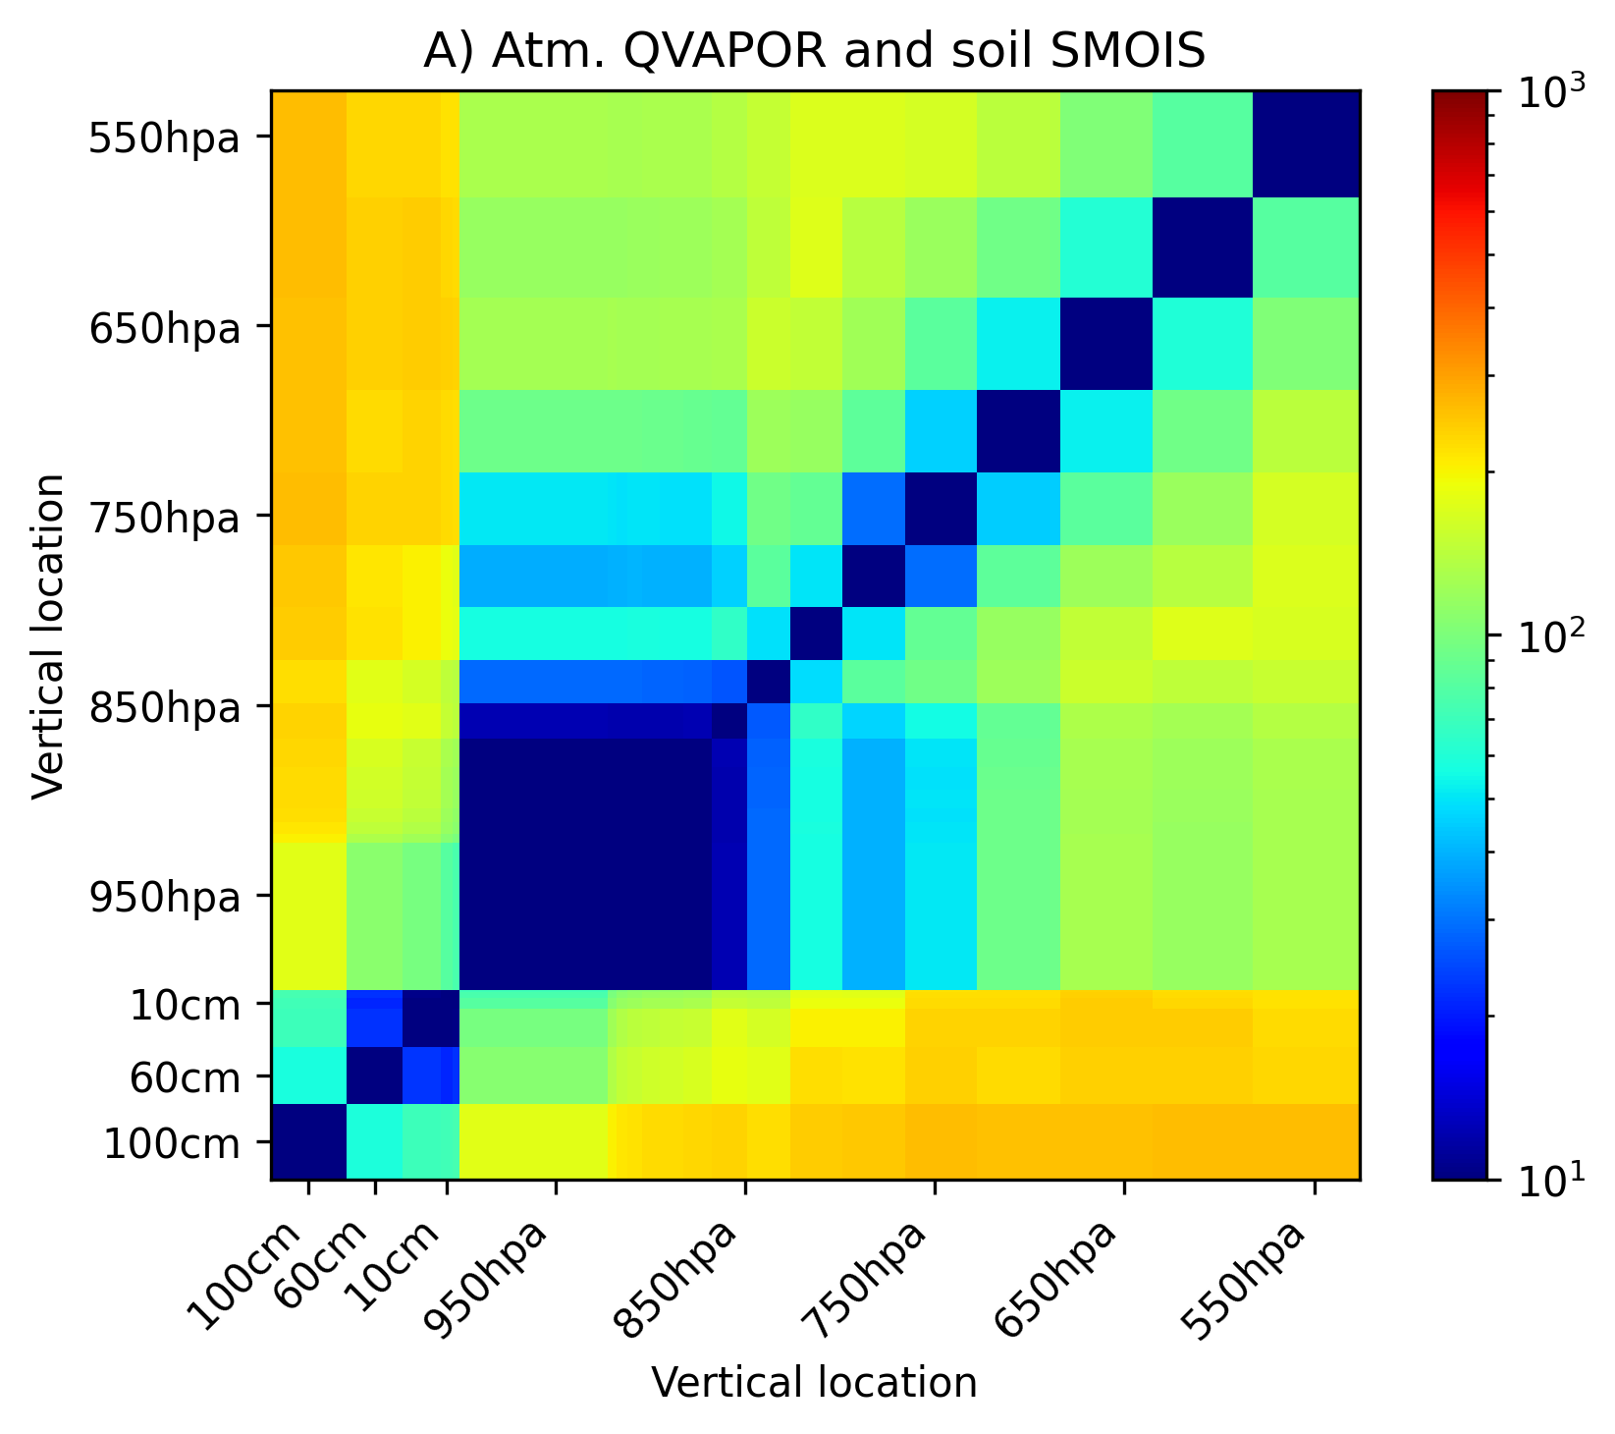
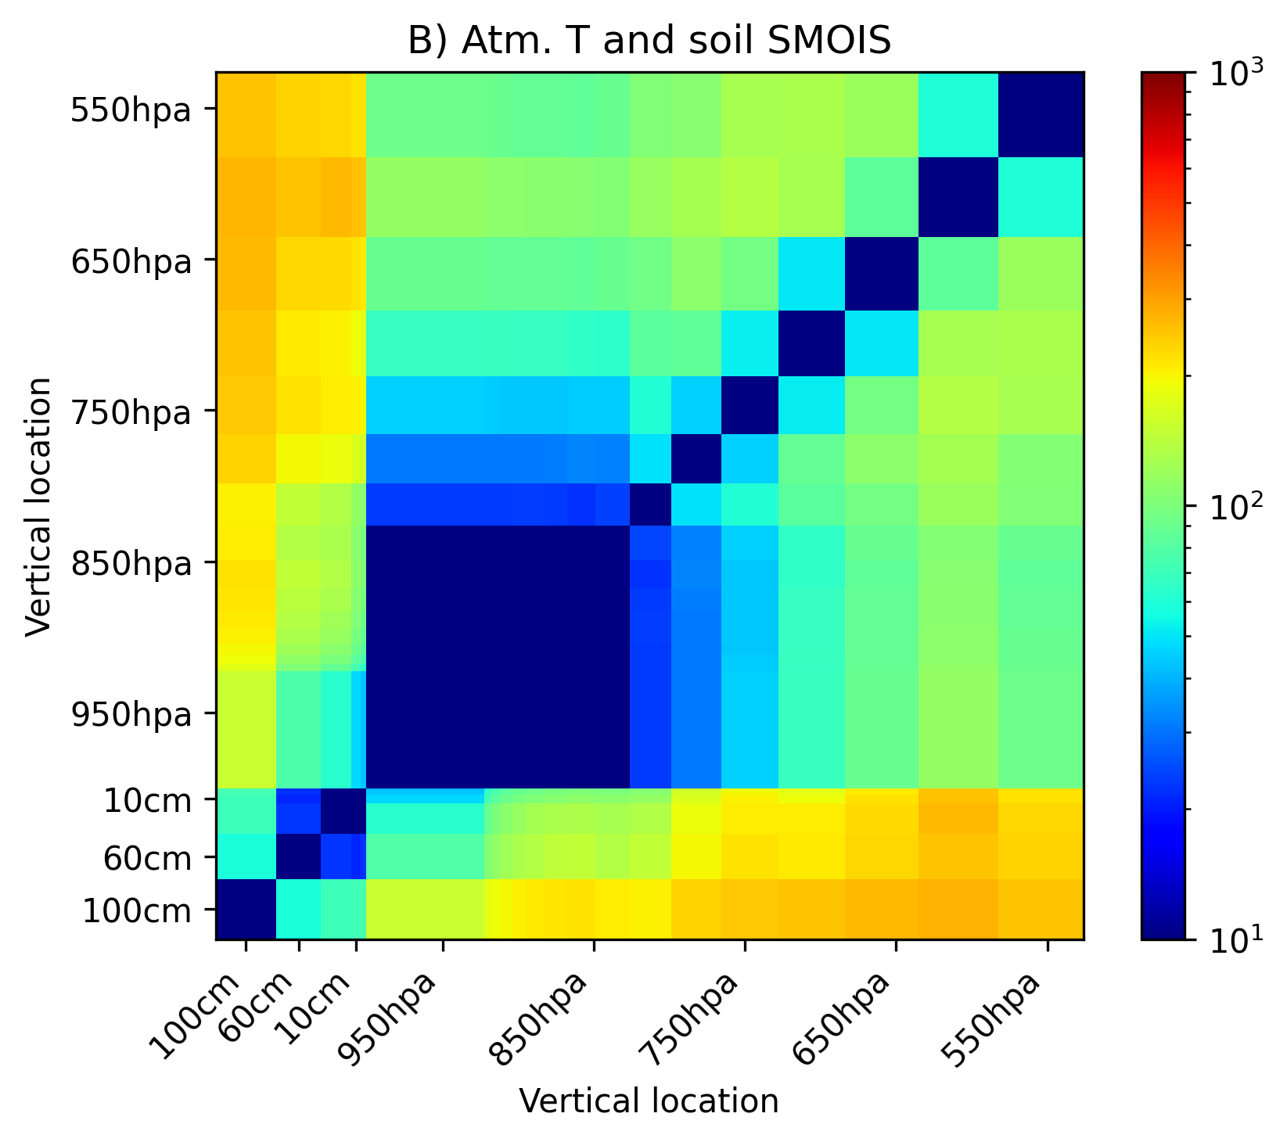
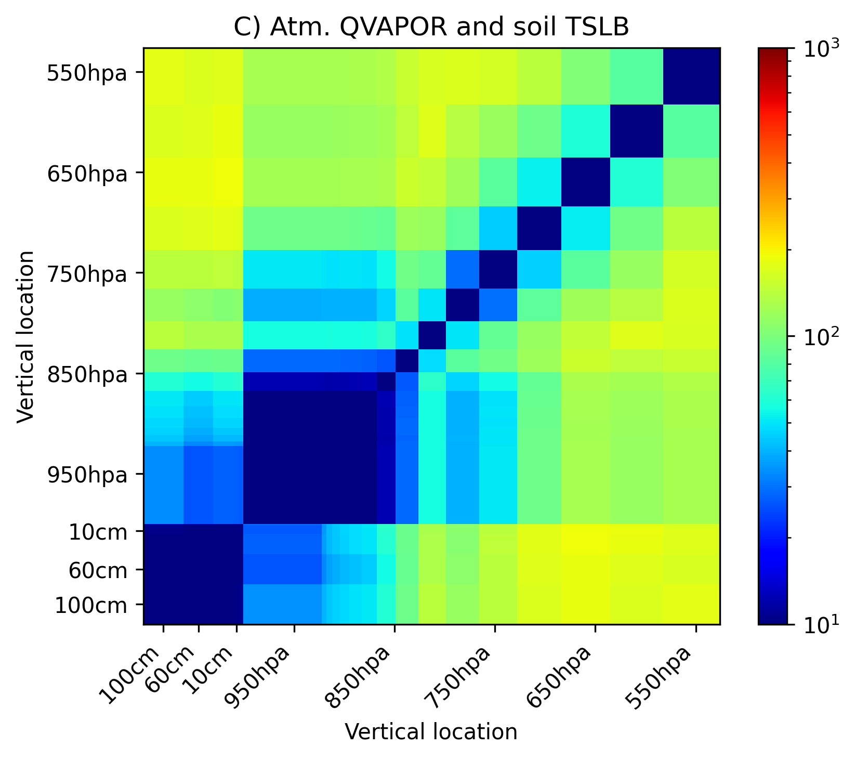
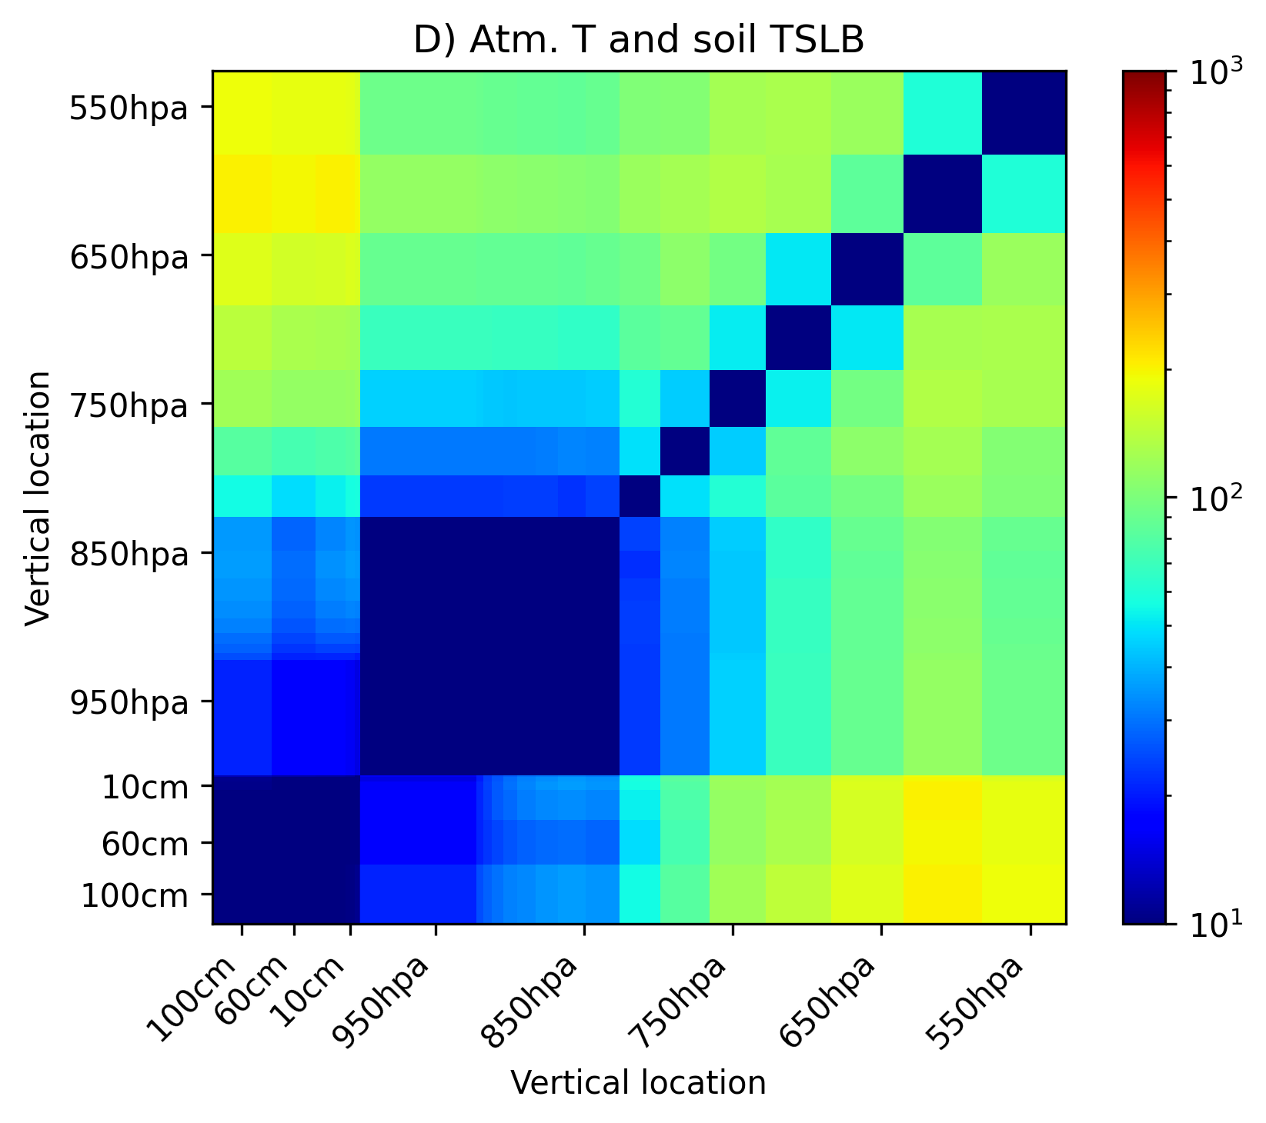
Vertical distribution of sampling error characteristics
Boundary layer top (~800 hPa) and land surface are barriers to reliable vertical spreading of information via ensemble correlation
i.e., abrupt increases in min. ensemble size across these levels
Cross-component correlations to soil temperature (bottom) are more reliably estimated than cross-component correlations to soil moisture (top)
<60 ensemble members for PBL temperature/moisture vs. soil temperature
~100-200 members for PBL temperature/moisture vs. soil moisture
Ens. size
Ens. size
Ens. size
Ens. size
Minimum ensemble size at which sign of correlation between different elements of same vertical column can be estimated with p-value<0.05, averaged over “large region”

Slide 10
Summary and Conclusions
Ultimate goal is improved convective-scale land-atmosphere SCDA through proper treatment of sampling error.
Focus on dryline CI cases where land-atmosphere coupling is particularly important
Evaluate coupled correlation structures and sampling error, associated with the part of the background error covariance originating from soil state uncertainty
Case study of sampling error characteristics
Shorter length scales of horizontal localization needed in soil than for atmosphere
On average, at least 100-200 members likely needed for reliable cross-correlation between soil moisture and PBL thermodynamics
Localized features associated with dryline CI can be reliably estimated with smaller ensembles, but may be displaced from obs location
Ongoing and future work
Continuously-cycled CADRE-MPAS-JEDI DA and SCDA with multiple sources of uncertainty
Explore non-distance-based treatment of cross-component sampling error in CADRE-MPAS-JEDI SCDA (e.g., group filter; Gasperoni et al. 2015)

