Slide 1
RRFS Development Towards the NWP Moonshot
Curtis Alexander
NOAA/OAR/GSL

Slide 2
NWP Moonshot Goals
Goal 1: Implement a global, coupled, km-scale Earth system prediction system based on the MPAS dynamical core. | Goal 2: Develop hybrid ensemble forecasts combining physical and AI models, underpinned by a world-leading continuous data assimilation system and high-resolution Earth system reanalyses.
Goal 3: Modernize NOAA modeling infrastructure and governance to promote R2O2R and optimize efficiency in the operational production suite | Goal 4: Advance seamless integration of probabilistic forecast guidance tools and services to increase access, reliability and trustworthiness of tailored data to meet forecaster and societal demands.

Slide 3
UFS SRW/CAM Applications Big Picture
NOW
NEXT
LATER
END GAME
2028
MOONSHOT
2034
2026
RRFSv1.0 (FV3-GSI)
REFSv1.0 (mix phys)
RAP/HRRR
RRFS/REFSv1+
Stand-alone MPAS forecasts
FV3-JEDI cycled analyses
MPAS stochastic physics
AI ensemble members
RAP/HRRR
RRFS/REFSv2+
MPAS in UFS infrastructure
MPAS-JEDI fully cycled
Single physics ensemble
AI ensemble members
Global MPAS-JEDI
3-km deterministic and ensemble
NAM/NAMnest
HRW ARW
HRW ARW2
HRW FV3
RAP/HRRR
HREF Members
UFS Applications and Infrastructure

Slide 4
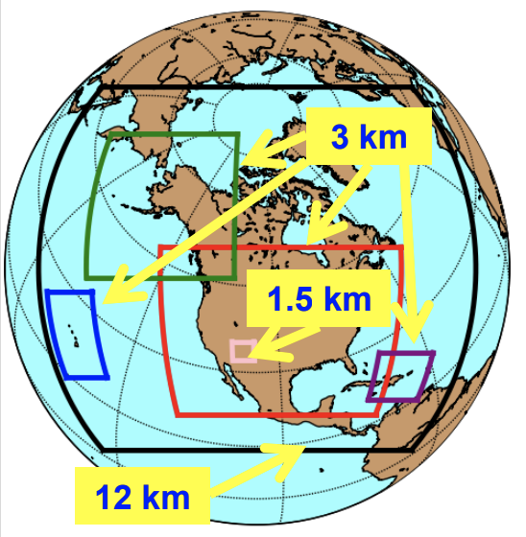
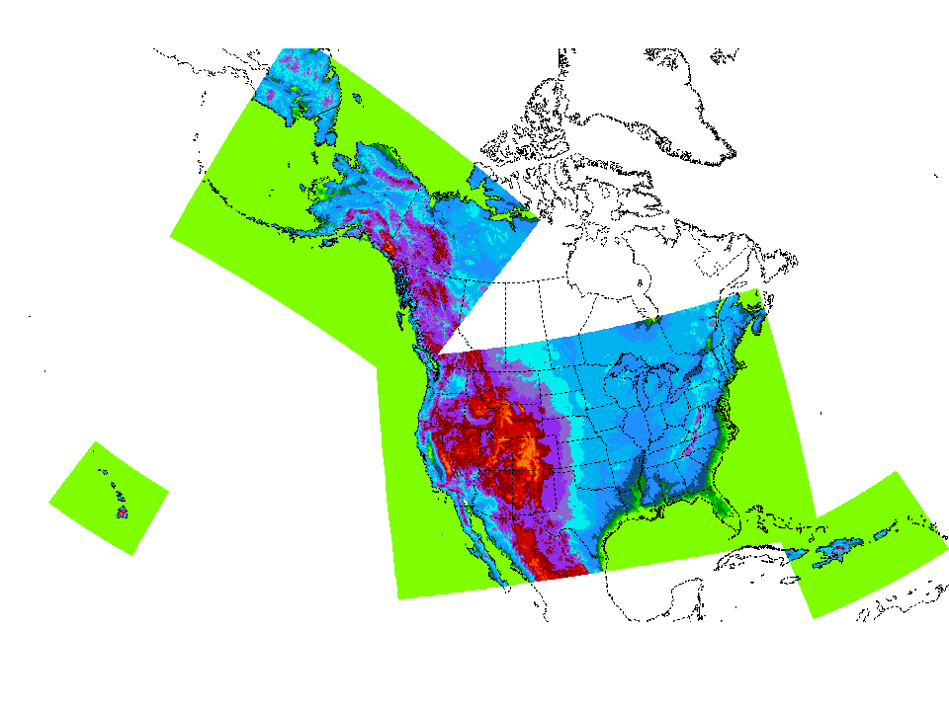
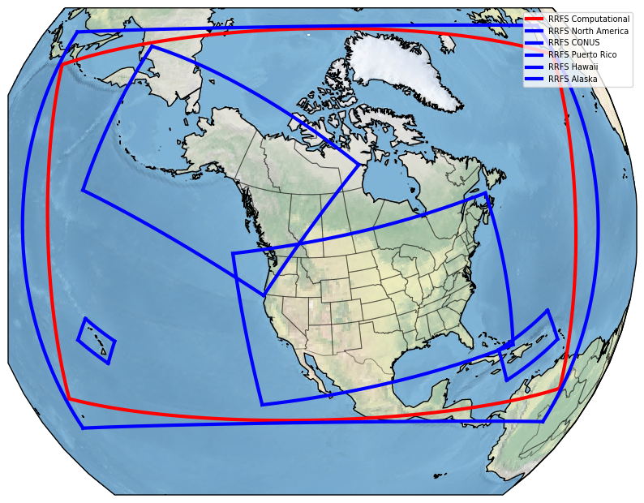
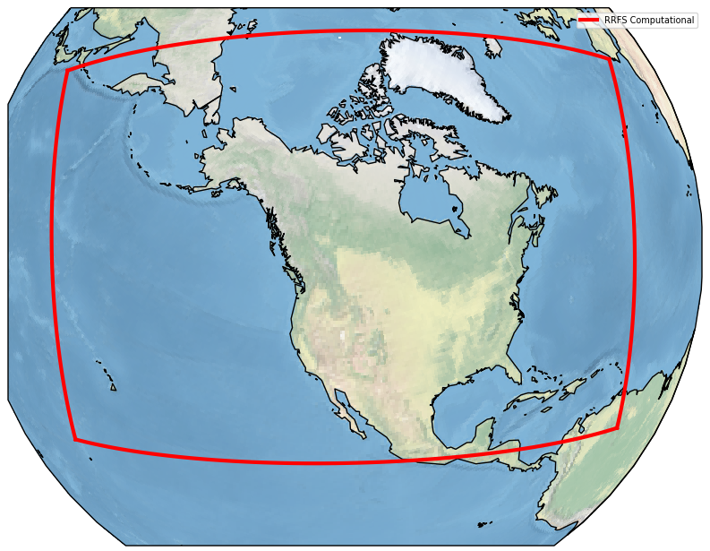
The Rapid Refresh Forecast System (RRFS) v1
A UFS Application
3-km grid spacing over North America
FV3 dynamical core
Hourly updated
65 vertical layers
Hybrid 3DEnVar assimilation (30 members)
Deterministic forecasts to 84 h, ensemble forecasts to 60 h, and a 1.5 km “firewx” domain to 36 h for 00/06/12/18Z cycles
Deterministic forecasts only to 18 h, other cycles
Deterministic runs include smoke & dust
NAM +
NAM Nests
HiResW/
HREF
RRFSv1 Compute Domain (red)
Operational implementation this fall (currently October 2026)

Slide 5


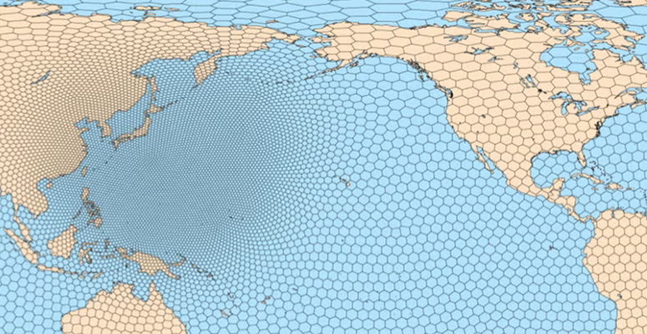
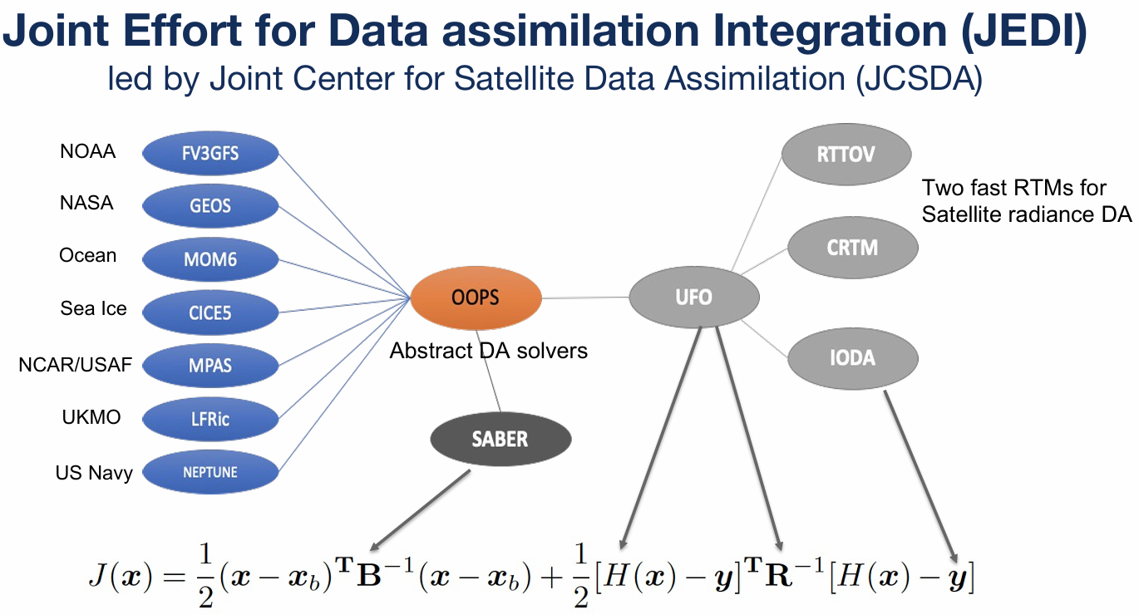
MPAS and JEDI transition in UFS

Slide 6
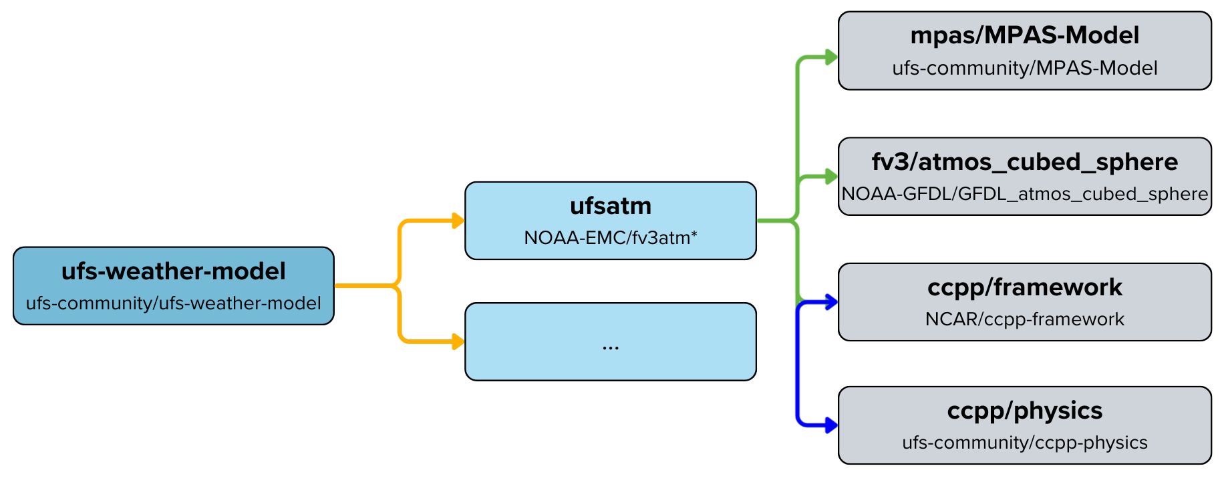
Integrating the MPAS Dynamical Core in the UFS
A joint GSL - DTC development effort to date
The UFS Atmosphere component has been generalized to accommodate multiple dynamical cores.
An initial MPAS-based atmospheric driver has been created for the UFS.
CCPP physics parameterizations are being refactored to return tendencies rather than update the model state (needed due to differing physics-dynamics coupling for MPAS).
NUOPC/ESMF infrastructure has been created for MPAS-based UFS Weather Model forecasts, and MPAS can run (in a basic sense w/limited physics) there now.
Traditional coupling layer
ESMF coupling layer
Image courtesy Dustin Swales (NOAA/OAR/GSL)
Decision Point: When to adopt MPAS-in-UFS for RRFSv2 (and other) application development? Early 2027 readiness?

Slide 7
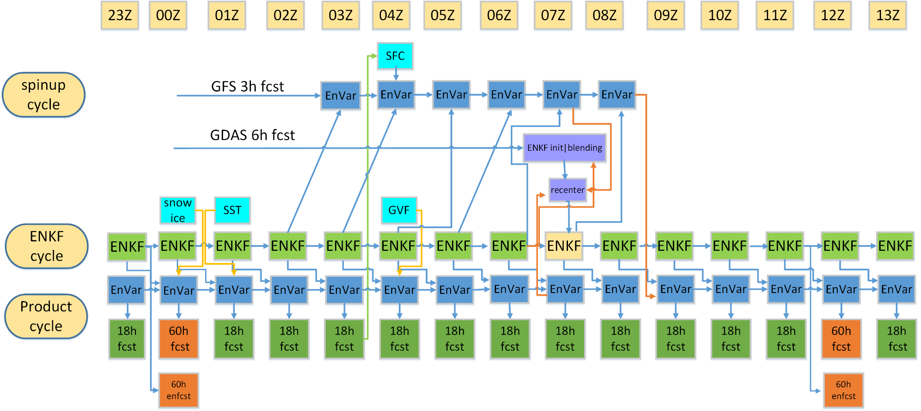
Key parts of RRFS DA cycling and forecast strategy
5. Coupled surface/ atmos. interaction with updates
1. Spin-up cycle to combine
large scale and small scale
Information
6. Enhanced/tuned GSI/EnKF
and non-var cloud analysis
2. Two-way coupled deterministic / EnKF cycling:
Determ
cycle
3. Multi-scale analysis
from SDL/VDL
4. Hourly cycling to accumulate the impact of all available observations;
Continuous cycling of soil fields
Decision Point: When will JEDI completely reproduce GSI-based regional (and other) DA capabilities? Early 2027 readiness for RRFSv2?

Slide 8
Physics Parameterizations for MPAS-Based RRFS Prototypes
Component | Parameterization | Recent/Ongoing Developments
Land-Surface | RUC/NoahMP | Initial NoahMP prototype pending updated soil static datasets and a four- or nine-to-ten layer soil initialization interpolation routine.
Surface Layer | MYNN | Code refactor in progress. Initial efforts underway to integrate within NoahMP, but not expected to be ready for initial NoahMP testing.
Turbulence + Shallow Cumulus | MYNN-EDMF | Now includes a level-2.7 option (total turbulent energy; not active) and an updated effective static stability formulation (active).
Deep Convection | N/A | Extended real-time testing in 2024 indicated no forecast impact at Δx = 3 km from using a deep convection parameterization.
Gravity-Wave Drag | Unified Gravity Wave Physics (UGWP) | Beginning to develop a Fourier-based terrain decomposition method for mesoscale orographic gravity-wave drag (NOAA JTTI-funded).
Radiation | Rapid Radiative Transfer Model for GCMs (RRTMG) | Potential change to RRTMGP when MPAS is available in the UFS.
Microphysics | Thompson-Eidhammer Microphysics Param. for Operations (TEMPO) | New ML diagnostic for cloud droplet number concentrations for PBL clouds. New freezing rain & hail diagnostics. Code recently refactored.
Stochastic Representations | SPPT et al. | Initial SPPT capability has been developed and is nearly ready for rigorous testing. Other representations (esp. SKEB and SPP) to follow.
Decision Point: When will physics suite converge between regional
and global UFS applications at convection allowing resolutions? LSM, PBL,…
Notes:
In addition, a new prognostic subgrid-scale cloud routine that couples microphysics, turbulence, and radiation is under development.

Slide 9
NWP Moonshot Goals
Goal 1: Implement a global, coupled, km-scale Earth system prediction system based on the MPAS dynamical core. | Goal 2: Develop hybrid ensemble forecasts combining physical and AI models, underpinned by a world-leading continuous data assimilation system and high-resolution Earth system reanalyses.
Goal 3: Modernize NOAA modeling infrastructure and governance to promote R2O2R and optimize efficiency in the operational production suite | Goal 4: Advance seamless integration of probabilistic forecast guidance tools and services to increase access, reliability and trustworthiness of tailored data to meet forecaster and societal demands.

Slide 10
RRFS ensemble forecast design and membership
Ensemble spread from:
ICs from different ensemble DA members
Lateral boundaries from different GEFS members
Multi physics
Stochastic (*) and fixed (#) parameter perturbations
Time lagging for ensemble product generation
Inclusion of HRRR for Alaska & CONUS domains
 | MP | PBL | sfc | lsm | Cu | IC/LBC
m1 (ctrl) | Thompson | MYNN | MYNN | RUC | saSAS deep | RRFS hybrid/GFS
m2 | Thompson* | TKE-EDMF | GFS | RUC* | G-F dp*+sh | RRFS enkf1/GEFSm1
m3 | Thompson* | MYNN* | MYNN* | RUC* | saSAS deep | RRFS enkf2/GEFSm2
m4 | NSSL# | MYNN* | MYNN* | RUC* | G-F deep | RRFS enkf3/GEFSm3
m5 | NSSL# | TKE-EDMF | GFS | RUC* | G-F dp+sh | RRFS enkf4/GEFSm4
m6 | NSSL# | MYNN* | MYNN* | RUC* | saSAS deep | RRFS enkf5/GEFSm5
m7 (m1-6h)
m8 (m2-6h)
m9 (m3-6h)
m10 (m4-6h)
m11 (m5-6h)
m12 (m6-6h)
m13 (HRRR) | Thompson | MYNN | MYNN | RUC | None | HRRRDAS / RAP
m14 (m13-6h)
This membership feeds into the REFS ensemble product generation
Decision Point: When will all (WRF-based) stochastic physics options be available in MPAS-in-UFS? Sometime in 2027?

Slide 11
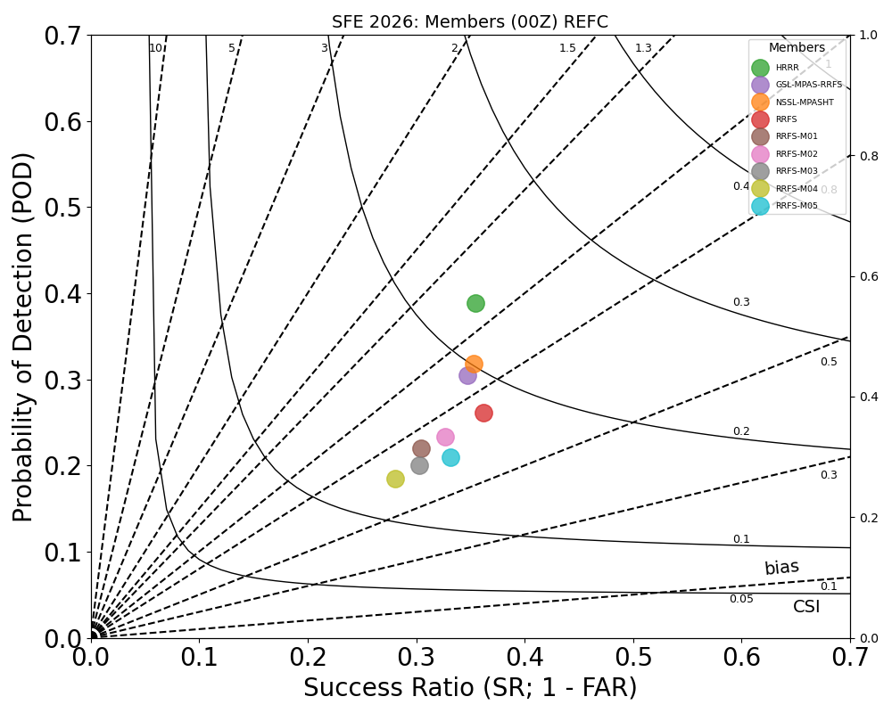


HWT 2026 Spring Forecasting Experiment
Day 1 40-km neighborhood REFC >=40 dBZ
All
CSI from highest to lowest for non-time-lagged 00Z runs:
HRRR
MPAS
RRFS
REFS perturbed
(Member 4)
Not desirable
Decision Point: RRFSv2 ensemble design? Mixed-physics/dycores not sustainable, current IC/BC/physics perturbation strategies not adequate, AI members?

Slide 12
Potential Moonshot Team 1 Components
Team 1 Co-Leads
Curtis Alexander and Kevin Garrett
Infrastructure
Physics / Sci Dev.
RRFSv2
MPAS-in-UFS
JEDI-reproduce-GSI
Global CAM physics suite convergence
Atmospheric composition lanes (smoke, dust, etc…)
MPAS-JEDI readiness
Ensemble design (AI)
Notes:
Organizational culture, now modeling, I feel like this is a senior thesis project for my time in NOAA.

Slide 13
NWP Challenges (Team 1 leading)
Short Term (now through 2027)
Operational implementation of RRFSv1
Complete integration of MPAS into UFS framework→stand-alone MPAS role?
Complete integration of JEDI regional DA capabilities→FV3-JEDI role?
Complete integration of stochastic physics capabilities in MPAS
Transition from RUC to NOAH MP land surface model
Transition of operational NWP suite to cloud (RAP/HRRR, RRFSv1, etc…)
Establish end-to-end R&D testing framework in-cloud →DevOps, Agile when?
Medium Term (through 2028)
Effective single core/physics suite ensemble design → AI membership
Operational implementation of RRFSv2→retirement of RAP/HRRR
Long Term (through 2034)
Convergence of regional and global CAM physics → surface/BL
Convergence of regional and global CAM DA → 3/4D Hyb EnVar, hourly cyc

