Slide 1



Impact of greenness vegetation fraction perturbations on convection-allowing ensemble-based land-atmosphere coupled background error covariance
Brett Castro, Aaron Johnson and Xuguang Wang
University of Oklahoma and Consortium for Advanced Data Assimilation Research and Education (CADRE)

Slide 2
Background and Motivation
  Land surface characteristics and land-atm. coupling can impact convective-scale forecasts
    E.g., weakly forced dryline CI (Trier et al. 2004 & Duda et al. 2017)
    Greenness Vegetation Fraction (GVF): Percentage of grid cell covered by vegetation
      Affects surface-based energy fluxes (Hong et al. 2009; Zhang and Tang 2013; Yan et al. 2019)
  GVF perturbations can reduce low-level ensemble under-dispersion in coarser resolution, longer range GEFS forecasts (Draper 2022)
    Uncertainty in GVF exists, but impacts on convective scales are not well studied
    Full range of uncertainty at convective scales should be represented by ensemble perturbations
      Improved ensemble estimates of coupled background error covariance is needed for land-atmosphere SCDA at convective scales
      Does representing the uncertainty in GVF have meaningful impacts on convection-allowing ensemble-based background error covariances of a weakly forced dryline case?

Slide 3
Experiment Design
  30-member ensembles initialized at 1200 UTC 19 May 2024 (same as previous talk)
  Two methods of generating ensemble perturbations are compared:
  “soilpert”: initialized with soil state perturbations only
    Soil state ensemble is spun up during 4 day cycling period (same as previous talk)
  “GVFpert”: initialized with GVF perturbations only
  Perturbations are generated consistent with uncertainty in unperturbed GVF dataset (see next slides)
  Purpose is to individually evaluate the impact of these different sources of IC uncertainty on convective-scale dryline CI forecasts

Slide 4
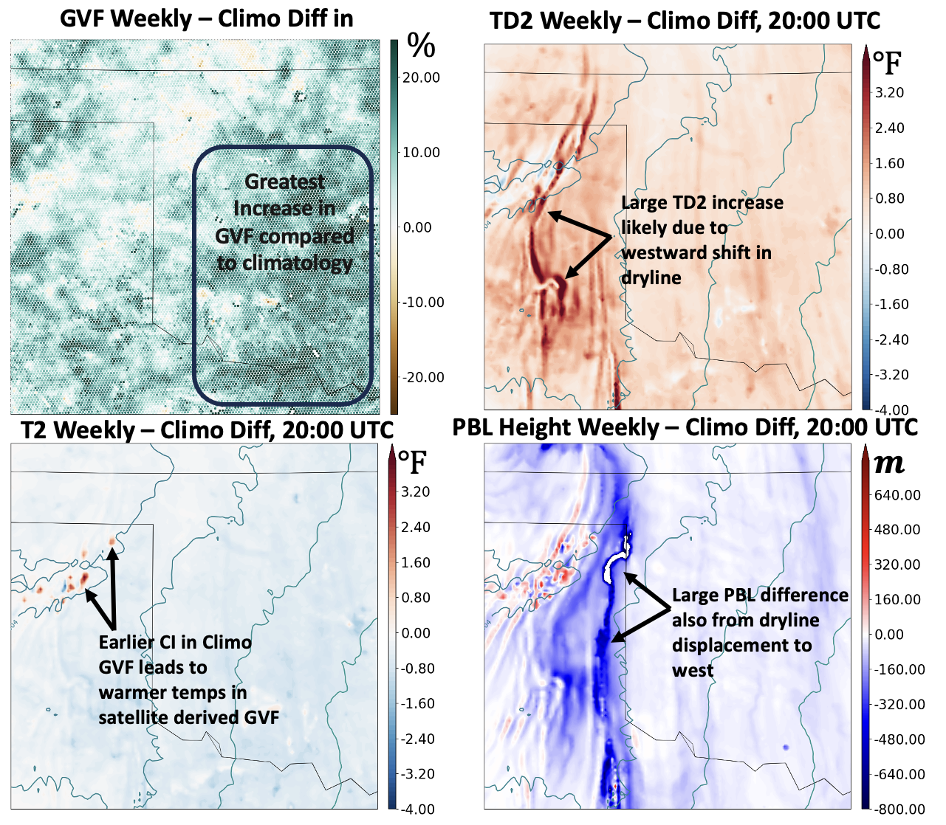
Deterministic forecast sensitivity to GVF
First, checked whether GVF affects features related to dryline CI within 8-hr convective-scale forecast period.
Initialized with climatological GVF vs. weekly rolling average GVF
Real-time GVF > climatological GVF
About 1 F difference in T/Td near dryline CI, ~200-400m HPBL diffeerence
Timing of CI and dryline location are also affected

Slide 5
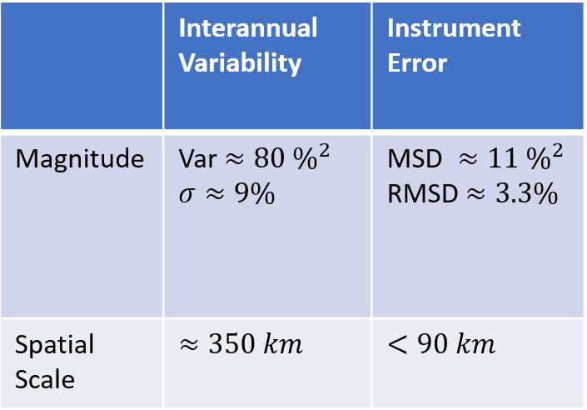
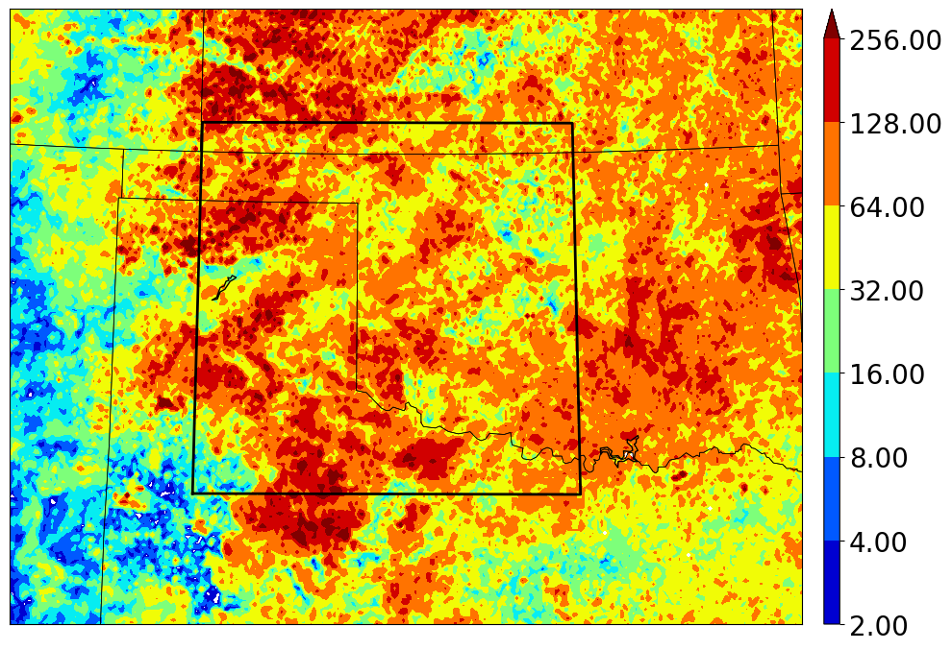
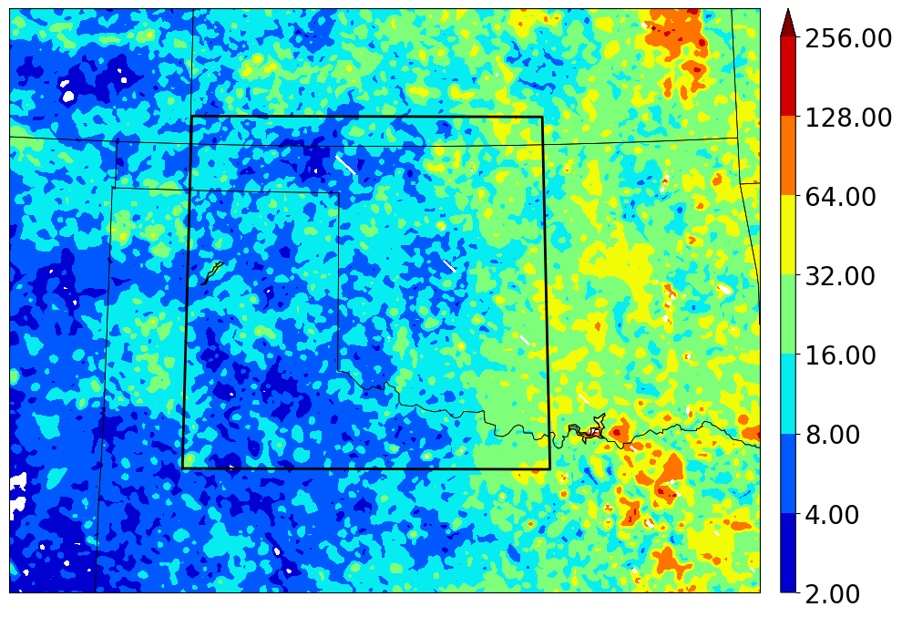
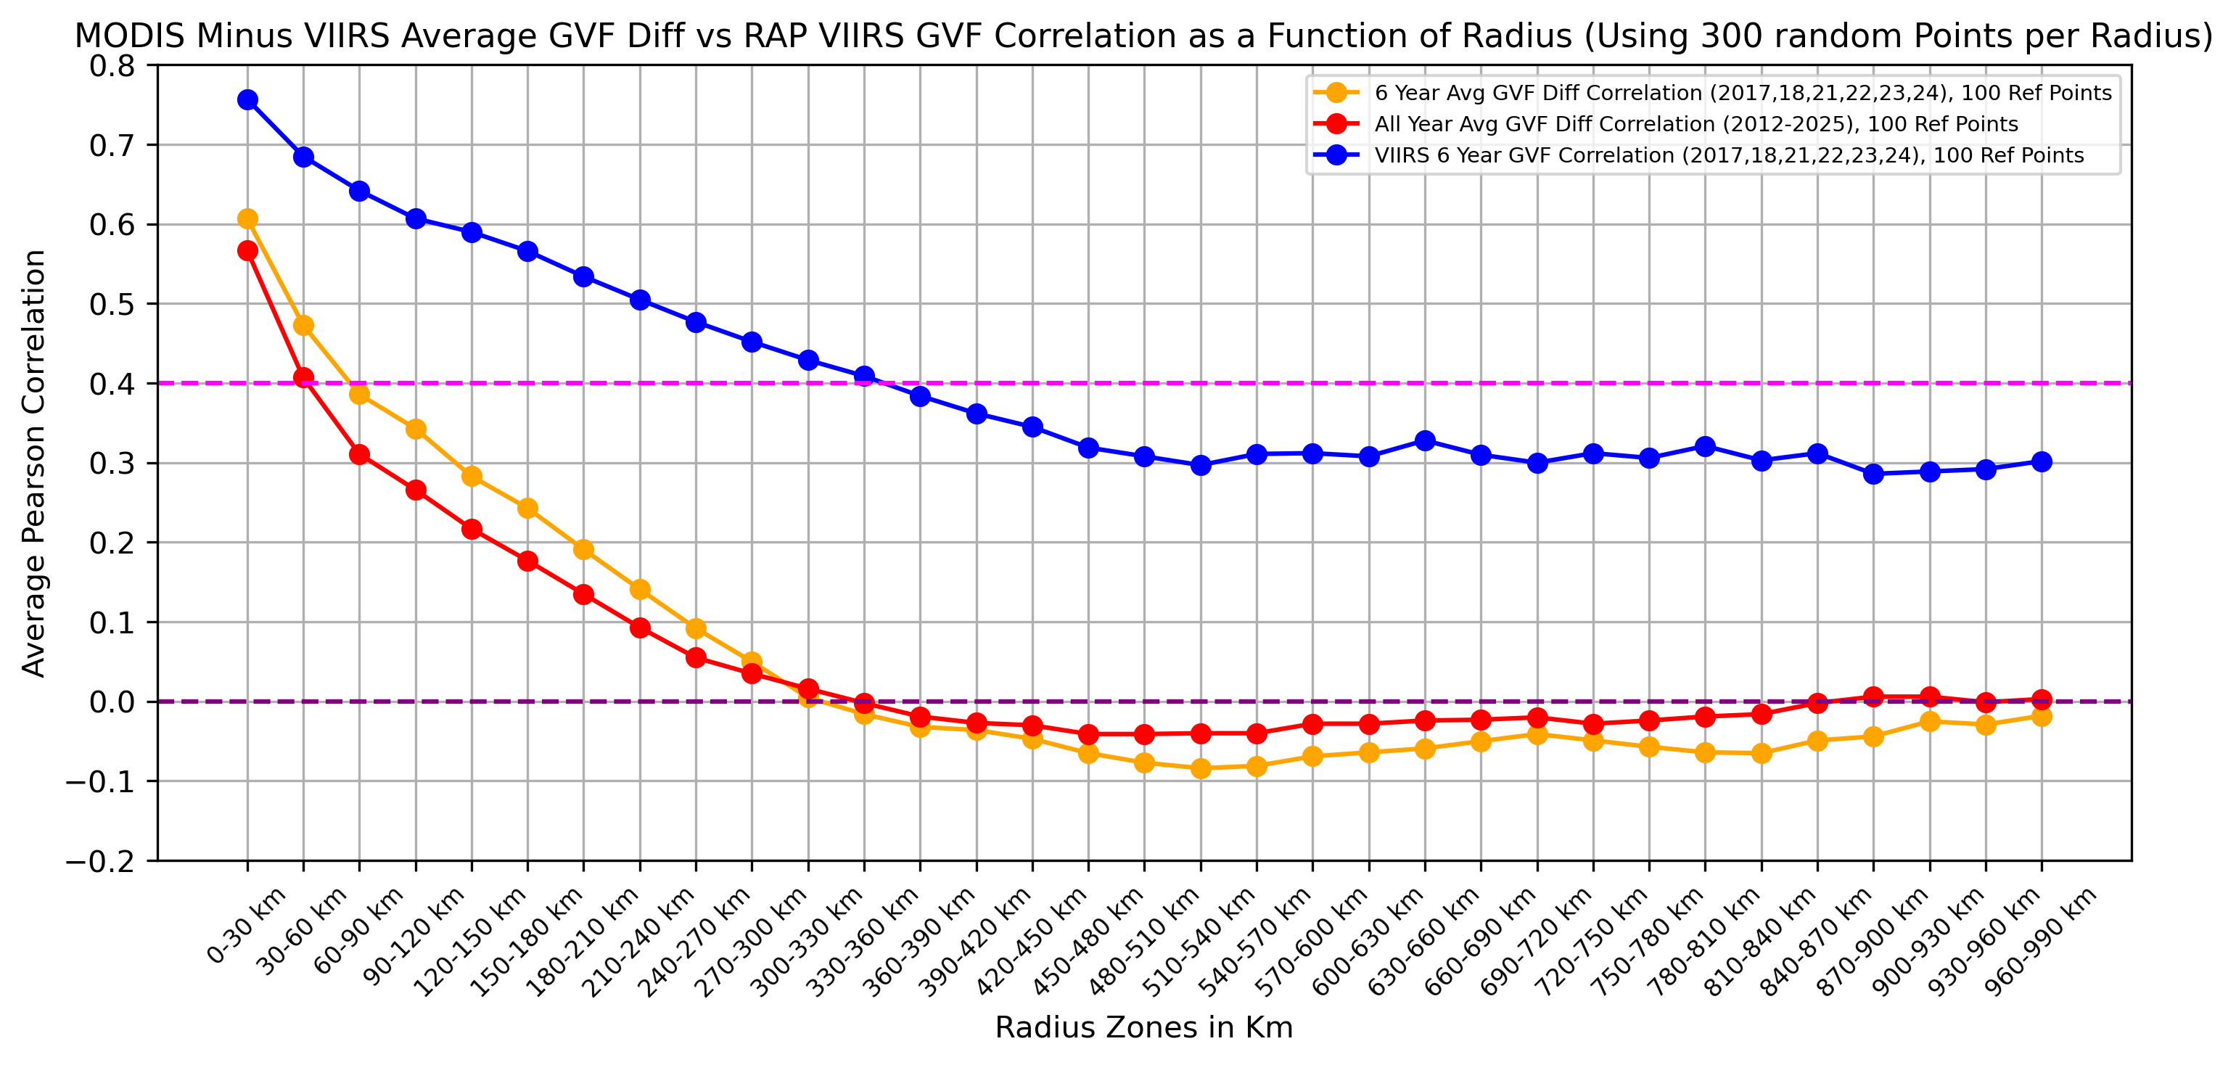
Characteristics of GVF uncertainty
By default, MPAS uses climatological dataset for each month to specify GVF
Uncertainty due to interannual variability: Estimated using variance in mid-May VIIRS-retrieved GVF, averaged over the black box below.
Uncertainty due to instrument/retrieval error: Estimated using mean squared difference (MSD) between MODIS- and VIIRS-based GVF retrievals averaged within the same region
  Spatial scale of uncertainty: Estimated using correlation of GVF variations (due to different years, or different satellite), averaged based on distance between grid points
    Magnitude and spatial scale of uncertainty due to interannual variability dominates instrument/retrieval uncertainty
VIIRS GVF Variance
MODIS vs VIIRS GVF MSD

Slide 6
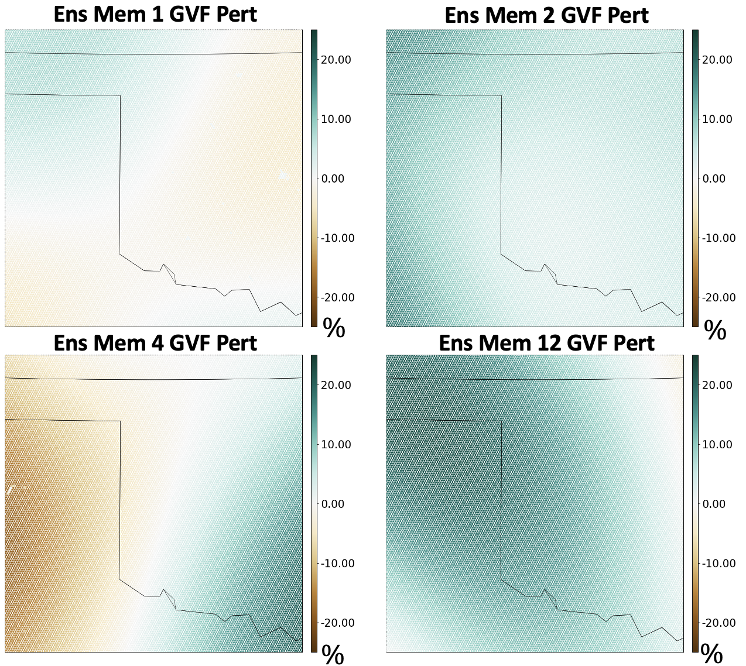
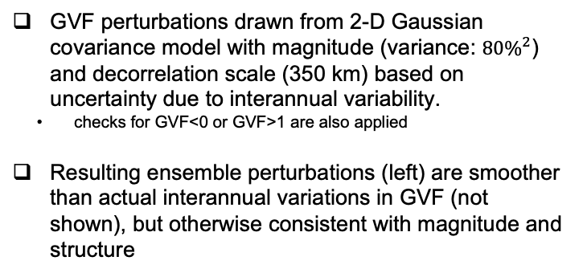
GVF ensemble perturbations
GVF perturbations drawn from 2-D Gaussian covariance model with magnitude (variance: ${80\%}^{2}$) and decorrelation scale (350 km) based on uncertainty due to interannual variability.
  checks for GVF<0 or GVF>1 are also applied
Resulting ensemble perturbations (left) are smoother than actual interannual variations in GVF (not shown), but otherwise consistent with magnitude and structure

Slide 7
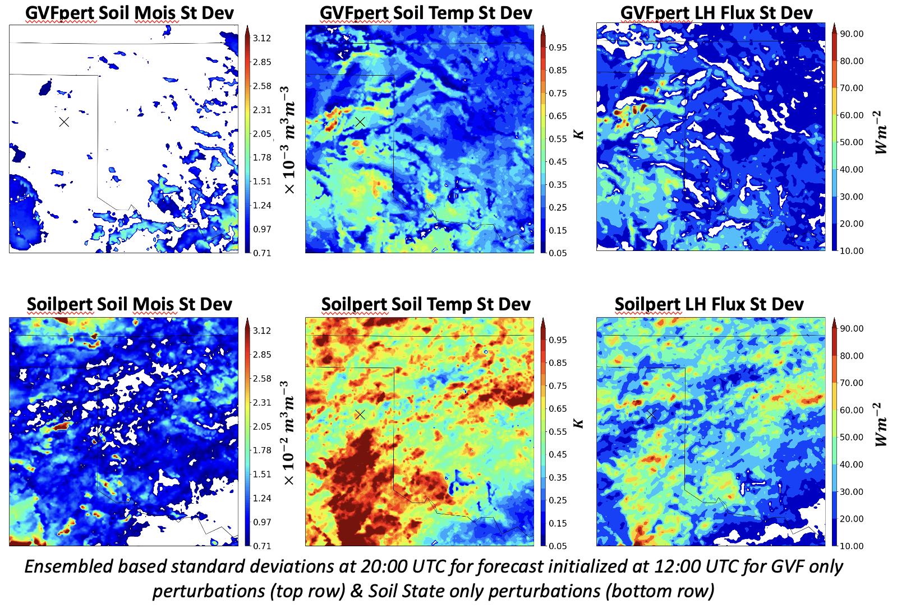
Ensemble spread: Land surface variables
GVF perturbations generate much less (more than an order of magnitude) spread in soil moisture and direct soil state perturbations.
Other variables (e.g., soil temperature or surface fluxes) have about half as much spread in GVFpert than Soilpert ensemble

Slide 8
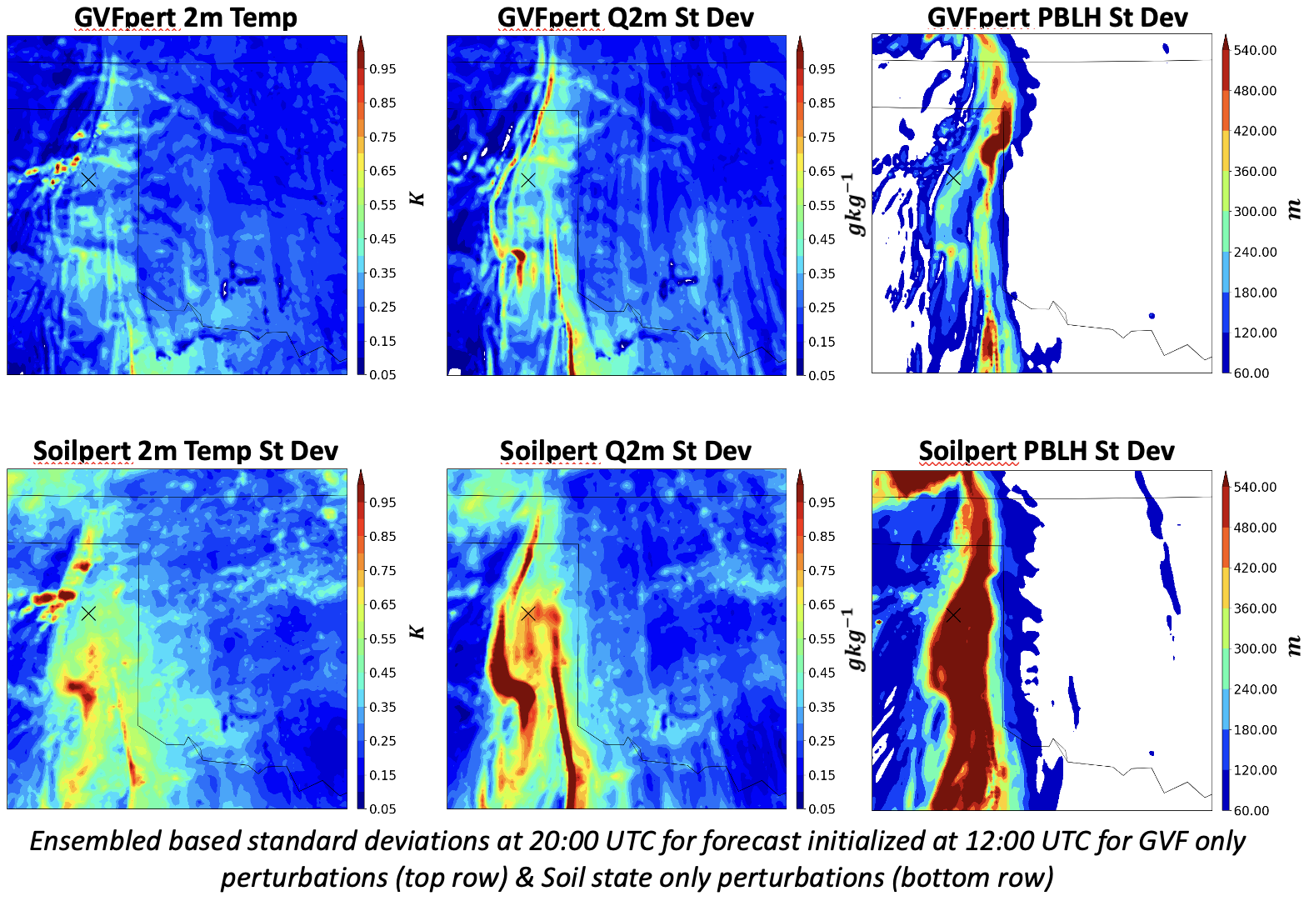
Ensemble spread: Atmosphere variables
In both ensembles, the greatest spread is in the vicinity of the dryline CI.
For 2m temperature, 2m water vapor, and boundary layer height, spread from GVFpert is again about half of that from soil pert
Supports hypothesis that including GVF perturbations in ensemble design should contribute meaningfully to magnitude of ensemble spread

Slide 9
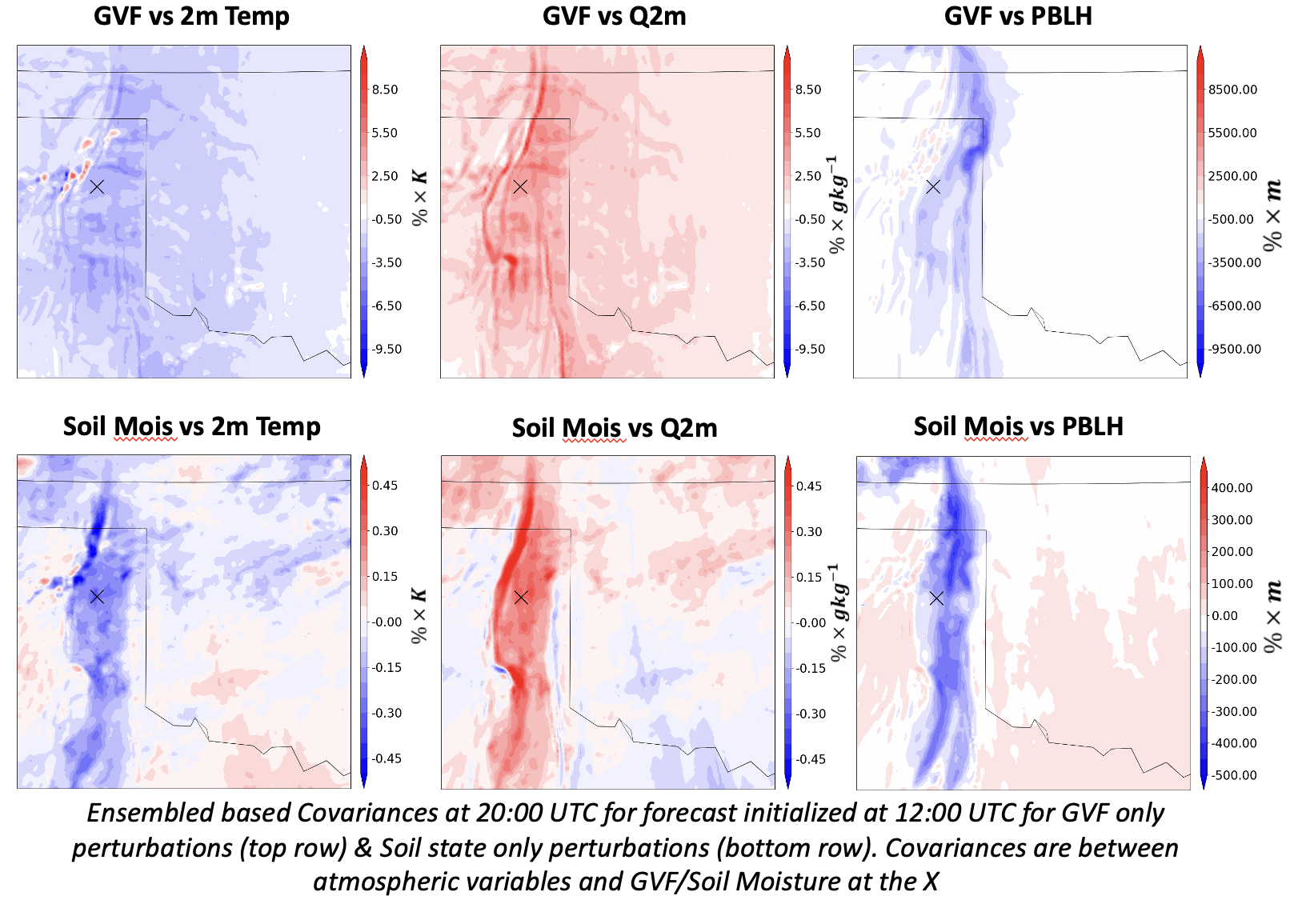
Covariance with perturbed variables
Covariances between 2m variables and GVF at the “x” in GVFpert ensemble are spread over broad areas
Covariances between 2m variables and soil moisture at the “x” in Soilpert ensemble are smaller scale, more concentrated along dryline.
Larger spatial scale of GVFpert covariance is consistent with the spatial scale of GVF uncertainty from interannual variability
  Magnitudes not directly comparable due to different perturbed variable

Slide 10
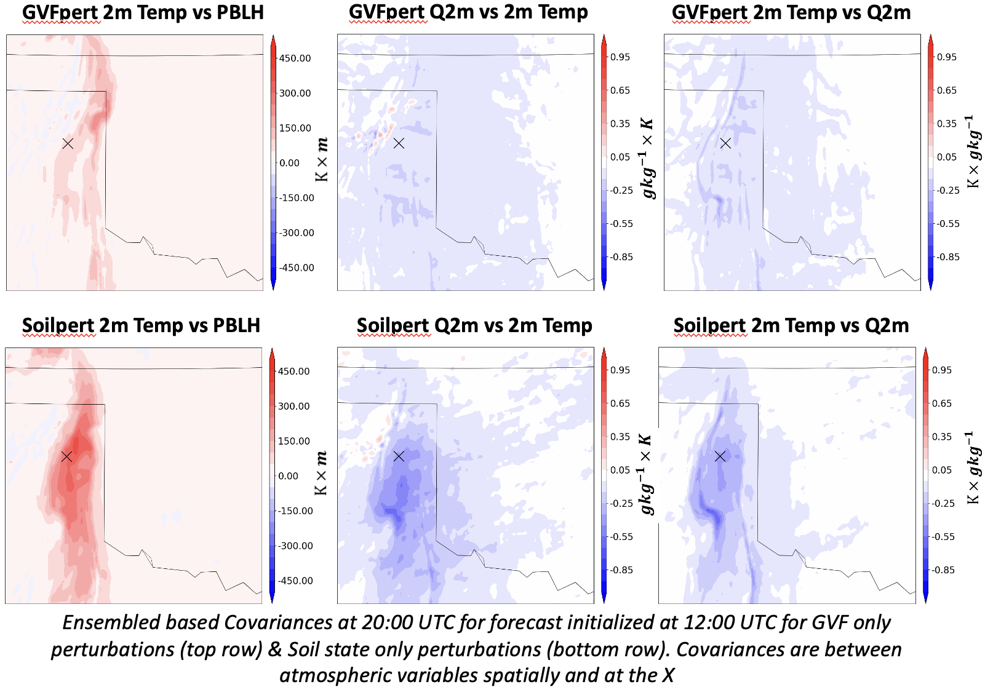
Covariances among unperturbed variables
”apples-to-apples” comparison of covariances among 2m variables and HPBL
GVFpert ensemble shows smaller magnitude and broader spatial scale of covariance structures than Soilpert ensemble
Combined effect of smaller variance of both variables in GVFpert, and larger spatial scale of GVF perturbations than soil state perturbations

Slide 11
Summary and Conclusions
Difference between climatological GVF and real time GVF is substantial enough to impact the evolution of the pre-convective environment in a deterministic forecast for this case.
Both spatial scale and magnitude of uncertainty in GVF is dominated by interannual variability.
Impact of ensemble GVF perturbations consistent with GVF interannual variability is compared to ensemble perturbations that isolate soil state uncertainty.
For many variables, spread due to GVF uncertainty alone is roughly half of that from soil state perturbations, consistent with hypothesis that GVF perturbations can mitigate convective-scale under-dispersion.
Spatial scale of GVF perturbations, and resulting forecast covariance, is larger than for soil state perturbations, suggesting potential impacts on how observation information is spread spatially during SCDA
Future Work
Continued analysis of impact of GVF vs. soil state perturbations in isolation
Evaluate impact of including GVF perturbations together with other sources of uncertainty in continuously cycled CADRE-MPAS-JEDI experiments

