Slide 1


Assimilating Boundary Layer Depths Observed by WSR-88Ds to Improve the Prediction of a Derecho
Braedon Stouffer, David Stensrud & Yunji Zhang
The Pennsylvania State University

Slide 2
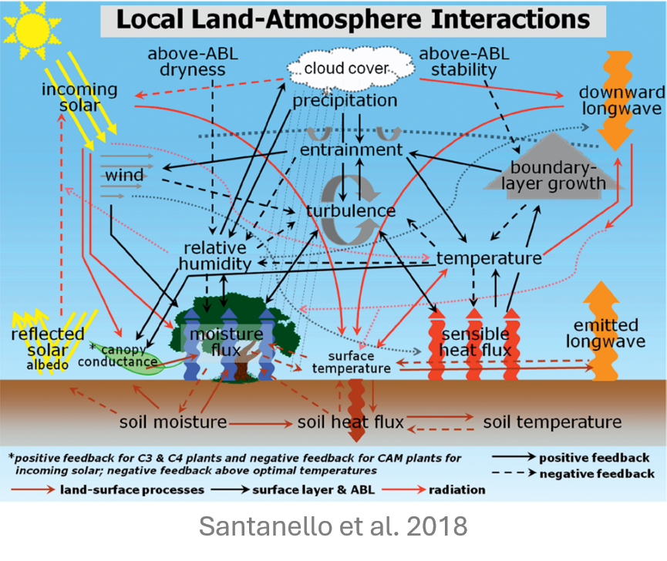
The planetary boundary layer (PBL) connects the land surface to the atmosphere
PBL characteristics such as height (PBLH) can heavily influence air quality, cloud formation and the initiation, organization and maintenance of deep convection
Accurate observations and model representation of the PBL are crucial

Slide 3
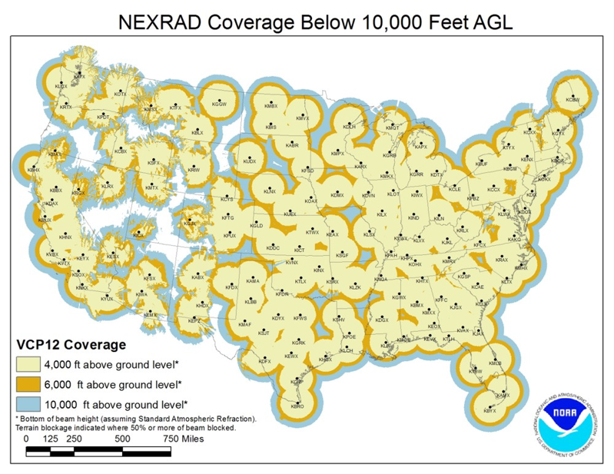
Observations of PBLH are sparse and inconsistent, and the direct assimilation of PBLH is rare
Recent developments:
NWS dual-polarization radars (WSR-88Ds) can provide accurate estimates of PBLH on ~ 50% of all days (Stouffer et al. 2024 & others)
Using WRF-EnKF, Zhang et al. (2025) successfully assimilated WSR-88D PBLH which improved a torrential rain forecast

Slide 4
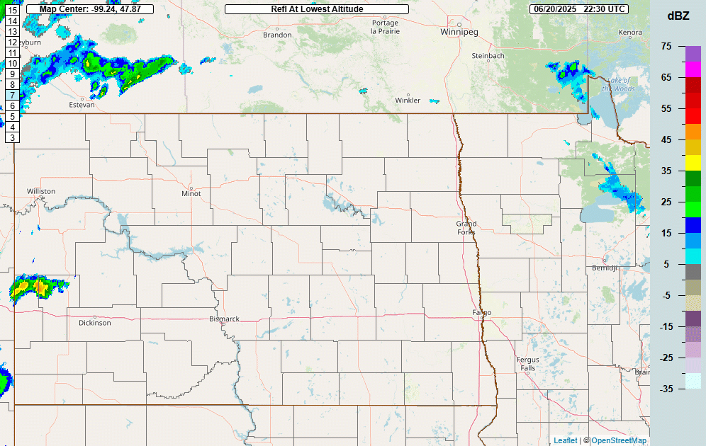
Case Selection: June 20-21, 2025, North Dakota Derecho
Convection formed in eastern MT, organized in western ND
Derecho impacts Bismarck and reaches peak intensity in east-central ND before weakening
Discrete supercells ahead of the derecho responsible for several tornadoes (Enderlin EF5)

Slide 5
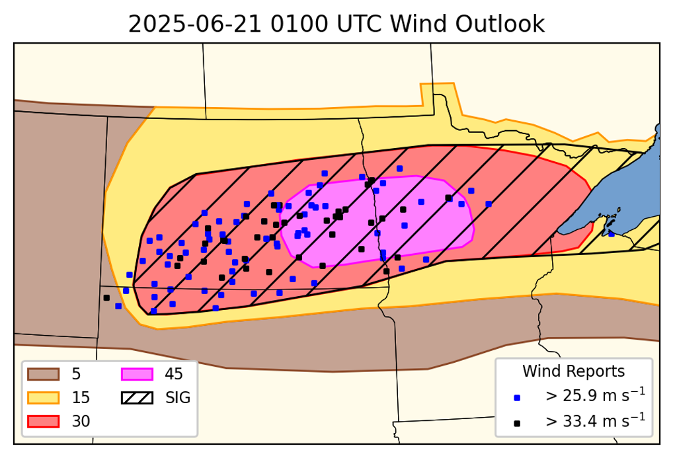
SPC’s 30% (ENH) wind contour is well placed along the track of the derecho
45% (MDT) contour is placed too far east relative to peak of derecho/clustering of wind reports
Derecho organized faster than expected, weakened before entering MN

Slide 6
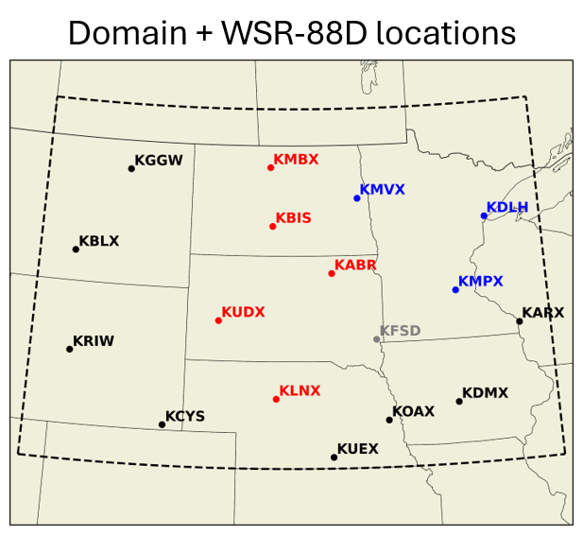
Simulations performed using the regional Model for Prediction Across Scales (MPAS) with HRRR physics suite, 3 km mesh
30-member ensemble: ICs generated from 1200Z HRRR analysis + GEFS perturbations, LBCs from GEFS. Soil perturbations also added
DA (GLETKF) performed for 6 hours using CADRE JEDI Workflow with 15-minute cycling following a 3-hour spinup from 1200Z-1500Z
Free forecasts from 6-20 1800-2100Z through 6-21 0600Z

Slide 7
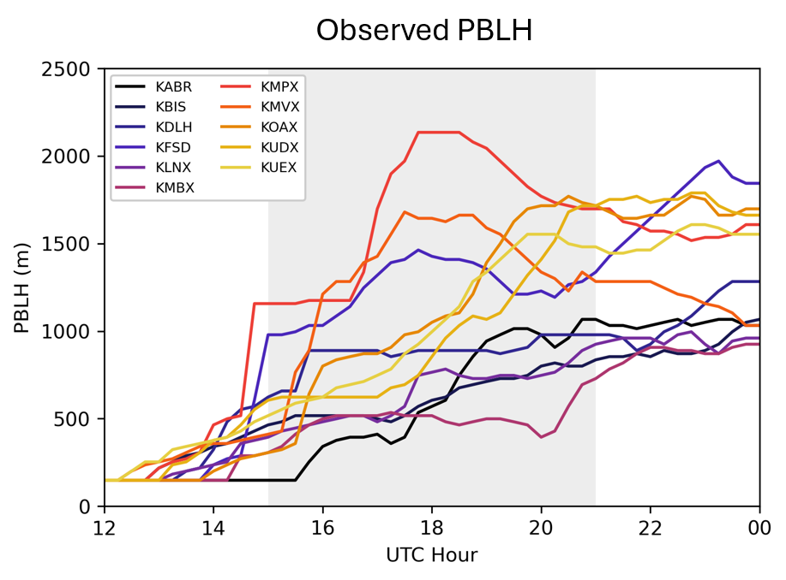
CONV experiment: surface, aircraft, sondes, etc. with 300 km GC horizontal, 0.3 logp vertical localizations; then radar reflectivity with 15 km GC horizontal, 10 model levels vertical.
PBLH experiment: same as CONV but with PBLH DA before radar reflectivity.
600 km GC horizontal, 0.3 logp vertical
Variable PBLH observation error: max(50, 0.1*PBLH) [m]
Both are strongly coupled (DA updates atmosphere + soil states)

Slide 8
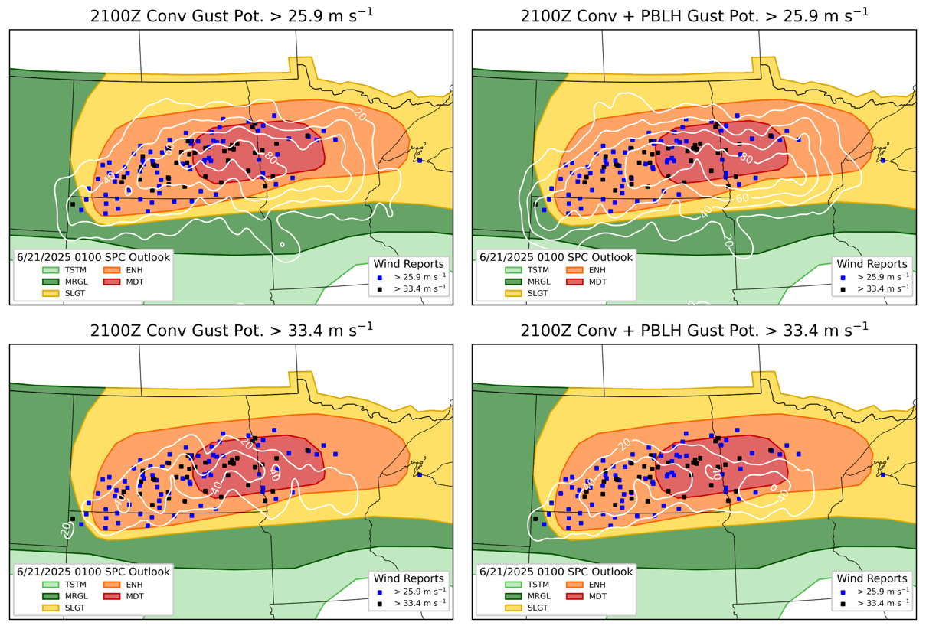
Neighborhood Maximum Ensemble Probabilities (NMEPs) used for verification
40 km neighborhood to align with SPC forecasting & verification practices
Metrics:
Updraft Helicity (UH)
Gust Potential (GP)
850 hPa wind (U850)

Slide 9
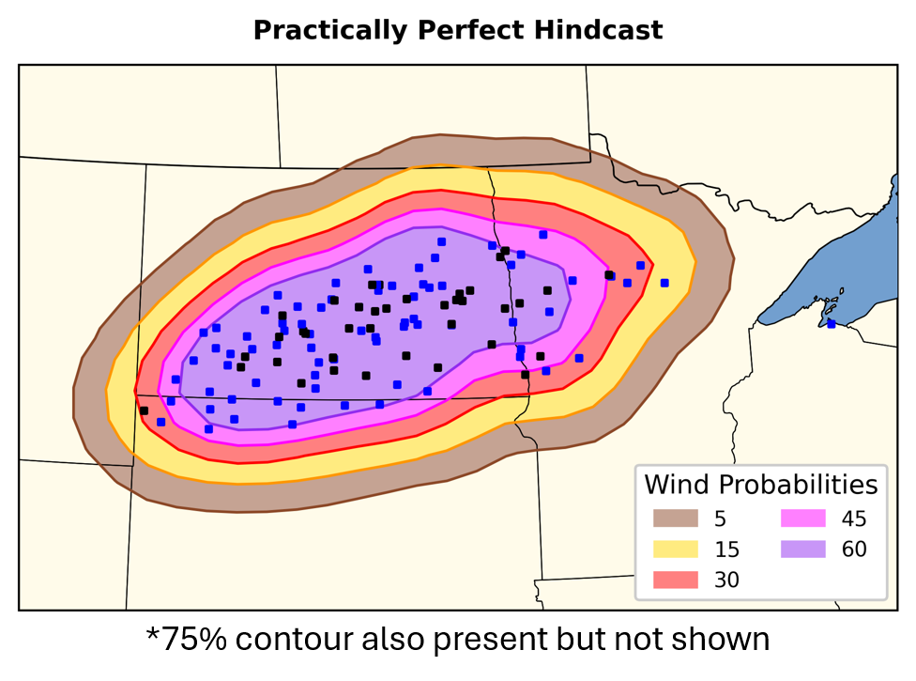
“Practically Perfect” forecast (Hitchens et al. 2013) allows for quantitative spatial comparison between forecasts
Using wind reports from 0000Z through 0600Z on 6/21
Sig. severe present but not shown; 60% + Sig. would have warranted a high risk in 2025 outlooks
60% CIG2 would have warranted a high risk in new system

Slide 10
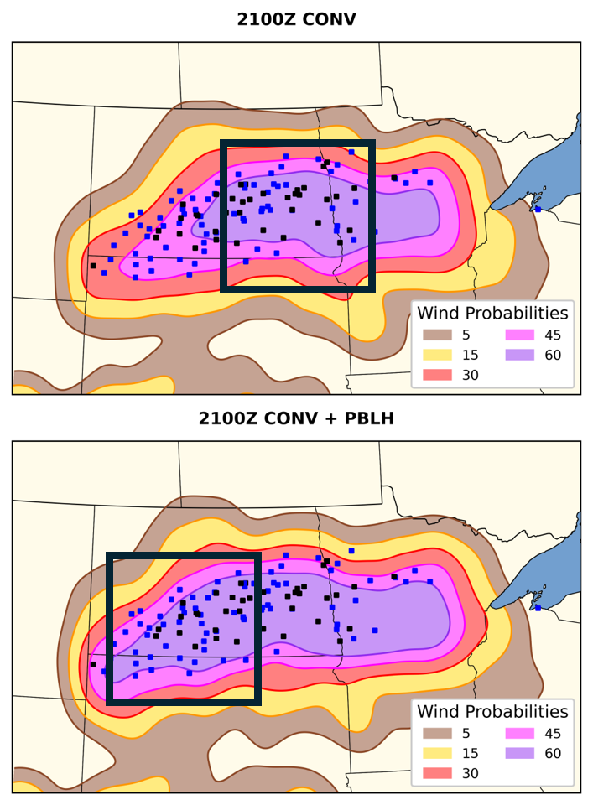
Gust potential NMEPs at each SPC % threshold can be used as a proxy for outlook
CONV forecasts place highest probs in eastern ND and western MN, similar to SPC outlook
PBLH forecasts extend highest probs further west into ND, better aligning with reports/PPH
Quantify accuracy using fractional skill score (FSS)

Slide 11
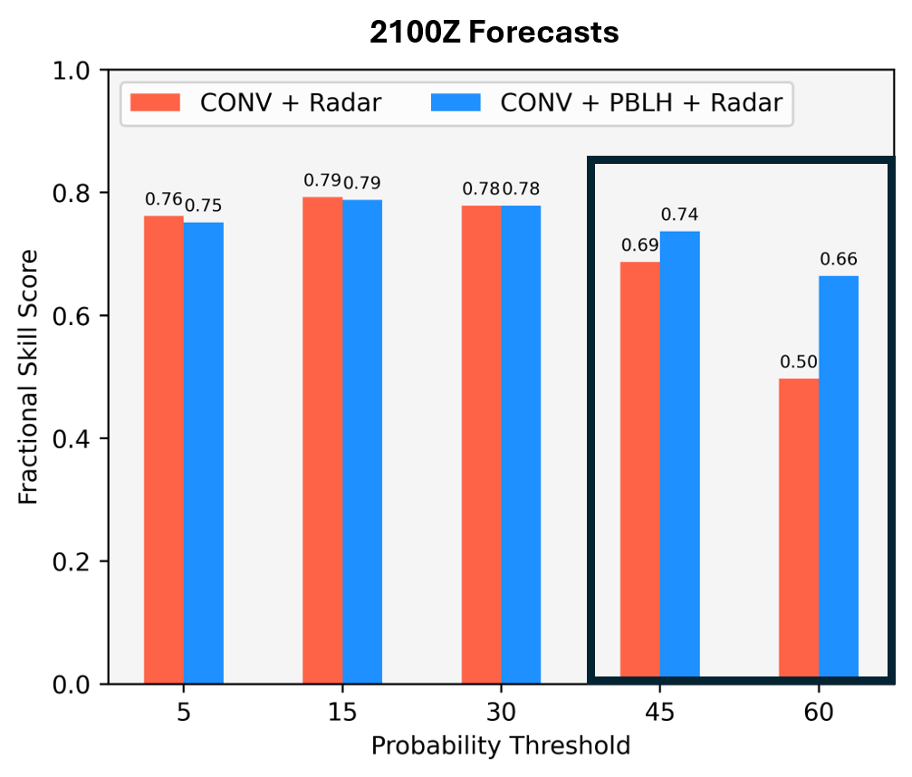
FSS show that CONV and PBLH are nearly identical in the lower three probabilities
PBLH improves on CONV in the 45% and especially in the 60% probabilities
PBLH forecast shows higher confidence in severe wind where the event actually occurred
What about other initialization times?

Slide 12
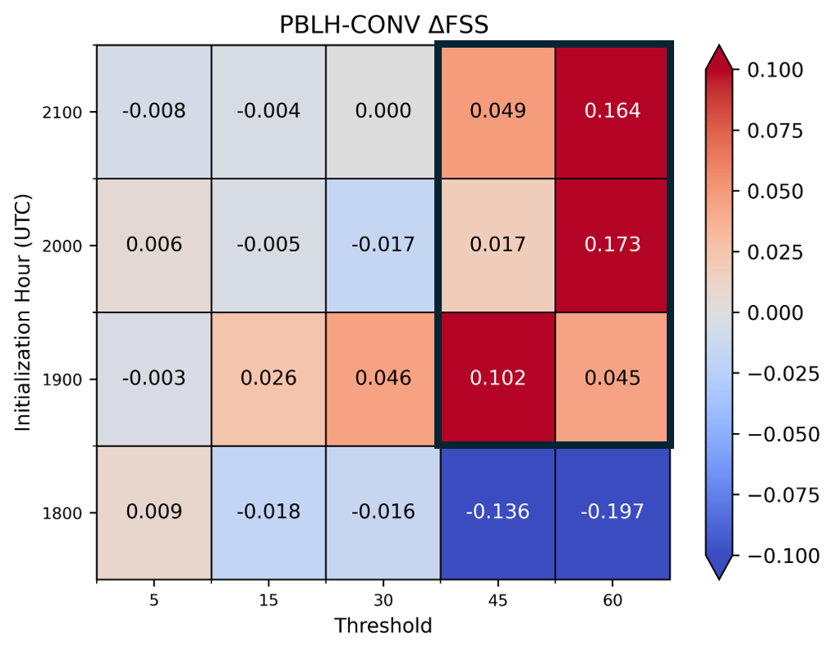
Other forecasts’ FSS are similar to previous findings
Besides 1800Z forecast, PBLH performs better than CONV
No major differences in lower probabilities; 45% and 60% show larger differences
After 1800Z, PBLH forecasts place highest wind probabilities more accurately than CONV

Slide 13
Conclusions
Retrieval of PBLH via WSR-88D network has allowed for novel assimilation
PBLH DA has been shown to improve representation of lower tropospheric temperature and moisture – important for severe weather
Impactful severe wind event selected: forecast was uncertain with room for improvement
Experiment with PBLH DA outperforms CONV across several metrics (better placement, higher probabilities) and lead times
Why? Still trying to figure that out, but PBLH DA is creating a more favorable environment for convection & upscale organization

Slide 14
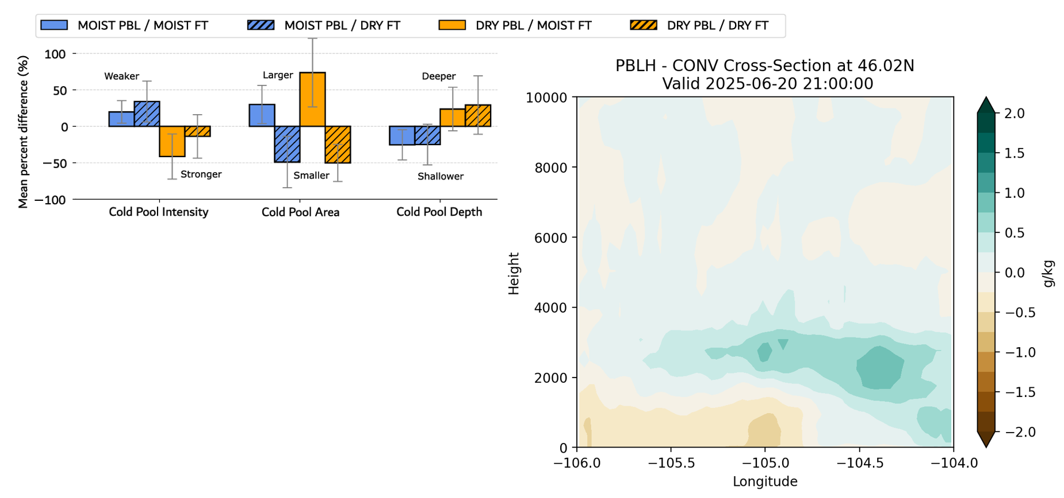
PBLH DA is changing the distribution of moisture along the axis of storm initiation
Increases cold pool strength, area and depth, leading to faster organization

