Slide 1
EPIC and the UFS
Presenter: D. Alex Burrows

Slide 2
about me…
Research
2017: PhD in Atmospheric Sciences with Gang Chen
Focus: Idealized modeling of the Midlatitude jet stream response to climate change like forcings
2018-2020: Postdoctoral work on low-level jet stream structure, dynamics, and mechanisms in the central US with Craig Ferguson
Research and Operations
2020: NCEP Central Operations to support forecast operations
2023: EPIC program focusing UFS atmospheric river applications
2025: EPIC program focusing on NOAA’s project EAGLE
Presenter: D. Alex Burrows

Slide 3




EPIC and the UFS
What is EPIC?
The Earth Prediction Innovation Center (EPIC) was created in response to the congressional charge to accelerate the development of the U.S. capacity to make early, accurate, and effectively communicated environmental predictions.
It is designed to support, sustain, and foster the collaborative work being done by the participating members of the Unified Forecast System (UFS).
EPIC fuels and enables the UFS.
What is UFS?
The Unified Forecast System (UFS) is a community-based, global, coupled Earth modeling system with the capability of configuring a set of common components (model components for atmosphere, land, ocean, sea ice, waves, aerosols, etc.) into different UFS Applications
span local to global domains
predictive time scales from sub-hourly to seasonal predictions
designed to support the entire Weather Enterprise (academia, government, and private industry)
to be the source system for NOAA‘s operational numerical weather prediction applications (e.g., GFS)
Presenter: D. Alex Burrows

Slide 4

UFS Through the Years
2015 – 2017
Foundation
DECEMBER 2015
UMAC (UCAR Modeling Advisory Committee) Report highlights need for operational changes in NOAA/NWS/NCEP.
MAY – JUNE 2016
Unified Modeling Task Force created; Next Generation Global Prediction System (NGGPS) Dynamical Core Evaluation.
APRIL 2017
Weather Research & Forecasting Innovation Act ("Weather Act") signed.
2019 – 2020
Strategy & Launch
JAN – SEP 2019
EPIC is federally mandated; Bill Lapenta presents the joint EPIC/UFS vision.
NOVEMBER 2019
UFS Steering Committee and Technical Oversight Charters formally signed.
JULY 2020
UFS R2O project launched; UFS Users’ Workshop; Medium-Range Weather application release.
2021 – PRESENT
Growth & Releases
OCT 2021 – JUL 2022
Neil Jacobs’ BAMS article “Open Innovation and the Case for Community Model Development” published; first UIFCW event held.
APRIL 2023
NSF letter for UFS App support
2023 – PRESENT
numerous public releases of EPIC support applications (more to come)

Slide 5
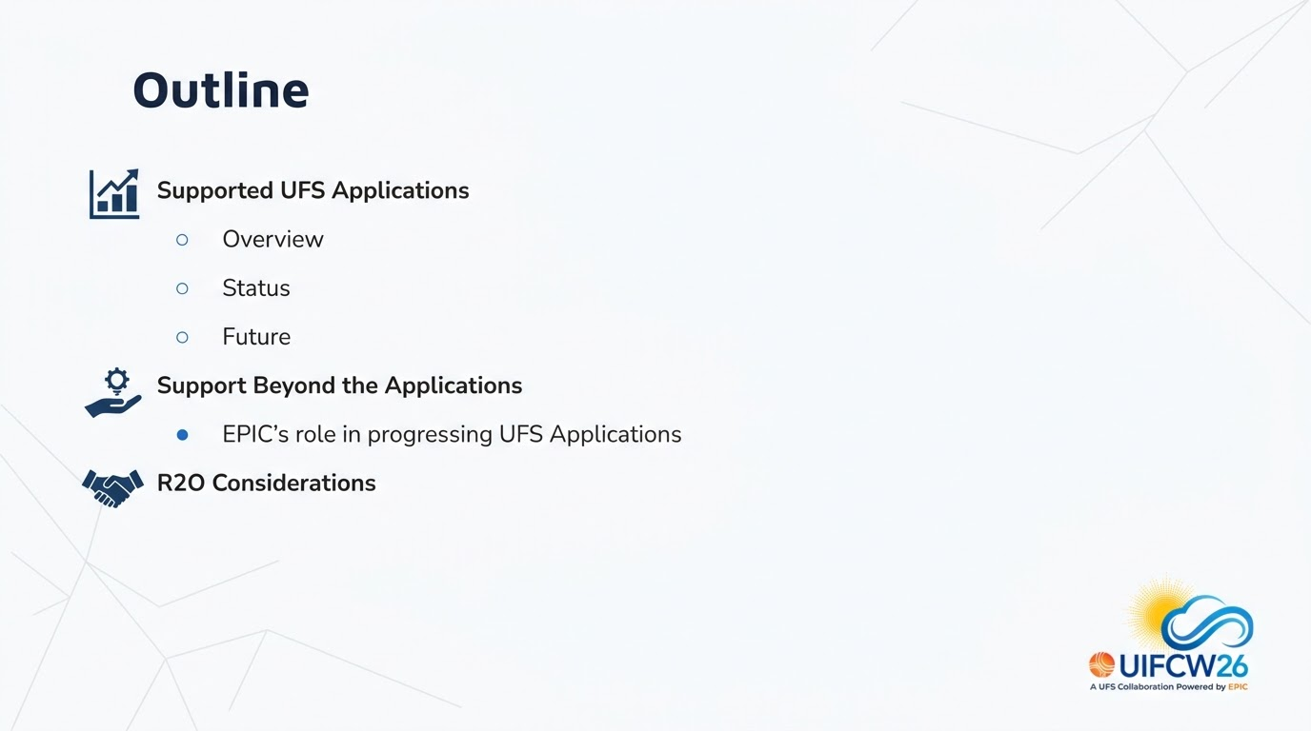


Slide 6
UFS Applications & Components
What is an Application?
A group of components targeting specific spatial and temporal scales to support forecast requirements. Combines numerical models, data assimilation, post-processing, and workflows.
Sub-seasonal to Seasonal (S2S)
Scale: ~2 weeks to 1 year
Components: Atmosphere, Land, Ocean, Sea Ice, Aerosol
Hurricane
Scale: Out to ~1 week
Components: Atmosphere, Land, Ocean, Wave
Short-Range Weather (SRW/CAM)
Scale: <1 hour to several days
Components: Atmosphere, Land
Space Weather
Scale: Out to ~1 month
Components: Atmosphere, Land, Ionosphere
What is a Component?
A distinct software package that models a certain aspect of the Earth system (e.g., atmosphere, land, ocean, sea ice, waves, aerosols).
Coastal
Scale: Out to ~1 week
Components: Storm Surge, Wave
Air Quality
Scale: Out to several days
Components: Atmosphere, Land, Aerosol

Slide 7
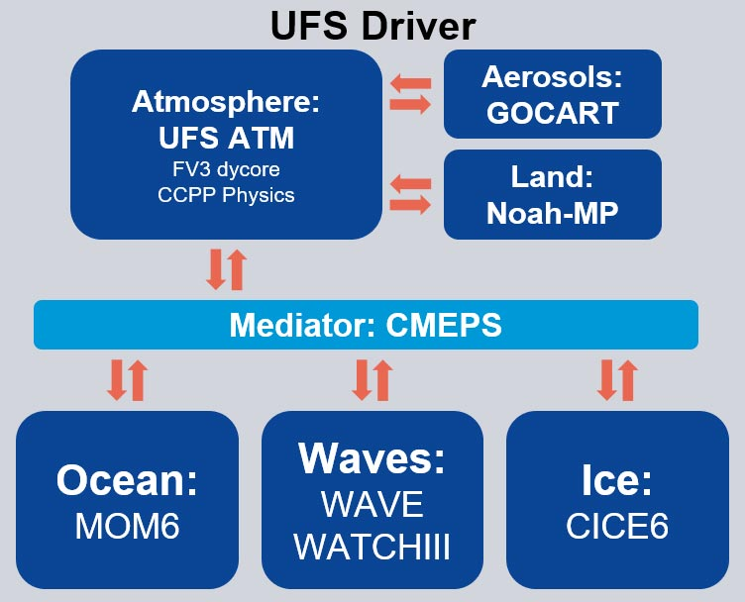
UFS Applications & Components
Earth System Application: All Components
Key components of the UFS
Atmosphere: ufs-weather-model
Land: Noah-Multi Parameterization Land Surface Model (Noah-MP)
Ocean: GFDL’s Modular Ocean Model Version 6 (MOM6)
Sea ice: Los Alamos Sea ice model version 6 (CICE6)
Wave: wave model (WAVE WATCHIII)
Aerosol: Goddard Chemistry Aerosol Radiation and Transport (GOCART) aerosol model.

Slide 8
UFS Applications & Components
Sub-seasonal to Seasonal
Key components of the UFS
Atmosphere: ufs-weather-model
Land: Noah-Multi Parameterization Land Surface Model (Noah-MP)
Ocean: GFDL’s Modular Ocean Model Version 6 (MOM6)
Sea ice: Los Alamos Sea ice model version 6 (CICE6)
Wave: wave model (WAVE WATCHIII)
Aerosol: Goddard Chemistry Aerosol Radiation and Transport (GOCART) aerosol model.

Slide 9
UFS Applications & Components
Hurricane
Key components of the UFS
Atmosphere: ufs-weather-model
Land: Noah-Multi Parameterization Land Surface Model (Noah-MP)
Ocean: GFDL’s Modular Ocean Model Version 6 (MOM6)
Sea ice: Los Alamos Sea ice model version 6 (CICE6)
Wave: wave model (WAVE WATCHIII)
Aerosol: Goddard Chemistry Aerosol Radiation and Transport (GOCART) aerosol model.

Slide 10
UFS Applications & Components
Short-Range Weather
Key components of the UFS
Atmosphere: ufs-weather-model
Land: Noah-Multi Parameterization Land Surface Model (Noah-MP)
Ocean: GFDL’s Modular Ocean Model Version 6 (MOM6)
Sea ice: Los Alamos Sea ice model version 6 (CICE6)
Wave: wave model (WAVE WATCHIII)
Aerosol: Goddard Chemistry Aerosol Radiation and Transport (GOCART) aerosol model.

Slide 12
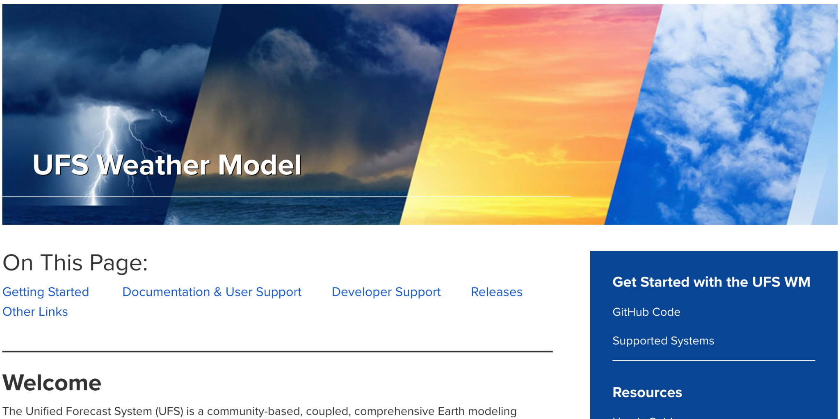
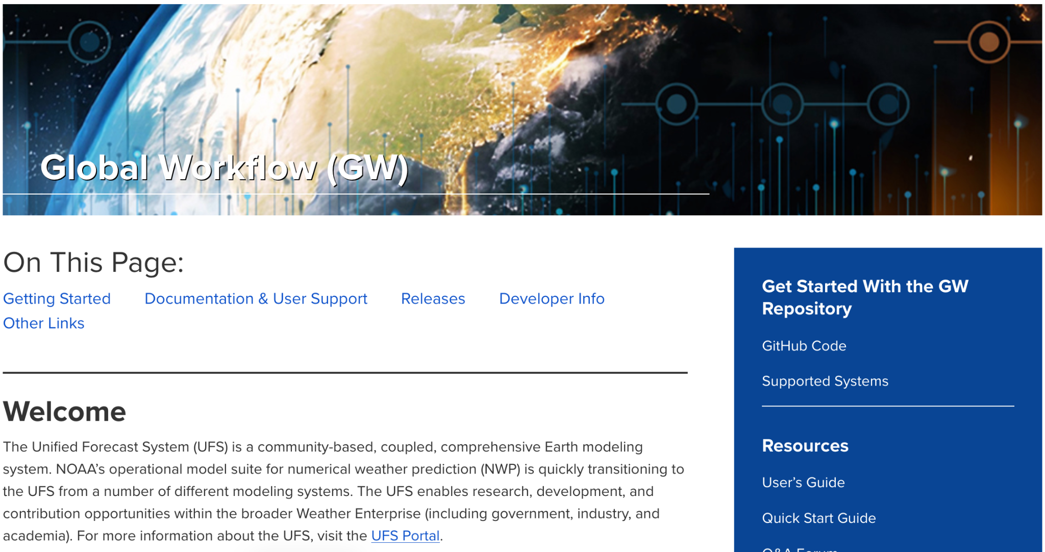
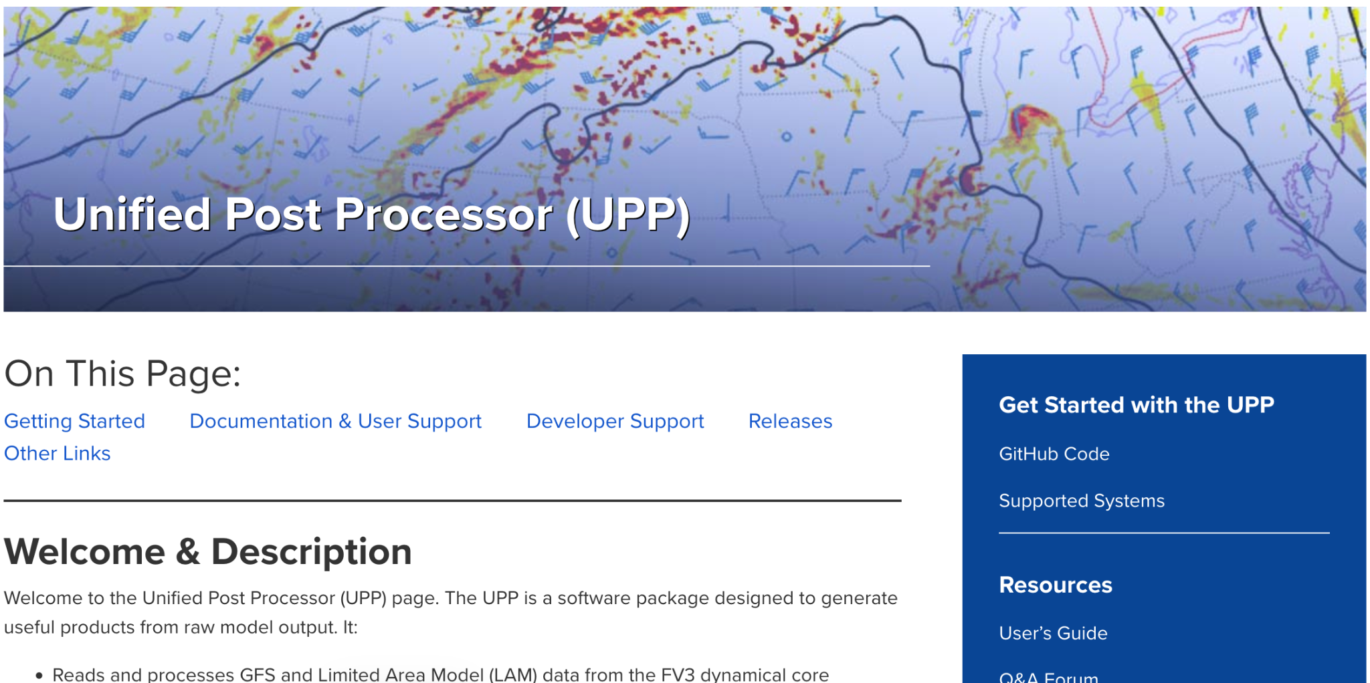
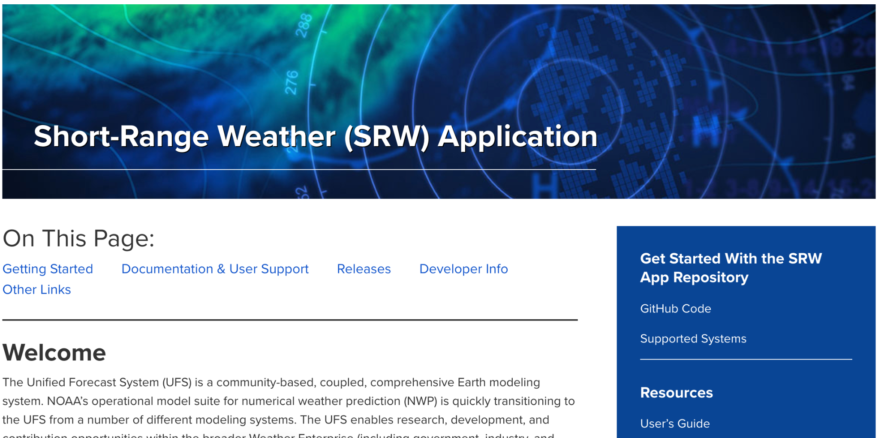
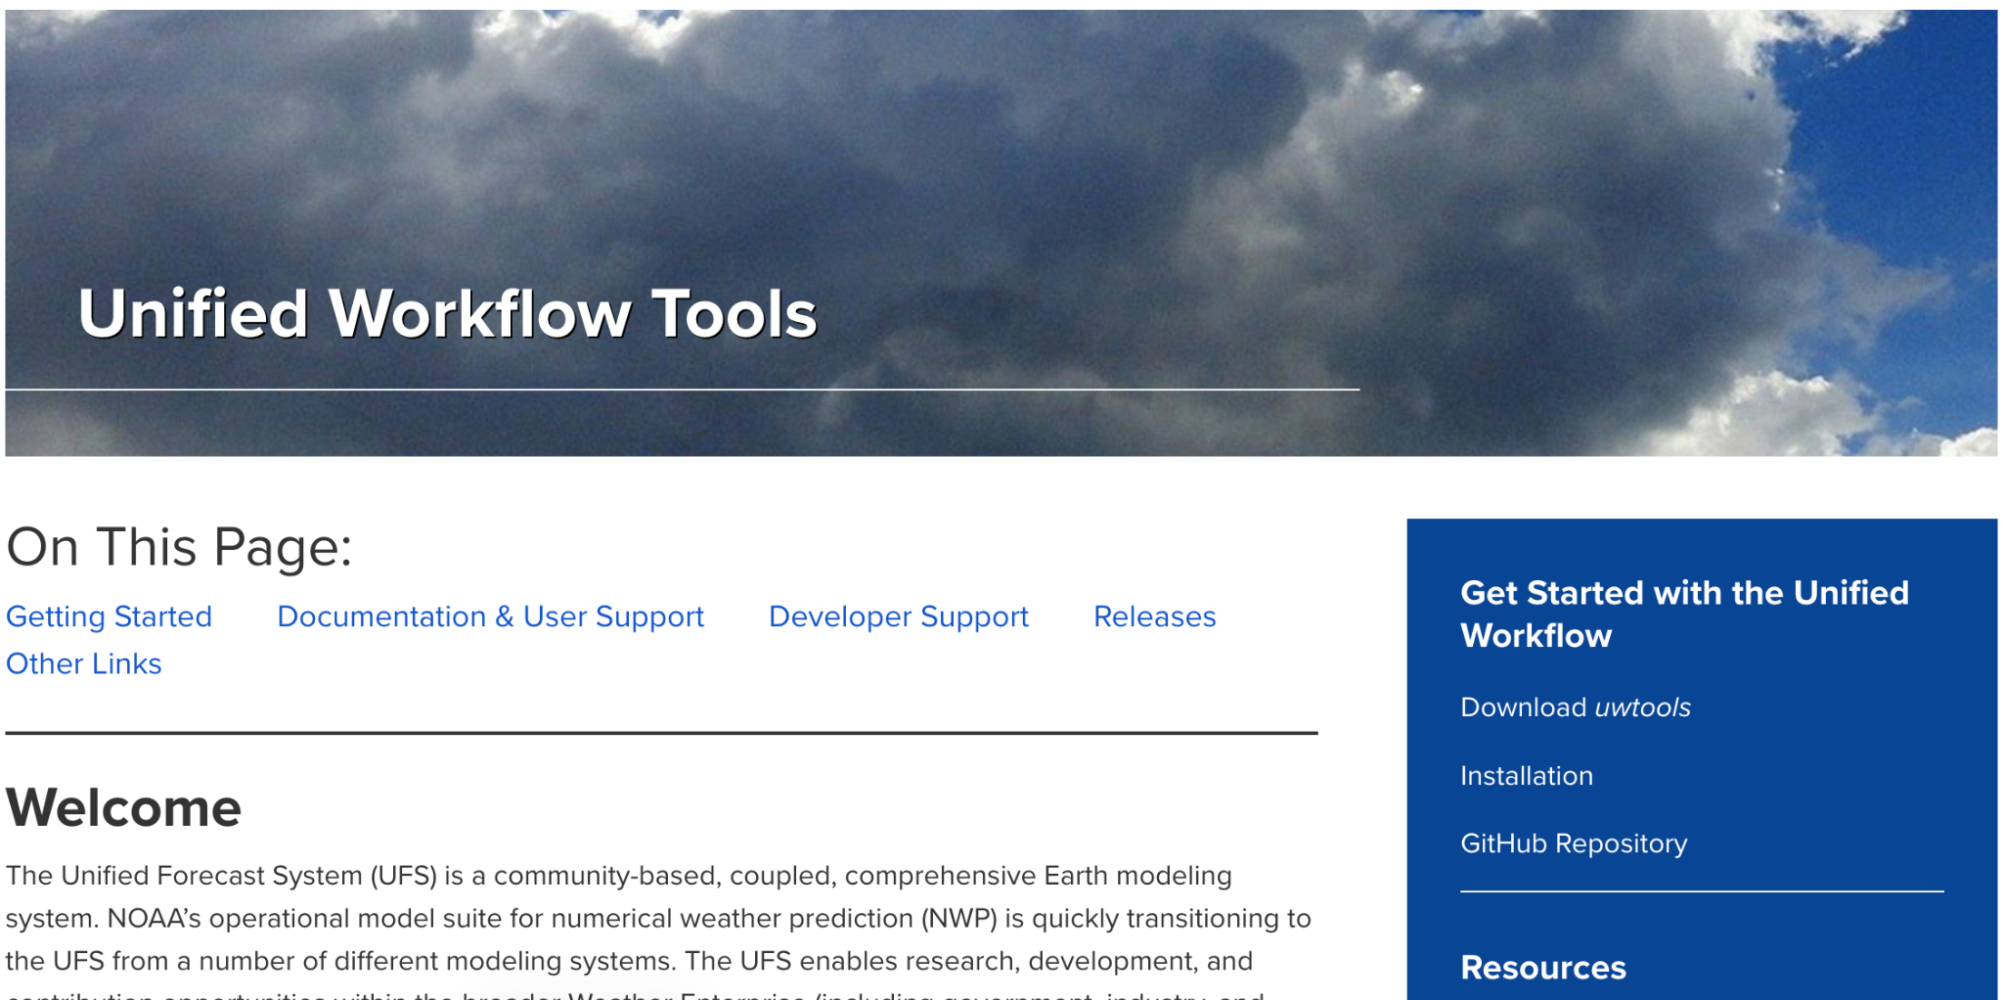
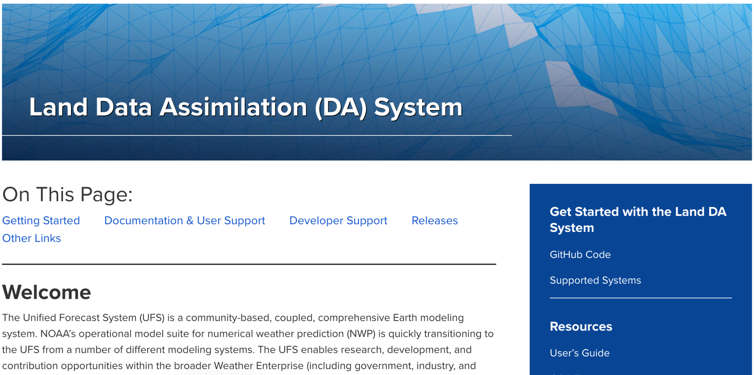
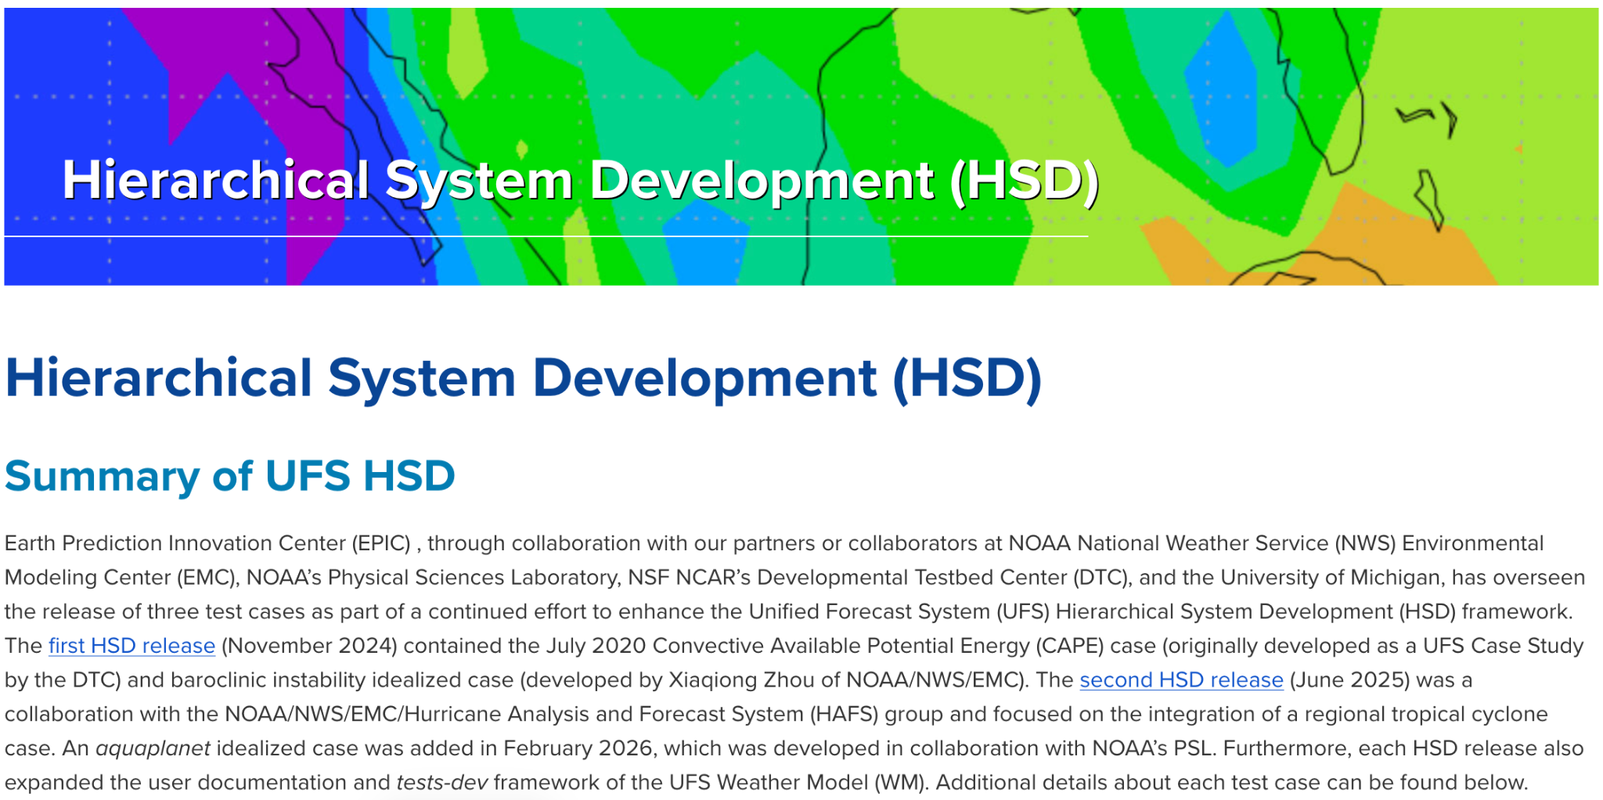
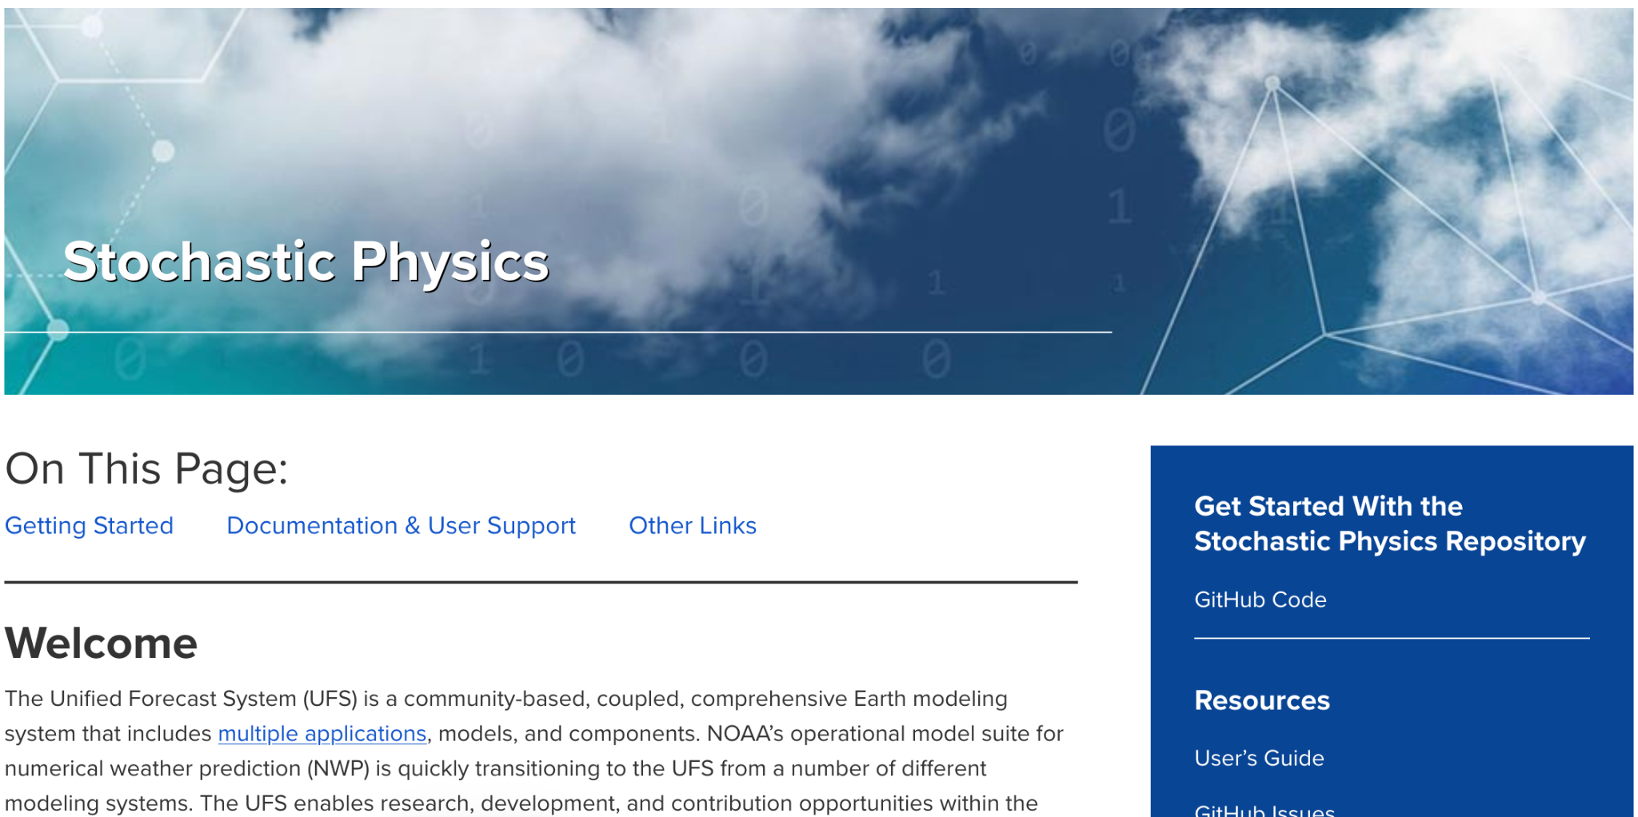
Supported Applications
Applications, Components, Development Frameworks, and Collaborations
Today: Focus on UFS-WM, SRW, GW, and UFS DA workflow

Slide 13


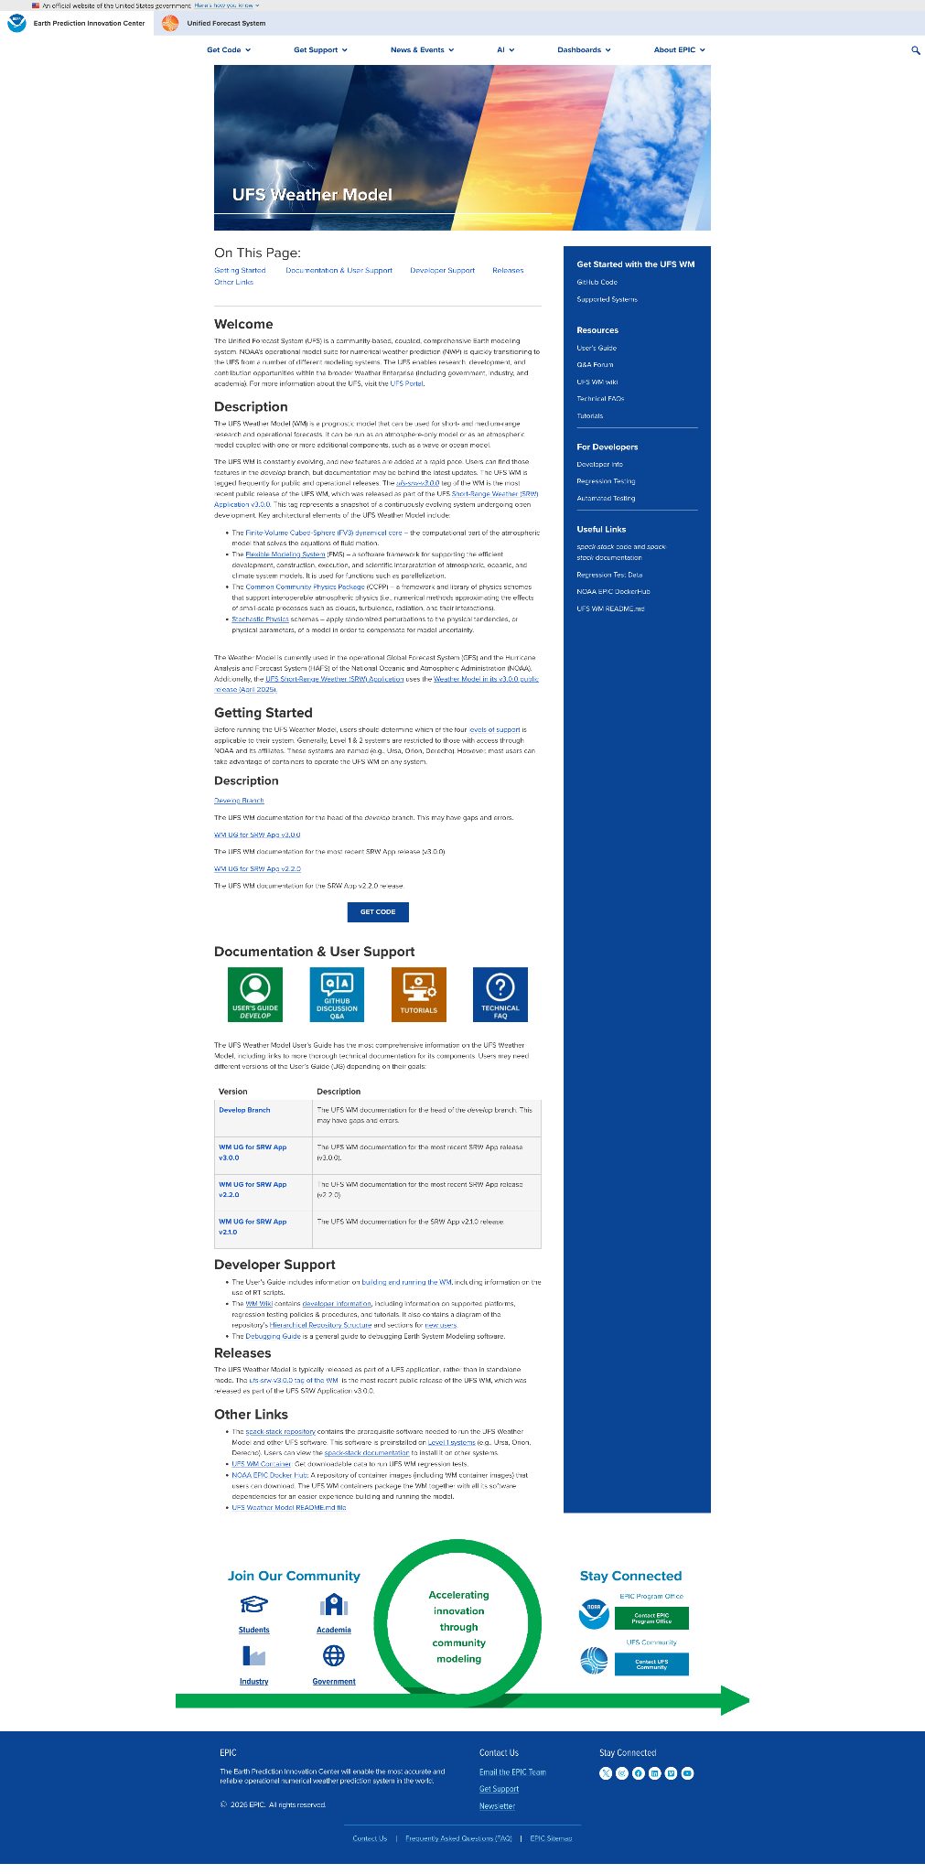
Supported Applications
Application Name
Identifies the active service/app
"On This Page" Links
Quick anchor navigation links
What is the UFS?
High-level system introduction
Application Description
Detailed general overview
Getting Started
Prerequisites & basic setup
Get Code Link
Direct link to download code
Documentation & Support
User Guide, Forums, FAQs
Version History Links
UFS-WM release history
Developer Support
Resources for contributors
Current Release Tag
Latest stable release info
Supporting Links
External documentation portals
Supported Applications, Components, Development Frameworks, and Collaborations:
WM, SRW, UPP, Land DA, UWTools, Stochastic Physics, HSD, Global-Workflow

Slide 14
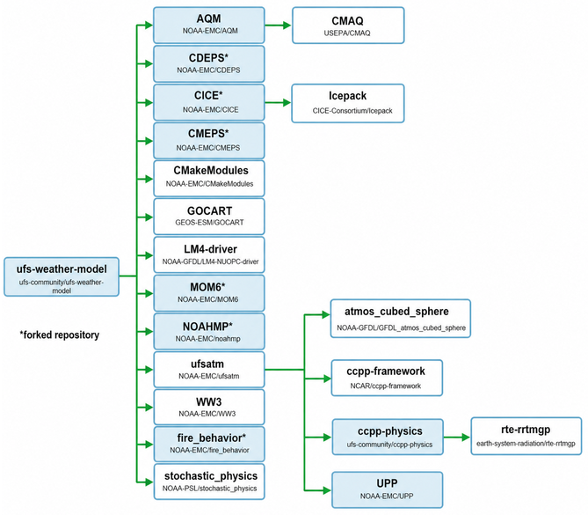
UFS Weather Model (UFS-WM)
UFS Weather Model Overview
Prognostic model for short- and medium-range research and operational forecasts. Runs atmosphere-only or coupled with wave and ocean components.
UFS Applications: SRW, GW, HAFS, RRFS, UFS-DA Workflow, UFS-Coastal
UFS Components: AQM, CICE, GOCART, MOM6, NoahMP, WAVEWATCHIII, fire, stochastic
Specs: Global Domain | Days to a couple weeks temporal scale
Future Roadmap & Integrations
UFS-MPAS Integration (EPIC Contributions):
??
??
??
GCAFS Integration:
??
??

Slide 15
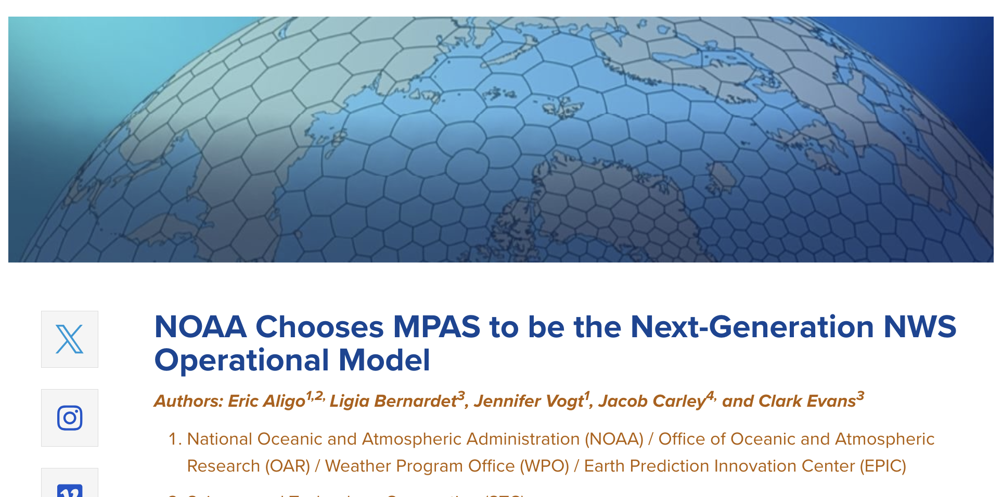

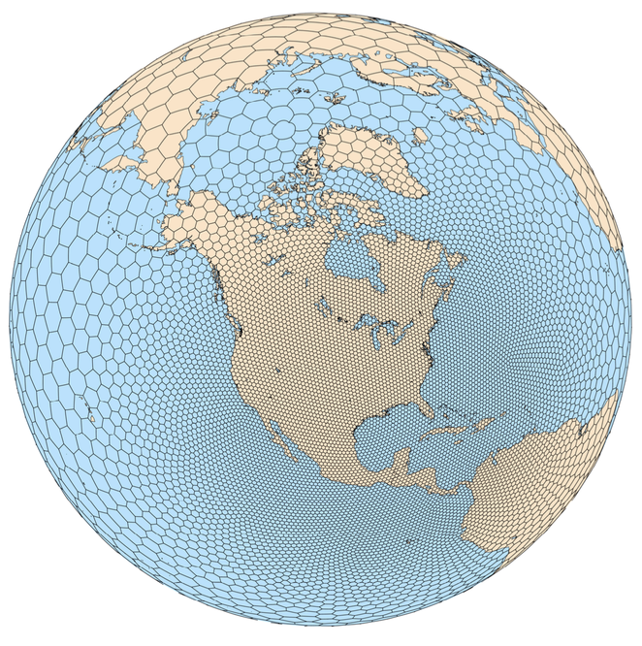

UFS Future: UFS-MPAS Integration
The Model for Prediction Across Scales (MPAS) is a collaborative project for developing atmosphere, ocean and other earth-system simulation components for use in climate, regional climate and weather studies.
MPAS to complement GFDL’s FV3 dynamical core
Designed to overcome limitations of traditional latitude-longitude grid models by using unstructured, variable-resolution meshes that allow seamless simulations from global to regional scales
Components: atmosphere, ocean, sea ice, ice sheets, and JEDI-DA
EPIC looking to support MPAS integration into UFS
Variable Resolution
Global - 60 km
North America - 15 km
CONUS - 3 km
MPAS
https://www2.mmm.ucar.edu/projects/mpas/site/documentation/mpas_overview.html

Slide 16
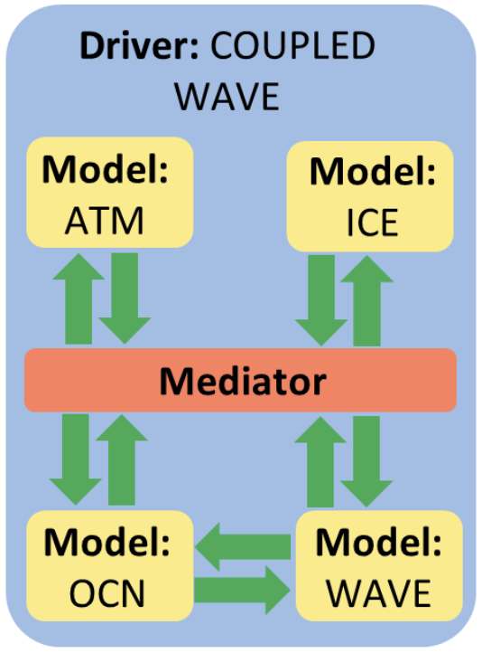
UFS Future: GCAFS
GCAFS: Global Chemistry and Aerosol Forecast System
CATChem: Configurable ATmospheric Chemistry (a new NUOPC component) - modelling component that includes all chemical and aerosol processes needed to perform atmospheric chemistry and composition simulations within a model
What is GCAFS? extends the Global Forecast System (GFS) with interactive aerosol and atmospheric chemistry capabilities. It provides a unified framework for predicting the evolution of atmospheric composition alongside traditional weather variables
Interactive GOCART for improving predictions of dust, sea salt, smoke from wildfires, sulfate, black carbon, and organic carbon in the atmosphere replacing the current capability of the GEFS.
CATChem and CECE plan to connect to the UFS-WM through CCPP
Alongside GCAFS version 1.0 comes the Global Constituent Data Assimilation System (GCDAS) which provides analyses of aerosol species to initialize the GCAFS forecasts using JEDI DA.
Initial plan was to release GCAFS v1.0 into operations. Now CATChem+CECE will make up the core of GCAFS v2.0 with operational plans for 2028
CECE: Community Emissions Computing Engine
GCAFS = CATChem + CECE
NUOPC: Layer that defines conventions and a set of generic components for building coupled models using the Earth System Modeling Framework (ESMF)

Slide 17
UFS Weather Model (UFS-WM)
UFS Weather Model Overview
Prognostic model for short- and medium-range research and operational forecasts. Runs atmosphere-only or coupled with ocean, land, sea-ice, fire, wave, and aerosol components.
UFS Applications: SRW, GW, HAFS, RRFS, UFS-DA Workflow, UFS-Coastal
UFS Components: AQM, CICE, GOCART, MOM6, NoahMP, WAVEWATCHIII, fire, stochastic
Specs: Global Domain | Days to a couple weeks temporal scale
Future Roadmap & Integrations
NCAR’s MPAS Integration (EPIC Contributions):
Generate memory usage and runtime metrics for MPAS & UFS WM
Update/refine operational regression testing framework
Implement automated regression and warning tracking (GitHub CI/CD)
GCAFS Integration:
EPIC supporting GCAFS integration into UFS WM (following GW)
Integrate CECE and CATChem as NUOPC components

Slide 18
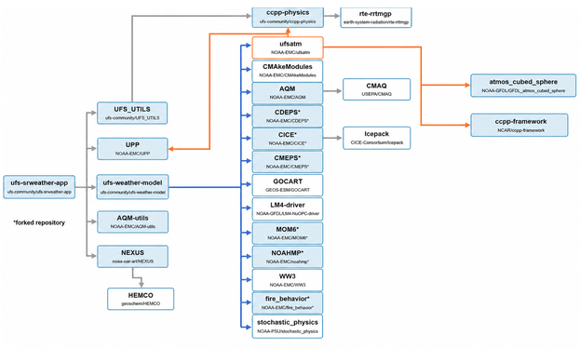
SRW App
Short-Range Weather (SRW) App Overview
Domain: limited area; atmosphere only
Temporal: from minutes to several days
UFS Applications: UFS WM
UFS Components: Atmosphere, Land, METPlus, UPP, UWTools
Initializations: GFS, NAM, RAP, HRRR, RRFS in grib2 format
Resolutions: 3-, 13-, and 25-km predefined CONUS domains (127 vertical levels)
Status: UFS SRW v3.0.0 Released
Integration of Community Fire Behavior Model (CFBM, NSF-NCAR)
Smoke and Dust capabilities
Continued UWTools integration
Future Outlook
Planning to deprecate the application:
Lack of general development within the application
Prioritizing resources for UFS transition from FV3 to MPAS
Migration of AQM outside of SRW into GCAFS
Lack of convergence with operational RRFS-workflow (R2O2R)

Slide 19
SRW App
Short-Range Weather (SRW) App Overview
Domain: limited area; atmosphere only
Temporal: from minutes to several days
UFS Applications: UFS WM
UFS Components: Atmosphere, Land, METPlus, UPP, UWTools
Initializations: GFS, NAM, RAP, HRRR, RRFS in grib2 format
Resolutions: 3-, 13-, and 25-km predefined CONUS domains (127 vertical levels)
Status: UFS SRW v3.0.0 Released
Integration of Community Fire Behavior Model (CFBM, NSF-NCAR)
Smoke and Dust capabilities
Continued UWTools integration
Future Outlook
Planning to deprecate the application:
Lack of general development within the application
Prioritizing resources for UFS transition from FV3 to MPAS
Migration of AQM outside of SRW into GCAFS
Lack of convergence with operational RRFS-workflow (R2O2R)
DEPRECATING

Slide 20
Global Workflow (GW)
Global Workflow Overview
GW is THE workflow that runs the global application with UFS WM in operations
An end‑to‑end workflow designed to run global configurations of medium range numerical weather forecasting for the UFS-Weather Model (WM). It seamlessly integrates components to pre-process, analyze, generate, post-process, and verify forecast data without manual stitching.
Domain: global
Temporal: days (GFS/GEFS) to months (SFS)
Initializations:
GFS and GEFS from GFS/GDAS
GCAFS/SFS from internal DA
UFS Applications: UFS WM
UFS Components: Atmosphere-only up to fully coupled
Status & Future
Status: Community GW v1.0.0
Released in June 2026. Supports GFS, GEFS, GCAFS, and SFS configurations with GSI (atmosphere-only) and JEDI systems.
Future Outlook
EPIC to provide support for community-generated GitHub discussions, issues, or pull requests.

Slide 21
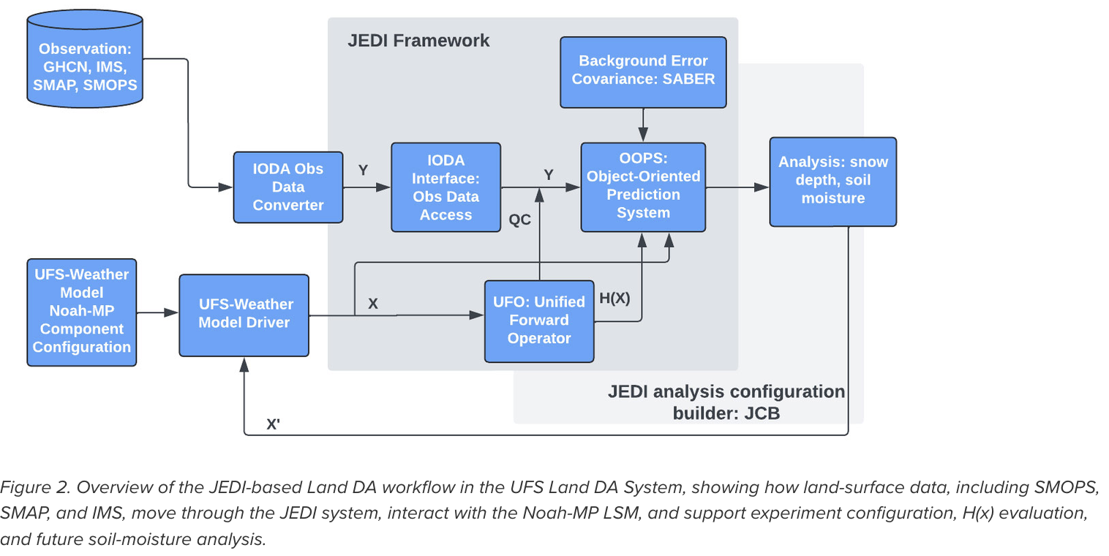

Land DA ⇒ UFS DA Workflow
Land DA Overview
Provides a flexible modular framework for land‑surface modeling and data assimilation via Noah-MP LSM and JEDI used within the UFS
UFS Components: Atmosphere, Land
UFS Applications: UFS WM
DA: JEDI for snow and soil moisture (SMAP/SMOPS) data
Initializations: GFS for ATML (FV3ATM + Noah-MP)
Status & Future
Status: UFS-DA Workflow v3.0.0 (March 2026)
Supports ATML (FV3ATM + Noah-MP) & DATM (ERA5/GSWP3) coupling
Adds IMS snow products & H(x) forward operator for SMAP/SMOPS
Future Outlook
Transition to UFS DA workflow for supporting land-DA, SOCA, and atm-DA with a single framework
GDAS App will be used as main component for DA

Slide 23

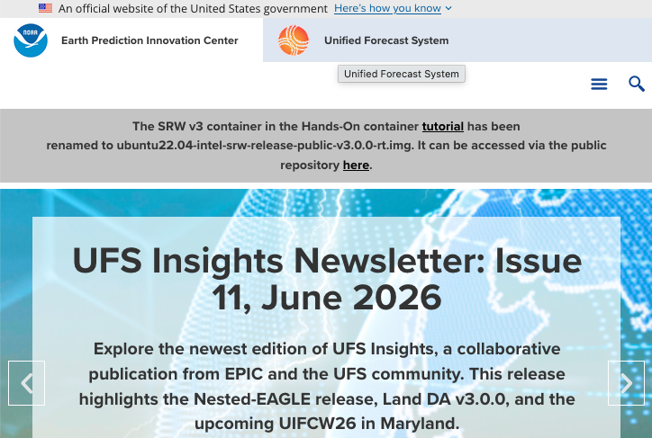
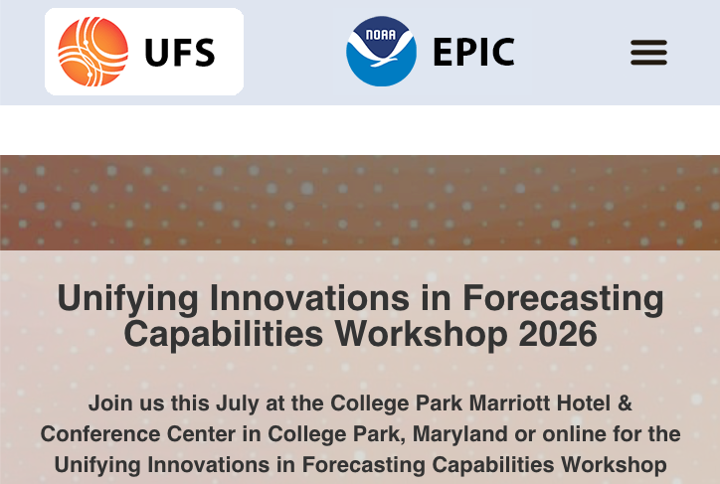
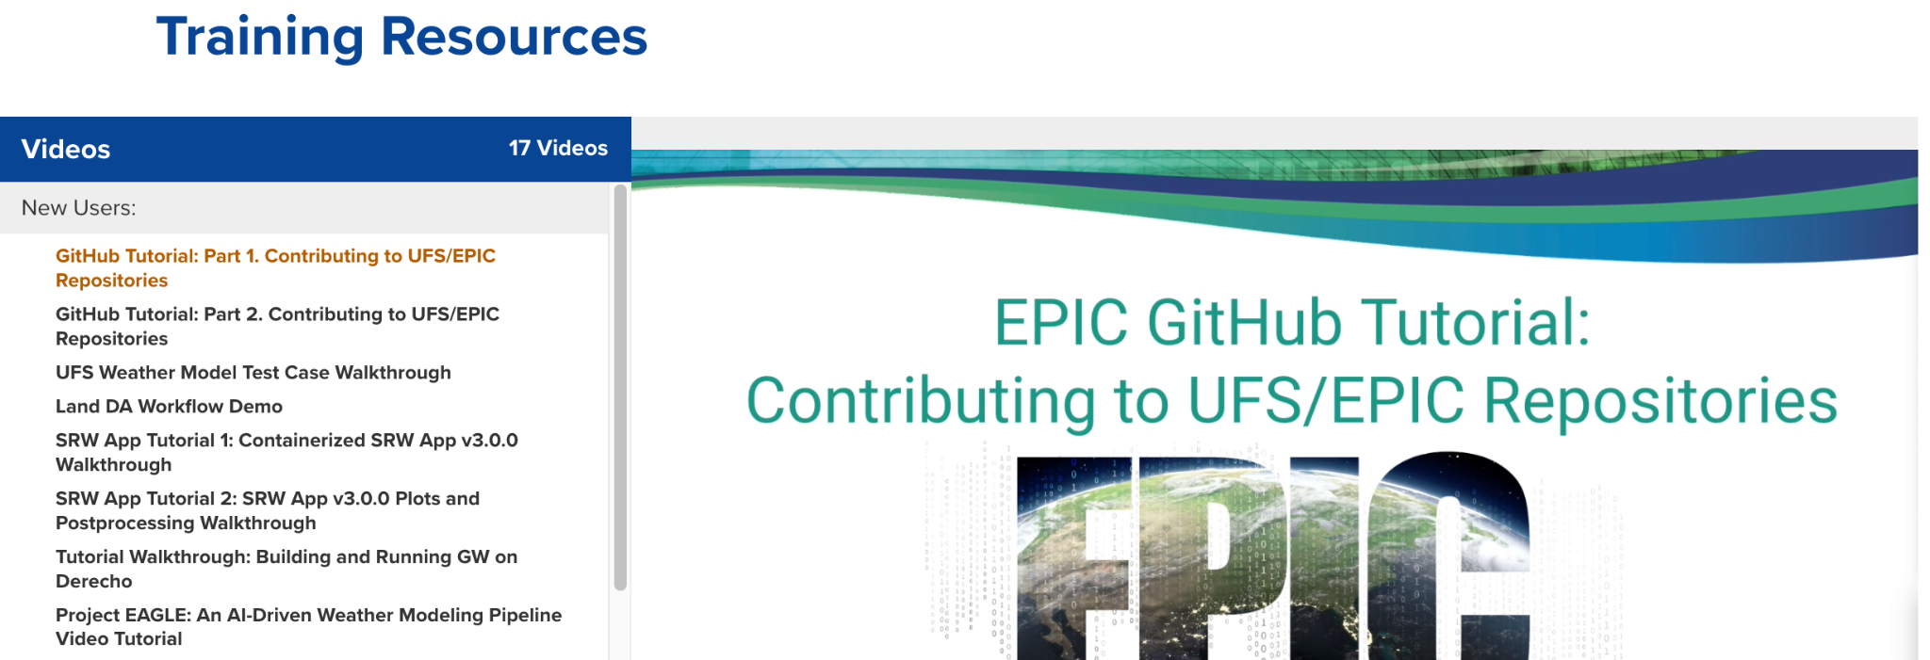
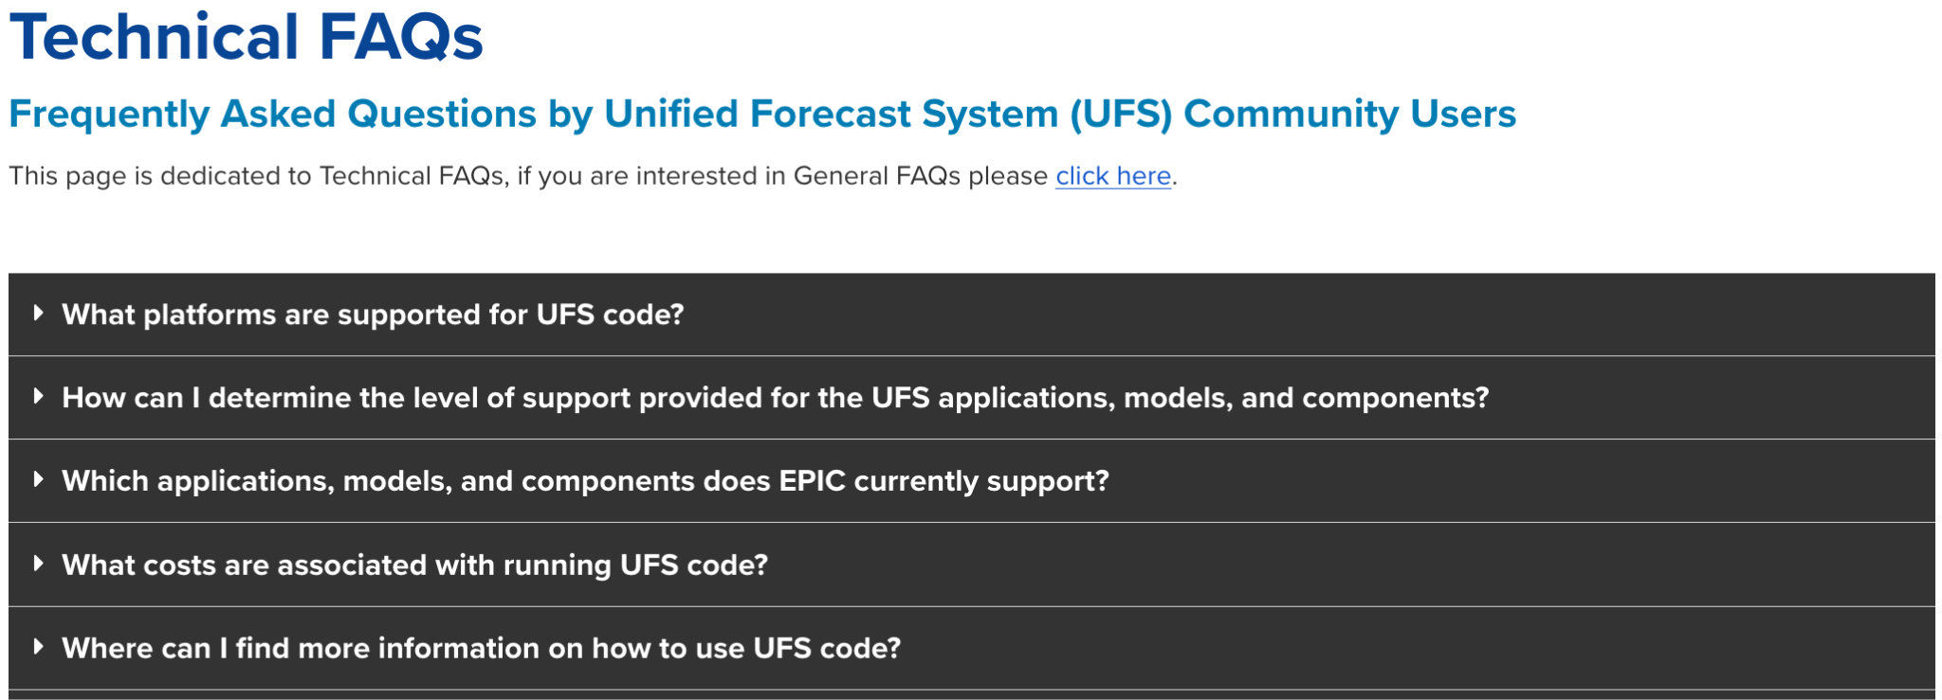
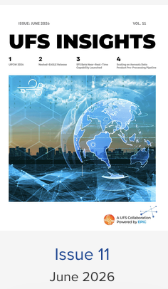
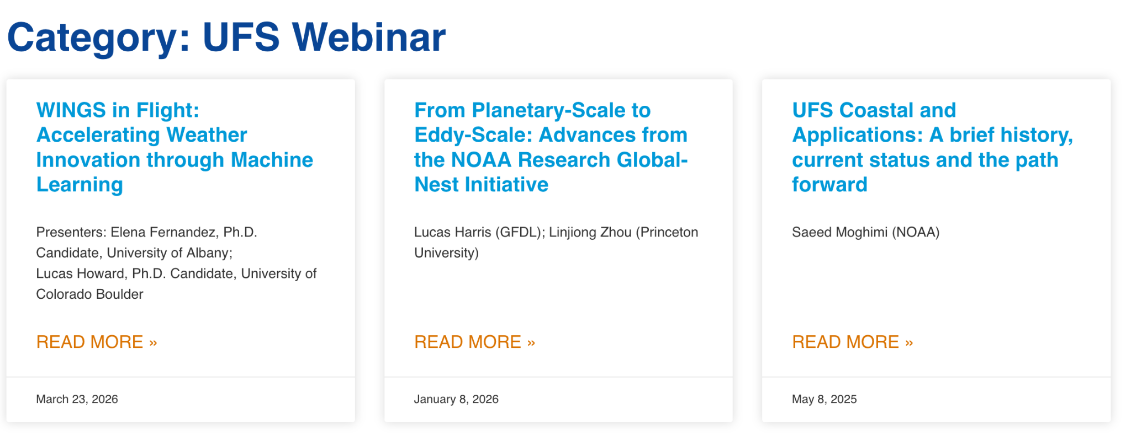


Community & Support Resources
Centralized access to portals, webinars, training materials, and documentation
EPIC Website
UFS Website
Trainings
Technical FAQs
Quarterly Newsletter
UFS Webinar Series
UIFCW Event
Code Fests

Slide 24
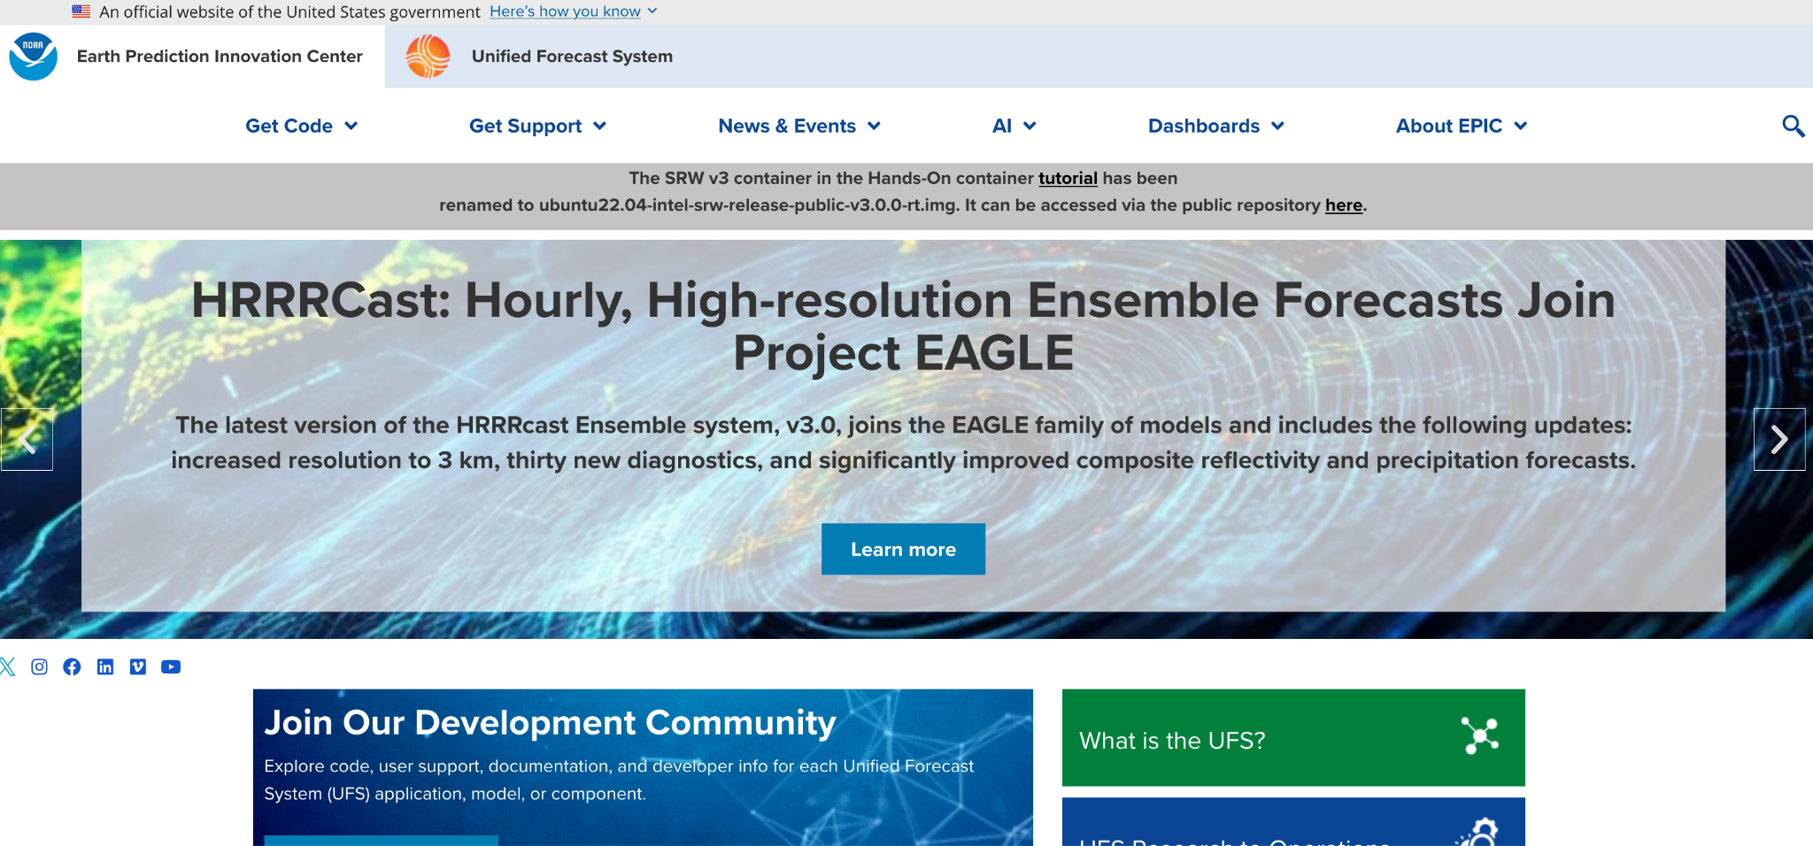
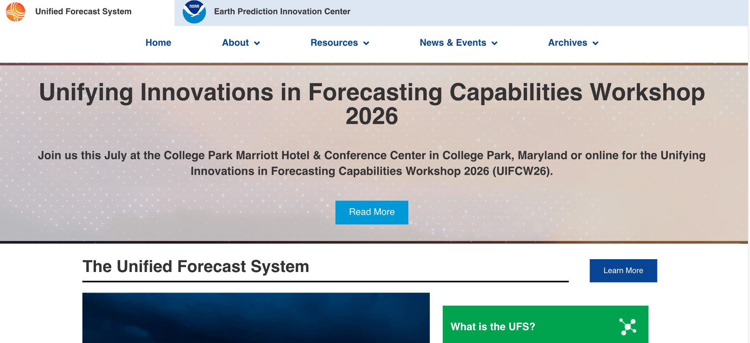
Web Portals
Explore and navigate the core resources offered by EPIC and UFS platforms
EPIC Webpage
UFS Webpage
Direct Access To:
Get Code Pages & Repositories
User Support & Technical Forums
News, Events & Community Highlights
Artificial Intelligence Dashboards
Direct Access To:
About UFS & System Governance
Resources & Support Documentation
News, Workshop & Event Updates
Historical Archives & Technical Reports

Slide 25
Trainings
New Users
GitHub Tutorial Part 1: Contributing to UFS/EPIC Repositories
GitHub Tutorial Part 2: Contributing to UFS/EPIC Repositories
UFS Weather Model Test Case Walkthrough
Land DA Workflow Demo
SRW App Tutorial 1: Containerized SRW App v3.0.0 Walkthrough
SRW App Tutorial 2: Plots & Postprocessing Walkthrough
Building & Running GW on Derecho
Cloud Tutorials
Creating a Base Image on AWS
Launching a PCluster Image to run SRW on AWS
Containerized Land DA Workflow on AWS
Unified Workflow
Intro to uwtools and the File Copy/Link Tool
Graduate Students
HPC-Stack Setup on a Mac
UIFCW 2025 Trainings
Compile & Run UFS Global-Workflow using Container Image (Singularity)
Artificial Intelligence in Weather Modeling
Introduction to Running Idealized Test Cases via UFS
NOAA AI Learning Journeys Tutorial
UIFCW 2026 Trainings
Introduction to Running NWS Global NWP Models in Development Mode
Adding Idealized Test Cases to the UFS HSD Framework
Project EAGLE Training: Machine Learning Weather Forecasting on Microsoft Azure

Slide 26
Technical FAQs
UFS Community FAQs
What platforms are supported for UFS code?
What costs are associated with running UFS?
Where can I go to get support for UFS code?
Where are required software libraries located?
UFS DA System
My tasks went DEAD. Why might this be?
UFS SRW App
How can I add a physics scheme (e.g., YSU PBL)?
I ran one experiment; how do I configure a new one?
Can SRW run on non-Tier-1 platforms?
Stochastic Physics
How do I run stochastic physics unit tests?
UFS Weather Model
What is the latest release & updates?
How can I get UFS WM to output physics tendencies?
UPP FAQs
Is UPP compatible with NetCDF4?
How to output satellite fields?
UPP fails in parallel runs.

Slide 27
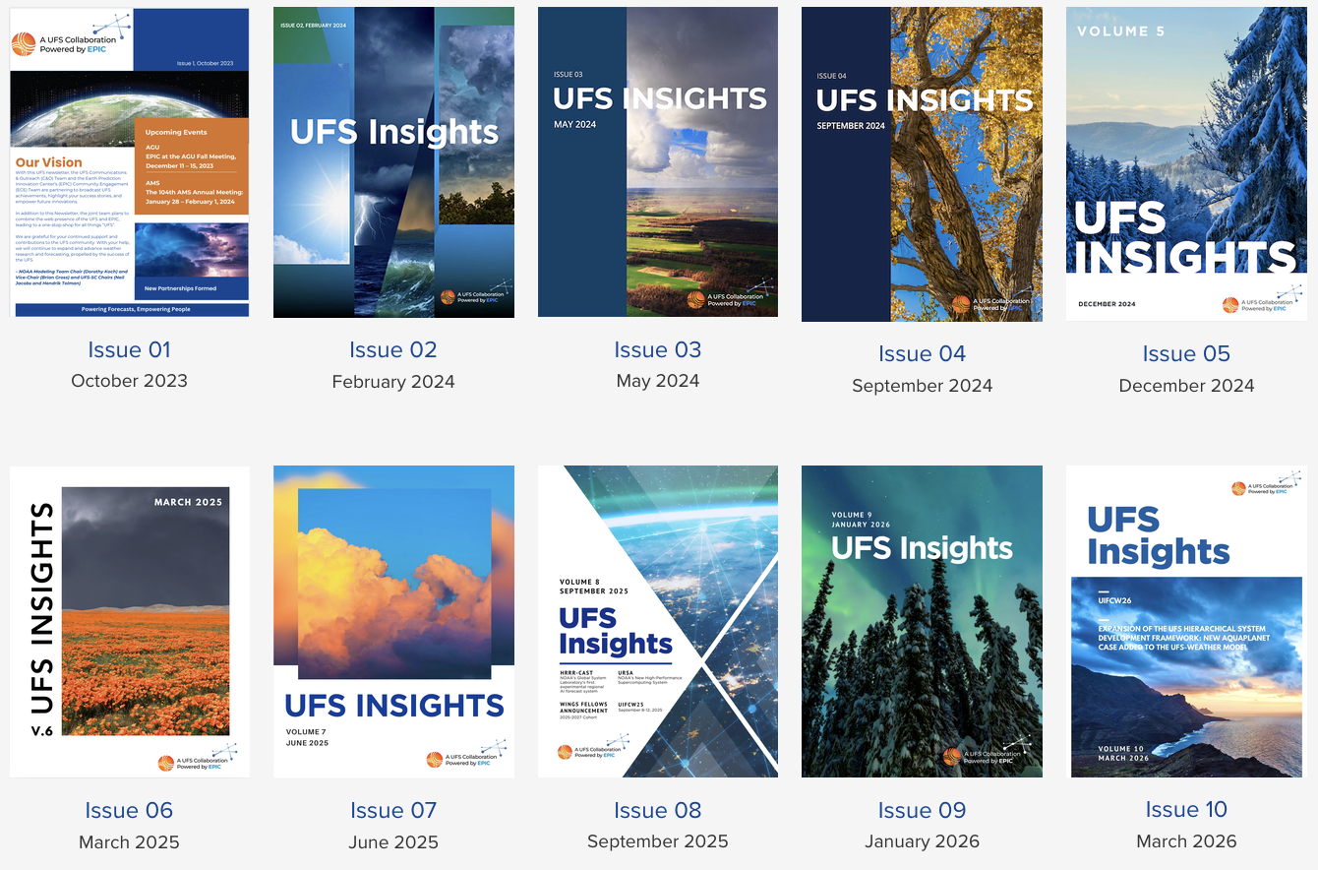
UFS Quarterly ==>Insights
6 UFS Quarterly reports spanning Spring 2020-Winter 2021
11 UFS Insights reports spanning October 2023 through June 2026

Slide 28
UFS Webinar Series
About the Series
The goal of these webinars is to share advancements in science and technology in all aspects of the UFS, in both research and operational settings.
We welcome speakers from NOAA and other collaborating organizations.
Subscribe for Notifications
ufs.epic.noaa.gov/ufs-webinar-series
Recent Topics & Presentations
WINGS in Flight: Accelerating Weather Innovation through Machine Learning
Planetary-Scale to Eddy-Scale: Advances from NOAA Research Global-Nest Initiative
UFS Coastal & Applications: A brief history, current status and the path forward
Monsoon Onset Vortex: Integrating Theory and Predictability Studies using UFS
GFDL’s core FV3: Novel grid capabilities in the dynamical core
Dust Emission Models: Wind Speed Bias and Alluvial Flows

Slide 29
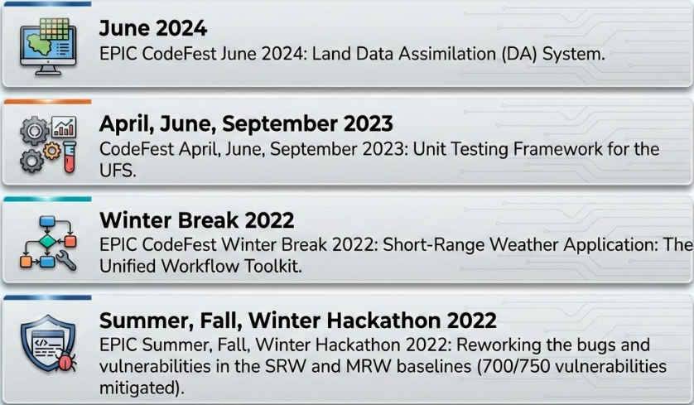
Code Fests

Slide 30
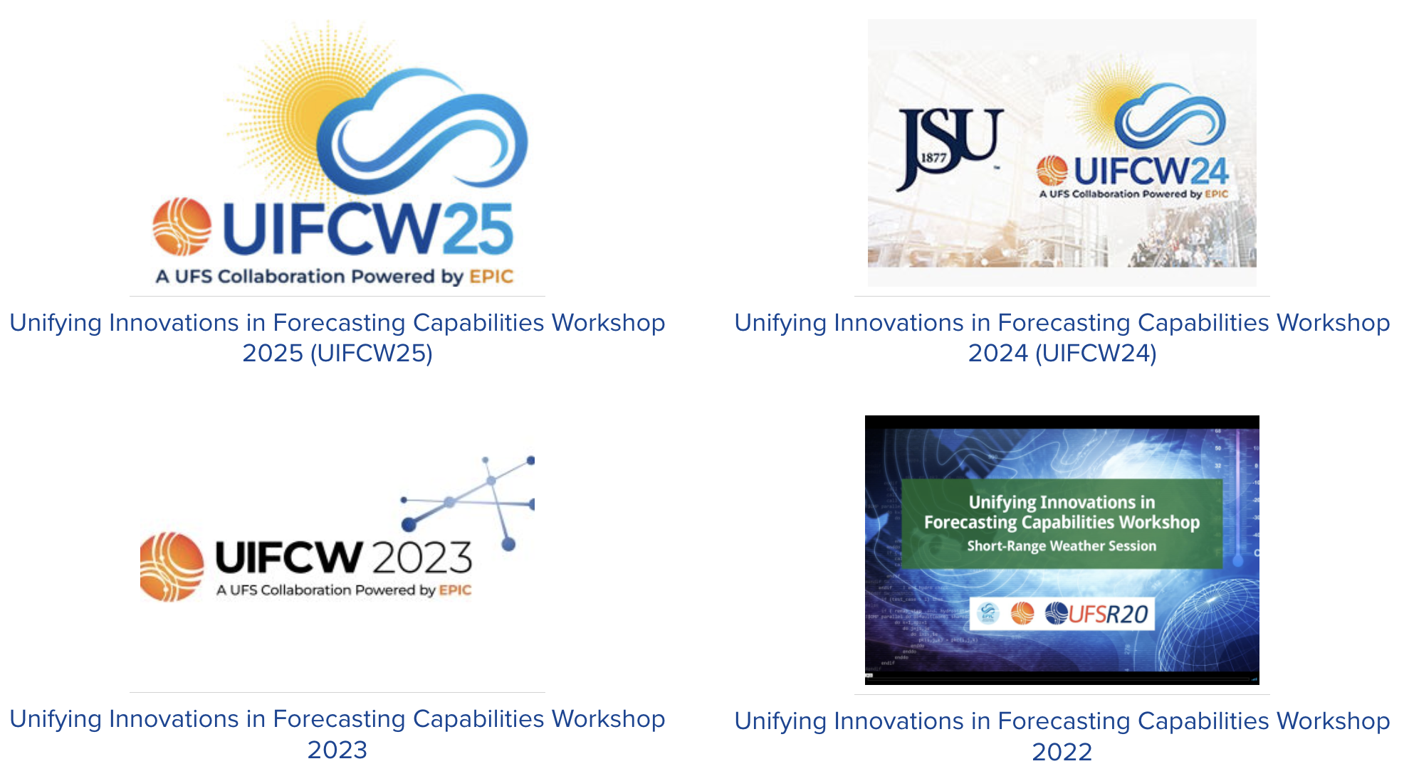
UIFCW
Unifying Innovations in Forecast Capabilities Workshop

Slide 31
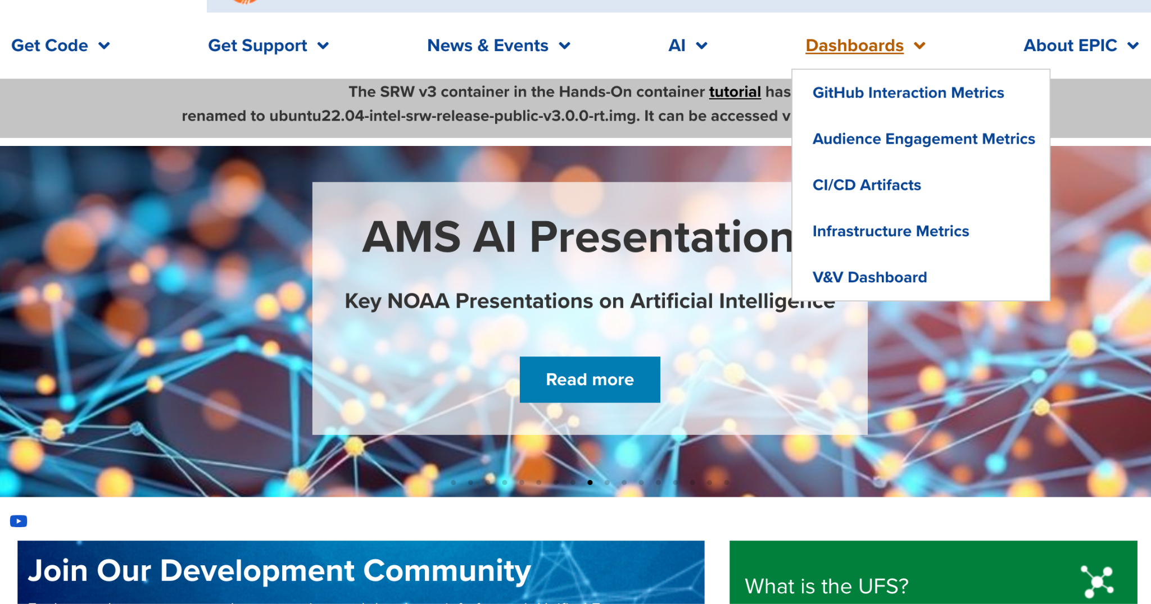
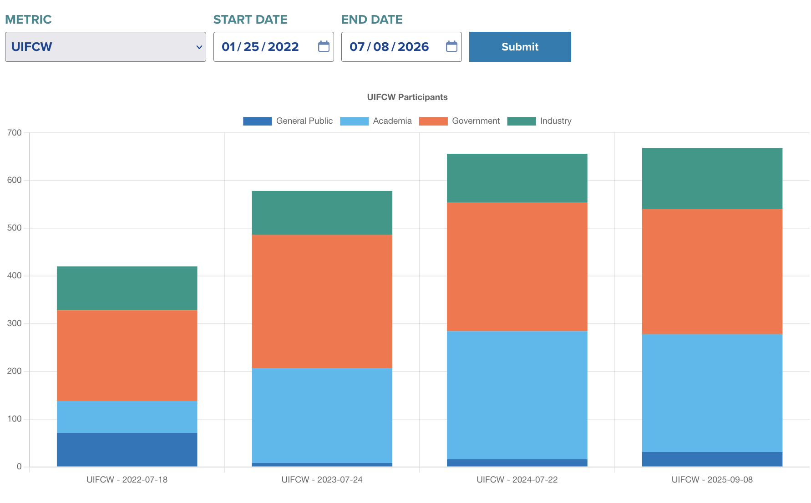
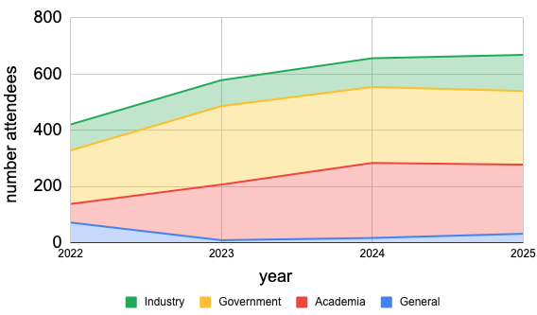
UIFCW

Slide 32
Conclusion
The UFS-R2O Project began in July 2020, and the first three years of the project (Phase I; July 2020 - June 2023) have resulted in many accomplishments, leading to significant advancements in developing the FV3-based systems including:
Hurricane Analysis and Forecast System (HAFS) version 1
regional Rapid Refresh Forecast System (RRFS) version 1
Global Forecast System (GFS) version 17
Global Ensemble Forecast System (GEFS) version 13.
The Phase II of the project (July 2023 - June 2026) will continue to develop and improve global, regional, and hurricane prediction systems and their components for data assimilation, physics, infrastructure, and verification and post-processing

Slide 33
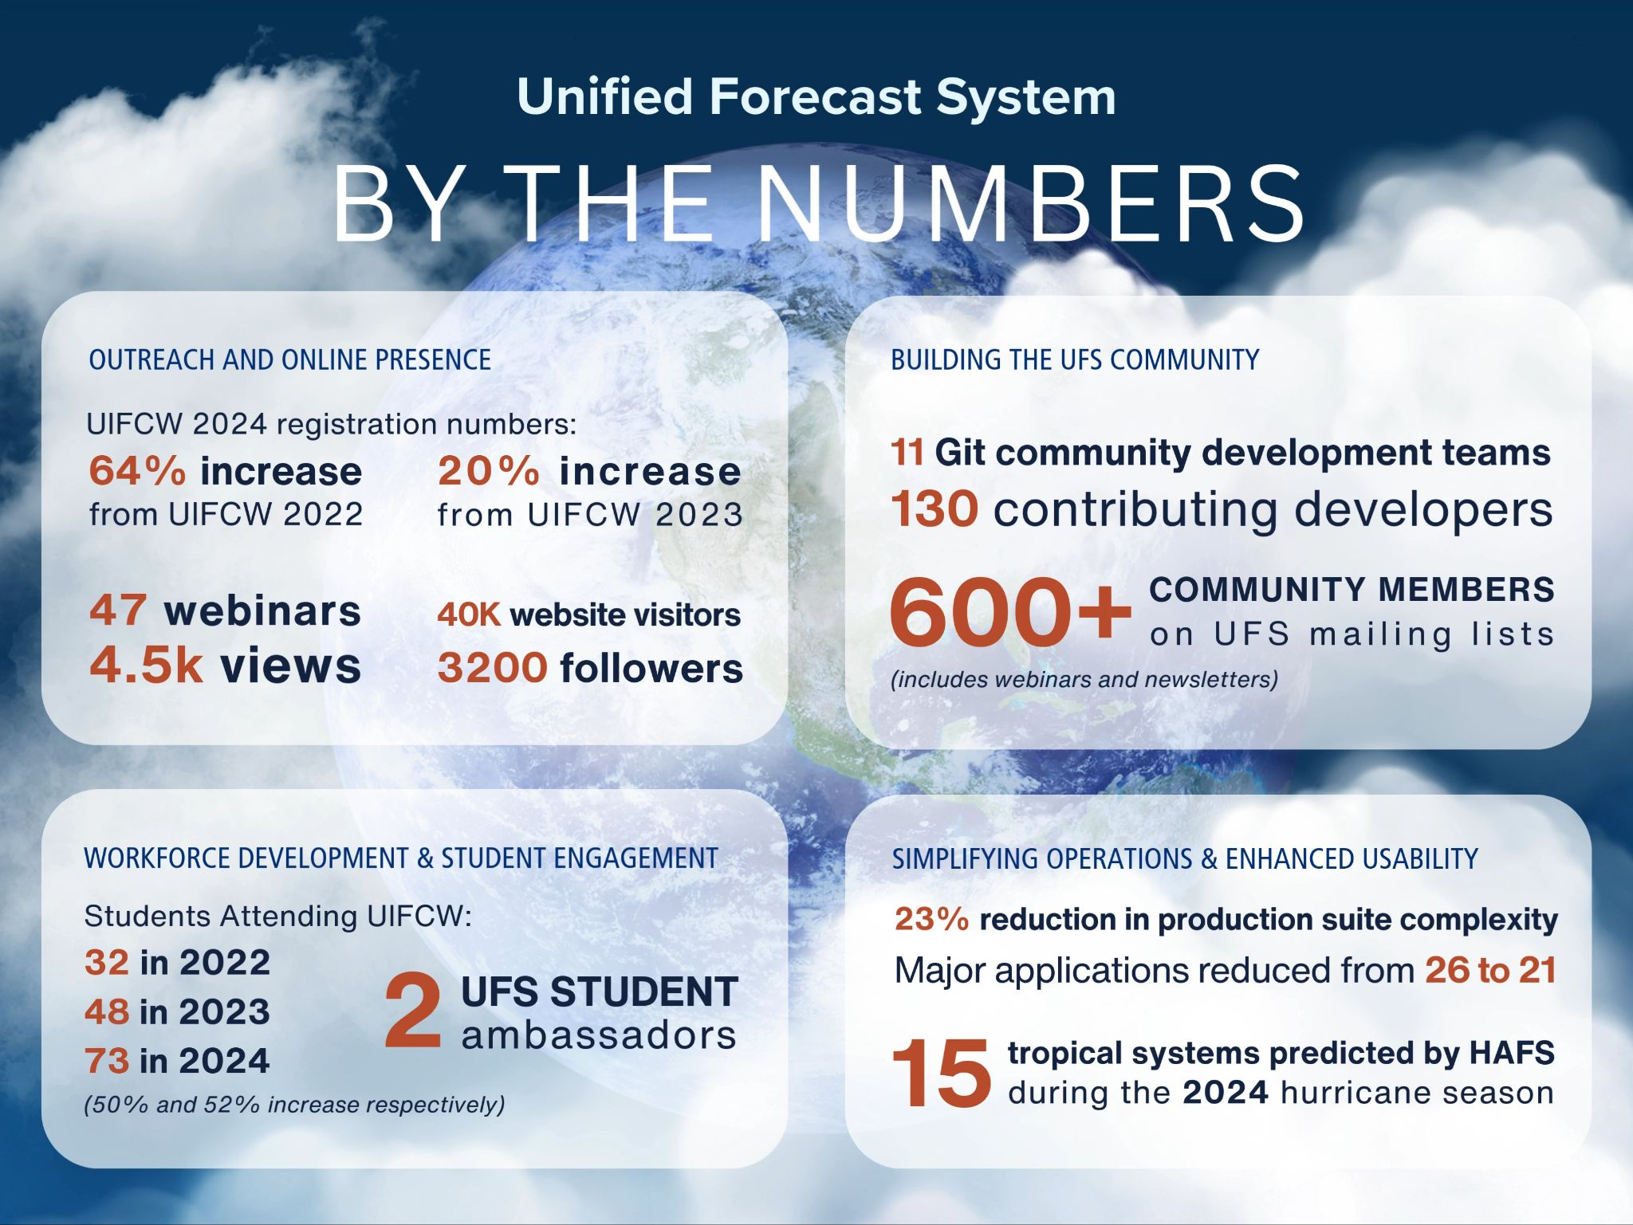

Slide 35
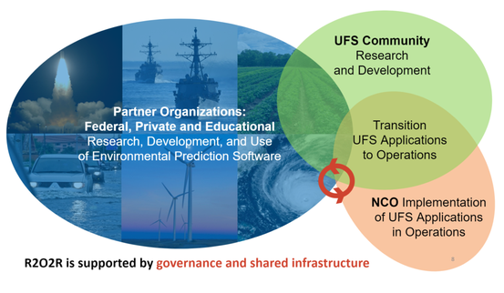


R2O
The success of the Unified Forecast System (UFS) depends on the communities of researchers and users in both the public and private sectors. This requires that the forecast goals and development needs of the UFS be documented and provided to the research community (operations to research, O2R). It is also necessary to provide the pathway for community research to contribute to the operational forecast models (research to operations, R2O)
partnerships across the research and operational environmental modeling communities with a focus on transitioning UFS-based applications into the NWS - National Centers for Environmental Prediction (NCEP)’s operational modeling suite
The UFS-R2O Project began in July 2020, and the first three years of the project (Phase I; July 2020 - June 2023) have resulted in many accomplishments, leading to significant advancements in developing the FV3-based systems including the Hurricane Analysis and Forecast System (HAFS) version 1, the regional Rapid Refresh Forecast System (RRFS) version 1, the Global Forecast System (GFS) version 17 and Global Ensemble Forecast System (GEFS) version 13. The Phase II of the project (July 2023 - June 2026) will continue to develop and improve global, regional, and hurricane prediction systems and their components for data assimilation, physics, infrastructure, and verification and post-processing

Slide 36
Extra/old slides

Slide 37
UPP - Unified Post Processor
Background
The UPP is a software package designed to generate useful products from raw model output. It:
Reads and processes GFS and Limited Area Model (LAM) data from the FV3 dynamical core
Generates output in GRIB2 format
Uses MPI parallel code
Produces hundreds of products like those used operationally on the same operational grids
Used in UFS, RRFS, HAFS, MRS, SRW
Status
Future

Slide 38
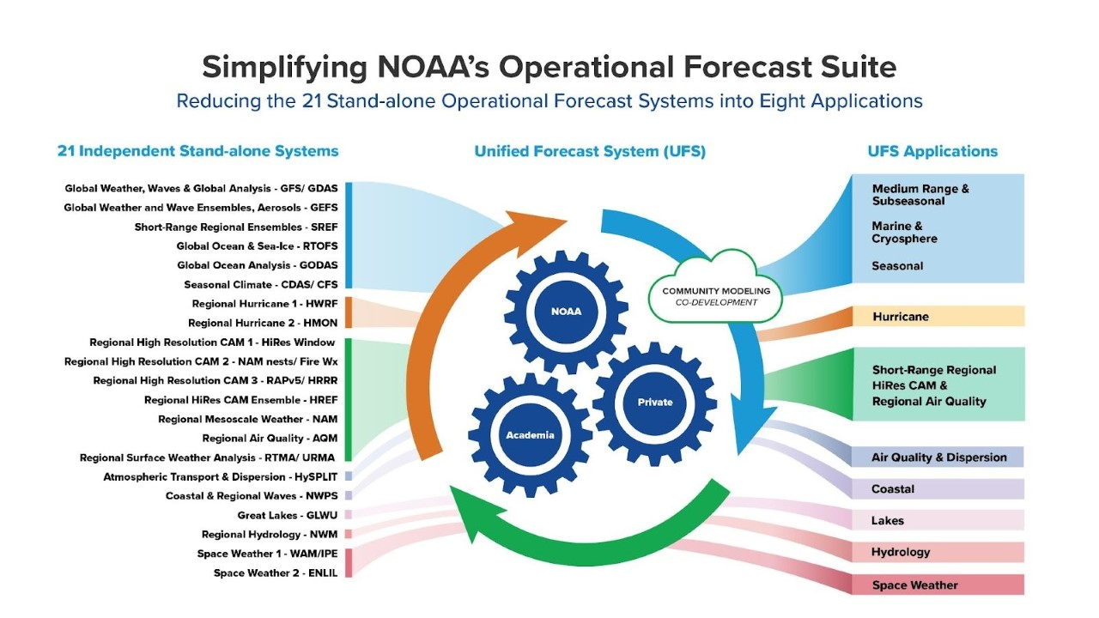

Slide 39
UWTools - Unified Workflow Tools
Background
The team’s uwtools software is a modern, open-source Python package that helps automate common tasks needed for many standard NWP workflows. It also provides drivers to automate the configuration and execution of UFS components, providing flexibility, interoperability, and usability to various UFS Applications. The Unified Workflow (UW) tools are accessible from both a command-line interface (CLI) and a Python API
Status
Future

Slide 40
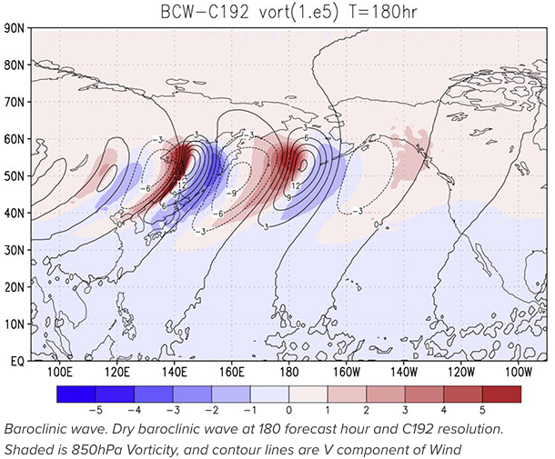
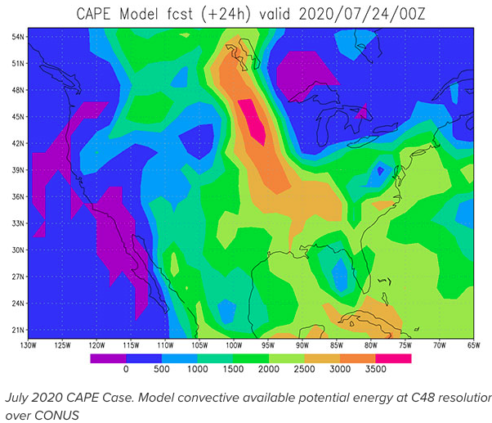
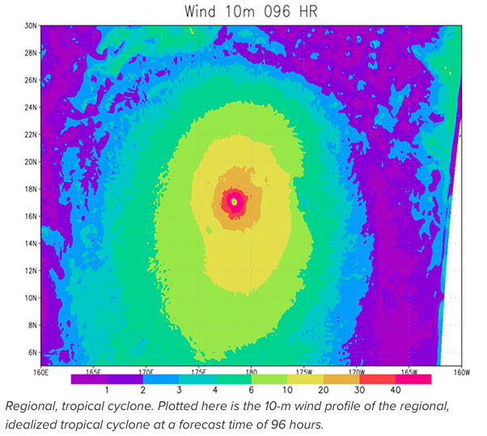
HSD
Background
The first release (November 2024) July 2020 Convective Available Potential Energy (CAPE) case (originally developed as a UFS Case Study by the DTC) and baroclinic instability idealized case (developed by Xiaqiong Zhou of NOAA/NWS/EMC)
The second release (June 2025) was a collaboration with the NOAA/NWS/EMC/Hurricane Analysis and Forecast System (HAFS) group and focused on the integration of a regional tropical cyclone case.
An aquaplanet idealized case was added in February 2026, which was developed in collaboration with NOAA’s PSL
Status
Future

Slide 41
Stochastic Physics
Background
Stochastic physics is a component of the UFS Weather Model (WM) and contains a variety of stochastic schemes. These schemes are used to represent model uncertainty and help maintain adequate ensemble spread, as global and regional numerical weather prediction (NWP) ensembles are known to be under-dispersive and often overconfident
Status
Future

Slide 42
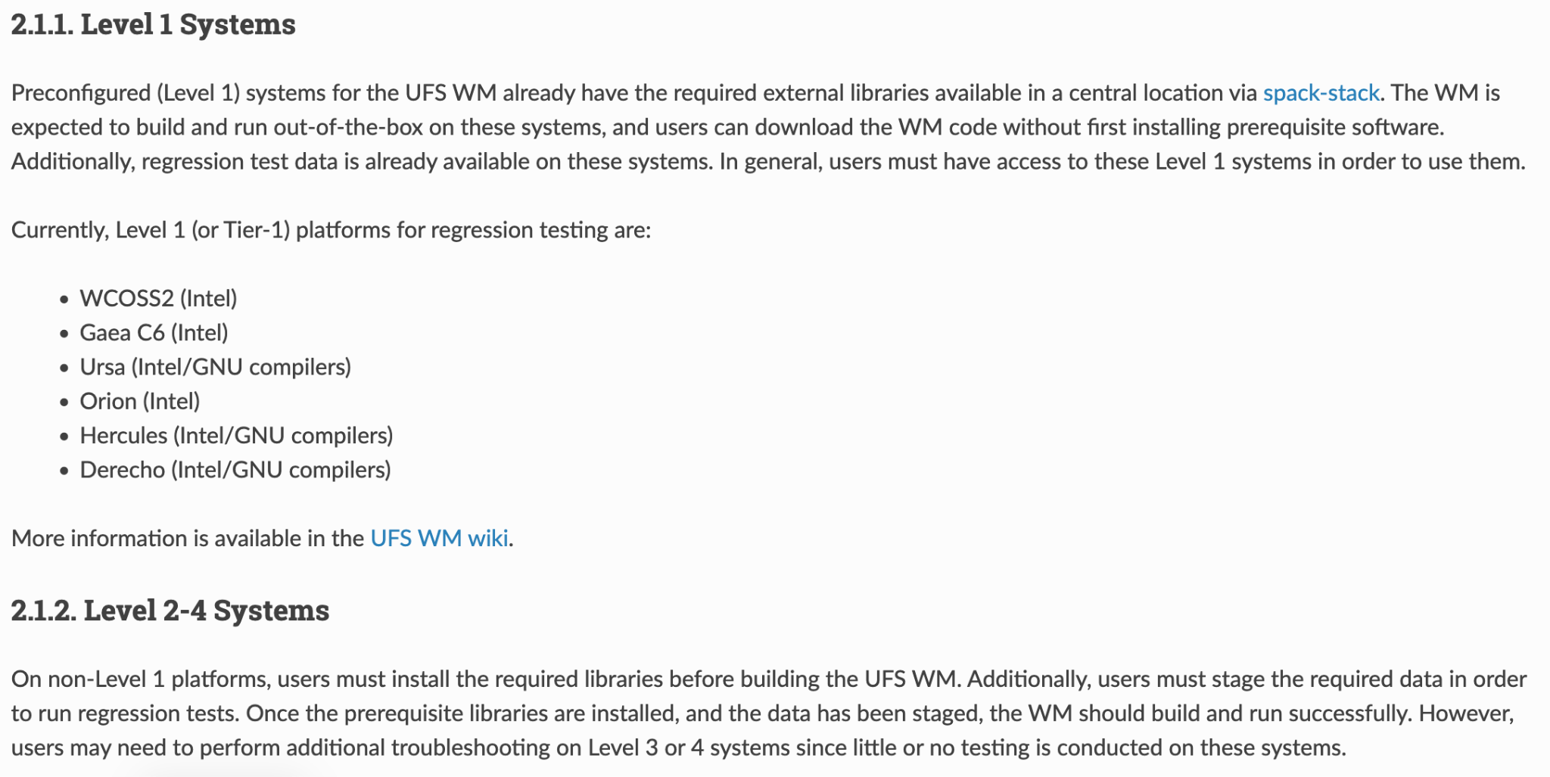

Slide 43
