Slide 1
AIDA: Operational AI
Data Assimilation from
Level 1 Observations
Ryan Keisler presenting on behalf of:
Alex Kleeman, Drew Bollinger, Jack DiCintio, Harshil Kamdar,
Hans Mohrmann, Daniel Rothenberg, Alistair White
UIFCW26, July 23, 2026

Slide 2




Making AI weather forecasting tools available to all, to help humanity adapt to increasingly extreme weather
Building an end-to-end probabilistic forecasting system
Open-sourcing benchmark datasets, models and metrics to spur innovation in AI weather forecasting
Providing AI weather forecasting tools to all

Slide 3
The Future of AI Weather is Observations
Notes:
A guiding principle for our work is that the Future of AI Weather is Observations

Slide 4
The Future of AI Weather is Observations
Data Assimilation
Forecast
Traditional Numerical Weather Prediction
Observations
Physics
Current State
Physics
Forecast
Notes:
And to motivate why observations are exciting for AI Weather, we can look at this very simplified workflow of how traditional NWP works.

Slide 5
The Future of AI Weather is Observations
Data Assimilation
Forecast
Traditional Numerical Weather Prediction
Observations
Physics
Current State
Physics
Forecast
Partial AI
Weather Prediction
Observations
Physics
Current State
AI Model
Forecast
Opportunity
Recent breakthroughs
(GraphCast, etc.)
Notes:
Opportunity in two ways: (1) more data, end-to-end training = potential for better model, (2) traditional DA can only be run by the experts at NOAA and ECMWF. If AI throughout, you democratize. You also get more control around, how often is forecast run? which observations?

Slide 6
The Future of AI Weather is Observations
Data Assimilation
Forecast
Traditional Numerical Weather Prediction
Observations
Physics
Current State
Physics
Forecast
Partial AI
Weather Prediction
Observations
Physics
Current State
AI Model
Forecast
Opportunity
Recent breakthroughs
(GraphCast, etc.)
Performance: more data, end-to-end, better forecasts
Notes:
Opportunity in two ways: (1) more data, end-to-end training = potential for better model, (2) traditional DA can only be run by the experts at NOAA and ECMWF. If AI throughout, you democratize. You also get more control around, how often is forecast run? which observations?

Slide 7
The Future of AI Weather is Observations
Data Assimilation
Forecast
Traditional Numerical Weather Prediction
Observations
Physics
Current State
Physics
Forecast
Partial AI
Weather Prediction
Observations
Physics
Current State
AI Model
Forecast
Opportunity
Recent breakthroughs
(GraphCast, etc.)
Performance: more data, end-to-end, better forecasts
Structural: more organizations can create forecasts
Notes:
Opportunity in two ways: (1) more data, end-to-end training = potential for better model, (2) traditional DA can only be run by the experts at NOAA and ECMWF. If AI throughout, you democratize. You also get more control around, how often is forecast run? which observations?

Slide 8
The Future of AI Weather is Observations
Data Assimilation
Forecast
Traditional Numerical Weather Prediction
Observations
Physics
Current State
Physics
Forecast
Partial AI
Weather Prediction
Observations
Physics
Current State
AI Model
Forecast
Opportunity
Recent breakthroughs
(GraphCast, etc.)
Full AI
Weather Prediction
Observations
AI Model
Forecast
Notes:
This is actually a bit confusing and misleading, because AIDA goes from Observations to Current State.

Slide 9
The Future of AI Weather is Observations
Data Assimilation
Forecast
Traditional Numerical Weather Prediction
Observations
Physics
Current State
Physics
Forecast
Partial AI
Weather Prediction
Observations
Physics
Current State
AI Model
Forecast
Opportunity
Recent breakthroughs
(GraphCast, etc.)
Full AI
Weather Prediction
Observations
AI Model
Current State
AI Model
Forecast
AIDA
Notes:
Today we’re presenting something that we’re really excited about, an AI Data Assimilation system we’re calling AIDA.

Slide 10
“AIDA”
AI Data Assimilation
Notes:
AIDA is the name of our AI Data Assimilation system

Slide 11





Related Work
Aardvark Weather: Allen et al (arXiv:2404.0041)
EarthNet: Vandal et al (arXiv:2407.11696)
FuXiWeather2: Xu et al, arXiv:2603.15358
GraphDOP & AIFS-DOP: Pennington et al. arXiv:2606.19093
Huracan: Ni et al, arXiv:2508.18486
HealDA: Gupta et al. arXiv:2601.17636
FuXi
Notes:
AIDA is the name of our AI Data Assimilation system

Slide 12
AIDA Overview
AI for Global Data Assimilation
Estimates atmospheric state from Level 1 observations
AIDA drives AIWP (forecast) models
Running operationally for users and delivers forecasts >1 hour before IFS.

Slide 13
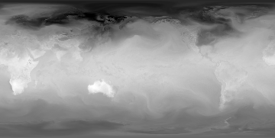
AIDA Architecture
Observation Encoder
Graph
Transformer
Observations
Analysis
Notes:
The main change is the observation, which pushes learning back to each of the 25M observations in the DA window. Cross attention.

Slide 14
AIDA Architecture
Observation Encoder
Graph
Transformer
Observations
Analysis
Training
data?
Training
data?
Notes:
The main change is the observation, which pushes learning back to each of the 25M observations in the DA window. Cross attention.

Slide 15
AIDA Architecture
Observation Encoder
Graph
Transformer
Observations
Analysis
Training
data?
IFS analysis
(HRES lead=0h)
Notes:
The main change is the observation, which pushes learning back to each of the 25M observations in the DA window. Cross attention.

Slide 16
AIDA Architecture
Observation Encoder
Graph
Transformer
Observations
Analysis
NNJA-AI Observational Archive
IFS analysis
(HRES lead=0h)
Notes:
The main change is the observation, which pushes learning back to each of the 25M observations in the DA window. Cross attention.

Slide 17
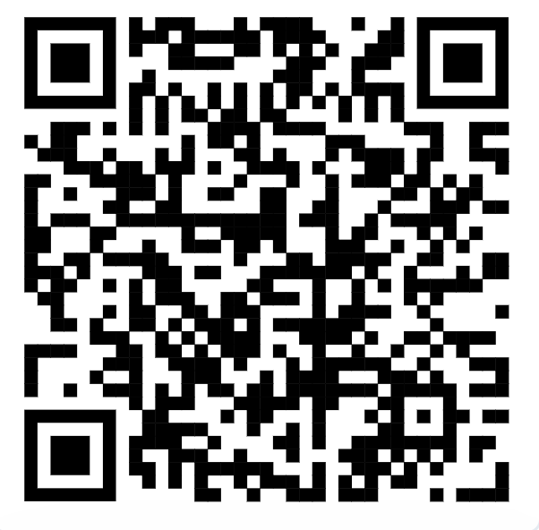
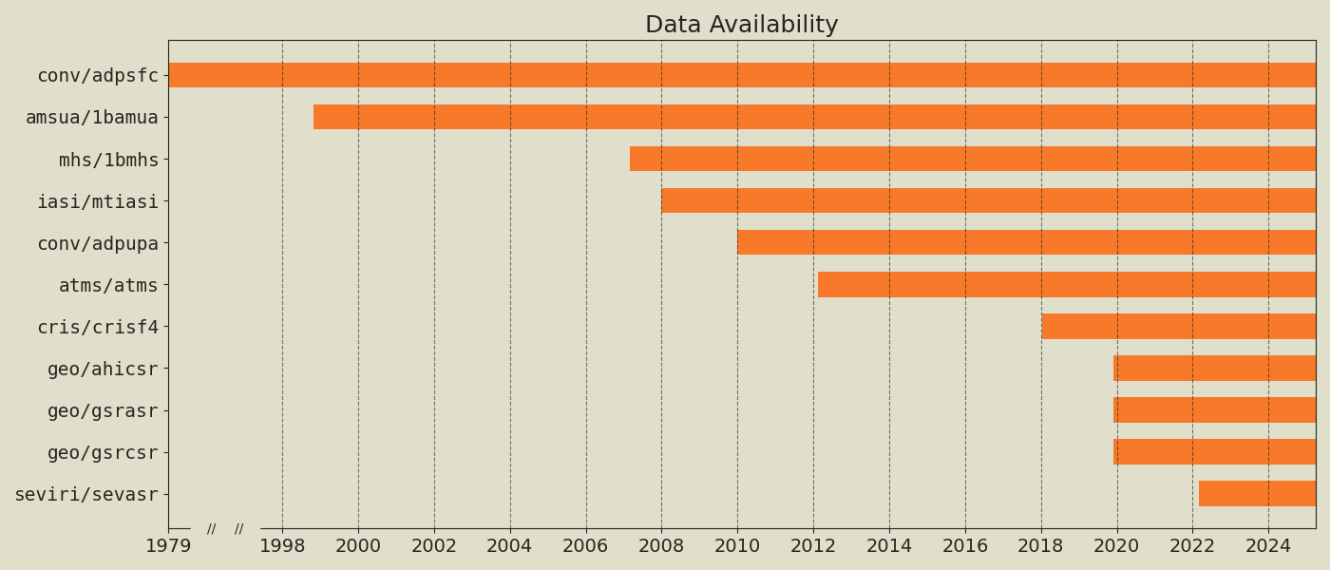
NNJA-AI v1.0
CRADA Collaboration between Brightband and NOAA
>50 TiB of curated observations from NNJA
ML-ready, cloud-native format (parquet) and Python SDK
IR/microwave satellite, surface station, balloon, and growing
nnja-ai.readthedocs.io
Surface
AMSU-A
MHS
IASI
Upper (radiosonde)
ATMS
CrIS
Himawari
GOES (all-sky)
GOES (clear-sky)
SEVIRI

Slide 18
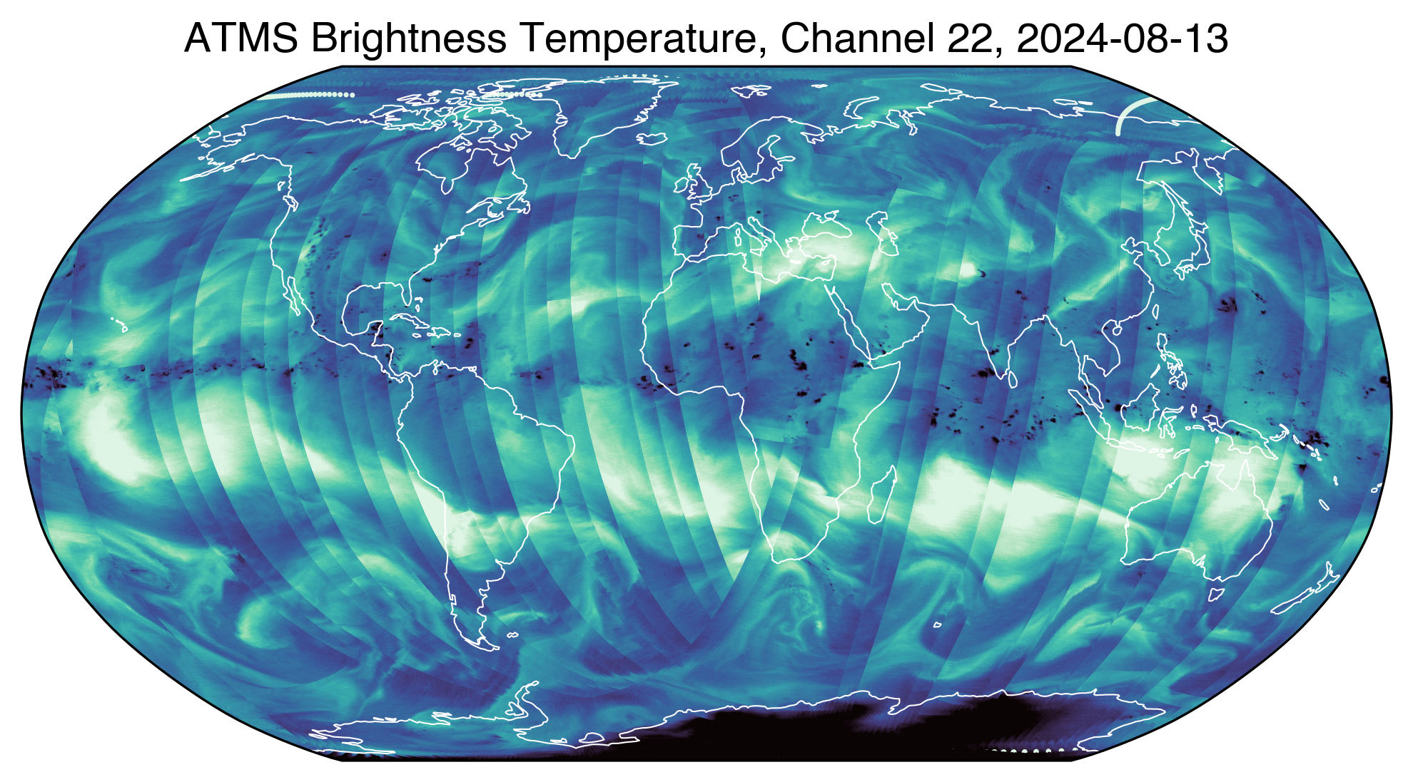
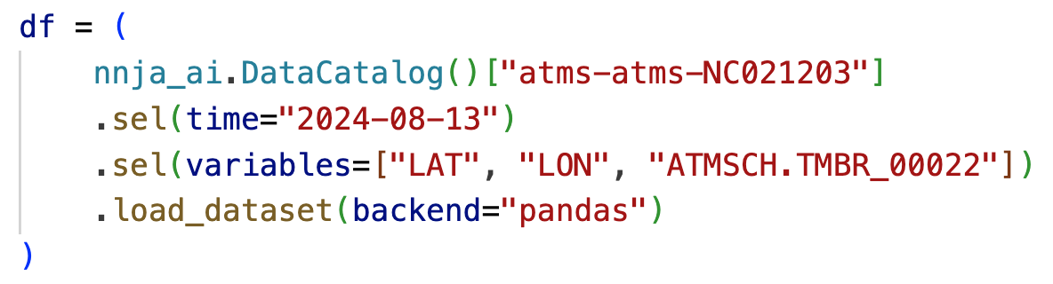
NNJA-AI v1.0
nnja-ai.readthedocs.io
Notes:
The image shows data from the Advanced Technology Microwave Sounder (ATMS) instruments from August 2024, plus a one-liner showing how to fetch the data with NNJA-AI. This particular channel sits near the 183 GHz water vapor line and is used to track humidity in the upper troposphere. Generally, darker = drier, but the full story is more complex!

Slide 19
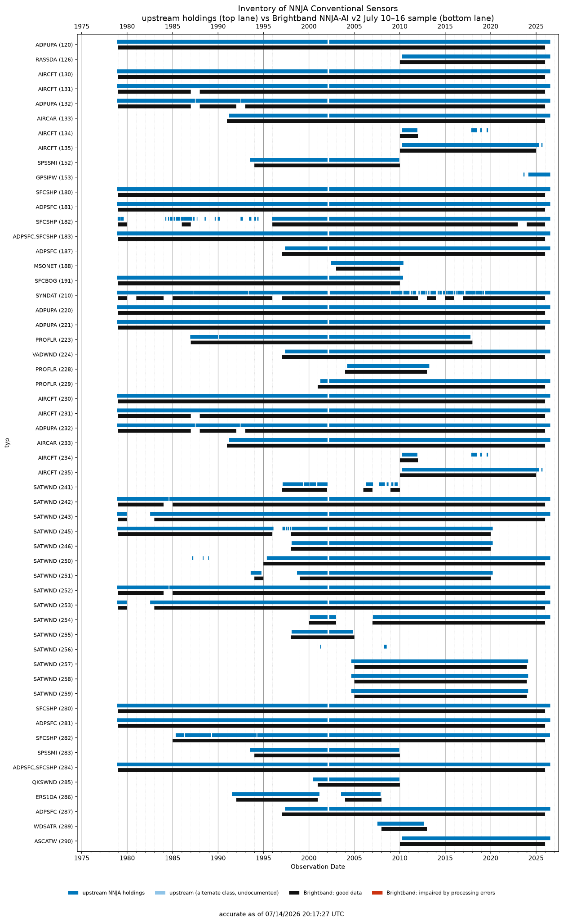
Coming Soon: NNJA-AI v2.0
NNJA-AI v1.0: A subset of observation types.
  14 message types (5 conventional, 5 LEO, 4 GEO)
  “Core data” - highest impact on forecasts
NNJA-AI v2.0: The full NNJA dataset.
  123 message types (ship, sfc, aircraft, radiosonde, GPS-RO, all satellites)
  Target release Q3 2026
Notes:
The image shows data from the Advanced Technology Microwave Sounder (ATMS) instruments from August 2024, plus a one-liner showing how to fetch the data with NNJA-AI. This particular channel sits near the 183 GHz water vapor line and is used to track humidity in the upper troposphere. Generally, darker = drier, but the full story is more complex!

Slide 20
AIDA Architecture
Observation Encoder
Graph
Transformer
Observations
Analysis
Notes:
The main change is the observation, which pushes learning back to each of the 25M observations in the DA window. Cross attention.

Slide 21
AIDA in action

Slide 22
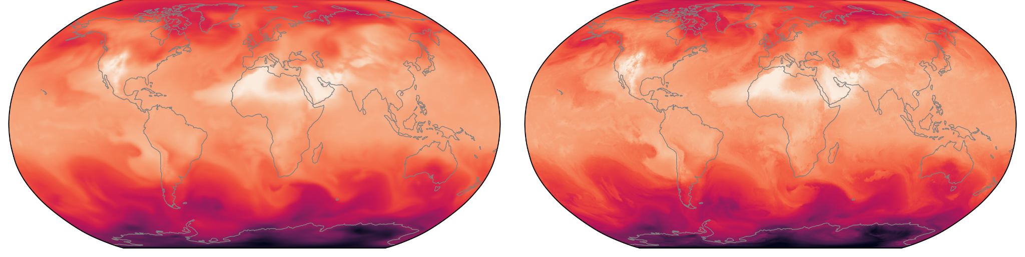
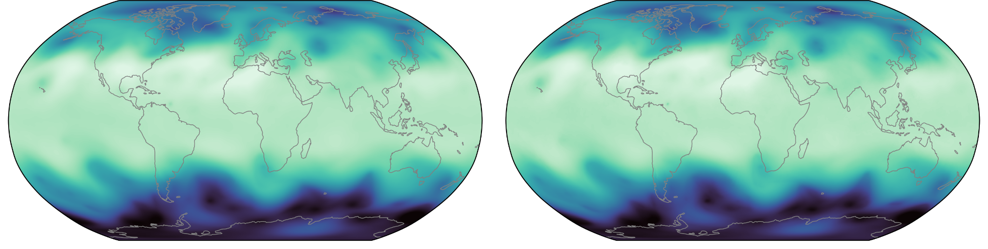
AIDA vs IFS
AIDA
IFS
T850
Z500
Valid time: 2024-07-01T00

Slide 23
AIDA vs IFS
AIDA
IFS
T850
RMSE(AIDA-IFS) = 0.77 K
RMSE(ERA5-IFS) = 0.78 K
Approaching the inherent accuracy of IFS/ERA5. Need to verify on obs.
Z500
Valid time: 2024-07-01T00

Slide 24
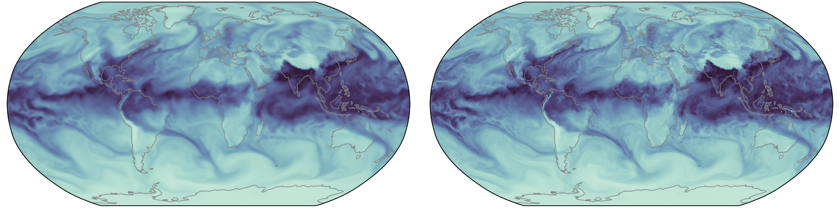
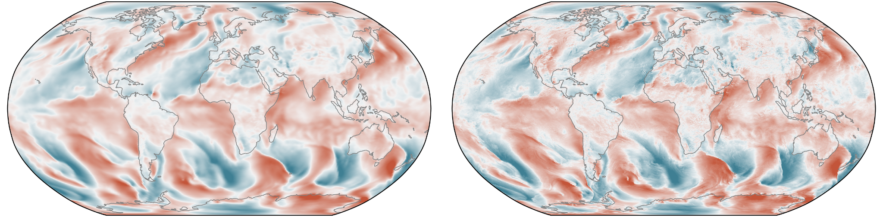
AIDA vs IFS
AIDA
IFS
TCW
10M V
Valid time: 2024-07-01T00

Slide 25
0-hour verification against Radiosondes

Slide 26
0-hour verification against Radiosondes
Input Observations
(-12h to 3h, 90% of radiosonde stations used)
Verifying Observations
(0h, remaining 10% of radiosonde stations)
AIDA
0h state
Repeat k times using different random 10%.
“Cross validation”.
Avoids needing a separate forecast model.
Notes:
For verification we're only using the mandatory pressure levels and only the measurements within +/- one hour of the target init_time. AIDA produces gridded atmospheric state (0.25 degree) and I use exact matches on pressure levels, no vertical interpolation, no temporal interpolation and a bilinear horizontal interpolation to the balloon's drifted location.

Slide 27
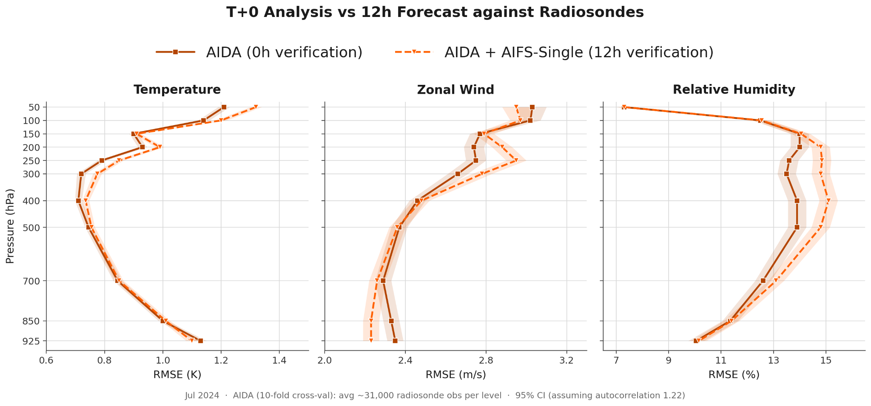
0-hour verification against Radiosondes

Slide 28
12-hour verification against Radiosondes

Slide 29
12-hour verification against Radiosondes
Input Observations
(-12h to 3h)
Verifying Observations
(12h)
AIDA
AIWP
0h state
(analysis)
12h state
(forecast)

Slide 30
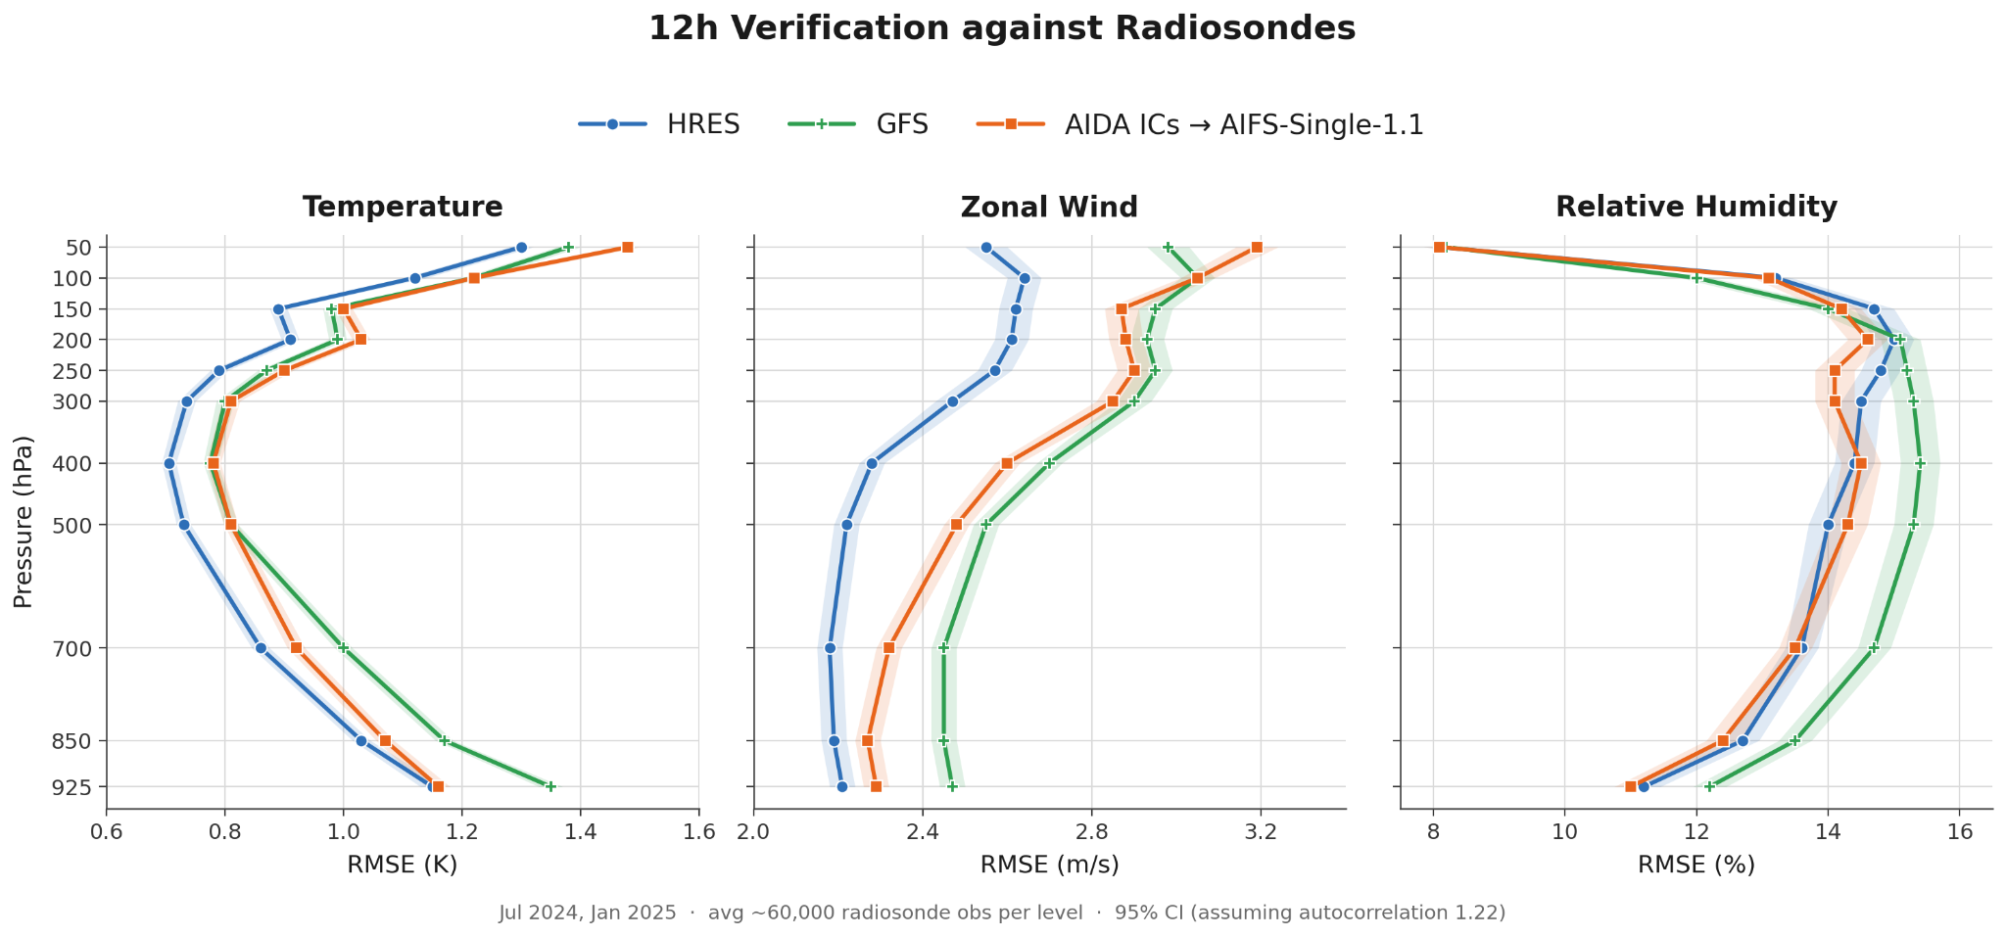
12-hour verification against Radiosondes
Notes:
AIDA ICs are comparable in quality to NWP ICs

Slide 31
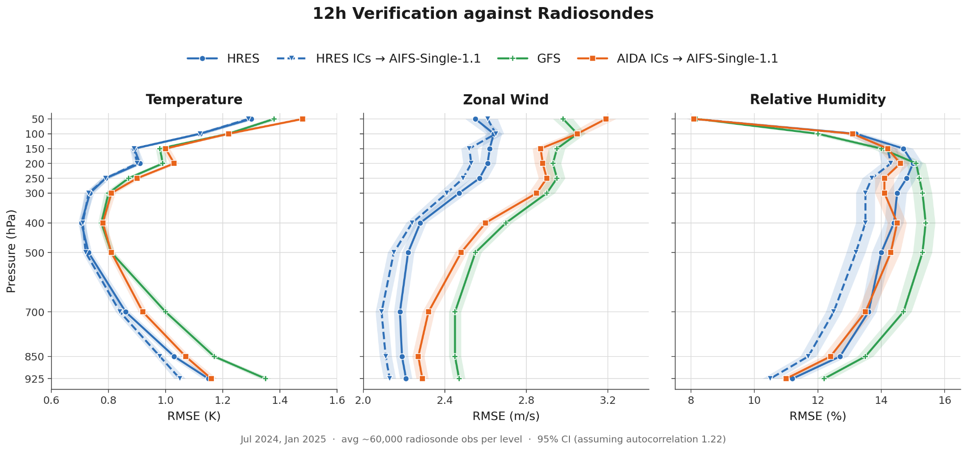
12-hour verification against Radiosondes
Notes:
Although the forecast model (AIFS) does an impact, even at a lead time as short as 12h.

Slide 32
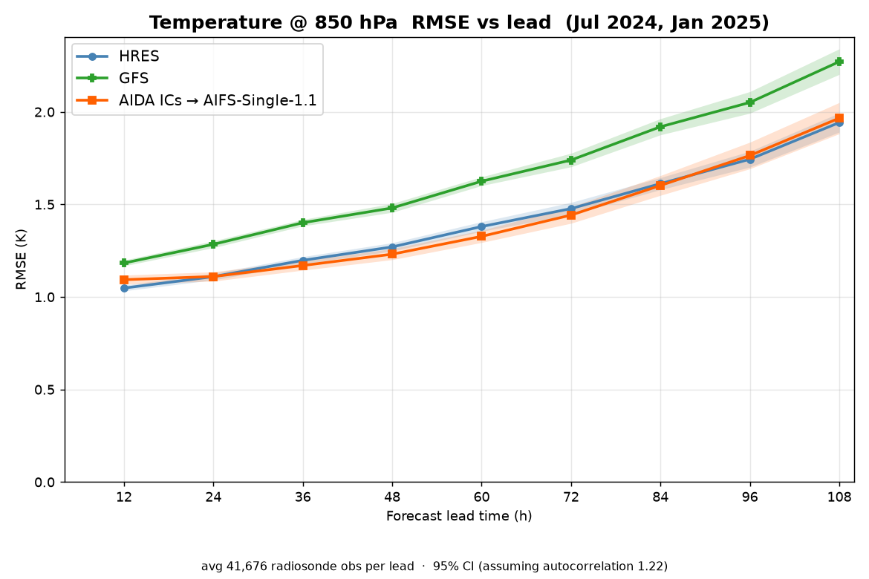
5-day verification against Radiosondes
Notes:
Pure AI system (AIDA+AIFS) better or equal skill vs Pure NWP systems (GFS or HRES)

Slide 33
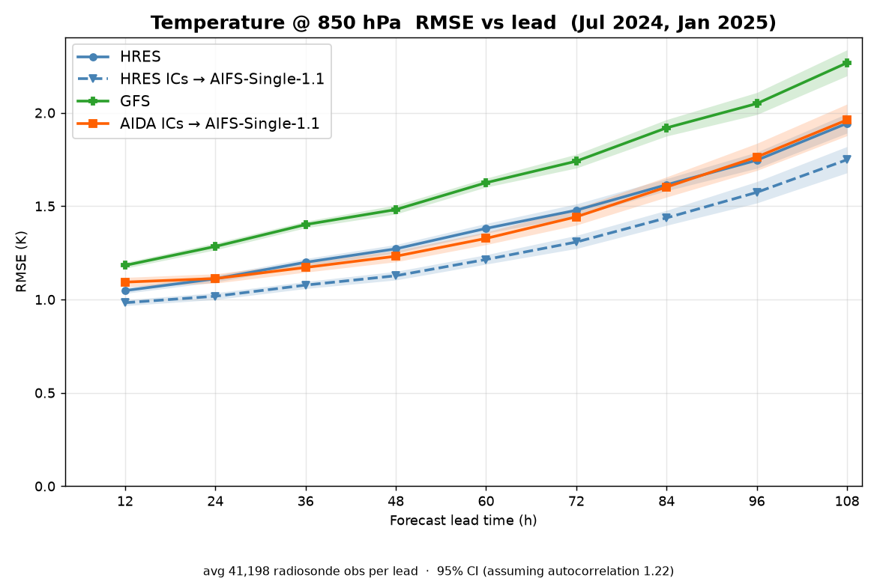
5-day verification against Radiosondes
Notes:
But the best is hybrid. AIDA+AIFS was helped by AIFS being a better forecast model than HRES is. True even at 12h.

Slide 34
Future Directions
Cycling DA
Ensemble DA
Directly optimize AIDA for short-term forecast of state
Directly optimize AIDA for short-term forecast of obs

Slide 35
End-to-End
AIDA
Observations

Slide 36
End-to-End
AIDA
AIWP
Observations
Forecast

Slide 37
End-to-End
AIDA
AIWP
Observations
Forecast
A DA+Forecast system, fully differentiable from forecast back to each observation.

Slide 38

End-to-End
AIDA
AIWP
Observations
Forecast
A DA+Forecast system, fully differentiable from forecast back to each observation.
Skill Optimization

Slide 39

End-to-End
AIDA
AIWP
Observations
Forecast
A DA+Forecast system, fully differentiable from forecast back to each observation.
Skill Optimization
Observation Valuation

Slide 40
End-to-End
AIDA
AIWP
Observations
Forecast
A DA+Forecast system, fully differentiable from forecast back to each observation.
Skill Optimization
Observation Valuation

Slide 41
Observation Valuation
We want to value the world’s weather observations.
Notes:
Using AIFS-Single for the forecast

Slide 42
Observation Valuation
We want to value the world’s weather observations.
End-to-end AI DA+Forecast provides a fast, flexible platform for:
Observation Denial (OSE, OSSE, sensor optimization)
Sensitivity Analysis (FSOI, etc.)
Notes:
Using AIFS-Single for the forecast

Slide 43
Observation Valuation
We want to value the world’s weather observations.
End-to-end AI DA+Forecast provides a fast, flexible platform for:
Observation Denial (OSE, OSSE, sensor optimization)
Sensitivity Analysis (FSOI, etc.)
Related work: “Using data assimilation tools to dissect GraphDOP”,
Laloyaux et al, arXiv:2510.27388
Notes:
Using AIFS-Single for the forecast

Slide 44
Obs Valuation: Sensitivities
As an example, we can look at
∂(output) / ∂(inputs)
Notes:
Using AIFS-Single for the forecast

Slide 45
Obs Valuation: Sensitivities
As an example, we can look at
∂(output) / ∂(inputs)
AIDA
AIWP
Observations
Forecast
Notes:
Using AIFS-Single for the forecast

Slide 46
Obs Valuation: Sensitivities
As an example, we can look at
∂(AIFS Forecast, Z500, London) / ∂(AMSU-A Channel 5)
AIDA
AIWP
Observations
Forecast
Notes:
Using AIFS-Single for the forecast

Slide 47
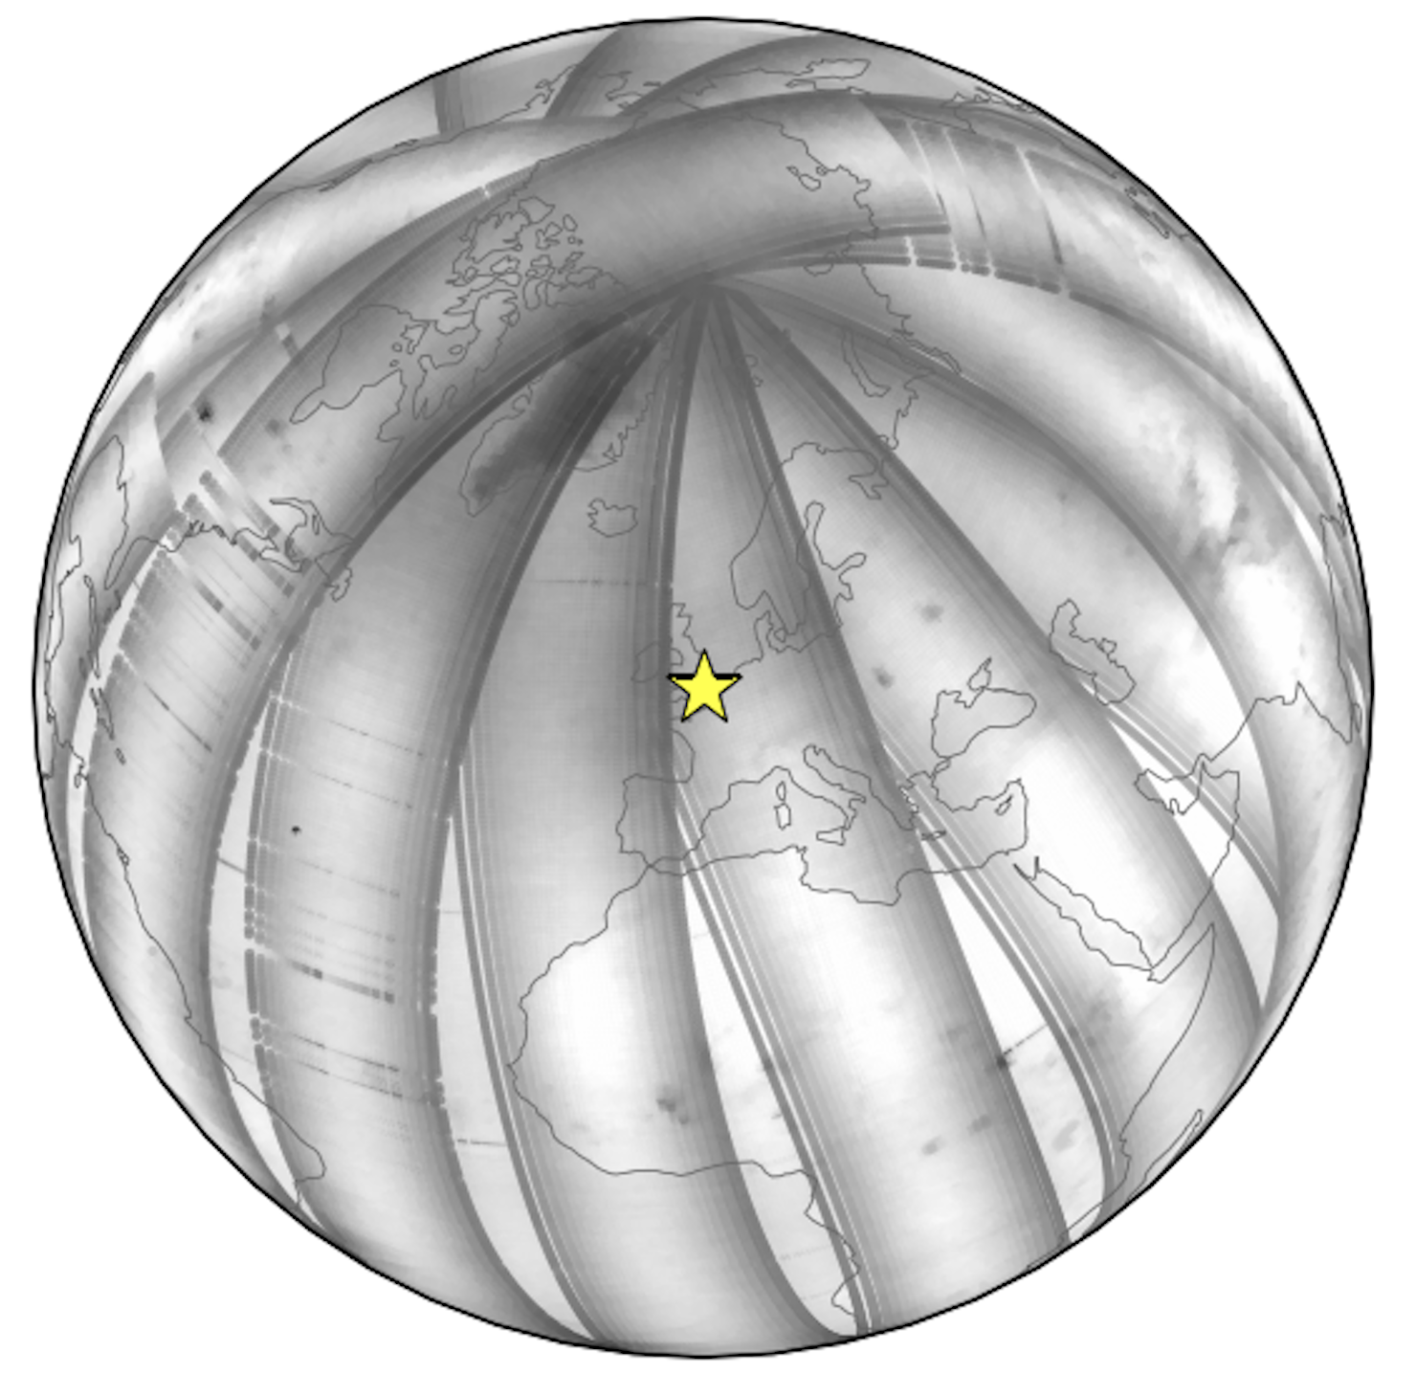
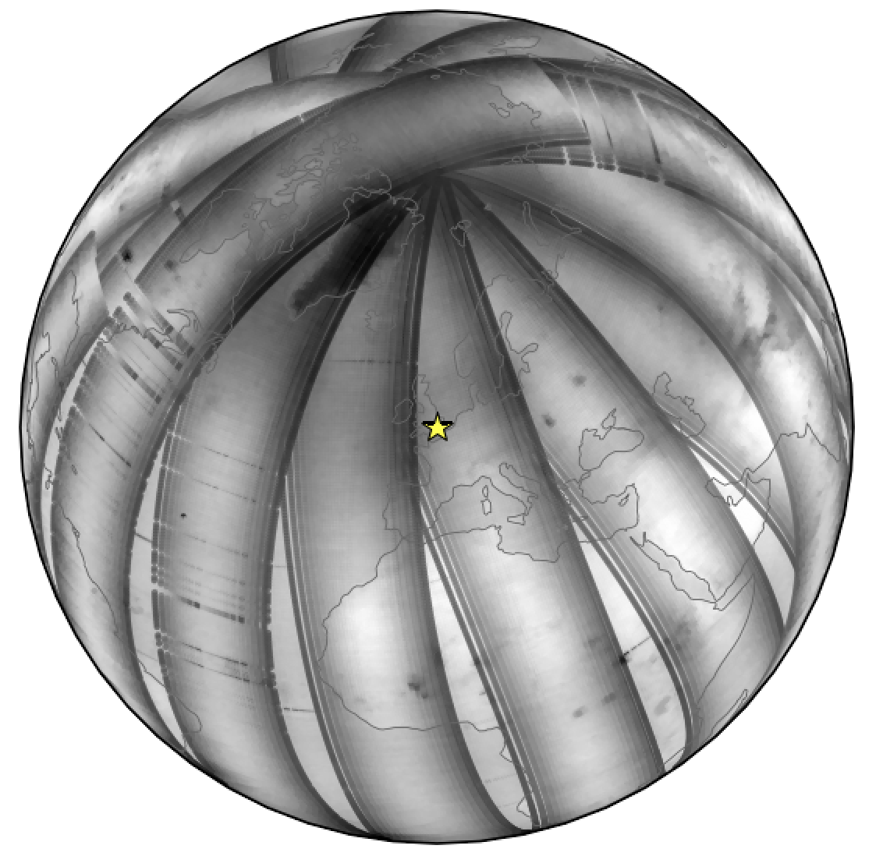
Obs Valuation: Sensitivities
As an example, we can look at
∂(AIFS Forecast, Z500, London) / ∂(AMSU-A Channel 5)
Notes:
Using AIFS-Single for the forecast

Slide 48
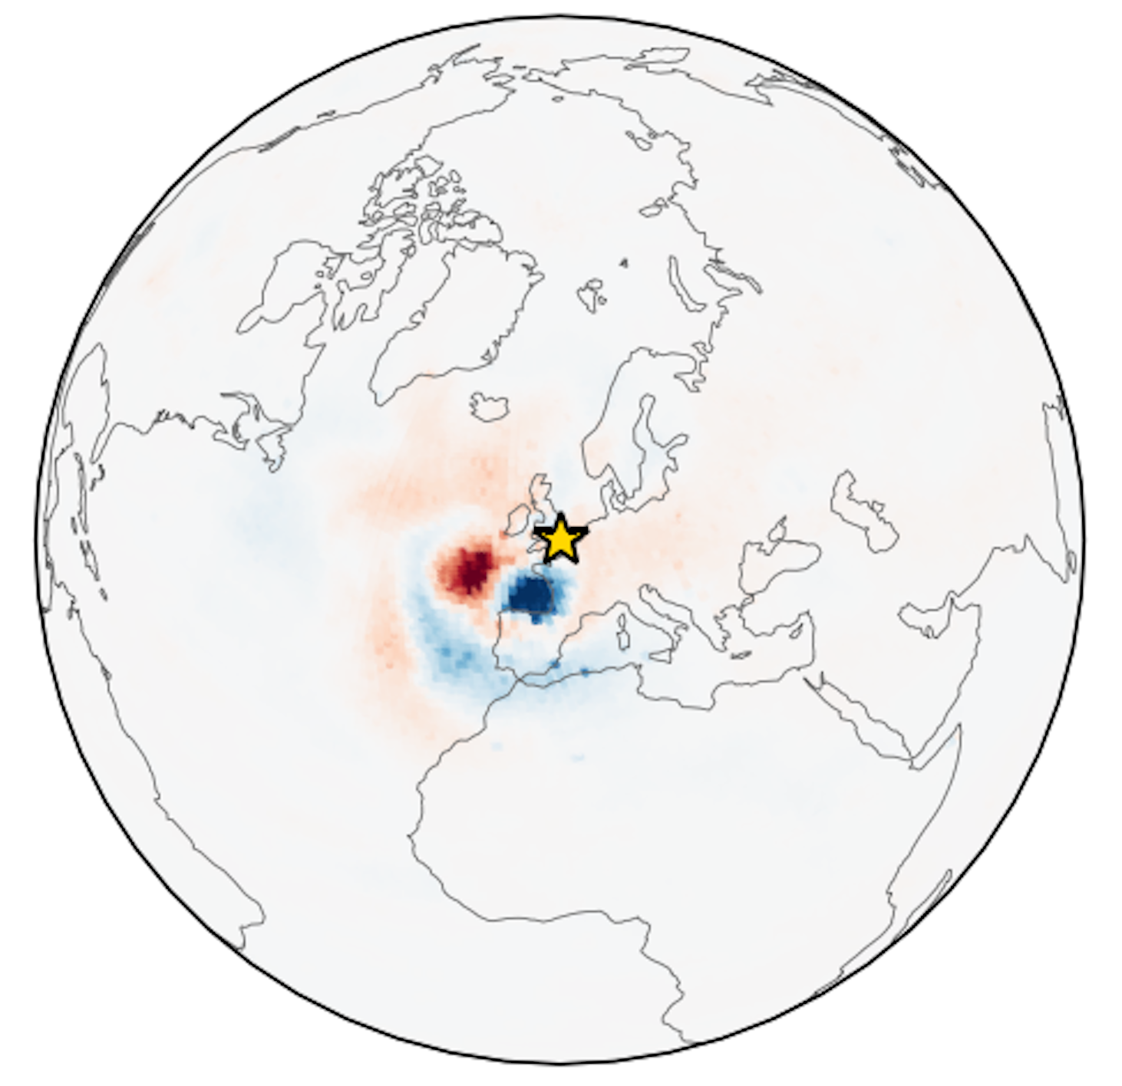
Obs Valuation: Sensitivities
As an example, we can look at
∂(AIFS Forecast, Z500, London) / ∂(AMSU-A Channel 5)
24h lead
Notes:
Using AIFS-Single for the forecast

Slide 49
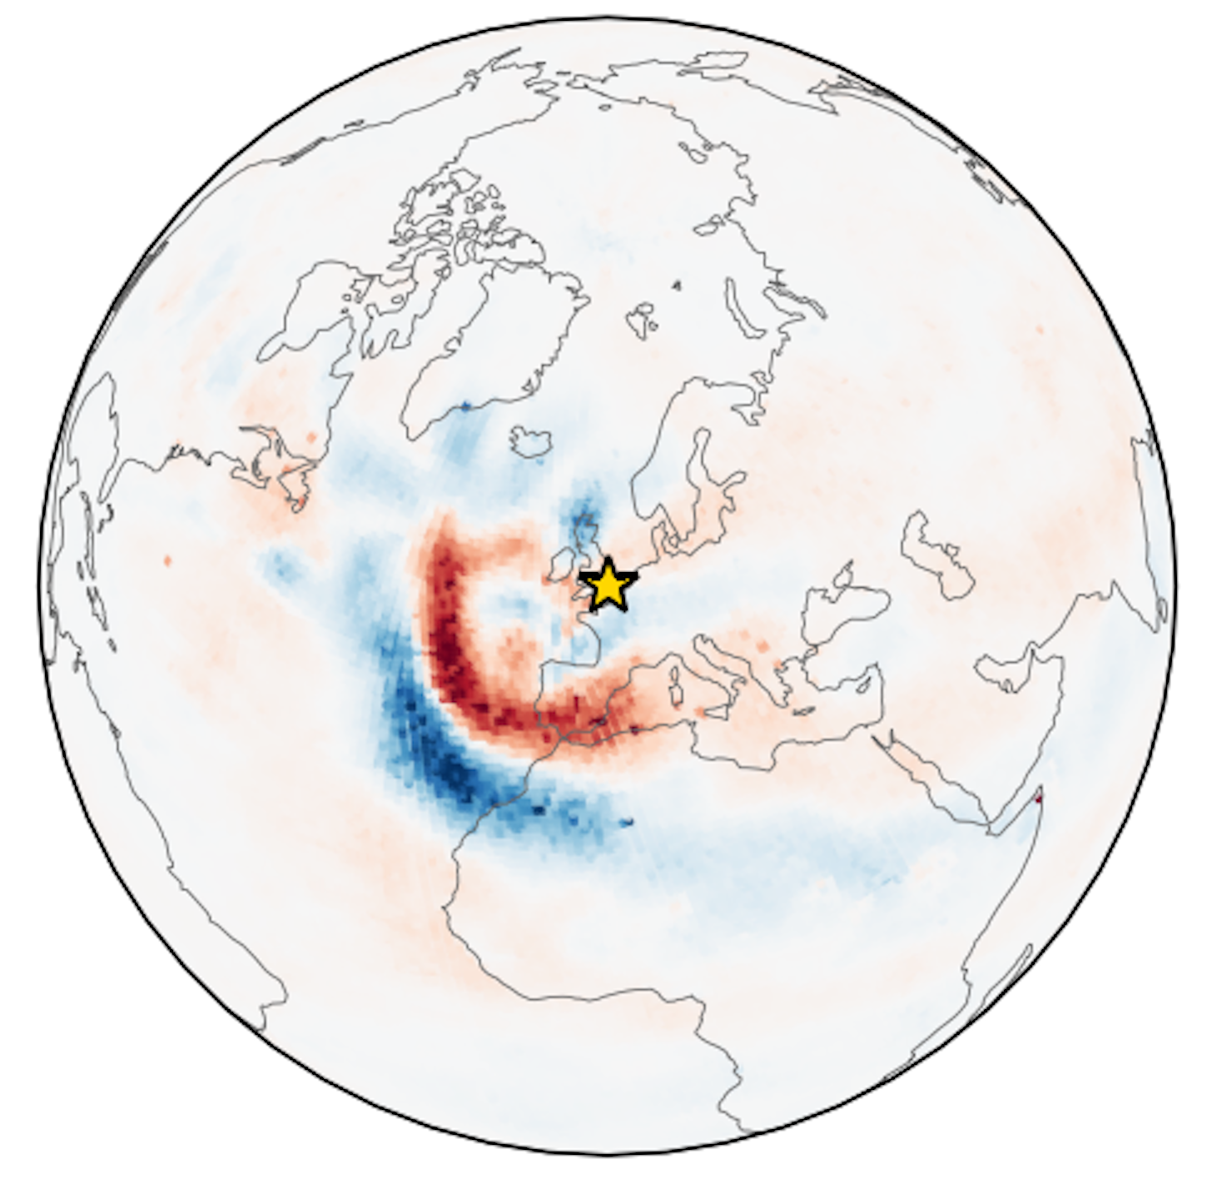
Obs Valuation: Sensitivities
As an example, we can look at
∂(AIFS Forecast, Z500, London) / ∂(AMSU-A Channel 5)
48h lead
Notes:
Using AIFS-Single for the forecast

Slide 50
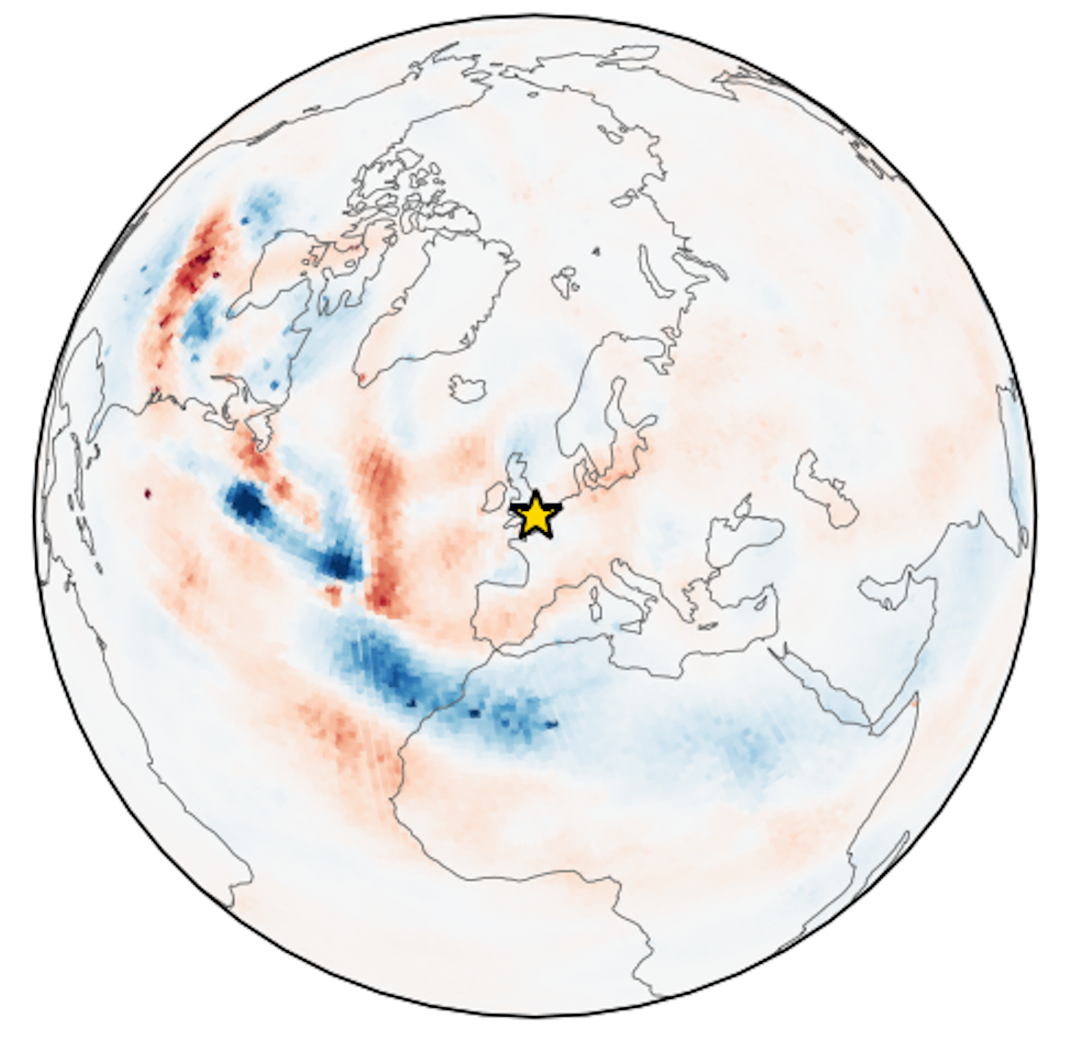
Obs Valuation: Sensitivities
As an example, we can look at
∂(AIFS Forecast, Z500, London) / ∂(AMSU-A Channel 5)
72h lead
Notes:
Using AIFS-Single for the forecast

Slide 51
Obs Valuation: Sensitivities
As an example, we can look at
∂(AIFS Forecast, Z500, London) / ∂(AMSU-A Channel 5)
24-hour lead
48-hour lead
72-hour lead
Notes:
And so even though this is still pretty early days for this, and we’re actively developing it, we’re encouraged to see these early signs of physically plausible sensitivities, and we’re excited to adapt this to observation valuation.

Slide 52
Obs Valuation: OSEs
Notes:
And so even though this is still pretty early days for this, and we’re actively developing it, we’re encouraged to see these early signs of physically plausible sensitivities, and we’re excited to adapt this to observation valuation.

Slide 53
Obs Valuation: OSEs
ATMS
AMSU-A
MHS
IASI
Verify against Radiosondes
(12h)
CrIS
GOES
Himawari
SEVIRI
AIDA
AIWP
Radiosonde
0h state
(analysis)
12h state
(forecast)
Surface
Marine
Aircraft
AMVs
Scatterometer
GNSS-RO

Slide 54
Obs Valuation: OSEs
ATMS
AMSU-A
MHS
IASI
Verify against Radiosondes
(12h)
CrIS
GOES
Himawari
SEVIRI
AIDA
AIWP
Radiosonde
0h state
(analysis)
12h state
(forecast)
Surface
Marine
Aircraft
AMVs
Scatterometer
GNSS-RO
Notes:
Mention that we train with “sensor dropout”, so that AIDA is capable of making reasonable predictions with a sensor or two missing, even if it’s a worse prediction

Slide 55
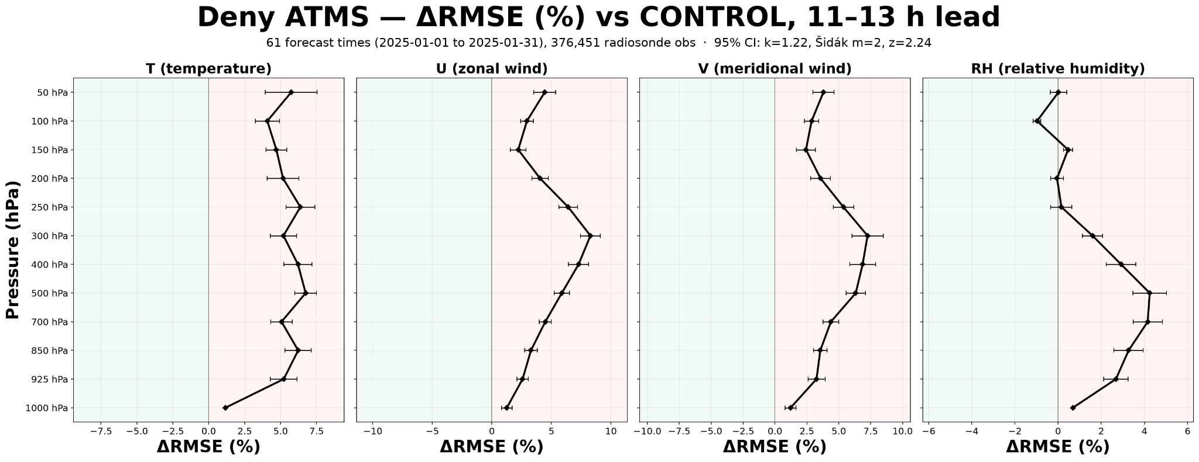
Obs Valuation: ATMS OSE

Slide 56
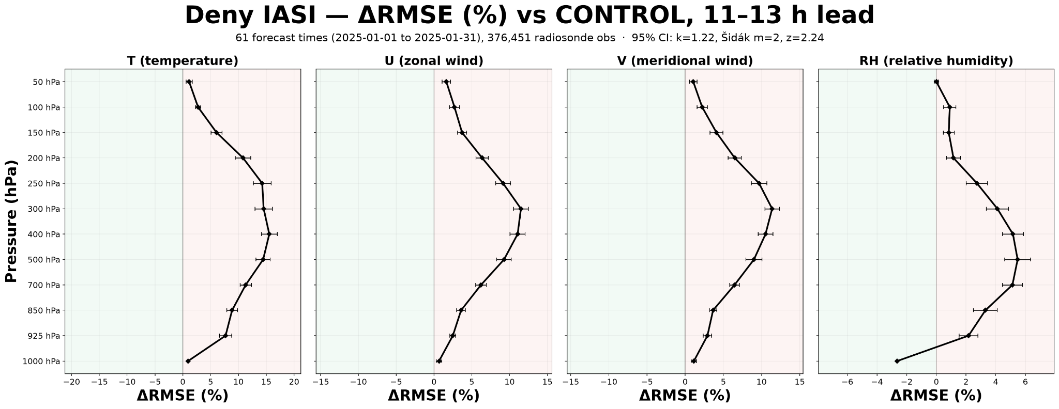
Obs Valuation: IASI OSE

Slide 57
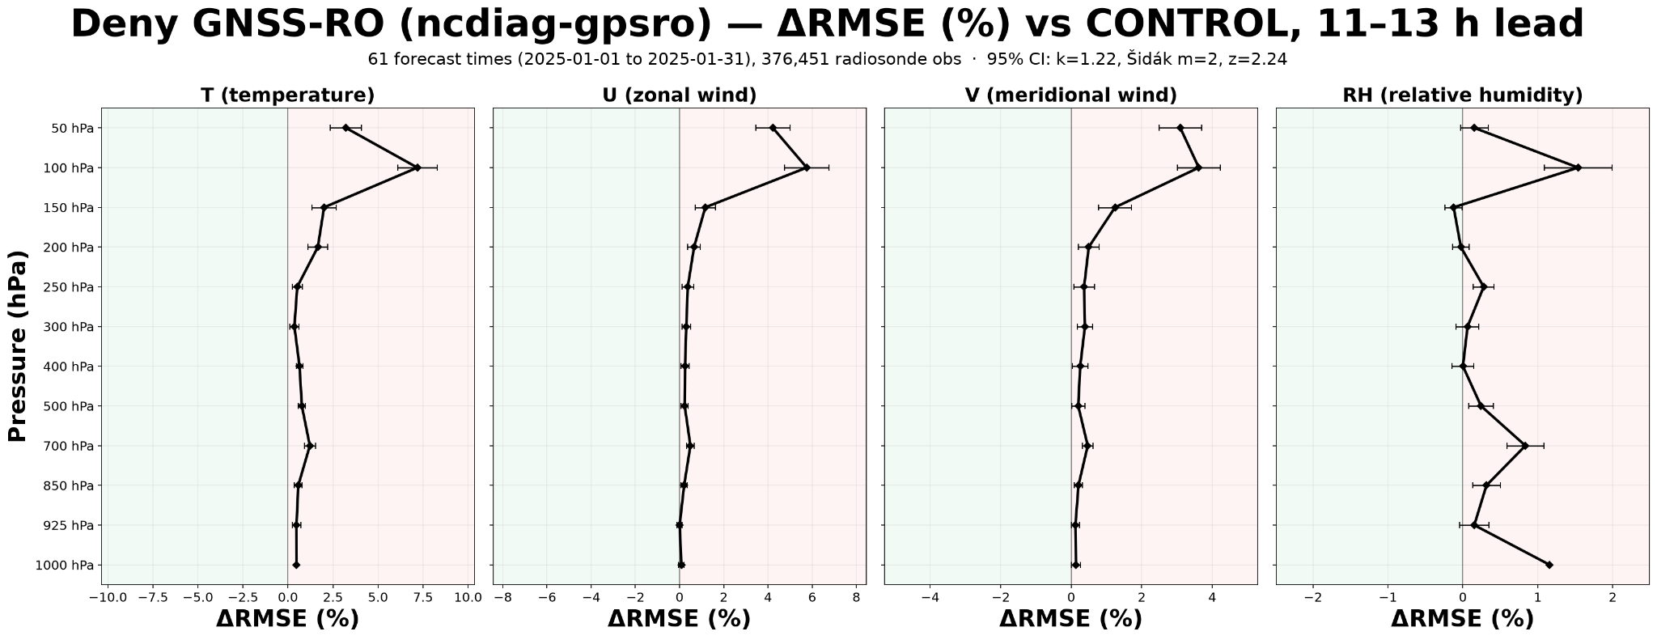
Obs Valuation: GNSS-RO OSE

Slide 58
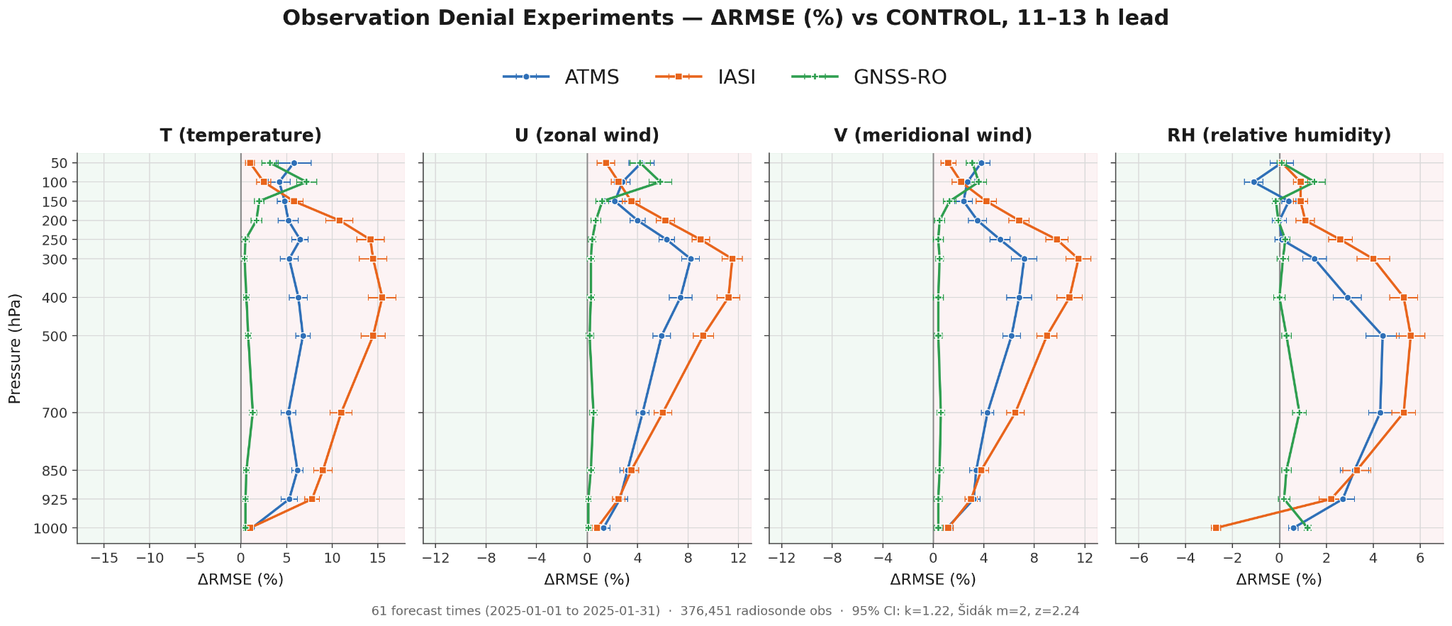
Obs Valuation: OSEs

Slide 59
Takeaways
Observations are the future of AI Weather
  More obs and more types of obs
  End-to-end optimization
  Check out NNJA-AI!
AI DA is moving fast
  AI analysis is on par with NWP analysis.
  AI DA is a fast, flexible platform for observation valuation.
  Operational at Brightband
We’d love to strengthen our partnership with NOAA.
hello@brightband.com
Notes:
To wrap up, we’ve built this AI DA system, it’s operational, the next-gen is more powerful, the whole Brightband team is here, and we’d love to talk.
If you want the weather early, or you buy or sell weather data, or you want to talk shop about observations + ML, we’d love to talk!

