Slide 1






Progress on the development of CATChem Version 2 within NOAA’s Unified Forecast System
Wei Li, Barry Baker, Maggie Bruckner, Rebecca Schwantes, Zachary Moon, Benjamin Koziol, Youhua Tang, Patrick Campbell, Quazi Rasool, Jian He, Li (Kate) Zhang, Brian McDonald
Notes:
This is a collaborative effort with many colleagues across. NOAA ARL, CSL and OMD.

Slide 2
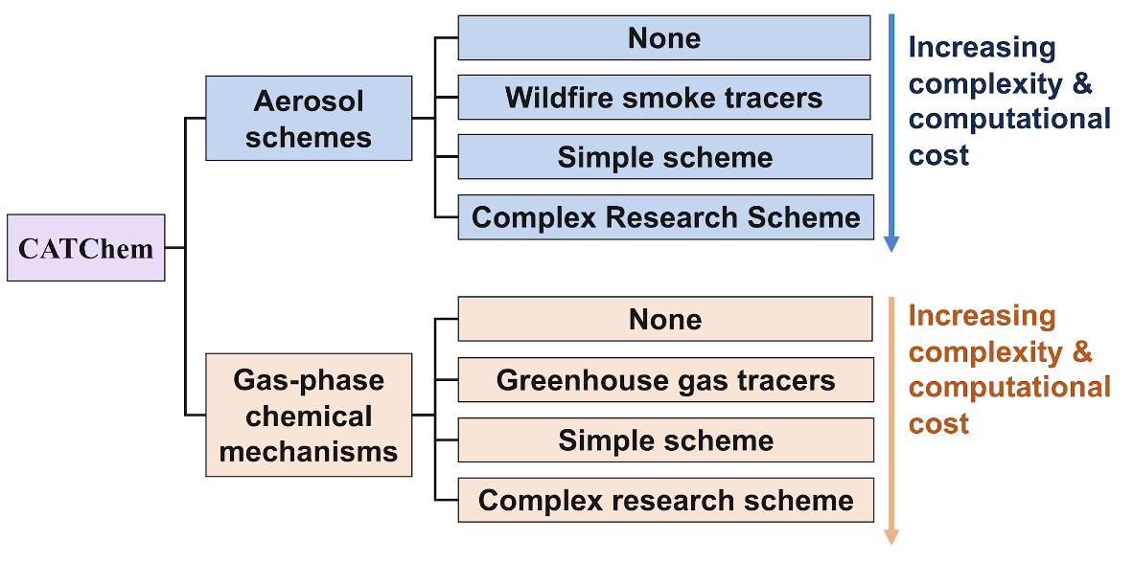
Overview of CATChem – Configurable ATmospheric Chemistry modeling component
Unify all chemistry related code in one location
Design to be flexible and configurable
For example, users can choose the aerosol scheme and the gas-phase chemical mechanism of the right complexity for their application
We will still link to authoritative repositories from external collaborators, but at a process level only
  Model Independent Chemistry Module (MICM) - developed by NSF NCAR
  The Community Regional Atmospheric Chemistry Multiphase Mechanism (CRACMM) - developed by US EPA, NOAA CSL, and the community
  GOCART Process Library - developed by NASA and NOAA
Notes:
CATChem is the new chemistry component we are developing to solve the problem that the current Chemistry-related code is duplicated across UFS applications, such as GCAFS and UFS-AQM. This lack of unification makes the code very time-intensive to maintain.
As the diagram illustrates, CATChem is designed to be flexible and configurable. Users can choose the complexity that fits their specific needs, from 'None' or ‘simple tracers' all the way up to 'Complex Research Schemes'.
This structure allows us to balance increasing complexity with computational cost, tailoring the model to the application.
The other major part of our strategy involves how we interact with the broader scientific community. While we are unifying the infrastructure, we will still link to external repositories from our collaborators. This ensures our architecture remains consistent while leveraging the best available science
However, we will do this at a process level only.
Key integrations include the Model Independent Chemistry Module (MICM) developed by NSF NCAR.
We are also incorporating the Community Regional Atmospheric Chemistry Multiphase Mechanism (CRACMM), a joint effort by the US EPA and NOAA CSL.
Finally, we continue to utilize the GOCART Process Library developed by NASA and NOAA.

Slide 3
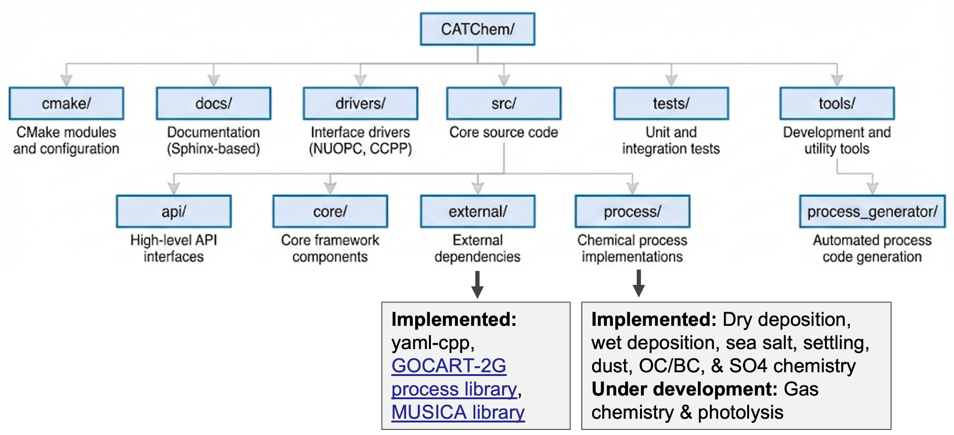
CATChem v2 Code Structure
Separation of concerns: Scientific processes isolated from software infrastructure
Modular process directories: Each process lives in its own self-contained folder
External dependencies via submodules: GOCART and MUSICA library kept separate for clean updates
Notes:
We completely restructured the codebased from version one. "This diagram provides a map of the CATChem repository. The structure is designed to separate the scientific physics from the software infrastructure.
[Section 1: The Support Layer (Top & Outer Edges)] At the top-level directories, they support the build and development lifecycle.
cmake/ [Top Left]: This holds our build configuration. It manages how the code compiles across different environments.
drivers/ [Top Center]: This is our connection to the host model. It contains the interface drivers—like NUOPC or CCPP—that allow CATChem to plug into larger Earth system models.
docs/ [Top Left]: Here we have our Sphinx-based documentation, ensuring that our manuals stay version-controlled alongside the code.
tests/ [Top Right]: This contains our unit and integration tests, which are critical for continuous model development."
[Section 2: The Core Framework (Inside src/)] The heart of the application is the src/ directory.
core/: [Point to center-left of src] This is the 'engine room.' It handles the low-level utilities that the rest of the model relies on—things like:
precision_mod: Defining numerical precision (single vs. double) in one place.
error_mod: A unified way to handle crashes or warnings.
metstate_mod: How we manage meteorological data variables.
api/: Just above that, we have the API layer. This provides high-level interfaces, from which external drivers can call internal functions without knowing the details of the function.
external/: [Point to center] This is for code we rely on but don't own. We use submodules here for libraries like yaml-cpp (for parsing config files) and the GOCART library. Keeping these separate ensures we can easily update dependencies without breaking our own code."
[Section 3: The Scientific Processes (Inside src/process/)] "Finally, for the scientists, the most important section is process/ [Point to center-right]. This is where the actual atmospheric process lives.
Each physical process has its own isolated directory:
seasalt/ for emissions.
drydep/ and wetdep/ for deposition.
settling/ for gravitational settling.
This modularity allows a scientist to work on their own code without accidentally breaking others."
[Conclusion: The Developer Workflow] "One final note on workflow: If you look at the far right under tools/, you’ll see the process_generator/. If you need to add a new chemical process, you don't start from scratch. You run this generator tool, and it automatically creates the folder structure and boilerplate code inside the process/ directory for you. This ensures that all new science modules follow the exact same standard as the existing ones."

Slide 4
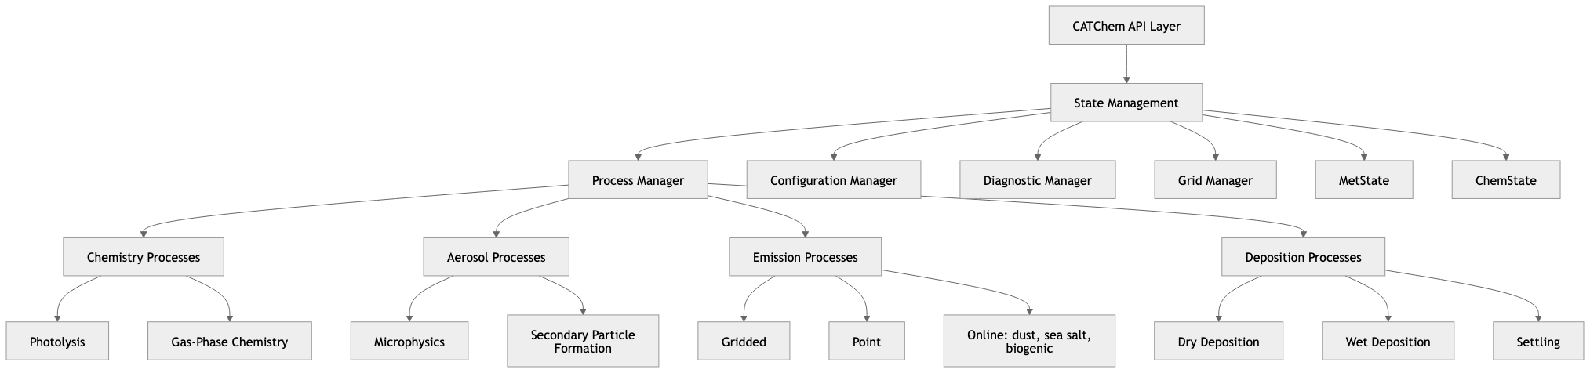
CATChem Core Architecture Components
Modular structure: Process Manager controls chemistry, aerosol, emission, and deposition components.
Centralized state management: Shared data handled through unified State Management layer.
Separated core states: Independent MetState and ChemState ensure clear meteorology–chemistry coupling.
Comprehensive process coverage: Includes photochemistry, aerosol microphysics, emissions, and deposition.
Flexible and extensible: Configurable framework designed for easy integration and future expansion.
Notes:
Zoom into the internal architecture. At the top is the CATChem API Layer, which is the single entry point for any external component communicating with us. Below that sits the State Management layer — contains several key managers: the Process Manager controls the execution of all scientific processes; the Configuration Manager handles how settings are loaded; the Diagnostic Manager collects output fields for analysis; and the Grid Manager handles spatial domain information.
This modularized structure ensure we have an easy integration and future expansion.

Slide 5
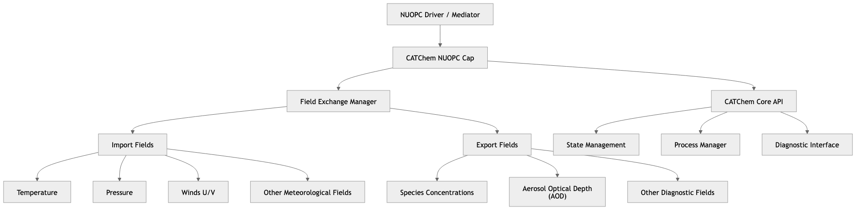
NUOPC Cap Architecture & Implementation
NUOPC Integration Overview
National Unified Operational Prediction Capability standard
Built on Earth System Modeling Framework (ESMF)
Enables seamless coupling with atmosphere, ocean, land, sea ice models
Used by NOAA, NASA, Navy, Air Force, international partners
CATChem NUOPC Cap Structure
Notes:
Now let's talk about how to plug CATChem into the UFS. We use NUOPC — the National Unified Operational Prediction Capability standard — as our coupling framework. NUOPC is built on top of the Earth System Modeling Framework (ESMF), and it enables seamless coupling among different components, such as atmosphere, ocean, land, and sea ice models. It's used by many agencies in the earth system modeling community.
The diagram shows the CATChem NUOPC Cap Structure. At the top sits the NUOPC Driver or Mediator, which controls the entire coupled system. Below it is the CATChem NUOPC Cap, which is the gateway to our system.
The cap has two main branches. On the left is the Field Exchange Manager, which handles what comes into CATChem — meteorological import fields, and determines what is exported back, such as species concentrations. On the right is the CATChem Core API, which manages our internal execution we just talked about.

Slide 6
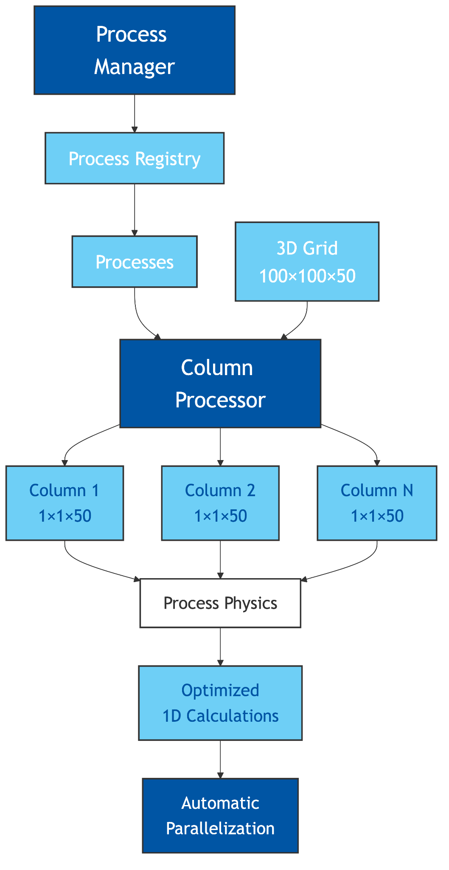
Column Virtualization
Transforms 3D atmospheric problems into independent 1D columns
Key Features:
  Reduces memory pressure: Only one column in memory at a time
  Enables efficient parallelization: Columns processed independently (OpenMP/MPI)
  Improves cache performance: Contiguous memory access
  Simplifies physics: 1D vertical profiles, easier algorithm development
How it Works
  4D arrays (nx, ny, nz, nspecies) are split into 2D arrays (nz, nspecies) and 3D arrays (nx, ny, nz) are split into 1D arrays (nz)
  Each column is extracted, processed, and re-inserted
  Thread-local column data for parallel safety
Notes:
A critical technical innovation in CATChem is Column Virtualization.
The Concept: This transforms 3D atmospheric problems into independent 1D columns. We split large 4D arrays into thread-local 2D columns.
Efficiency: By having only one column in memory at a time, we significantly reduce memory pressure and improve cache performance through contiguous memory access.
Parallelization: Since columns are processed independently, this architecture enables efficient parallelization via OpenMP or MPI or even GPU in the future.
Simplicity: It also simplifies the physics algorithms, as developers only need to solve for 1D vertical profiles.

Slide 7
CATChem Process Generator Overview
Automated Process Development Tool
**Purpose:** Replace manual Fortran coding with automated, standardized process generation.
Technology Stack:
Python-based orchestration
YAML configuration files
Jinja2 templating engine
Automatic MetState field discovery
Key Benefits:
⚡ Much faster development
🔒 Consistent architecture across all processes
🛡️ Built-in validation and error handling
📚 Complete documentation & tests generated
Jinja2 file
YAML file
MetState file
process_generator.py
Fortran codes for the process
Notes:
To make the development much easier, we created the CATChem Process Generator.
Purpose: This is tool designed to replace manual Fortran coding with standardized process generation.
Inputs: As shown in the diagram, you simply feed it a YAML file and the MetState definition, and it generates the documented Fortran code automatically .
Benefits: This tool drastically speeds up development from weeks to just a few days .
Consistency & Safety: We moved from variable coding patterns to a standardized architecture with built-in state management, eliminating common memory and field access errors .
Documentation & Testing: Perhaps most impressively, we now have auto-generated test suites and 100% documentation coverage for generated processes.

Slide 8
Progress on Incorporating GOCART-2G Process Library
Process Type | Schemes Available | Status | Purpose
Dry Deposition | WESELY, ZHANG, GOCART | Finished | Surface removal of gases/aerosols
Wet Deposition | Jacob | Finished | Large-scale Precipitation scavenging
Sea Salt | GONG97, GONG03, GOES12 | Finished | Ocean-derived aerosol emissions
Settling | GOCART | Finished | Gravitational particle
Dust | Fengsha, Ginoux | Finished | Dust emission
OC/BC | GOCART | Finished | Organic/Black carbon conversion from emissions
SO4 Chemistry | GOCART | Finished | Chemical conversion from SO2 to SO4
IO | Regrid/tile operations for global workflow | Finished | Read and output global emission and diagnostics
Notes:
This table summarizes the processes we've completed.
We currently have seven fully finished processes. Dry Deposition supports three schemes — WESELY, ZHANG, and GOCART. Wet Deposition uses the Jacob scheme for large-scale precipitation scavenging. Sea Salt supports three emission schemes — GONG97, GONG03, and GEOS12 — for ocean-derived aerosol emissions. Gravitational Settling uses the GOCART scheme, Dust emission schemes include Fengsha and Ginoux. OC/BC and SO4 are all from GOCART simple chemistry.
We've also created the I/O layer for regridding and tile operations within the global workflow. These processes cover what the Global Chemistry and Aerosol Forecast System — GCAFS — is currently using, which allows us to do a direct comparison.

Slide 9
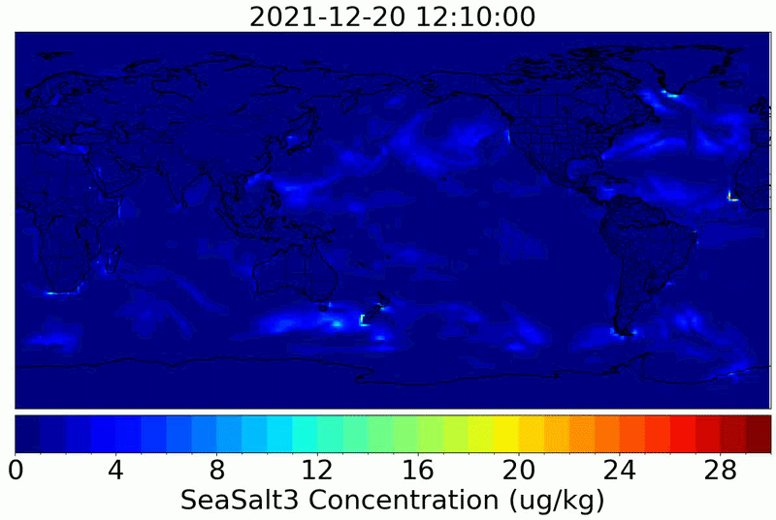
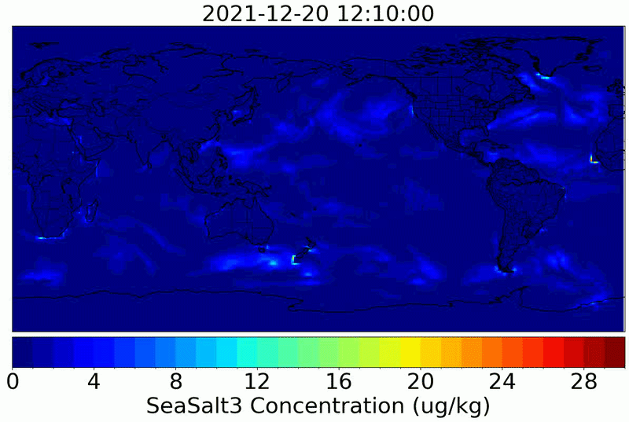
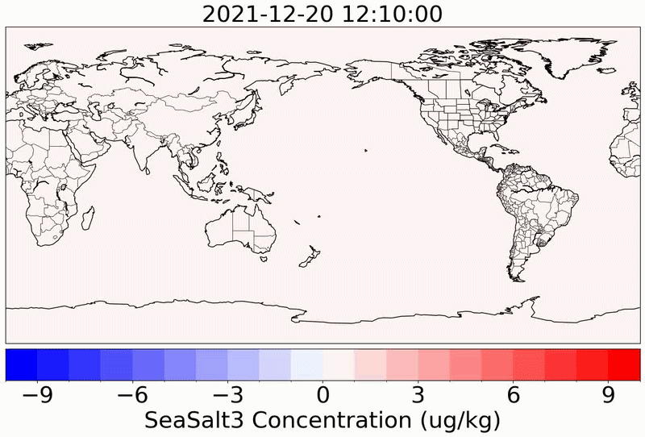
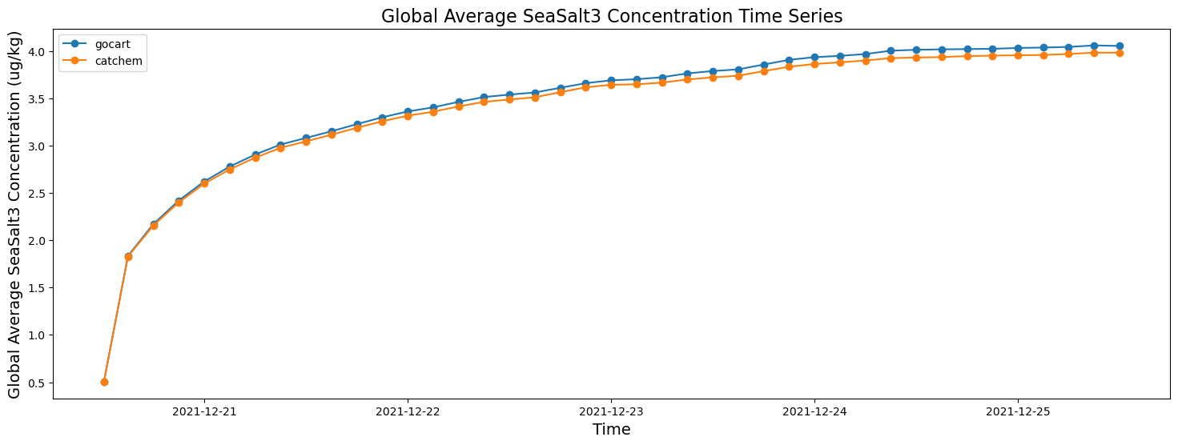
Initial Results Compared with GCAFS - Sea Salt Bin 3
GCAFS
CATChem
CATChem - GCAFS
Global mean at the surface
• An initial comparison with GCAFS for a 5-day free run using global workflow.
• CATChem v2 shows similar spatial patterns and concentrations of Sea Salt aerosols.
• Small differences due to customized wet deposition after bug correction.
Notes:
Now let me show you some initial results. This slide compares CATChem v2 against GCAFS for sea salt aerosol — specifically bin 3 — from a 5-day free run using the global workflow.
On the left is the CATChem result, in the middle is GCAFS, and on the right is the difference between them. The bottom panel shows the global mean concentration at the surface over the 5-day period.
As you can see, CATChem v2 reproduces the spatial patterns and concentration magnitudes of sea salt very well. The major emission regions over the Southern Ocean, the North Atlantic, and the North Pacific are all captured consistently. The small differences you see in the difference plot are mainly due to a customized wet deposition scheme in CATChem where we corrected a bug in the original implementation.

Slide 10
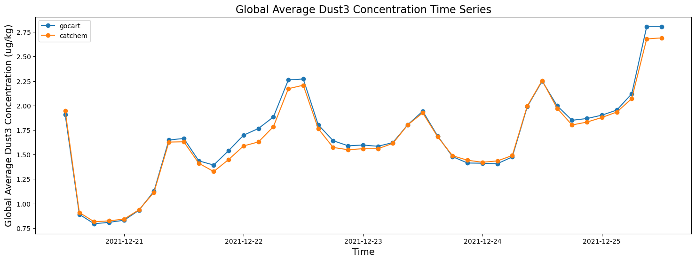
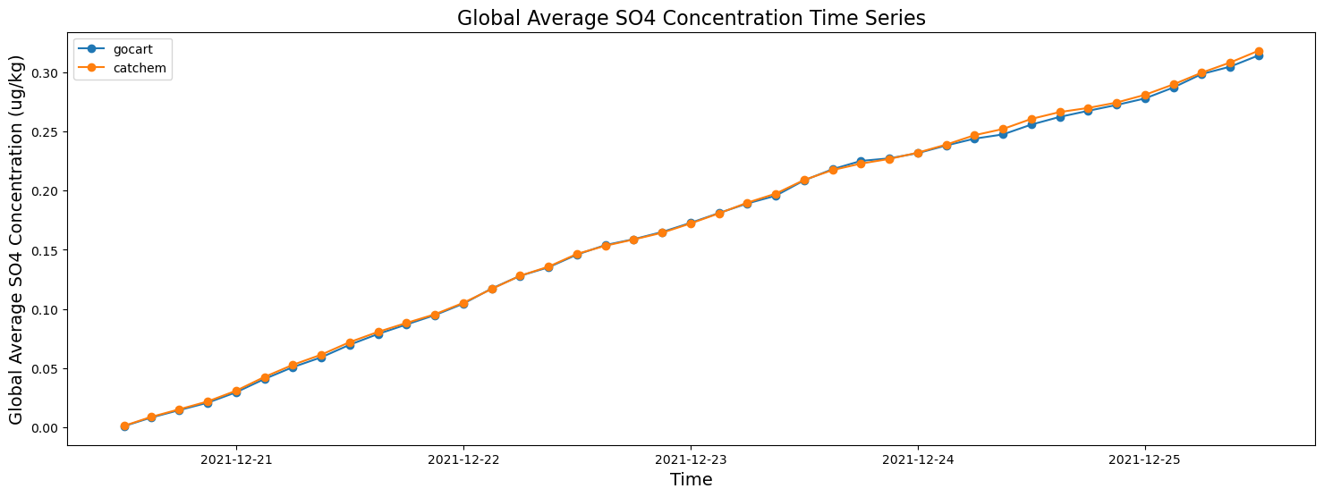
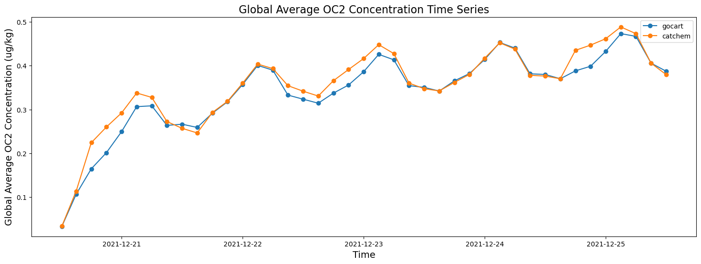
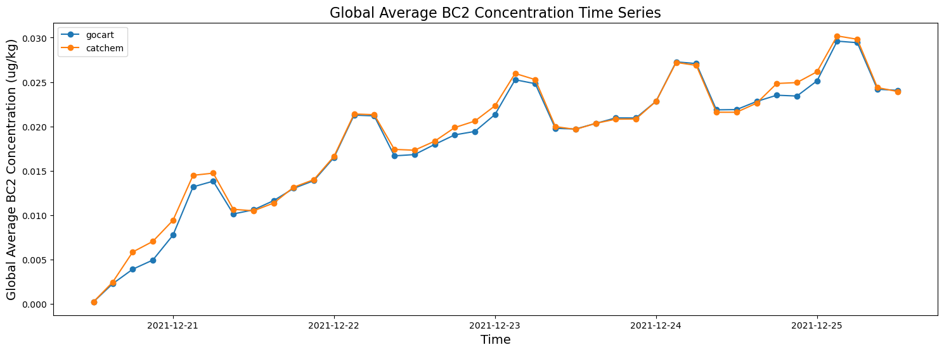
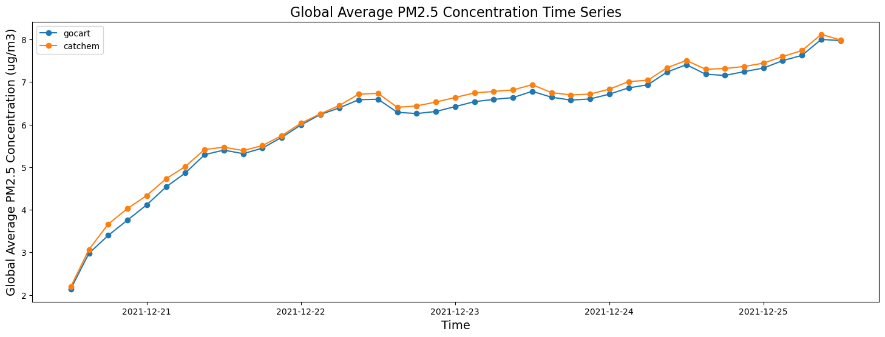
Initial Results Compared with GCAFS - Other Species
Dust Bin 3
Sulfate
Organic Carbon Bin 2
Black Carbon Bin 2
• Comparable results between CATChem and GCAFS for all GOCART-2G aerosols.
• Differences are mainly due to systematic bias from IO (MAPL v.s. CATChem IO) in addition to some minor changes in process scheme itself.
PM_{2.5}
Notes:
Extending the comparison to other species, here we show sulfate, dust bin 3, organic carbon bin 2, black carbon bin 2, and total PM2.5. In each pair, CATChem is on the left and GCAFS is on the right.
The key takeaway is that CATChem and GCAFS produce comparable results across all GOCART-2G aerosol species. The spatial distributions and magnitudes are in good agreement. Where differences do appear, they are mainly due to two factors: first, systematic differences in the I/O layer — GCAFS uses MAPL for its input/output handling while CATChem has its own I/O implementation — and second, some minor changes in the process schemes themselves, such as the wet deposition correction I mentioned. These results give us confidence that the CATChem framework is producing physically consistent output, no indications of fundamental problems.

Slide 11


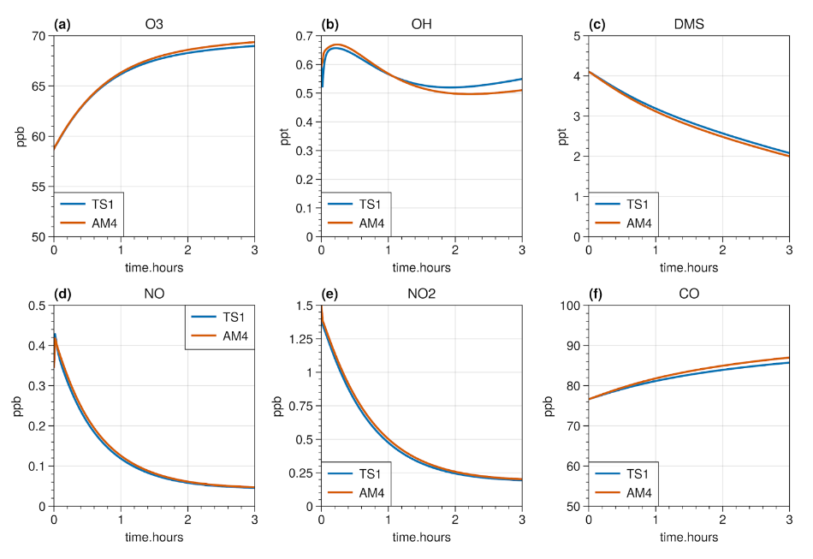

Progress on Adding Gas Chemistry through MUSICA Library
Gas-Phase Mechanisms
• Repository: NOAA-CSL/CATChem_mechanisms
• Reformatted to MICM format and tested in MusicBox: AM4.1 (finished) & RAQMS (Started)
Poster: Progress update on incorporating the MICM gas-phase chemical solver in CATChem
Maggie Bruckner
NOAA CSL /
NRC Postdoc
Connecting MUSICA
• MUSICA library is connected to CATChem and builds
• Updated CATChem input files to be consistent with MICM formatting
• Started adding MICM as a process to CATChem following other processes.
•Next steps: Test with simple SO₂ loss in GOCART-2G configuration
Notes:
Looking ahead, this slide summarizes our progress on incorporating gas-phase chemistry through the MUSICA library and MICM solver THe work is led by Maggie Bruckner from CSL. She has a poster tomorrow with more details.
On the gas-phase mechanisms side, we have a dedicated repository — NOAA-CSL/CATChem_mechanisms — where we are reformatting chemical mechanisms into the MICM format and testing them in MusicBox. The AM4.1 mechanism is finished and RAQMS has been started.
On the software integration side, the MUSICA library is now connected to CATChem and builds successfully. We've updated the CATChem input files to be consistent with MICM formatting requirements, and we've started adding MICM as a process within CATChem, following the same modular pattern as our other processes. The next concrete step is to test with a simple SO2 loss reaction in the GOCART-2G configuration, which will serve as a proof of concept before we scale up to full mechanisms.

Slide 12
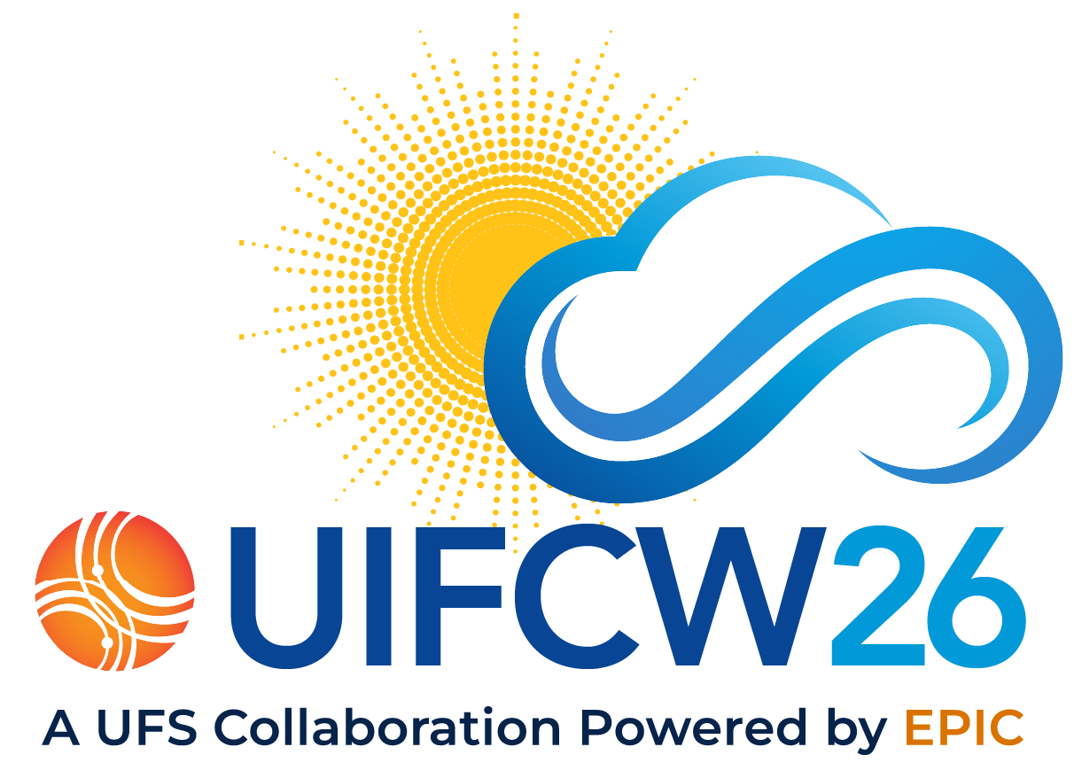
CATChem v2 Future Development Priorities
Gas-Phase Chemistry
Scope: RAQMS, AM4 and CB6 mechanism implementation
Challenge: 100+ species, 300+ reactions, chemical solver
01
Aerosol Microphysics
Scope: GOCART, ISORROPIA and MOSAIC mechanism
Challenge: Modal vs sectional approaches, computational efficiency
02
More Online Emission Processes
Scope: MEGAN BVOC, Lightning/Soil NOx, and Fire Plume Rise
Tool: The Community Emissions Computing Engine (CECE): A High-Performance, Portable Framework for Atmospheric Emissions in UFS (poster by Barry Baker)
03
Longer Term Run and Evaluation
Scope: Longer term comparisons against GCAFS and observations
Tool: Evaluating UFS and other Models Against Atmospheric Composition and Meteorological Observations Using MELODIES MONET (poster by Rebecca Schwantes)
04
Notes:
We've made good progress, but there's a lot of work ahead.
First, we need to finish gas-phase chemistry. We have three mechanisms in scope: RAQMS, AM4, and CB6. What makes this hard is scale and stiffness — a full mechanism like CB6 involves over 100 species and over 300 reactions with reaction rates spanning many orders of magnitude. Getting the chemical solver to work correctly, conserve mass, and remain computationally affordable at operational scales is genuinely difficult.
Second is aerosol microphysics. We have GOCART as a bulk scheme baseline, ISORROPIA for inorganic thermodynamic equilibrium, and MOSAIC as a full sectional scheme. The core challenge is the modal versus sectional tradeoff — sectional schemes are accurate but expensive, modal schemes are cheaper but make lognormal assumptions that can break down. Choosing the right approach for CATChem's different use cases is both a scientific and engineering decision.
Third, we need more online emission processes — MEGAN for biogenic VOCs, lightning and soil NOx, and fire plume rise. We are actively developing the Community Emissions Computing Engine or CRCE for this. Barry Baker has a poster for CECE tomorrow.
Fourth, we need longer-term runs and systematic evaluation against GCAFS and observations. Rebecca Schwantes also has a poster on MELODIES MONET, the evaluation tool we'll be using.

Slide 13
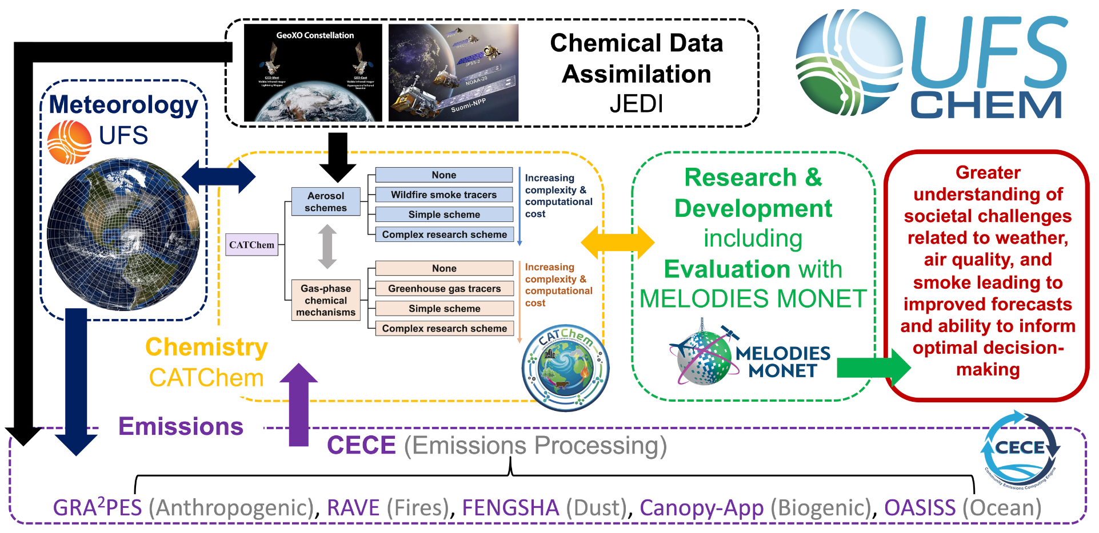
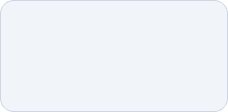
Summary
CATChem unifies all chemistry-related codes; it utilizes modularized architecture to orchestrate chemistry, aerosol, emission, and deposition components; it couples with UFS through a NUOPC cap.
All GOCART-2G processes have been implemented; initial evaluation against GCAFS show comparable results; long term simulation is needed for a better comparison.
Gas phase chemistry is under development; CECE emission process component will be coupled and MELODIES MONET tool will be used for future evaluation, which are key parts of the next-generation air quality forecast system in the UFS.
CATChem
Code: github.com/ufs-community/CATChem
User Guide:
catchem.readthedocs.io
Notes:
To summarize: CATChem v2 uses a modularized architecture to orchestrate chemistry, aerosol, emission, and deposition components, and it couples with the UFS through a NUOPC cap.
All GOCART-2G processes have been implemented, and our initial evaluation against GCAFS shows comparable results. Longer-term simulations are needed for a more thorough comparison.
Looking ahead, gas-phase chemistry is under active development. The CECE emissions component will be coupled in, and the MELODIES MONET tool will be used for systematic evaluation. Together, these are key parts of the next-generation air quality forecast system in the UFS as shown in this diagram.
You can find the source code and use guide for catchem through the link here.

