Slide 1



NSF NCAR’s Next-Generation Online-Coupled Air Quality and Weather Analysis and Forecasting System using MPAS-GOCART2G-JEDI
NASA ROSES-2023: “Advanced air quality forecasting through coupled data assimilation of hyperspectral PACE aerosol retrievals and all-sky radiances from multiple satellite-based sensors”
Soyoung Ha (NSF NCAR)
Special thanks to: Jun Park, Shih-Wei Wei, Mary Barth, Rajesh Kumar (NCAR), Maryam Abdi-Oskouei (NASA), Jaqueline Pereira (INPE, Brazil)

Slide 2

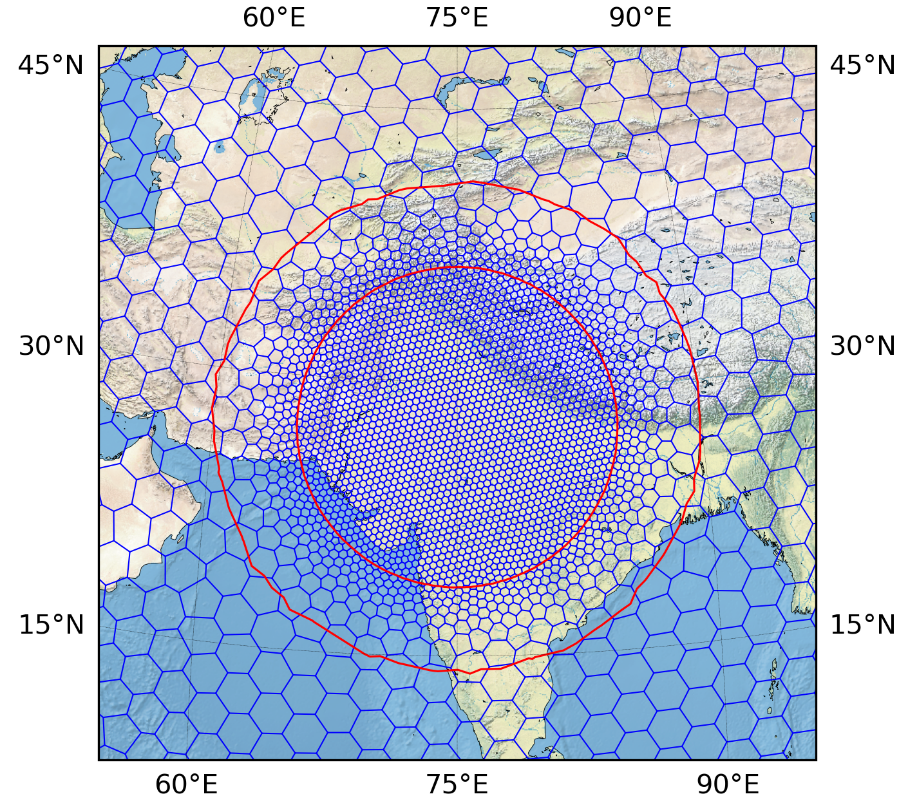
Key aspects
MPAS-GOCART2G-JEDI: An online-coupled atmosphere–aerosol system using the Model for Prediction Across Scales (MPAS) with GOCART-2G interfaces with the Joint Effort for Data Assimilation Integration (JEDI).
Multi-sensor, multi-channel AOD products can be incorporated simultaneously (e.g., PACE, MODIS, and VIIRS), enabling consistent intercomparison, analysis, and validation for research-to-operations applications.
Coupled DA capability: Supports the assimilation of aerosol and meteorological observations, including all-sky radiances from microwave to infrared channels.
Unified global–regional framework: Variable-resolution MPAS meshes enable consistent analysis and forecasting across both global and regional applications.
Global MPAS 30-5 km mesh w/ three 5-km regions

Slide 3
JEDI
Today’s talk
Credit: Mary Barth (NCAR)

Slide 4
GOCART-2G
Goddard Chemistry, Aerosol, Radiation, and Transport Second Generation (Collow et al. 2024)
Externally mixed aerosols: hydrophobic and hydrophilic BC/BrC/OC, sulfate (including volcanic), ammonium, nitrate (3 size bins), dust (5 size bins), sea salt (5 size bins)
Trace gases: DMS, SO₂ (including volcanoes), MSA, NH₃, SOA precursors from anthropogenic, biomass burning, biogenic sources.
Prescribed oxidants: OH, H₂O₂, NO₃ radical, HNO₃
Processes: Emissions, hydrophobic-to-hydrophilic conversion, gravitational settling, sulfate production, dry and wet deposition, SOA formation, thermodynamics of SO₄² - NH₄⁺ - NO₃⁻
Credit: Mary Barth (NCAR)

Slide 5
MPAS-GOCART2G Emissions
GOCART-2G Emissions | Details
Anthropogenic Emissions | CAMS emissions inventory: SO2, BC, OC, NH3, CO, NO2, monoterpenes, isoprene
Biogenic Emissions | CAMS pre-calculated emissions inventory: isoprene, a-pinene, b-pinene, other monoterpenes
Biomass Burning Emissions | FINN v2.5.1 externally read input files: BC, BIGENE, CO, isoprene, NH3, NO2, OC, SO2 Includes climatological diurnal profile. A plumerise scheme is being developed (INPE collaboration).
Dust Emissions | Ginoux et al. (2001); 5 size bins
Sea Salt Emissions | Gong (2003); 5 size bins
Credit: Mary Barth (NCAR)

Slide 6
MPAS-GOCART2G workflow
Plume-rise model
Biomass-burning smoke injection height
gocart2G_emissions
Emissions ・ dust ・ seasalt => aerosol mixing ratios in scalars
Physics_driver
radiation SW/LW
sfc_layer ・ LSM
PBL ・ GWDO
convection
apply tendencies
gocart2G_chemistry_driver
aging ・ dry/wet removal ・ gas chem => gocart2G_forMPASphys, GOCART2G_rrtmg
cloud microphysics
Dynamics (atm_timestep)
advect aerosol scalars
Chemistry outputs feed physics on the next step (1-step lag)
Species transport processes are updated by the dynamics solver while emissions and chemistry processes are updated with the GOCART-2G chemistry.

Slide 7
MPAS-GOCART2G aerosol-physics feedbacks
Radiation
rrtmg_sw/lw
Aerosol optical properties from gocart2G LUT, summed into total tauaer, ssaaer, asyaer when aer_opt=2 → direct radiative effect
PBL
bl_mynn
Vertical mixing and dry deposition
Deposition velocity is calculated in gocart2G chemistry.
Microphysics
mp_thompson_gocart2G
Thompson-Eidhammer aerosol-aware scheme, taking prognostic aerosol mass every step.
Convection
cu_ntiedtke
Scale-aware
Hydrophilic species
Coarse dust → nifa (IN)
Scavenging of aerosols and trace gases are included.
Up/downdraft tracer transport + convective wet scavenging (in-cloud fscav + below-cloud washout) of soluble trace gases and aerosols.
→ nwfa (CCN)
toRRTMG
toMYNN+mynn_mixchems
toNITEDTKE+ctr/scavchems
toTHOM
Two-way coupling in a new “MPAS-GOCART2G” physics suite in MPAS V8.3.1.

Slide 8
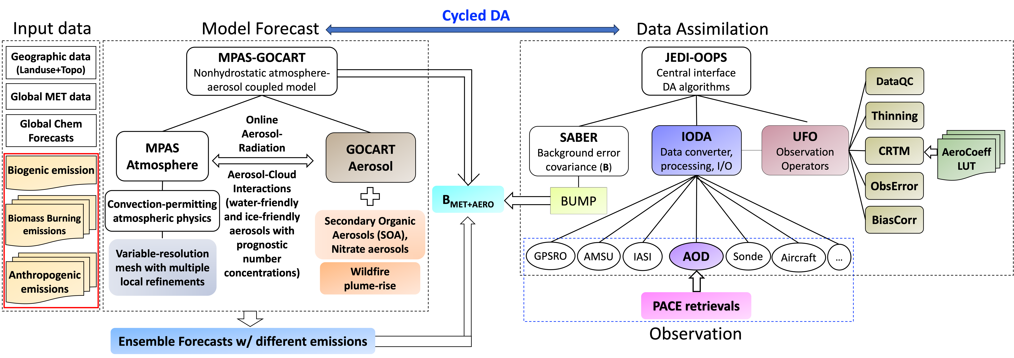
MPAS-GOCART2G-JEDI
New developments in colored boxes.
Aerosol optical properties (AOPs) are consistent across components by using the same GEOS5-GOCART look-up table in both the model’s RRTMG radiation scheme and the CRTM-AOD observation operator used in DA (Dang et al., 2026).

Slide 9
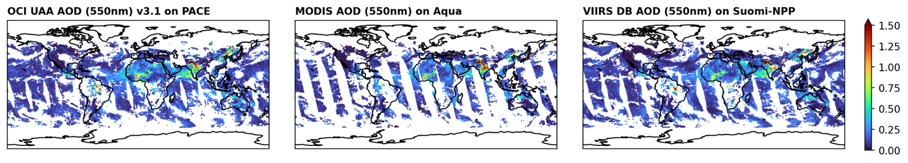
Aerosol Optical Depth (AOD) in JEDI
NASA PACE has been producing hyperspectral AOD retrievals since Feb 2024.
  Ocean Color Instrument (OCI) — a primary sensor
  HARP2 and SPEXone — secondary polarimeters
All AOD products are incorporated into the JEDI system for either data assimilation or cross validation: Wei et al. (GMD2026)
Global distribution on 8 November 2024 (4 times/day)
a) PACE OCI AOD @ 550nm
b) MODIS Aqua AOD @ 550nm
c) VIIRS DB AOD @ 550nm

Slide 10
Satellite retrievals vs. AERONET: AOD 550 nm (Nov 2024)
AERONET AOD @550 nm

Slide 11
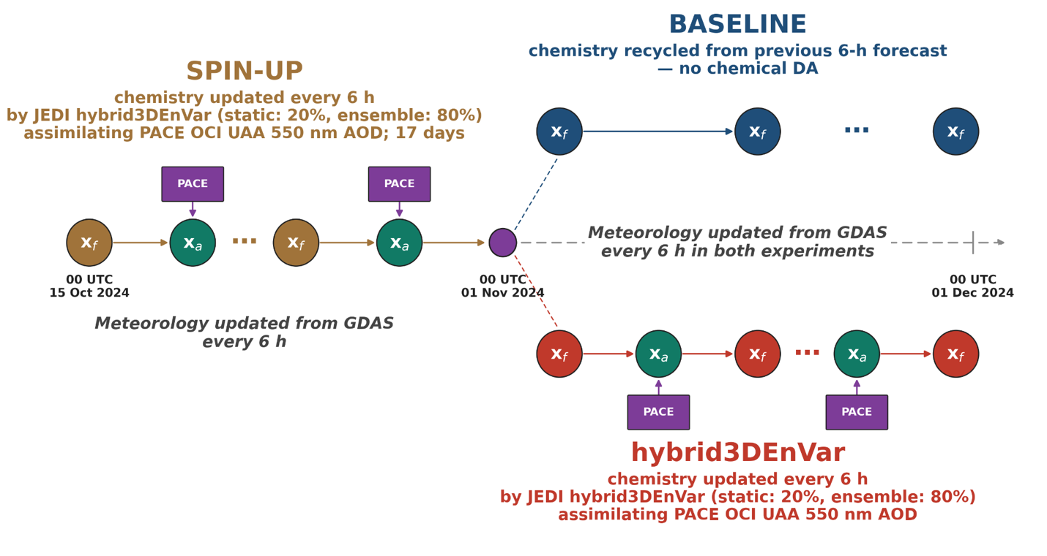
Cycling data assimilation with MPAS-GOCART2G-JEDI
PACE OCI (UAA) AOD at 9 channels is converted into the IODA format for JEDI
: 354, 388, 480, 550, 670, 870, 1240, 1640, and 2200 nm
We assimilate AOD 550 nm from PACE OCI, but also incorporate other channels and sensors such as VIIRS and HARP2/SPEXone for evaluation purposes.
A global 60-km uniform MPAS mesh (x1.163842) w/ 55 levels up to 30-km
A new ‘MPAS-GOCART2G’ physics suite based on convection-permitting parameterizations
Hybrid-3DEnVar Analysis for {Meteorology + Aerosol} with {static+ensemble} B
Ensemble B was estimated from 7-day forecasts of a 27-ensemble (GEFS MET + EMIS AERO).
6-h cycling for Nov 2024.

Slide 12
Background Error Covariance Modeling
Component | # of samples | Description
Static B | 60 | NMC method; 48-24 h forecast differences initialized every 12 hour with cold-start GDAS + MERRA2 GMI ANL + cntl emission over Nov 2024
Ensemble B | 27 | Localization Matrices (H:1200km,V:30km) 7-day ensemble forecasts initialized at 00 UTC on Oct 25, 2024 using 27 GEFS MET perturbations combined repeatedly with 9 emission perturbations.
Table. A list of 9-member emissions ensemble (EMIS)
Emission perturbation | Biogenic | Anthropogenic | Biomass Burning
cntl | CAMS (Global, 0.1 deg) | CAMS (Global, 0.1 deg) | FINN
pert01 |  |  | GFAS
pert02 |  |  | QFED
pert03 |  | CEDS (Global, 0.1 deg) | FINN
pert04 |  |  | GFAS
pert05 |  |  | QFED
pert06 |  | MIXv2 | FINN
pert07 |  |  | GFAS
pert08 |  |  | QFED
BUMP within the SABER component in JEDI is employed to calculate and apply background error covariance matrices.

Slide 13
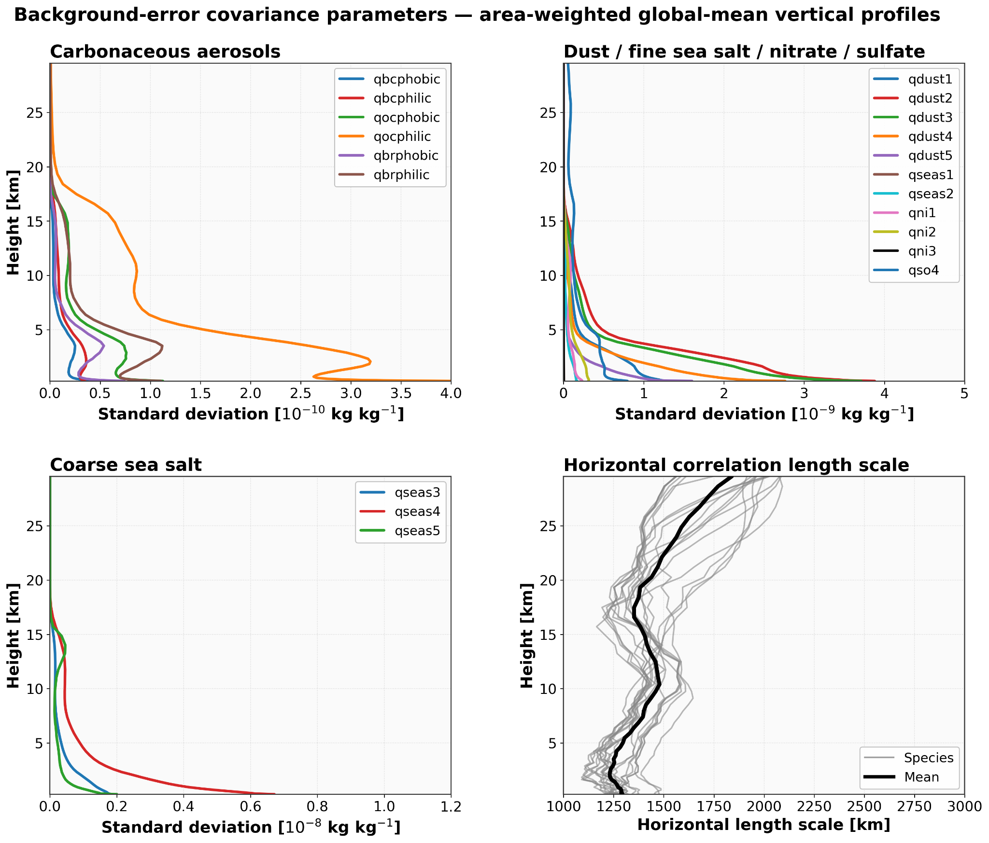
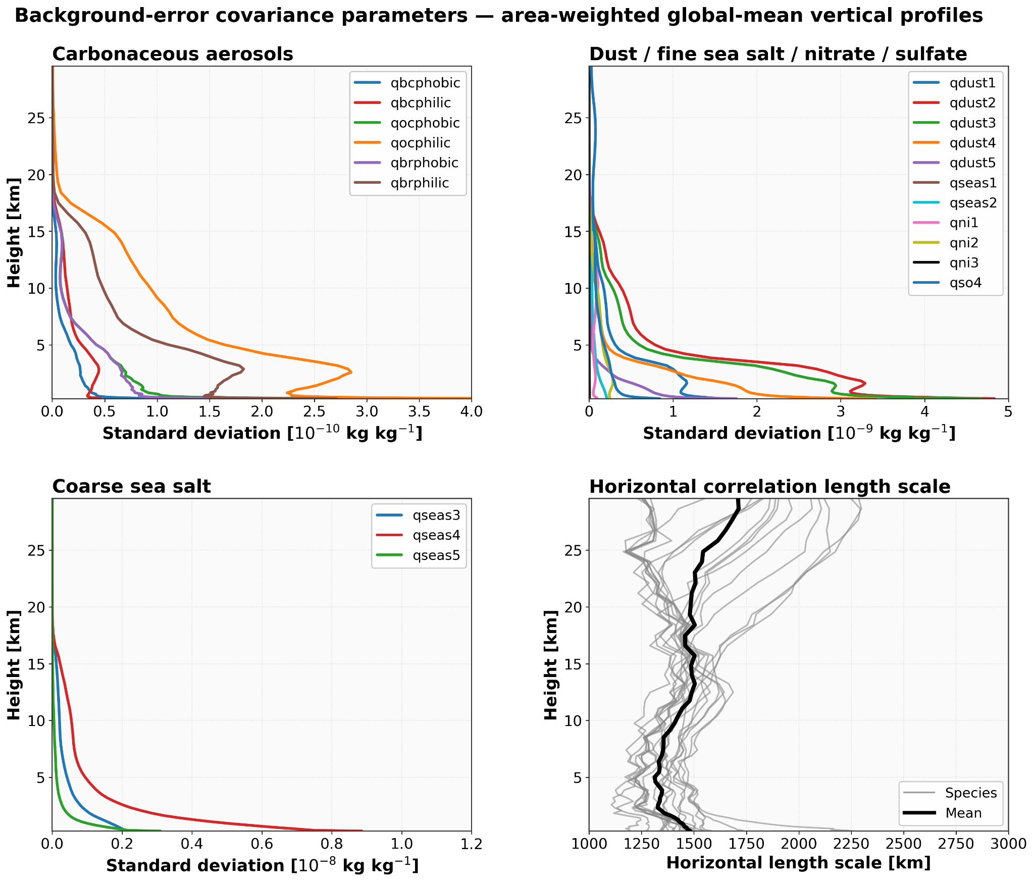
Background Error Covariance
Static B
Ensemble B
TOP LEFT/RIGHT and BOTTOM LEFT: Standard Deviation of chemical species.
BOTTOM RIGHT: Horizontal correlation length scale

Slide 14
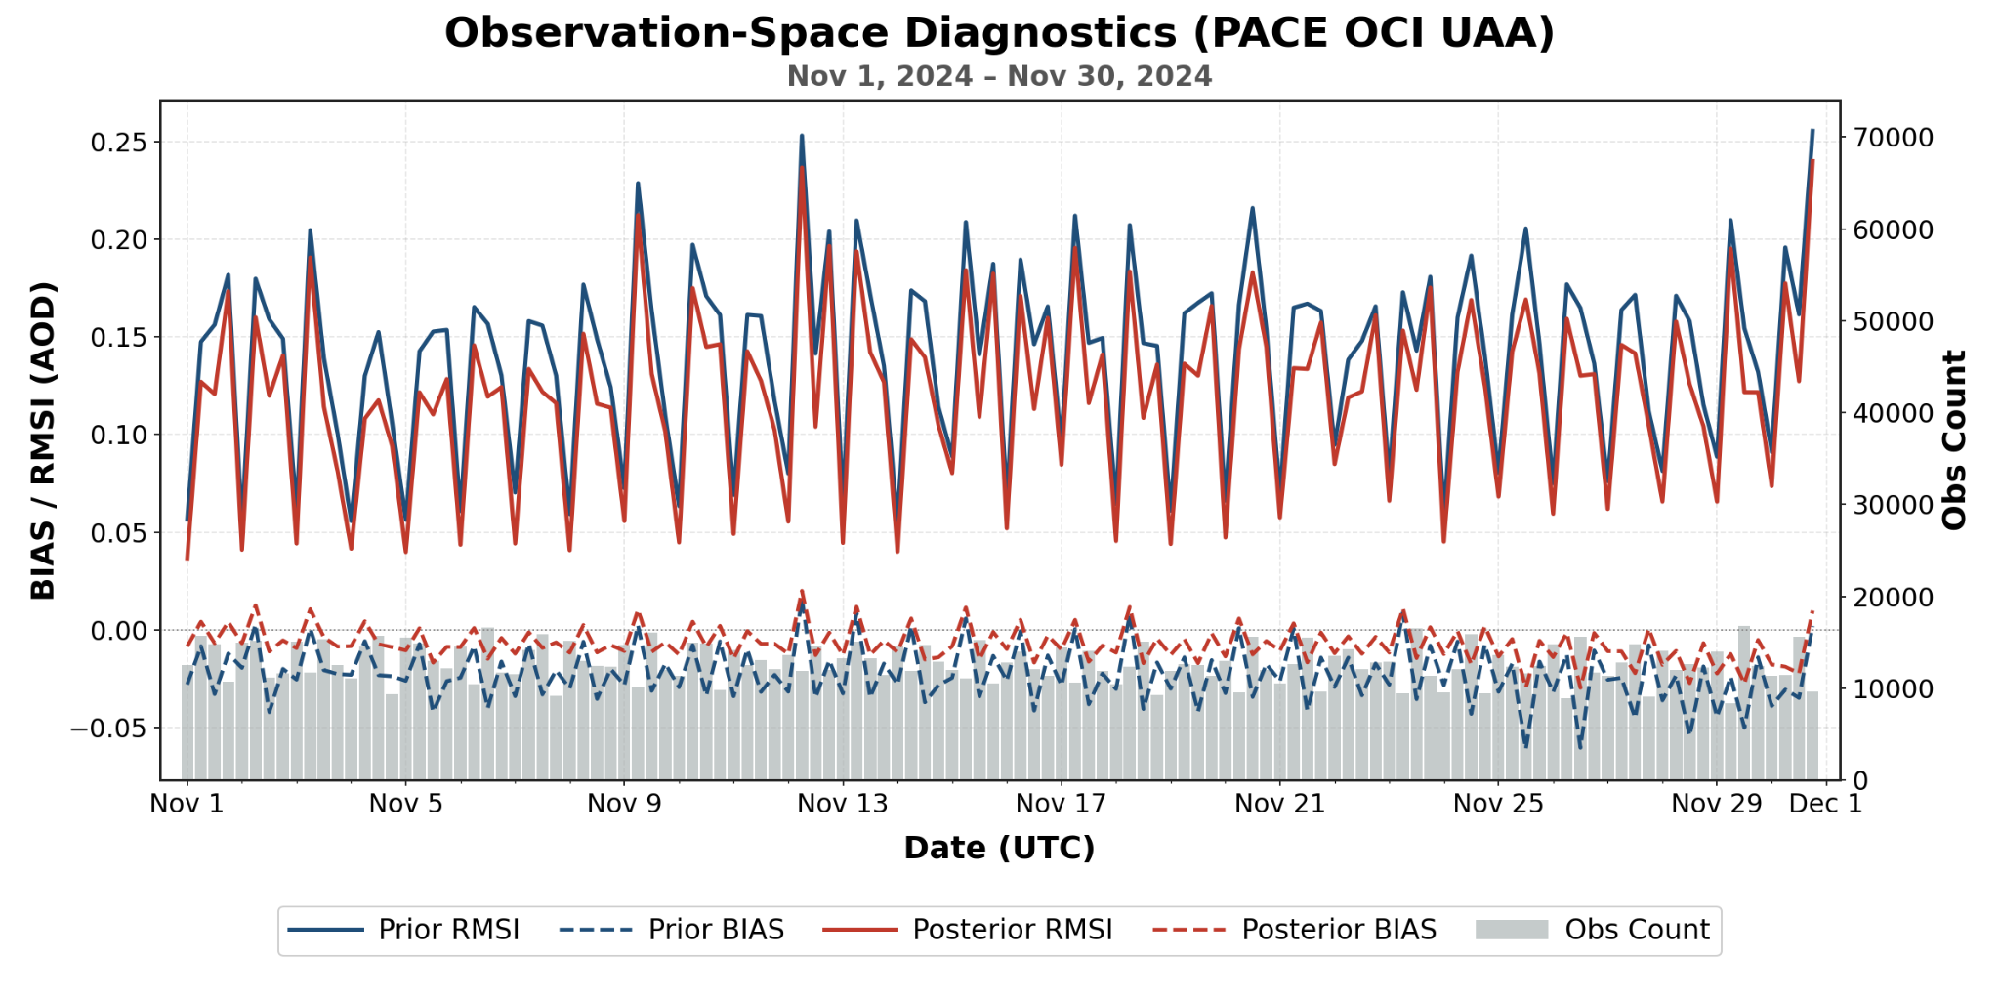
Hybrid-3DEnVar AOD DA in MPAS-GOCART2G-JEDI
Prior RMSI
Posterior RMSI
Posterior Bias
Prior Bias
RMSI = root mean square innovation (o-f)
Hybrid-3DEnVar 6-h cycling for Nov 2024 is robust.
Both RMSI and O-F AOD bias errors are systematically reduced.

Slide 15
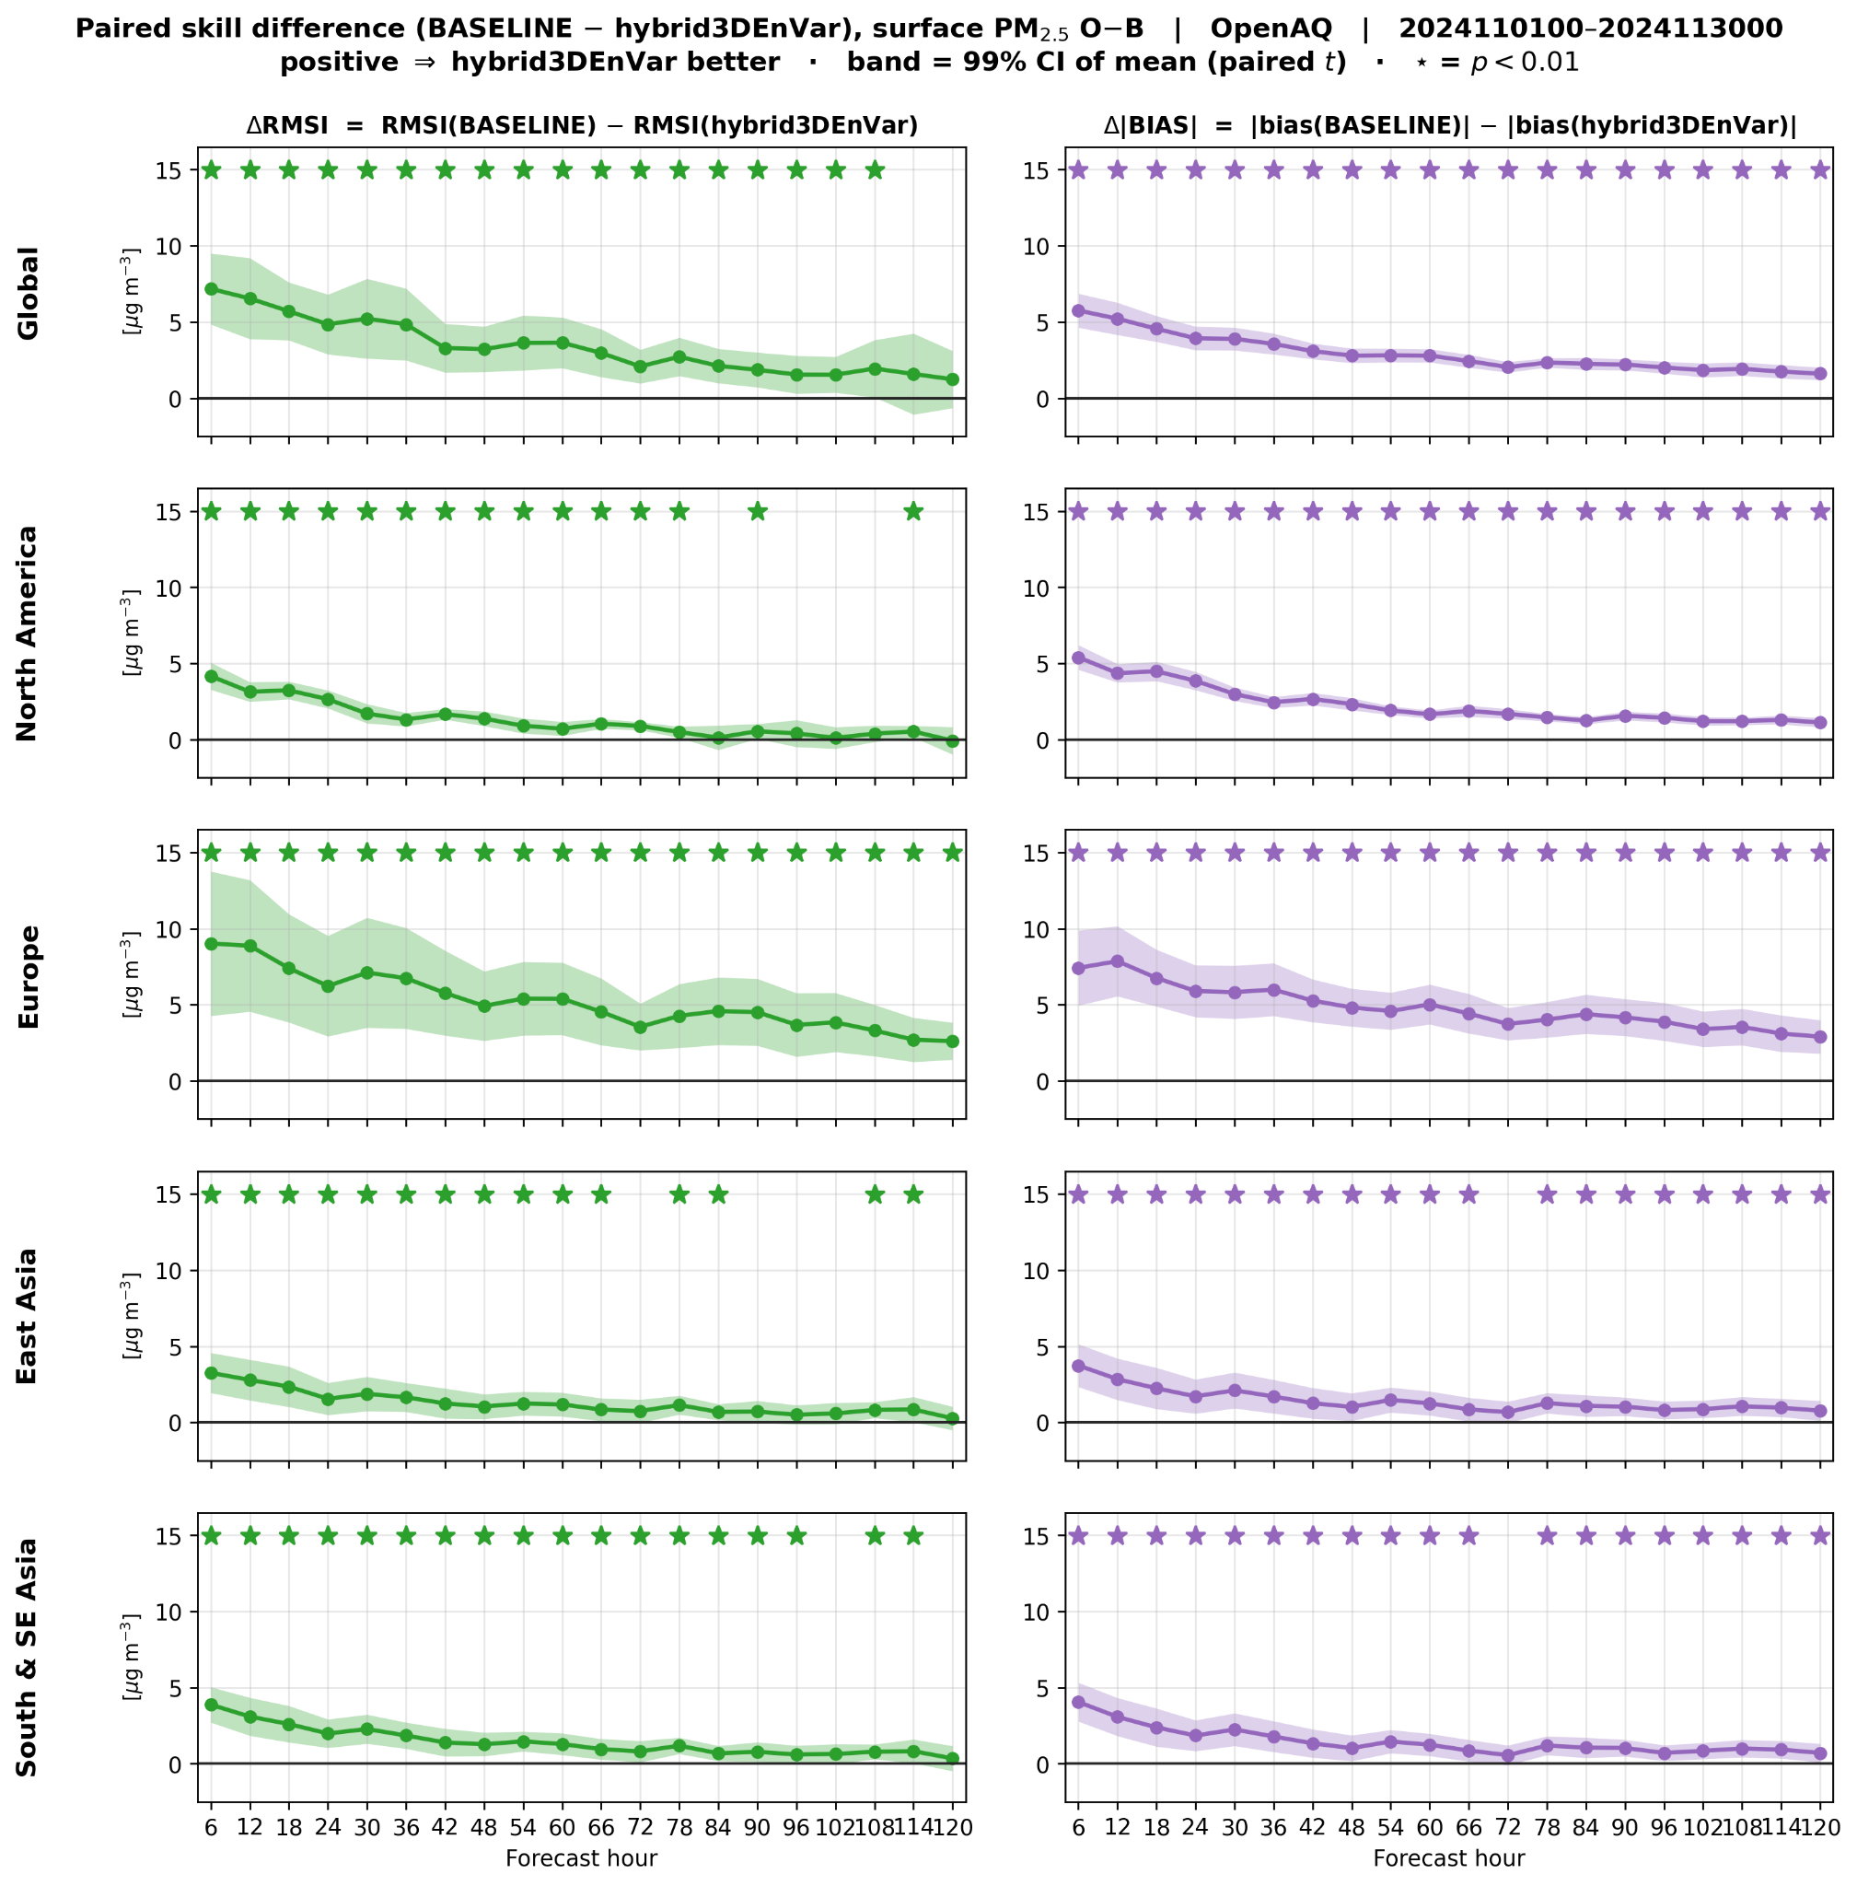
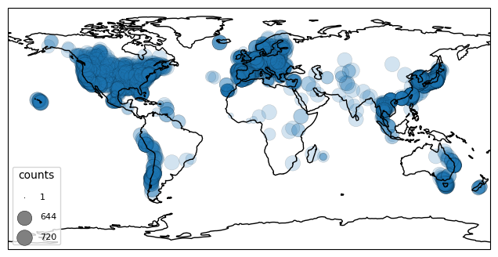
5-day forecast verification in PM2.5: Baseline - hybrid3DEnVar
Surface PM2.5 (OpenAQ sites)
Positive in both RMSI (left) and Bias (right): Hybrid3DEnVar outperforms BASELINE throughout the 5-day forecast, with 99% confidence intervals (shaded).

Slide 16
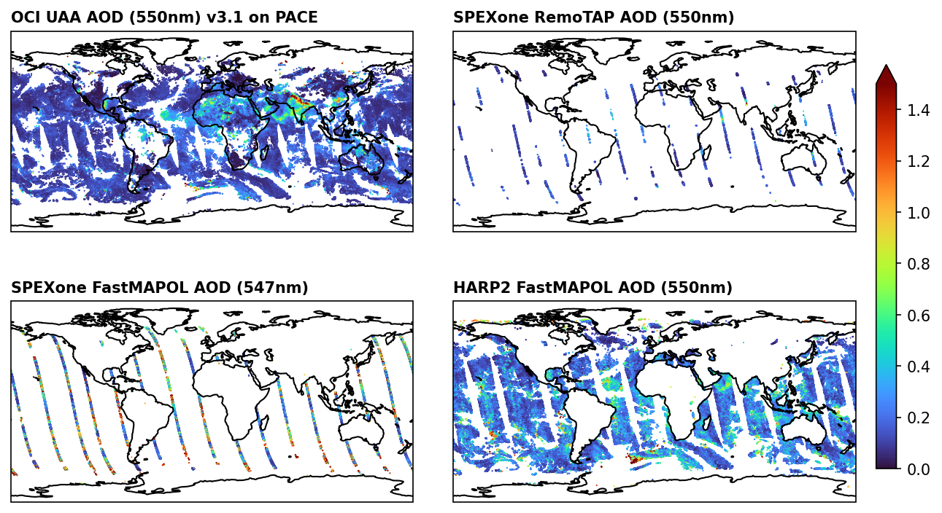
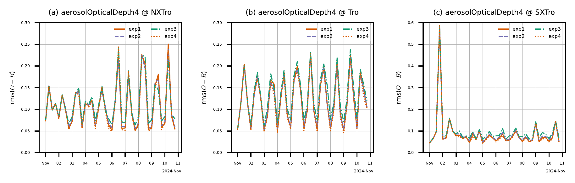
Can assimilating more AOD help?
Hybrid-3DEnVar cycling experiments assimilating more AOD:
EXP1: PACE OCI AOD at 550 nm (shown in the previous slides)
EXP2: PACE OCI AOD at 550 nm + 388 nm
EXP3: PACE OCI AOD AOD 550 nm + HARP2 and SPEXOne AOD 550 nm
EXP4: VIIRS/Suomi-NPP DB AOD 550 nm
=> Verified against MODIS Aqua AOD 550nm.
Assimilating additional AOD products shows little improvement over EXP1 w/ OCI only.
Further optimization of observation errors, QC, and localization is underway.

Slide 17
Concluding remarks
MPAS-GOCART2G-JEDI, our next-generation online-coupled air quality and weather analysis and forecasting system, has recently been developed to support coupled data assimilation.
Various AOD retrievals have been successfully assimilated into MPAS-GOCART2G-JEDI, effectively constraining aerosol forecast error growth.
References:
Collow et al., 2024: Benchmarking GOCART-2G in the Goddard Earth Observing System (GEOS). Geosci. Model Dev., 17, 1443-1468.
Dang et al., 2026: Aerosol Optical Properties in the Community Radiative Transfer Model for Data Assimilation, JGR-Atmosphere (Minor revision).
Wei et al., 2026: Leveraging JEDI for Atmospheric Composition: A unified framework for evaluating observations and model forecasts, Geosci. Model Dev. (In print).

