Slide 1


MAPCast: A Convection Allowing MPAS Emulator for Ensemble-based Background Error Covariance Estimation Toward Multi-Scale Data Assimilation
Yongming Wang^{a,b}, Xuguang Wang^{a,b}
a. Multi-scale data Assimilation and Predictability (MAP) Laboratory, University of Oklahoma
b. Consortium for Advanced Data assimilation Research and Education (CADRE)
Collaborators: David Dowell (NOAA GSL), Sergey Frolov (NOAA PSL)

Slide 2



Motivation
Cost-effective ML emulators achieved promising global and regional weather forecasting (Pathak et al., 2022, Bi et al., 2023, Lam et al., 2023, Oskarsson et al. 2023, Flora and Potvin 2025, Abdi et al. 2025).
Are ML emulators optimized for free forecasts ready to surrogate the short-term background ensemble forecasts for data assimilation (DA)?
Studies just began to examine the global model emulator for DA (e.g., Slivinski et al. 2025)
Recent efforts also show that combining physics and data-driven background ensemble can improve DA (Kubalek, Wang, and Wang 2026, Next talk)
Limited efforts for developing and evaluating convection-allowing emulators in surrogating background ensembles for data assimilation.
This study focuses on the development and evaluation of a convection-allowing ML emulator to generate surrogate background ensemble toward convection-allowing multiscale DA.

Slide 3
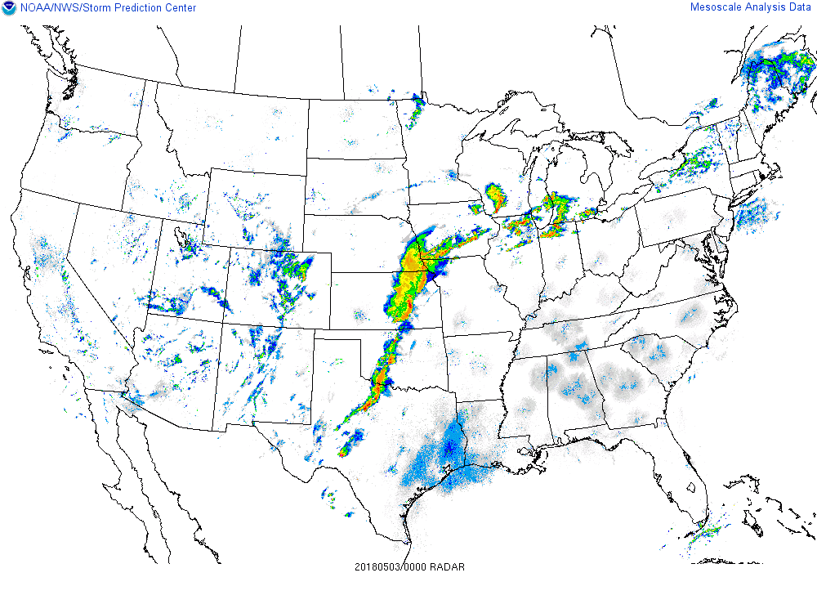
A convection-allowing emulator toward multiscale DA (MAPCast)
Training Datasets
Requirements:
Spatial and temporal resolution need to be capable of depicting multi-scales, i.e. sampling across meso-convective scales including e.g. short-lived supercells and long-lived squall lines, etc.
Variables need to include critical variables for convective scales and with ensemble DA need in mind
Generation of training datasets
MPAS forecast covering CONUS domain initialized from HRRR/RAP with a 15-min timestep and the grid spacing of 3 km.
Data for 5 seasons so far, valid during spring-early summer 2021-2025
3D Variables
U, V, W, T, QVAPOR, Pressure, Reflectivity
2D Variables
t2m, q2m, u10m, v10m
Squall line
Supercell

Slide 4
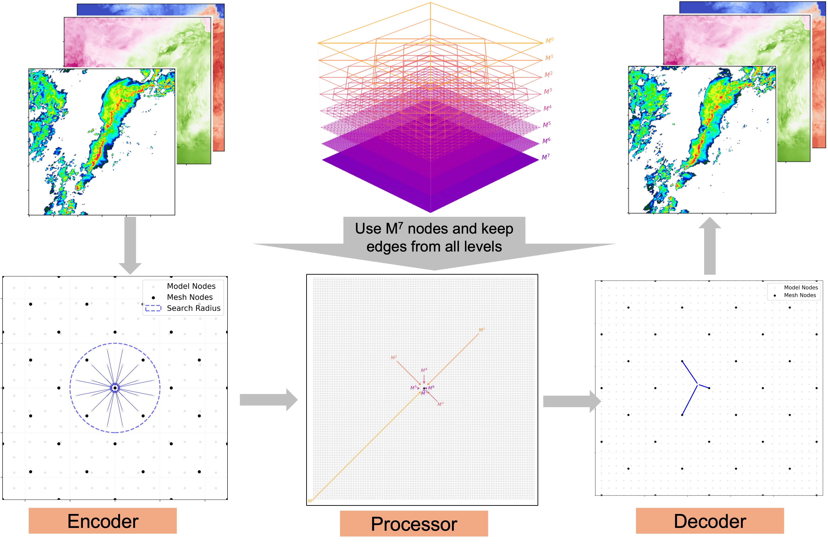
A convection-allowing emulator toward multiscale DA (MAPCast)
Emulator Architecture (Wang and Wang 2026)
Refactored Google’s GraphCast for a regional domain and built upon Keisler (2022) and Lam et al. (2023).
Examined both square and triangle meshes.
MAPCast uses an “encoder-processor-decoder” architecture.
144 Channels

Slide 5
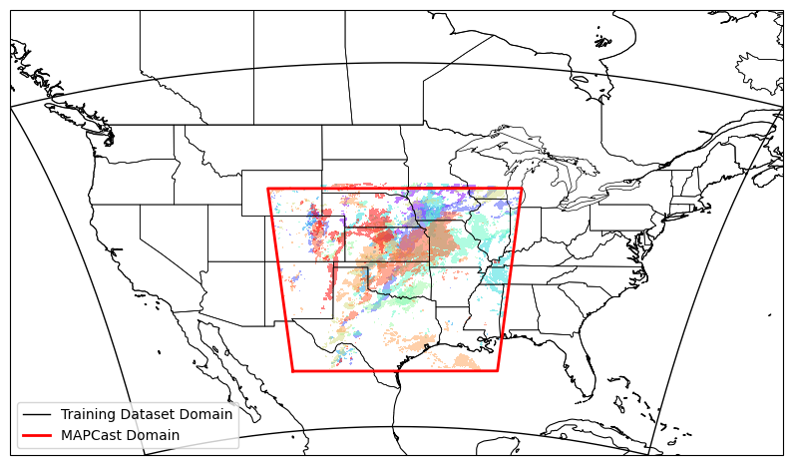
Evaluation Data
The evaluation data comprises ensemble forecasts for 10 convective storm events that occurred in May 2018 and 2019, including supercells, squall lines, and MCSs.
The 36-member MPAS ensemble forecasts are initialized using the OU MAP 2018 and 2019 HWT ensemble analyses.
The observed composite reflectivity paintballs exceeding 30 dBZ valid at 0045 UTC in each day of the 10 evaluation cases are overlaid.

Slide 6
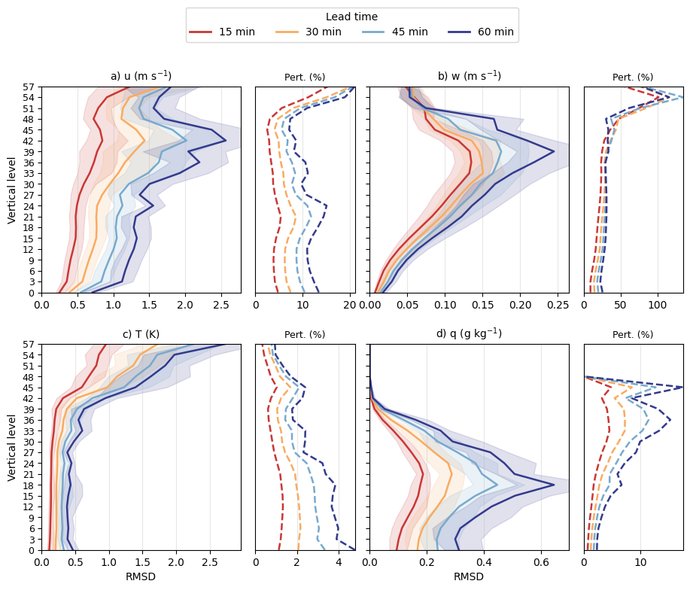
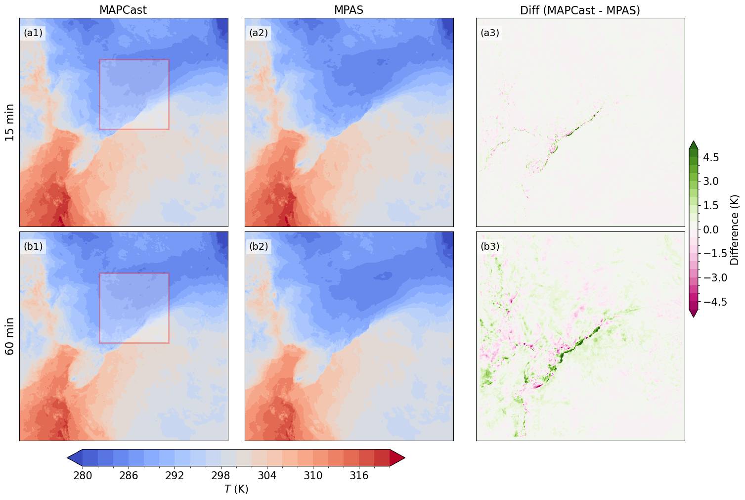
Individual Background Ensemble Members
Spatial Distributions
15 min
60 min
MAPCast performs well in matching MPAS for 15-min and 1-h forecasts.
Remarked differences are featured by small scales.
MAPCast shows differences with MPAS less than 5% of the domain average for 15-min forecasts for most fields.
Potential temperature at the lowest model level from member 1 of the 21 May 2019 case

Slide 7
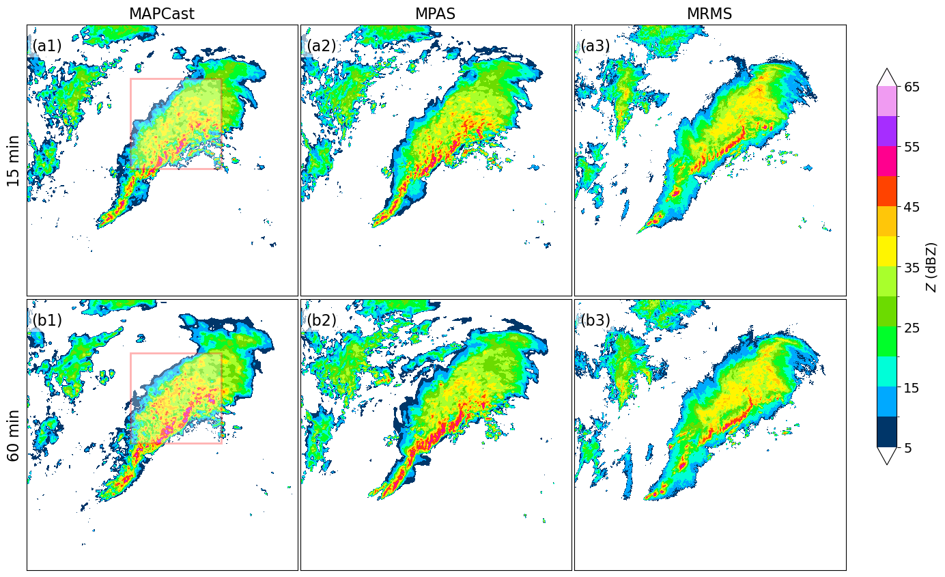
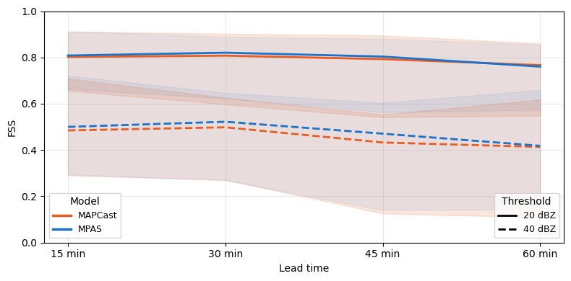
Individual Background Ensemble Members
Spatial Distributions
15 min
60 min
Fractions skill scores (FSSs) of composite reflectivity aggregated over 10 retrospective events for MAPCast and MPAS ensembles at 20 and 40 dBZ.
Composite reflectivity forecasts from member 1 of the 21 May 2019 case
The MAPCast ensemble produces similar composite reflectivity forecasts as the MPAS ensemble

Slide 8
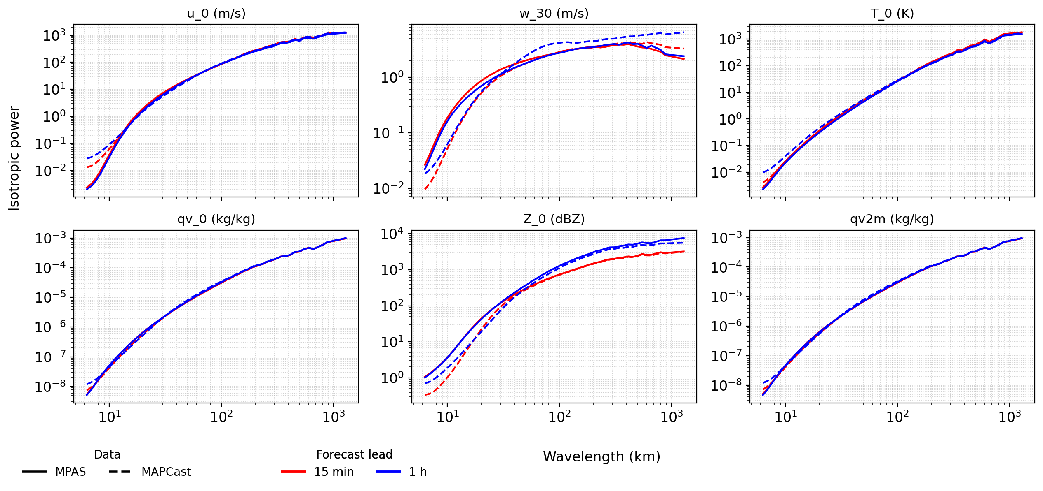
Individual Background Ensemble Members
Spectral Distributions
Both models show similar spectrum distributions for most variables in both 15-min and 1-hr background forecasts, except for small scales.
Differences between MAPCast and MPAS are larger in Z & W than other variables.

Slide 9
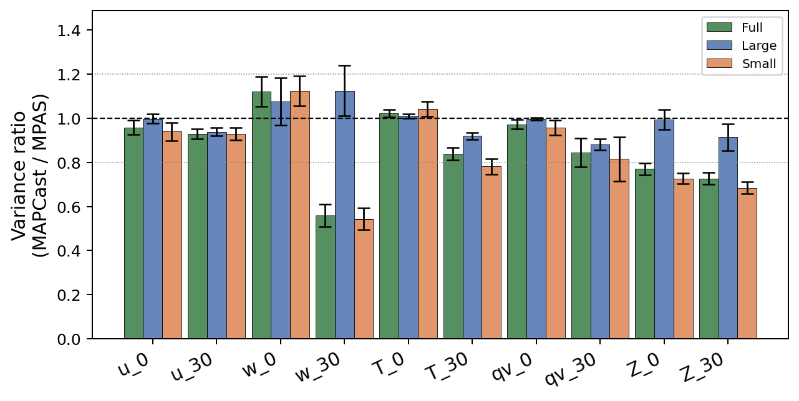

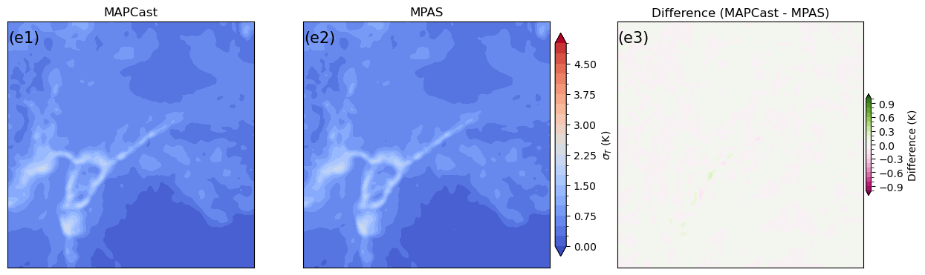
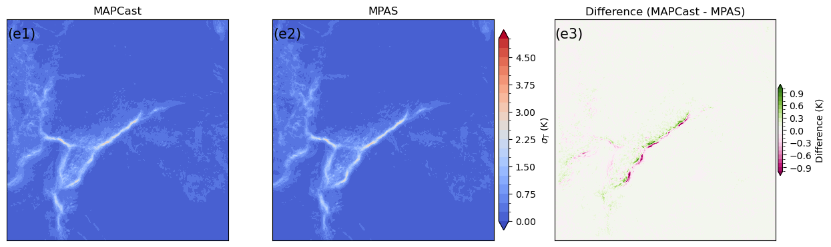
Multi-scale Ensemble Spread
Variance Ratio between MAPCast and MPAS
Ensemble spread aggregated over 10 events
The MAPCast ensemble spread is comparable to the MPAS ensemble spread for most variables, except for Z and upper-level w.
For Z and upper-level w, the large-scale spread is better than the small-scale spread.
Best
Large scale
Small scale
Ensemble spread for T0 from the 21 May 2019 case

Slide 10
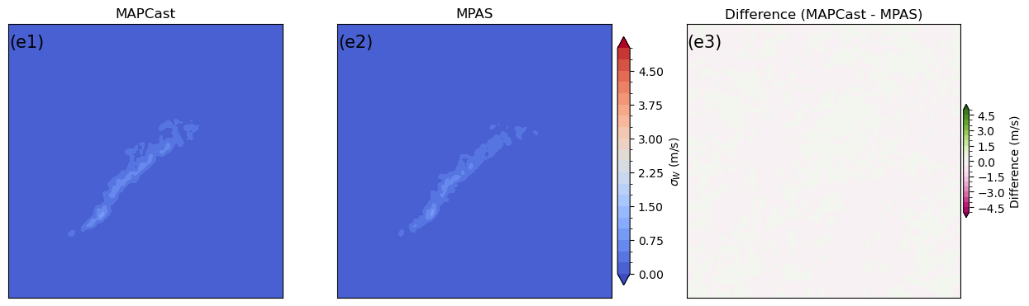
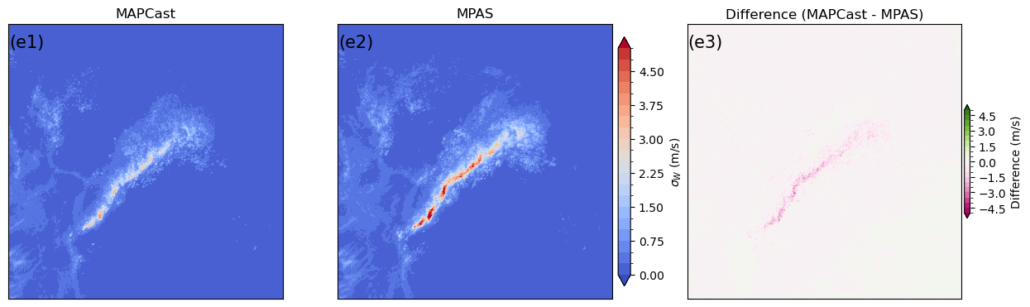
Multi-scale Ensemble Spread
Variance Ratio between MAPCast and MPAS
Ensemble spread aggregated over 10 events
The MAPCast ensemble spread is comparable to the MPAS ensemble spread for most variables, except for Z and upper-level w.
For Z and upper-level w, the large-scale spread is better than the small-scale spread.
Best
Large scale
Small scale
Ensemble spread for W30 from the 21 May 2019 case

Slide 11
Multi-scale Background Ensemble Uni-Variable Correlation
u-wind
MAPCast emulates MPAS u spatial correlations well.
Correlation emulation performs better when MPAS correlation shows larger values.
MAPCast reproduces the spatial correlation structure of MPAS most accurately at large scales, while differences between MAPCast and MPAS increase substantially at full and small scales.

Slide 12
Multi-scale Background Ensemble Uni-Variable Correlation
Reflectivity (Z)
MAPCast emulates MPAS reflectivity spatial correlations well.
Compared with the u correlations, the Z correlations are substantially more localized, reflecting the intermittent and highly convective nature of Z-related background errors
MAPCast performs better at decomposed large scale than at full and small scales with a fixed cutoff radius.

Slide 13
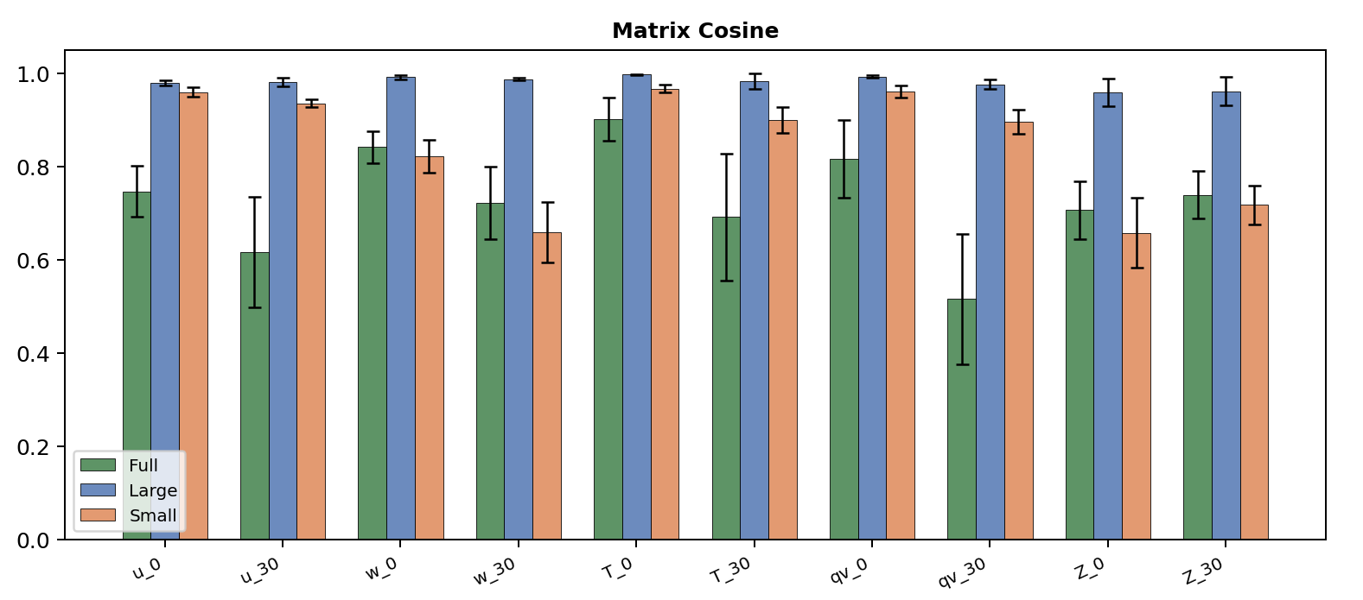
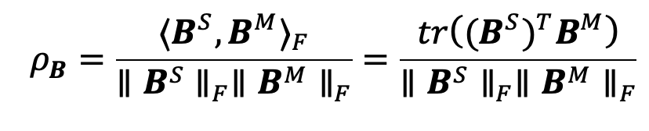
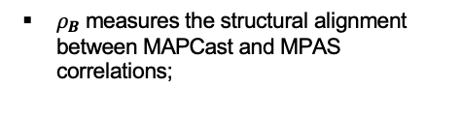
Multi-scale Background Ensemble Uni-Variable Correlation
Correlation Structure
Better
$ρ_{B}$ measures the structural alignment between MAPCast and MPAS correlations;
Worse
The better agreement at large and small scales than at full scale is caused by the proper application of localization
Matrices aggregated over 10 events
The MAPCast ensemble exhibits similar correlation structures as the MPAS ensemble, particularly for large-scale correlations.
The large- and small-scale correlations are represented more accurately than the corresponding full-scale correlations for most variables.
For small-scale correlations, Z and upper-level w have worse correlations than the other variables.

Slide 14
Multi-scale Background Ensemble Cross-Variable Correlation
cov(T, Z)
Emulated cross correlations show encouraging results.
Compared to the univariate spatial correlations, larger differences between MAPCast and MPAS exist in the cross correlations.
Differences are smaller in the cross correlation between T and reflectivity at large scale than at small and full scales.

Slide 15
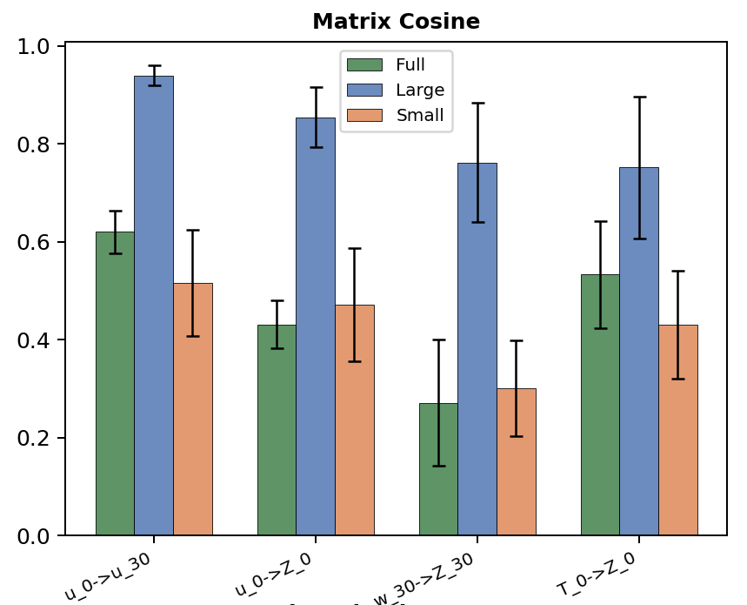
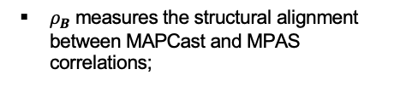
Multi-scale Background Ensemble Cross-Variable Correlation
Cross-variable spatial correlation structure
Better
$ρ_{B}$ measures the structural alignment between MAPCast and MPAS correlations;
Worse
Matrices aggregated over 10 events
Compared to the same-variable correlation, the inter-variable correlation shows larger differences between MAPCast and MPAS.
The differences between MAPCast and MPAS ensembles are smaller at large scales than at full and small scales.

Slide 16
Remarks and Future Work
Convection-allowing ML emulator aiming for multi-scale DA and prediction (MAPCast) is developed and demonstrates promising results.
Background ensemble evaluation using 10 convective storm events in May 2018 and 2019:
  Individual members
    MAPCast emulates MPAS well for individual ensemble members;
    MAPCast gains similar statistical and similar spectral distributions (except at small scales) as MPAS.
  Ensemble spread
    MAPCast has similar variances with MPAS for most variables. Reflectivity and upper-level w has slightly larger difference.
  Multi-scale uni-variable correlation
    MAPCast emulates spatial correlations at large and small scales well especially when MPAS correlation is large;
  Multi-scale cross-variable correlation
    Relatively larger differences between MAPCast and MPAS exist in the cross correlation compared to same-variable correlations, in general. Large scale performs better than small and full scales.
    15-min vs. 1-hr ensemble covariances
    Both are promising. 15-min is better than 1-hr.
    Planned work
  Improve MAPCast for adapting it within CADRE MPAS-JEDI workflow and explore its applications for multi-scale DA
  Investigate scale-aware loss functions and diffusion model-based emulator/other methods to better emulate small-scale and cross-variable covariances for DA.

Slide 17
References
Abdi, D., I. Jankov, P. Madden, V. Vargas, T. A. Smith, S. Frolov, M. Flora, and C. Potvin, 2025: HRRRCast: a data-driven emulator for regional weather forecasting at convection allowing scales, https://doi.org/10.48550/ARXIV.2507.05658.
Bi, K., L. Xie, H. Zhang, X. Chen, X. Gu, and Q. Tian, 2023: Accurate medium-range global weather forecasting with 3D neural networks. Nature, 619, 533–538, https://doi.org/10.1038/s41586-023-06185-3.
*Chen, Z., and X. Wang, 2026: Investigation of data driven background ensemble covariance from Graphcast toward Hurricane data assimilation and prediction. To be submitted.
Flora, M. L., and C. Potvin, 2025: WoFSCast: A Machine Learning Model for Predicting Thunderstorms at Watch‐to‐Warning Scales. Geophysical Research Letters, 52, e2024GL112383, https://doi.org/10.1029/2024GL112383.
*Kubalek, D., X. Wang, and Y. Wang, 2026: Using U-NET-based Emulator to Increase Background Ensemble Members for Cost-Effectively Improving LGETKF Cycling Data Assimilation. In preparation.
Lam, R., and Coauthors, 2023: Learning skillful medium-range global weather forecasting. Science, 382, 1416–1421, https://doi.org/10.1126/science.adi2336.
Oskarsson, J., T. Landelius, and F. Lindsten, 2023: Graph-based Neural Weather Prediction for Limited Area Modeling.
Pathak, J., and Coauthors, 2022: FourCastNet: A Global Data-driven High-resolution Weather Model using Adaptive Fourier Neural Operators, https://doi.org/10.48550/ARXIV.2202.11214.
Slivinski, L. C., Whitaker, J. S., Frolov, S., Smith, T. A., and Agarwal, N., 2025: Assimilating observed surface pressure into ML weather prediction models. Geophysical Research Letters, 52(6), e2024GL114396.
*Wang, Y., and X. Wang, 2023: Simultaneous Multiscale Data Assimilation Using Scale‐ and Variable‐Dependent Localization in EnVar for Convection Allowing Analyses and Forecasts: Methodology and Experiments for a Tornadic Supercell. J Adv Model Earth Syst, 15, e2022MS003430, https://doi.org/10.1029/2022MS003430.
*Wang, Y., and X. Wang, 2024: Improving CONUS Convective‐Scale Forecasting with Simultaneous Multiscale Data Assimilation. JGR Atmospheres, 129, e2023JD040206, https://doi.org/10.1029/2023JD040206
*Wang, Y., and X. Wang, 2026: MAPCast: A Convection Allowing Emulator for Estimating Multi-Scale Background Error Covariances. To be submitted.
* indicates OU MAP’s work.

