Slide 1
Towards a Continuously Cycled AI Weather Prediction Model: An LETKF-Based Data Assimilation System for HRRRCast
Vanderlei Vargas Jr.^{1,2,4}, Daniel Abdi^{3,4}, Isidora Jankov⁴, Paul Madden^{3,4}
¹Colorado State University, Cooperative Institute for Research in the Atmosphere (CSU/CIRA)
²Developmental Testbed Center (DTC)
³University of Colorado, Cooperative Institute for Research in Environmental Sciences (CU/CIRES)
⁴National Oceanic and Atmospheric Administration (NOAA) Global Systems Laboratory

Slide 2
Contents
HRRRCast Model
HRRRCast Data Assimilation System (HDAS)
Local Ensemble Transform Kalman Filter (LETKF)
Experiment Design
Results
Conclusions
Future Work

Slide 3
HRRRCast Model
HRRRCast is a diffusion-based data-driven model trained on the NOAA HRRR model, producing 3km convection-allowing forecasts over the CONUS;
Probabilistic forecasting in seconds using GPUs, enabling uncertainty estimation in real time;
Forecasts hundreds of weather variables including precipitation and reflectivity;
Ensemble forecasts outperform HRRR on several variables.

Slide 4
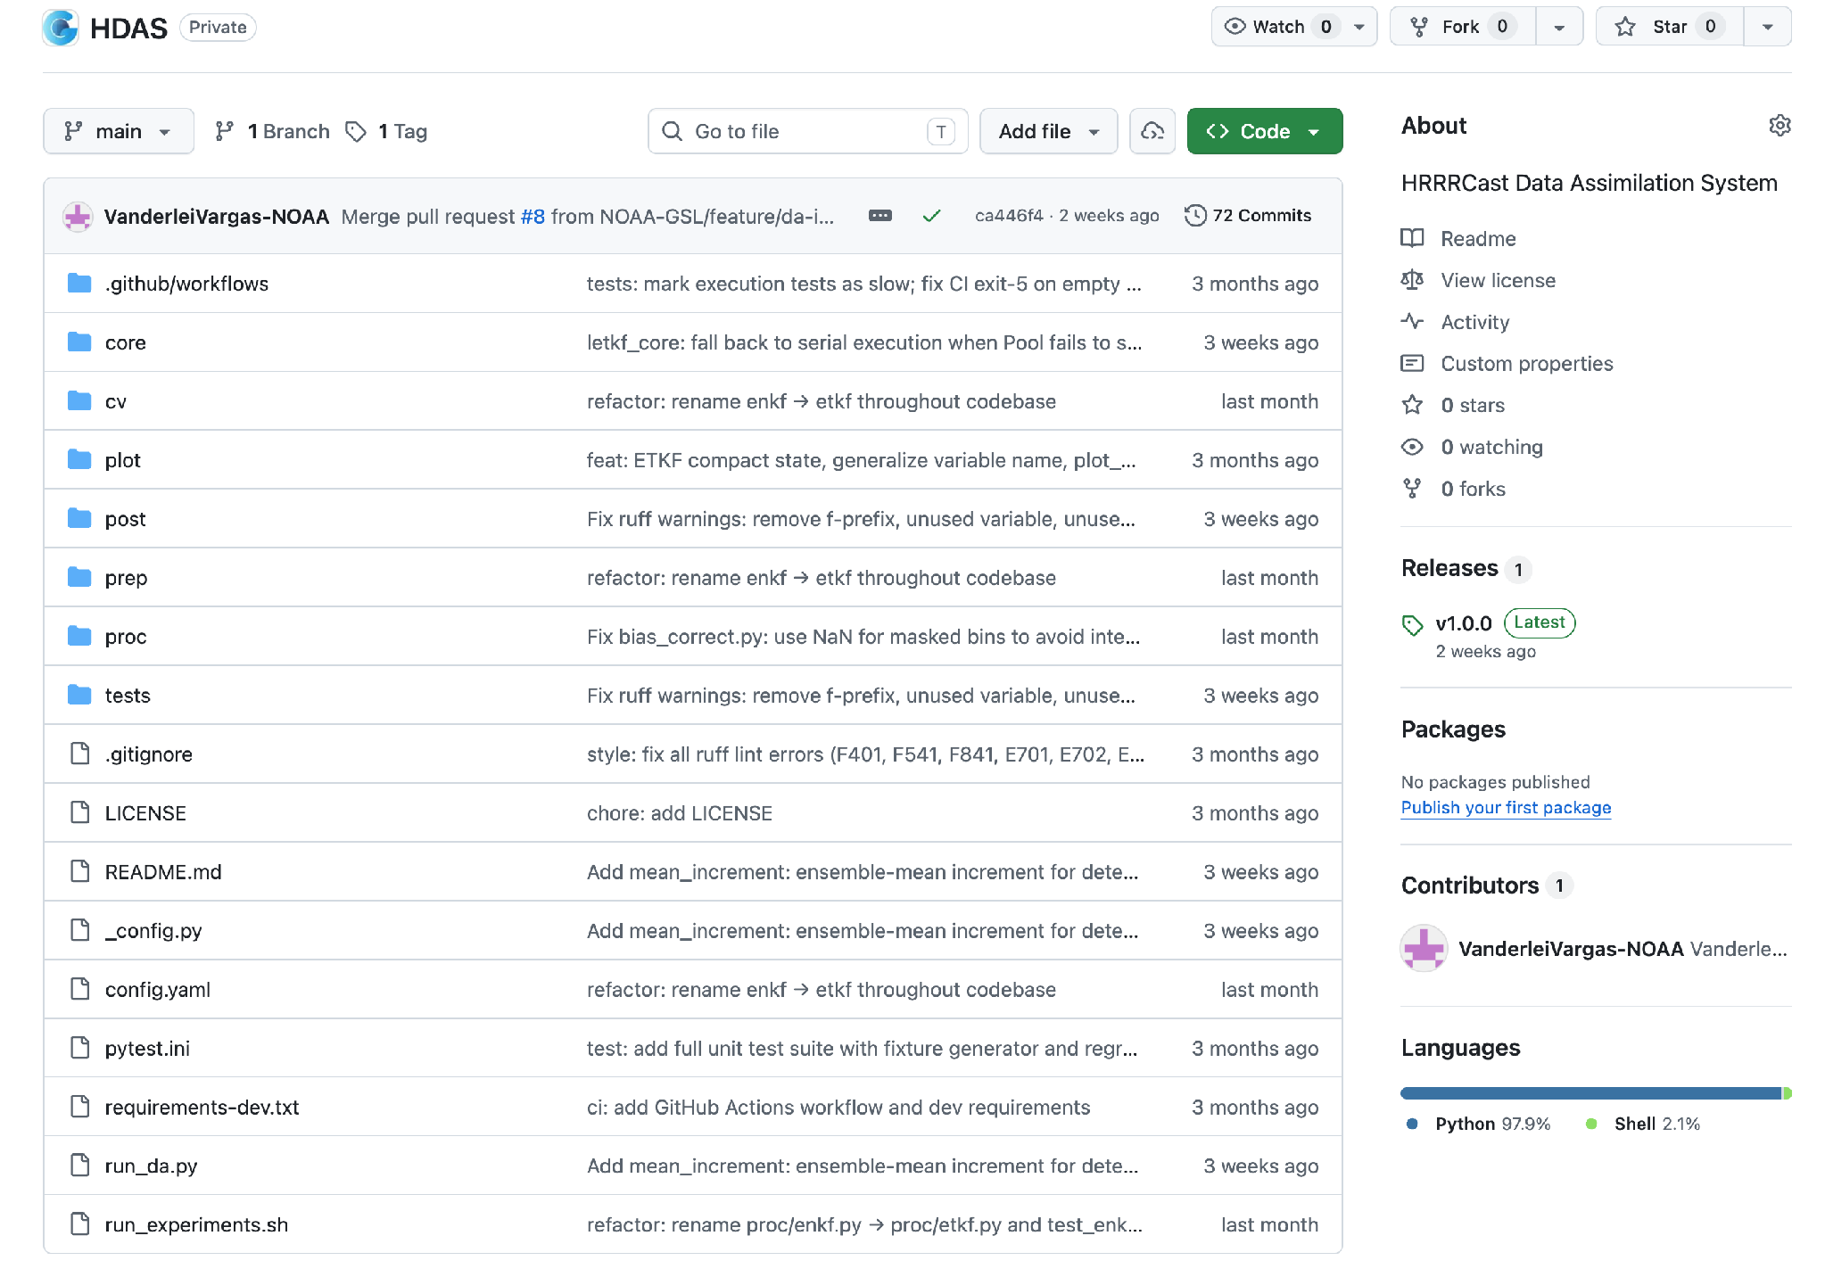
HRRRCast Data Assimilation System (HDAS)
Written in Python with a step-by-step pipeline design and each stage saves its output to disk so runs can be restarted or inspected at any point without rerunning the full system;
Observations are read from NAM ADPSFC BUFR decoded CSV files, cleaned for missing values, and interpolated to the model grid using inverse distance weighting with 4 nearest neighbors;
The LETKF analysis is computed on the full CONUS 3-km grid and the resulting per-member increments are smoothed with a Gaussian filter to remove noise at the observation scale;
The ensemble mean filtered increment is then applied directly to the HRRRCast initial condition file, updating only the T2M channel on the HRRR IC file while leaving all other channels unchanged.
Each cycle is configured through a YAML file that records the analysis time, ensemble member paths, observation file, and assimilation parameters;
Diagnostic outputs are generated at each step, increment statistics, ensemble spread, etc.

Slide 5
Local Ensemble Transform Kalman Filter (LETKF)
LETKF performs analysis independently at each grid point, assimilating all nearby observations simultaneously using ensemble-based covariances;
Ensemble-based DA method that computes the analysis in the space spanned by the ensemble perturbations (no adjoint or tangent linear model required);
Analysis at each grid point uses only observations within a specified radius (300 km), preventing spurious long-range correlations;
RTPP (Relaxation to Prior Perturbations): after the analysis update, ensemble perturbations are partially relaxed back toward the background (α = 0.75) to prevent ensemble collapse and maintain spread over cycling
Each grid point solved independently enabling parallelization;

Slide 6
Experiment Design
Two-month evaluation period: April 1 – May 31, 2026 (244 cycles, 6-hourly);
10-member HRRRCast ensemble initialized from perturbed HRRR analyses;
cycle0 (control): HRRR analysis IC, no data assimilation;
cycle1–4 (DA): each cycle initialized from previous cycle’s 6-h ensemble forecast corrected by LETKF;
LETKF assimilates SYNOP/METAR surface observations at each 6-h analysis time;
Only T2M (2-m temperature) corrected via ensemble-mean increment applied to IC;
Verification against T2M observations at lead times 0, 6, 12, 18, 24h;
Per-member statistics (10 members × 244 cycles = 2,440 samples per lead time) for confidence interval estimation;
>500 TB of data.

Slide 7
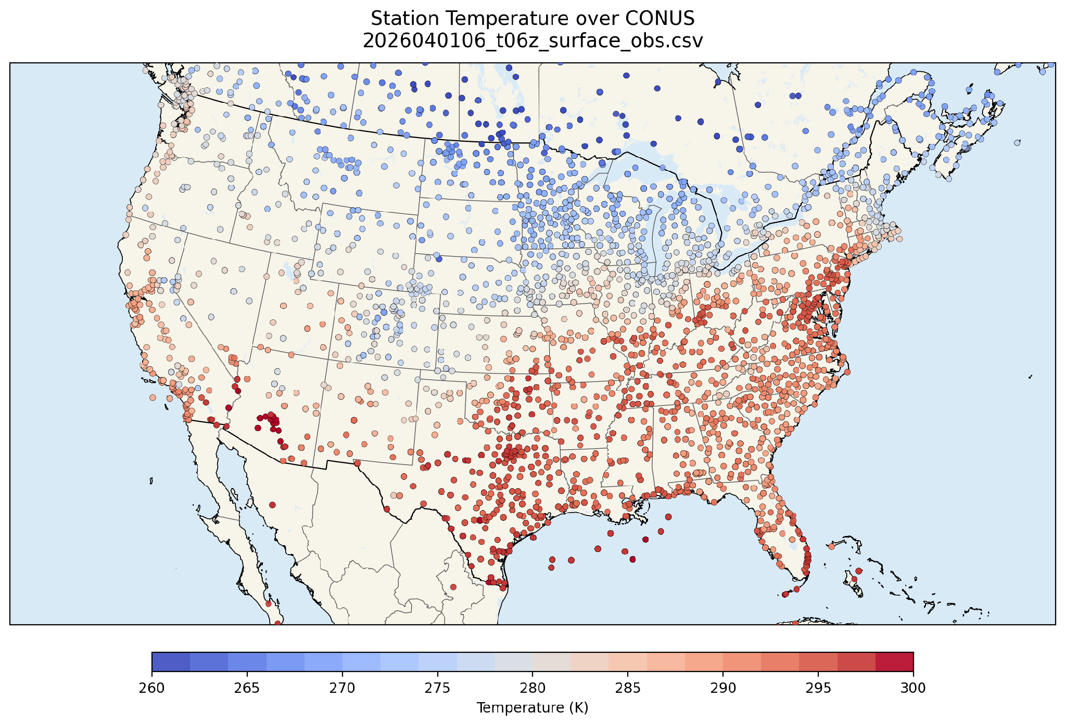
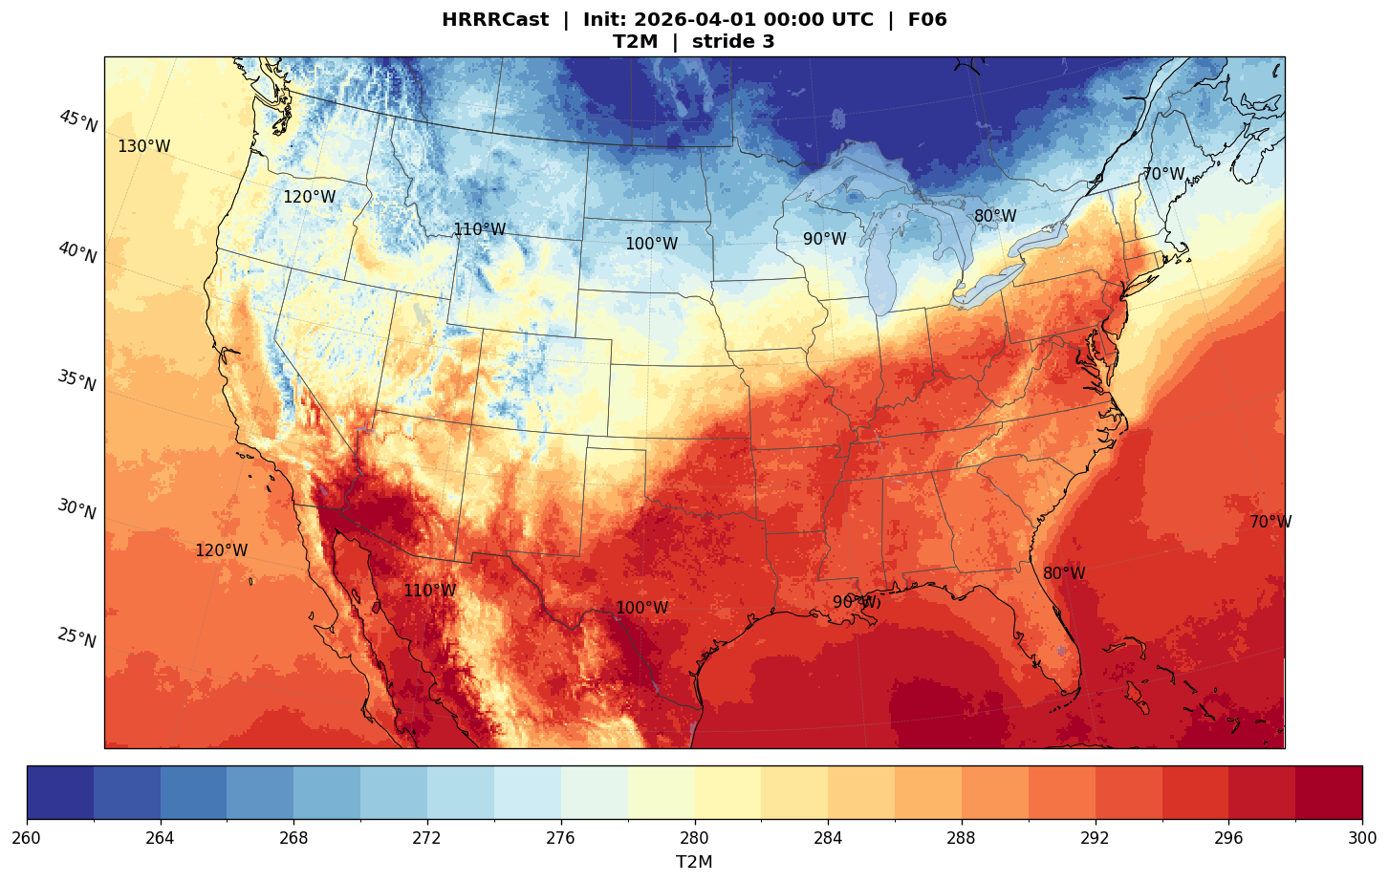
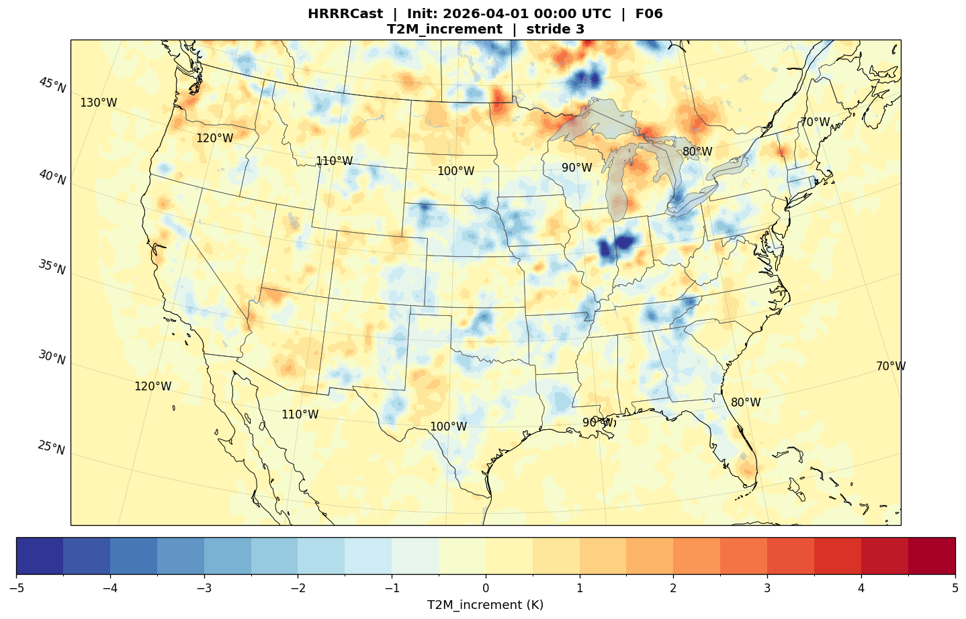
Results: DA Increment (2026-04-01 06UTC only m01)

Slide 8
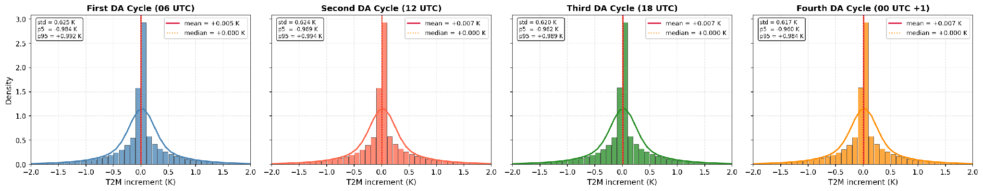
Results: DA Increment Distribution

Slide 9
Results: DA Increment Distribution
All four DA cycles show near-identical increment distributions;
Std decreases slightly from 0.625 K (first cycle) to 0.617 K (fourth cycle), suggesting the ensemble backgrounds become slightly more consistent with observations as cycling progresses;
Near-Gaussian, symmetric shape with slight positive skew in the tails indicates balanced corrections with occasional larger adjustments;
90% of corrections fall within ±1.0 K, increments are physically small and unlikely to destabilize the model state;

Slide 10
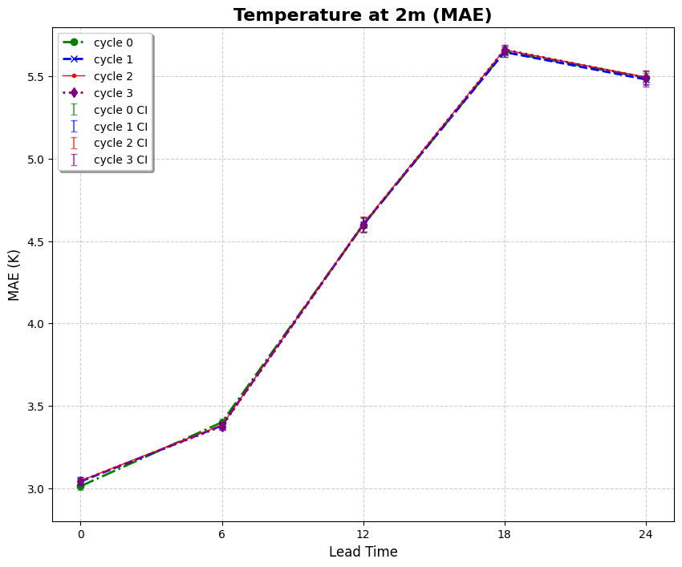
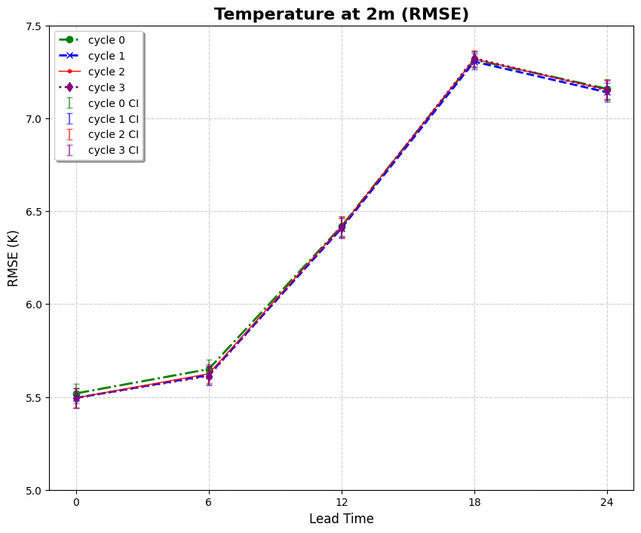
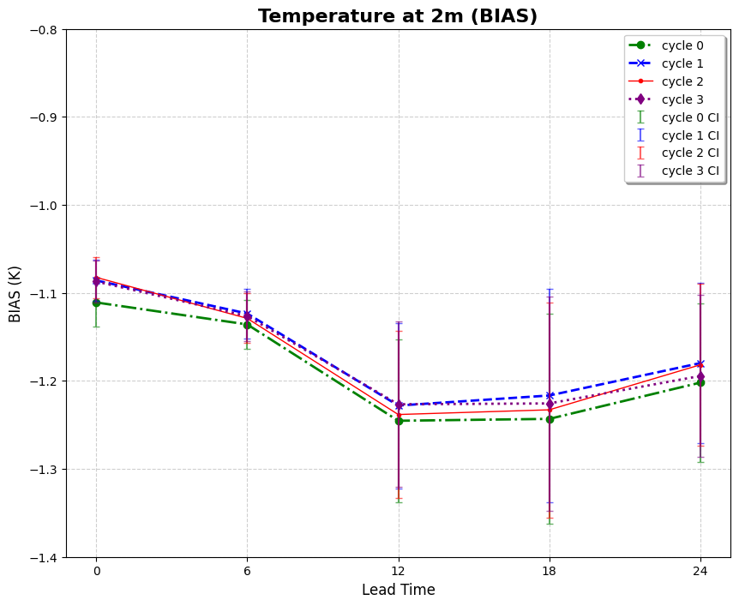
Results: Model Error

Slide 11
Results: Model Error
All four DA cycles are statistically indistinguishable. Confidence intervals overlap completely at every lead time, confirming no skill degradation from continuous cycling;
Cold bias: next step will be applying bias correction;
T2M beyond 6-h lead time does not depend on T2M at the initial step.

Slide 12
Conclusions
LETKF successfully assimilates NAM ADPSFC BUFR surface observations (METAR/SYNOP) into HRRRCast ensemble, producing physically consistent T2M increments (mean ≈ 0 K, std ≈ 0.97 K);
DA-corrected ICs are statistically equivalent to HRRR analysis ICs at all lead times - no degradation from replacing HRRR ICs with DA-corrected 6-h backgrounds;
DA cycling is stable across 4 consecutive cycles - no error accumulation or forecast degradation observed;
Results support replacing HRRR T2M IC dependency at sub-daily cycles (06/12/18 UTC) with DA-corrected HRRRCast backgrounds;
Systematic cold bias (≈ −1.2 K) persists at all lead times regardless of IC quality;
Demonstrates feasibility of a continuously HRRRCast cycling system driven by surface observations.

Slide 13
Future Work
Extend DA to all surface variables (winds, humidity, pressure) beyond T2M;
Implement hourly rapid refresh DA cycles instead of 6-hourly;
Tune LETKF parameters: localization radius, ensemble inflation, and observation error covariance;
Evaluate impact on additional forecast variables beyond T2M (precipitation, wind, visibility);
Extend verification to longer forecast horizons (48h, 72h);
Test continuous cycling beyond 4 DA cycles to assess long-term system stability;
Incorporate additional observation sources;

Slide 14
Thank you!

