Slide 1


Fully non-Parametric Ensemble Data Assimilation: Idealized and Sea Ice Model Experiments Using Data-driven Estimates of Likelihood Functions
Henry Santer and Jonathan Poterjoy
UIFCW Day 3
July 22 2026

Slide 2
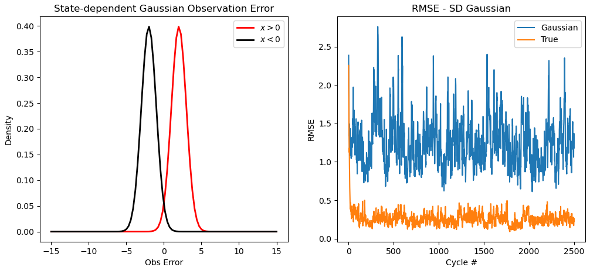
Particle filters can assimilate observations with complex (potentially non-Gaussian) error characteristics. Using the right error statistics matters!
Lorenz 96 Model Experiments with the Poterjoy (2022) Localized Particle Filter.

Slide 3
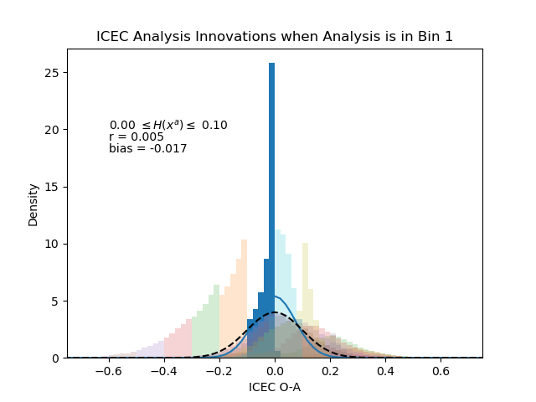
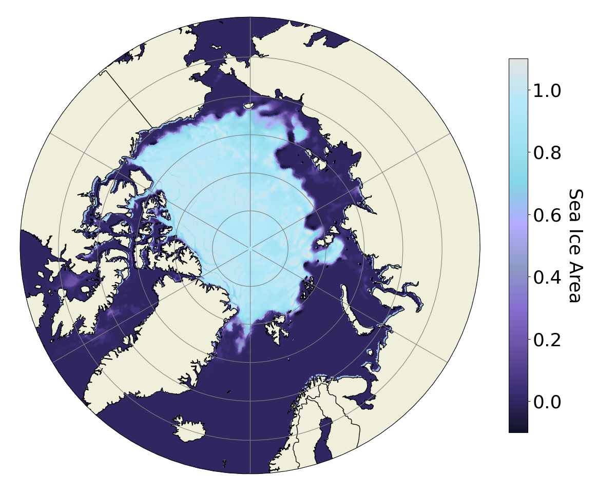

State-dependent, non-Gaussian observation errors show up in experiments within the Sea Ice and Ocean Coupled Assimilation (SOCA) UFS framework.
3DVar analysis of sea ice concentration (SIC)
SIC is a bounded quantity → errors are inherently non-Gaussian
Notes:
And we see observation errors that look even hairier than this in experiments with real models! We borrowed some coupled atmosphere-ocean-sea ice experiments from collaborators at NOAA that were done within the SOCA system within UFS. on the left here is variational analysis field for SIC
nongaussianity in the retrieval algorithm that introduces lots of nonlinearity into obs when SIC is low
Very few of these conditional dists are well characterized by first couple moments - green curve is desroziers estimate

Slide 4
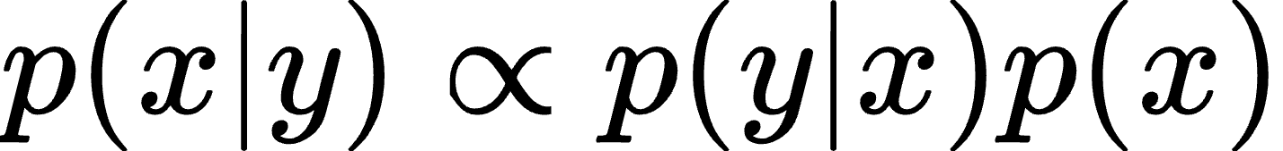
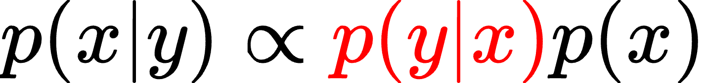
“How likely is the model state x to yield the observation y?”
Goal: Given training data in the form of N matched observations {y_{i}} and model states {x_{j}}, we seek to estimate p(y_{i}|x_{j}) for each i and j.
Big Idea: Embedding the model states and observations into convenient spaces transforms this problem into a linear regression problem.
Notes:
I’ve been talking about nongaussian observation errors so far but in the context of a bayesian DA method fundamentally what we’re targeting is the likelihood function for model states given an observation, and so in the slides that follow i’m going to be talking about a way to estimate p(y|x). Specifically, given… and the big idea is…

Slide 5
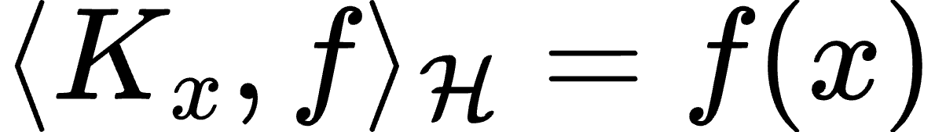
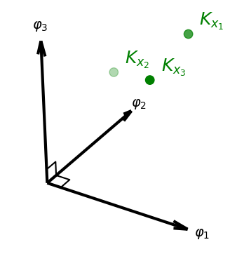
We start by constructing Reproducing Kernel Hilbert Spaces (RKHSs) to represent x (and y!) in.
RKHSs are special vector spaces with an element K_{x} satisfying the reproducing property:
x₁
x₂
X
x₃
Takeaway: evaluation of RKHS functions can be represented as an inner product.
We construct RKHSs with the Diffusion Maps algorithm (Coifman and Lafon, 2006)
H
Notes:
The first step is to take x and y and represent them as functions in reproducing kernel hilbert spaces (or RKHSs). RKHSs are special vector spaces with the property that for any given model state x that I choose, there exists a function K_x in the RKHS such that taking an inner product of a function against K_x is equivalent to evaluating that function at x. The takeaway here is that we can take a model state and associate it uniquely to a function in this special space.
We decide what this space actually looks like with something called the diffusion maps algorithm. In a nutshell, the idea of diffusion maps is to apply a diffusion operator to the dataset we’re interested in. the eigenfunctions of that operator correspond to modes of diffusion as you move around the data, which encode information about how the data is shaped and distributed. As an example, i’ve applied DMs to what’s called a swiss roll dataset here, where you have a cloud of points that exist along sort of a rolled sheet, and the first two eigenfunctions learn the two dominant features of the dataset, the first being distance as you spiral out and the second being depth along. And the nice thing about this algorithm is that it doesn’t just give us some functions in the RKHS but it forms a basis for it.

Slide 6
We start by constructing Reproducing Kernel Hilbert Spaces (RKHSs) to represent x (and y!) in.
RKHSs are special vector spaces with an element K_{x} satisfying the reproducing property:
x₁
x₂
X
x₃
Takeaway: evaluation of RKHS functions can be represented as an inner product.
We construct RKHSs with the Diffusion Maps algorithm (Coifman and Lafon, 2006)
H
Diffusion maps give us a basis for each RKHS.
Notes:
The first step is to take x and y and represent them as functions in reproducing kernel hilbert spaces (or RKHSs). RKHSs are special vector spaces with the property that for any given model state x that I choose, there exists a function K_x in the RKHS such that taking an inner product of a function against K_x is equivalent to evaluating that function at x. The takeaway here is that we can take a model state and associate it uniquely to a function in this special space.
We decide what this space actually looks like with something called the diffusion maps algorithm. In a nutshell, the idea of diffusion maps is to apply a diffusion operator to the dataset we’re interested in. the eigenfunctions of that operator correspond to modes of diffusion as you move around the data, which encode information about how the data is shaped and distributed. As an example, i’ve applied DMs to what’s called a swiss roll dataset here, where you have a cloud of points that exist along sort of a rolled sheet, and the first two eigenfunctions learn the two dominant features of the dataset, the first being distance as you spiral out and the second being depth along. And the nice thing about this algorithm is that it doesn’t just give us some functions in the RKHS but it forms a basis for it.

Slide 7
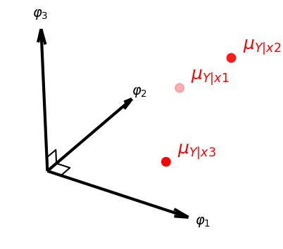
RKHSs can also be used to represent information about distributions on x and y.
After performing our embeddings, we find a best fit from “model states” (K_{x1}, K_{x2}, etc.) to “conditional distributions” (μ_{Y|x1}, μ_{Y|x2}, etc.)
Song. et al. (2009) derive the map C_{Y|X} such that
μ_{Y|x =} C_{Y|X}K_{x}
C_{Y|X} is the solution to a linear regression problem (!) from H to G.
G
H

Slide 8
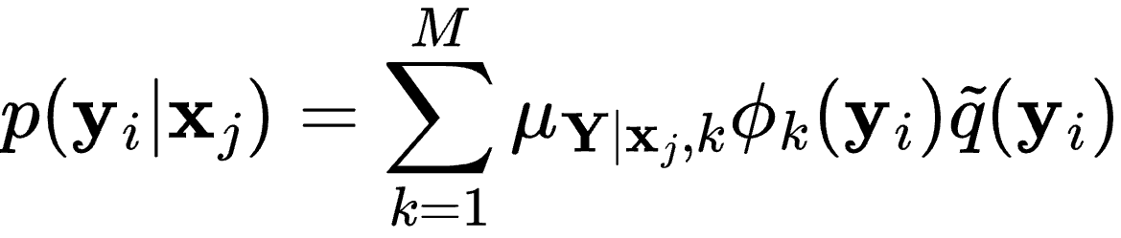
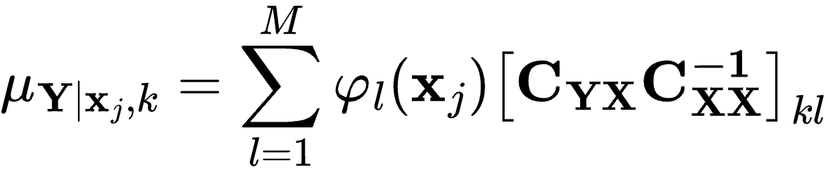
Nonparametric Likelihood Estimation In Practice
Berry and Harlim (2017): we can approximate the conditional embedding with only the M largest eigenfunctions. The result is that we can estimate p(y_{i}|x_{j}) with
Represents C_{Y|X} up to first M modes; can be estimated from Monte Carlo averages of the data.

Slide 9
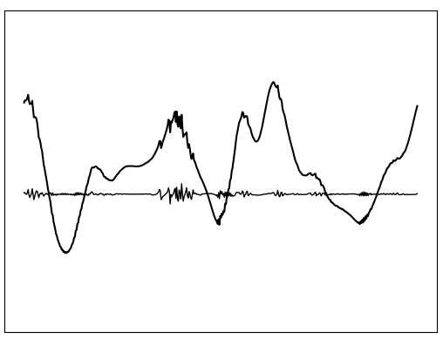
Idealized Model OSSEs
Lorenz (2005) Model:
DA: Poterjoy (2022) Local Particle Filter
Sample observations from x_{t} with a known error distribution.
Start by assimilating conventional observations, assuming Gaussian errors.
Estimate p(y|x) using observations and random draws from posterior at same location/time.

Slide 10
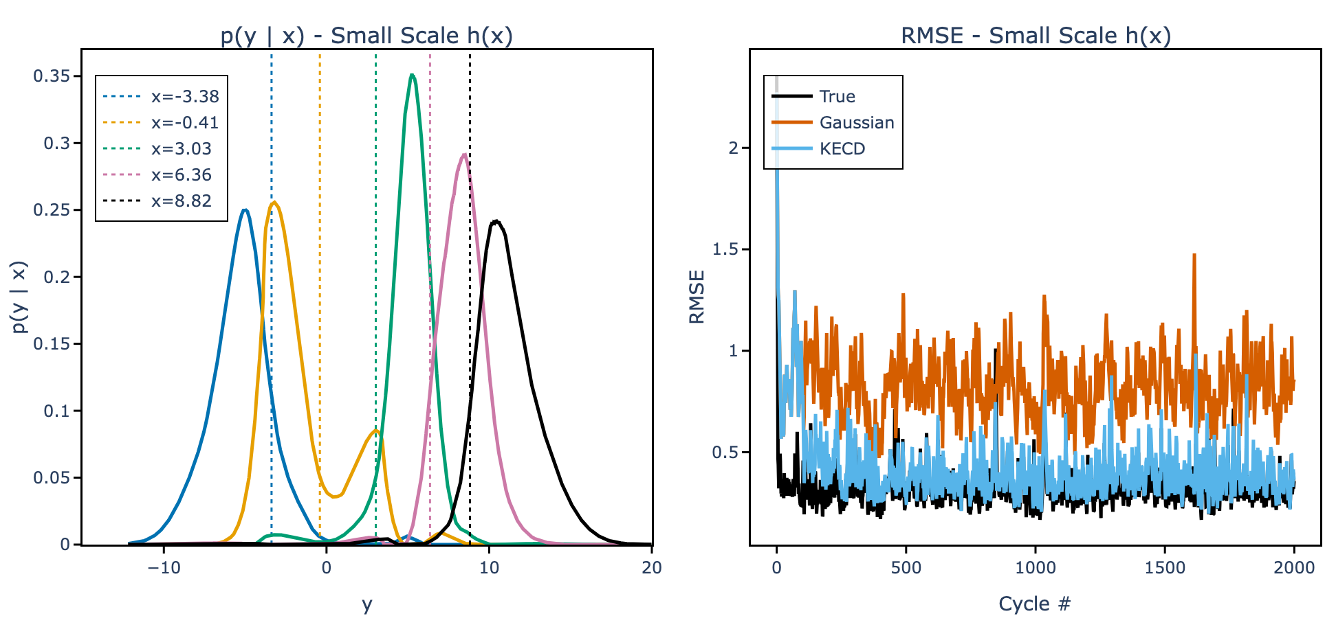
Revisiting state-dependent Gaussian observation errors
*Gaussian experiment uses an error variance consistent with the true observation errors if there were no state dependence.

Slide 11
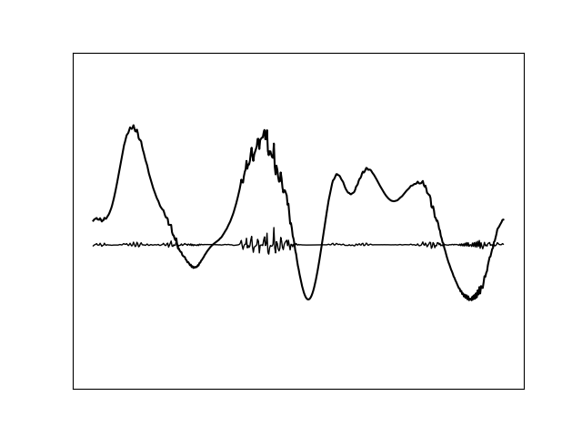
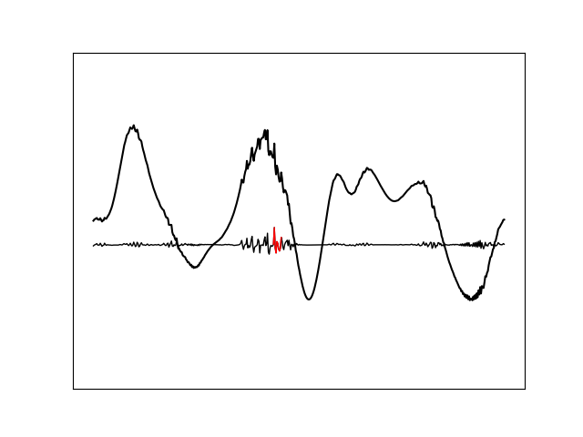
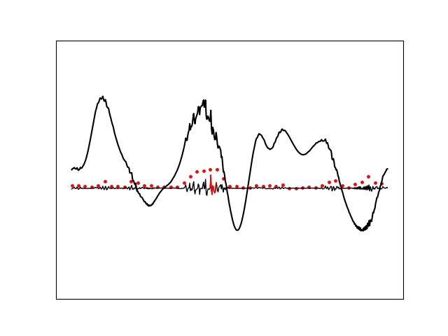
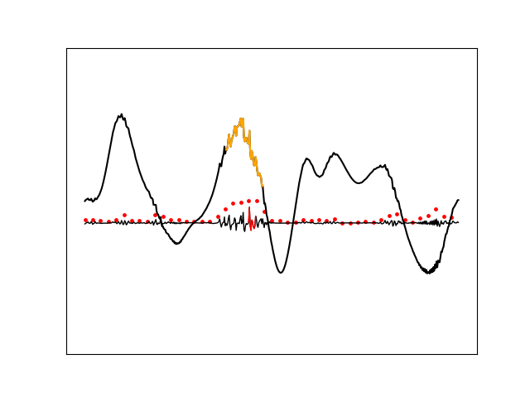
Directly estimating likelihoods for observations given model states means we can assimilate observations without measurement operators!
Observations are spatial averages of the magnitude of the small scale.
The corresponding model states are patches of the model state near the center of each observation.
We are seeking p(y|x)

Slide 12
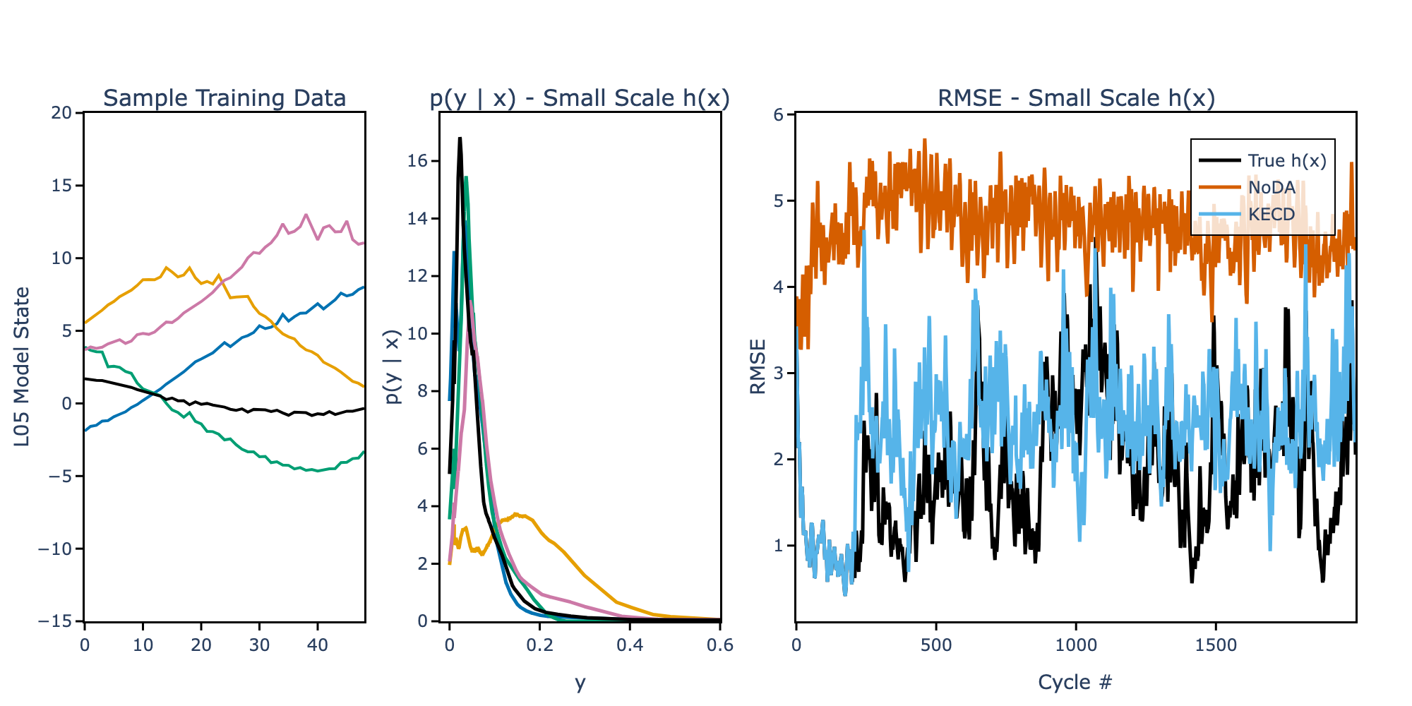
Directly estimating likelihoods for observations given model states means we can assimilate observations without measurement operators!

Slide 13
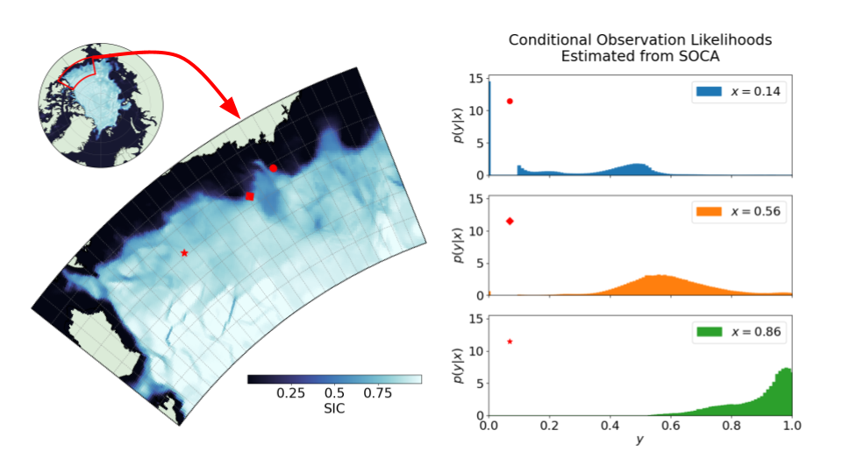
The KECD method recovers the non-Gaussianity and state dependence of SIC observations - including the discontinuity when SIC is small. We use the variational analyses as the model states for training.
Wang et al., 2026: The Multi-University Consortium for Advanced Data Assimilation Research
and Education (CADRE). Bulletin of the American Meteorological Society, under revision.

Slide 14
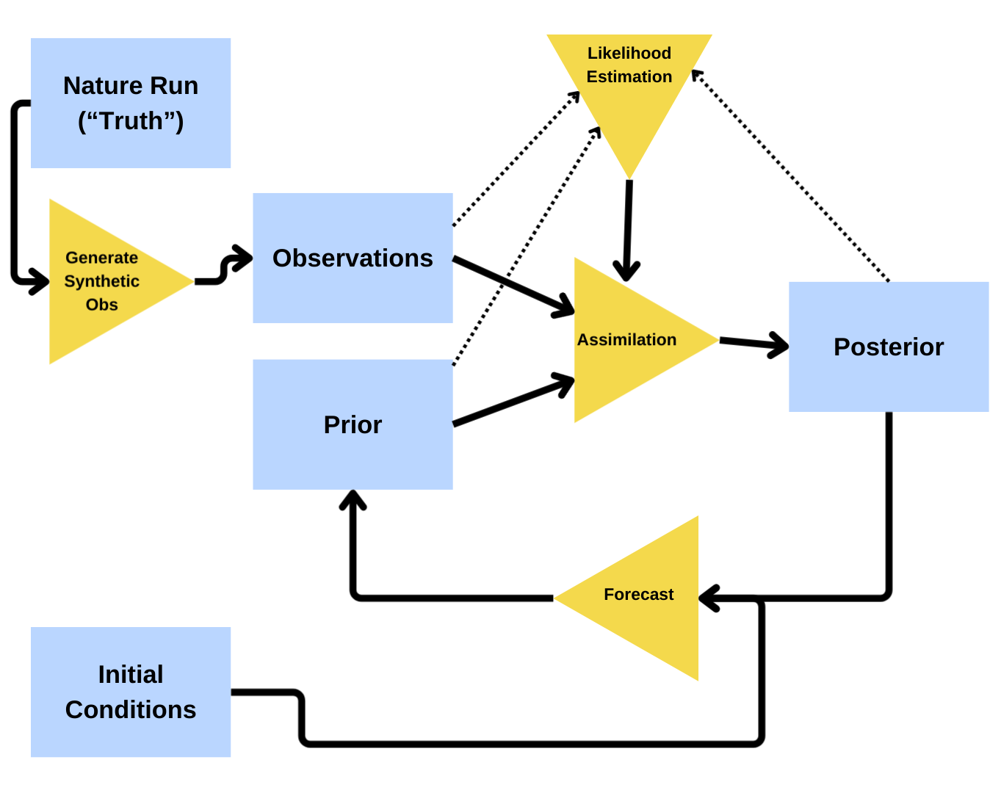
What value do KECD-estimated likelihoods add to cycling DA runs with CICE5?
Nature run: fully coupled CESM run
Observations generated based on SOCA-estimated likelihoods
Ensemble: 80 Standalone CICE5 runs
  Ensemble of atmospheric forcings generated from reanalysis data
Notes:
Running 80 fully coupled CESM runs would be bad, run 80 standalone CICE5 runs. To make sure that the uncertainty associated with an ensemble of atmospheres forcing the sea ice model is still respected, i’m planning to borrow some work that’s being done by another member of our group to construct an ensemble of atmospheric forcings that’s statistically consistent in space and time with the atmospheric forcing that the nature run received. This ensemble of forcings is itself generated from a reanalysis dataset constructed with CESM.

Slide 15
Takeaways/Future Work
State dependent, non-Gaussian observation errors are present in satellite retrievals of SIC.
We can form data-driven estimates of the associated likelihood functions using kernel embeddings of conditional distributions (KECD).
Experiments with the KECD method with idealized models demonstrate that we can get value out of using the estimated likelihood functions in a cycling DA system, and even assimilate observations directly without a measurement operator.
Considering other applications of likelihood estimation methodology:
  Expensive measurement operators (direct radiance assimilation?)
  Nongaussian/bounded observation errors (tracer concentrations?)
  Assimilating variables not resolved within models (precip within coarse-resolution atmospheric models?)
Questions? hsanter@umd.edu
‹#›

Slide 16
Supplemental

Slide 17
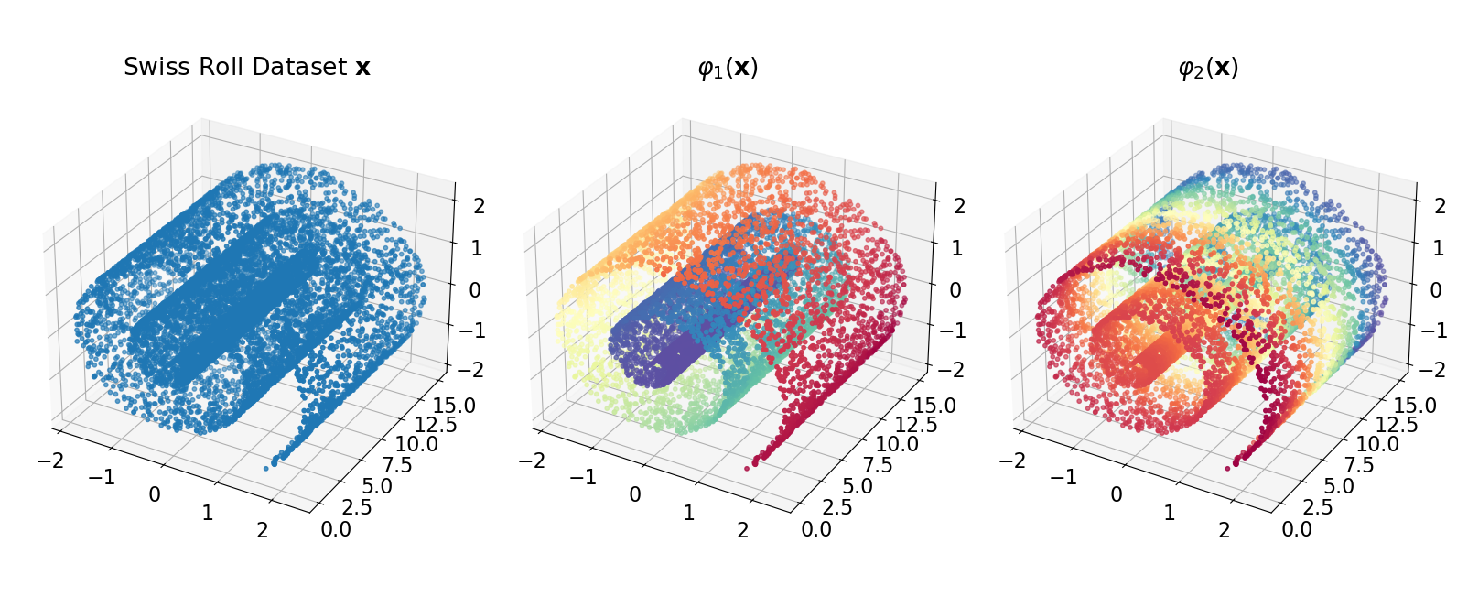
Diffusion Maps yields functions that correspond to modes of diffusion along the input data. These functions encode information about the data’s shape and distribution.

