Slide 1



Young Investigator Program
N00014-25-1-2023
Distribution-respecting Model-space Localization for Ensemble DA
Man-Yau (“Joseph”) Chan¹, Elizabeth Satterfield², Juli Rubin³
¹Department of Geography, The Ohio State University, USA
²Marine Meteorology Division, Naval Research Laboratory
³Remote Sensing Division, Naval Research Laboratory
Chan et al (major revisions, MWR)

Slide 2
Motivation
Costly NWP models = small ensembles
Sampling errors thus contaminate ensemble statistics used by ensemble DA.
Localization mitigates sampling errors in the ensemble covariances.
Goal of this study: improve EnsDA by advancing localization techniques used to suppress spurious covariances.

Slide 3
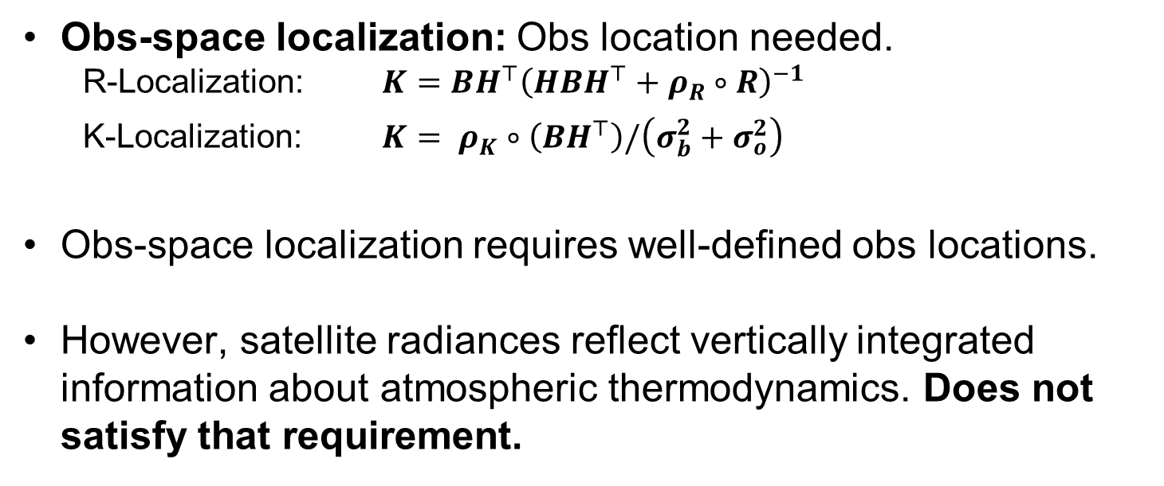
Review: Localization Methods for EnKFs
(note: only focusing on distance-based localization here)
Obs-space localization: Obs location needed.
  R-Localization: $K=BH^{⊤}{\left(HBH^{⊤}+ρ_{R}∘R\right)}^{−1}$
  K-Localization: $K= ρ_{K}∘\left(BH^{⊤}\right)/\left(σ_{b}^{2}+σ_{o}^{2}\right)$
Obs-space localization requires well-defined obs locations.
However, satellite radiances reflect vertically integrated information about atmospheric thermodynamics. Does not satisfy that requirement.

Slide 4
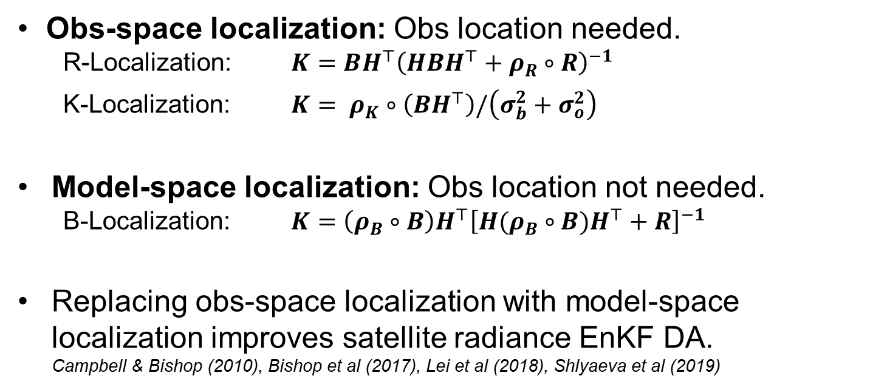
Review: Localization Methods for EnKFs
(note: only focusing on distance-based localization here)
Obs-space localization: Obs location needed.
  R-Localization: $K=BH^{⊤}{\left(HBH^{⊤}+ρ_{R}∘R\right)}^{−1}$
  K-Localization: $K= ρ_{K}∘\left(BH^{⊤}\right)/\left(σ_{b}^{2}+σ_{o}^{2}\right)$
Model-space localization: Obs location not needed.
  B-Localization: $K=\left(ρ_{B}∘B\right)H^{⊤}{\left[H(ρ_{B}∘B)H^{⊤}+R\right]}^{−1}$
Replacing obs-space localization with model-space localization improves satellite radiance EnKF DA.
Campbell & Bishop (2010), Bishop et al (2017), Lei et al (2018), Shlyaeva et al (2019)

Slide 5
Model-space Localization Operates through Increasing # of Ensemble Members
Conceptual Procedure for Model-Space Localized EnKFs:
Efficiently generate many "localized" members that follow localized covariances.
Apply unlocalized EnKF onto the “localized” members to yield analyses with model-space localization.
JEDI’s Localized Member Generator: Ensemble Modulation
…. also the most popular method … (EMOD; Bishop & Hodyss, 2009)
EMOD is a key ingredient in JEDI’s LGETKF.

Slide 6
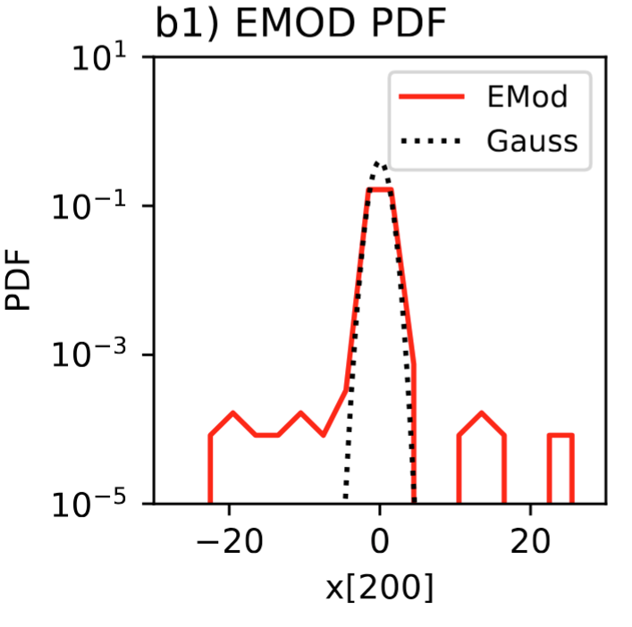
Issue: EMOD Distorts Forecast Distributions
Distortion: EMOD overproduces members with extreme values.
Those distortions degrade the statistics of ensemble-simulated radiances.
Those distortions degrade non-parametric EnsDA methods.

Slide 7
Our proposal: Generate “localized” members using Localized Probit-space Ensemble Size Expansion for Gaussian Copulas (LPGC)
Some Attractive Properties:
Generates “localized” members without distorting the marginals (i.e., distribution-respecting).
Works for non-Gaussian distributions too!

Slide 8
Demo: Offline NAVGEM DA Expts
Perfect model Observing System Simulation Experiments (OSSEs) with 79 NAVGEM prior members.
Data Assimilation Research Testbed (DART) with the Rank Histogram Filter (RHF)
Two IR channels assimilated: 6.2 um and 7.3um.
Only assimilating clear-sky IR radiances. Used RTTOV for radiative transfer.

Slide 9
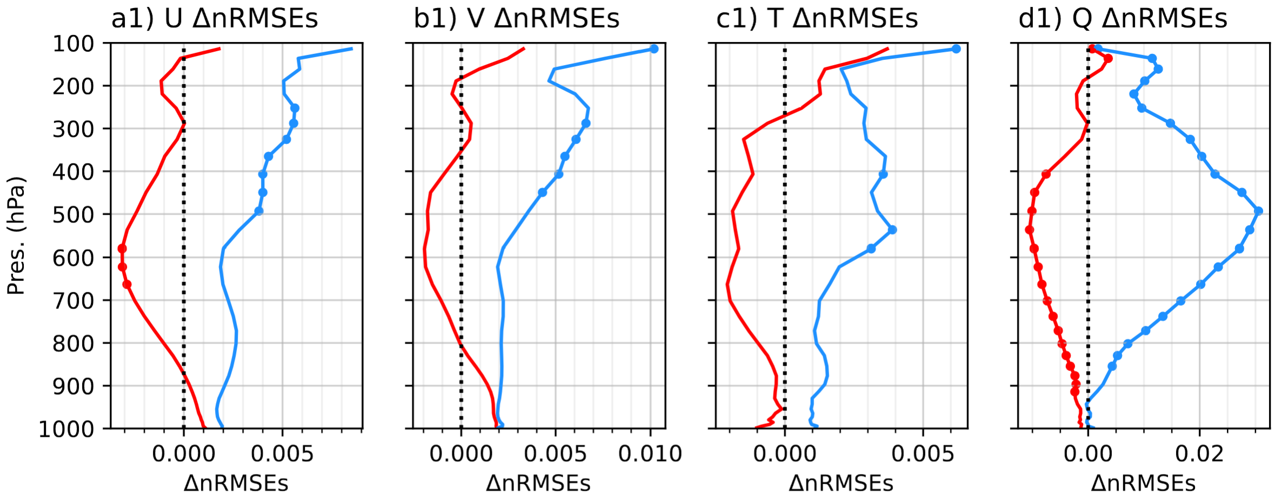
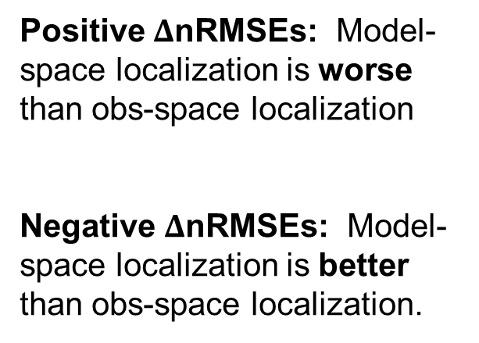
Switching from EMOD to LPGC greatly improves clear-sky IR DA performance
Positive $Δ$nRMSEs: Model-space localization is worse than obs-space localization
Negative $Δ$nRMSEs: Model-space localization is better than obs-space localization.
LPGC
LPGC
EMOD
EMOD

Slide 10
Take-home Messages
Model-space localization is, in principle, better than obs-space localization for radiance DA
Model-space localization via EMOD distorts distributions. Potentially degrades DA performance.
Note: EMOD is used by JEDI and GSI.
Model-space localization via our LPGC avoids the distortions introduced by EMOD. Thus, LPGC potentially results in better DA performance than EMOD.

Slide 11
Next Steps
Cycled WRF ensemble DA experiments to verify whether findings transfer from offline experiments to cycled experiments.
Bring into JEDI framework after a few more studies.
Using LPGC to produce training data for AIWP (see Horeb’s poster on Tuesday).

Slide 12
Fin.
Thank you for your attention!
Happy to take questions & comments.

Slide 13
Take-home Messages
Model-space localization is, in principle, better than obs-space localization for radiance DA
Model-space localization via EMOD distorts distributions. Potentially degrades DA performance.
Note: EMOD is used by JEDI and GSI.
Model-space localization via our LPGC avoids the distortions introduced by EMOD. Thus, LPGC potentially results in better DA performance than EMOD.

