Slide 1





Transitioning HAFS Data Assimilation to JEDI: Observation Dataset Readiness and Integration in HAFS
Jing Cheng¹, Xu Lu², Yonghui Weng², Bin Liu², Zhan Zhang³, Shun Liu³, Daniel Holdaway³, Daryl Kleist³, Fanglin Yang³, and Vijay Tallapragada³
¹Axiom at NOAA/NWS/OMD, ²Lynker at NOAA/NWS/OMD; ³NOAA/NWS/OMD
UIFCW 2026, 20 July - 25 July 2026, College Park, MD
National Weather Service
Notes:
If title is two lines, re-center with blue line

Slide 2
Outline
Introduction: The HAFS Data Assimilation System
Integration to the HAFS-JEDI Workflow
Transitioning to JEDI: Observation Validation Process
Retrospective and Real-time Testing
Summary and Next Steps

Slide 3
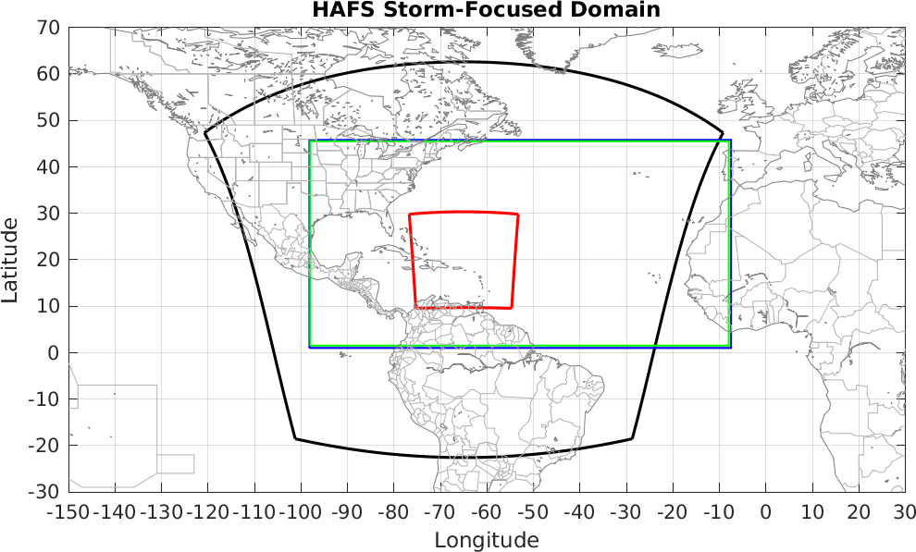
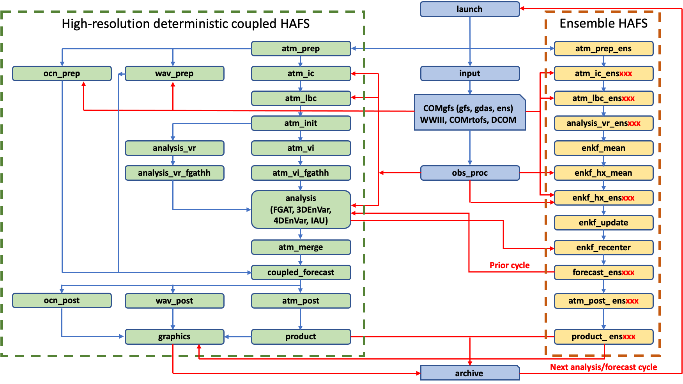

Introduction: The HAFS Data Assimilation System
Current HAFS DA Framework
DA is conducted in nested domain (red box)
All observations assimilated in GFS
Conventional obs
Recon
Satellite derived winds
Satellite radiance
TCVitals
HighRes. Obs.
Recon: Tail Doppler Radar (TDR) and HDOB
NEXRAD
Dropsondes with drift corrections
METAR observations
Meso-floater High resolution GOES AMVs
Assimilate additional obs (HAFS v2.2): Commercial GPS RO and sUAS
HAFS DA Framework with GSI

Slide 4
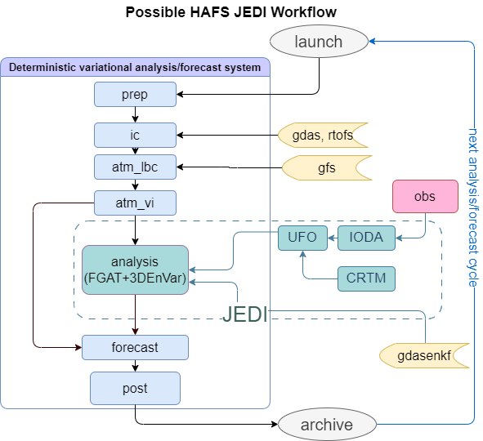
Integration to the HAFS-JEDI Workflow
Tested JEDI functions with HAFS model interface:
  3DEnVar, 4DEnVar, GETKF, FGAT
Observation operators used in HAFS JEDI:
  Vertinterp, sfccorrected, crtm, gnssro, radarradialvelocity
Background Covariance options:
  40 members HAFS cold-started ensemble
  80 members GDAS ensemble
  40 members self-cycled HAFS ensemble
Localization:
  BUMP Nicas, Scale-dependent Localization
HDASApp
HAFS Data Assimilation System Application
linkgithub.com/NOAA-EMC/HDASApp
Core Submodules
oops
saber
vadar
fv3
fv3-jedi
ufo
crtm
ioda
bufr-query
jcb
HAFS DA Framework with JEDI

Slide 5
Integration to the HAFS-JEDI Workflow
Observation Pre-process: Obs_Proc Steps
A combination of mapping yamls and python scripts based on BUFR-QUERY are developed to make the file format conversions from bufr_d to IODA NetCDF.
And more …
Bufr conversion:
Surface, Sondes, Satwind, Aircft/Aircar, ASCAT wind, HDOB, Tempdrop, AMSUA, ATMS, IASI, CRIS, ABI,
Offline SuperOb + Bufr conversion:
NEXRAD, TDR
Bufr conversion + offline thinning:
VADWND
Bufr conversion + offline domain profile check:
GPSRO

Slide 6
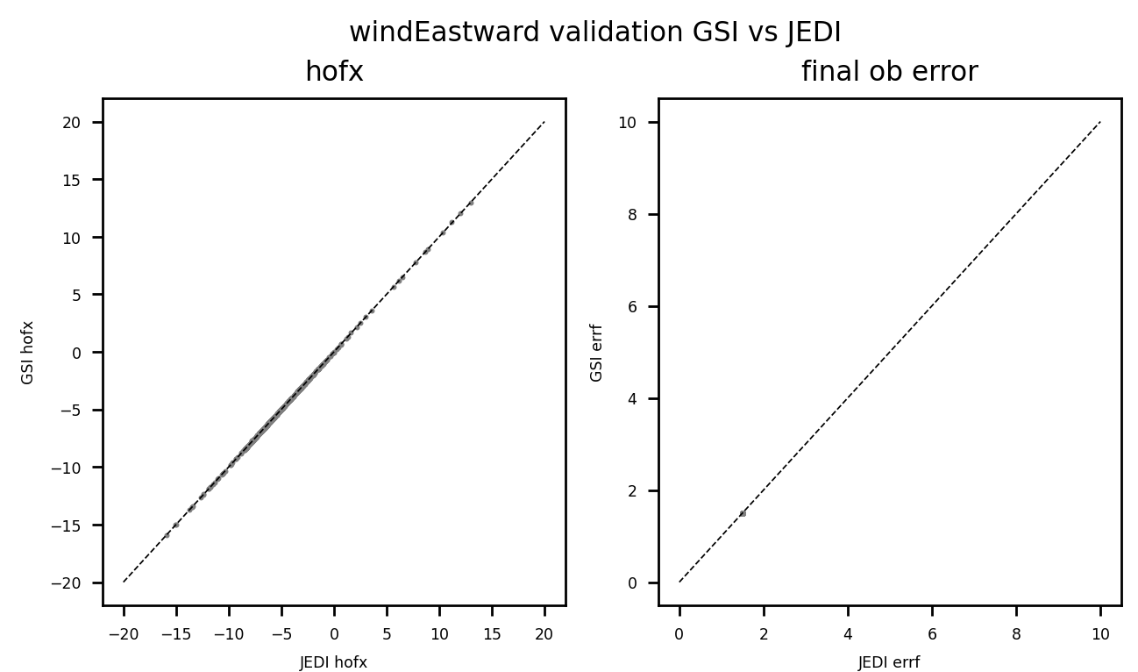
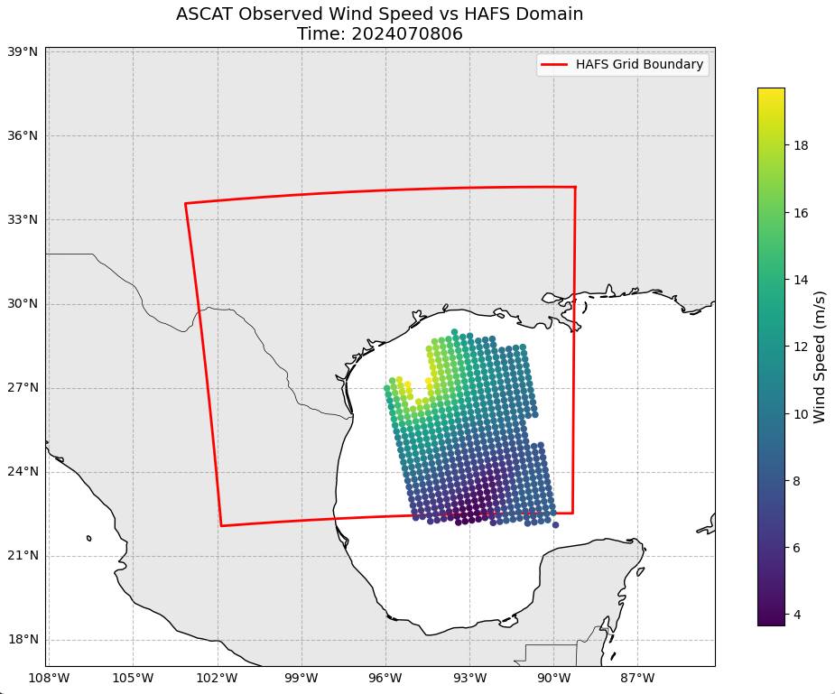
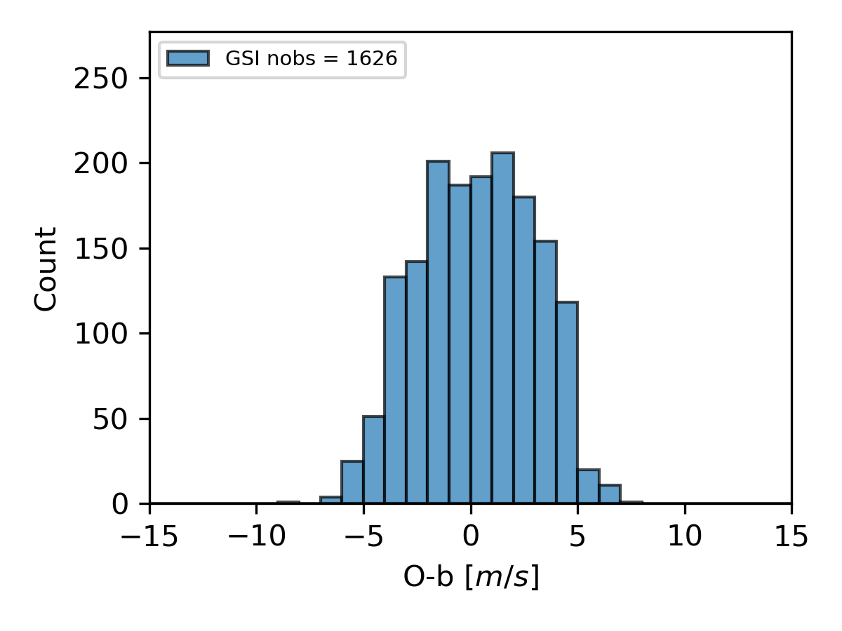
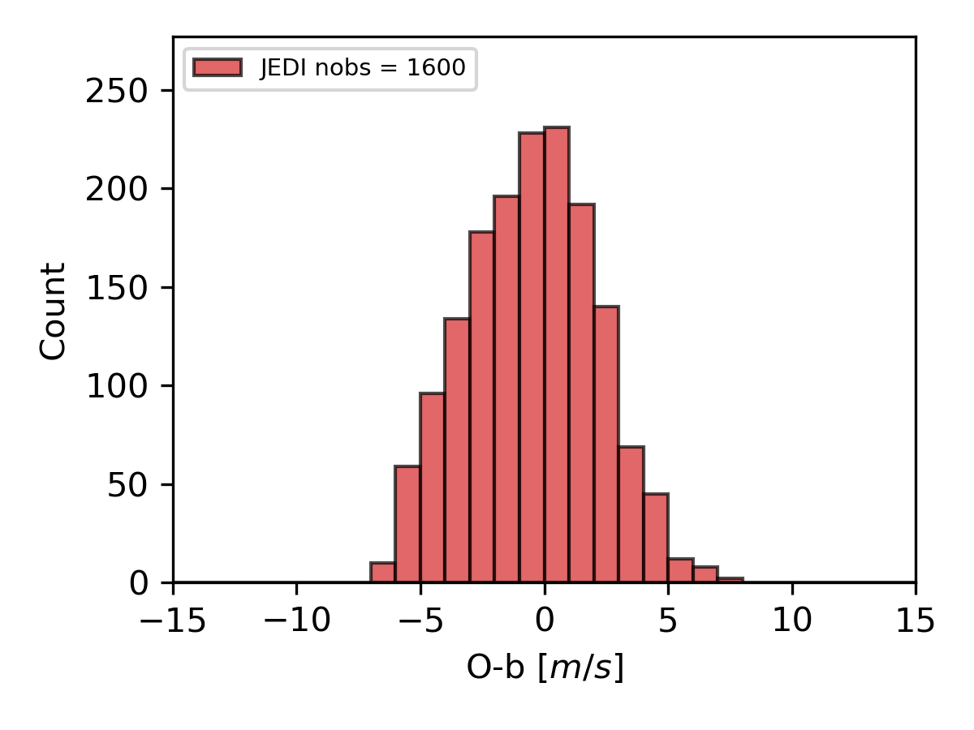
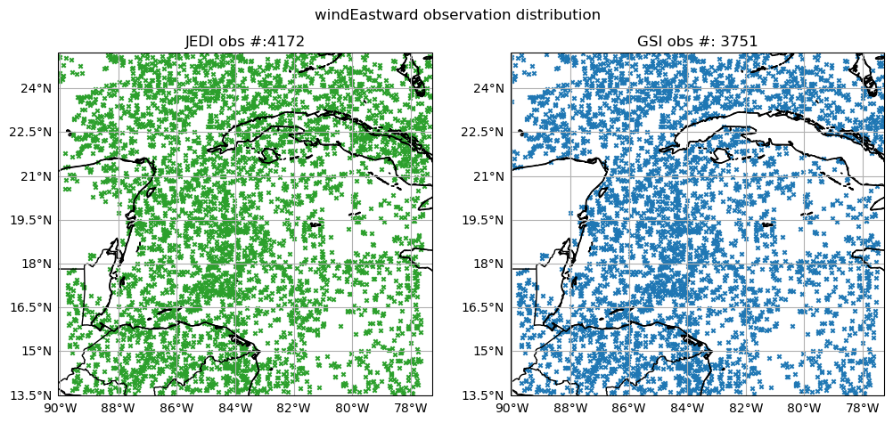
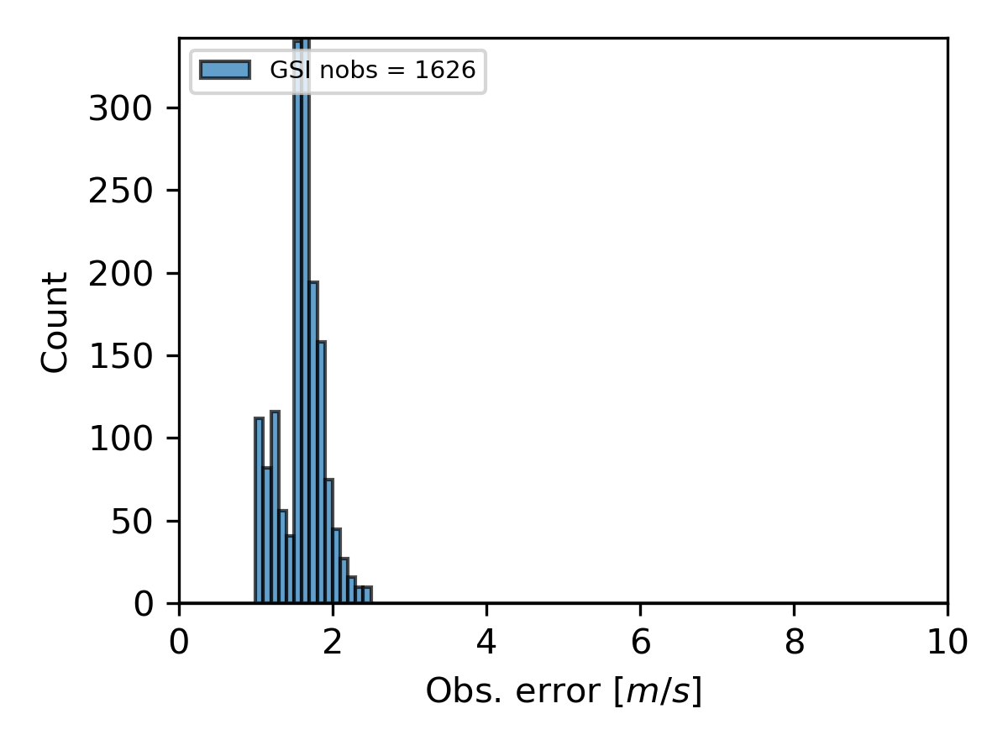
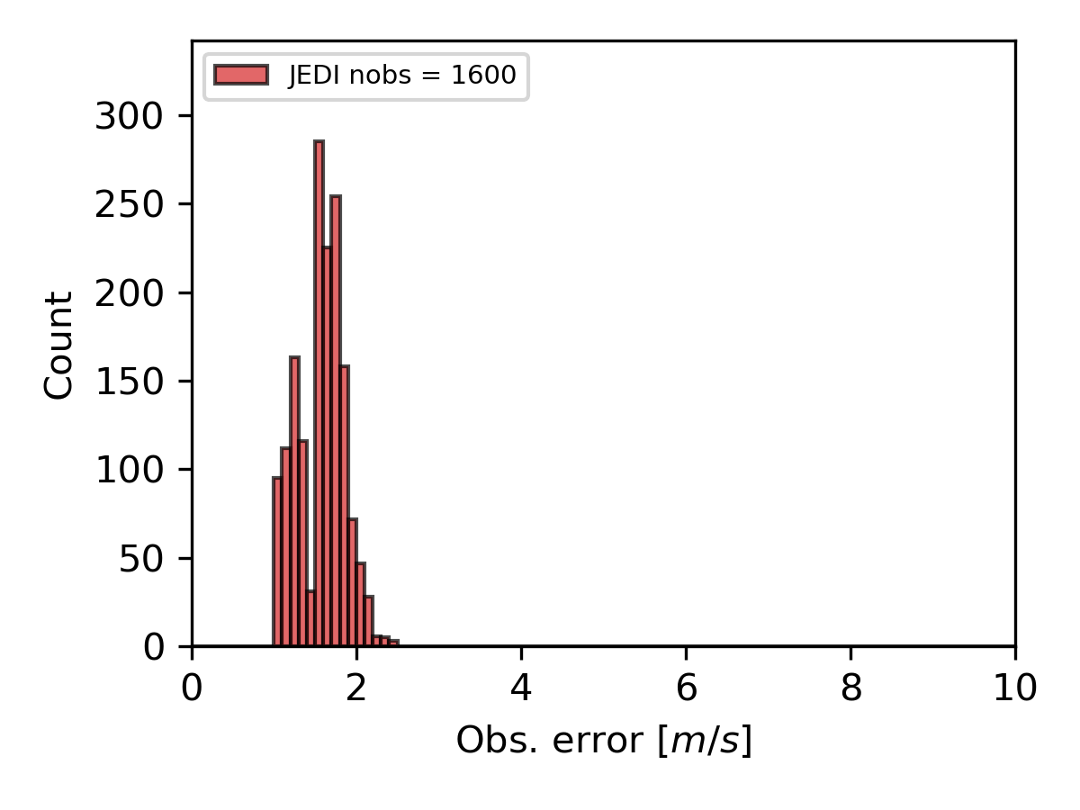
Transitioning to JEDI: Observation Validation Process
Phase I Validation Example
Three Phase Validations:
Phase I: HofX, Obs Error
Input Data: GSI QCed Observations
Phase II: QC options
Input Data: Bufr-query converted Observation
Phase III: Increments
Input Data: Bufr-query converted Observation
Phase II Validation Example

Slide 7
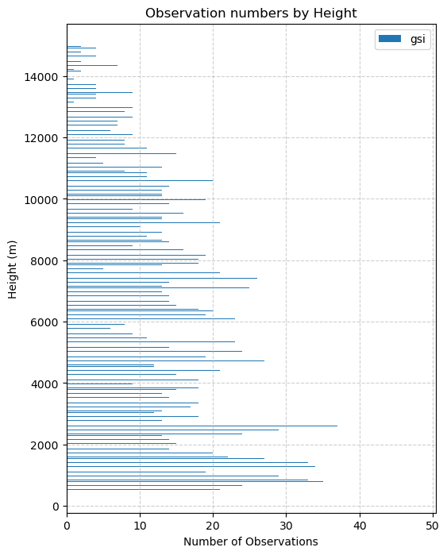
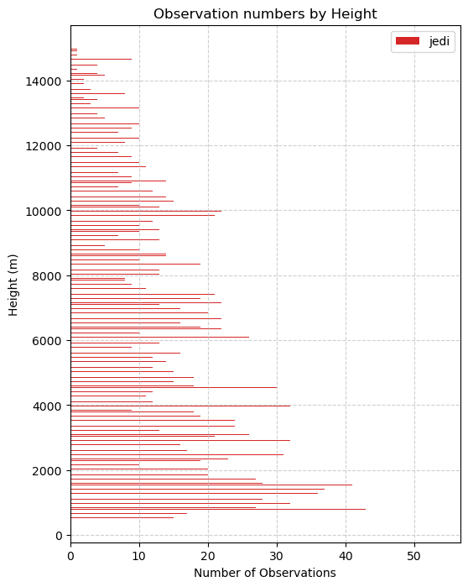
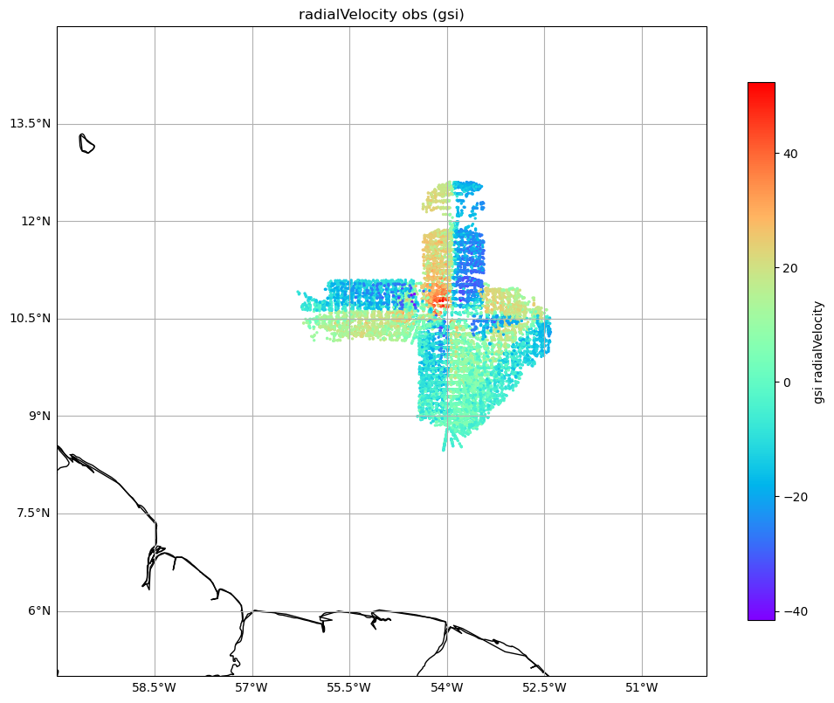
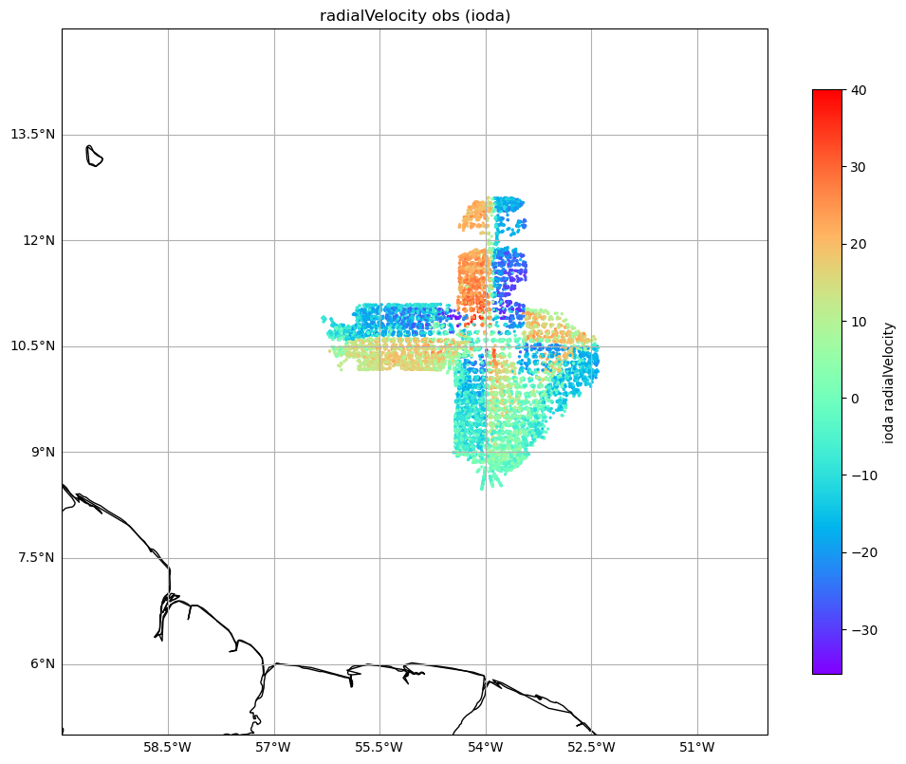
Transitioning to JEDI: Observation Validation Process
GSI Obs # 20391
JEDI OBS# 20528
Phase II Validation Example
GSI thinning rmesh = 12km
JEDI 5 layers thinning
horiz = 12km , 5 vertical layers

Slide 8
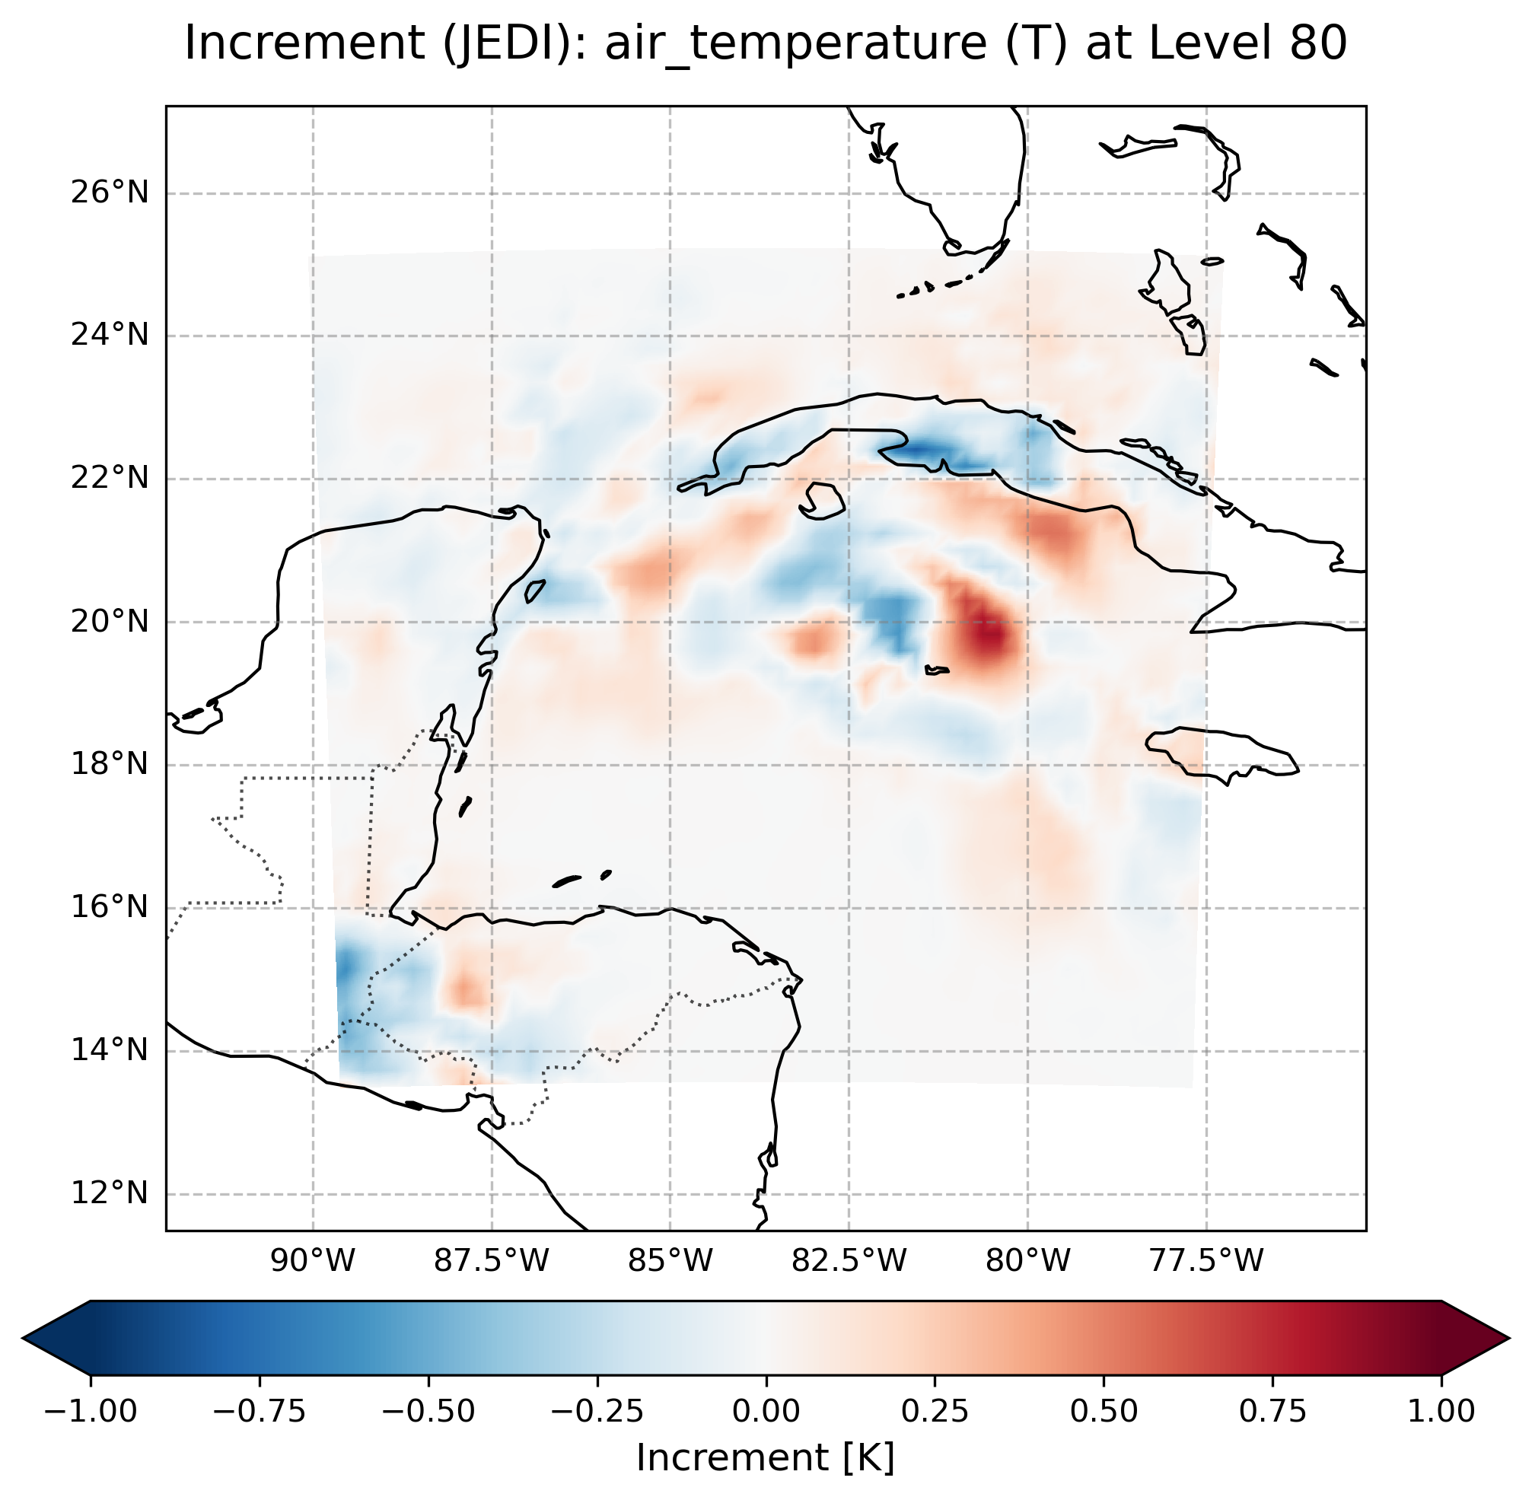
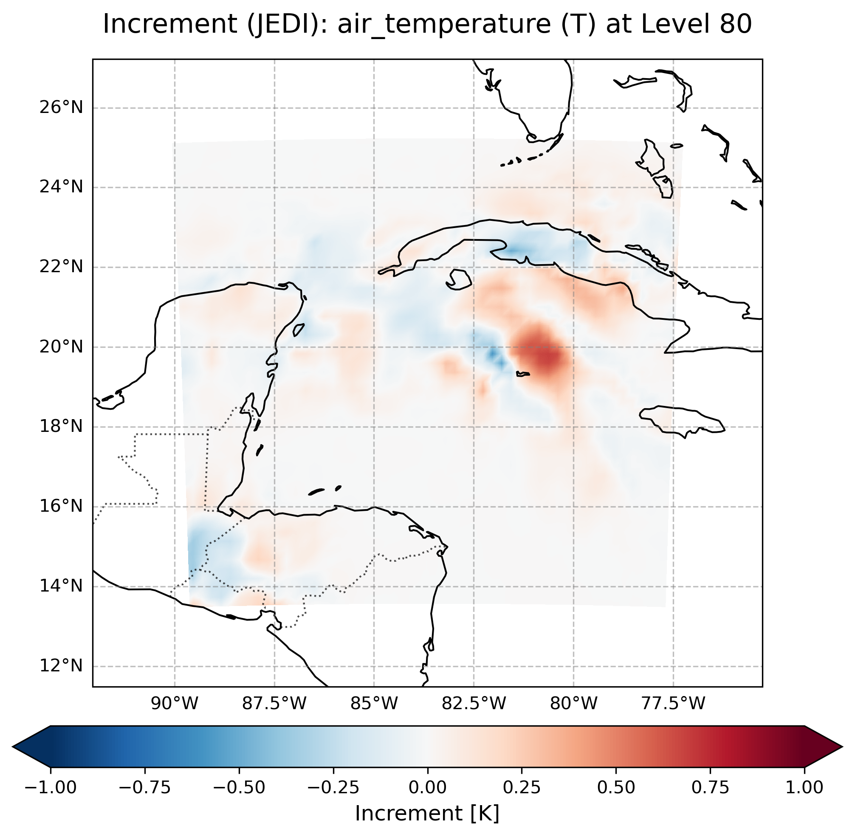
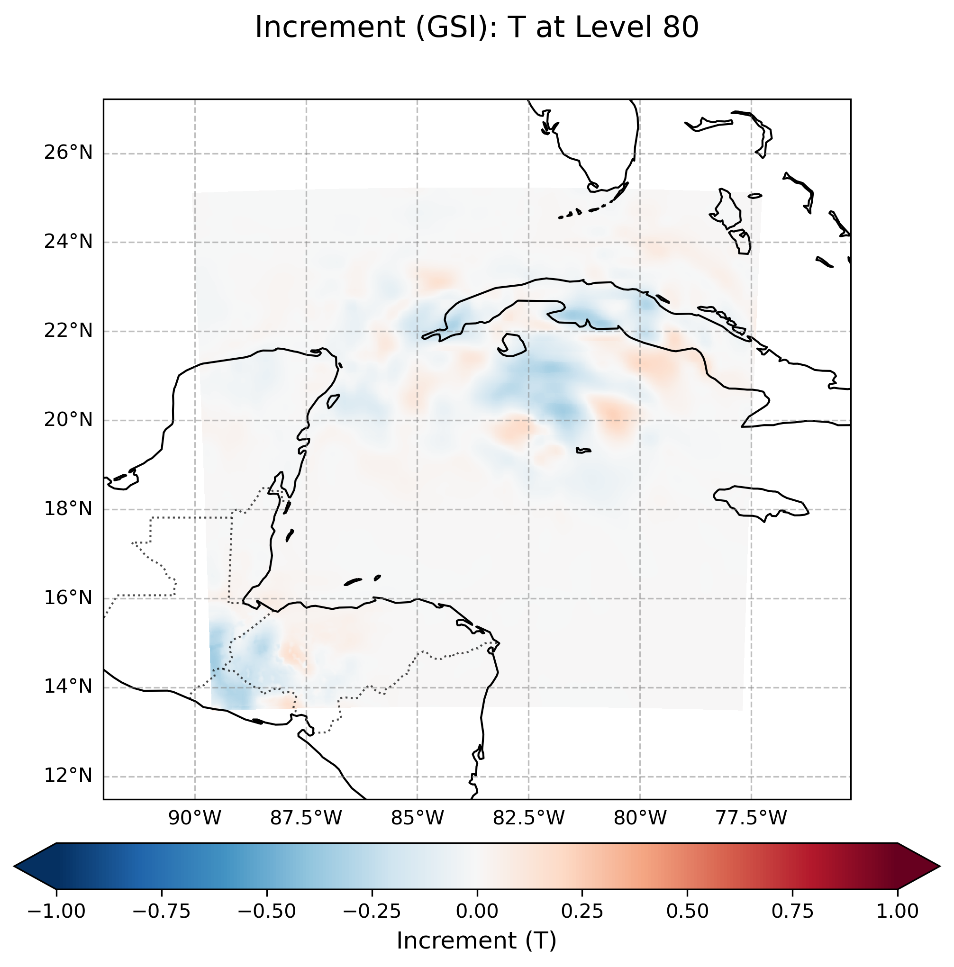
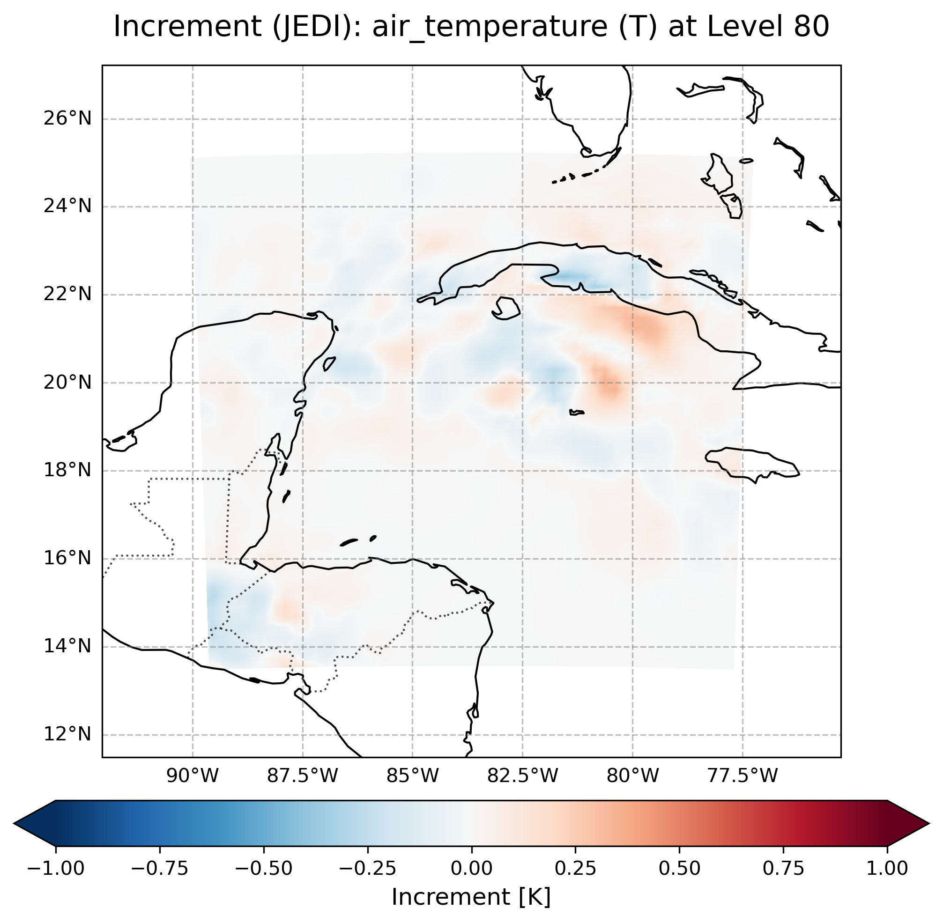
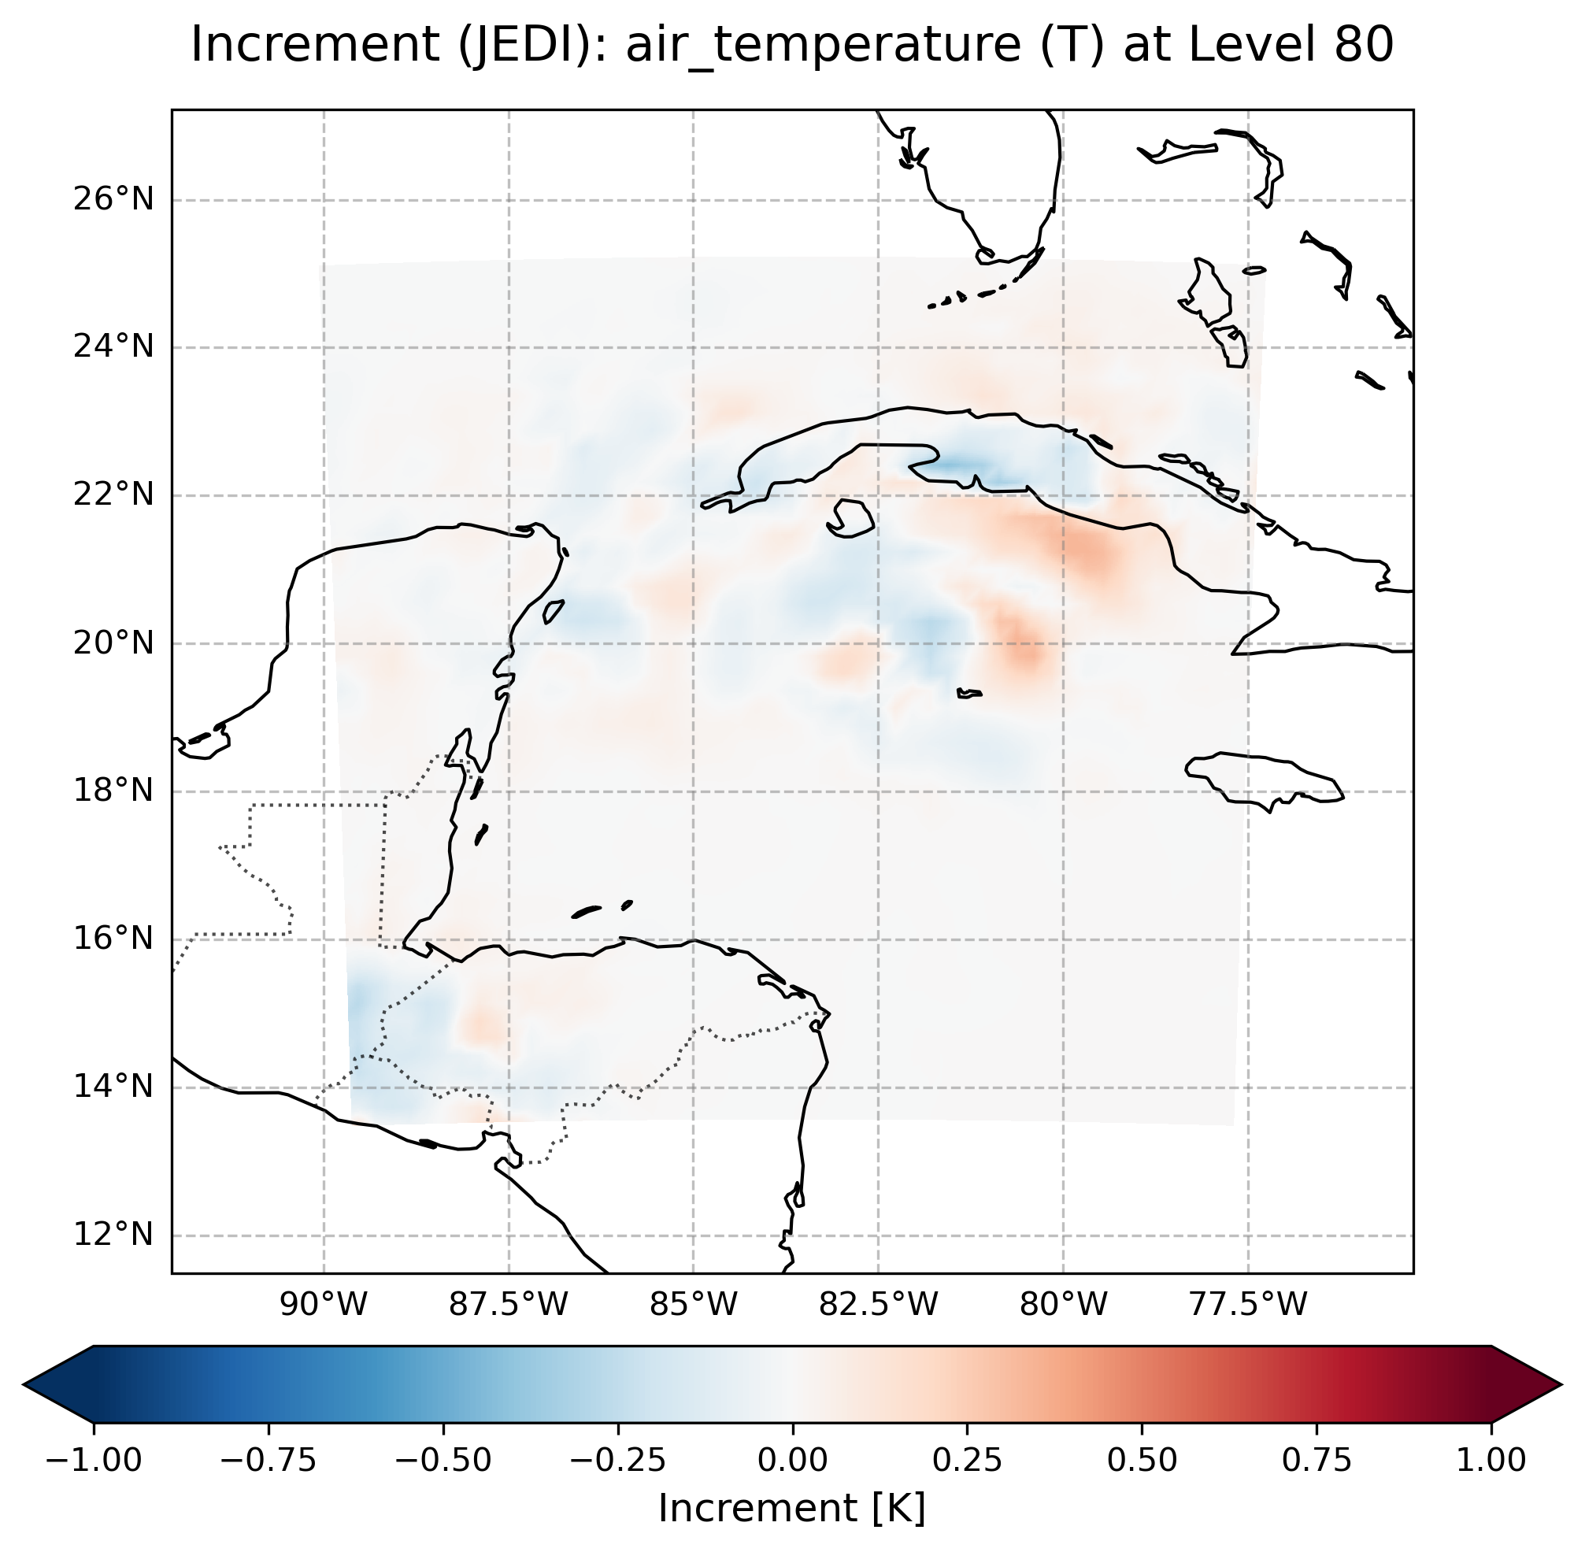
Transitioning to JEDI: Observation Validation Process
Vertical:0-35 km
Vertical:6-35 km
Phase III Validation Example
GSI Increment
Inflate ObsErr below 10 km
Toss profile across border

Slide 9
Transitioning to JEDI: Observation Validation Process
HAFS Assimilated Observation Types
HAFS-GSI vs 2025 HAFSv2.1.1J-JEDI vs 2026 HAFSv2.2.1A-JEDI
Conventional Data
Observation Type | HAFS-GSI | HAFSv2.1.1J JEDI (2025) | HAFSv2.2.1A JEDI (2026)
Surface (t,q,wind,ps) | Y | Y | Y
Sondes (t,q,wind,ps) | Y | Y | Y
Aircraft/Aircar (t,q,wind) | Y | Y | Y
ASCAT (wind) | Y | N | Y
Satwnd (wind) | Y | Y | Y
Vadwnd* (wind) | Y | N | Y
HDOB (t,q,wind) | Y | Y | Y
TempDROP (t,q,wind) | Y | Y | Y
TDR (radial wind) | Y | Y | Y
GPS RO (bending angle) | Y | N | Y
TCP (ps) | Y | N | Y
Nexrad* (radial wind) | Y | N | Y (WIP)
Satellite Radiance Data
Observation Type | HAFS-GSI | HAFSv2.1.1J JEDI (2025) | HAFSv2.2.1A JEDI (2026)
AMSUA (metop-b, metop-c, noaa-18, noaa-19) | Y | Y | Y(all-sky)
ATMS (npp, noaa-20, noaa-21) | Y | Y | Y(all-sky)
IASI (metop-b, metop-c) | Y | Y | Y
ABI (goes-16(19), goes-18) | N | Y | Y
SSMIS (f17) | Y | Y | Y (phase-out)
CRIS (npp, noaa-20, noaa-21) | Y | N | Y
MHS (noaa-18, noaa-19, metop-b, metop-c) | Y | N | Y(WIP)

Slide 10
2026 HAFSv2.2.1A Real-Time Experiment Configurations
Retrospective and Real-Time Testing
System and infrastructure: Driven by upcoming/parallel GFSv17 (instead of GFSv16) input data
Physics and dynamics fine-tunings: Leverage HAFSv2.3A upgrades for GFSv17 downstream upgrade
JEDI-based atmospheric inner-core DA, improved upon 2025 HAFSv2.1.1J real-time experiment
  Using 80-member GDAS ensemble covariance (capability recently developed for HAFS JEDI DA)
  Observation types and features
    Observations same as in 2025 HAFSv2.1.1J
      SATWND, SFCSHP, SURFACE, SONDE, AIRCFT/AIRCAR
      TDR, Dropsonde, HDOB (including UAS)
      ATMS, AMSUA, IASI, ABI
    New enabled observations in 2026 HAFSv2.2.1A
      TCVtial, GPSRO, NEXRAD (work in progress), CRIS, VADWND, ASCATW, MHS (work in progress)
    New feature: ATMS and AMSUA will be all-sky DA (instead of clear-sky)
  Scale-Dependent Localization (SDL) not available in JEDI yet (in HAFS-GSI though)
  Further improved observation preprocessing to convert bufr into IODA format for JEDI DA

Slide 11
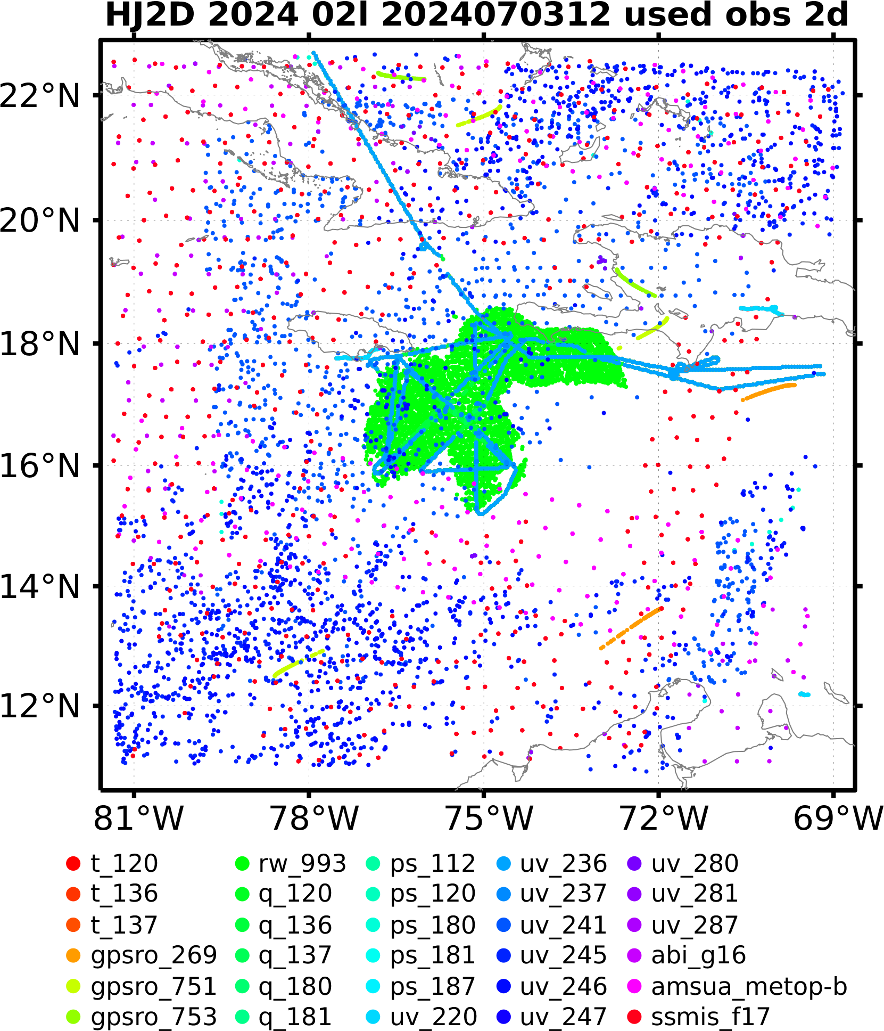
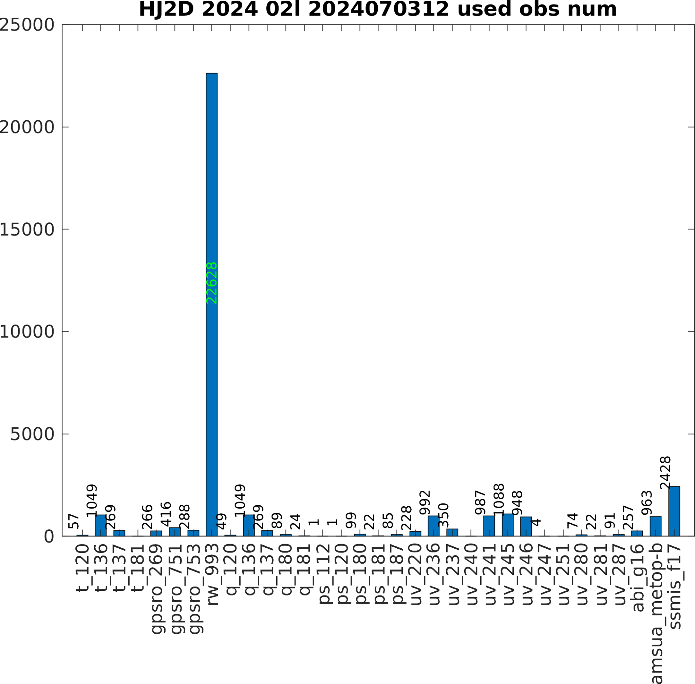
Retrospective and Real-Time Testing
Observations Assimilated in 2024 02l Beryl case

Slide 12
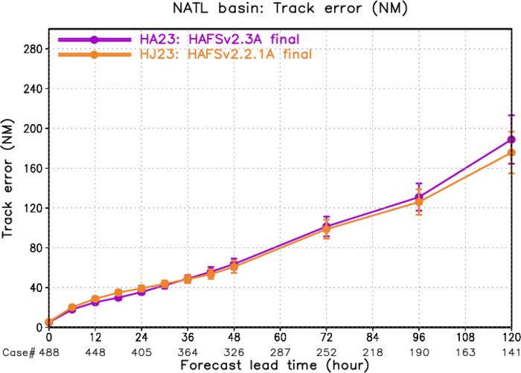
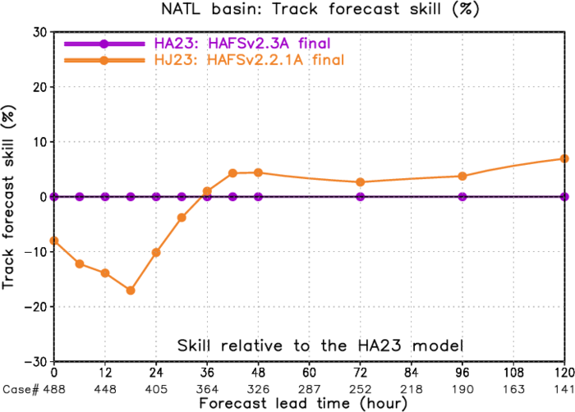
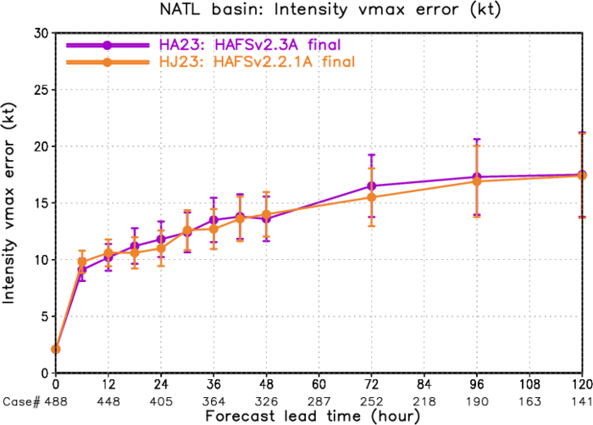
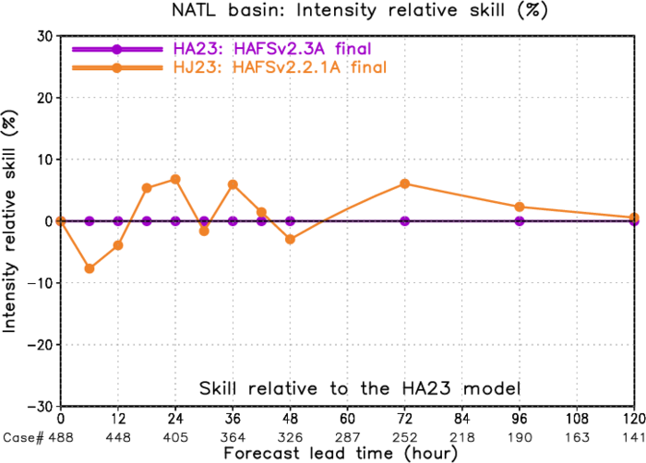
Retrospective and Real-Time Testing
HAFSv2.2.1A Retrospective Experiment Performance
(2024 & 2025 season)
HA23: HAFSv2.3A final
HJ23: HAFSv2.2.1A final
Track error
Track skill
Vmax error
Intensity skill

Slide 13
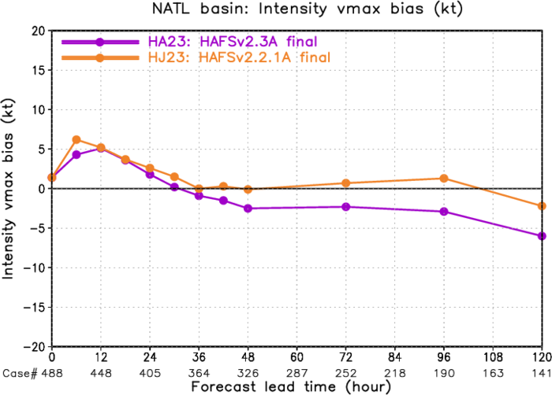
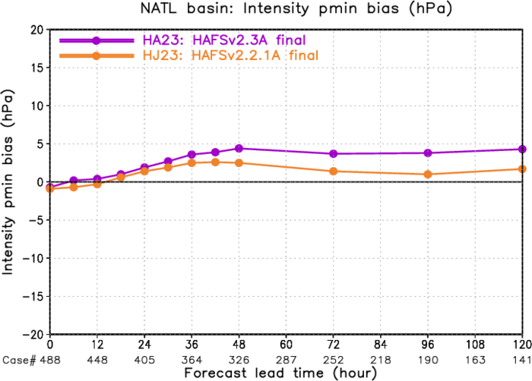
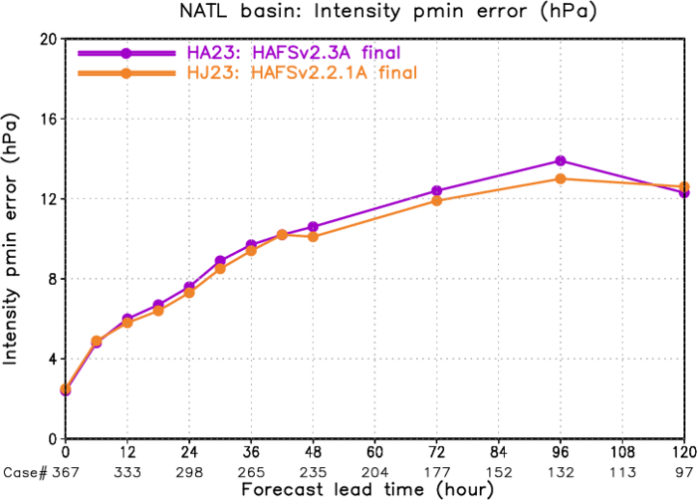
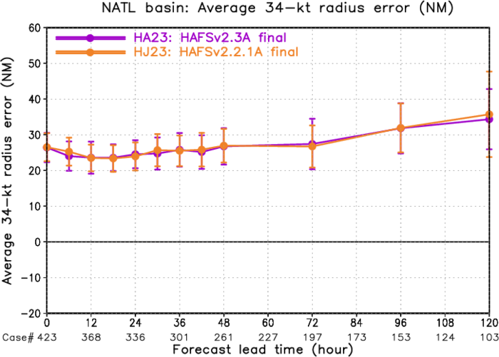
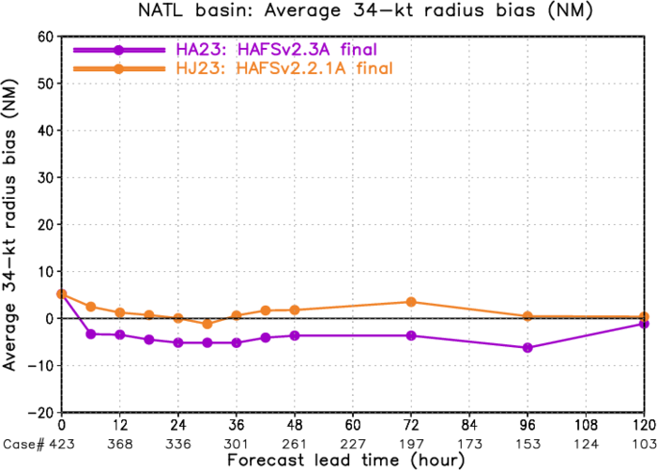
Retrospective and Real-Time Testing
HAFSv2.2.1A Retrospective Experiment Performance
(2024 & 2025 season)
HA23: HAFSv2.3A final
HJ23: HAFSv2.2.1A final
Vmax bias
Pmin bias
Pmin error
R34 error
R34 bias

Slide 14
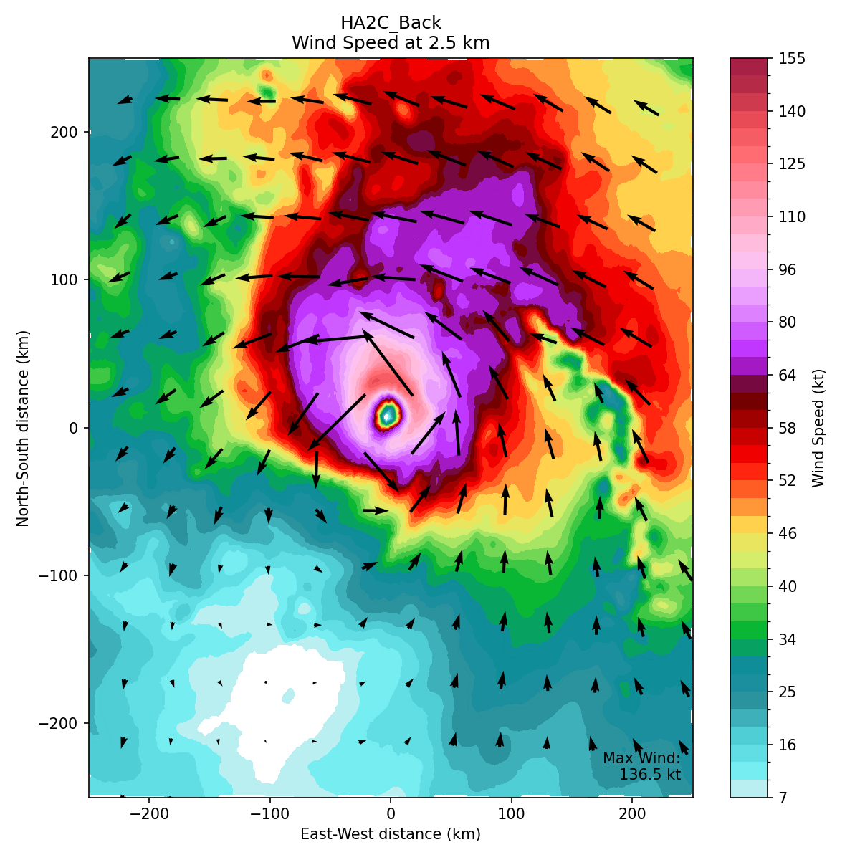
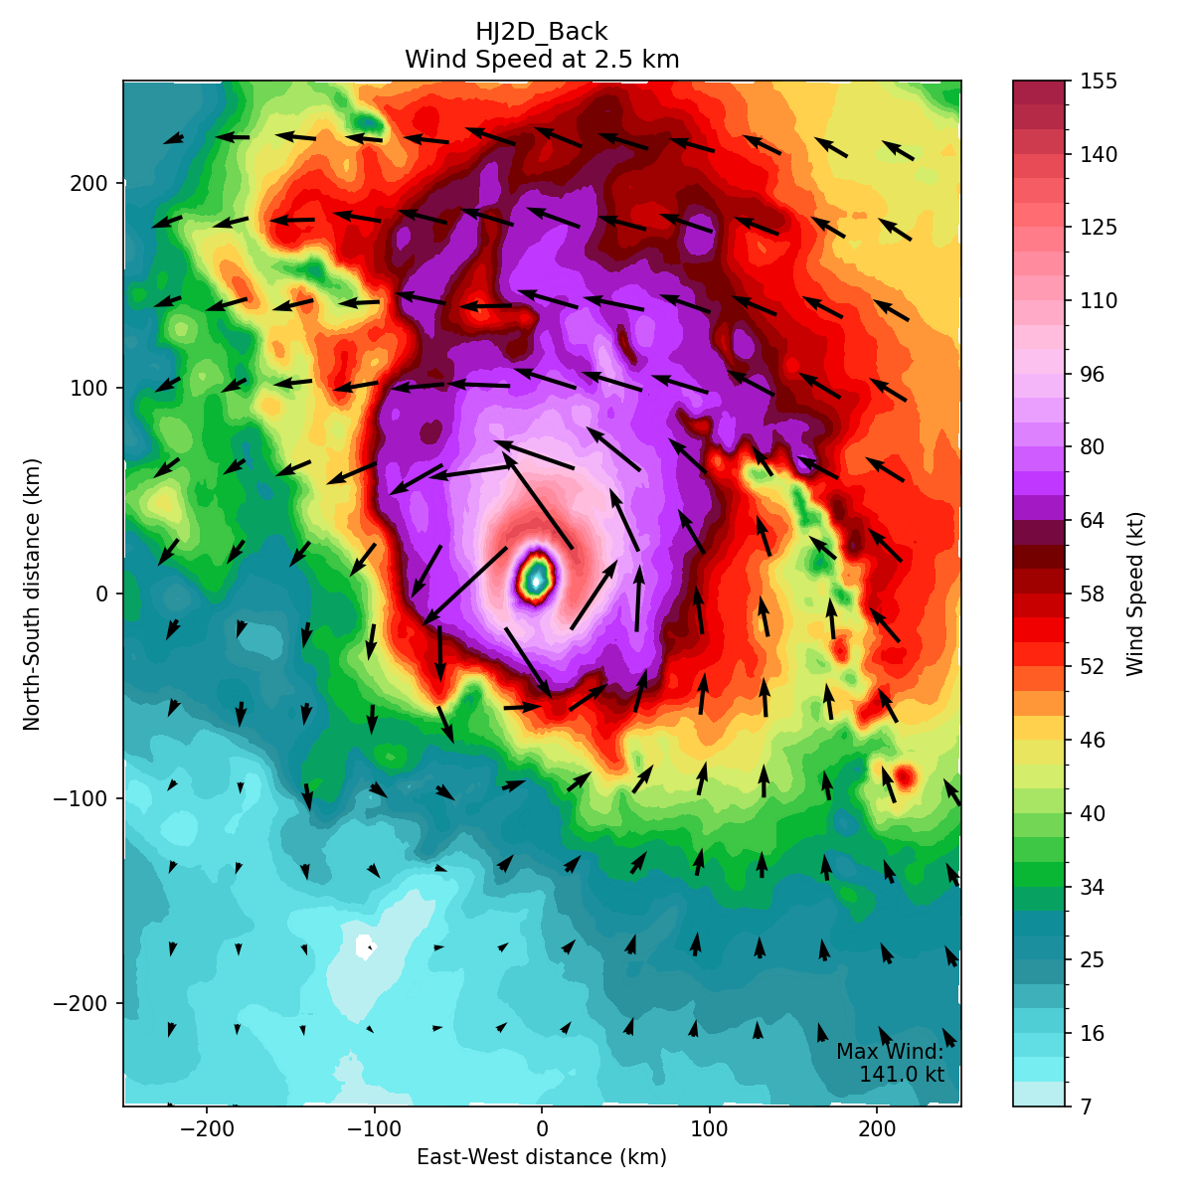
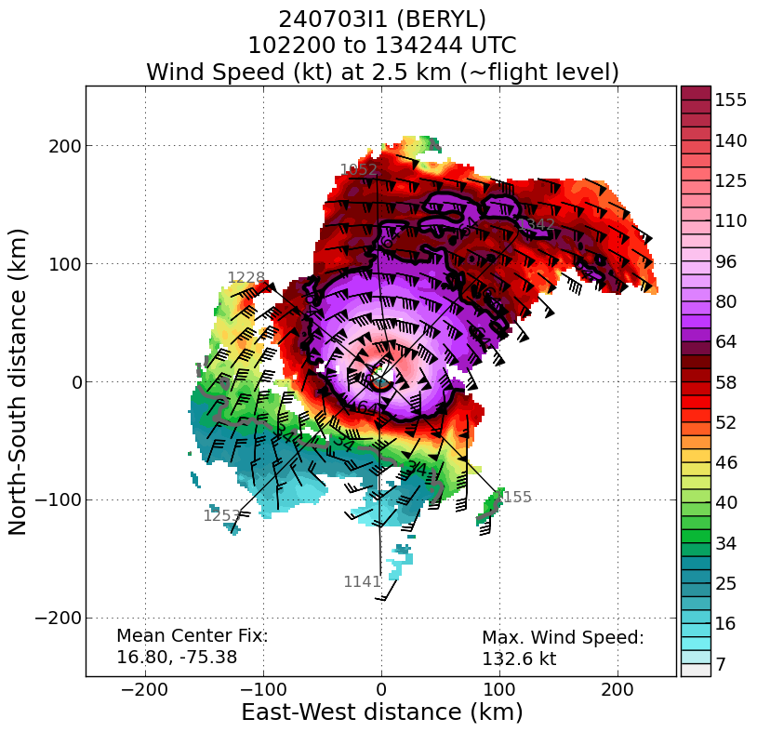
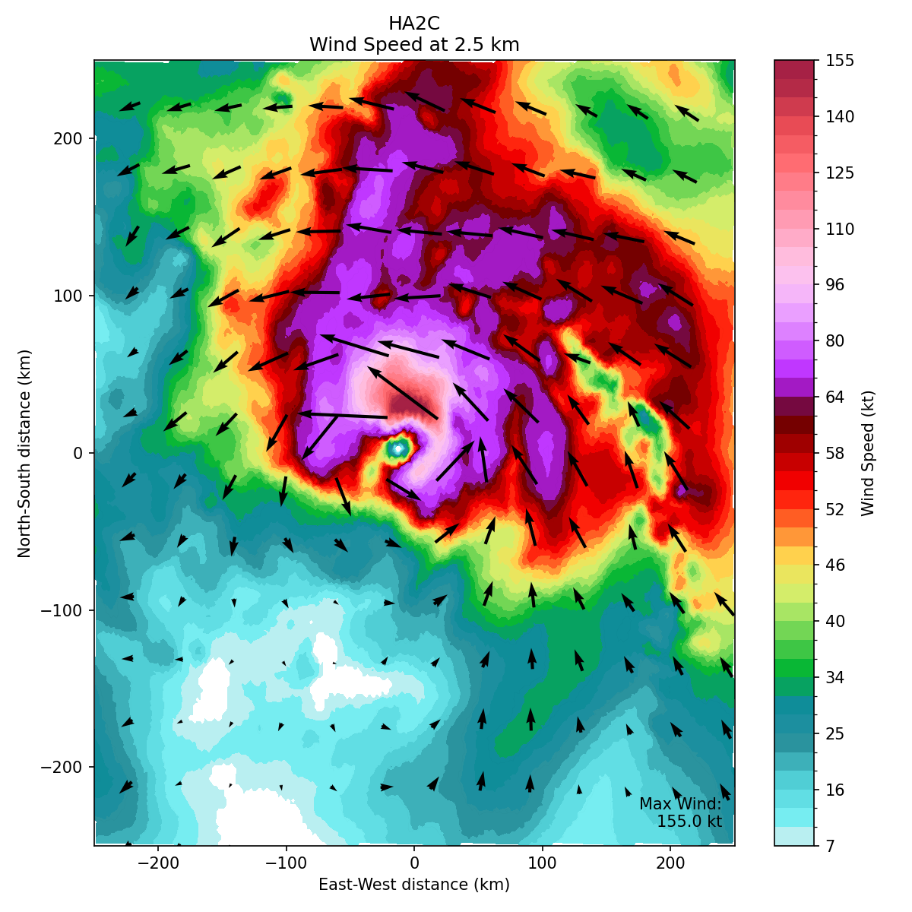
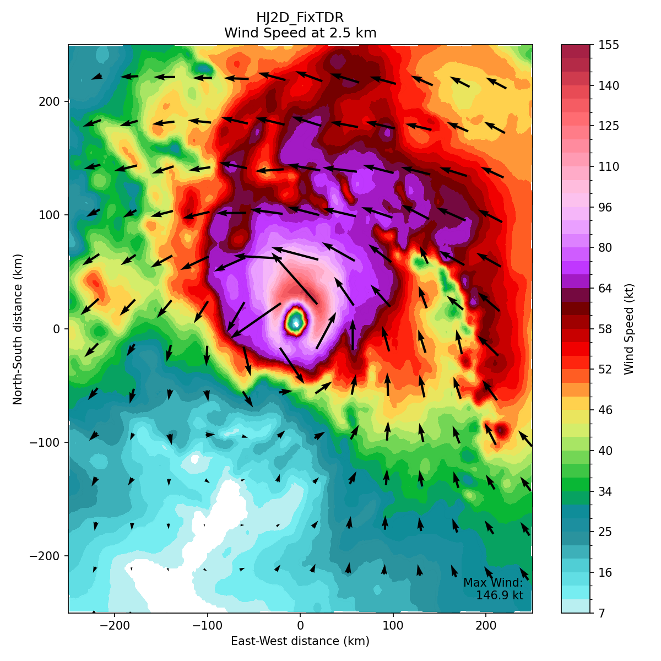
Retrospective and Real-Time Testing
GSI BKG
JEDI BKG
GSI ANA
JEDI ANA

Slide 15
Summary and Next Steps
The JEDI-based HAFS-DA system is capable of assimilating a comprehensive suites of observations types.
Retrospective experiments for 2024 and 2025 demonstrate that the JEDI-based framework performs on par with the legacy GSI framework .
This configuration-potentially expanded with additional observation types-will run in real-time during the upcoming 2026 North Atlantic hurricane season.
We will conduct extensive analyses of both retrospective and real-time experiments to continually fine-tune the data assimilation configuration.

Slide 16

Questions?

Slide 17
Backups

Slide 18

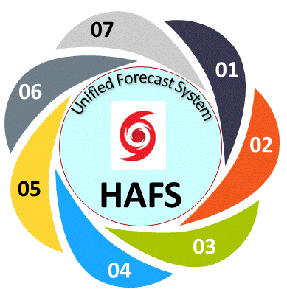
Acknowledgement to a Team of Active HAFS Developers
Atmospheric model dynamics/configurations/workflow MDC Bin Liu, Dusan Jovic, Avichal Mehra, JungHoon Shin,Vijay Tallapragada, Biju Thomas, Jun Wang, Zhan Zhang, Yangxing Zheng AOML/HRD Ghassan Alaka, Sundararaman Gopalakrishnan, William Ramstrom, Xuejin Zhang DTC Mrinal Biswas, Kathryn Newman, GFDL Rusty Benson, Jan-Huey Chen, Kun Gao, Lucas Harris, Joseph Mouallem GSL Samuel Trahan | Ocean/Wave coupling through CMEPS MDC Santha Akella, Maria Aristizabal, Saeideh Banihashemi, Jessica Meixner, John Steffen AOML/HRD Lew Gramer AMOL/PhOD HeeSook Kang, Hyun-Sook Kim, Ming Ming Shao NCAR/ESMF Dan Rosen, Gerhard Theurich, Ufuk Turuncoglu | Data Assimilation MDC Jing Cheng, Daniel Holdaway, Daryl Kleist, Ting Lei, Shun Liu, Donald Lippi, Xu Lu, Yonghui Weng, Sho Yokota AOML/HRD Brittany Dahl, Sarah D. Ditchek, Kathryn Sellwood, Jason Sippel, OU Xuguang Wang UM/CIMAS Altug Aksoy, Dan Wu UMD Joseph Knisely, Kenta Kurosawa, Jonathan Poterjoy SUNY/U at Albany Ryan Torn
Model Pre- and Post-processes MDC George Gayno, Qingfu Liu, Chuan-Kai Wang, Wen Meng, Lin Zhu GFDL Timothy Marchok | Atmospheric Physics MDC Michael Barlage, Jongil Han, Ruiyu Sun, Xu Li, Weiguo Wang, Fanglin Yang, Rongqian Yang AOML/HRD Andrew Hazelton UAH Xiaomin Chen FIU Ping Zhu PSL Lisa Bengtsson | Verification/Evaluation MDC Hananeh Jafary, Jiayi Peng NHC Michael Brennan, Wallace Hogsett, Jon Martinez, Jamie Rhome, Pablo Santos, Ben Trabing, David Zelinsky, JTWC Brian Strahl, Levi Cowan
Funding support from HFIP, IFAA, DSUP, JTTI, and UFS-R2O Projects. Thanks to MDC management team

