Slide 1
Student Career Panel
Panelists:
Andrew Markowitz, Kate Fossell, Cody Ledbetter, Sim James
July 22, 2026

Slide 2
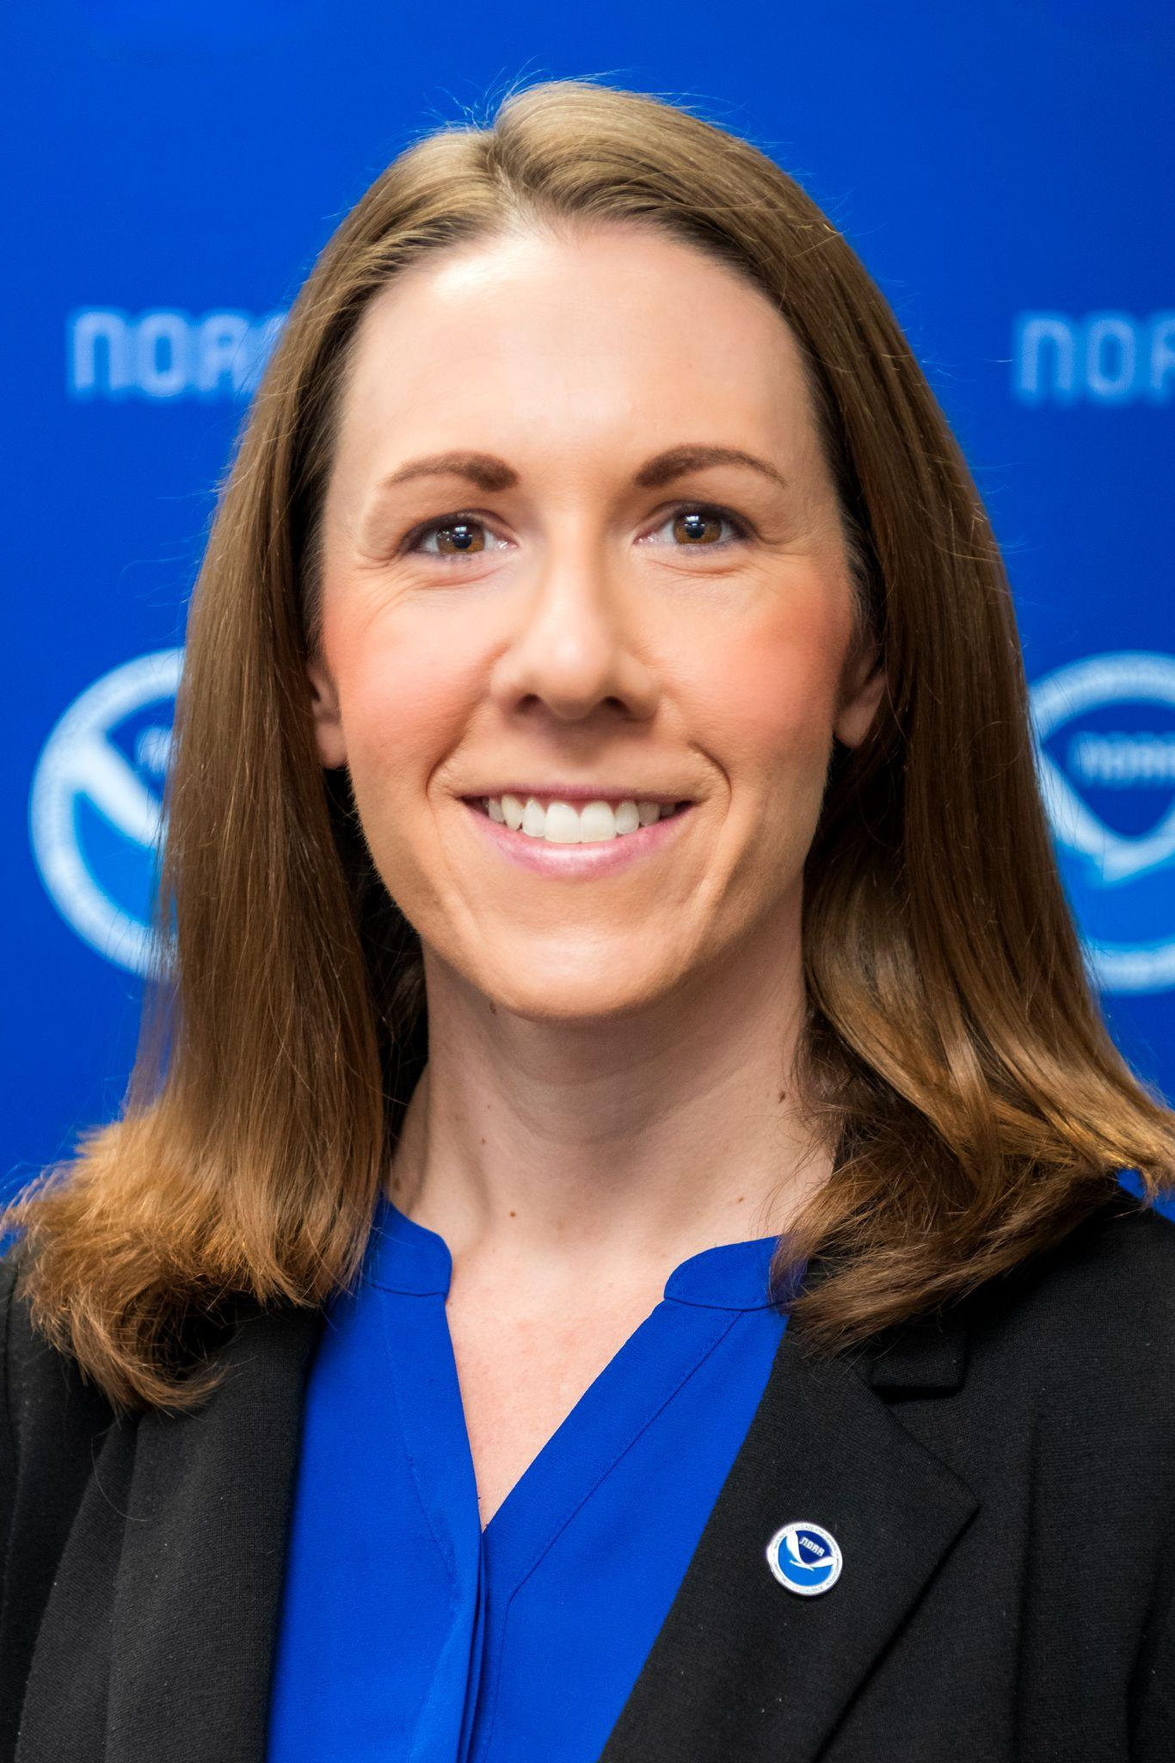
Jennifer Vogt
EPIC Deputy Program Manager
Physical Scientist
B.S. Meteorology, Millersville University of Pennsylvania (2007)
M.S. Atmospheric Science, University of Wyoming (2010)
Gov’t contractor for NESDIS, Satellite Analysis Branch - 2010-2014
NWS WFO Jackson, KY Meteorologist - 2014-2016
NWS WFO Albany, NY Meteorologist - 2016-2021
Gov’t contractor for NOAA/OAR/WPO/EPIC - 2021-2023
Physical Scientist for NOAA/OAR/WPO/EPIC - 2023 - current
**Promoted to EPIC Deputy Program Manager in spring 2025
**Community Engagement and Outreach Lead for EPIC
**Led UIFCW from 2021-Present
***EXAMPLE SLIDE***
Notes:
Example slide

Slide 3
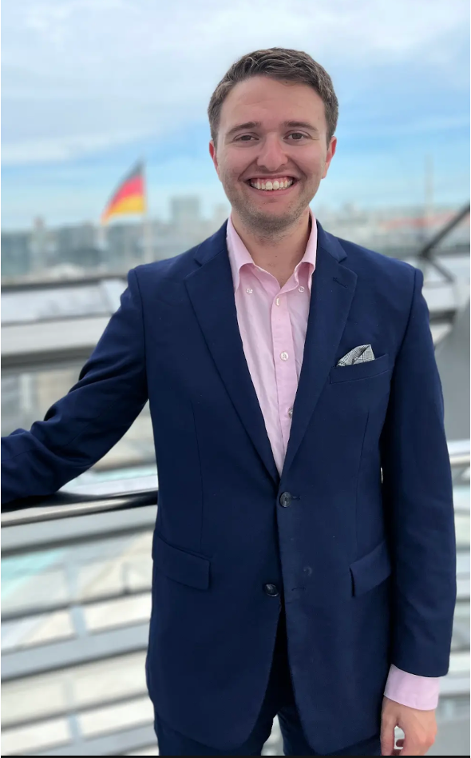
Andrew Markowitz
B.S. Meteorology, Penn State University (2019)
Minor, Energy Business and Finance
Environment Intelligence Analyst - WorldAware, Annapolis, MD - Jul. 2019- Jan. 2021
Market Associate - Wood Mackenzie, Boston, MA - Jan. 2021- Sep. 2022
Meteorologist - Xcel Energy, Denver, CO - Sep. 2022 - present
Digital Meteorologist (200K+ followers cumulative)

Slide 4
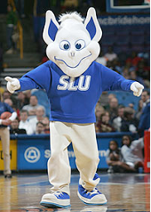

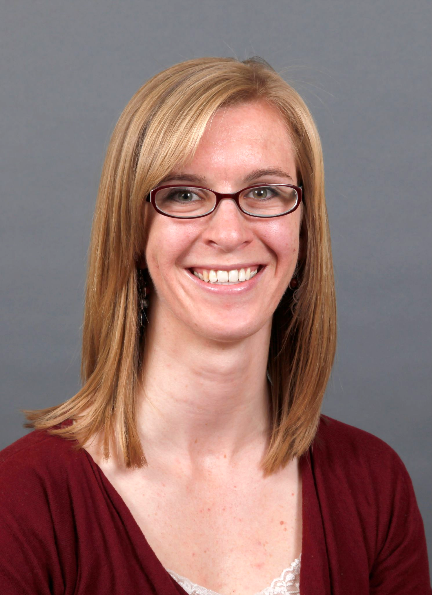



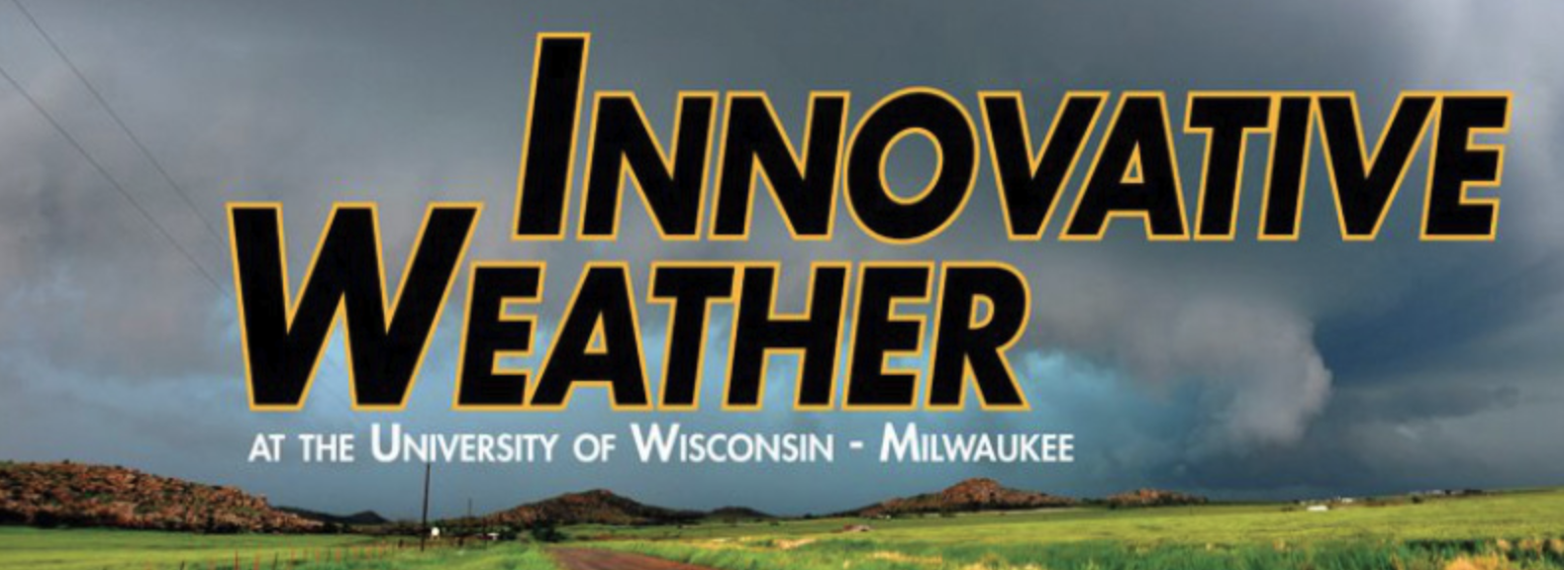

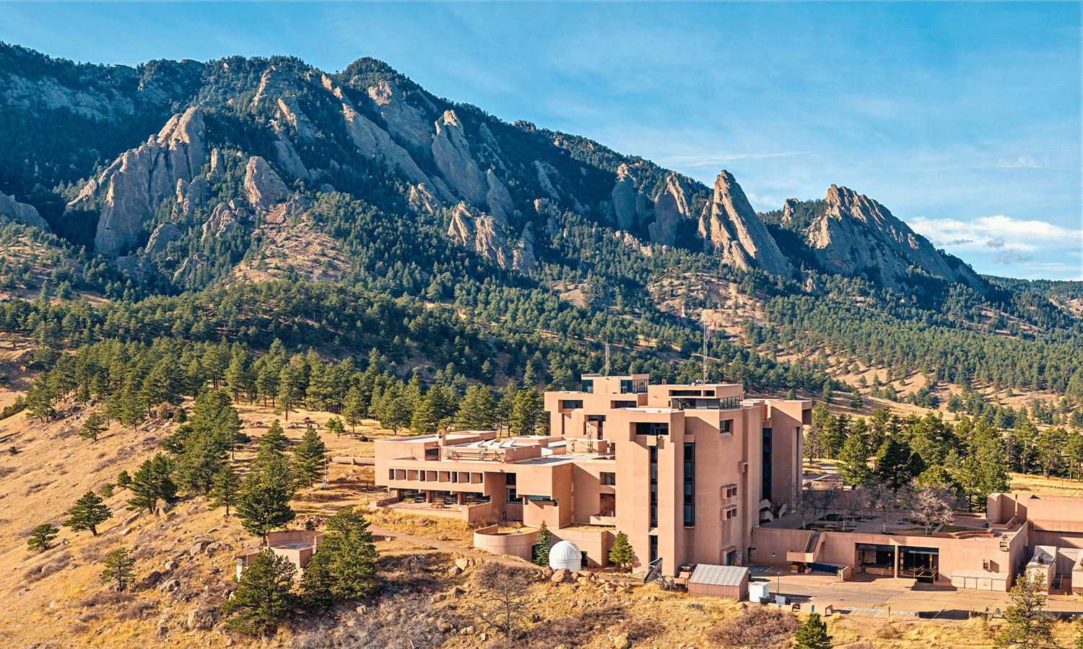


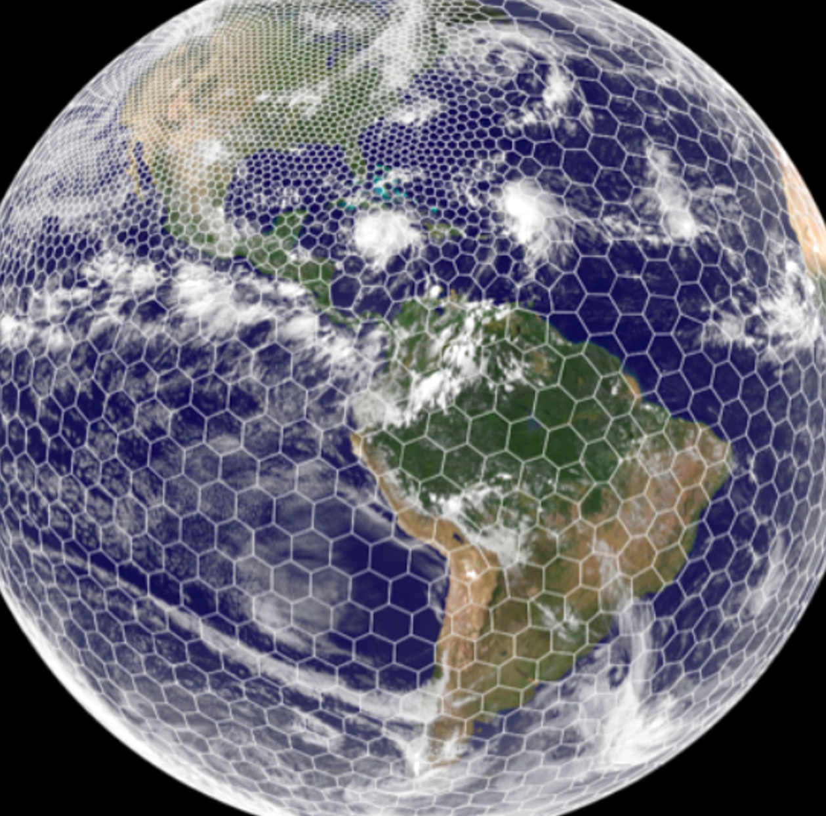
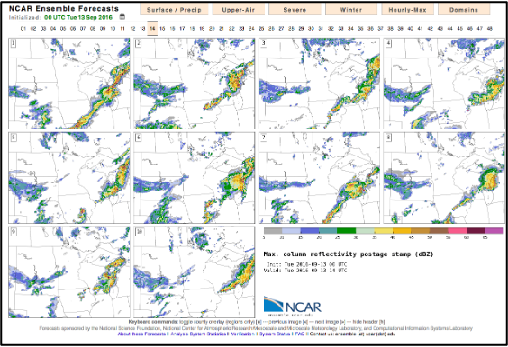

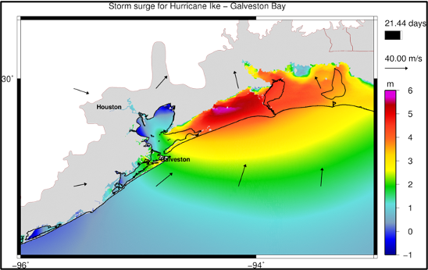

Kate Fossell
B.S. Meteorology, Saint Louis University (2006)
M.S. Mathematics, University of Wisconsin - Milwaukee (2008)
Operational Meteorologist, Innovative Weather (2007-2010)
Research Meteorologist, UW-Milwaukee (2008-2011)
Associate Scientist (II-IV), MMM, NSF NCAR (2011-2024)
Interim Strategic Partnerships Lead, NSF NCAR (2024)
Assistant Director, MMM, NSF NCAR (2024-current)
Acting Deputy Director, MMM, NSF NCAR (2026-current)
Extra Credit: What is a Billiken?
Circa 2014

Slide 5
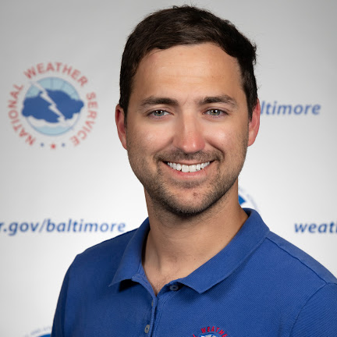
Cody Ledbetter
B.S. Meteorology, University of North Carolina at Charlotte (2016)
M.S. Earth Science, University of North Carolina at Charlotte (2018)
NWS WFO Newport, NC, Student Volunteer - 2017
NWS WFO Boulder, CO, Pathways Student Intern - 2018
NWS WFO Sterling, VA, Meteorologist - 2018-Present
Certified Incident Meteorologist
Lead Fire, Marine, and Tropical Programs

Slide 6
Sim James
B.A. Political Science, Auburn University (1996)
M.S. Meteorology and Physical Oceanography, Naval Postgraduate School (2005)
US Navy Meteorology and Oceanography Officer: 1996 - 2016
Gov’t contractor for NOAA/OAR/OWAQ (now WPO): 2016-2018
Office of the Federal Coordinator for Meteorology: NOAA/UNSEC-2018-2023
Deputy Team Lead, Staff of the Oceanographer of the Navy: 2023 - current
Deputy Team Lead, Naval Oceanography, interagency, international, and interservice engagement
Deputy lead for the Naval Deputy to NOAA for the Oceanographer of the Navy

Slide 7
Potential Questions
What are the most important skills for undergraduates to develop?
In what ways is the current landscape of your industry changing?
How can students best prepare for and adapt to these changes?
What is your favorite part of your job?
What is the most unexpected part of your job?

