Slide 1




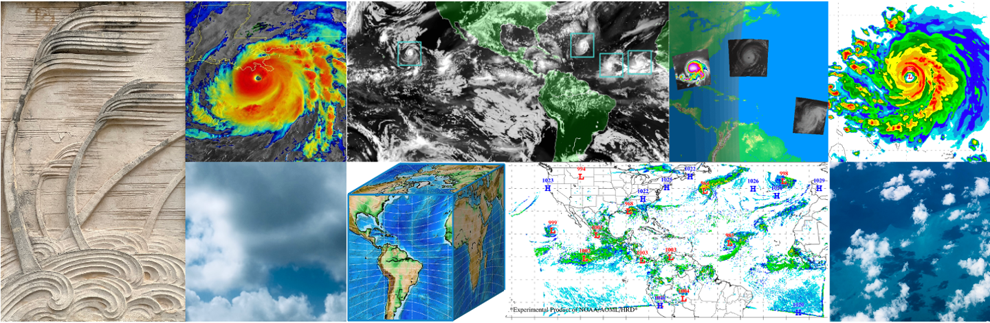
Efficient High-Resolution Forecasts of Hurricanes through Basin-Scale and Telescoping Nest HAFS
William Ramstrom^{1,2}, Lewis Gramer^{1,2}, Andrew Hazelton^{1,2}, Sundararaman Gopalakrishnan²
1- University of Miami / CIMAS
2- NOAA / AOML / Hurricane Research Division

Slide 2
Overview
Fine scale details in hurricanes are critical
Model efficiency
Telescoping nest development
Telescoping nest Hurricane Melissa case

Slide 3
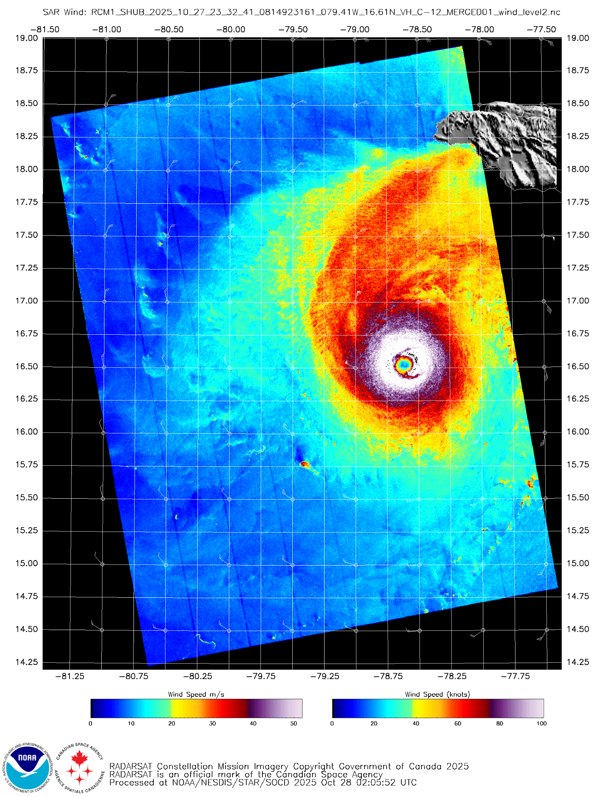
Fine-Scale Features in Hurricanes
Fine model resolution needed to capture sharp gradients and small features in eye and eyewall region
Improves ability of model to capture strong storms with compact eyes
Improves structure and intensity forecasts

Slide 4
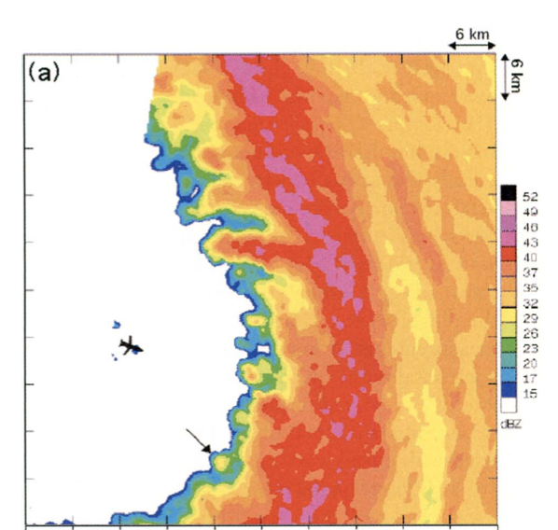
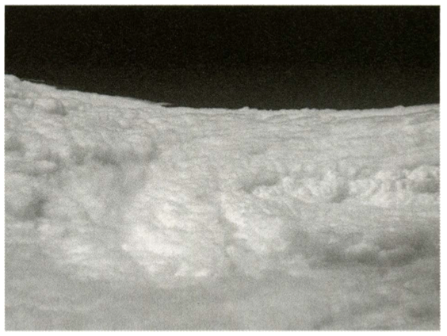
Fine-Scale Features in Hurricanes
Dropsonde in Isabel (2003) recorded 107 m/s winds and 25 m/s updraft, likely in eyewall misocyclone
From: Aberson, et al. 2006 BAMS

Slide 5
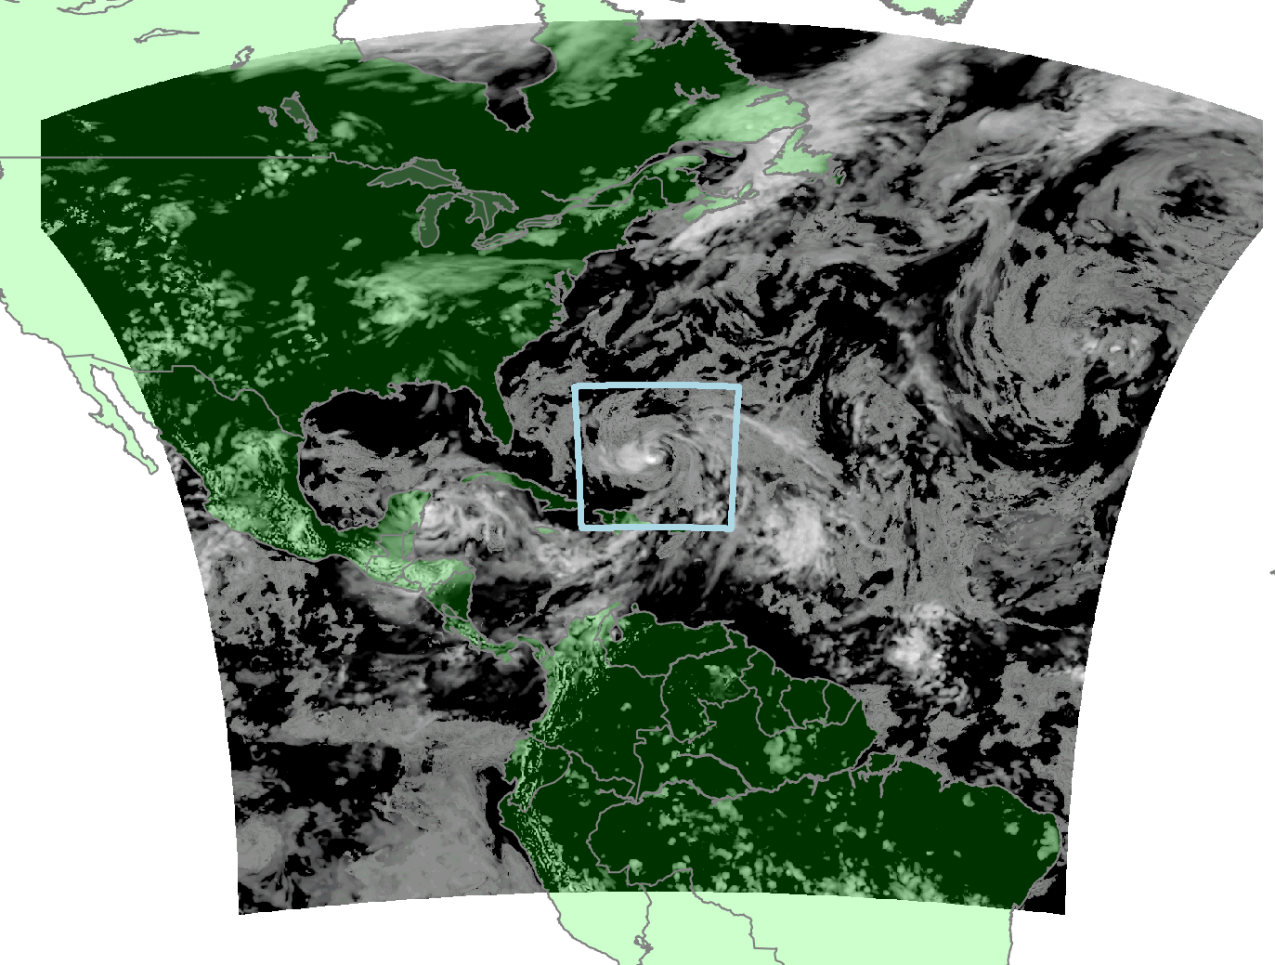
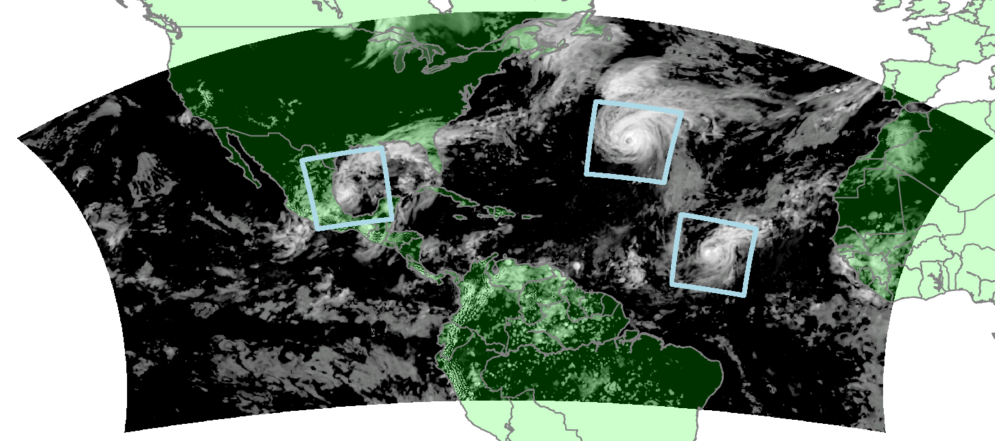
HAFS-M and HAFS-B
125 degrees X 62 degrees
2089 X 1051 parent points
2,195,539 points
75 degrees X 75 degrees
1201 X 1201 parent points
1,442,401 points

Slide 6
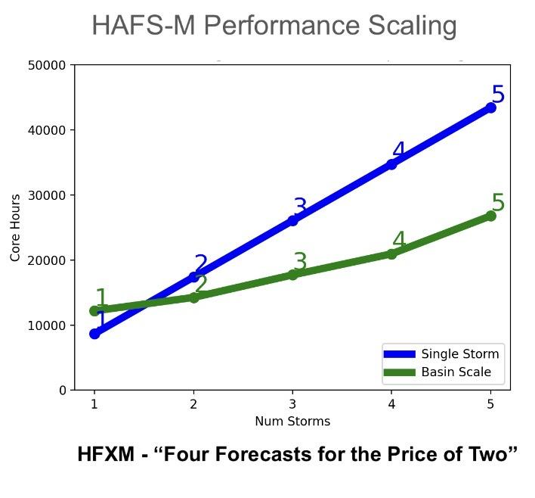
Model Efficiency
HAFS-Basin Multi-Storm saves compute resource compared to storm-centered HAFS
Forecast accuracy gains from storm-storm interactions

Slide 7
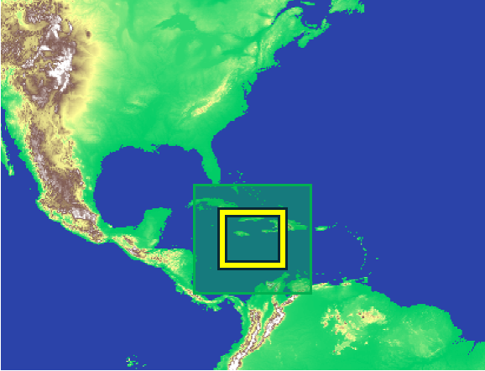
Telescoping Nest
●Development of moving telescoping nests underway at HRD
●Model code changes
●Workflow prep changes
●Flexibility for many resolution options
●Test sub-km scale forecasts
●Exercise workflow for telescoping
●Prepare for moving telescoping nests

Slide 8
Implementation of Telescoping Moving Nests
Preprocessing
Generate static surface fields
Run chgres for all nests
Model Dynamic Core
Read in tiled static surface fields
Adapt internal tracker
Move intermediate and fine nests
Data transfer between PEs
Choose n_split, k_split (timestep)
Vortex Initialization/Data Assimilation
Adapt scripts to run on correct nests
Analysis merge all levels
Post Processing and Graphics
GFDL Tracker
GRIB2 Outputs for all nests
HRD Graphics for all nests

Slide 9
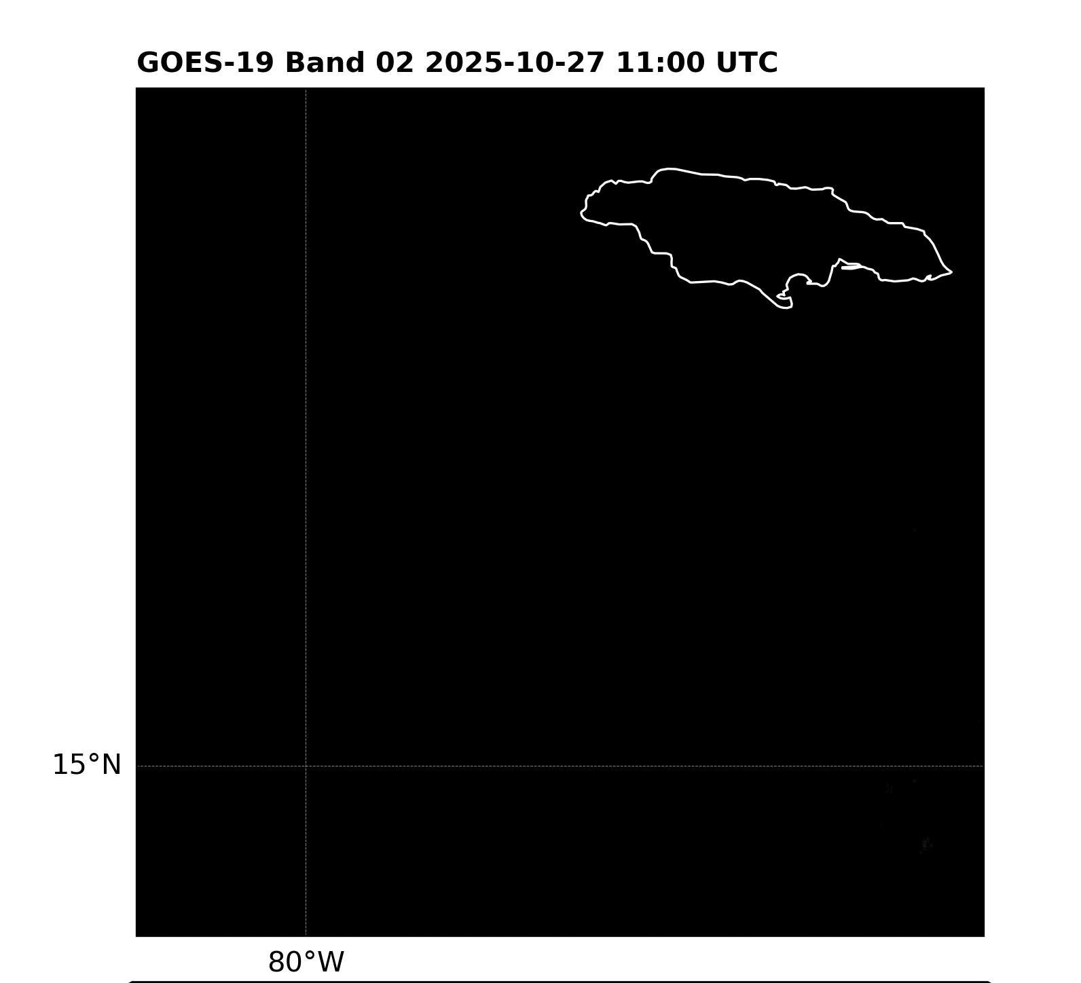
Sample Case: Hurricane Melissa
Melissa was in intense, compact hurricane
Maximum sustained winds 165kts
Model resolution key to capturing maximum intensity and small eyes
Comparison HAFS-M, HAFS-B, and telescoping nest
HAFS-M, HAFS-B 6km/2km
Static telescoping nest 6km/2km/660m

Slide 10
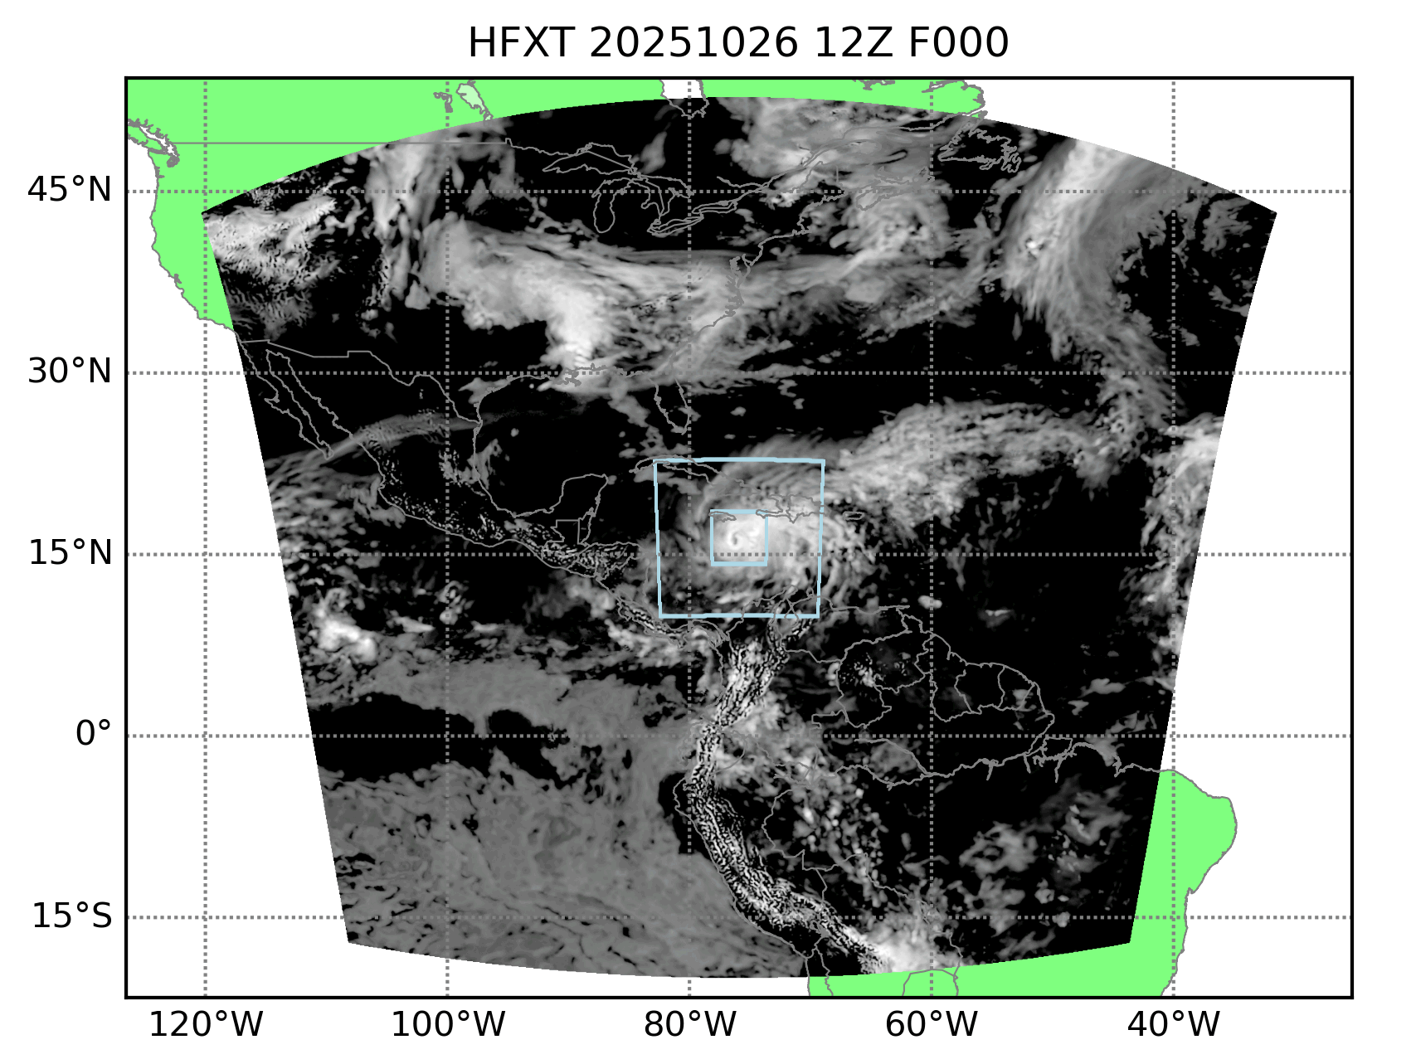
Telescoping Nest Domain
6km/2km/660m
MOM6 Ocean Coupling
Cold-start from GFS
Thompson Convection on all nests
Scale-aware PBL
NOAH MP LSM
No VI/DA
600/360/360 PEs, 3 threads
126 hour forecast
24 Ursa nodes: 173 minutes

Slide 11
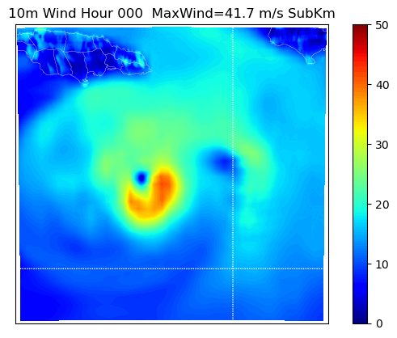
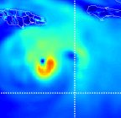
10m Winds from Telescoping and 2km Control
Telescoped Nest ~660m
Control Run 2km Nest
Max Wind 71.4 m/s at hour 30
Max Wind 65.7 m/s at hour 33

Slide 12
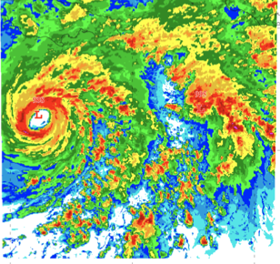
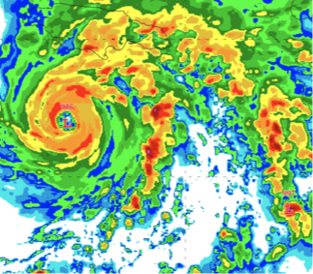
REFL from Telescoping and 2km Control - Hour 33
Telescoped Nest ~660m
Control Run 2km Nest

Slide 13
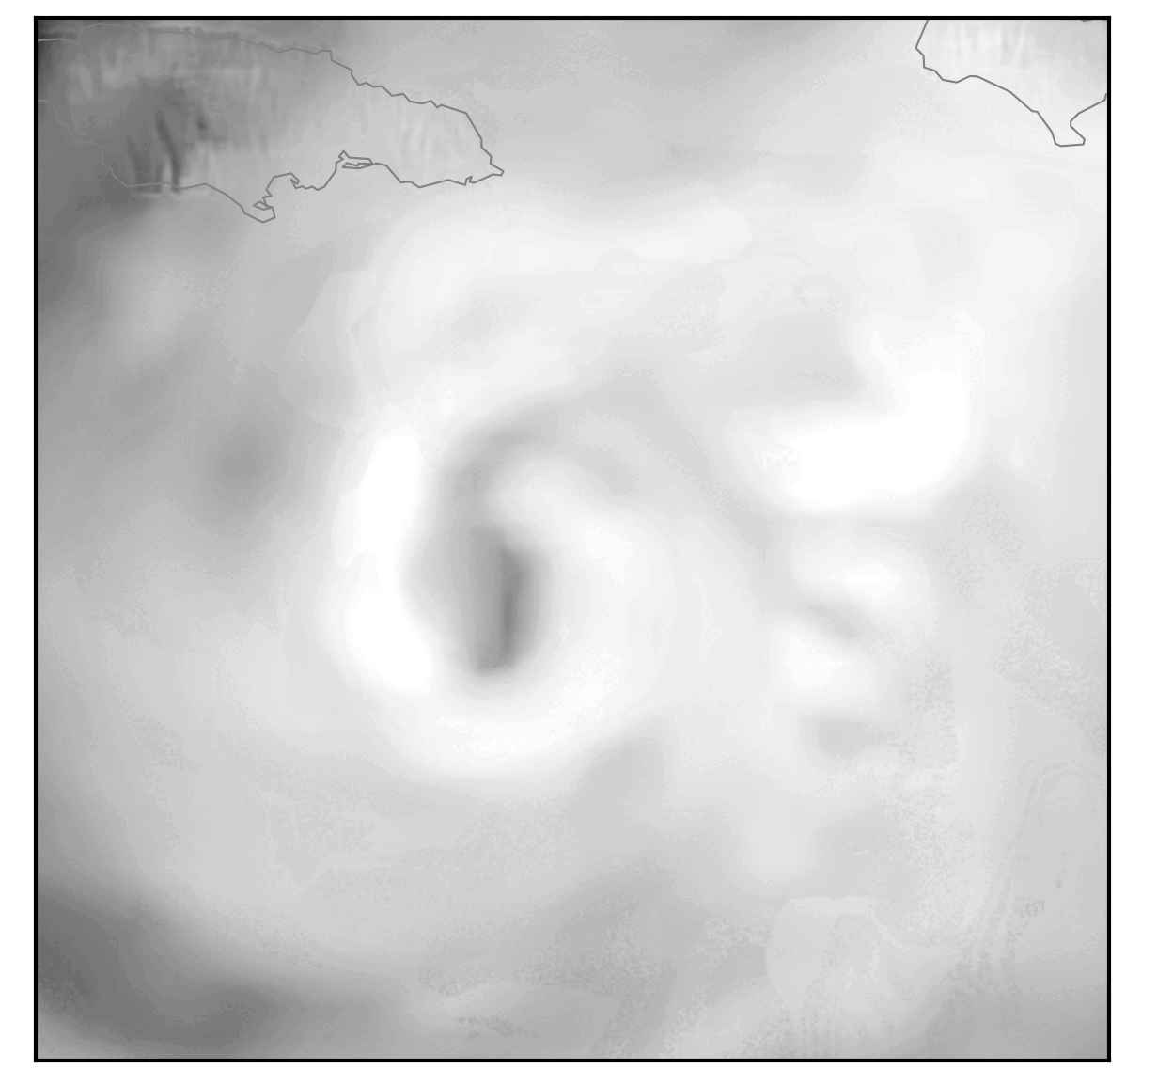
Summary
Static telescoped forecast at sub km scale resolution
Fine-scale details
Stronger max winds
Central pressure comparable
Moving telescoping nest implementation underway

Slide 14
Extra Slides

Slide 15
Efficient High-Resolution Forecasts of Hurricanes through Basin-Scale and Telescoping Nest HAFS
William Ramstrom^{1,2}, Lewis Gramer^{1,2}, Andrew Hazelton^{1,2}, Sundararaman Gopalakrishnan²
1- University of Miami / CIMAS
2- NOAA / AOML / Hurricane Research Division

