Slide 1
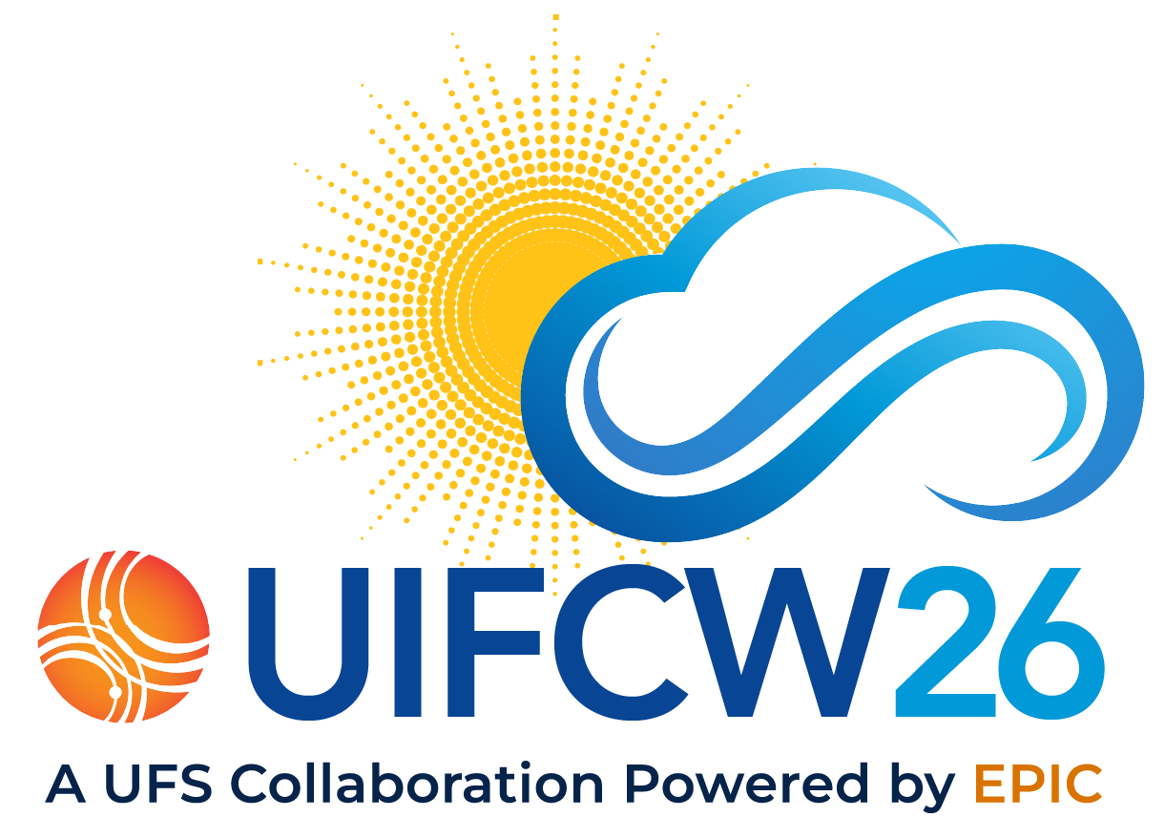
Crossing the Boundaries:
Global Moving Nest Project
Rusty Benson (NOAA/GFDL)
Jesse Lentz (SAIC - Princeton, NJ)
Lucas Harris (NOAA/GFDL)
Joseph Mouallem (CIMES, Princeton University)
Kun Gao (CIMES, Princeton University)
22 July 2026

Slide 2
Why are we doing this?
Existing nesting technology in FV3 (used by NOAA/NWS) has limitations:
Nests must align with parent grid lat-lon indices
Must be contained within a single cubed-sphere tile when running global system

Slide 3
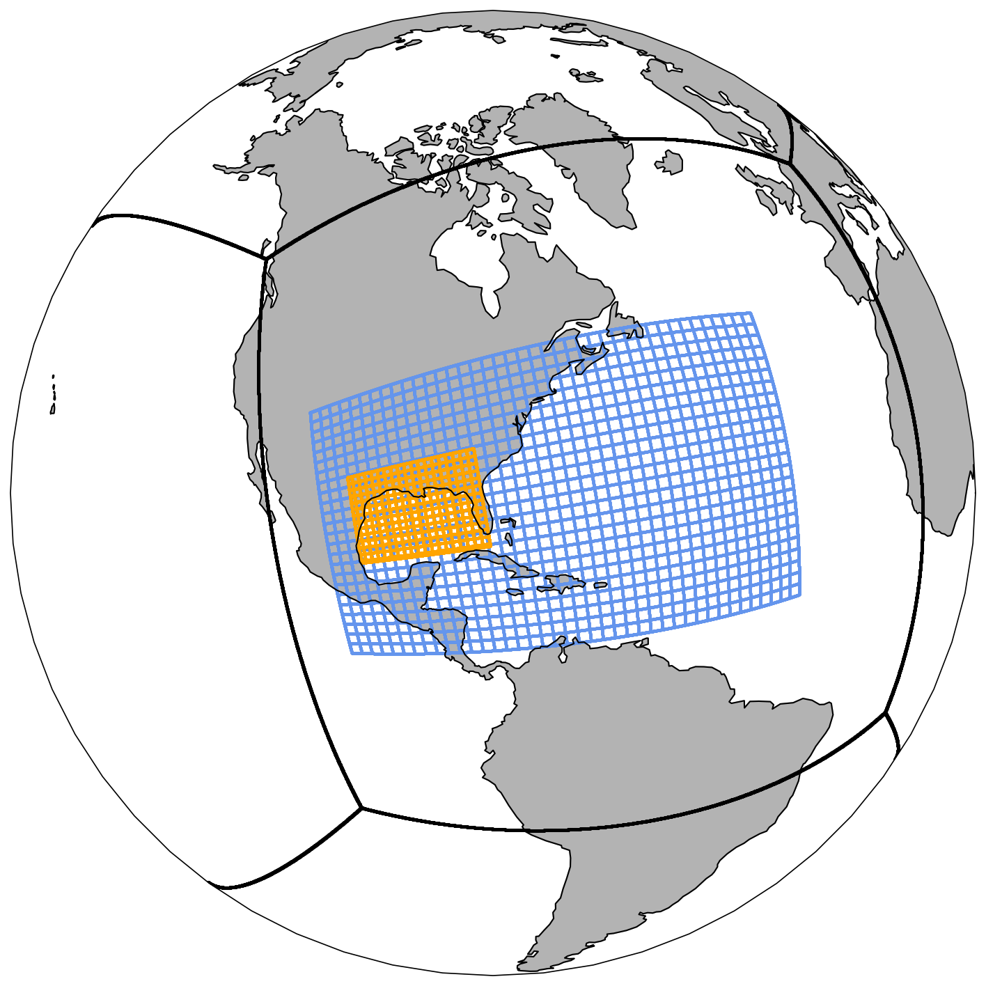
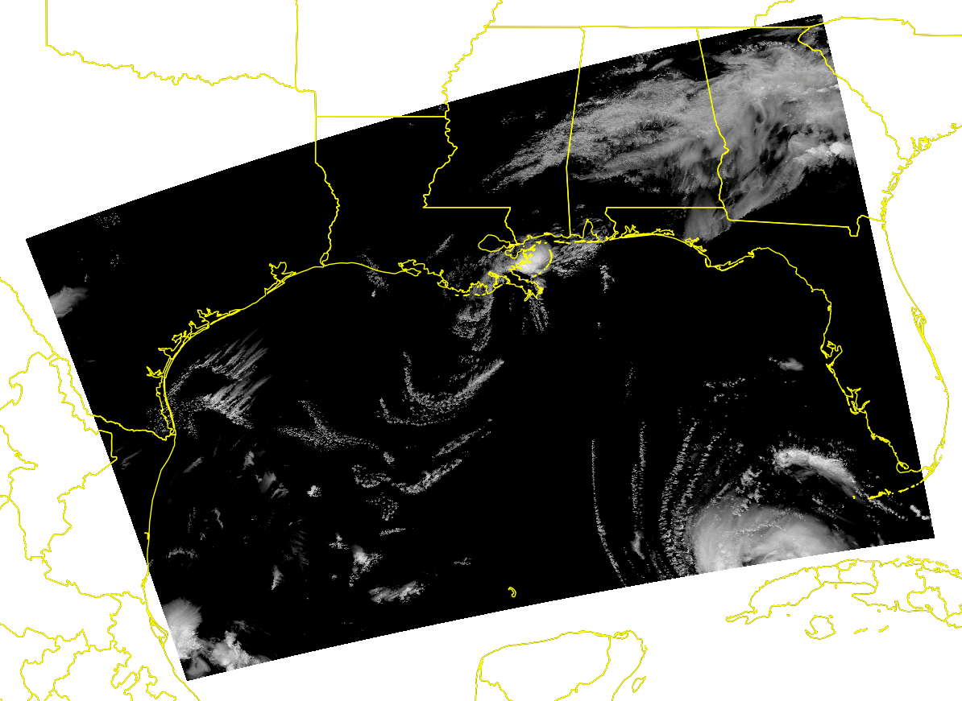
Hurricane Laura (2020)
Global Grid: 13km
Level 1 Nest: 2.6km
Level 2 Nest: ~500m
3-Day forecast initialized on 2020-08-25 00Z
Uses new FV3 3D-TKE scheme
Animation shows the simulated composite
radar reflectivity from 500m nest
Excellent efficiency: 2h walltime with ~12k AMD cores
Courtesy Kun Gao

Slide 4
Why are we doing this?
Existing nesting technology in FV3 (used by NOAA/NWS) has limitations:
Nests must align with parent grid lat-lon indices
Must be contained within a single cubed-sphere tile when running global system
Goal: Remove these limitations to allow nests to span tiles and move freely
Outcome: Tracking of multiple global atmospheric features
Tropical cyclones, atmospheric rivers, mesoscale convective systems, etc
Who Benefits: All existing FV3-based configurations
Hurricane Analysis and Forecast System (HAFS)
Reduce UFS configurations

Slide 5
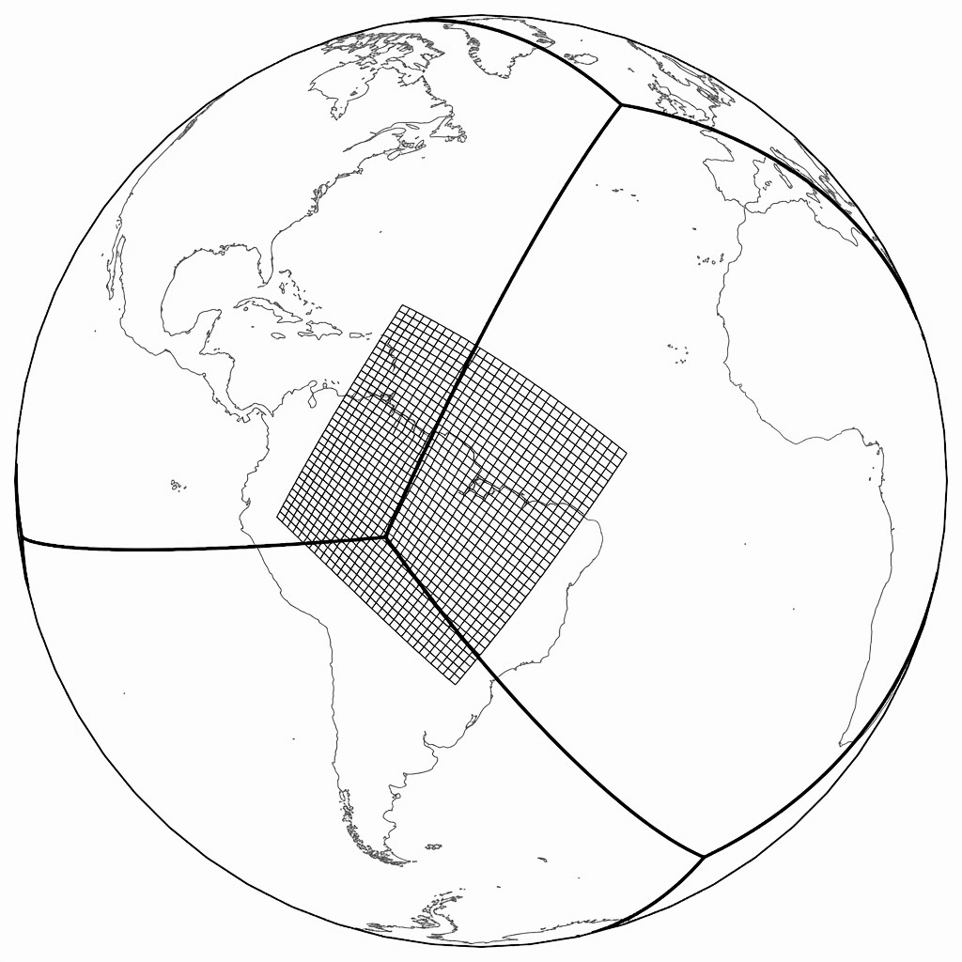
Technical Approaches
Floating Nest
Use a nest that can be arbitrarily oriented with respect to the parent grid
  without co-incident lat-lon indices
Rely on the exchange grid technology for nest
  creation of an initial exchange grid
  on-the-fly updates as the nest moves
Create FMS/FV3 logic for two-way updates via the exchange grid
  parent to nest for boundary conditions
  nest interior to parent for solution features
Image credit: Joseph Mouallem

Slide 6
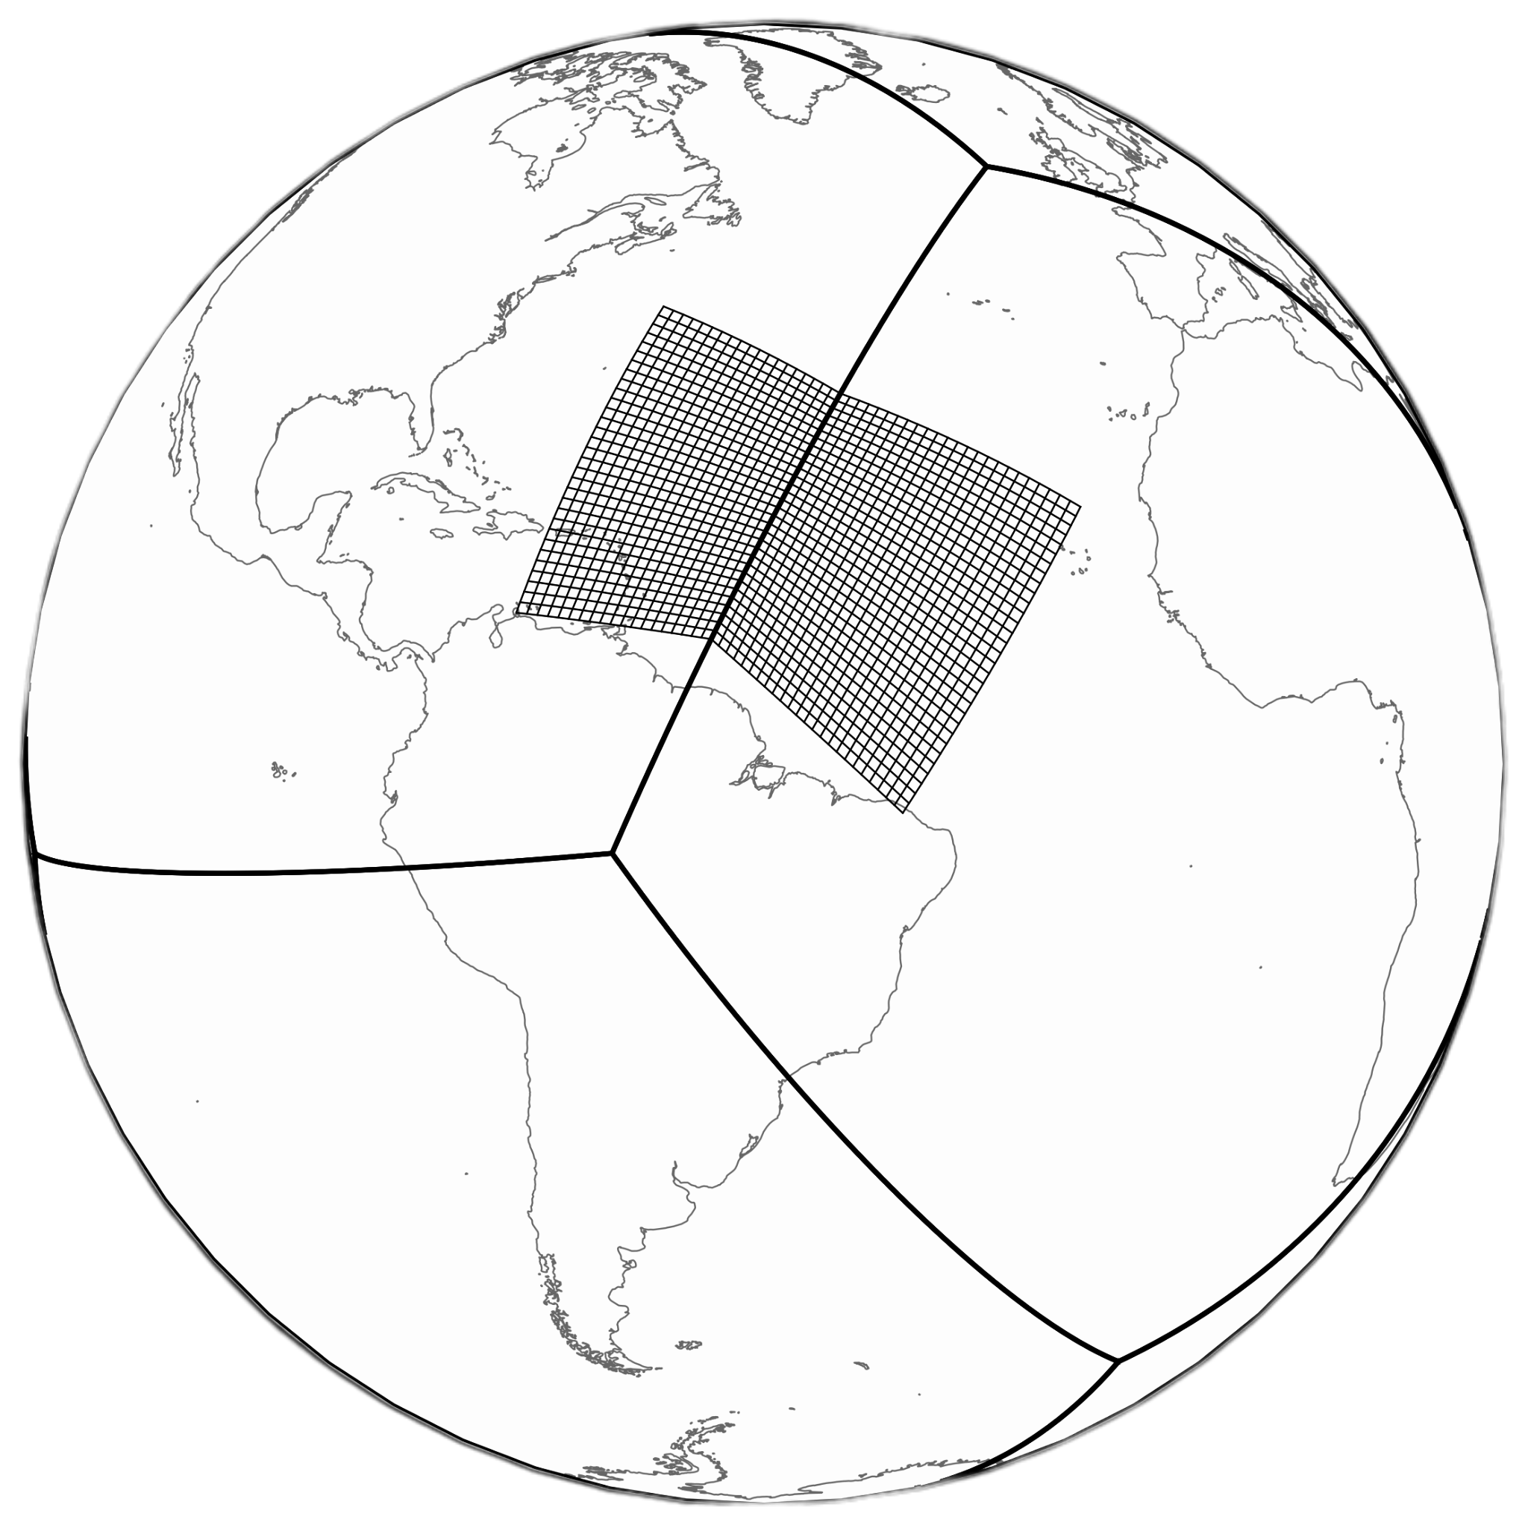
Technical Approaches
Aligned Nest
Single nest patch for the cubed-sphere grid topology spanning parent tiles
Data-only prototype demonstrating FMS capability has existed for years
Changes needed to FV3 logic to fully implement
Image credit: Joseph Mouallem

Slide 7
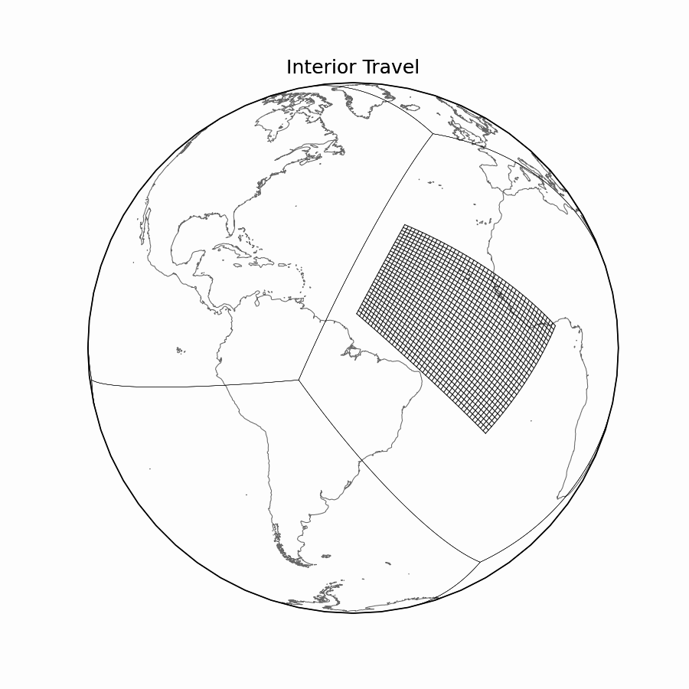
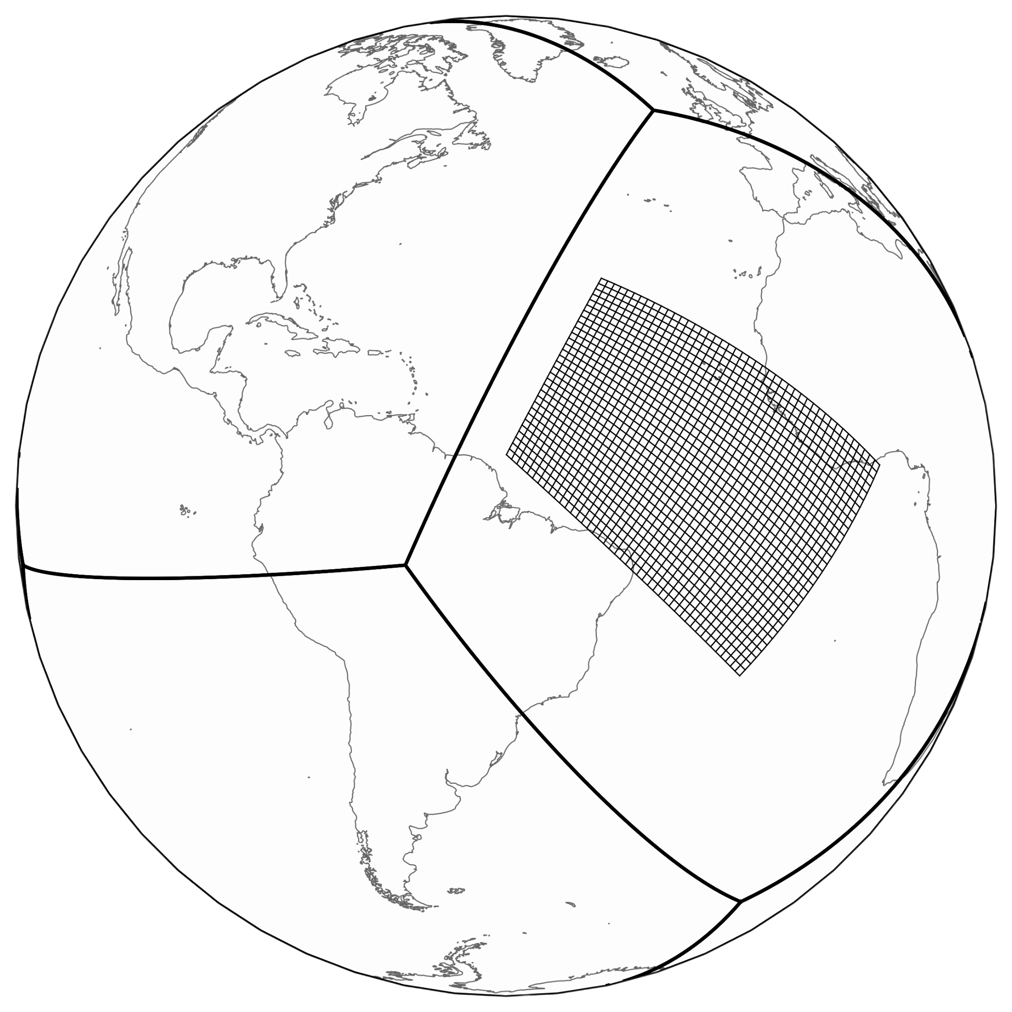
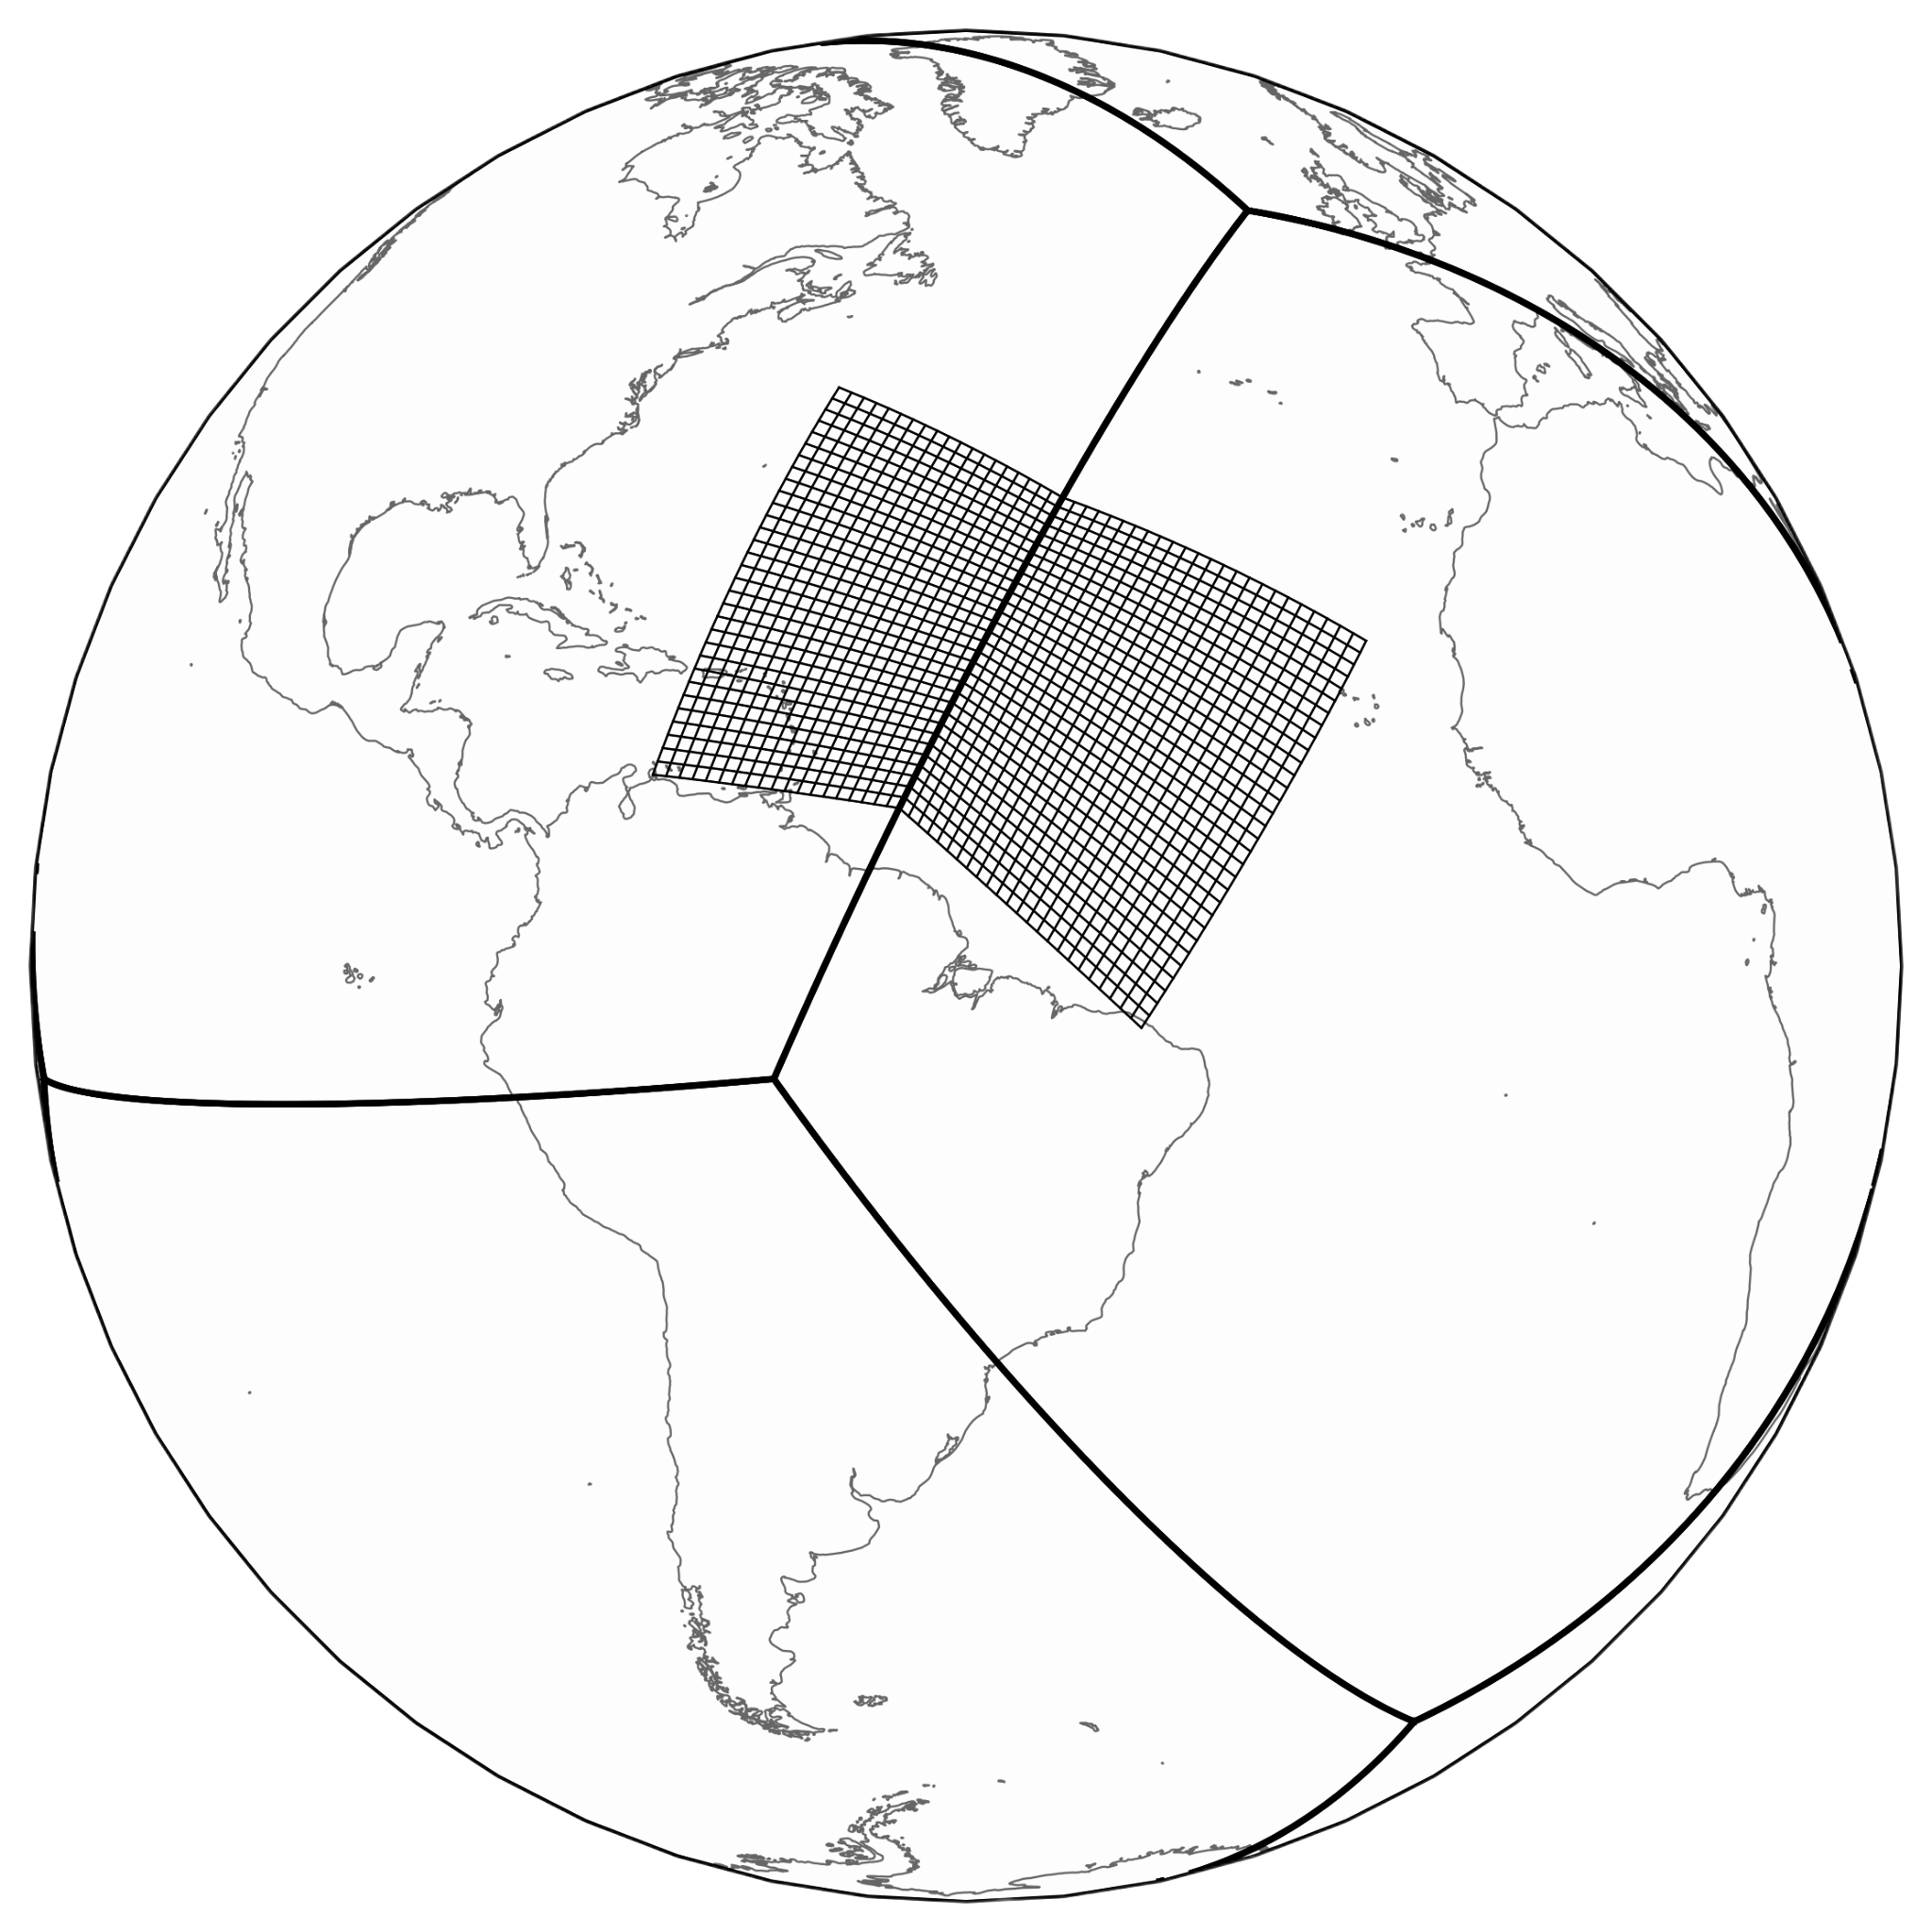
Technical Approaches
Aligned Nest
Single nest patch for the cubed-sphere grid topology spanning parent tiles
Data-only prototype demonstrating FMS capability has existed for years
Changes needed to FV3 logic to fully implement
Image credit: Joseph Mouallem

Slide 8
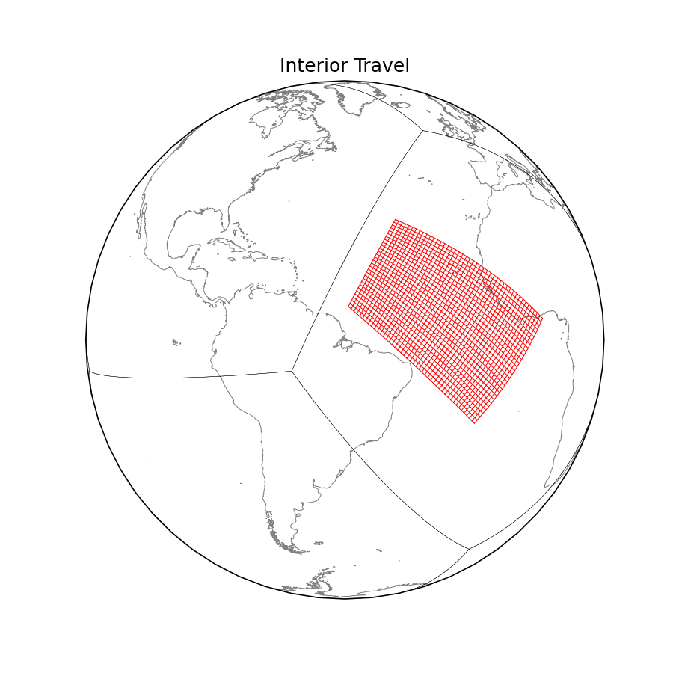
Technical Approaches
Aligned Multiple Tile Mosaic Nest
Allow a nest to span multiple tiles and follow the cubed-sphere grid topology
Capability exists within FMS to treat nest as multi-tile grid patch
Split nest into multiple tiles at an edge
Image credit: Joseph Mouallem

Slide 9
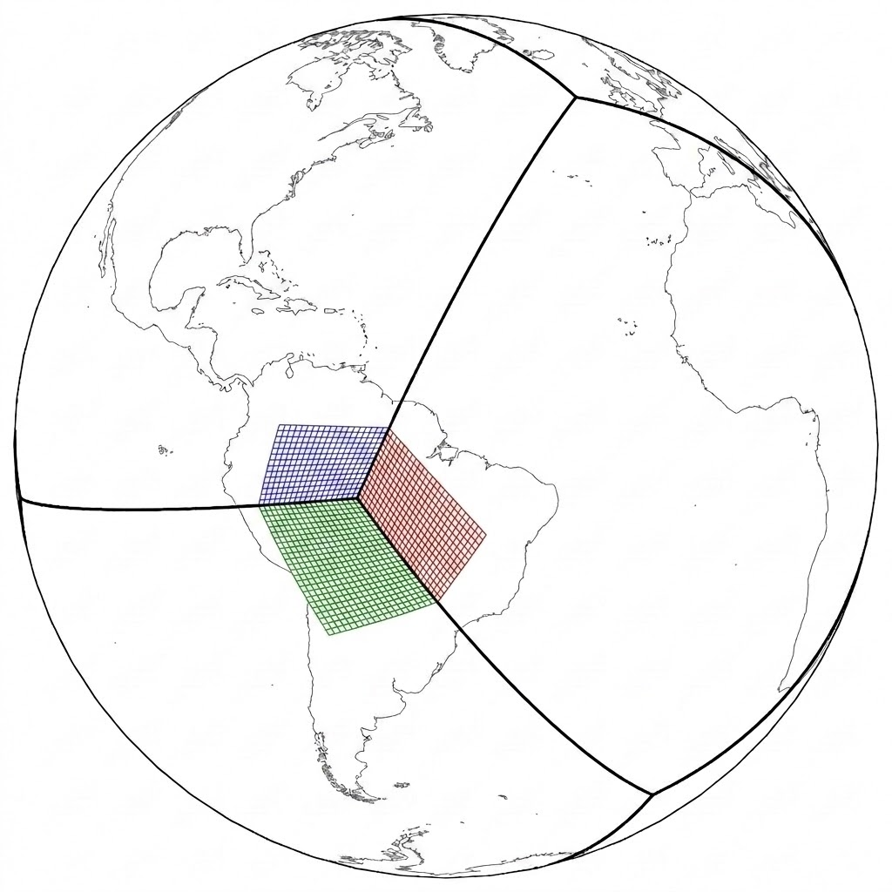
Technical Approaches
Aligned Multiple Tile Mosaic Nest
Allow a nest to span multiple tiles and follow the cubed-sphere grid topology
Capability exists within FMS to treat nest as multi-tile grid patch
Split nest into multiple tiles at an edge and at corner
Three Tile Nest Mosaic
Image credit: Joseph Mouallem

Slide 10
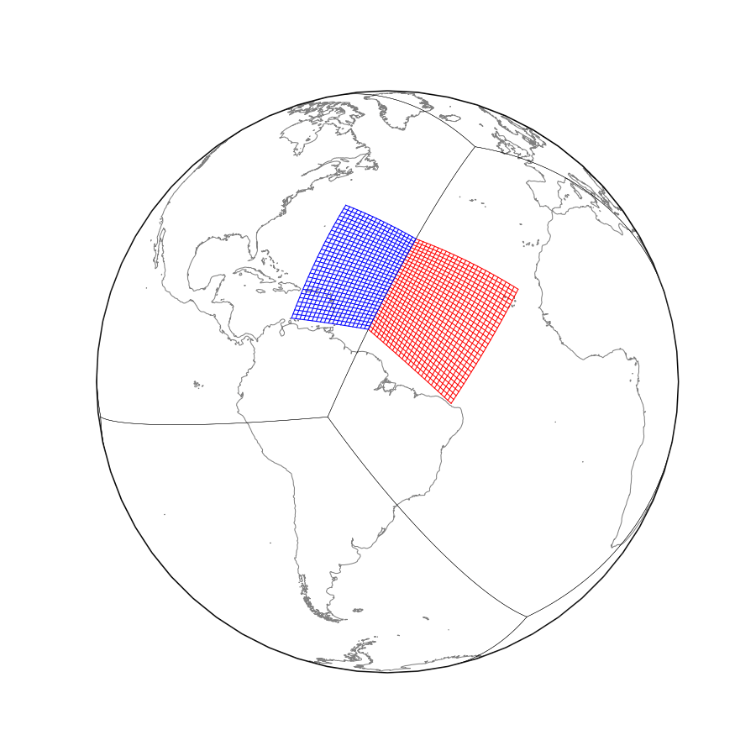
Current Prototype Status
Multiple-tile nest domain halo updates
Scalar variable update
C- & D-Grid vector quantity update
Re-allocate single tile → two-tile → three-tile and back using same compute resources
Two-way updates for multi-tile nest on a global cubed-sphere parent working - mostly
fine-to-coarse interior update works
coarse-to-fine update for nest boundary conditions
  some corner problems requiring extension of existing logic
Image credit: Joseph Mouallem

Slide 11
Next Steps For The Project
Extend logic within FMS to properly handle coarse-to-fine boundary corners for multi-tile nests
Working with AOML to understand logic triggering nest movement in HAFS
Heuristic algorithm for re-allocating nest compute resources as nests are modified
Implement static aligned multi-tile nest prototype within FV3-based SHiELD model
Nests moving throughout the global domain without restrictions

Slide 12
Acknowledgements
This work is supported by EPIC/WPO funding
Thanks are extended to both NCEP/EMC and AOML

