Slide 1
UFS-Coastal: Engineering the Enterprise Backbone for NOS’s Next-Generation Coastal Earth System Model and Operational Applications
Saeed Moghimi (NOAA/NOS/OCS), Maoyi Huang (NOAA/OAR/WPO/EPIC), Ufuk Turuncoglu (UCAR/NCAR), Yunfang Sun (NOAA/NOS/OCS), Mansur Jisan (NOAA/NOS/CO-OPS), Felicio Cassalho (NOAA/NOS/OCS), Alexander Kurapov (NOAA/NOS/OCS), Soroosh Mani (NOAA/NOS/OCS), Fariborz Daneshvar (NOAA/NOS/OCS), Liujuan Tang (NOAA/NOS/OCS), Ed Myers (NOAA/NOS/OCS), Ann Tsay (UCAR/NCAR), Greg Seroka (NOAA/NOS/OCS), Ayumi Fujisaki-Manome (CIGLR), Lucila J. Houttuijn Bloemendaal (NOAA/NOS/IOOS), Ali Abdolali (USACE/ERDC/CHL), Carsten Lemmen (Hereon), Joseph Zhang (VIMS), Damrongsak Wirasaet (UND), Joannes Westerink (UND), Hernan G. Arango (Rutgers), Scott Durski (OSU), Jihun Jung (OSU), Joseph Smith (OSU), Kristopher Booker (NOAA/OAR/WPO/EPIC, Tomorrow.io), Todd Arbetter (NOAA/OAR/WPO/EPIC,I2X), Aijun Zhang (NOAA/NOS/CO-OPS), Shachak Peeri (NOAA/NOS/NGS), Corey Allen (NOAA/NOS/OCS), Patrick Burke (NOAA/NOS/CO-OPS), Stephan Smith (NOAA/NOS)

Slide 2




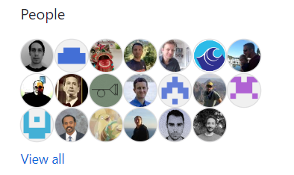
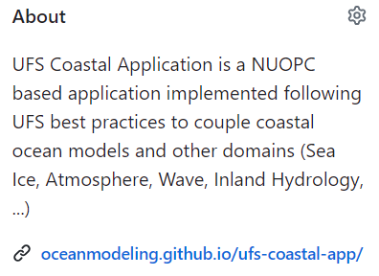
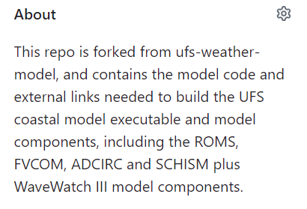
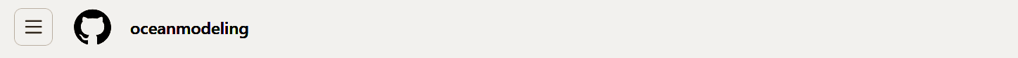
Community-owned collaborative environment
https://github.com/oceanmodeling
UIFCW25
UIFCW26
‹#›

Slide 3
UFS-Coastal: From Code to Operations
UFS-Coastal Model (code base)
UFS-Coastal Applications:
  SECOFS: DATM+SCHISM+WW3
  STOFS-3D-Alaska: DATM+SCHISM+CICE+WW3
Operational workflow:
  NOS Unified workflow project
  CI/CD pipeline to support R2O
SECOFS: Southeast Coastal Operational Forecast System
STOFS: Surge & Tide Operational Forecast System

Slide 4
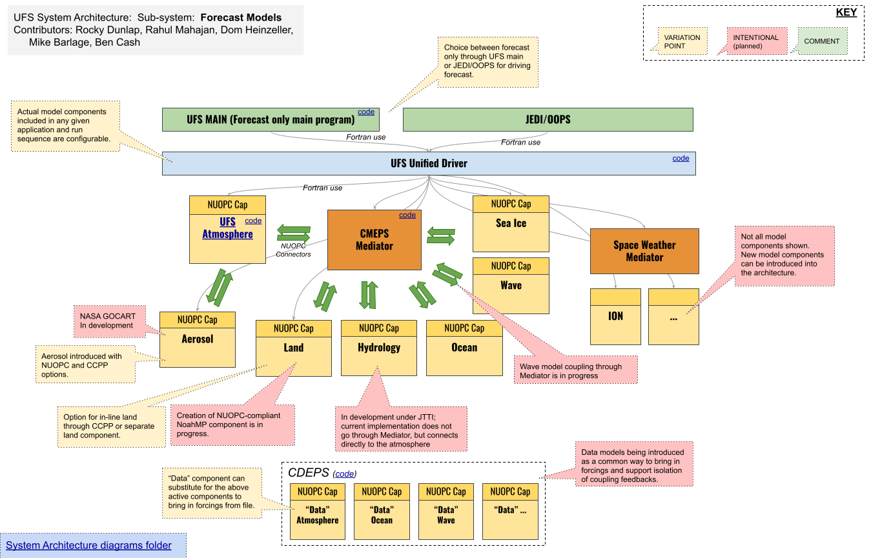

UFS Weather Model (Fork) => UFS Coastal Model
Additional
Components:
Ocean:
SCHISM
ADCIRC
ROMS
FVCOM
Atmosphere:
PaHM
Turuncoglu et al

Slide 5
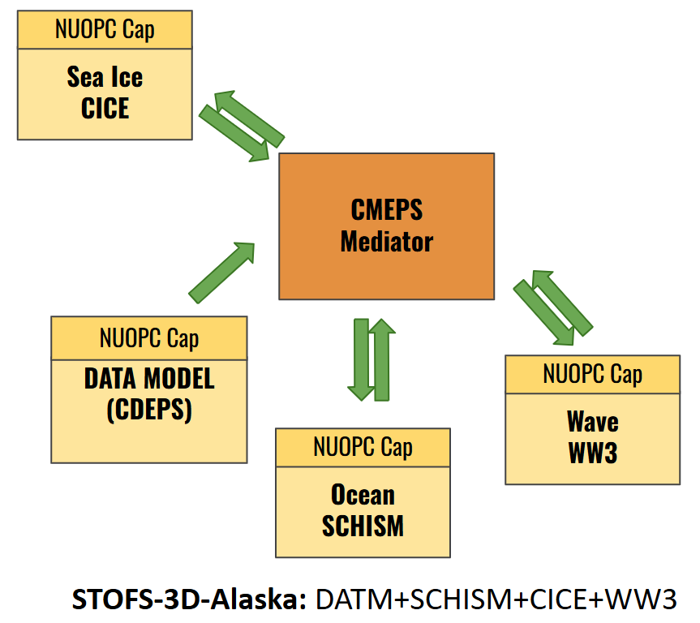
Advances in UFS-Coastal Model
EPIC CI/CD Pipeline: Achieved significant progress in pipeline utilization.
Co-processing Development: Continuing work on the co-processing component, with a specific focus on S-100 navigation support file formats.
Model Implementation: Successfully implemented WW3 and CICE, including targeted enhancements to their respective model component caps.
Data Integration: Executed the initial implementation of the NWM data component via CDEPS.
Community Support: Maintaining ongoing technical assistance through:
  Regular troubleshooting.
  Modifying existing Regression Tests (RTs) to establish new configurations.
First official UFS-Coastal code base manuscript submitted and is in review
Partners: OCS, NCAR, CO-OPS, EPIC, EMC, Academic partners, …
Notes:
This slide highlights the significant advances we are making in the UFS-Coastal model. We are seeing real momentum across our core development.
Our key ocean model components are now undergoing continuous, automated testing through the EPIC CI/CD pipeline. On the innovation front, we've successfully developed a new co-processing tool called GeoGate, which is being utilized to create mission-critical data in navigation-ready formats.
These advances allow us to build and successfully test complex, coupled systems, like the new configuration we are using for the Bering Sea. This progress is a direct result of our strong community-based approach, which is central to the project's success.

Slide 6
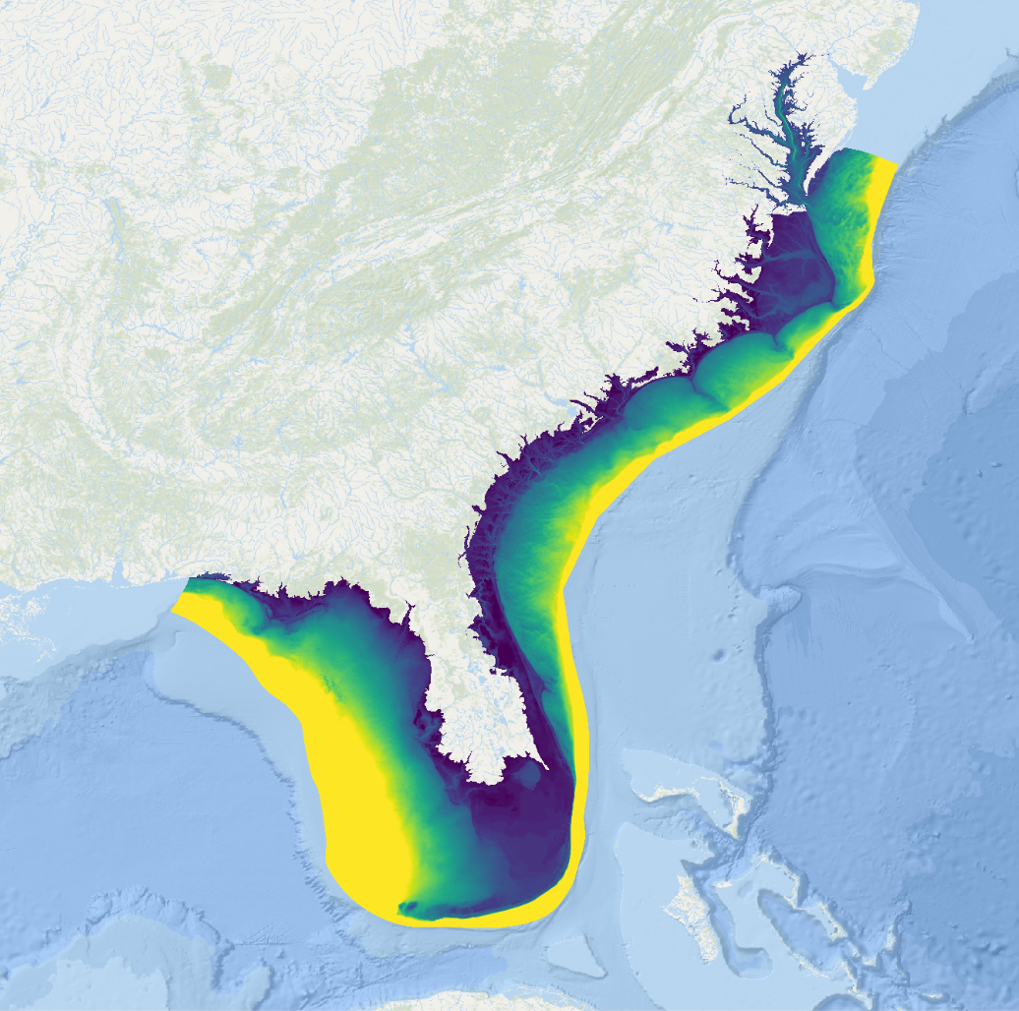
SECOFS: DATM+SCHISM+WW3
CMEPS
Mediator
NUOPC Cap
DATA MODEL (CDEPS)
NUOPC Cap
Wave
WW3
NUOPC Cap
Ocean SCHISM
Southeast Coastal Operational Forecast System (SECOFS)
‹#›

Slide 7

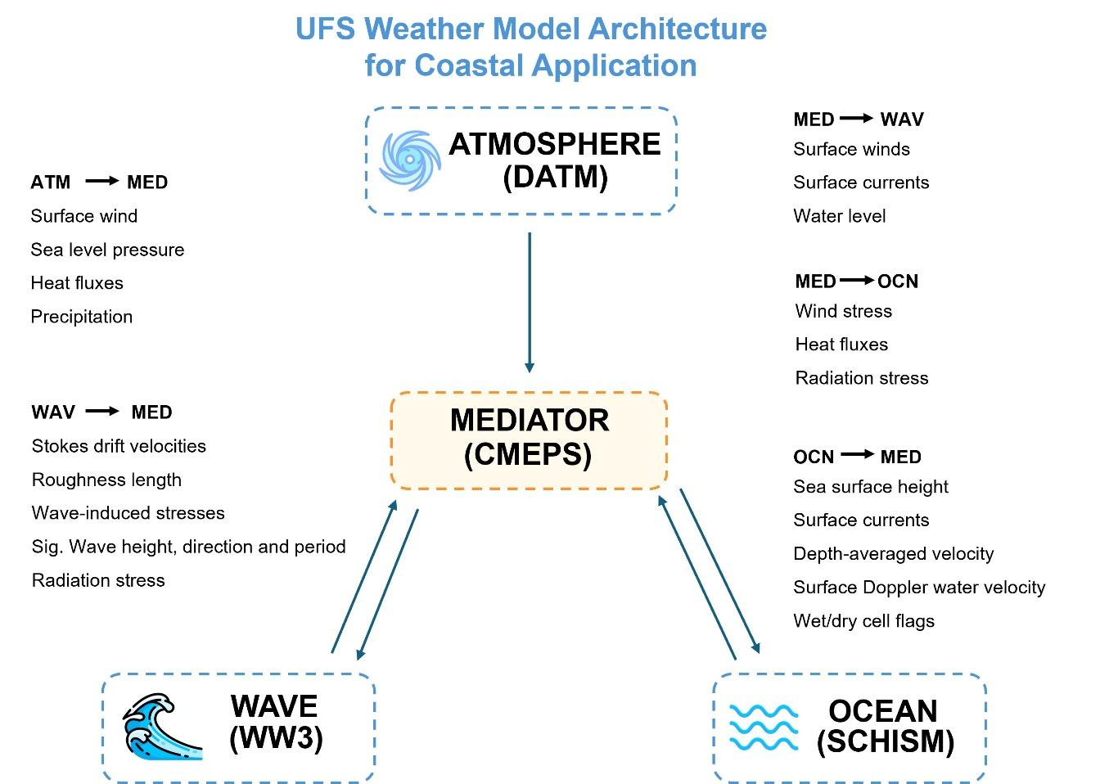
SCHISM-WW3 coupling
Case | Components | Details
#1 | ATM+WW3 | Without water level forcing
#2 | ATM+OCN+WW3 | With water level forcing
#3 | ATM+SCH | 2D
#4 | ATM+SCH | 3D
#5 | ATM+SCH+WW3 | Longuet-Higgins Radiation Coupling
#6 | ATM+SCH+WW3 | 3D Vortex Coupling
Duck, NC test case
See Yunfag Sun's presentation
Y. Sun et al

Slide 8
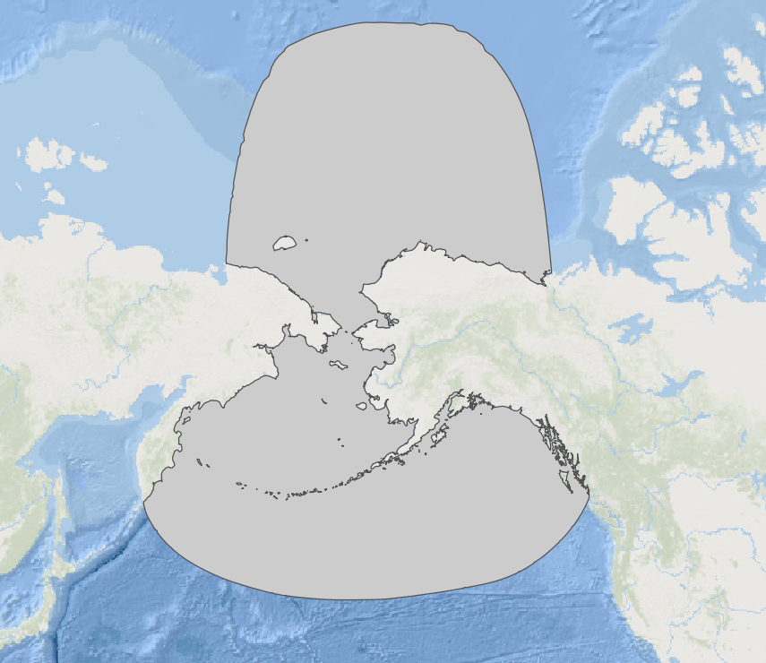
STOFS-3D-Alaska
NUOPC Cap
Sea Ice
CICE
CMEPS
Mediator
NUOPC Cap
DATA MODEL (CDEPS)
NUOPC Cap
Wave
WW3
NUOPC Cap
Ocean SCHISM
Surge & Tide Operational Forecast System (STOFS)
STOFS-3D-Alaska: DATM+SCHISM+CICE+WW3
See Scott Durski's presentation
‹#›

Slide 9
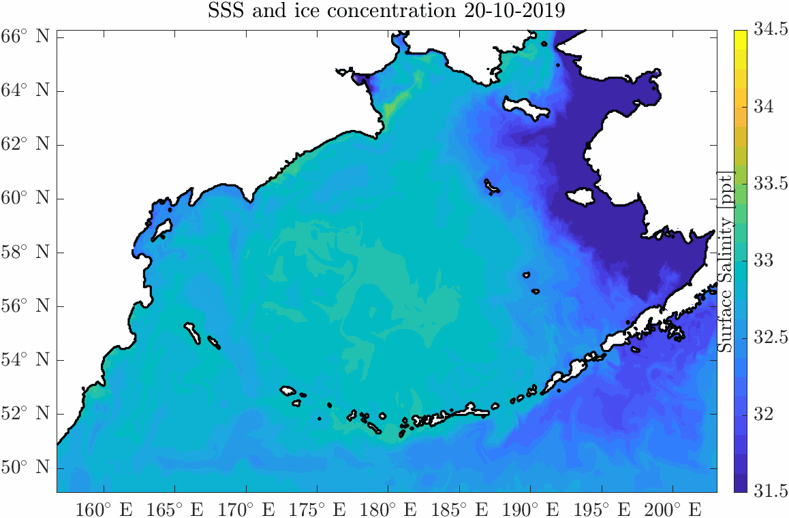
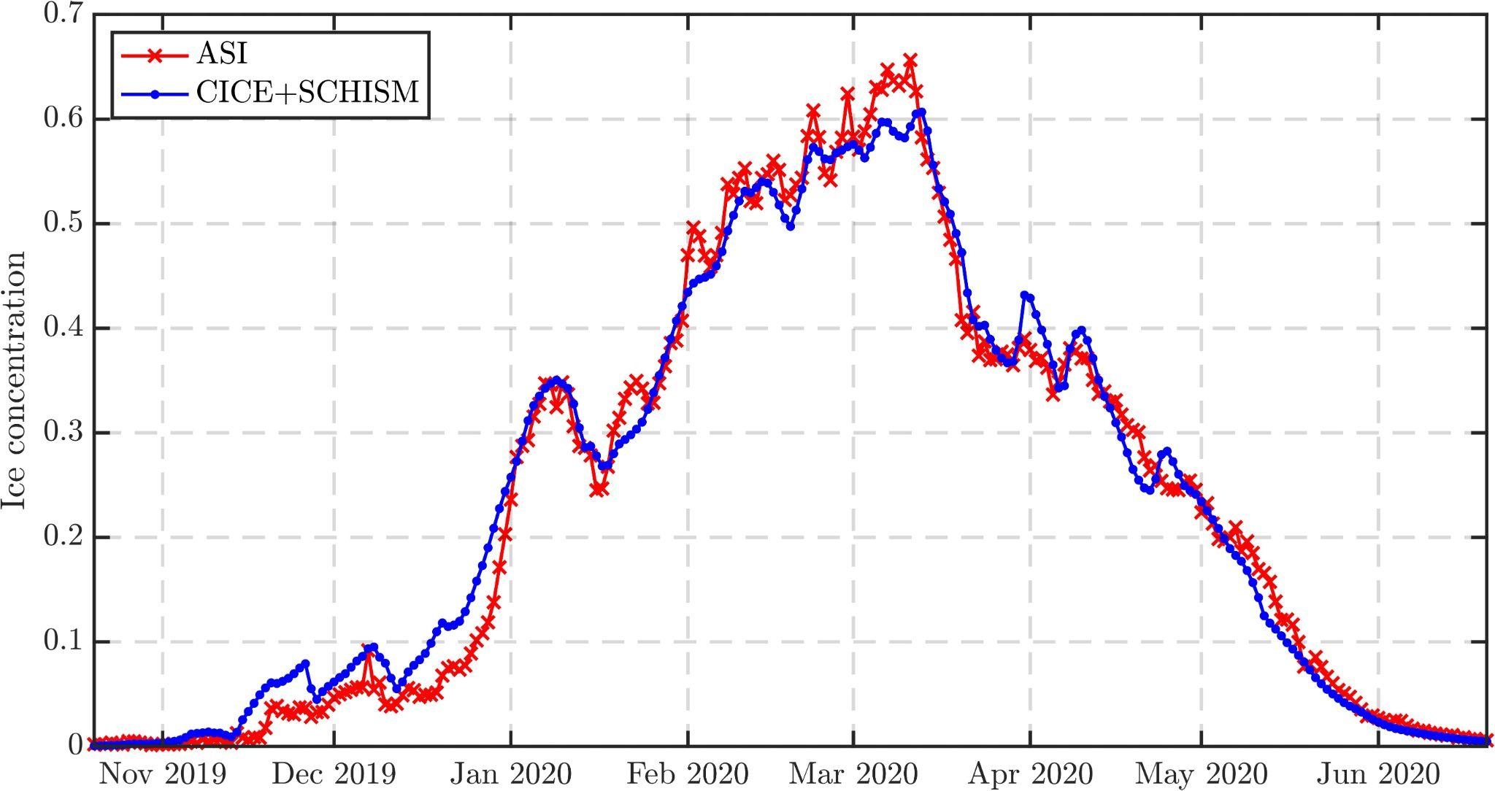
STOFS-3D-Alaska
We have successfully implemented and validated the DATM+SCHISM+CICE (see Scott’s presentation) and DATM+SCHISM+WW3 (see Yungang’s presentation) configurations. Our next objective is to initiate the implementation and testing of the fully integrated DATM+SCHISM+CICE+WW3 system.
See Scott Durski's presentation
Shelf averaged ice fraction (satellite obs., model)
STOFS-3D-Alaska UFS application
Partners: OCS, OSU, NCAR and VIMS
‹#›
Notes:
What it shows: Alaska's Bering Sea and coastal regions
Colors = surface salinity, white = sea ice coverage (the whiter the thicker the ice).
Fresher (bluer) water hugs the coast where ice melts, saltier water sits offshore.
Sea ice and salinity are tightly linked as ice formation and melt directly reshape ocean saltiness (ice formation release salt and ice melt release freshwater).
Ice peaks in Feb–Mar and melts out by June, matching the natural yearly cycle.
Why it matters: Our UFS coupled application closely matches satellite data, proving we can reliably forecast Alaskan coastal conditions.

Slide 10
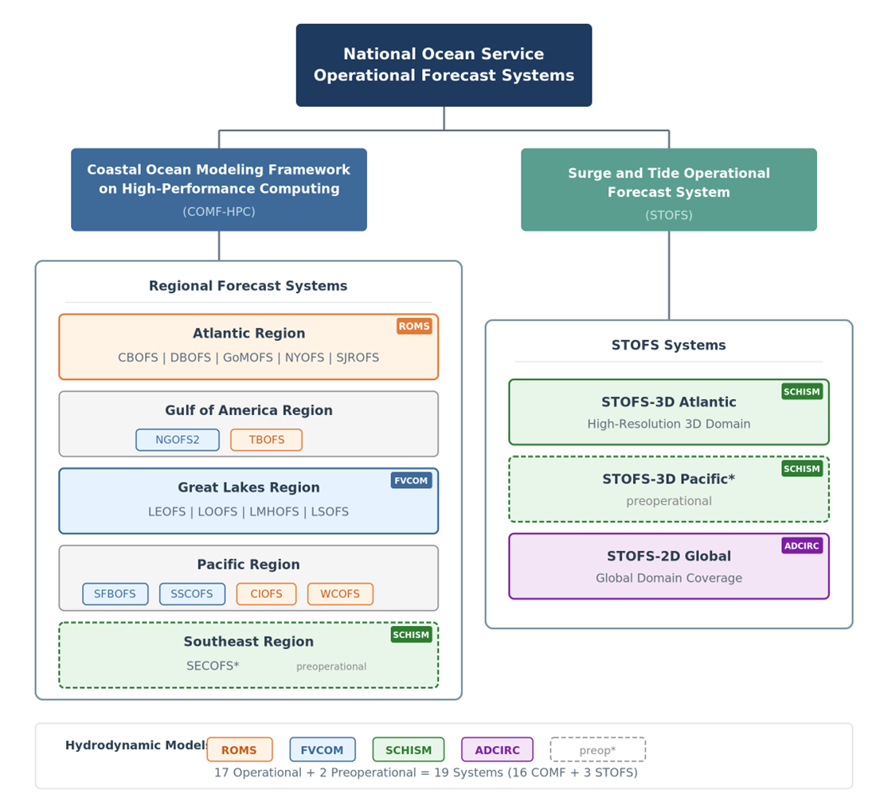
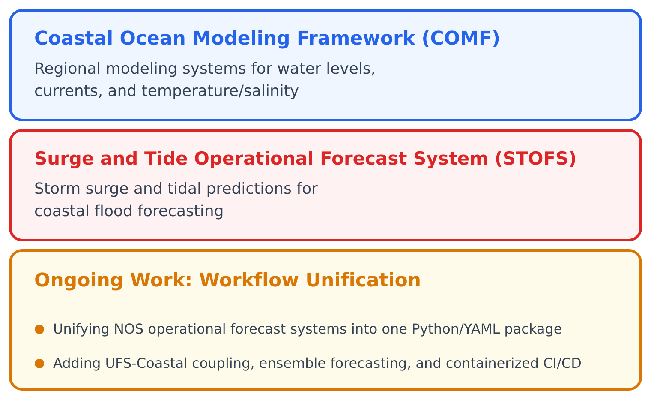
NOS Operational Forecast Systems
NOS operates a suite of operational forecast systems to support:
Coastal resilience
Emergency management
Navigation safety.
See Mansur Jisan's poster

Slide 11
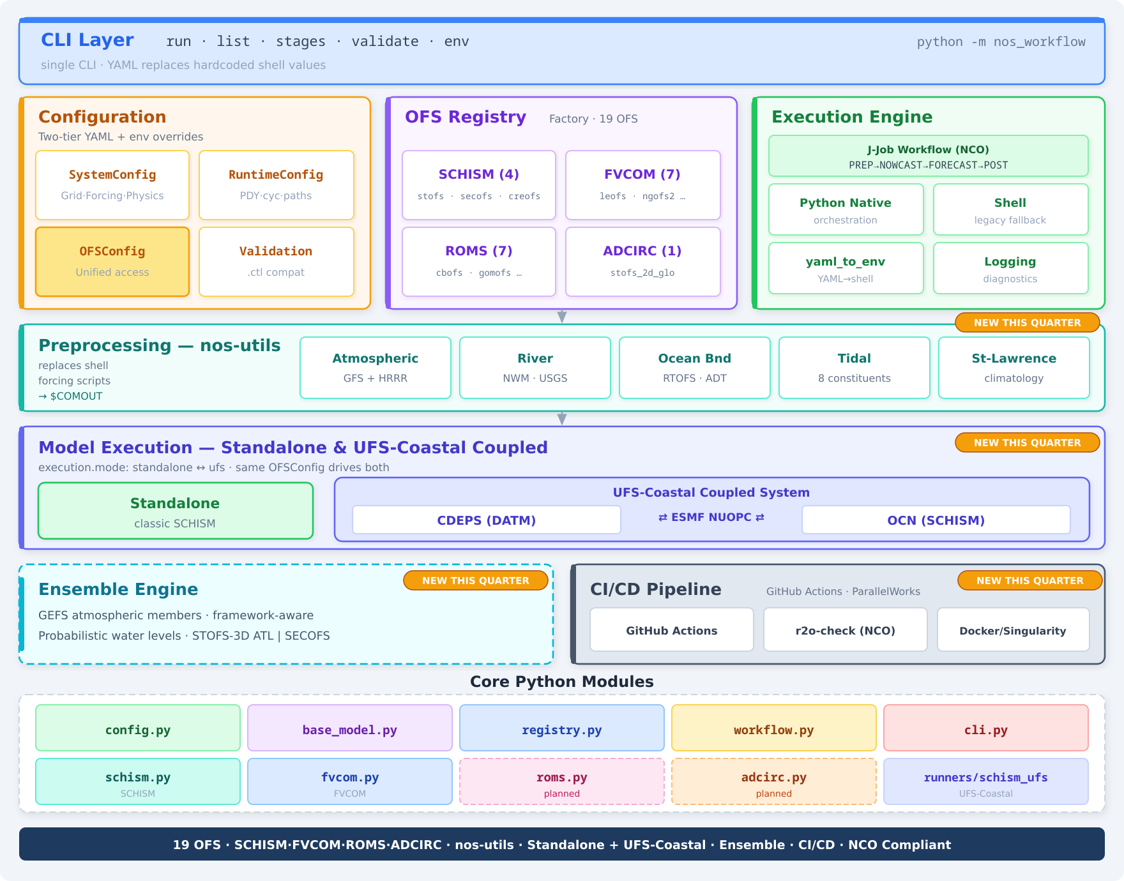

NOS Unified Workflow — Package Architecture
Single CLI for 19 OFS
nos_workflow drives prep, nowcast, forecast and post for every SCHISM, FVCOM, ROMS and ADCIRC system.
YAML over hardcoded values
An OFSRegistry factory auto-selects the model; per-system YAML configs replace scattered shell constants.
Standalone ↔ UFS-Coastal
One execution.mode switch runs standalone SCHISM or UFS based DATM and OCN coupled system.
See Mansur Jisan's poster

Slide 12
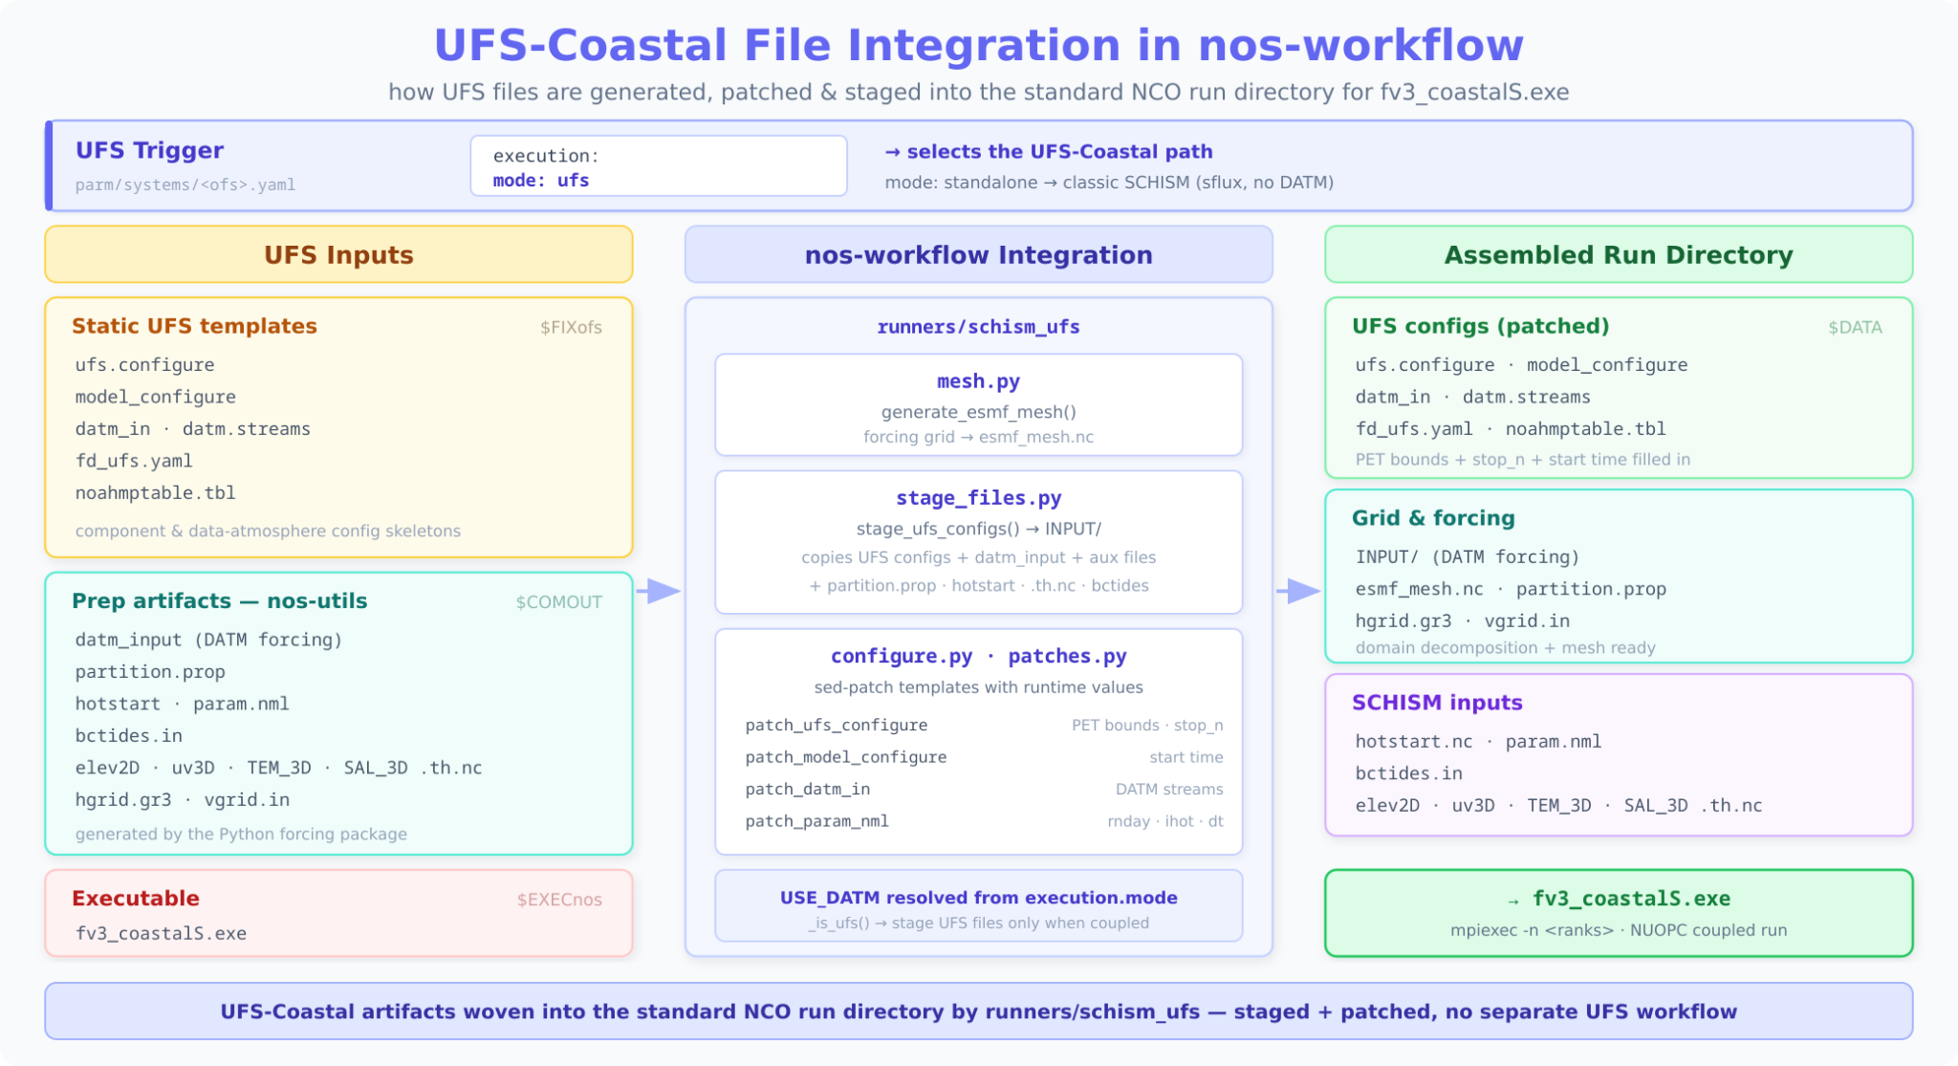
UFS-Coastal Integration to NOS-Workflow
See Mansur Jisan's poster

Slide 13
Outlook
Need to address the significant risk of a funding cliff, which threatens the retention of a talented and experienced team that would be difficult to replace.
Initiate operational prototype configurations for SECOFS and STOFS-3D-Alaska per NCEP/NCO standards using the NOS-Workflow and UFS-Coastal executable.
Implement operational CI/CD integration using the Jenkins-based EPIC pipeline on Hercules, including cross-platform validation and expanded regression testing.
Continue implementation and testing of the co-processing unit to facilitate data delivery from active coupled applications.
Perform ongoing model upgrades adjustments, enhancements, and community support, including the update of documentation for user adoption and deployment.

Slide 14

Thanks for your attention

