Slide 1



Developing Two-Way Hydrologic–Hydrodynamic Coupling for Coastal Backwater-Affected and Compound Flood Prediction
Yi Hong, Joseph Zhang, Jason Ducker, David Canon, Dan Titze, Jesse Feyen

Slide 2
Compound flooding & Backwater Effect
Storm rainfall
Fast runoff raises tributary flow
River - Lake/Ocean interface
Local water level reflects both upstream discharge and downstream boundary forcing
Watershed flow
Lake level
Upstream discharge pushes water toward the outlet
Elevated lake water pushes back into low-gradient reaches
Compound flood risk increases when these drivers overlap in time
Understanding the backwater effect is essential for accurately predicting compound flooding

Slide 3
Background
Compound flooding in Great Lakes tributaries results from interactions between river discharge and lake water levels.
Coastal backwater alters river hydraulics and increases upstream flood risk.
Existing forecasting systems typically neglect downstream hydraulic feedbacks.
Two-way hydrologic–hydrodynamic coupling is needed to improve coastal flood prediction.

Slide 4
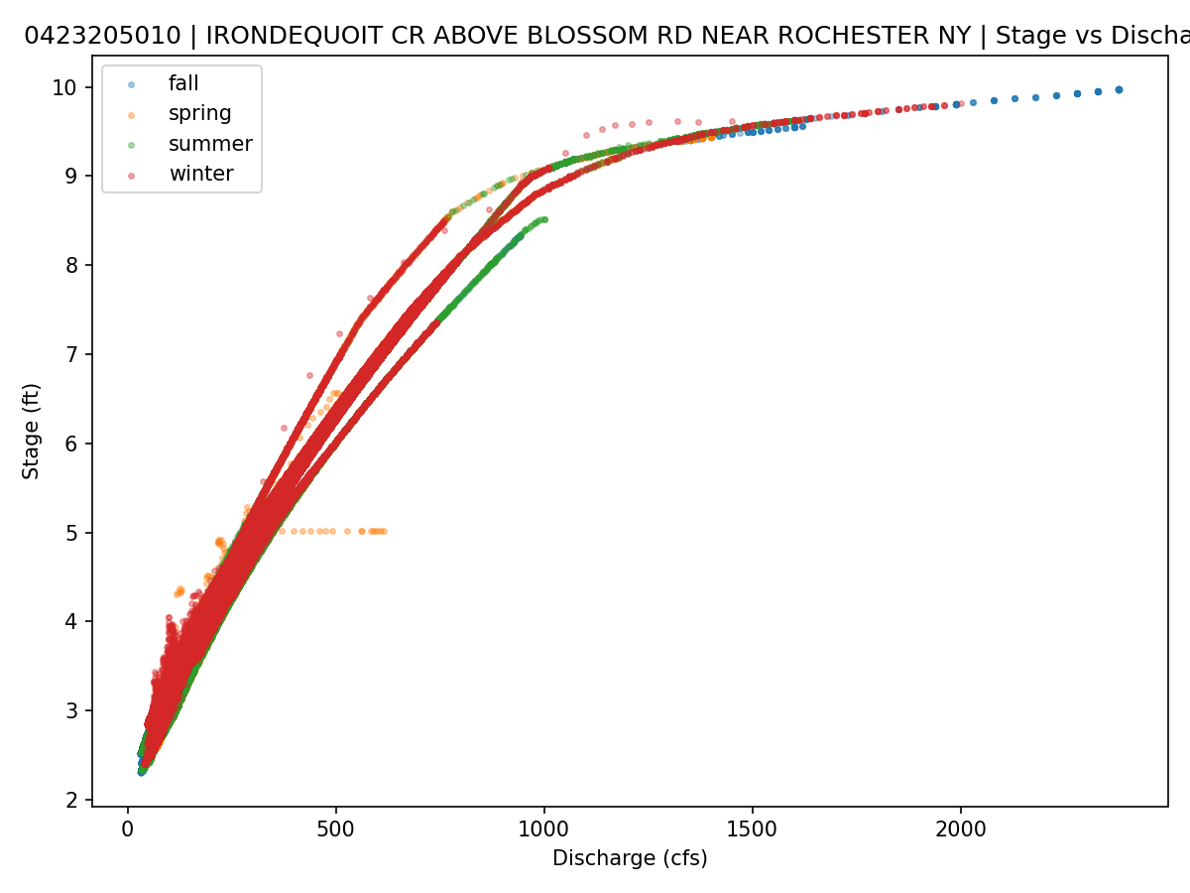
Backwater effect
Backwater occurs when downstream water levels control upstream river stage, reducing the hydraulic gradient and altering the normal stage–discharge relationship.
Daily data may not be sufficient, USGS has 15-minutes data
Typical drivers in Great Lakes tributaries: Elevated Lake levels; Wind and seiches; Low river slope near the river mouth.

Slide 5
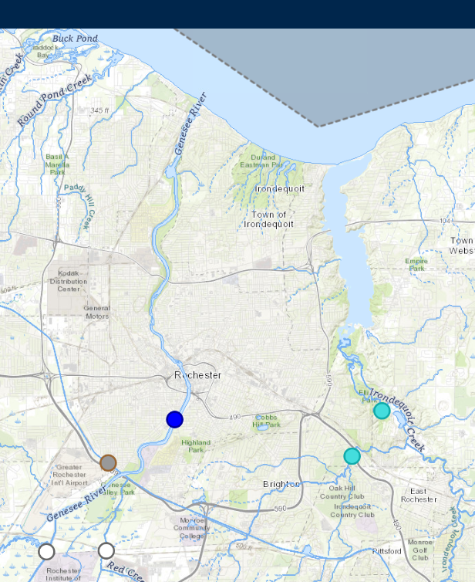
Study Domain & Backwater Event Selection
Three approaches for event selection:
Scatter plot for visual identification.
Timeseries anomalies where water level change strongly without flow change (or reversed).
Upstream-downstream water-surface slope collapse analysis.

Slide 6
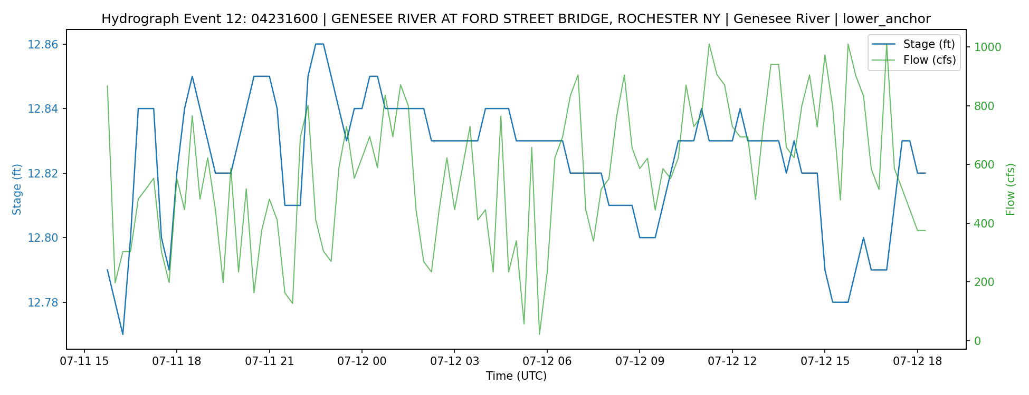
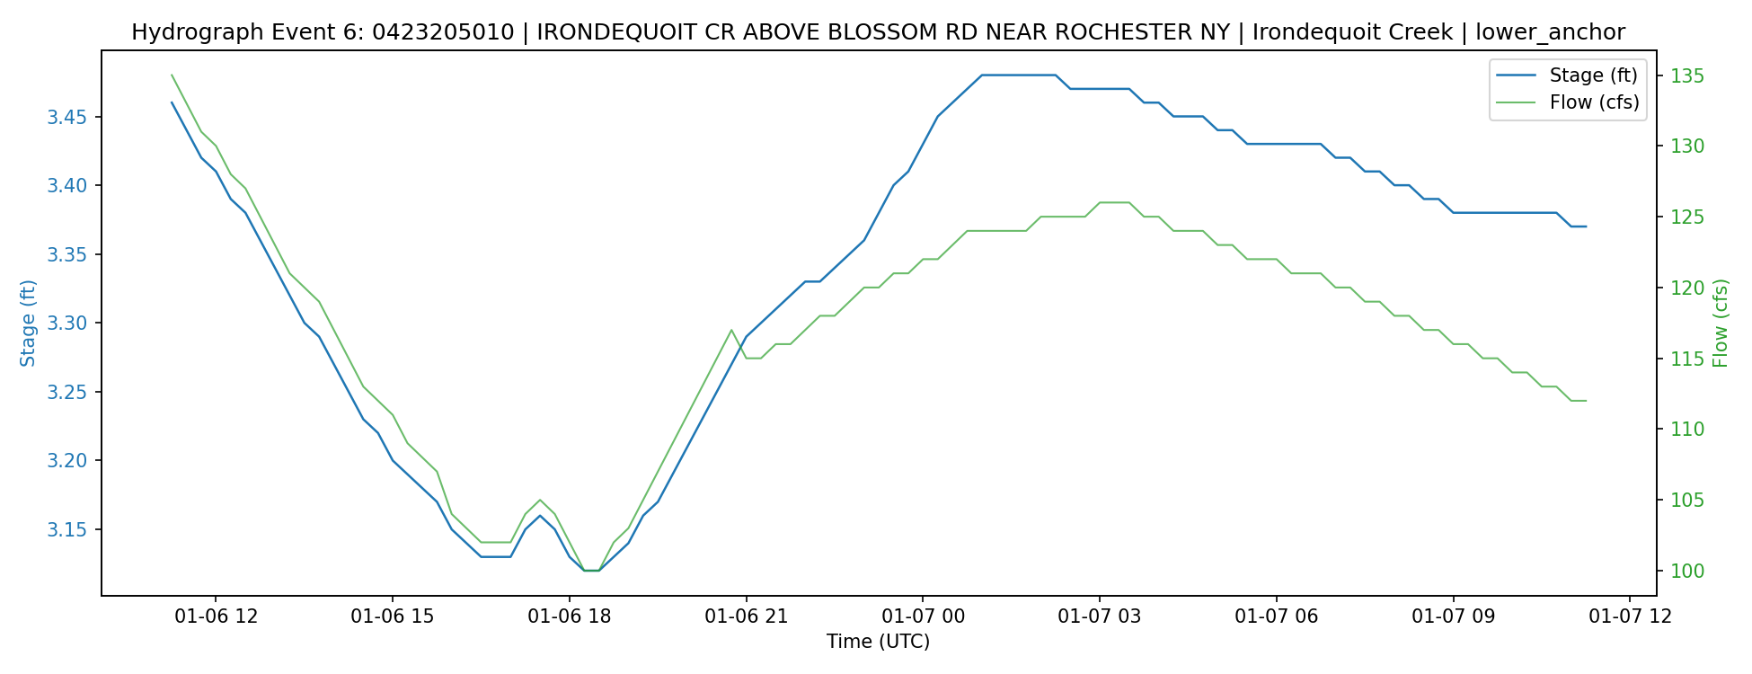
Selected backwater events

Slide 7
Modeling: T-Route & SCHISM Coupling
NWM V3 streamflows
Streamflow simulations
NextGen / T-Route
SCHISM
Coastal boundary information
Hydrofabric static information

Slide 8
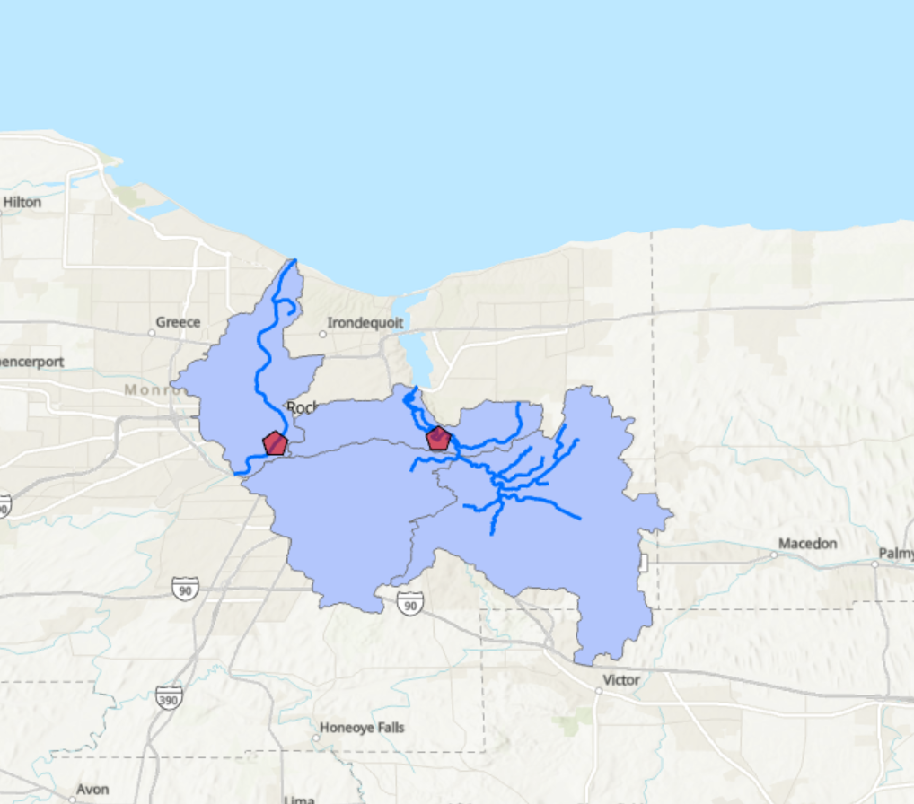
T-Route Configuration
NWM Streamflows
Coastal Boundary Water Level

Slide 9
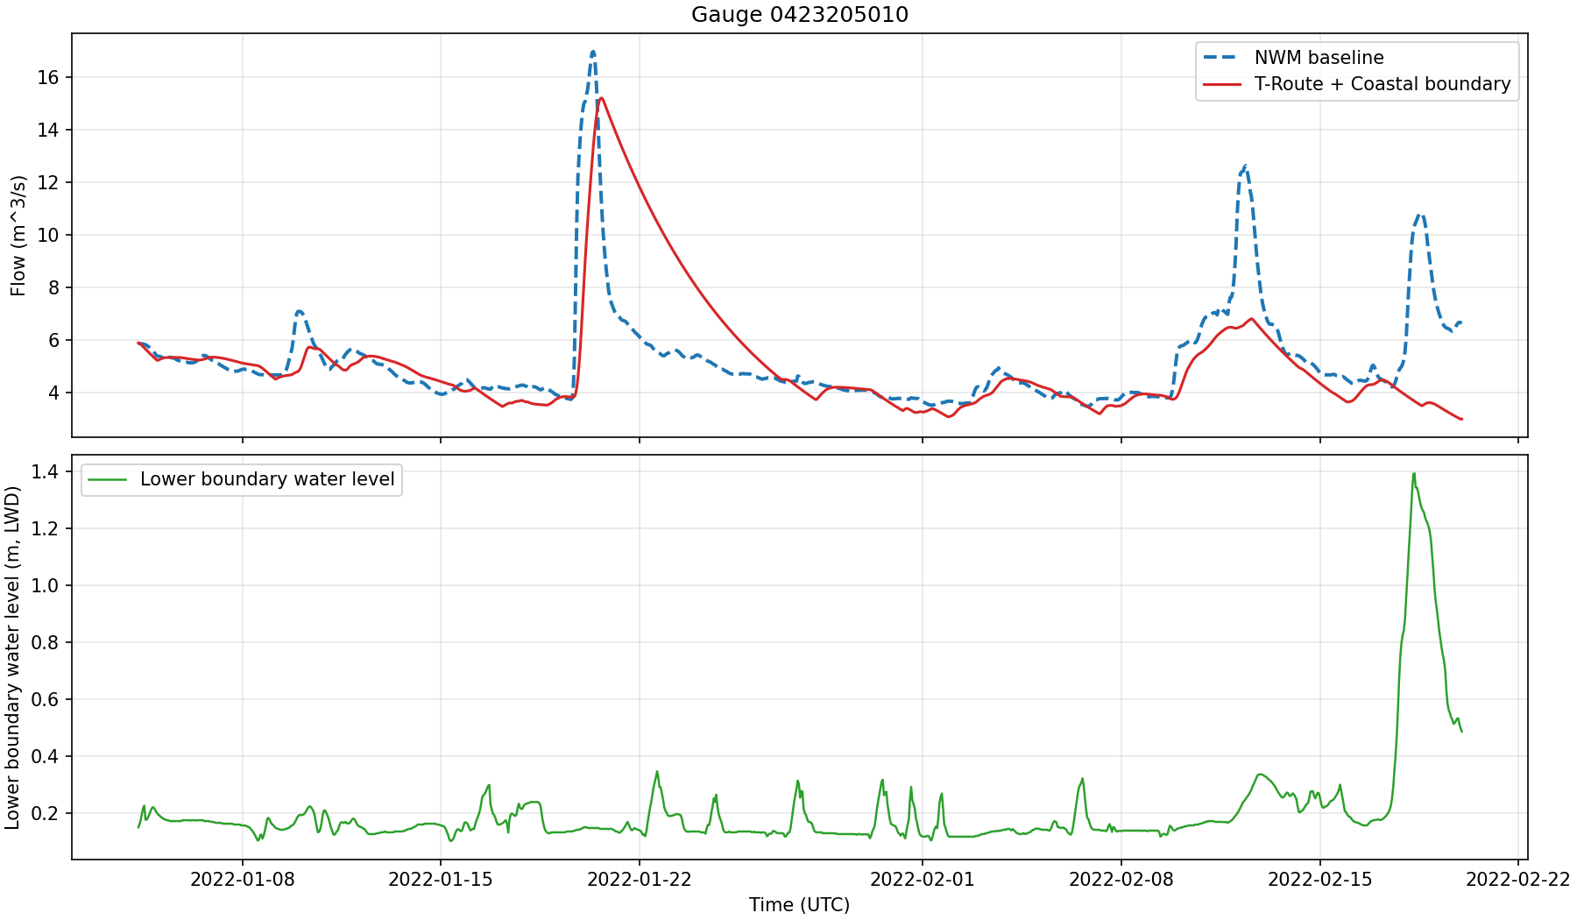
Simulation Results

Slide 10
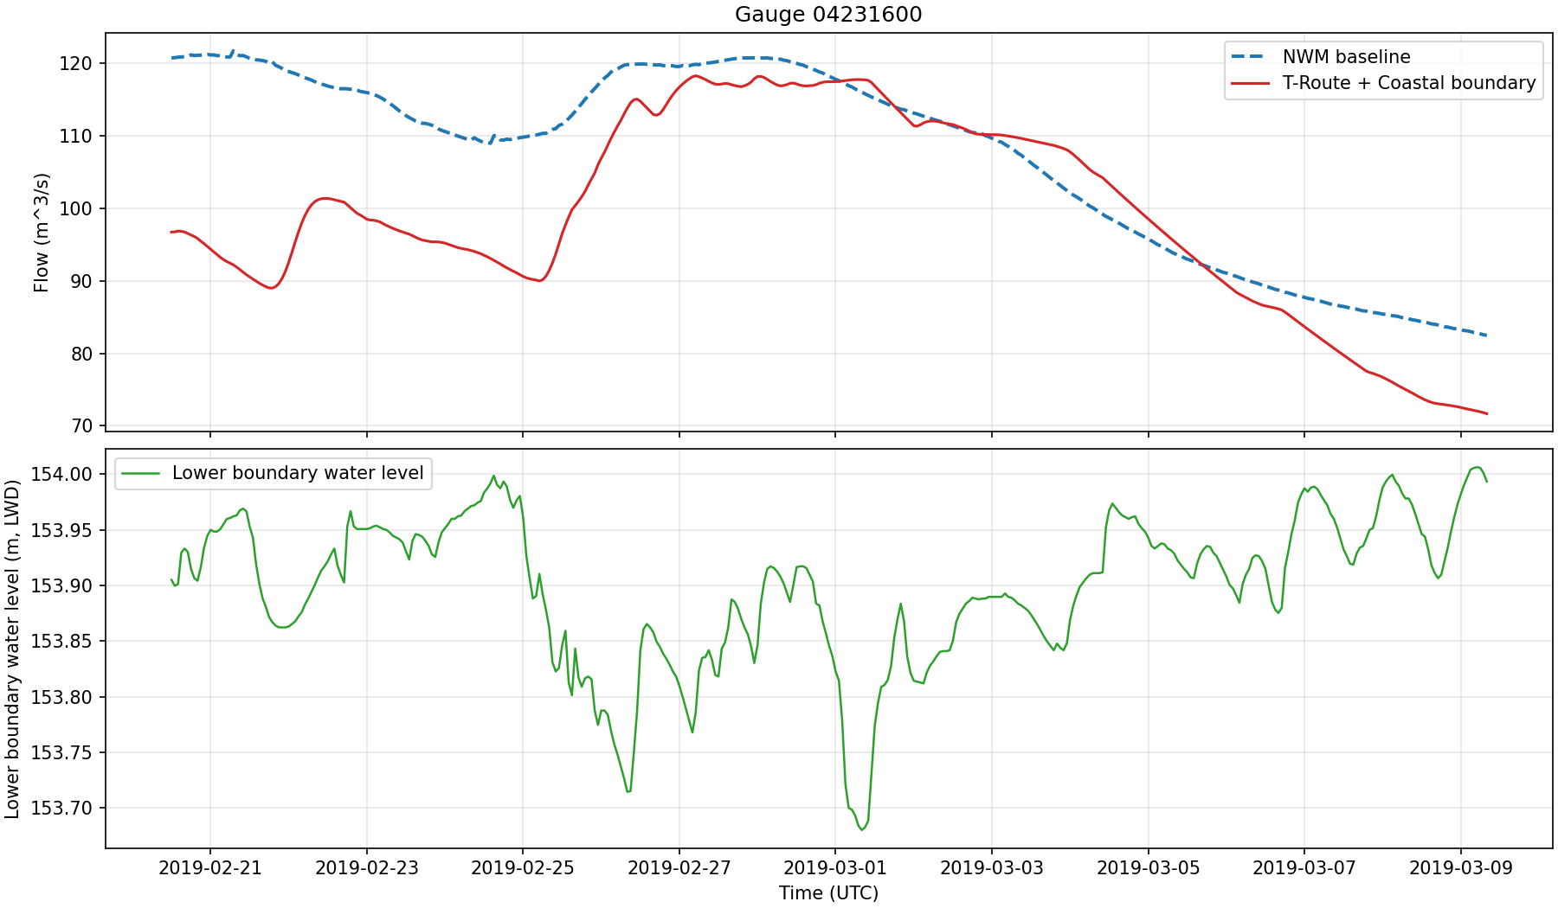
Simulation Results

Slide 11
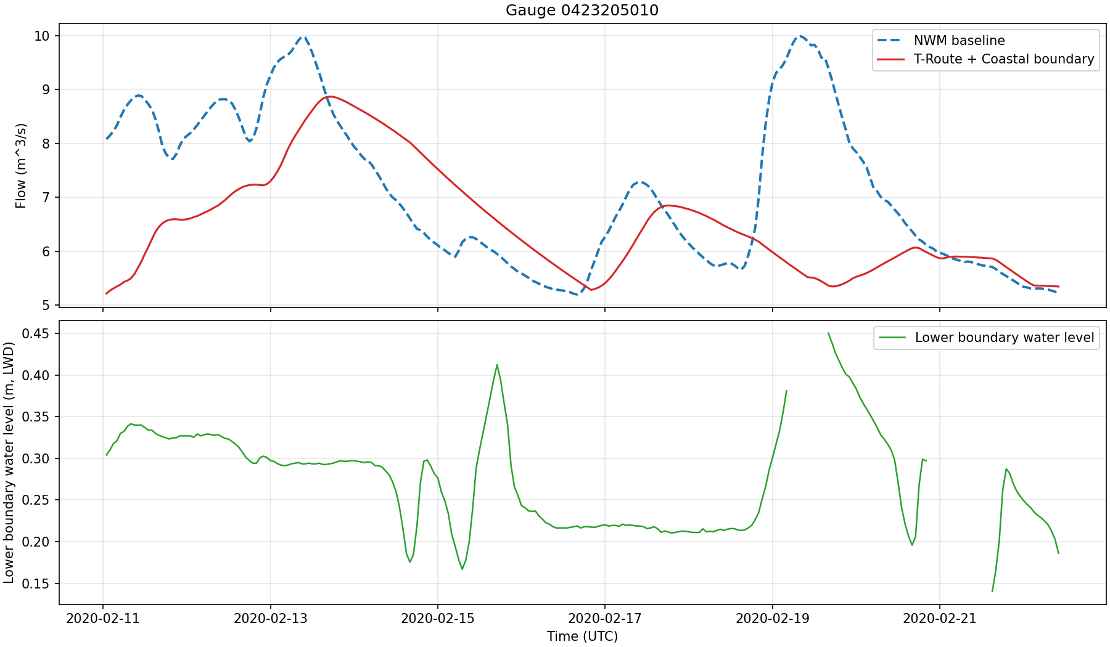
Simulation Results

Slide 12
Next Steps
  Refine model configurations and validate hydrologic–hydrodynamic simulations across selected Great Lakes tributaries.
  Evaluate multiple modeling scenarios under varying modeling domains and coupling strategies.
  Develop a BMI-based two-way coupling framework to enable dynamic exchange between T-Route and SCHISM.
  Assess improvements in compound flood prediction through coupled model simulations and comparison with observations.

