Slide 1
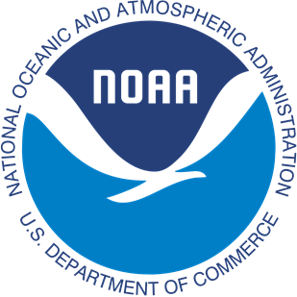
The applications of UFS-Coastal: wave-current coupling of SCHISM and WAVEWATCH III
Y. Sun, U. Turuncoglu, M. Jisan, H.g Yu, J. Zhang, C. Lemmen, A. Abdolali, D. Worthen, I.A Tsay, J. Haddad, P.s Velissariou, F. Cassalho, S. Mani, F. Daneshvar, S. Banihashemi, A. Salimi-Tarazouj, J. Smith, E.d Myers, S. Moghimi

Slide 2
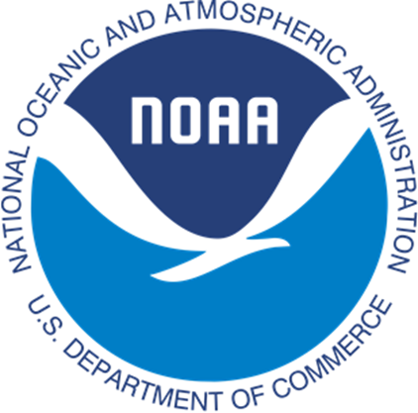
Outline
Brief introduction of the UFS-Coastal
Regression tests in the UFS-Coastal
Wave-current coupling regression tests in the Duck domain
Summary
NOAA/NOS’ Office of Coast Survey
Contact: Yunfang.sun@noaa.gov

Slide 3
Introduction of the UFS-Coastal
  The UFS-Coastal is a modeling framework for coupled coastal applications and regional forecasts
  Contains coupled model components that link the atmospheric, ocean and terrestrial realms under one common framework
  Contains the Community Data Models for Earth Prediction Systems (CDEPS) and the NUOPC based Community Mediator for Earth Prediction Systems (CMEPS) components
  Includes two types of components
    1-way and 2-way coupled model components (coupled via CMEPS)
    Data component (e.g., CDEPS/datm CDEPS/docn ) that pass forcing data, as required, to the model components
  Uses the spack-stack framework for its compilation and run-time requirements
  Includes full regression test capabilities for all model components
NOAA/NOS’ Office of Coast Survey
Contact: Yunfang.sun@noaa.gov

Slide 4


UFS-Coastal (Coastal Application)
UFS WEATHER MODEL
with new coastal components
Fortran use
UFS Unified Driver (ESMF)
https://github.com/oceanmodeling/ufs-weather-model
Fortran use
NUOPC Cap
NUOPC Cap
Wave
code
CMEPS
Mediator
Sea Ice
NUOPC Connectors
NUOPC Cap
ADCIRC
NUOPC Cap
NUOPC Cap
NUOPC Cap
SCHISM
ROMS
FVCOM
CDEPS
NUOPC Cap
NUOPC Cap
NUOPC Cap
NUOPC Cap
“Data” Atmosphere
“Data” Ocean
“Data” Wave
“Data” ...
NOAA/NOS’ Office of Coast Survey
Contact: Yunfang.sun@noaa.gov

Slide 5
Regression tests
Regression test is a testing process that verifies recent code changes, such as bug fixes or new features, haven't accidentally disrupted modeling integrity. In UFS-Coastal, we developed a series of small realistic cases to test each components.
Available in multiple Platforms: Frontera, Orion, Hercules
https://github.com/oceanmodeling/ufs-weather-model/wiki/Current-Status-of-UFS%E2%80%90Coastal-Implementation
NOAA/NOS’ Office of Coast Survey
Contact: Yunfang.sun@noaa.gov

Slide 6
Regression tests
To be accurate, models must be:
  Reliable: consistently reproduce observed conditions.
  Reproducible: same setup yields the same result anywhere.
  Systematically evaluated: standardized tests against real-world data.
NOAA/NOS’ Office of Coast Survey
Contact: Yunfang.sun@noaa.gov

Slide 7
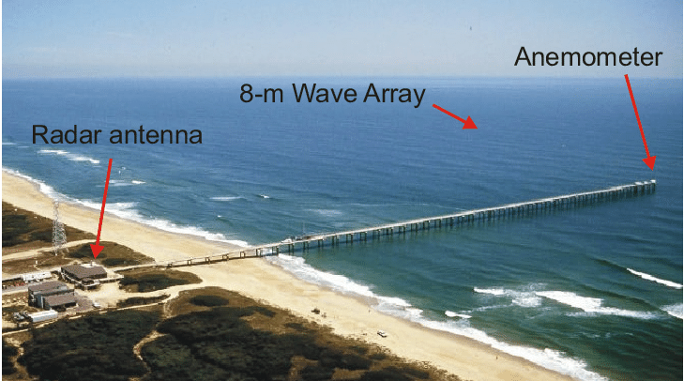
Regression tests in the Duck domain
Why Duck/FRF?
Longest continuous coastal wave-current dataset in the U.S.
Dense instrumentation: tide gauges, ADCPs, buoys, wave spectra.
Recognized international testbed for coastal processes.
NOAA/NOS’ Office of Coast Survey
Contact: Yunfang.sun@noaa.gov

Slide 8
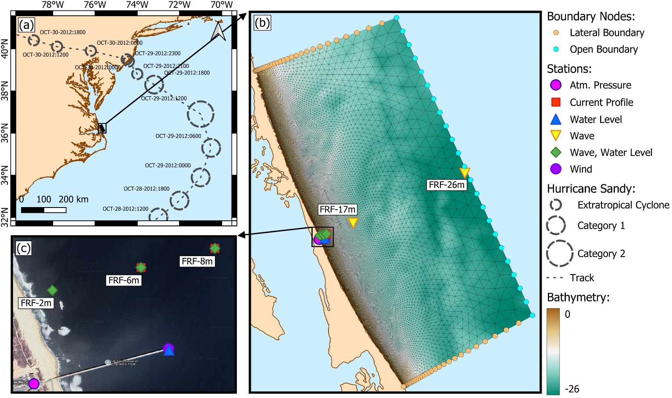
Regression tests in the Duck domain
Hurricane Sandy originating as a tropical cyclone in the southwestern Caribbean Sea, Sandy moved northward parallel to the U.S. Atlantic coastline before sharply turning northwest toward the mid-Atlantic region. Sandy’s unique trajectory and extensive geographic scale made it one of the most severe storm surge and coastal flooding events.
NOAA/NOS’ Office of Coast Survey
Contact: Yunfang.sun@noaa.gov

Slide 9
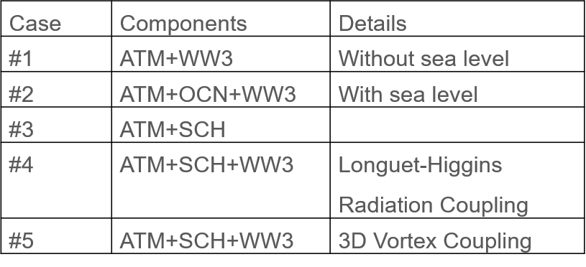
Regression tests in the Duck domain
SCH: Semi-implicit Cross-scale Hydroscience Integrated System Model ( two-dimensional: depth-averaged)
WW3: WAVEWATCH III
ATM: Atmospheric forcing by using CDEPS (ERA5 here, the fifth generation ECMWF reanalysis)
NOAA/NOS’ Office of Coast Survey
Contact: Yunfang.sun@noaa.gov

Slide 10
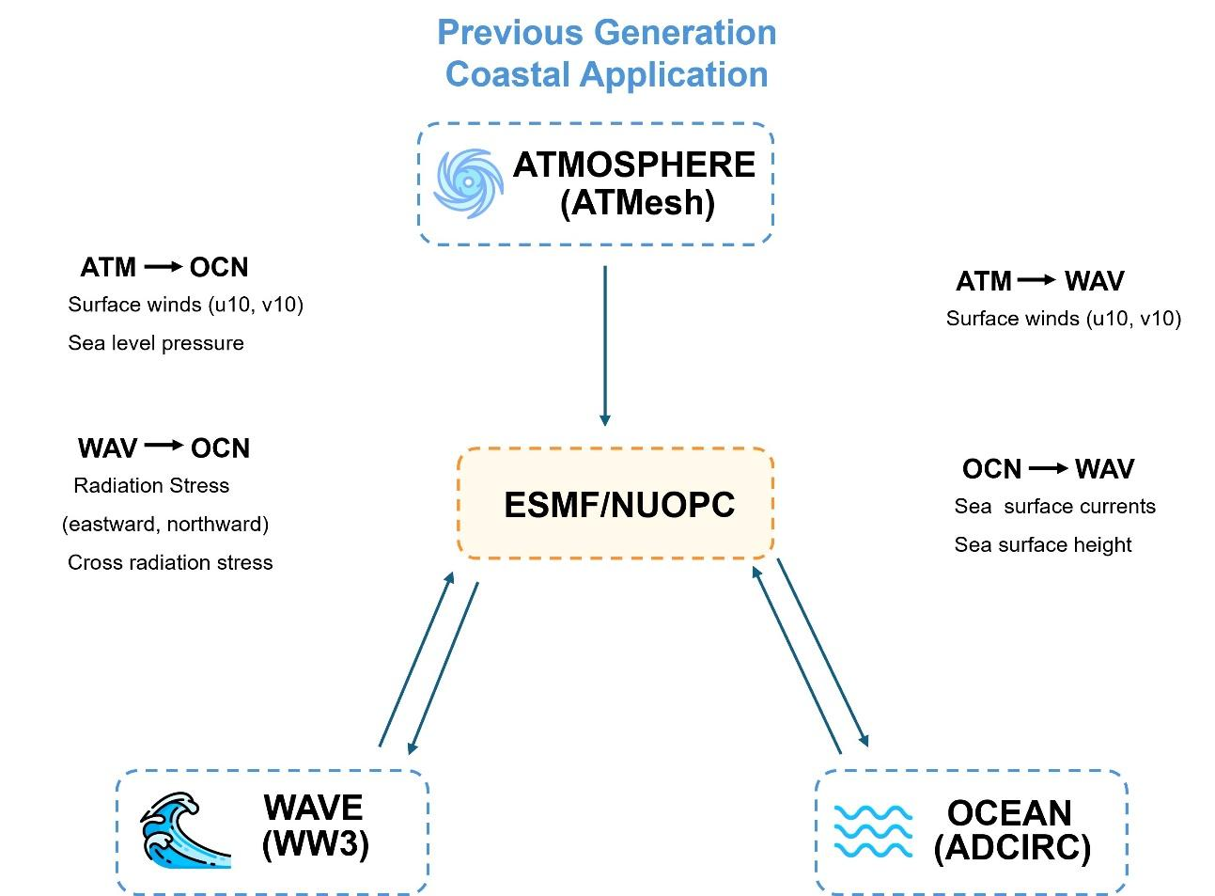
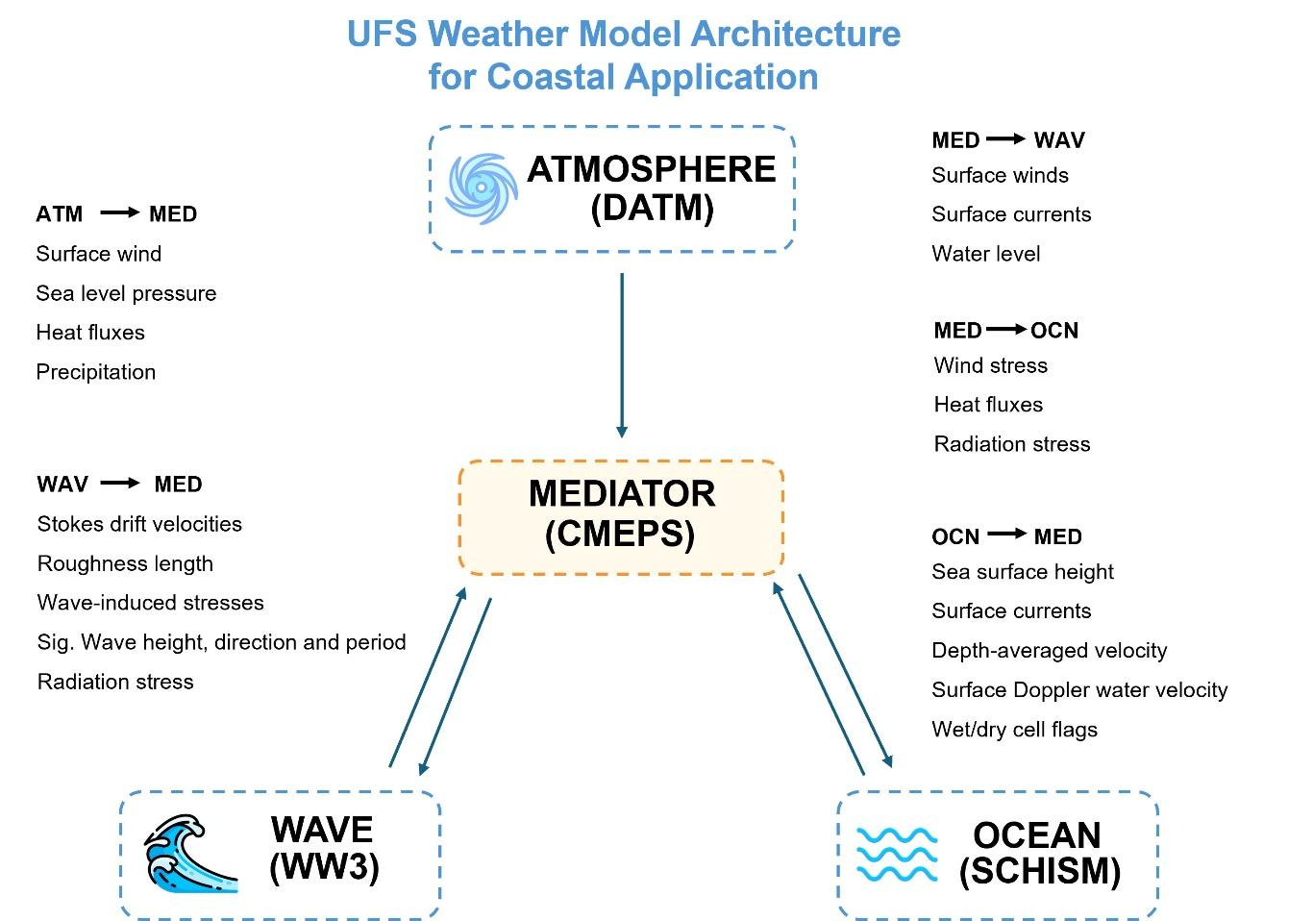
Regression tests in the Duck domain
Longuet-Higgins Radiation Coupling
3D Vortex Coupling
NOAA/NOS’ Office of Coast Survey
Contact: Yunfang.sun@noaa.gov

Slide 11
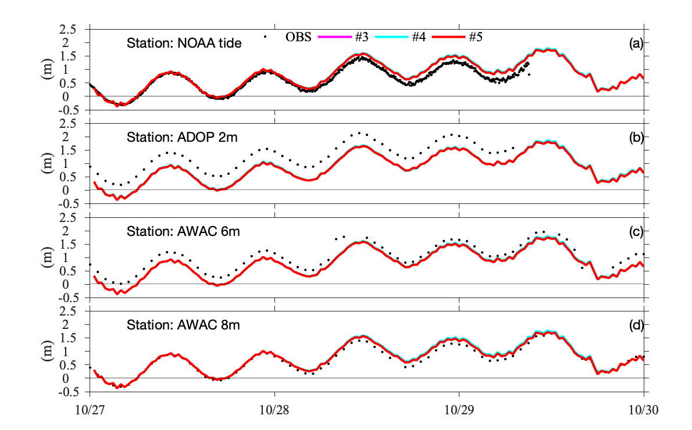
Water elevation comparisons between observations and numerical experiments
NOAA/NOS’ Office of Coast Survey
Contact: Yunfang.sun@noaa.gov

Slide 12
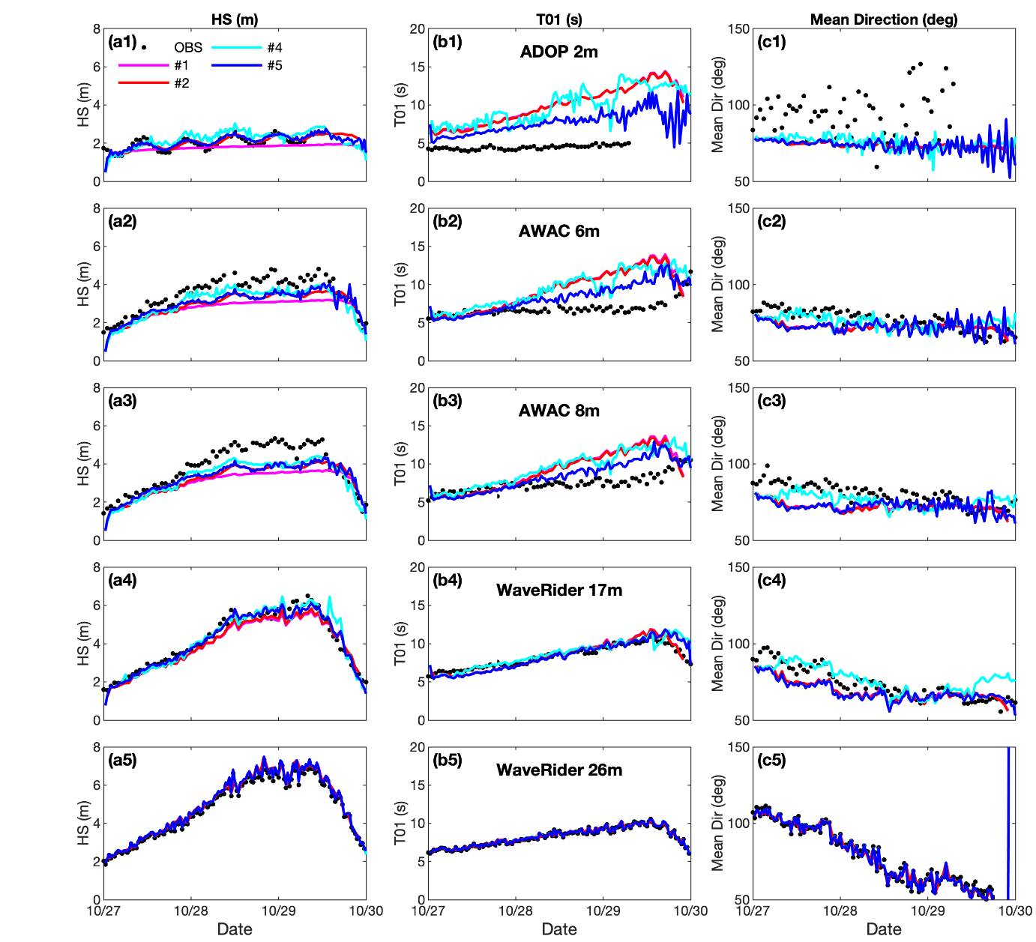
Significant wave height, Mean time period, and mean direction comparisons between observations and numerical experiments
NOAA/NOS’ Office of Coast Survey
Contact: Yunfang.sun@noaa.gov

Slide 13
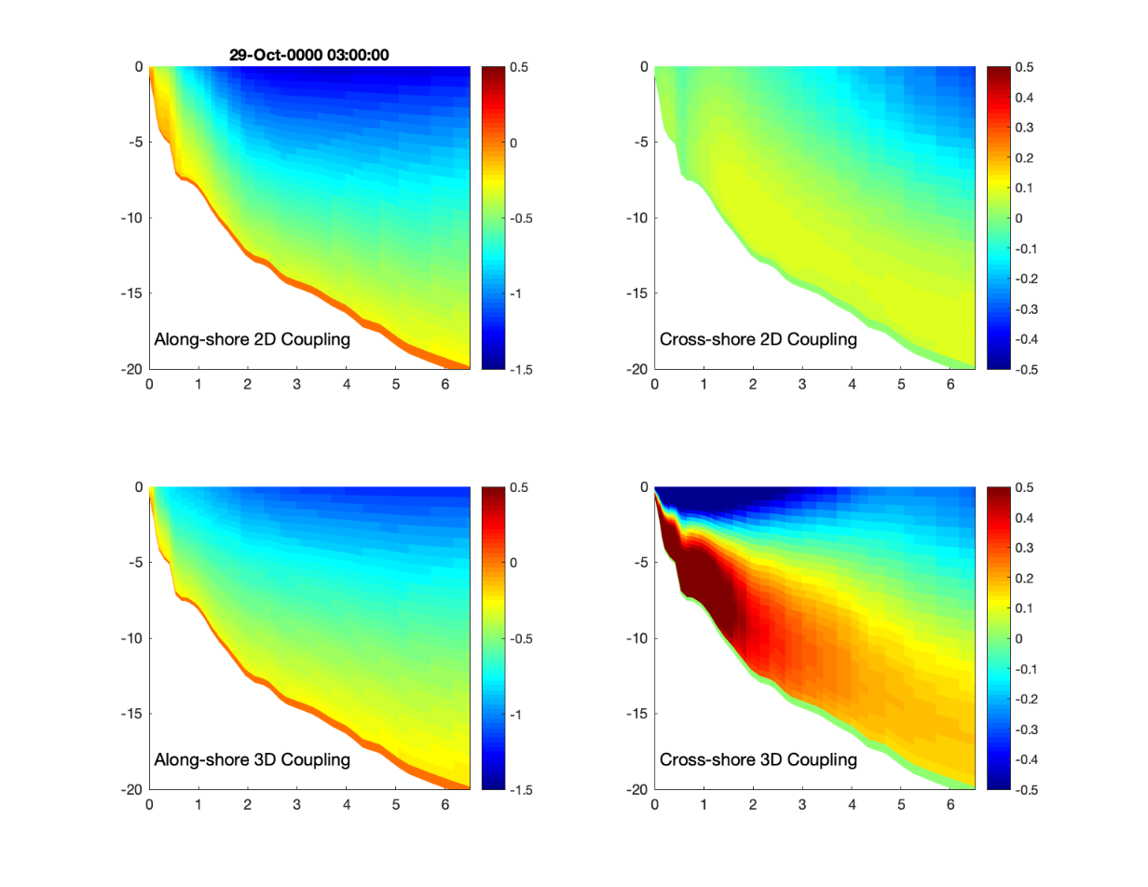
The along shore and cross shore velocity components from coast to awac6m
NOAA/NOS’ Office of Coast Survey
Contact: Yunfang.sun@noaa.gov

Slide 14
Summary
The core advancement of UFS-Coastal lies in its integration of specialized coastal hydrodynamic models (SCHISM, ADCIRC, FVCOM, and ROMS), the wave model WW3 and the sea ice model CICE, coupled through the flexible and modular CMEPS infrastructure, significantly improving predictive capabilities in coastal environments.
Experimental validations conducted at Duck, NC, rigorously assessed individual model components as well as their interactions within fully coupled model configurations. Validation results confirmed robust performance of each modelling component.
NOAA/NOS’ Office of Coast Survey
Contact: Yunfang.sun@noaa.gov

Slide 15
Summary
Comparison of two distinct wave-current interaction methodologies: the traditional Longuet-Higgins radiation stress formulation and the advanced 3D vortex coupling method.
While both methods successfully captured overall storm surge magnitudes and nearshore wave characteristics, important distinctions emerged.
The depth-integrated Longuet-Higgins approach accurately represented wave-driven coastal setup and flows, effectively handling scenarios dominated by surface and depth-integrated processes.
The advanced 3D vortex coupling provided significant improvements by explicitly resolving vertical momentum transfers and turbulent mixing, leading to enhanced realism in modeling vertical current structures, mixing processes, and vertical gradients critical for sediment transport, pollutant dispersion, and ecological modeling.
NOAA/NOS’ Office of Coast Survey
Contact: Yunfang.sun@noaa.gov

Slide 16
THE END
Thank you for your attention!
Q/A
NOAA/NOS’ Office of Coast Survey
Contact: Yunfang.sun@noaa.gov

