Slide 1
National Ocean Service (NOS)
Core Model Evaluation Plan
Patrick Burke
July 22, 2026

Slide 2

NOS Mission Value Chain
Hazardous Spill Response / Search and Rescue
Safe, Efficient Marine Navigation
Observations
Core Hydrodynamic Models
Applications / Tools
Protecting Human Health
Coastal Resilience and Risk Reduction

Slide 3
Definitions
Core Model:
  The central numerical model that solves governing physical equations and provides fundamental hydrodynamic calculations. Examples include ROMS, ADCIRC, FVCOM, and SCHISM.
Model Application:
  An implementation of a core model for a specific region, purpose, or use case.
**Not comprehensive term lists for these models**

Slide 4
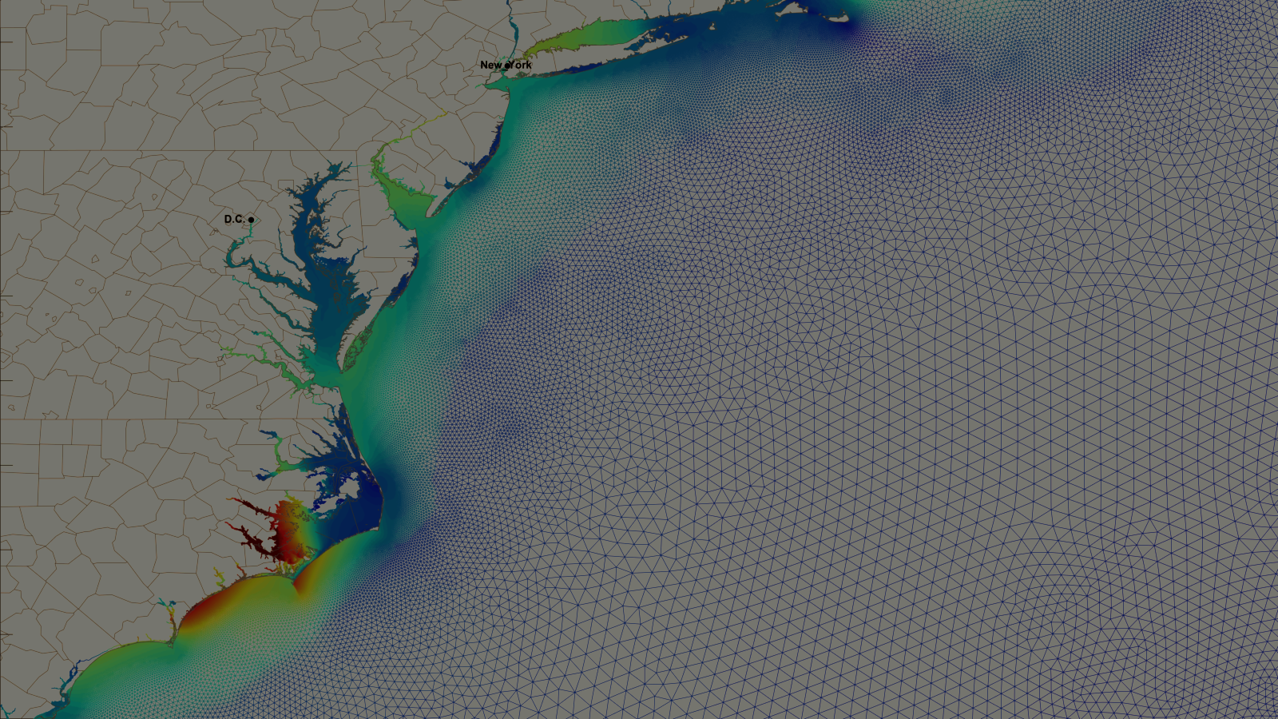
Vision
Modernize NOS’s predictive modeling suite to deliver high-precision, actionable data critical for preparedness efforts at state, local, and individual levels, generating the rigorous data required to improve the safety of marine navigation, safeguard public health, and strengthen the resilience of coastal communities.

Slide 5
Core Model Evaluation Plan
Goal
Standardize and modernize physical oceanography modeling systems.
Reduce resource fragmentation to capitalize on cloud, HPC, and AI/ML.
Develop a unified national system integrating with NOAA’s UFS.
Approach
Conduct objective evaluations benchmarking models against NOS requirements.
Maintain a collaborative network involving partners, academia, and industry.
Expected Outcome
A recommendation for an optimal set of core model codes.
A comprehensive roadmap for infrastructure investment.
A phased transition plan providing clear benefits.

Slide 6

Phase 1: Market Research [FY26]
Seeking Feedback
  Technical Capabilities: Information on model readiness, including compatibility with high-performance computing (HPC) and cloud environments, as well as opportunities for integrating advanced methods like ML/AI.
  Strategic Vision: Perspectives on long-term design, community governance, and workflows that will strengthen our operational forecasting capabilities.
Transparent Communications
  Community Engagement
  Request for Information (RFI)
  Interagency Interviews
RFI Open Now!
Closes August 14
Notes:
Rfi
Conducting interagency interviews
Here are the types of questions we’re asking
Types of questions -general
Transparency with the community, buy in
(1) Community Engagement
(2) RFI (closes aug 15)
Interested in hearing about approaches - integrating AI, ML
(3) Interagency Interviews
RFI
Market research tool to gather data on oceanographic models.
Help define the final scope and criteria for the model evaluation approach.

Slide 7
Phase 2: Evaluation Scenarios [FY27]
Purpose
  Quantitatively assess core model capabilities under real-world scenarios
Example Test Cases
  Safe marine navigation
  Oil spill response
  Harmful algal bloom (HAB) forecasting
Result
  Deliver recommendations for future consolidated coastal modeling suite
  In FY28, NOS will begin implementing these recommendations in partnership with external modeling community
Notes:
Goal is to quantitatively assess core model capabilities under real-world scenarios
Potential scenarios for consideration:
Safe navigation
Oil spill response
HAB forecasting
Criteria for evaluation
Build recommendations for future modeling suite

Slide 8
Thank You!
Contact Information:
pat.burke@noaa.gov
stephan.smith@noaa.gov
joanna.peth@noaa.gov

