Slide 1
NOAA Precipitation Prediction Grand Challenge (PPGC) Initiative
in Supportive of UFS Improvement and Applications
Co-Leads of NOAA PPGC Initiative
David Novak (NOAA National Weather Service)
John Ten Hoeve (NOAA Weather Program Office)
Jin Huang (NOAA Climate Program Office)
Chris Spells (NOAA Weather Program Office)
July 22, 2026
UIFCW

Slide 2
Outline
Overview of NOAA’s PPGC Initiative
Ongoing and planned activities in supportive of UFS improvement and applications
Summary

Slide 3
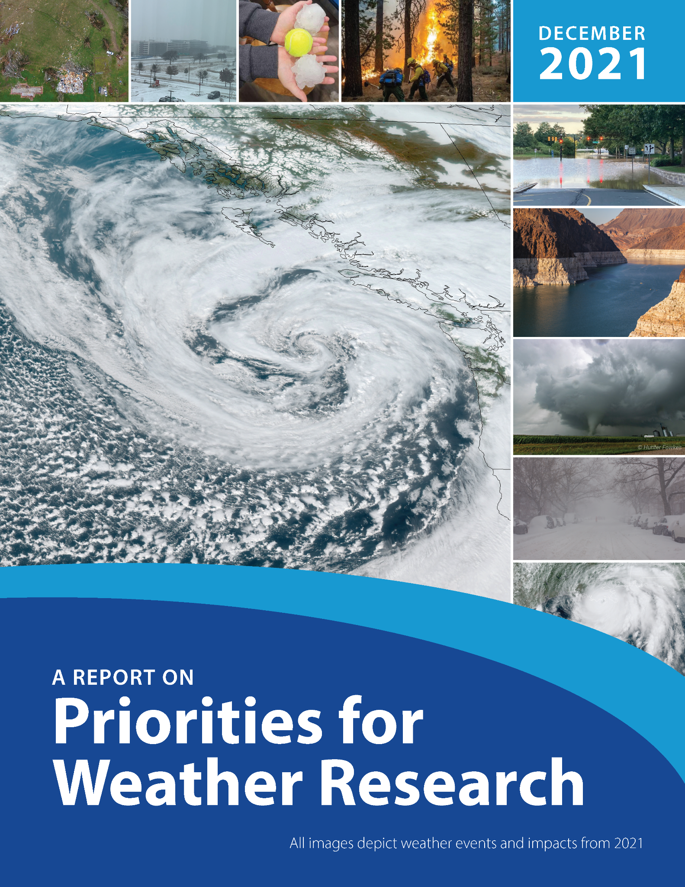
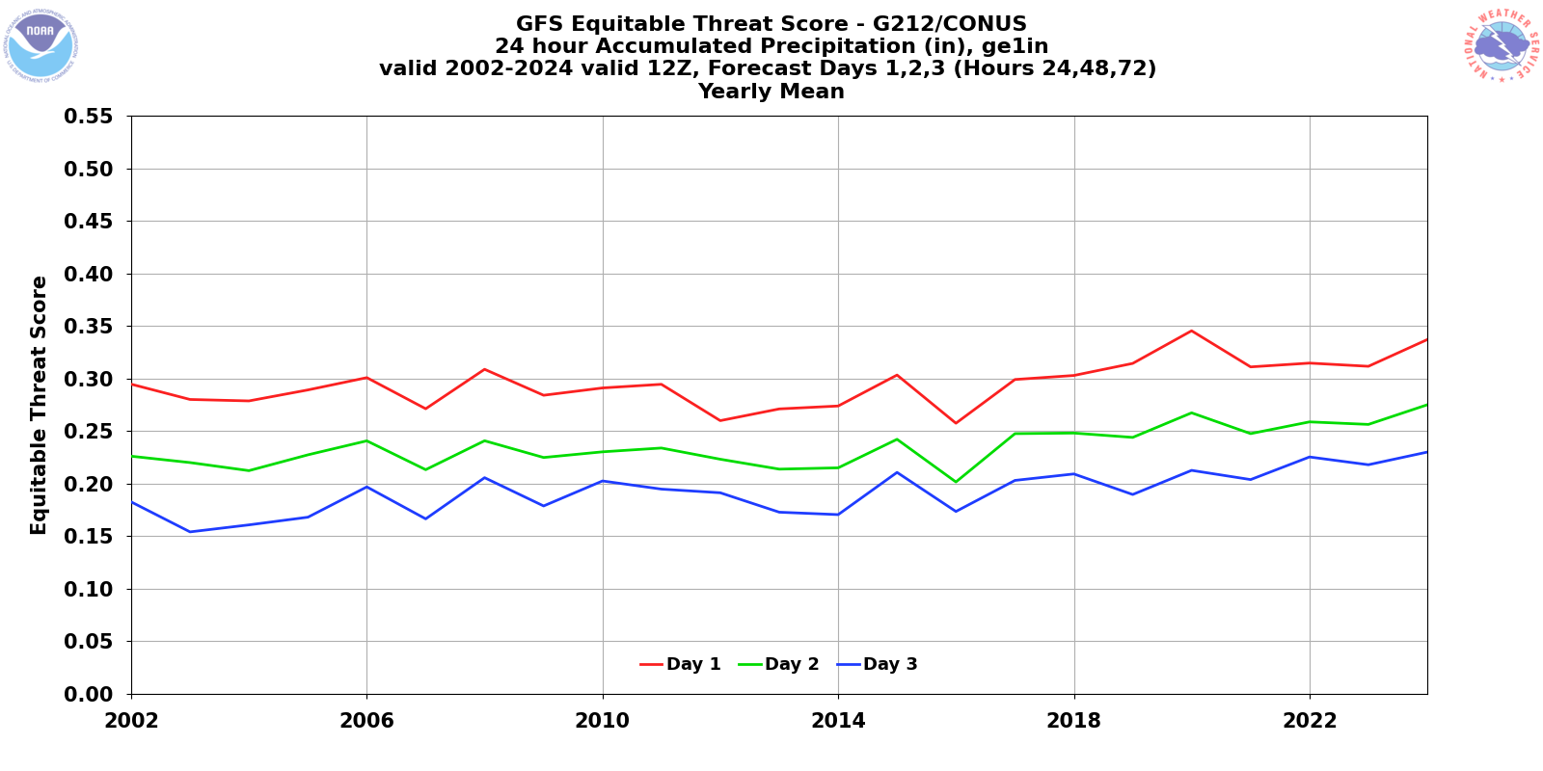
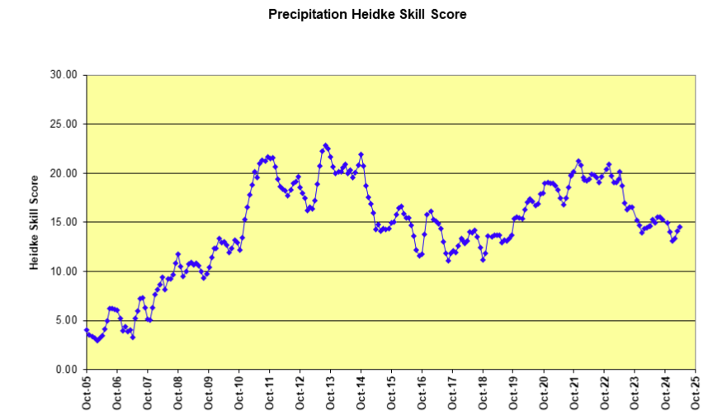
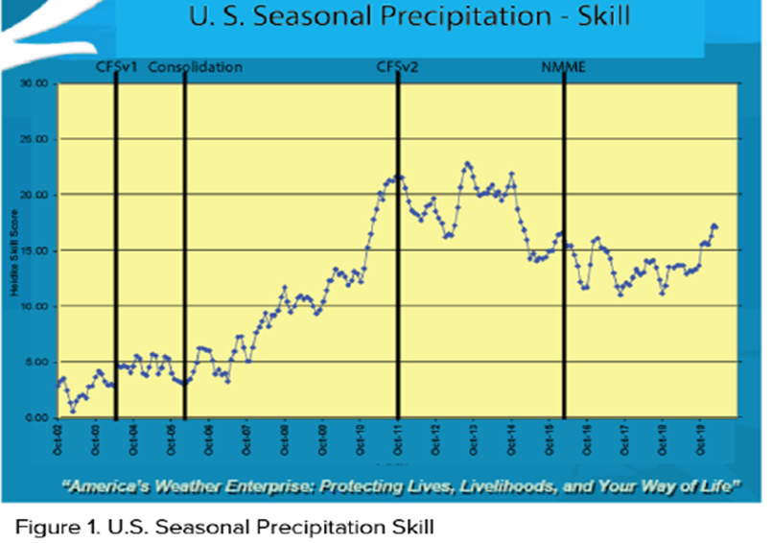
Urgent Need to Accelerate Improvements in Forecasts
Priorities for Weather Research Report
“Unfortunately, precipitation forecast skill has not improved substantially over decades and remains one of the major technical challenges in atmospheric sciences.
US Daily Precipitation Skill
US Seasonal Precipitation Skill
Model Accuracy at 1, 2, & 3 days in advance
2002 - 2024
Notes:
GFS 24/48/72h annual Equitable Threat Score
1” / day threshold
2002 - 2023

Slide 4
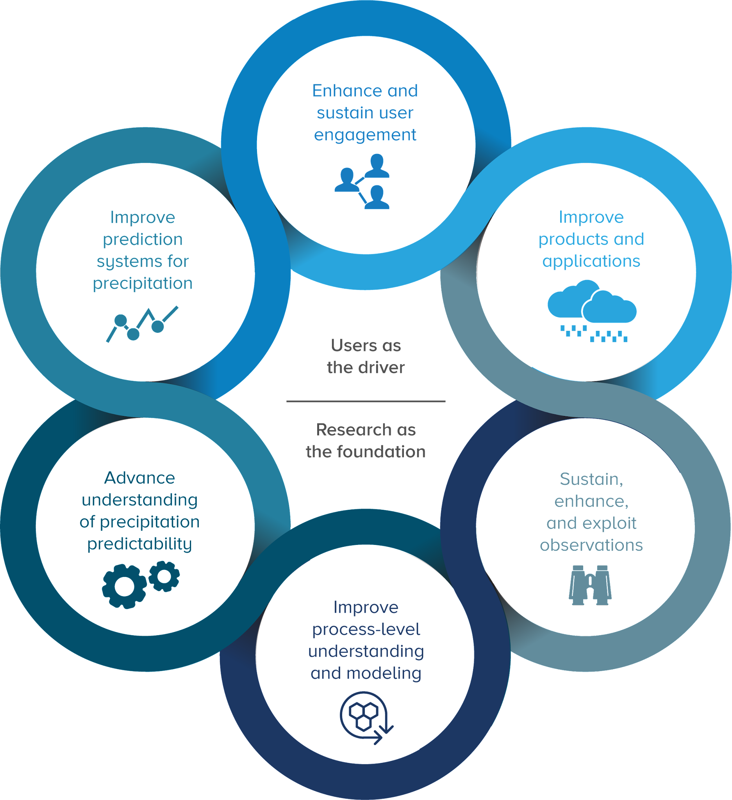
What is NOAA’s Precipitation Prediction Grand Challenge (PPGC)?
PPGC capitalizes on scientific and technological opportunities to provide more accurate, reliable, and timely precipitation forecasts across timescales, from minutes to seasons, through the development and application of a seamless, fully coupled Earth System prediction model.
Notes:
Better predictions at all time scales lead to increased ability to adapt, prepare, and respond.
In an effort to make progress on precipitation forecasts, predictions and projections, NOAA is working to implement the Precipitation Prediction Grand Challenge (or PPGC).
The PPGC Strategy (the front cover of which is shown on this slide) is the result of a collaborative effort across NOAA over the past 3 years, and in coordination with the broader research enterprise and with our international partners through the World Climate Research Program of the World Meteorological Organization.
The PPGC strategy, objectives, and vision for progress at 2-, 5- and 10-years in the future is found on the NOAA webpage at the link on this slide.
Implementation of this strategy will capitalize on scientific and technological opportunities to provide more accurate, reliable, and timely precipitation forecasts across timescales, from hours to decades, through the development and application of a seamless, fully coupled Earth System prediction model.
The initiative fully embraces the linkages between weather, water, and climate variability and change, with an emphasis on the water cycle using an Earth System Science approach.
The PPGC Strategy has six interconnected objectives (shown on the slide) that align NOAA’s capabilities to address precipitation prediction skill across all readiness levels and timescales. The six objectives, which we will refer to frequently in this briefing, are…….
This connected approach centers around an understanding of our end-users and their needs in order to ensure that what PPGC delivers is both useful (based on sound science) and usable (actionable).
All six interconnected objectives must be supported to achieve the overarching goal of the PPGC.
—————————————————
PPGC has set a strategic goal of doubling the rate of improvement of the skill of precipitation forecasts from 15% per decade to 30% per decade. This is a stretch goal, but we think we can achieve it by adhering to the HFIP traits.
Science = double rate of improvement
‘So what’ = add 2 days of lead time. Talk to any emergency manager or water resource manager, and having 2 additional days to prepare is priceless!

Slide 5
PPGC Skill Improvement Goals
 | Metric | 2025 Score | 2035 Goal | % Improve
Daily Weather | Flash Flood Warning Lead Time | 60 min | 80 min | 33%
 | GFS Threat Score for 1”/day threshold (Day 1) | 31 | 40 | 29%
 | NWS Threat Score for 2”/day threshold (Day 3) | 14 | 20 | 43%
 | GEFS Brier Skill Score for > 10mm/Day (Day 5) | 19 | 25 | 32%
 | Day 5 AR landfall error by 100 miles | 450 miles | 350 miles | 29%
Sub- Seasonal | GEFS Brier Skill Score for > 10mm/Day (Day 10) | 0 | 10
 | Heidke Skill Score (HSS) for CONUS week 3-4 precipitation | 12 | 18 | 33%
Seasonal | Heidke Skill Score (HSS) for CONUS seasonal precipitation | 17 | 25 | 47%

Slide 6
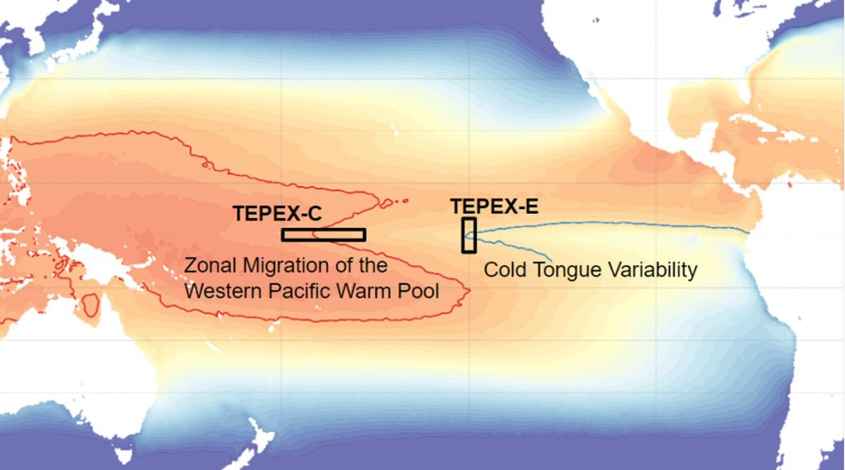
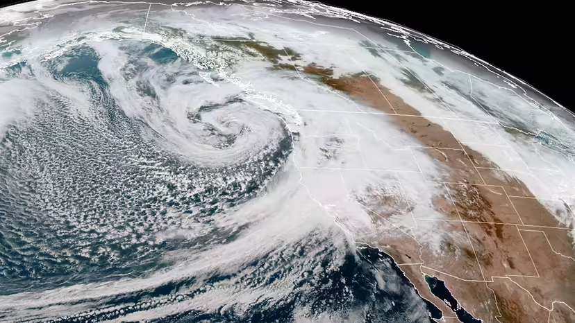
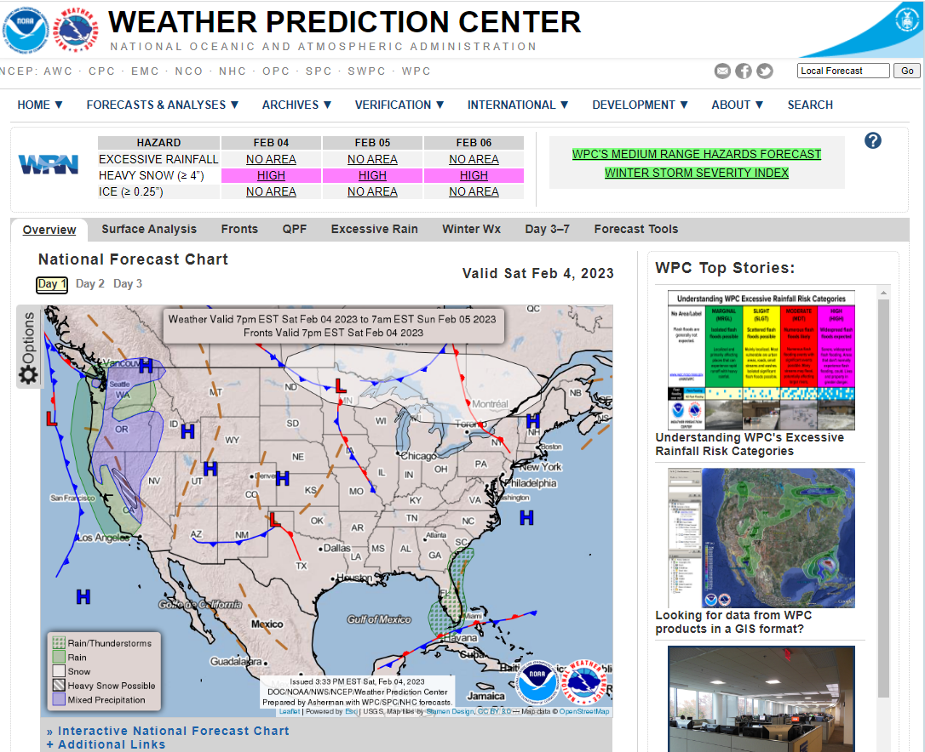
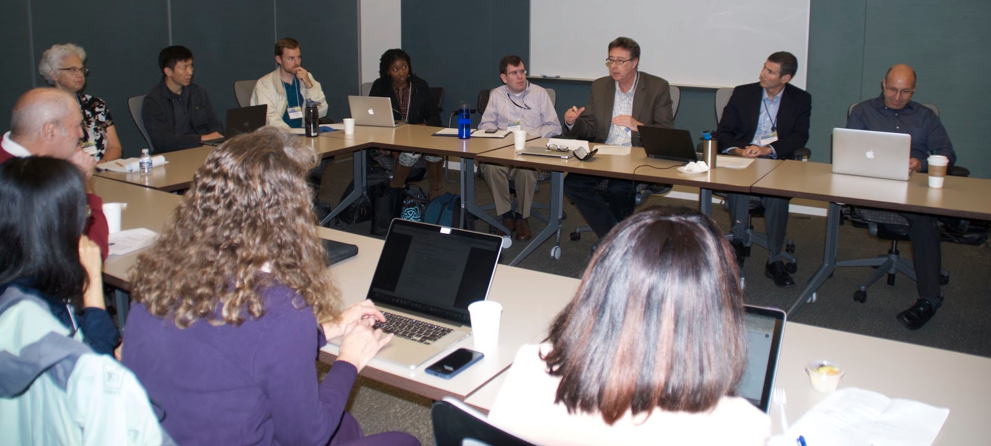
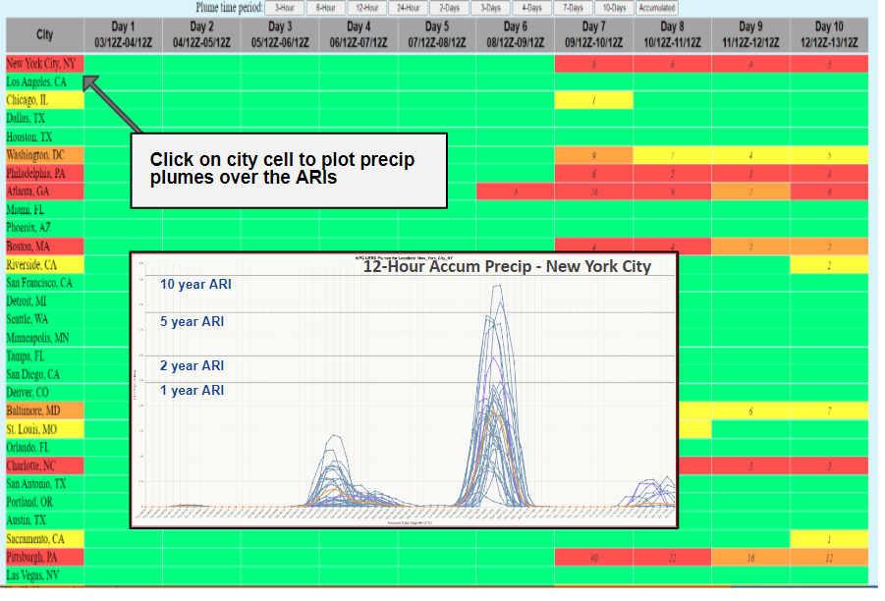
Ongoing PPGC Activities to Improve Predictions
Improve Understanding of Physical Processes
Exploit Observations
Improve Models for Precipitation
AI satellite approach for heavy precipitation nowcasting
Address model errors & interaction between the atmosphere & ocean
- Operational data assimilation and physics improvements:
-Next Generation Operational Global Forecast System
Improve Products & Applications
Enhance & Sustain User Engagement
Urban Rain Rate Dashboard

Slide 7
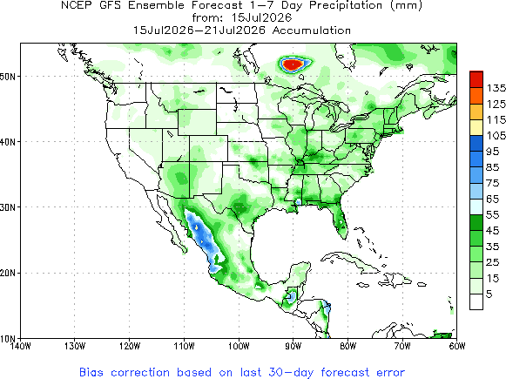
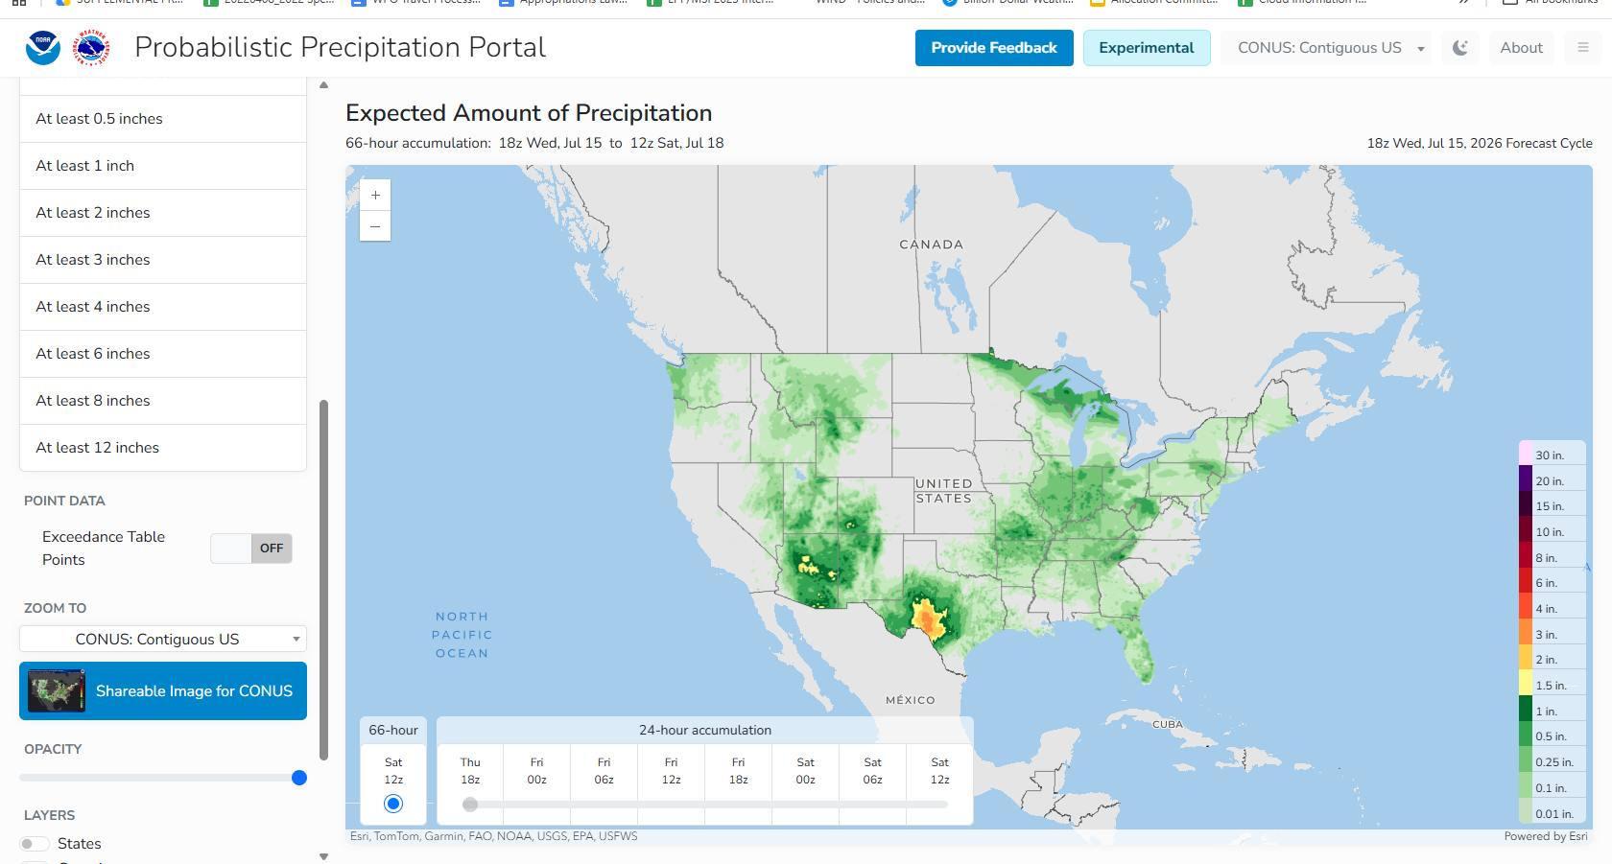
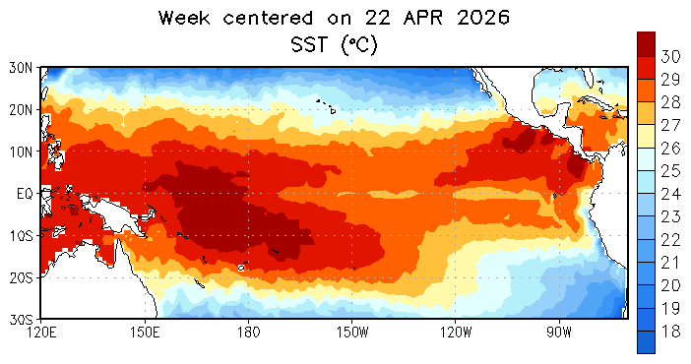
Modeling-Related Accomplishments from DRSA
Developing and unifying multi-scale UFS physics and dynamics to reduce model biases and improve precipitation prediction forecast accuracy to accelerate R2O transitions.
Model improvements and Advancements
Advance Data Assimilation with AI/ML Approaches
Extreme Precipitation Predictability & Verification
Standardized parameterizations across multiple UFS scales (including GFSv17, GEFSv13, and SFSv1 prototypes) to minimize model systematic biases
Enhanced global MPAS capabilities to track extreme precipitation events
Preprocessed US precipitation datasets using deep learning, essential for validating and initializing model states
Tested MPAS-JEDI 3DVar in regional models, improving initial conditions and early-stage forecasts
Standardized C3 parameterization across scales, integrating aerosol interactions to reduce global precipitation biases
Pinpointed tropical Pacific sea surface temperature errors as the primary driver of winter precipitation forecast errors

Slide 8
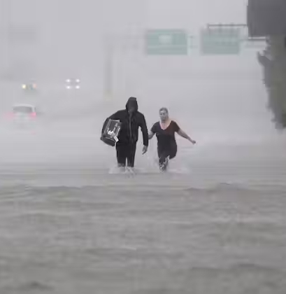
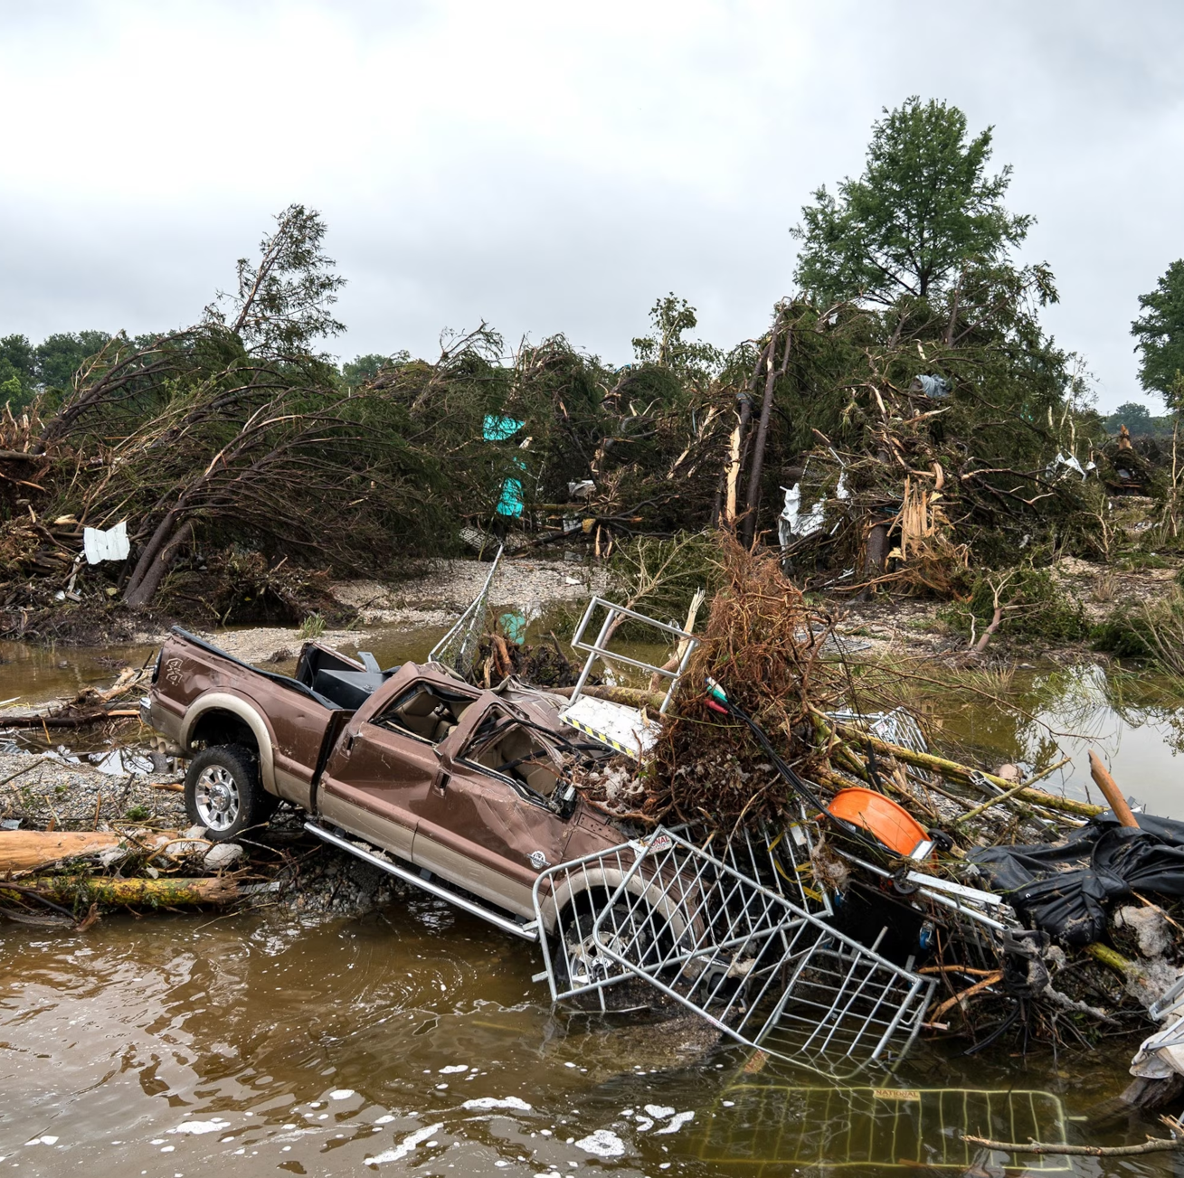
NOAA PRECIPITATION PREDICTION GRAND CHALLENGE (PPGC)
FY25/26 Supplemental Funding
HOW: $21M Cross-Line Office Investments across the value chain
Analyses: Advance Analyses through MRMS (Multi-Radar-Multi-Sensor) / FLASH (Flooded Locations and Simulated Hydrographs) systems
Modeling & Validation: Advance cloud-resolving regional models; AI/ML emulator predictions of extreme precipitation; DA and model physics
Tools & Products: Extend the lead time of operational extreme rainfall tools and establish experimental tools
Risk Communications & Preparedness: Better communicate real-time risk of extreme rainfall and potential impacts
Physical Process Understanding & Dataset Development: TEPEX field campaigns; Enhance and assess datasets; Better use of satellite and co-located in situ observation
WHAT: Better predictions of warm-season extreme precipitation events on two specific timescales: 1-10 hours and 3-5 days
Notes:
This forecast challenge has become even more prescient given recent flash flooding disasters in Texas, New Mexico, North Carolina and elsewhere .

Slide 9
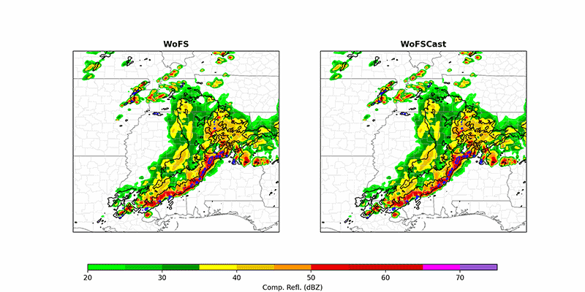
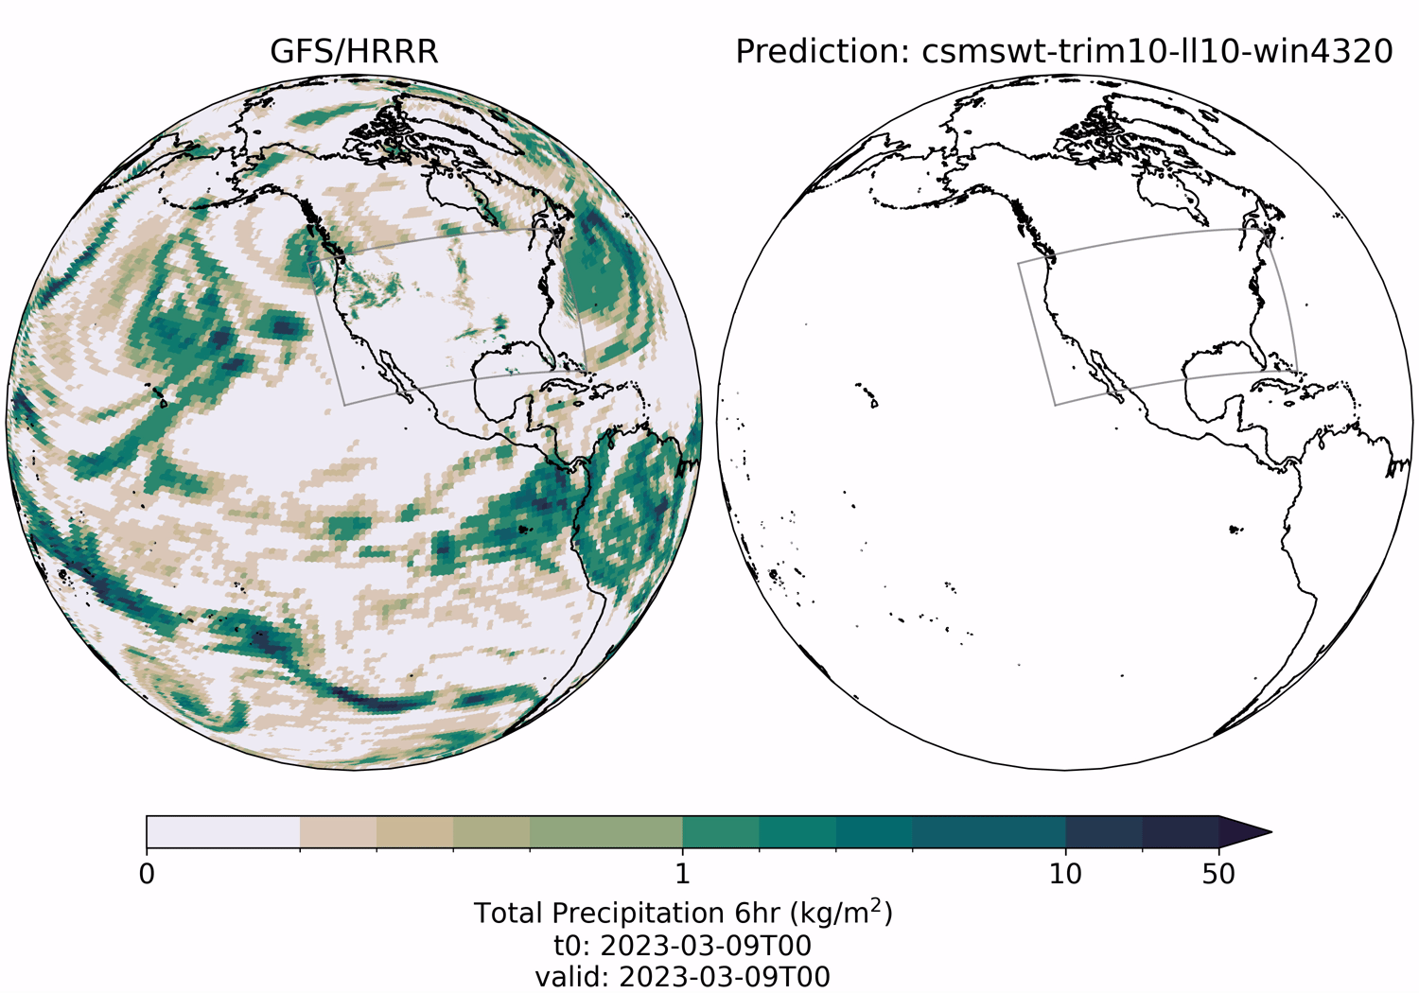
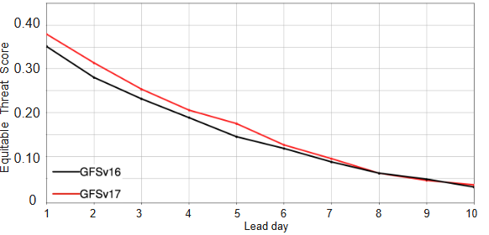
Highlights for FY25/26 PPGC Supplemental
WOFS
WOFSCast
AI & Project EAGLE
GFS/GEFS Improvements
Couple WOFS with FLASH
Build next generation WOFSCast
Support operational hardening and transition of WOFSv1
Improve precip forecasts of landfalling hurricanes using WoFS
Improve global to regional AI-based precip forecasts
Use AI to build Forecast Sensitivity-based Observation Impact (FSOI) capabilities
Advance QPF nowcasts by combining AI/ML: with satellite observations
Improve physics and reduce systemic biases of UFS models
Develop concept of operations of a global continuous DA system
Process-level model diagnosis
Red bullets directly support NOAA’s Modeling Moonshot Initiative
Notes:
Talking Point: Many of these projects support Modeling Moonshot

Slide 10

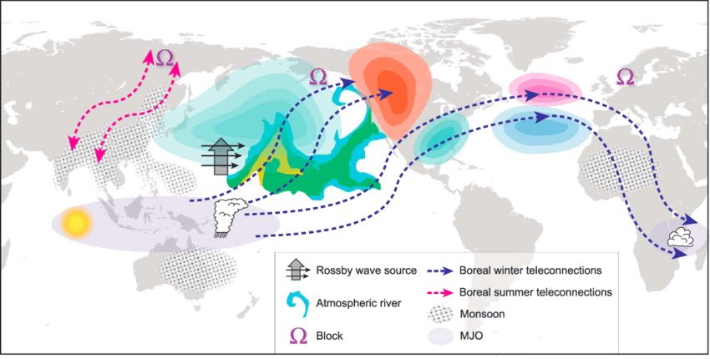
TEPEX: TPOS Equatorial Pacific Experiment
Contribute to global atmosphere-land-ocean coupled field campaigns of GPEX
TEPEX (2027 - 2028)
ATOMIC (2020)
Years of Maritime Continent (2017-2019)
Dynamo (2011-2012)
TOGA-CORE (IOP in 1991-1992)
GATE (1974)
TEPEX Objectives:
Builds on NOAA’s History in Tropical research
Better understand ocean- atmosphere processes in Tropical Pacific that drive precip extremes in the U.S. and globally
Address systematic errors in global models through enhanced observations and improve model precipitation forecasts.

Slide 11
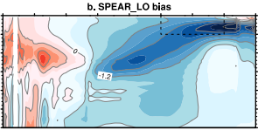
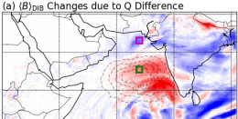
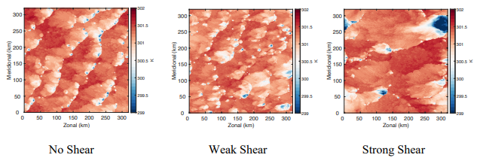
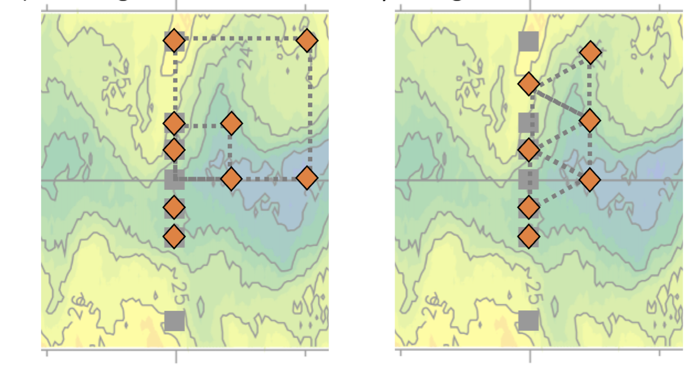
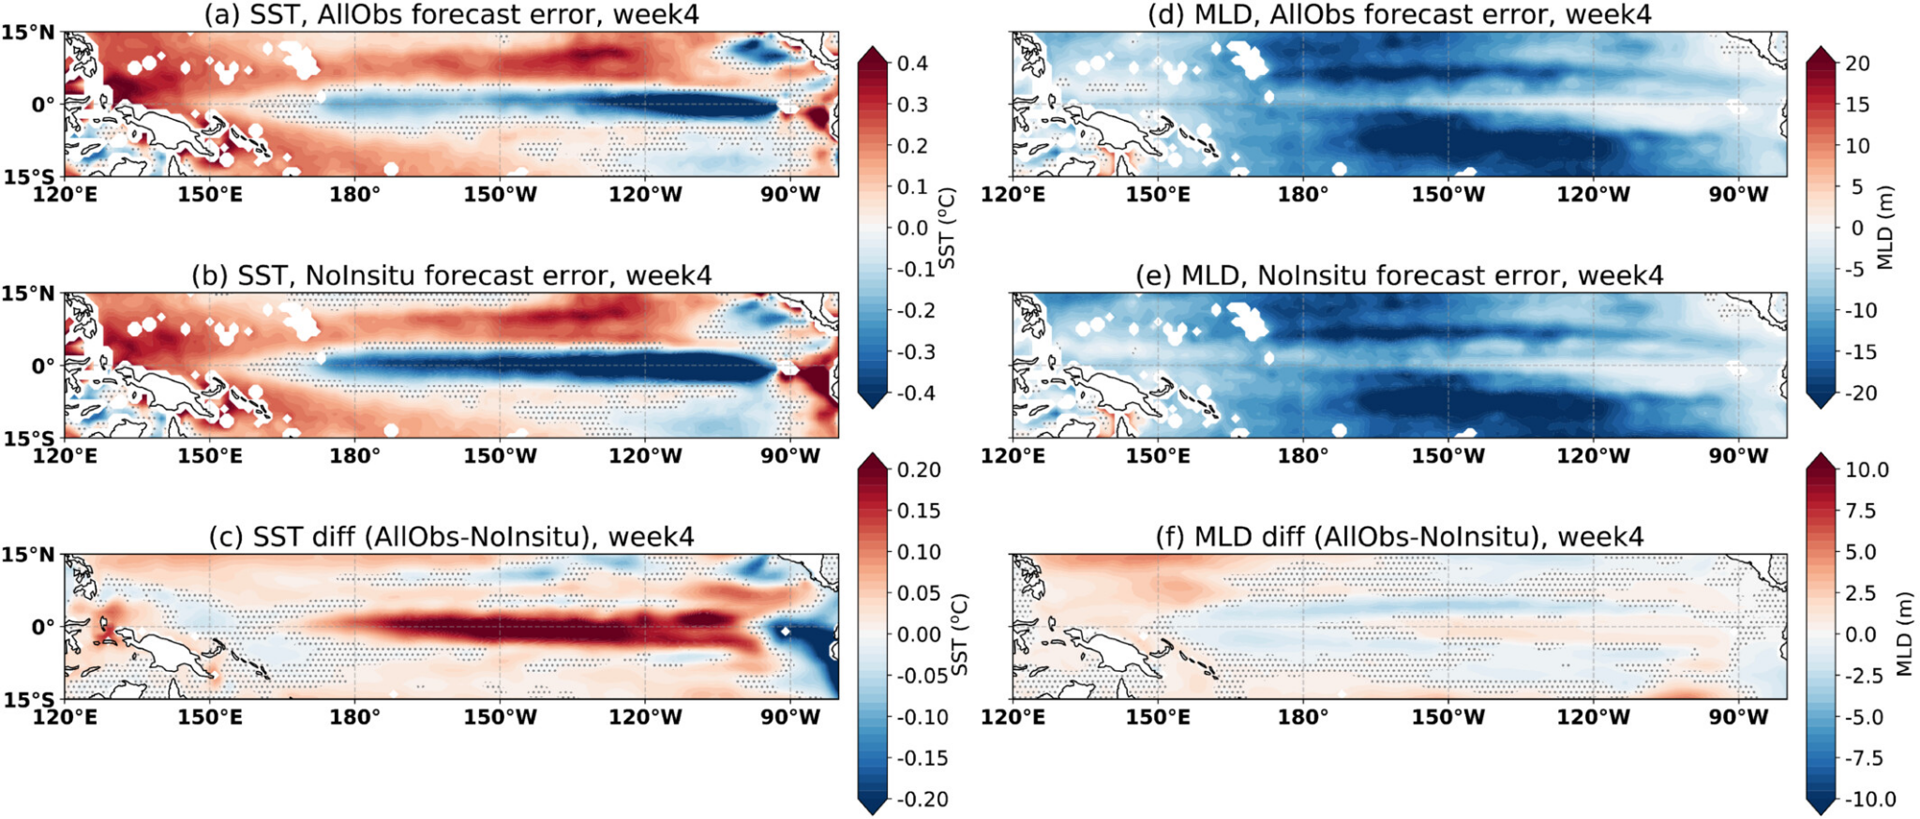
TEPEX Pre-Field Modeling Studies
To understand model representation of precipitation processes
Determining vertical wind shear influences on cold pool and precip
Diagnosing coupled model biases
Testing SST impacts on rainfall and moisture
NCEI
NESDIS
WU ET AL., 2026
SUN ET AL., 2026
To Inform and Optimize
TEPEX Field Campaign Strategies
Reducing cold-tongue bias through ocean data assimilation

Slide 12
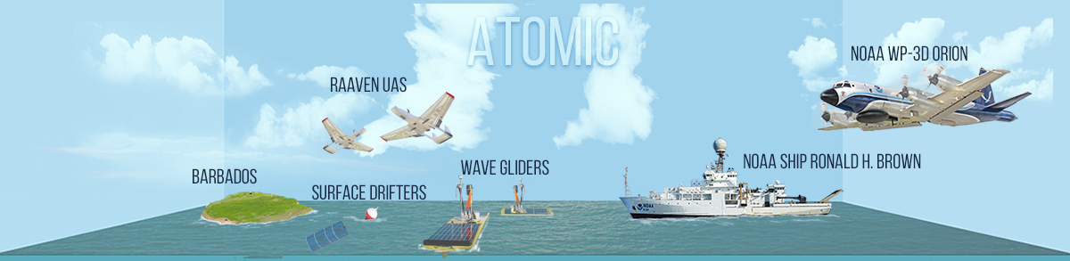
Process-level field observations enable meaningful improvements to precipitation representation in forecast models
Field Observations for UFS Improvement
The 2020 Atlantic Tradewind Ocean–Atmosphere Mesoscale Interaction Campaign (ATOMIC) delivered coordinated air-sea observations of trade-wind shallow convection in the tropical Atlantic, key for global precipitation. (funded by NOAA CPO/CVP +
PSL internal funds + CPO/COM data funds)
How are ATOMIC observations used for UFS ?
Drive UFS single-column model experiments, constrained by ATOMIC observations, to directly test and diagnose precipitation and convection physics
Inform improvements to UFS physics used in forecasts
Reveal precipitation biases in shallow convection regimes
Evaluate simulations of clouds, heat and moisture fluxes, and rainfall against observations
BOTTOM LINE

Slide 13
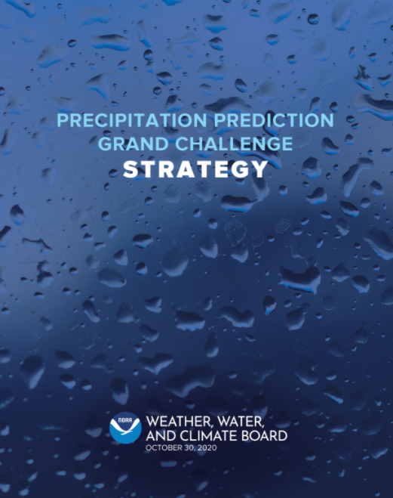
BOTTOM LINE
Summary
NOAA Precipitation Prediction Grand Challenge (PPGC) is an historic research-to-operations opportunity in NOAA to accelerate improvements of precipitation prediction skills
  PPGC targets doubling the rate of forecast skill improvement over the coming decade, a challenge for the UFS community!
  PPGC leverages and contributes to UFS development, improvement and applications.
PPGC activities contributing to UFS improvement and applications
  Improve physics and reduce systemic biases within the UFS framework
  Develop next-generation models, including WOFSCast and operational hardening of WOFS
  Integrate AI/ML for precipitation emulators and data assimilation
  Support process studies and use field observations (e.g.,TEPEX) to diagnose and improve model physical processes

