Slide 1
WELCOME
Unifying Innovations in Forecasting Capabilities Workshop 2026
July 23rd, 2026

Slide 2
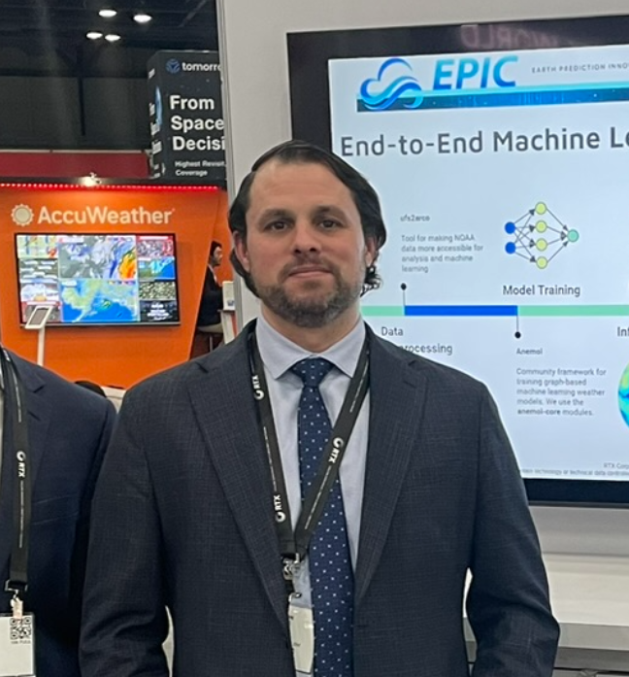
Today’s Master of Ceremonies
Aaron Jones
EPIC Community Engagement Scrum Master
RTX/EPIC RTE

Slide 3
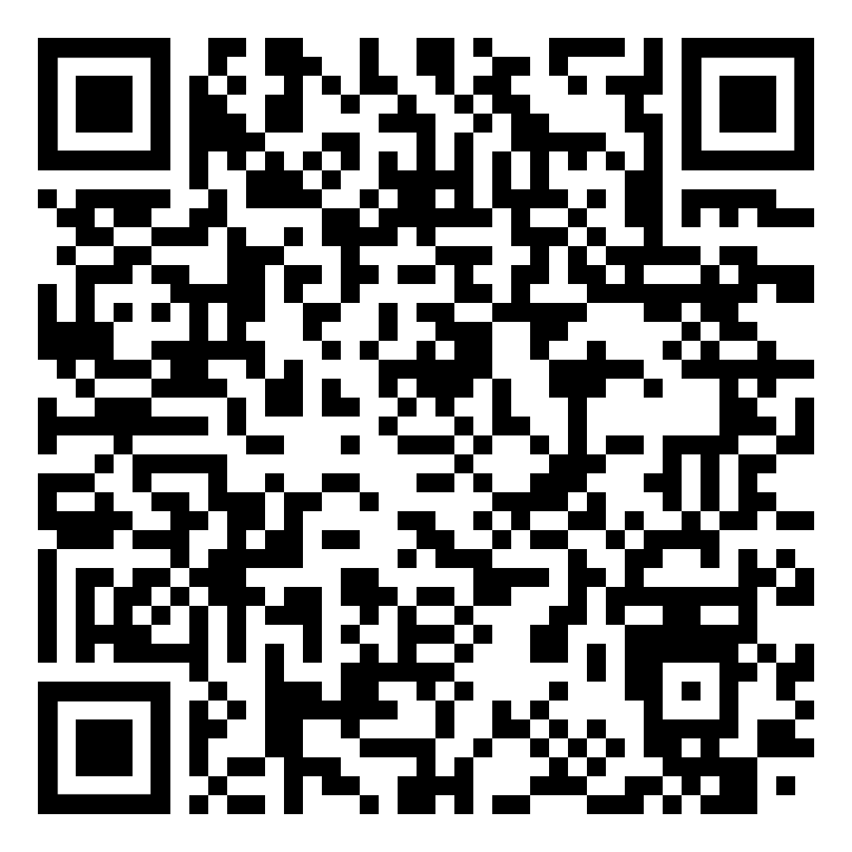
Transcription Announcement
The UIFCW is an open event that will be held via Google Meet and will be transcribed. By staying in the room (and online), you understand that your image, in video or still, and any sound recorded alongside it, will be streamed over Google Meet. The information that you provide may be used for websites, agenda's, and event descriptions.
For more information on NOAA's Privacy policy,
scan to read more:

Slide 4
Thursday, July 23rd
09:00 AM - 09:10 AM Welcome (General Vessey Ballroom)
09:10 AM - 10:45 AM Parallel Session 1:
Research to Operations to Research (R2O2R)
09:20 AM - 10:45 AM Parallel Session 2:
Data Assimilation (Part 3) (Rm 1101/1102)
10:45 AM - 11:15 AM Morning Break
11:15 AM - 12:00 PM Community Engagement
12:00 PM - 01:00 PM LUNCH

Slide 5
Thursday, July 23rd
01:00 PM - 01:30 PM AI4NWP at NOAA: Progress, Partnerships,
and the Path Forward (General Vessey Ballroom)
01:30 PM - 03:00 PM Artificial Intelligence (AI) for Numerical
Weather Prediction (NWP) (Part 1)
03:00 PM - 04:00 PM Poster Session II (Chesapeake Ballroom) + Afternoon Break
04:00 PM - 05:30 PM Artificial Intelligence (AI) for Numerical
Weather Prediction (NWP) (Part 2)
05:30 PM Adjourn

Slide 6
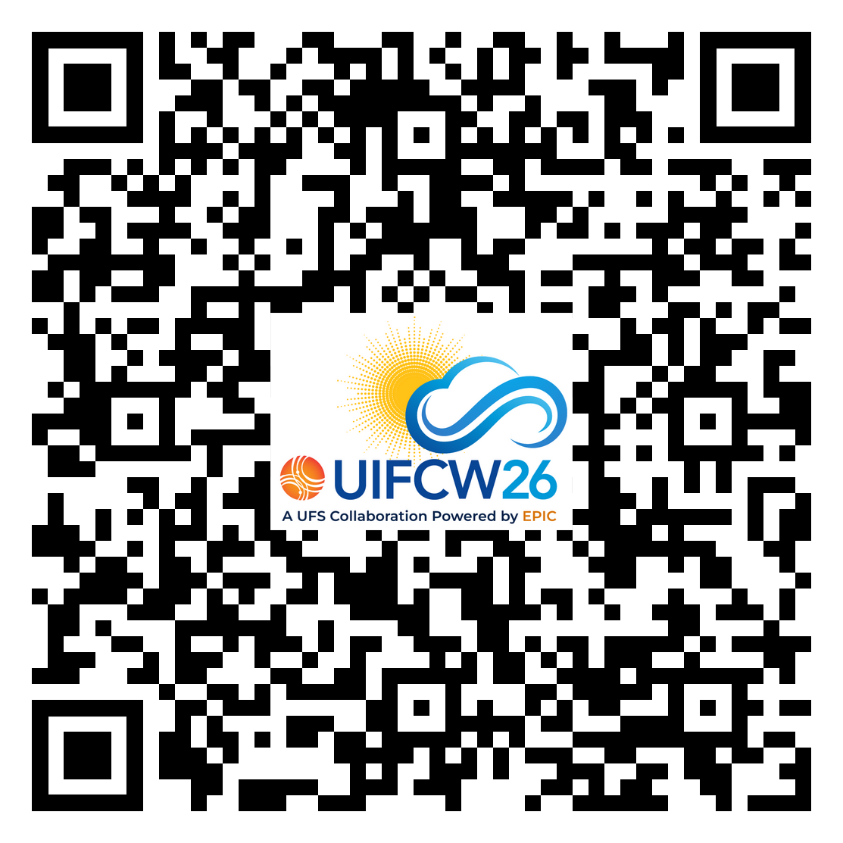




Connect With Us!
Event Guide
Use Google Meet Q&A to connect with speakers and other attendees.
Find us on:
@NOAAEPIC
NOAAEPIC
#NOAAEPIC
NOAAEPIC
Wi-Fi: UMUC-Guest Network
No password is required.

