Slide 1


An Overview of NOAA Unified Forecast System (UFS) Applications for Operational Forecasting Across Scales
Fanglin Yang
Modeling Division
NWS Office of Modeling and Development (OMD)

Slide 2
Acknowledgements
Project leads, model developers, and management across NWS/OMD.
Collaborators from OAR laboratories, EPIC, NCEP centers, and the broader UFS community.
Funding support from the NWS/OSTI Modeling Program; OAR/WPO Synoptic, DRSA, IRA, and JTTI programs; and other funding sources.

Slide 3
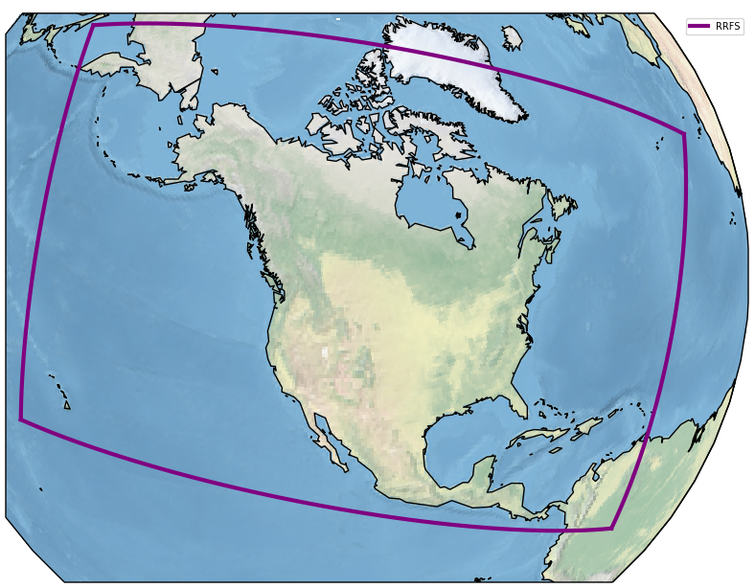
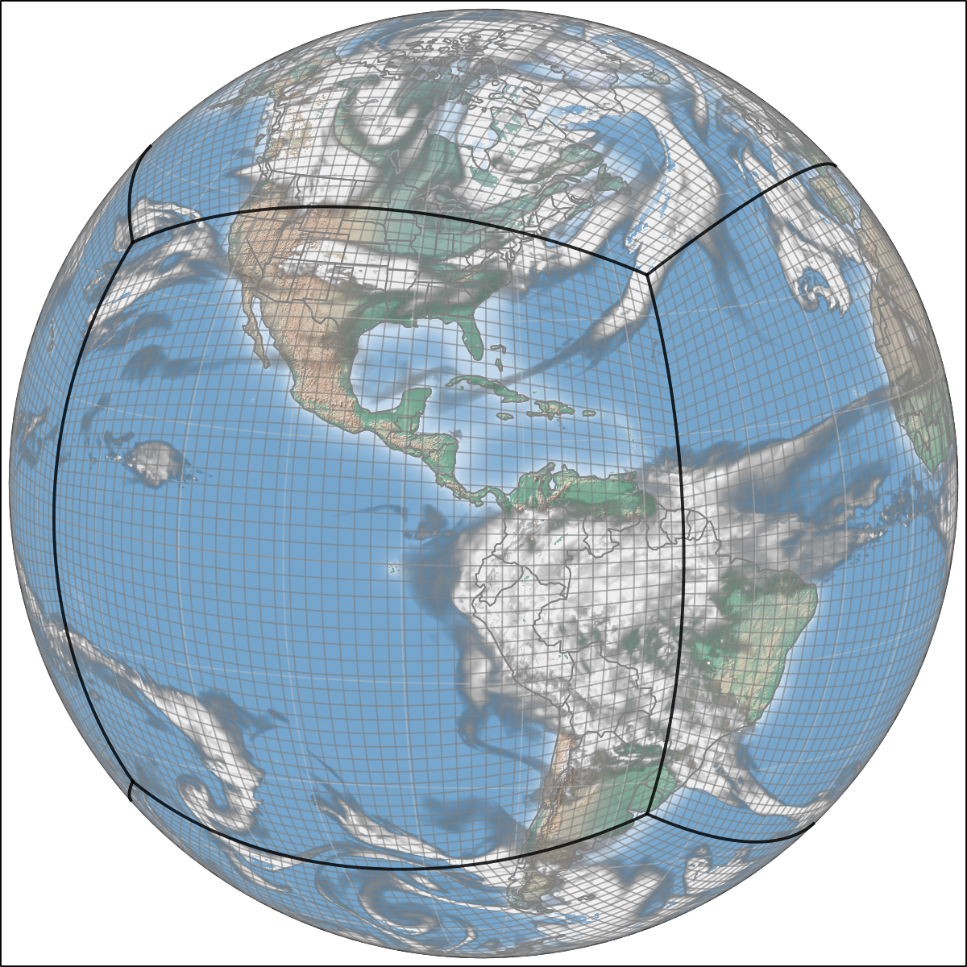
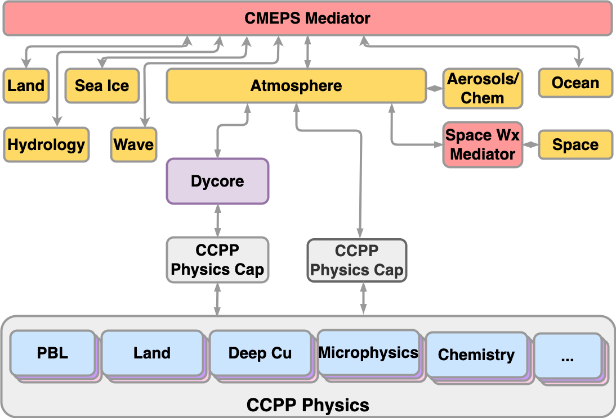
NOAA has been collaborating with the US weather and climate science community in the past few years to develop the next generation fully coupled earth system modeling capability for both research and operational forecast applications across different temporal and spatial scales.
GEFS
RRFS
WAM
SFS
AQM
GFS
GCAFS
HAFS
Regional:
HAFS - Hurricane Analysis and Forecast System (~4km/2km)
RRFS - North America Rapid Refresh Forecast System (3km)
AQM - North American Air Quality Model (12km)
Global:
GFS - Medium-Range Deterministic Weather Forecast Model (9km)
GEFS- Global Ensemble Sub-Seasonal Forecast System (25km)
GCAFS- Global Chemistry and Aerosol Forecast System (25km)
SFS - Seasonal Forecast System (50km)
WAM - Whole Atmospheric Model (up to 500 km; 100km)
  WAVEWATCH III wave
  CICE6 sea-ice
  GOCART aerosols
  CMAQ air quality
  CMEPS mediator
  FV3 dycore
  CCPP physics
  MOM6 ocean
  Noah-MP LSM

Slide 4
Upcoming Implementations for NWS Operation (not inclusive)
NWS Central Operation (NCO) will upgrade its operational supercomputer in late 2026 and 2027. The following applications have reached T2O status. However, OMD and NCO have to prioritize implementations.
Model | Major Changes | schedule
HAFSv2.2 | upgrade physics and vortex initialization | Q3 FY26
RRFSv1/REFSv1 | North American deterministic and ensemble systems | Q4 FY26
NWPSv1.5 | Nearshore Wave Prediction System; upgrade to unstructured meshes, add wave runup (erosion/overwash) and rip currents guidances | Q3FY26
GFSv17 | First fully coupled NWP system | FY27
SFSv1 | Seasonal prediction system, to replace CFSv2 | FY27-FY28
GCAFSv1 | First global aerosol modeling system with JEDI DA | Delayed
AQMv8 | Upgrade physics and CMAQ | Delayed
RTOFS.v3 | Real-time high-res ocean analysis and forecast system. Replacing HYCOM with MOM6 | canceled

Slide 5

Global Forecast System (GFSv17)
Oral Presentation (Wed, PARALLEL SESSION 4)
Catherine Thomas - Overview of the Next Global Forecast System GFSv17
Ruiyu Sun - Physics Advancements in GFSv17
5 Posters
(Tue) Ming Chen - Wave Evaluation for the next Global Forecast System GFSv17
(Tue) Zhichang Guo - Evaluation of Land Surface Variables in the Global Forecast System (GFSv17) Retrospective and Real-Time Forecast Experiments
(Tue) Lydia Stefanova - Examining the Shift in Large-Scale Biases and RMSE: From GFSv16 to the Fully Coupled GFSv17
(Tue) Young-Joon Kim - Evaluating Global Model Fidelity via Troposphere-Stratosphere Coupling and Teleconnection Indices
(Thurs) John Steffen - Implementation of a JEDI-based marine data assimilation system for GFSv17

Slide 6
GFSv17 -- NOAA First Fully Coupled Earth System NWP Model
Forecast Model
ATM: FV3
13 km → 9 km horizontal resolution
Fractional land-sea mask
GFDL → Thompson Microphysics
Updates in Convection, PBL, and GWD, etc
Noah → Noah-MP Land Model
WAV: WAVEWATCH III
Unstructured grid (~15km)
Feedback to ATM & OCN
New Components:
MOM6 (¼° tripolar, 75 hybrid layers)
CICE6 (¼° tripolar)
CMEPS (coupling mediator)
Data Assimilation
ATM (Analysis/DA Ensemble: 25km)
Adding multiscale formulation
Adding soil temperature/moisture analysis
LAND
New JEDI snow DA component
OCN/ICE
New JEDI marine DA component
UFS Driver
Atmosphere:
UFS ATM
FV3 dycore
CCPP Physics
Noah-MP
Ocean:
MOM6
Mediator:
CMEPS
Waves:
WAVEWATCH III
Ice:
CICE6

Slide 7
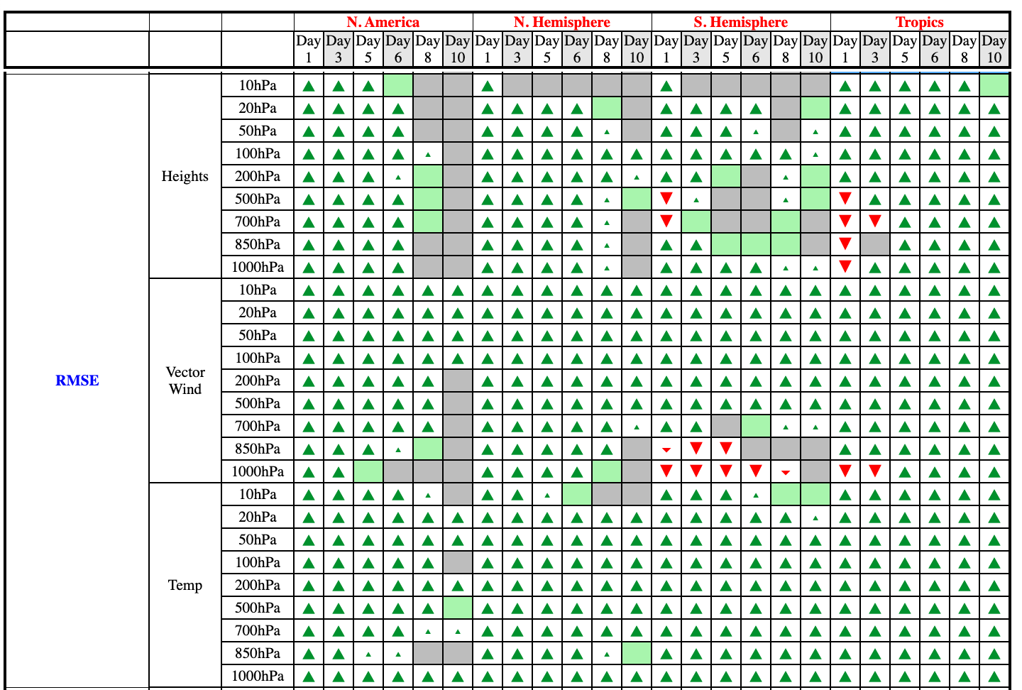
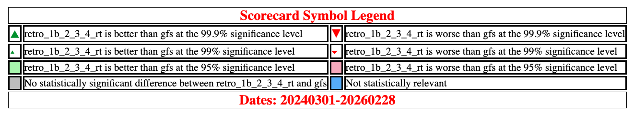
GFSv17 vs. GFSv16 Scorecard (3/1/24–2/28/26)
The GFSv17 vs. GFSv16 Scorecard (right) highlights
the statistically significant improvement over North America and the Northern Hemisphere at all pressure levels and at most lead times
Some statistically significant degradation in mid-level geo. height and low-level vector
wind over the Southern Hemisphere and Tropics at
shorter lead times, but much
more improvement overall
Geo. Height
RMSE
Vector Wind
Temperature

Slide 8
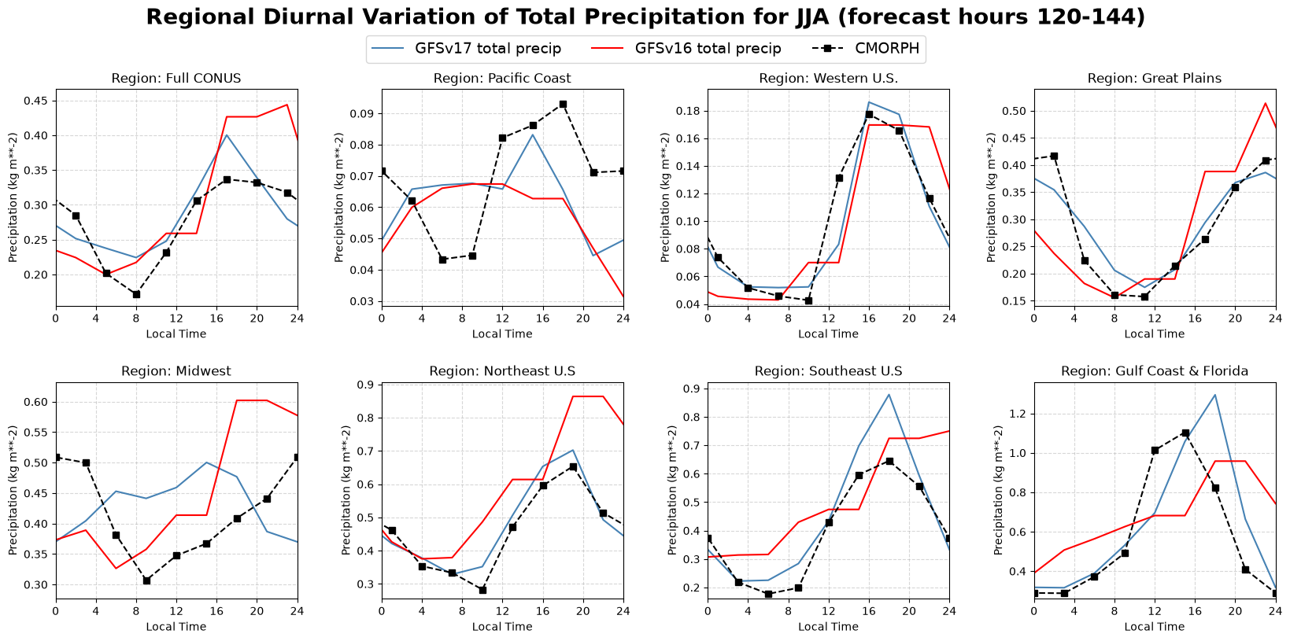
+
+
+
+
+
Graphics Made by NERTO summer intern: Zack H'Doubler from UMD

Slide 9
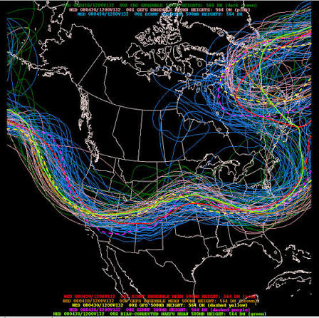
Global Ensemble Forecast System (GEFSv13)
NOAA’s first fully coupled ensemble subseasonal prediction system.
Uses the same system components and atmospheric physics suite as GFSv17, but at 25-km resolution.
Reforecasts are initialized by replaying ERA5/ORAS5 analyses, while real-time forecasts use GFSv17 initial conditions.
Approximately 50% of the reforecast dataset had been completed as of September 22, 2025.
However, due to resource limitations and the reprioritization of OMD projects, GEFSv13 development has slowed. The timeline for its operational implementation has not yet been determined.

Slide 10
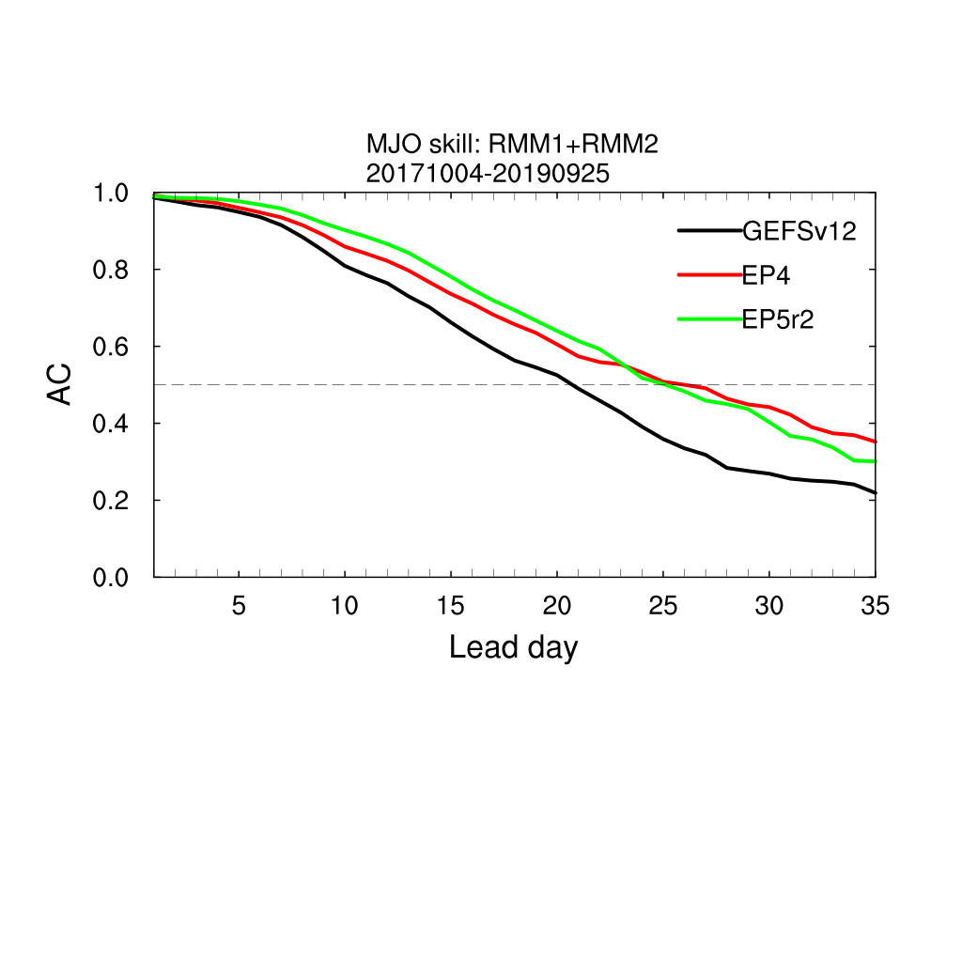

Slide 11


Seasonal Forecast System (SFS)
Web Link
Experimental Data on AWS Bucket
Oral Presentations
Yan Xue: NOAA’s Seasonal Forecast System Project: Progress, Challenges, and Stakeholder Engagement
Phillip Pegion: Practical Strategies for Initialization of the Seasonal Forecast System
Wanqiu Wang: Evaluating SFS Beta: Early Skill Relative to CFSv2
Weizhong Zheng: Performance Assessment of Land Surface Fields in NOAA’s Seasonal Forecast System (SFS)

Slide 12
SFS to replace CFSv2
 | CFSv2 | SFS
Atmosphere | T126/L64, GSM | C192L127 (~50km), FV3
Land | Noah 4 level soil model | NOAH-MP
Ocean | 2-way coupling with MOM4 (0.25°-0.5°, tripole grid, 40 Levels) | 2-way coupling with MOM6 (0.25° tripole grid, 75 layers)
Sea Ice | 2-way coupling with SIS1 (0.5° tripole grid, 5 ice thickness categories) | 2-way coupling with CICE6 (0.25° tripole grid, 7 ice thickness categories)
CFSv2 has been in operation since 2011. It runs four times per day using a lagged ensemble
SFS will run once per month with 30 perturbed ensemble members.
Accelerated implementation timeline: direct deployment on WCOSS3 by the end of 2027.
CFSv2 will not be ported to WCOSS3 and will be retired when WCOSS2 is decommissioned.

Slide 13
SFS related development
  Hydrostatic FV3 dynamics (up to a 40% reduction in computational cost).
  ECMWF nonstationary gravity wave scheme for improved QBO simulation.
  Updated McCormack (2015) ozone parameterization, restoring the Antarctic ozone hole.
  Total turbulent energy (TTE)-based eddy-diffusivity mass-flux (EDMF) vertical mixing scheme.
  Tuned atmospheric physics and MOM6 background gustiness to reduce systematic SST biases.
  Sliding 6-year averaged MERRA-2 aerosol climatology.
  Refined SKEB and SPPT schemes to improve SST ensemble spread.
  Reduced sea-ice analysis and prediction biases, particularly the underestimation of Arctic sea-ice coverage during the warm season.

Slide 14
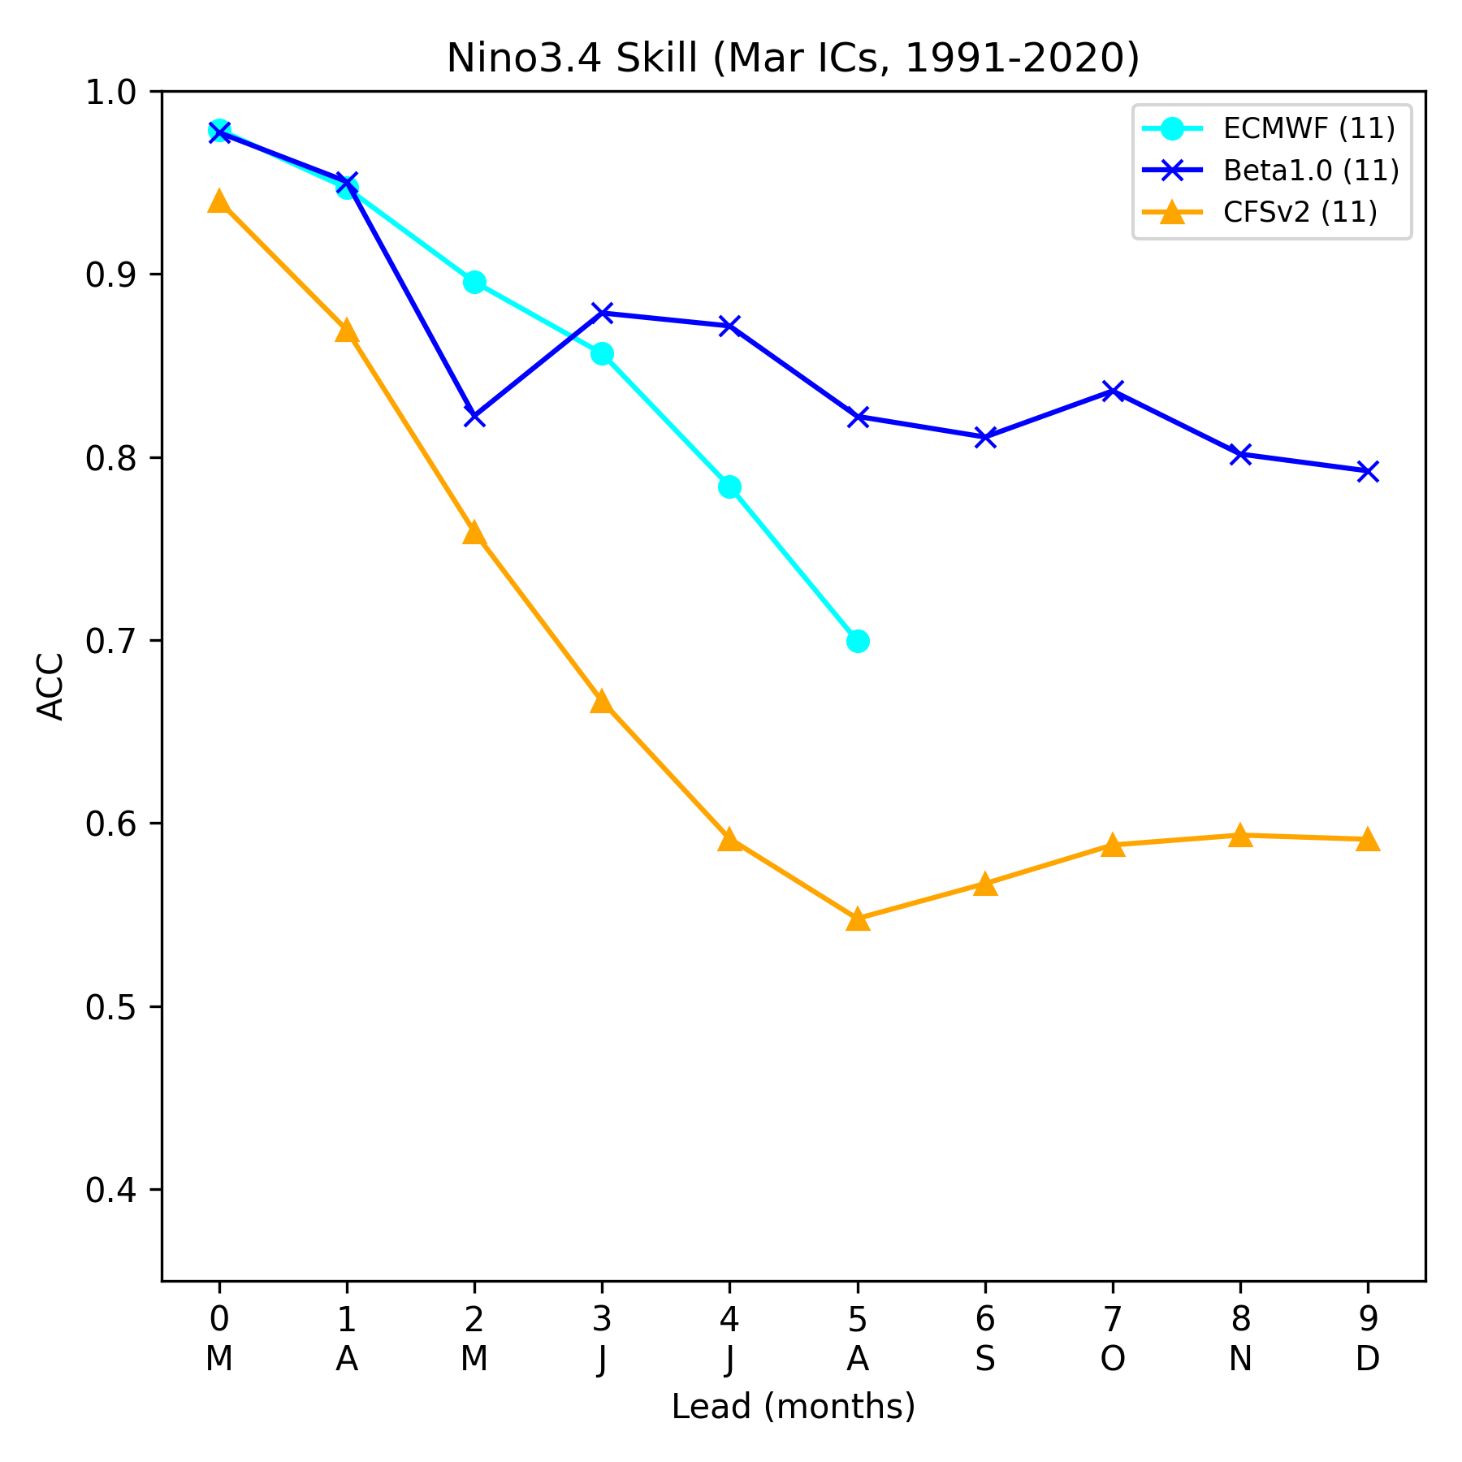
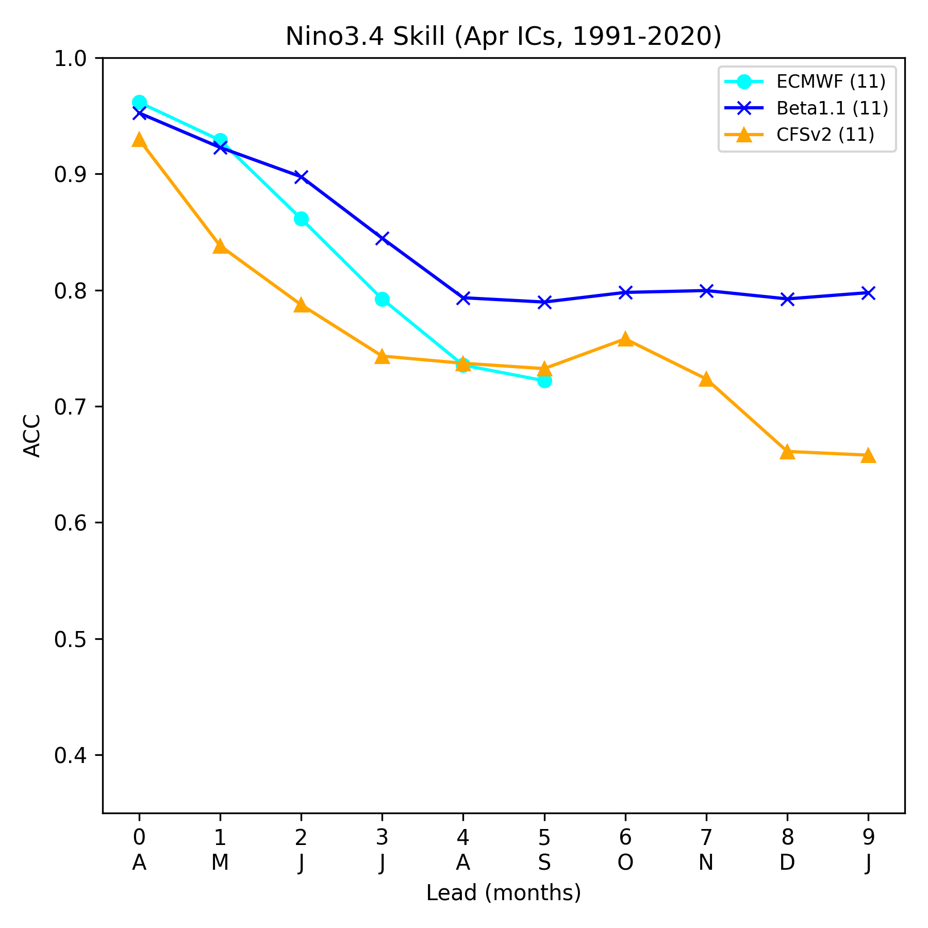
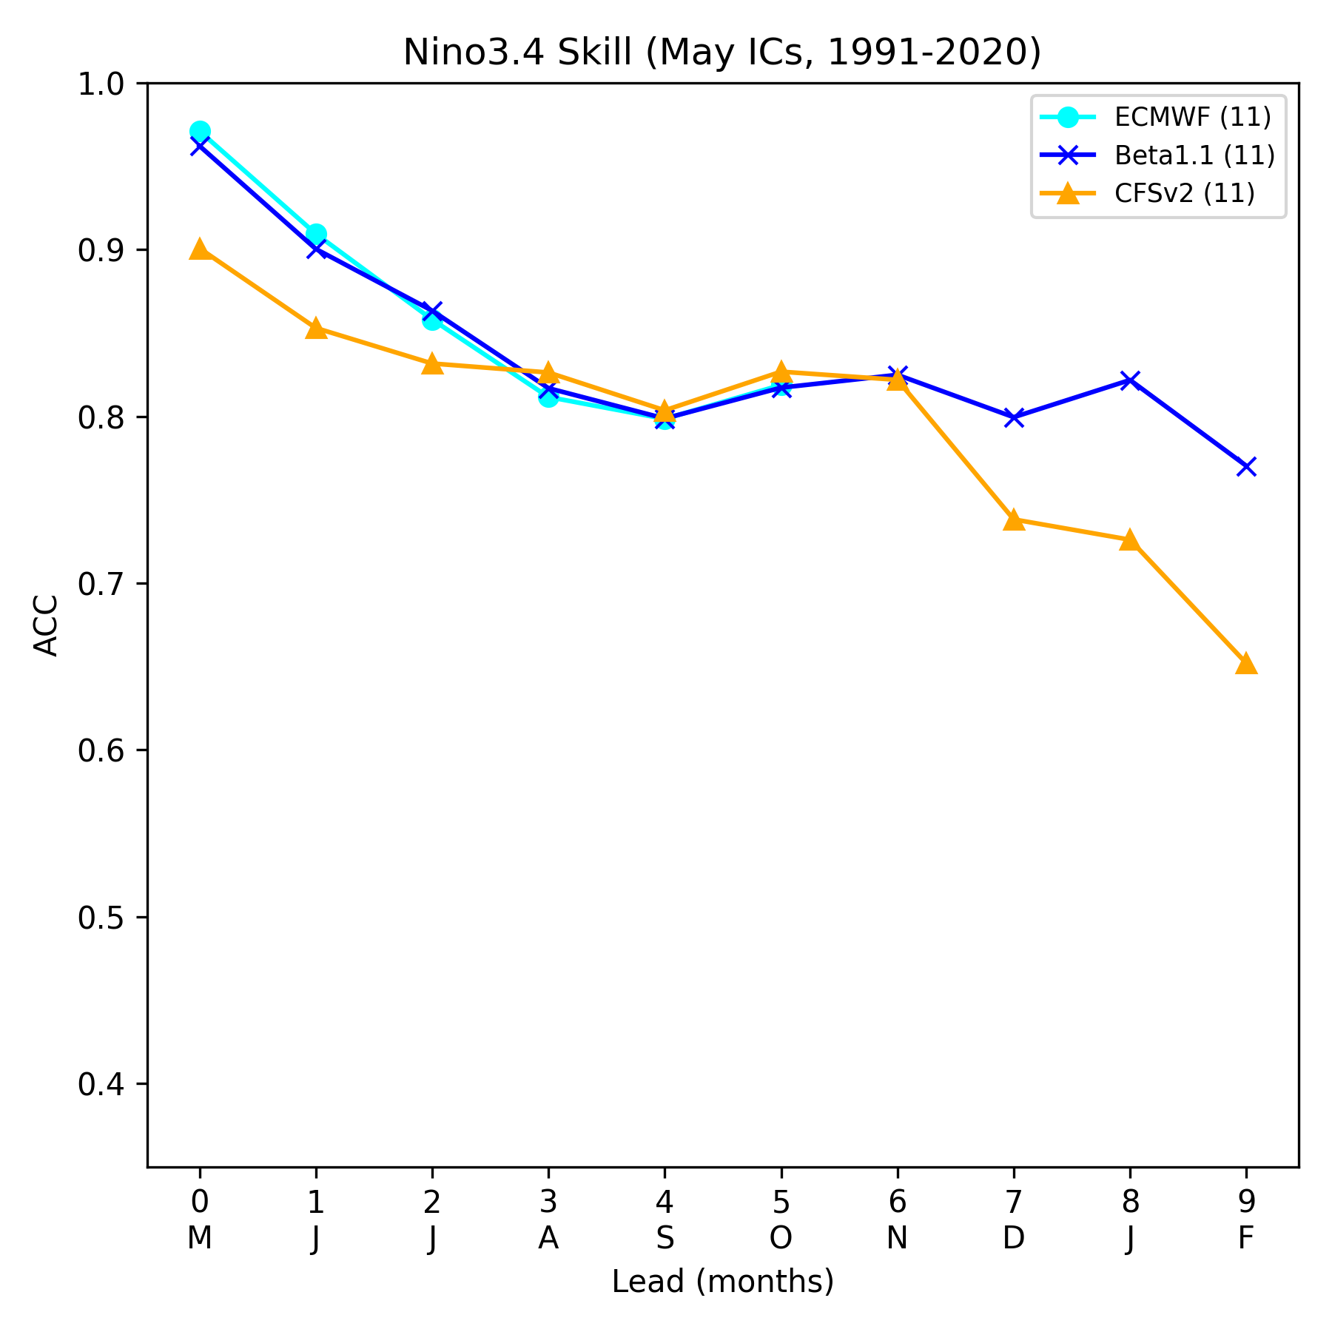
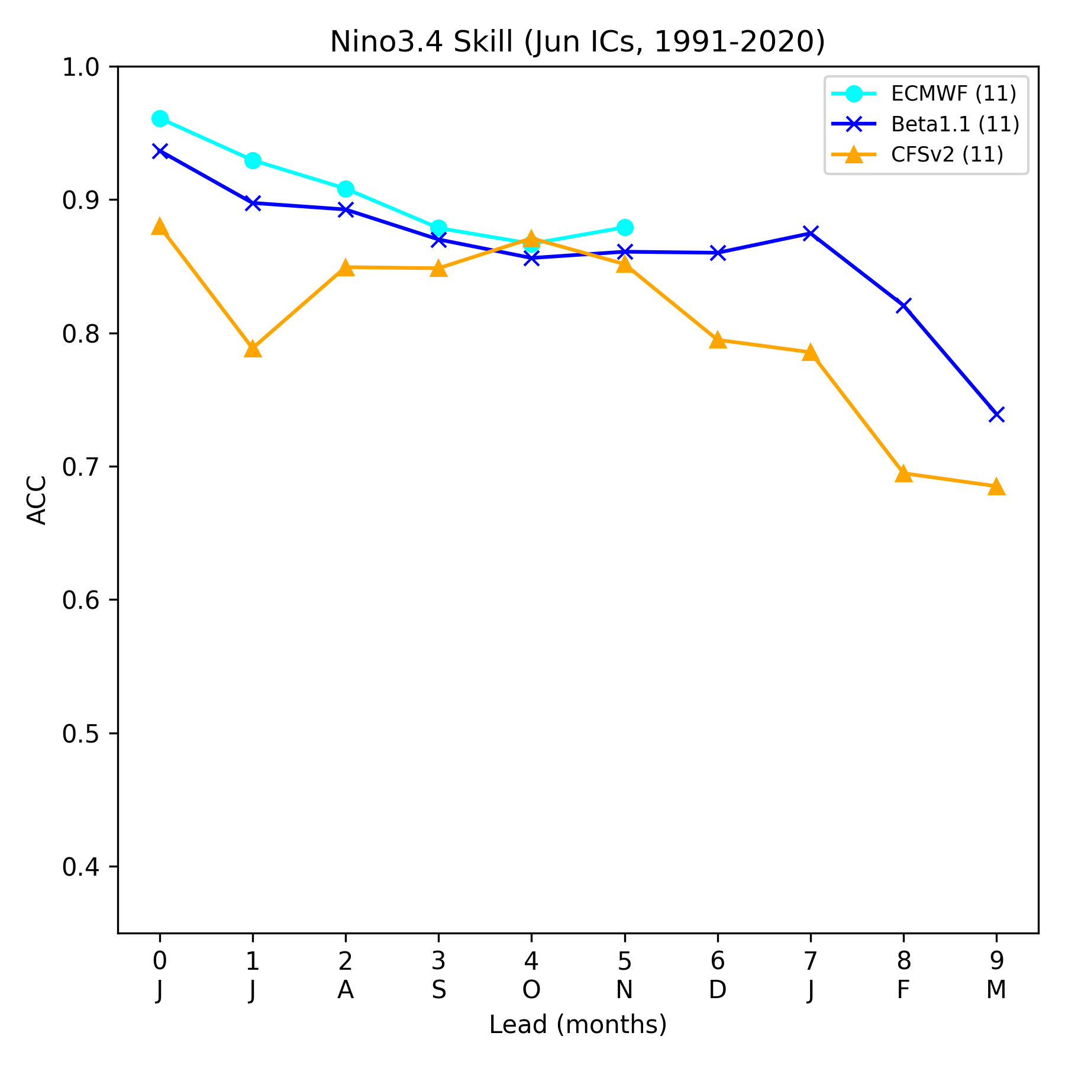
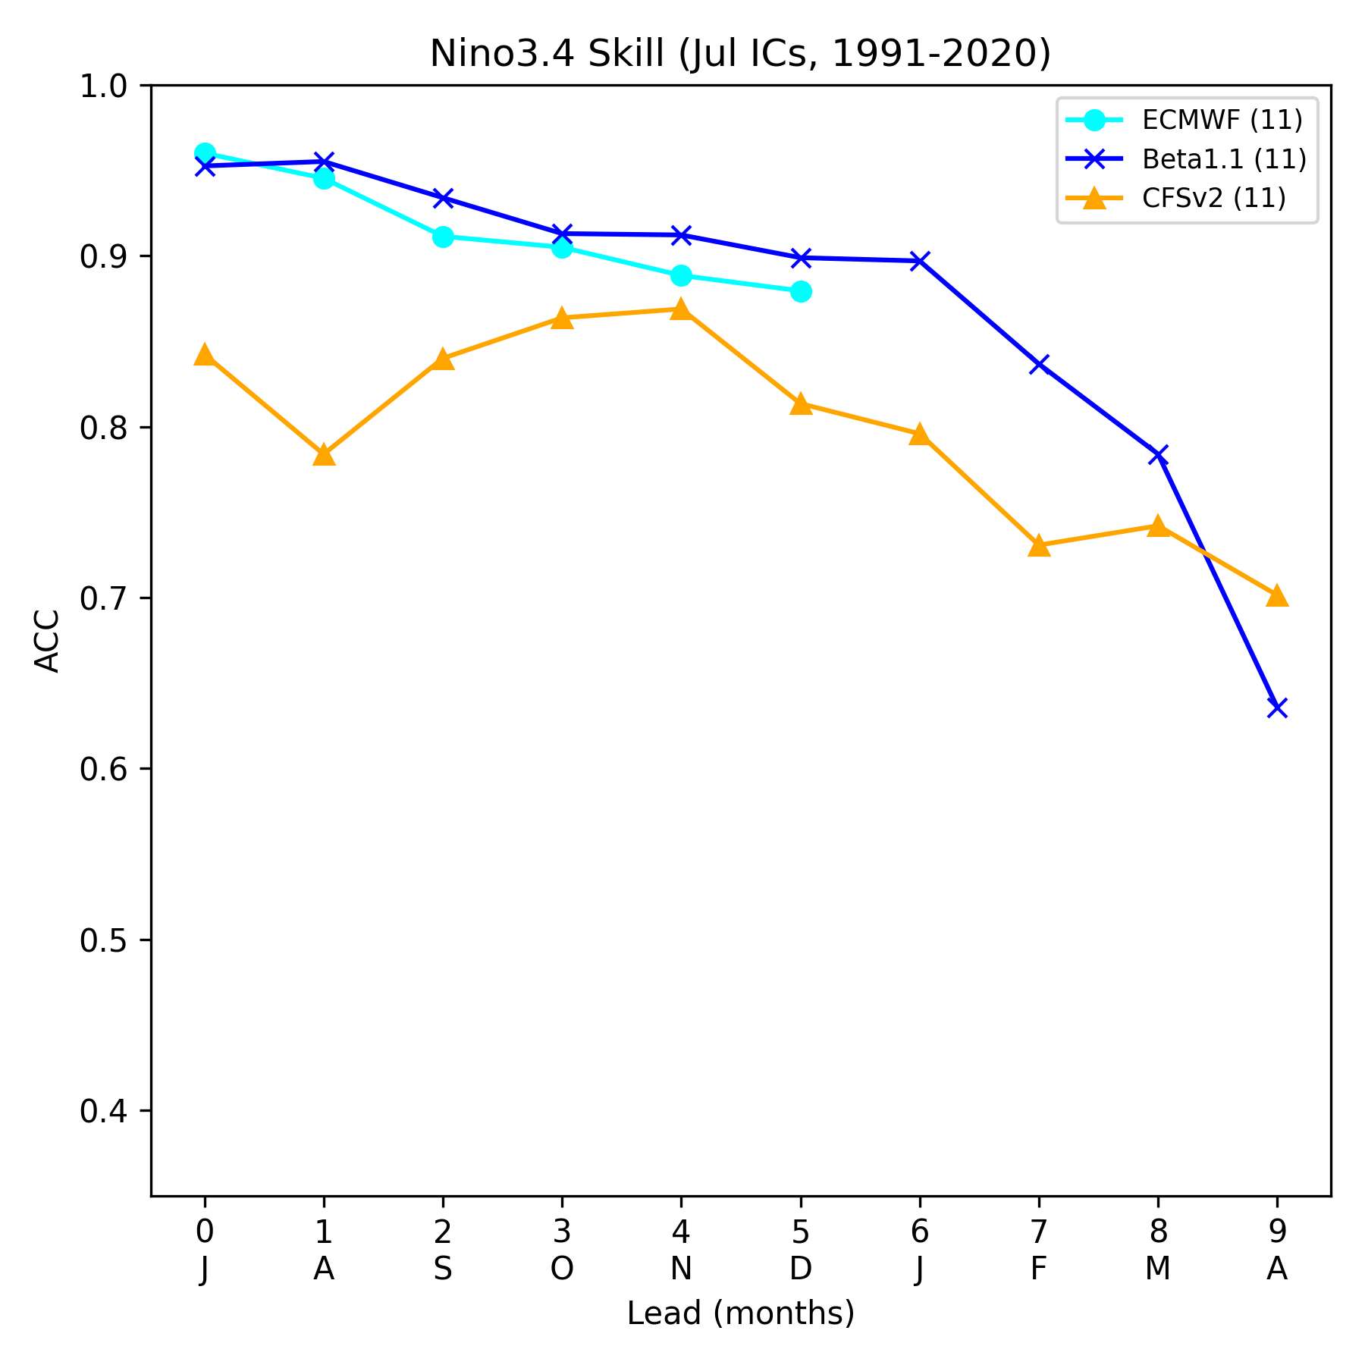
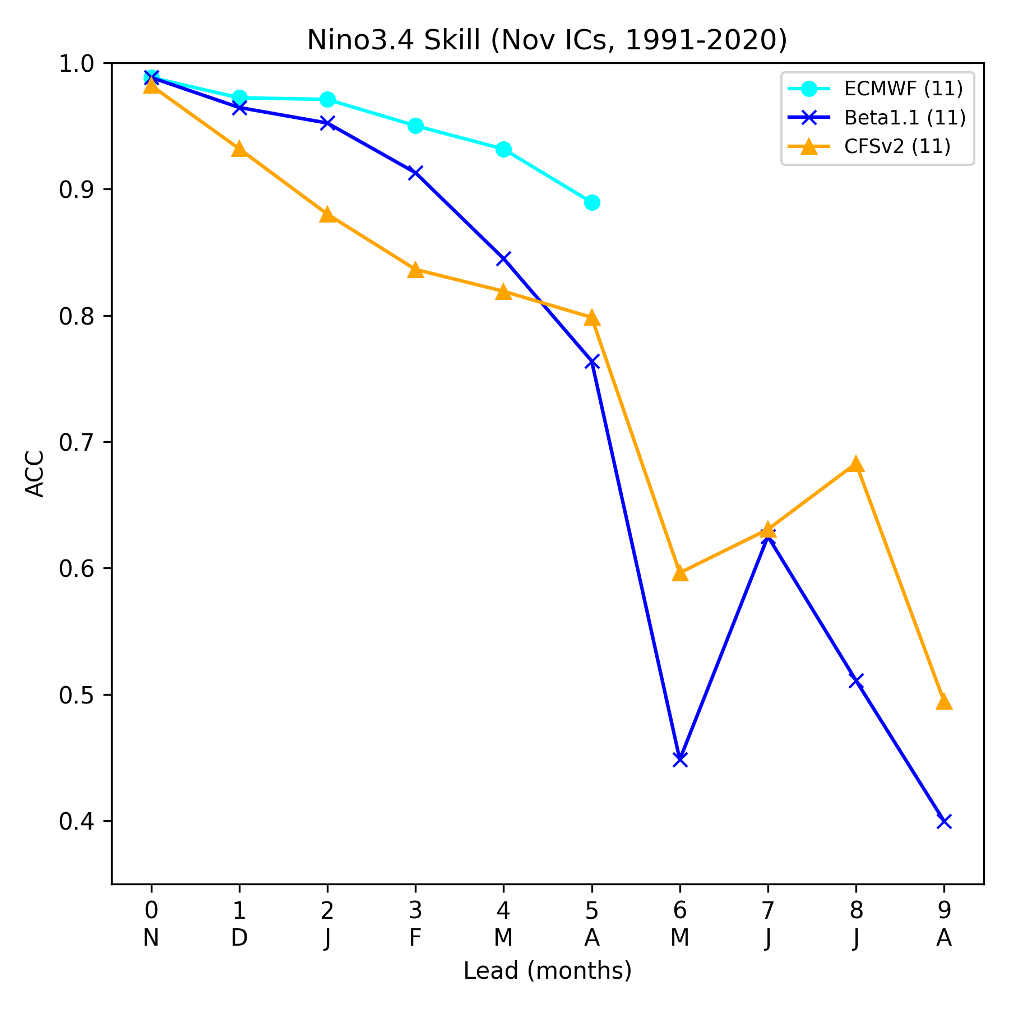
SFS-beta1 evaluation: Nino3.4 ACC comparison
Mar ICs
April ICs
May ICs
Jun ICs
  Mar-Jul
    SFS shows improved skill for March-July ICs, especially for March and April
    SFS is overall comparable to SEAS5
  Nov
    SFS shows improved skill for the first 5 months
    SFS becomes less skillful after April
Jul ICs
Nov ICs
Provided by NCEP/WPC Wanqiu Wang

Slide 15
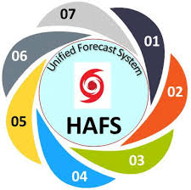
Hurricane Analysis and Forecast System (HAFS)
HAFSv1, first major UFS-based hurricane application, was implemented for NWS operation on June 27, 2023
HWRF and HMON will be retired after the 2026 hurricane season
Oral Presentation (6)
Zhan Zhang: UFS Hurricane Application HAFS: 2026 Upgrades and Future Plans
Jing Cheng: Transitioning HAFS Data Assimilation to JEDI: Observation Dataset Readiness and Integration in HAFS
Sundararaman Gopalakrishnan: Hurricane Analysis and Forecast System: R&D and R2O
William Ramstrom: Efficient High Resolution Forecasts of Hurricanes through Basin-Scale and Telescoping Nest HAFS
Jason Sippel: A Summary of HAFS Data Assimilation Activities at the Atlantic Oceanographic and Meteorological Laboratory
Hyun Sook Kim: Preliminary Results of Weakly Coupled Data Assimilation - Hurricane Analysis and Forecast System (WCDA-HAFS) Forecasts
Posters (7)
Bin Liu: 2025 and 2026 HAFS Real-Time Parallel Experiments: Innovations, Performance, and Operational Transition
Jiayi Peng: HAFS Ensemble Development on Cloud Platforms
Feng Hsiao: Physics Sensitivity of All-Sky Infrared Radiance Assimilation in HAFS-JEDI and Its Impact on Tropical Cyclogenesis Forecasts
Yu-Shin Kim: Strongly Coupled Assimilation of Atmospheric Boundary Layer Observations for the Rapid Intensification of Hurricane Ida (2021) using the CADRE Self-cycled HAFS-JEDI System
Chuan-Kai Wang: Impact of High Resolution and Scale-Aware Physics on HAFS: Results from Idealized Tests and Hurricane Milton (2024)
Hananeh Jafary: Evaluation of GFDL and EMC Hurricane Tracking Systems During the 2025 Hurricane Season
Xuejin Zhang: A Prototype AI-Based Quality Control Package for Cloud Physics Observations of Hurricane Field Program at NOAA

Slide 16
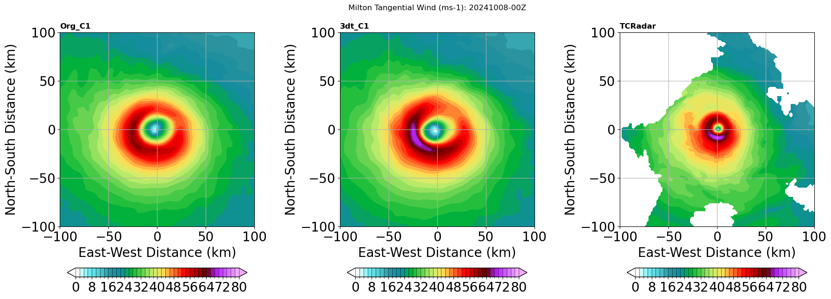
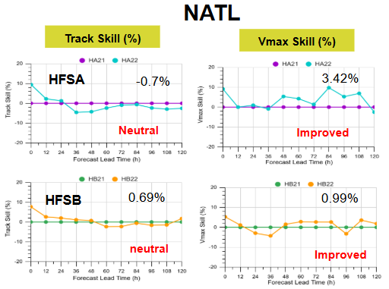
HAFS v2.2 Major Upgrades
Scale-aware 3DTKE turbulent mixing scheme
Vortex Initialization
Adjusted warm cycling threshold (40 kt to 30 kt)
VI related changes with storm perturbation smoothing
Data Assimilation
Adjusted IAU window
hafs_datool updates: fix related to uv_rotation, use of MPI
TDR superobbing
Additional obs: Commercial GPS RO and sUAS observation data
Model Physics
Scale-aware 3DTKE EDMF GFS PBL
Noah-MP LSM
Transition from RRTMG to RRTMGP
Variable mixing length scales with wind speed and PBLH
Notes:
progsigma: prognostic updraft area fraction that is used for closure computations in saSAS deep and shallow convection

Slide 17
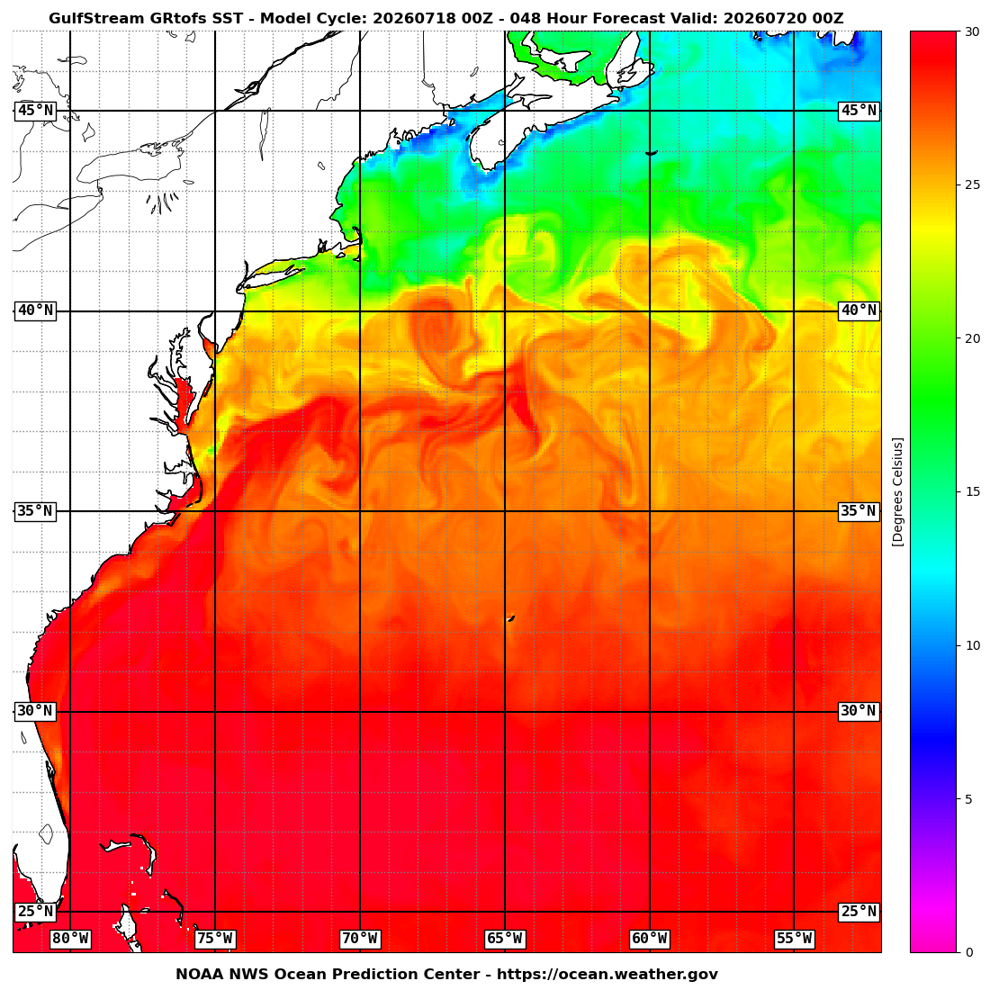
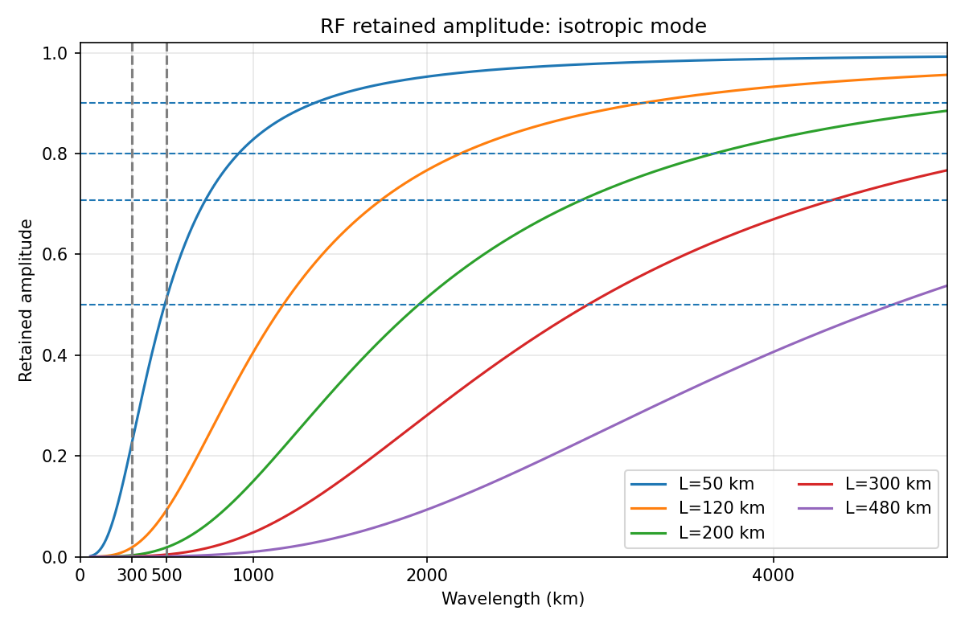
Key Priorities for Future Development and Transition to Operation (1)
GFS
  Mitigate biases identified in GFSv17
  Spectral nudging to AI-GFS
  Transition atmospheric data assimilation to JEDI
  Merge RTOFS into GFS, increase ocean resolution to 1/12°, and update marine DA
  Transition to the MPAS dycore
RTOFS
HAFS
  Spectral nudging parent domain to AI-GFS
  JEDI transition for data assimilation
  Storm-Centric config with telescopic higher resolution moving nest
  Basin scale multi storm structure
  AI/ML HAFS ensemble predictions
Recursive filter separates large vs small scales

Slide 18
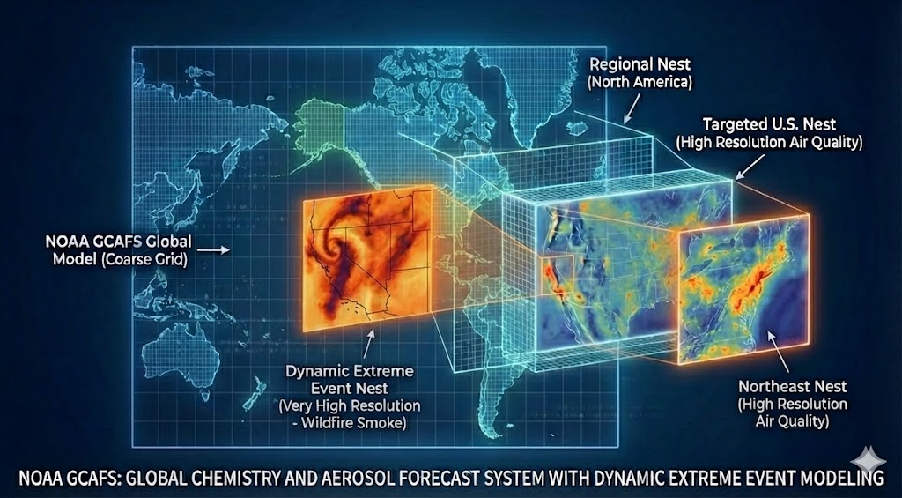
Key Priorities for Future Development and Transition to Operation (2)
GEFS
  Redesign the GEFSv12 two-tier SST system to remove its dependency on CFSv2 and prepare for the transition to WCOSS3.
  Reconfigure GEFSv13 to reduce computational cost, complete reforecasts, and prepare for future operational implementation.
Air Quality and Atmospheric Composition Modeling
  Transition AQMv8 and GCAFSv1 into operation
  Include gas-phase chemistry in GAFSv2
  Merge AQMv8 to GCAFS, retire AQM.
  AI/ML ensemble AQ/AC modeling
  Transition to MPAS dycore

Slide 19
Key Priorities for Future Development and Transition to Operation (3)
RRFS: JEDI data assimilation; RRFSv2 development and T2O
WoFS: Warn on Forecast System (v2), JEDI+MPAS, development and T2O
RWPS: replace multi-domian NWPS with a single-domain high-resolution wave forecast system

Slide 20
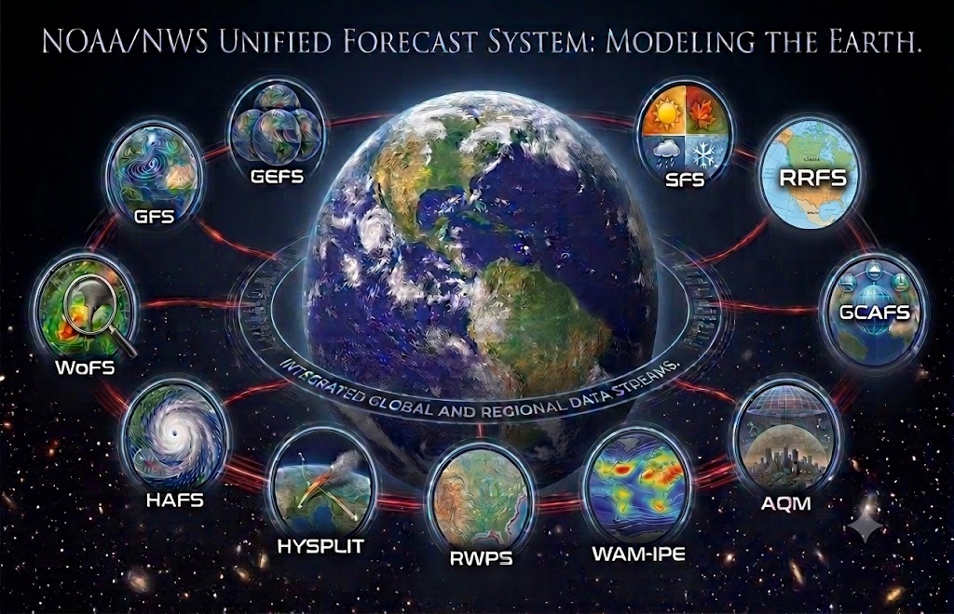
Thanks you
Image Created with Gemini

