Slide 1

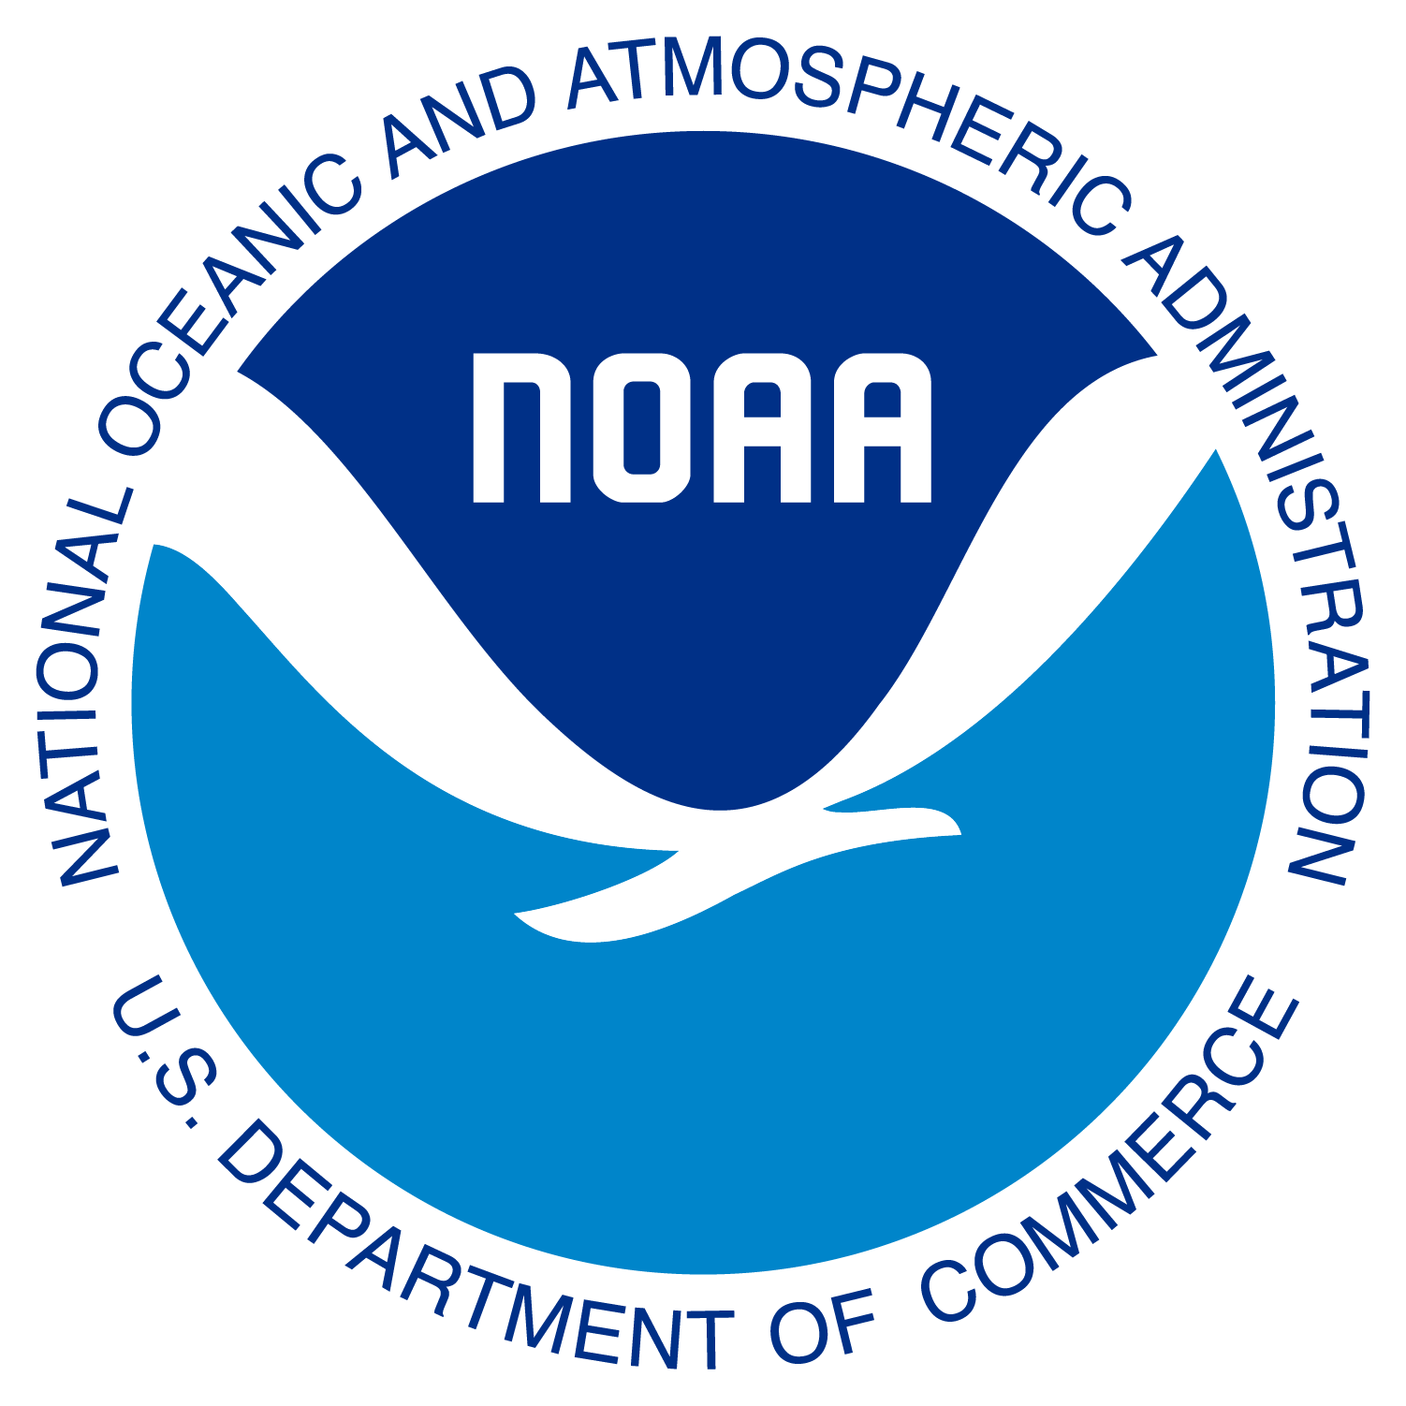
An Efficient and Sustainable Development and Implementation Lifecycle
Jacob R. Carley¹, Steven Earle², Rahul Mahajan¹, Daniel Holdaway¹, Jason J. Levit¹, Vijay Tallapragada¹, Geoffrey Manikin¹, Scott Scallion¹, and Arthur Taylor¹
¹NOAA/NWS/Office of Modeling and Development, Riverdale Park, Maryland
²NOAA/NWS/NWS Central Operations, Riverdale Park, Maryland
Gemini was used to assist with drafting portions of this presentation.
The content has been reviewed, edited, and validated by NWS staff.

Slide 2
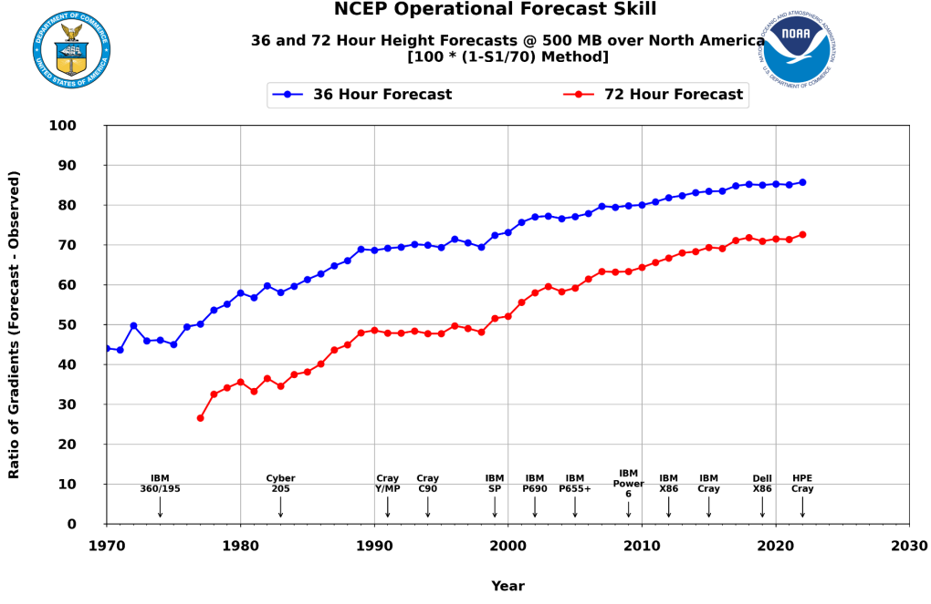
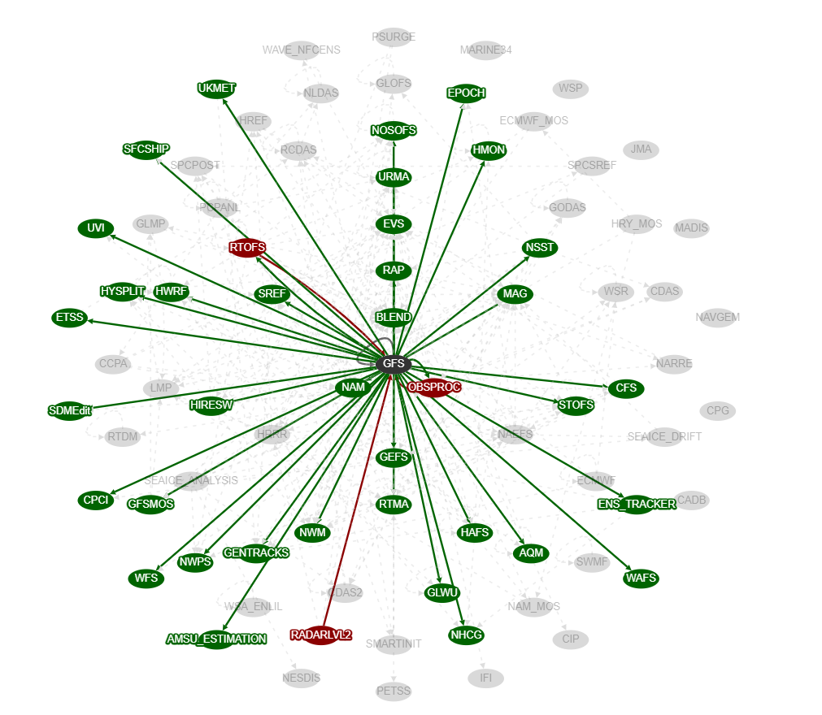
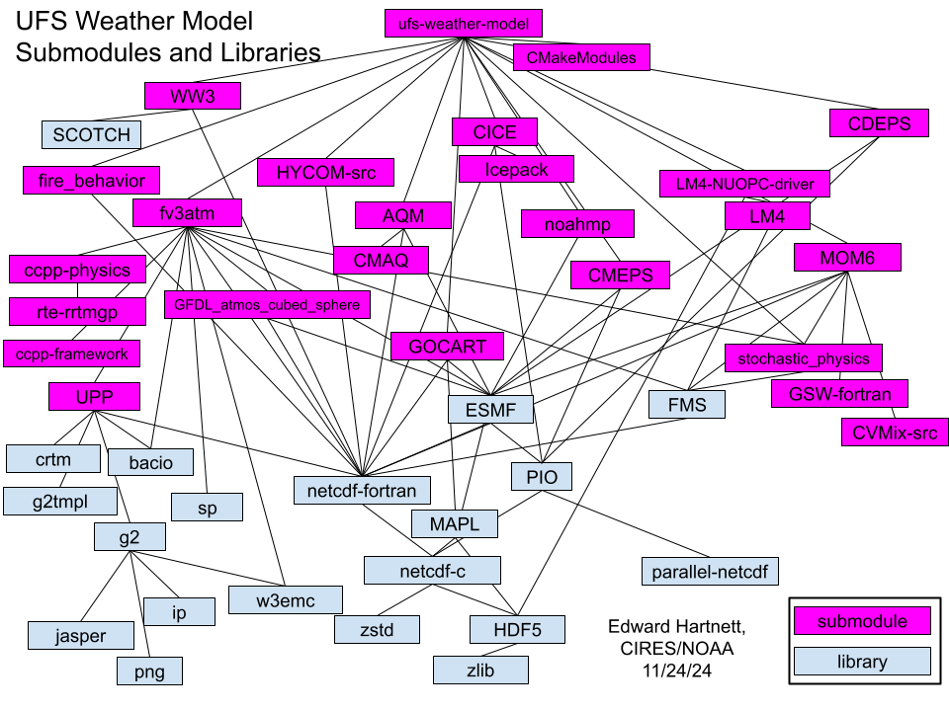
A Foundation of Success Built Upon Growing Complexity
Our Success
25 Years of 97.5%+ On-Time Product Delivery, enabled by strict standards and fault tolerant designs.
The Growing Complexity
The operational suite has grown increasingly complex.
1997: ~2 million lines of code.
2025: ~106 million lines of code.
Improved skill
18 MegaFlops 11 PetaFlops
The operational production suite and its associated dependencies. The GFS is highlighted.

Slide 3
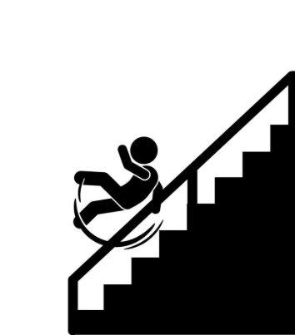
The Danger of Waterfall Development Cycles
Cascading Delays
If one flagship component is delayed, the entire monolithic upgrade is delayed.
Unpredictable Readiness
Upgrades are planned based on anticipated scientific innovations, but science evolves nonlinearly.
Requirements
Design
Major Risk
Full end-to-end testing occurs at the end of the multi-year dev cycle, maximizing delivery stress and operational risk.
Development
Testing
Deployment
Maintenance

Slide 4
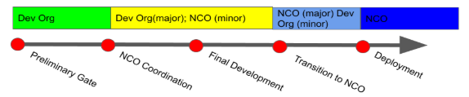
The Current T2O Gates Approach [~5 years old]
Dev
Ops
This is a fundamentally linear, waterfall exercise.
Hand-offs lead to friction.
Dev and Ops remain at opposite ends.
Hardening code is delayed until final deployment → burnout!

Slide 5
Paradigm Shift → Addressing Complexity and Bringing Agility
 | Legacy | DevOps
Planning | Anticipated scientific maturity | Based on what is verified ready now
Pacing | Infrequent, 2-4 year, monolithic deployments | Predictable, continuous rhythm of smaller upgrades
Testing | Manual, system-level end-to-end | Automated, CI tests
Architecture | Highly coupled, monolithic codebase | Decoupling software, introducing APIs and SLAs

Slide 6
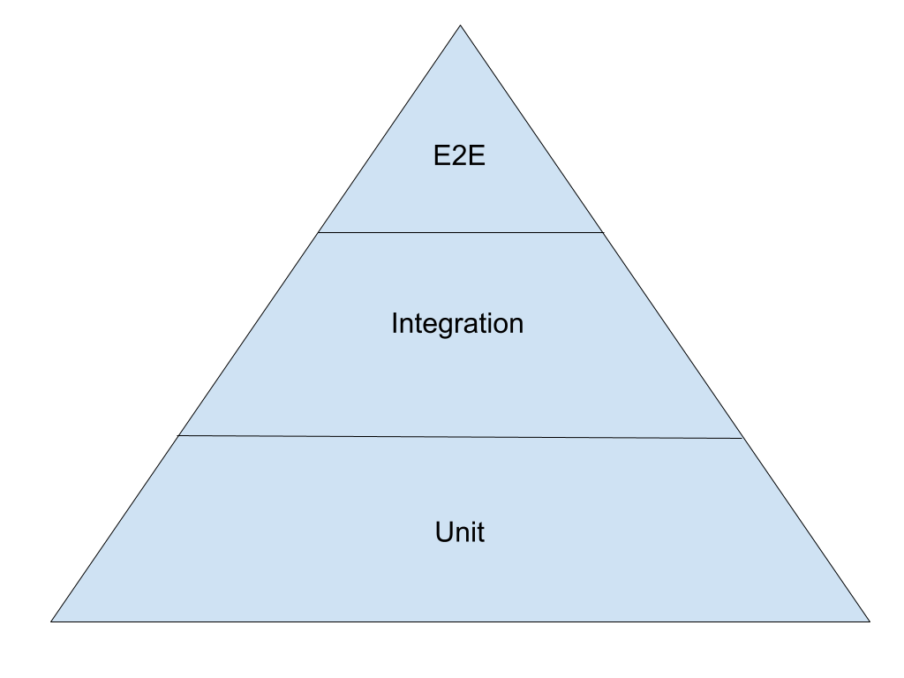
Architectural Enablers for DevOps
Improved Testing with Automation
Toward Coupled Models & Decoupled Software
More integration
Slower
Fewer tests
Faster
More tests
More isolation
Decompose monolithic applications into components and libraries
Introduce APIs and mandatory SLAs for upstream dependencies in the production suite
Increase automation (CI)
Increase unit test coverage
Decrease massive, manual system-level testing

Slide 7
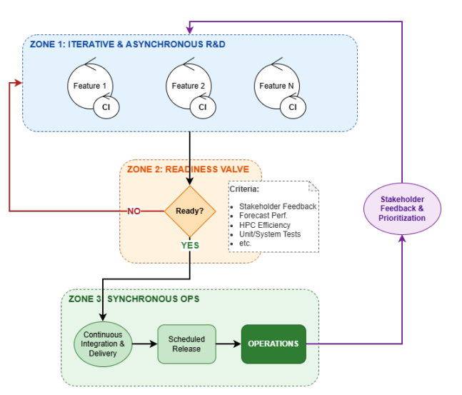
DevOps R2T2O
Zone 1: Iterative & Asynchronous R&D: Continuous scientific exploration protected by rapid automated CI testing loops.
Zone 2: The Readiness Valve: An objective, metrics-driven gate assessing stakeholder feedback, forecast performance, computing efficiency, and test coverage.
Zone 3: Synchronous Operations: Ready components enter a continuous deployment pipeline for fixed, predictable operational releases (e.g., biannually).

Slide 8
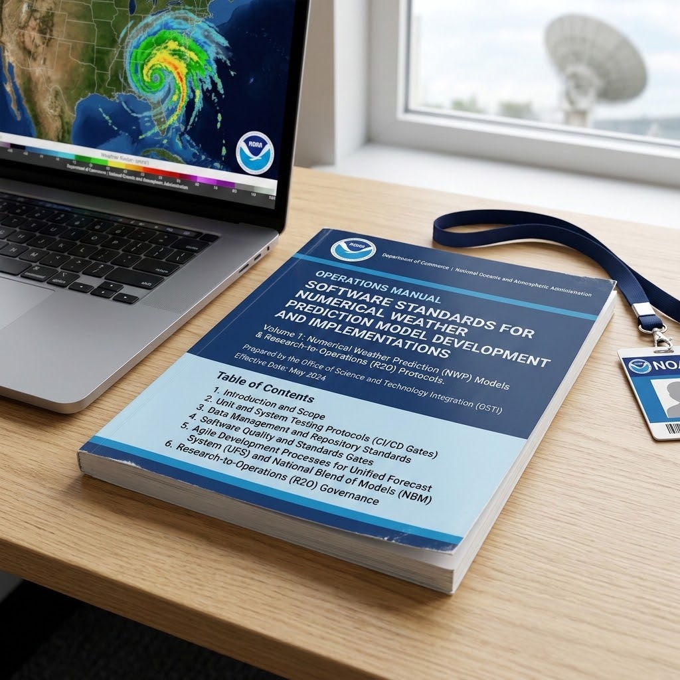
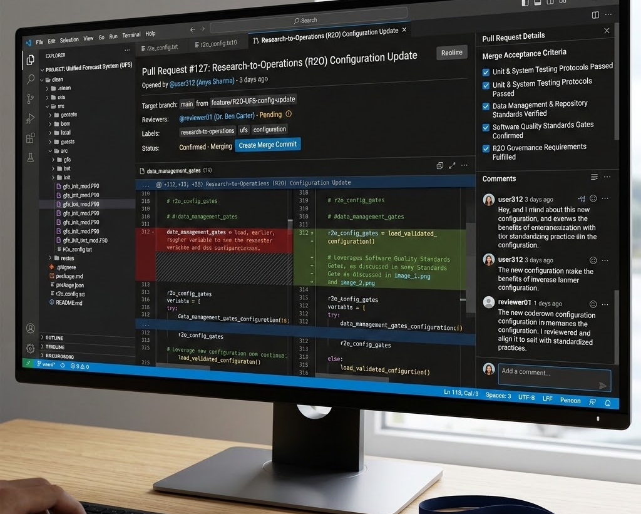
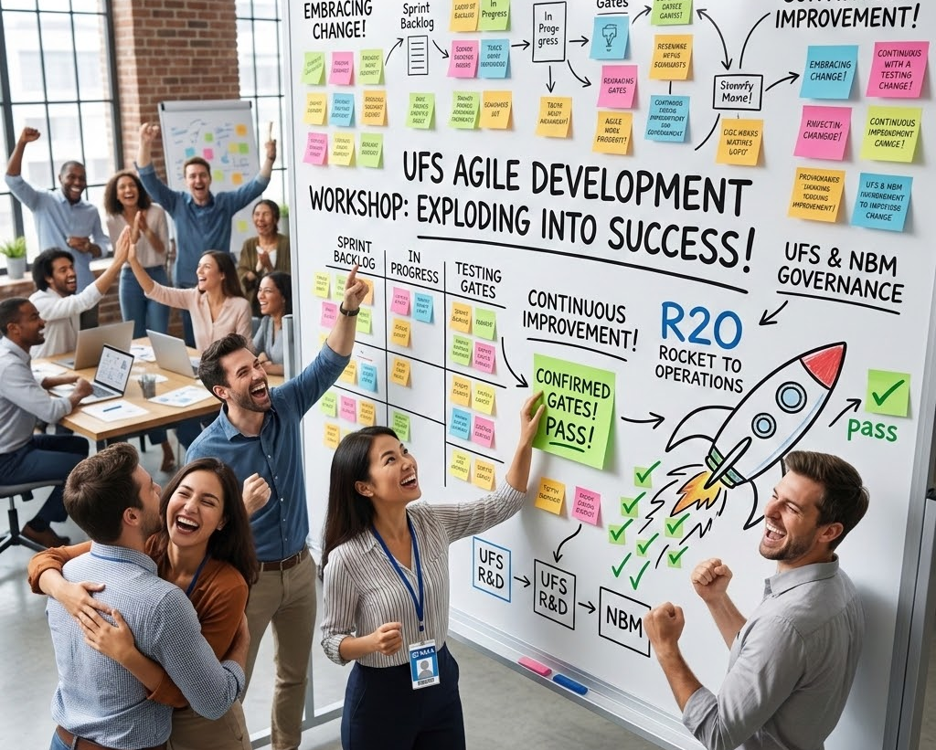
Some Other Suggested Changes
Standards
Tools
Culture
Employ uniform employment of standards and practices across our repositories. Adopt industry standards when possible.
Leverage enterprise tools for repo management, IDEs for development, AI coding agents (a UFS MCP/RAG?).
Dedicated Agile/Scrum training. Change champions. Developing cross-functional teams with both developer and operations staff.

Slide 9
Some Challenges
The UFS includes code from many organizations - who sets standards?
The UFS is around 2 million lines of code - most is not unit tested. Coding agents have a role.
The long feedback loop on earth system model science changes
People! We need to cultivate a critical mass of enthusiasm behind this endeavor
Organizational rigidity → Establish clear, cross-functional Agile roles (Product Owners, Scrum Masters, DevOps teams) and flatten communication pathways to focus on team-based accountability
Notes:
The production suite, and UFS in particular, features code from many different organizations. Can we enforce things like unit testing requirements on someone else? Instead of using a “stick” approach, can we look to build a coalition among our partners?

Slide 10
Start By Building on Current Success
Git, open source, community development
Excellent unit testing in place for some repositories already
Some CI/CD pipelines are already established
Advancing managing complex software stack, e.g. Spack-stack
Widespread agreement across the enterprise for modernization
  Including Development and Operations Orgs!

Slide 11
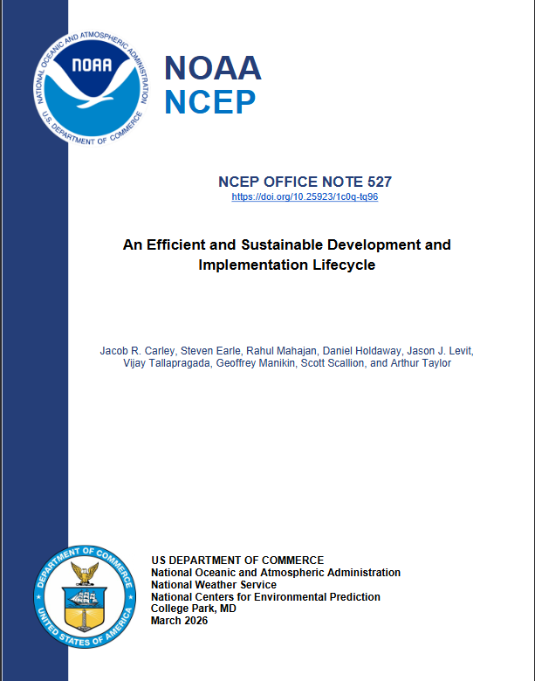
Closing
This transformation will not happen overnight
Requires considerable change across the enterprise
We expect:
  Faster improvements to our systems
  Faster deployment of new science
  More time available for exciting work
  Less time debugging, reduced burnout
Contact: jacob.carley@noaa.gov
https://doi.org/10.25923/1c0q-tq96

