Slide 1
Enhancing UFS Air Quality Predictions with Aircraft-Derived Regional Emission Adjustments
Youhua Tang^{1,2}, Patrick Campbell^{1,2}, Wei Li^{1,2}, Barry Baker³, Kai Wang^{3,4}, Jianping Huang³, Daniel Tong^{1,2}, Xinrong Ren¹, Eleanor Waxman^{5,6}, Ken Aikin⁶, Andrew Rollins⁶, John Crounse⁷, Paul Wennberg⁷, Ryan Bennett⁸, Ilana Pollack^{5,6,9}, Emily Lill⁹, Matthew Coggon⁶, Kelvin Bates^{5,6}, Amy Sullivan⁹, Mike Robinson⁶, Carsten Warneke⁶, Lu Xu^{5,6}, Kristen Zuraski^{5,6}, Jeff Peischl^{5,6}, Chris Jernigan^{5,6}, Wyndom Chace⁵, Steven S. Brown⁶, Caroline Womack⁶, Gordon Novak⁶, Patrick Veres⁶, Chelsea Stockwell⁶, Ann Middlebrook⁶, Rebecca Schwantes⁶, Brian McDonald⁶, Charles Gatebe¹⁰, Youngsun Jung¹¹
1. NOAA Air Resources Laboratory, College Park, MD.
2. George Mason University, Fairfax, VA.
3. NOAA/NCEP/EMC, College Park, MD
4. Lynker, Leesburg, VA
5. CIRES, University of Colorado, Boulder, CO
6. NOAA Chemical Sciences Laboratory, Boulder, CO
7. California Institute of Technology, Pasadena, CA
8. Bay Area Environmental Research Institute, Moffett Field, CA
9. Colorado State University, Fort Collins, CO
10. NASA Ames Research Center, MS 245-5, Moffett Field, CA
11. NOAA NWS/STI, College Park, MD

Slide 2
Why do we need to adjust UFS model’s emission with aircraft observations?
Emissions are one of the fundamental driving forces of atmospheric composition, and their accuracy is critical for reliable atmospheric composition predictions..
To accurately represent the temporal and spatial variability of atmospheric pollutants, the current NOAA UFS-AQM requires emission adjustments to account for uncertainties and changing emission patterns.
Aircraft-based atmospheric composition measurements collected during field campaigns provide comprehensive, three-dimensional observations of numerous chemical species. These measurements are often regarded as the benchmark for model evaluation and for the calibration and validation of satellite retrieval products. Compared with surface observations alone, aircraft data offer unique insights into the vertical distribution, transport, and chemical evolution of pollutants.
Recent aircraft field experiments have generated extensive datasets
that can be used to constrain and improve emission inventories.

Slide 3
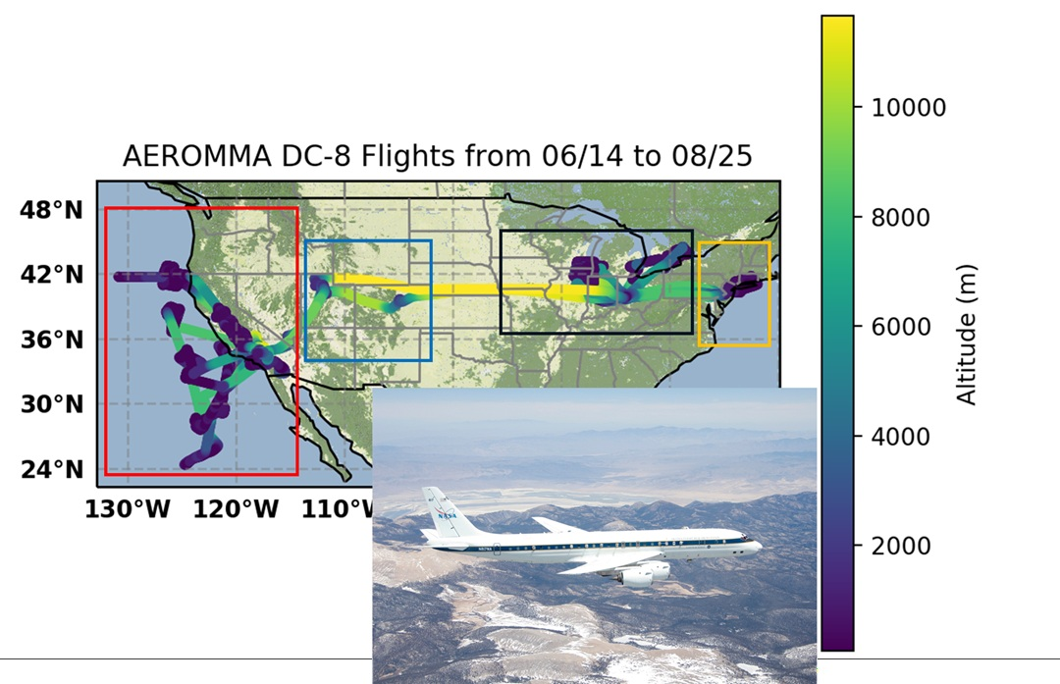

Emission Adjustment Methods
$\frac{∆E}{E}=β\frac{∆C}{C}$ (Lamsah et al., 2011)
where E is the targeted emission over certain regions, and C is the corresponding receptor concentrations.
2023 AEROMMA Field Campaign over CONUS

Slide 4
Regional Emission adjustment factors for anthropogenic emissions based on the biases below 3km
 | Northern CA | Southern CA | CA Central Valley | Rockies | North Central | Northeast | Southeast | South Central
CO | 1.2 | 1 | 1.2 | 0.3 | 2 | 1.7 | 2 | 2
C₂H₄ | 0.7 | 2 | 0.4 | 0.8 | 0.8 | 0.5 | 1 | 1
C₂H₆ | 2 | 2 | 2 | 1.5 | 3 | 2.5 | 2 | 2
C₂H₂ | 2 | 1 | 0.5 | 1.5 | 2 | 0.8 | 2 | 2
Propane | 5 | 5 | 5 | 1.5 | 3 | 1.5 | 3 | 3
Benzene | 1.5 | 2 | 0.7 | 1 | 2 | 2 | 2 | 1
SO₂ | 5 | 1 | 5 | 1 | 0.5 | 0.5 | 2 | 1
NH₃ | 3 | 3 | 3 | 2 | 3 | 2.5 | 1 | 1

Slide 5
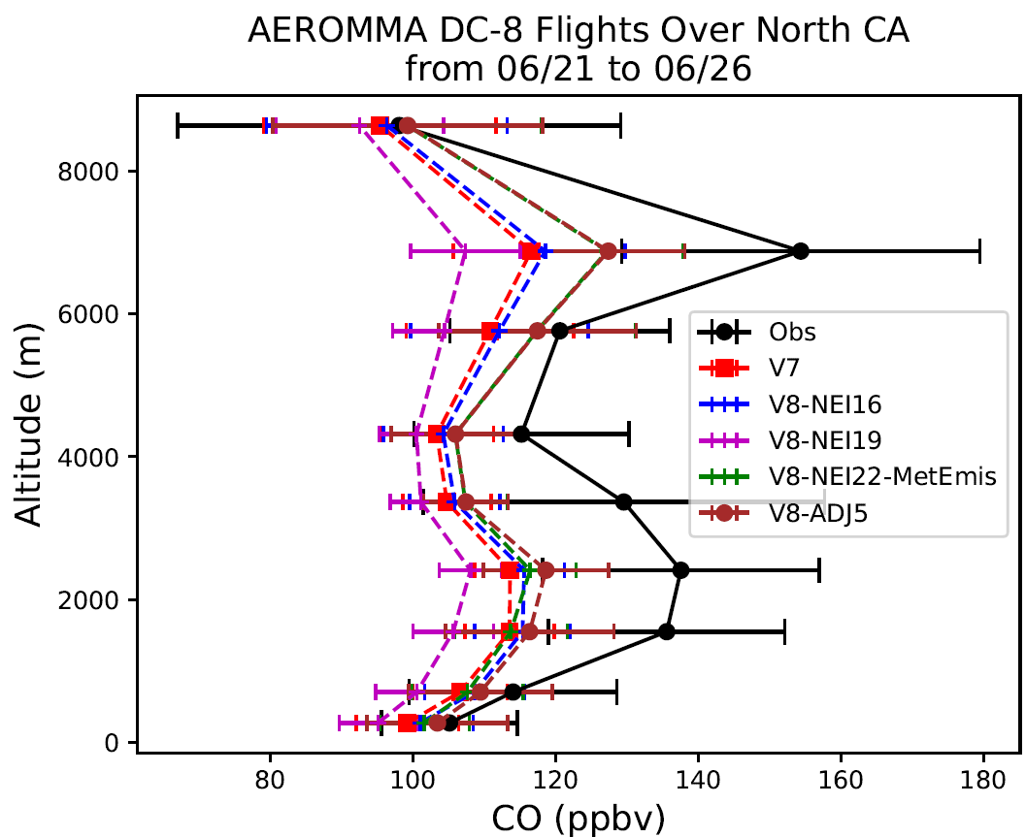
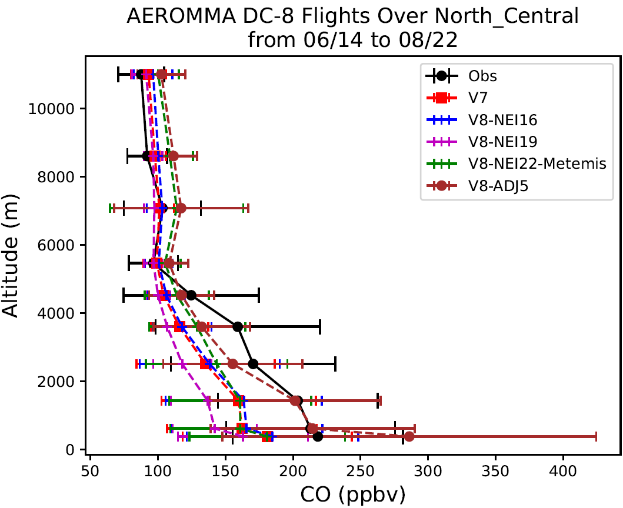
This regional emission adjustment generally improved the predictions for emitted species compared with aircraft data

Slide 6
Same but for C₂H₆

Slide 7
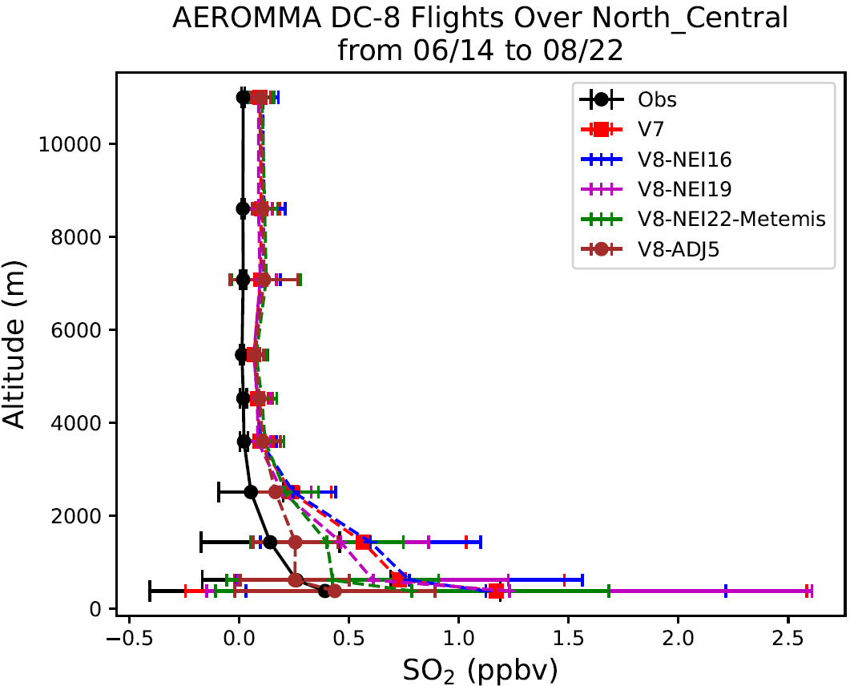
Same but for SO₂

Slide 8
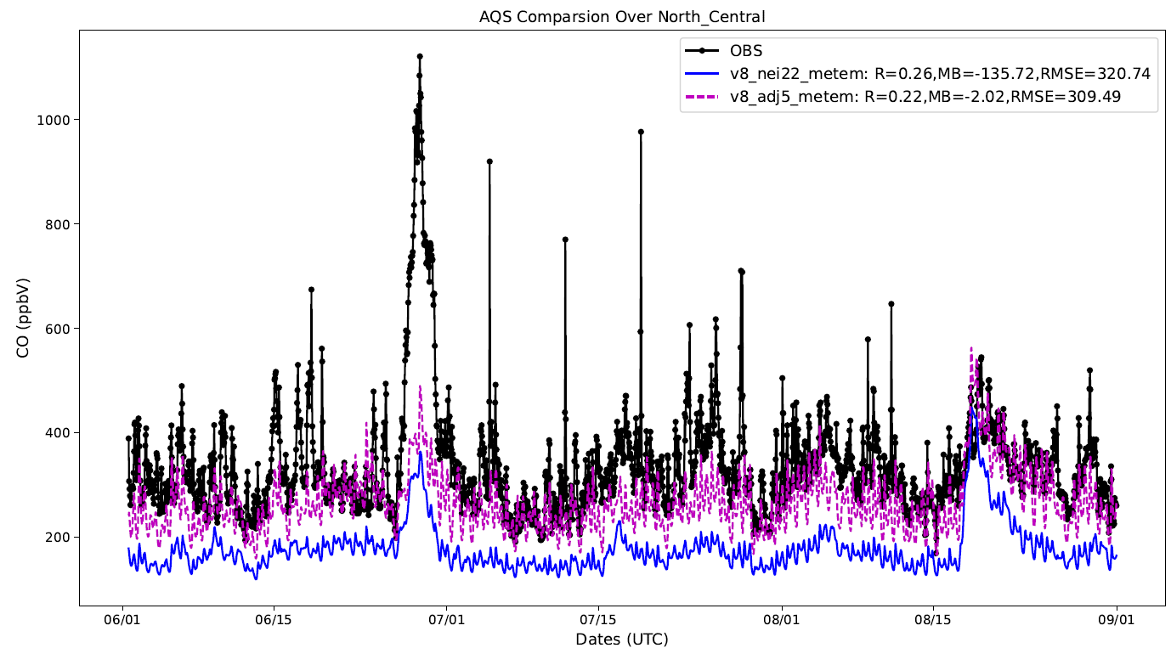
The improvement is also shown near surface compared to AQS data

Slide 9
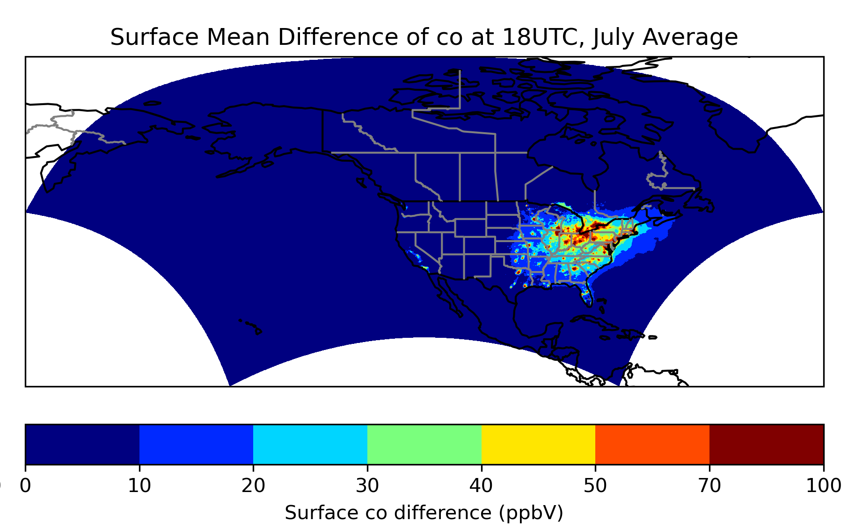
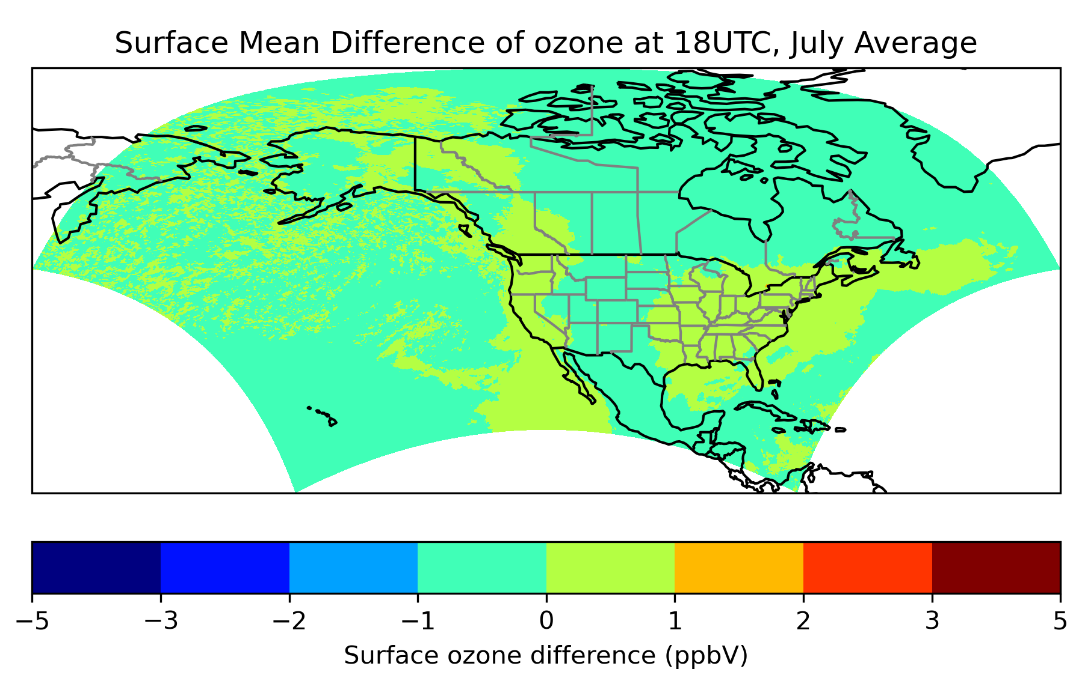
Mean daytime CO concentration changed due to the this emission adjustment, July, 2023
Mean daytime O₃ concentration changed due to the this emission adjustment, July, 2023
The impact of CO and VOC emission adjustments on O₃ is relatively small for summer 2023.

Slide 10
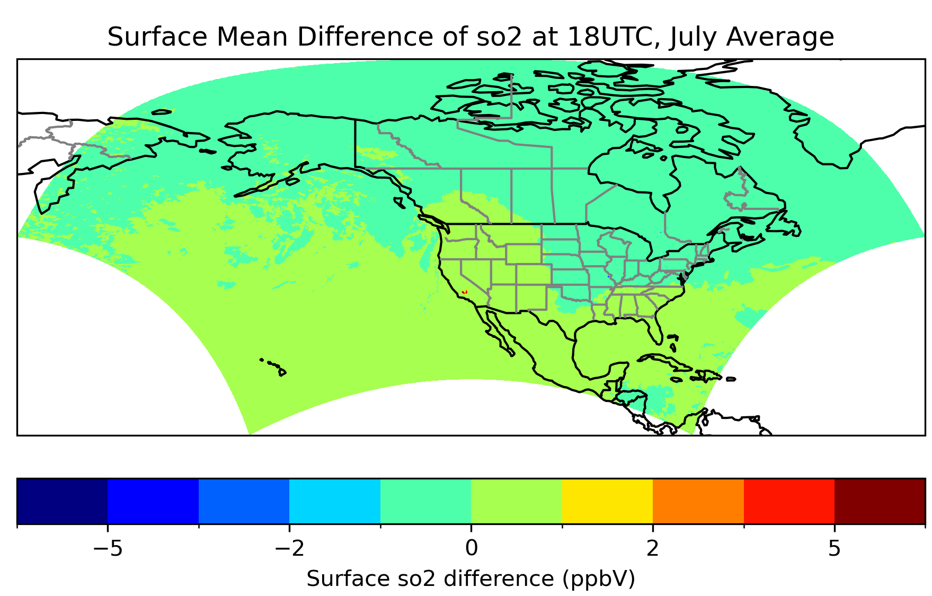
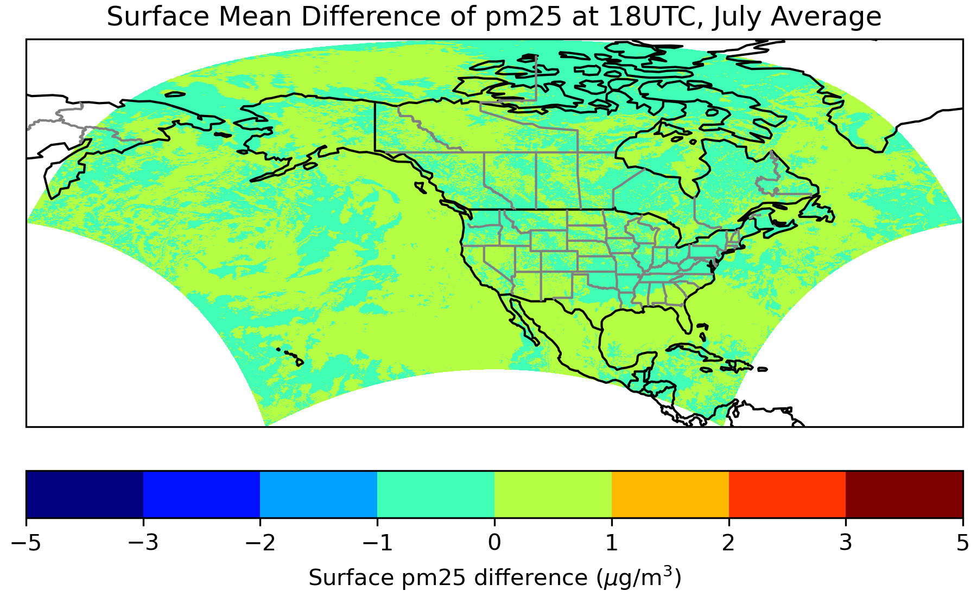
The impact of the emission adjustments on PM2.5 is also very small for summer 2023.

Slide 11
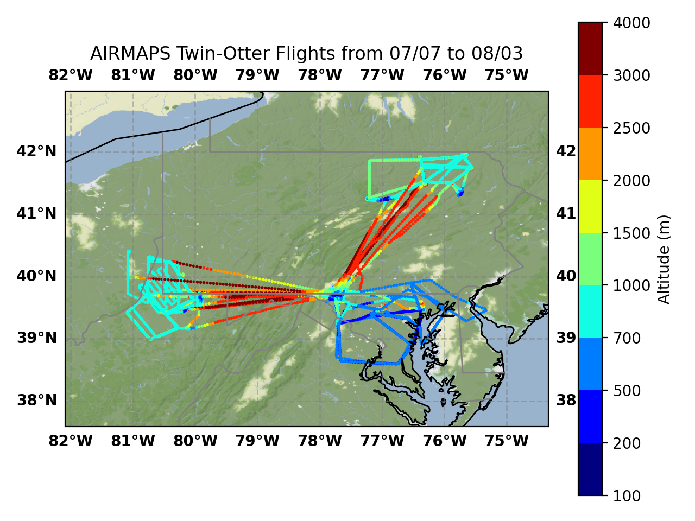
Baltimore Air Quality and Marcellus Survey (BAQMS)
07/07-08/03, 2025
EmisAdj1: local CO and ethane emission adjustment
EmisAdj2: EmisAdj1 + soilnox
EmisAdj3: double CO and ethane emissions in east of Rocky mountain and North of 38N
Northeast Marcellus
ETHA*2, CO*2
Southwest Marcellus
ETHA*4, CO*4
Great Washington/Baltimore Region ETHA*3, CO*2

Slide 12
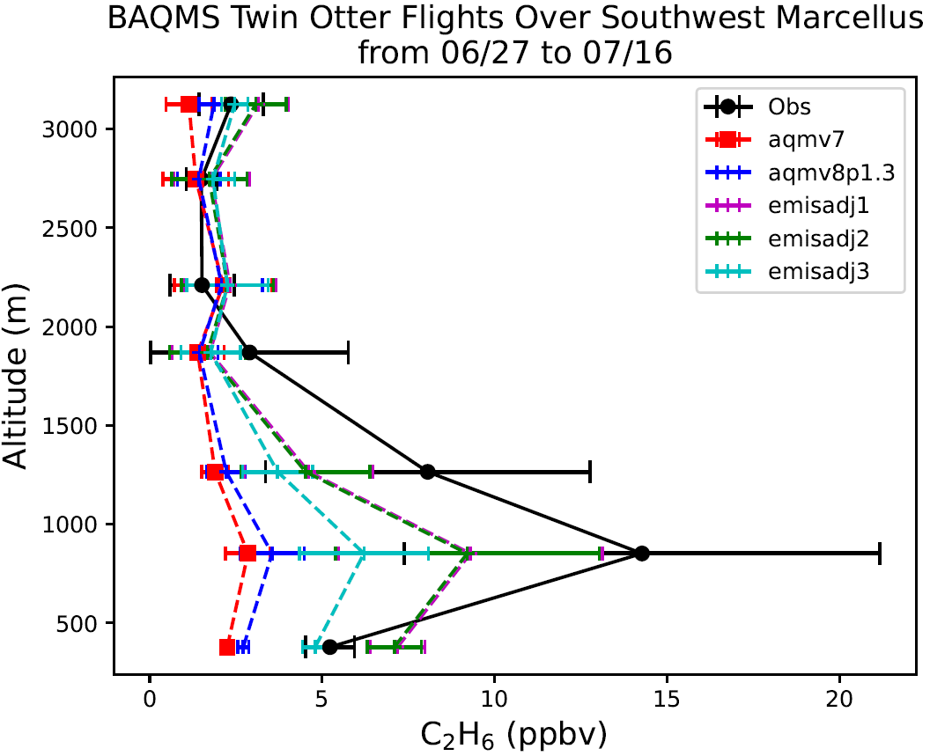

Slide 14
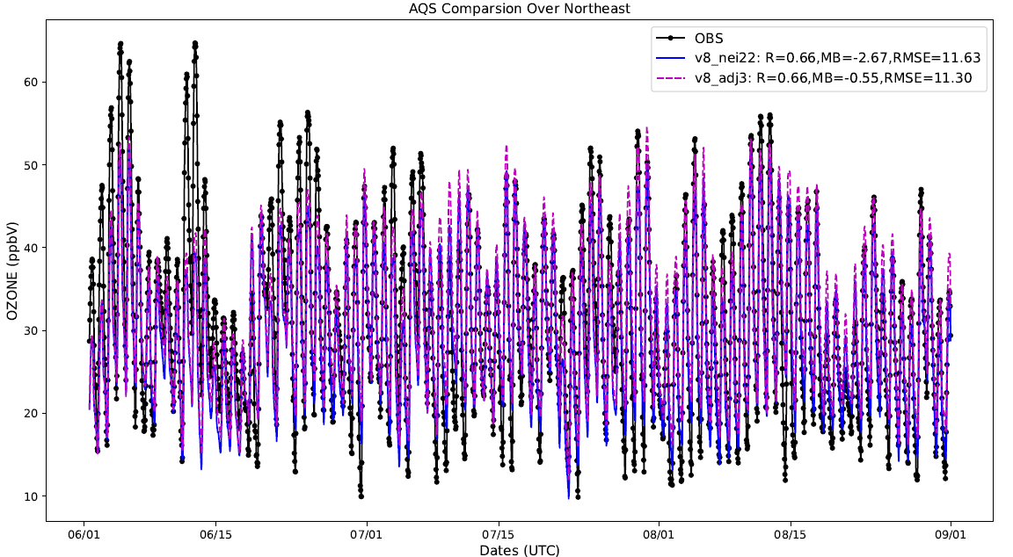
For summer 2025 (BAQMS) case, this emission adjustment help correct the ozone underpredictions.

Slide 15
Summary
Regional emission adjustments derived from aircraft observations reflect systematic biases in emission inventories over large geographic areas. These adjustments generally improve simulations of emitted trace gases near surface including CO, ethane, ethene, and SO₂ etc, as verified by both surface and aircraft measurements across CONUS.
The local sensitivity factor (β) for long-lived species, such as CO, can exhibit substantial spatial variability, which may not be adequately represented by a constant value.
Adjustments to CO and VOC emissions have only a limited impact on ozone and PM2.5 forecasts, with the mean regional change in O₃ concentrations being approximately 1–2 ppb.

