Slide 1


From Forecast to Fireline: Advancing UFS Wind Prediction for Wildland Fire Operations
Samantha J. Kramer,¹ Benjamin Kirtman,² Natalie Perlin³
¹Atmospheric Interdisciplinary Research Institute; early career scientist; ²University of Miami; ³NOAA/EPIC
UIFCW July 23, 2026, College Park, MD

Slide 2





Acknowledgment
This material is based upon work supported by the NOAA/OAR Weather Program Office under Award No. NA23OAR4590383
Team:
  Lead-PI: Samantha J. Kramer, PhD, now at Atmospheric Interdisciplinary Research Institute (previously Sonoma Technology)
    Sonoma Technology: Tyler M. Fenske, Alejandro Valencia, PhD, Nate C. Benson, Lindsay A. Nash
      Kayla Besong-Cowan, PhD now at Pacific Tsunami Warning Center*
      ShihMing Huang now at National Interagency Fire Center*
  Co-PI: Ben Kirtman, PhD, University of Miami
  Co-PI: Brian Potter, PhD, U.S. Forest Service
    U.S. Forest Service: Jay Charney, PhD (collaborator)
  Collaborator: Hosmay Lopez, PhD, NOAA AOML
  Collaborator: Natalie Perlin, PhD, EPIC Expert

Slide 3
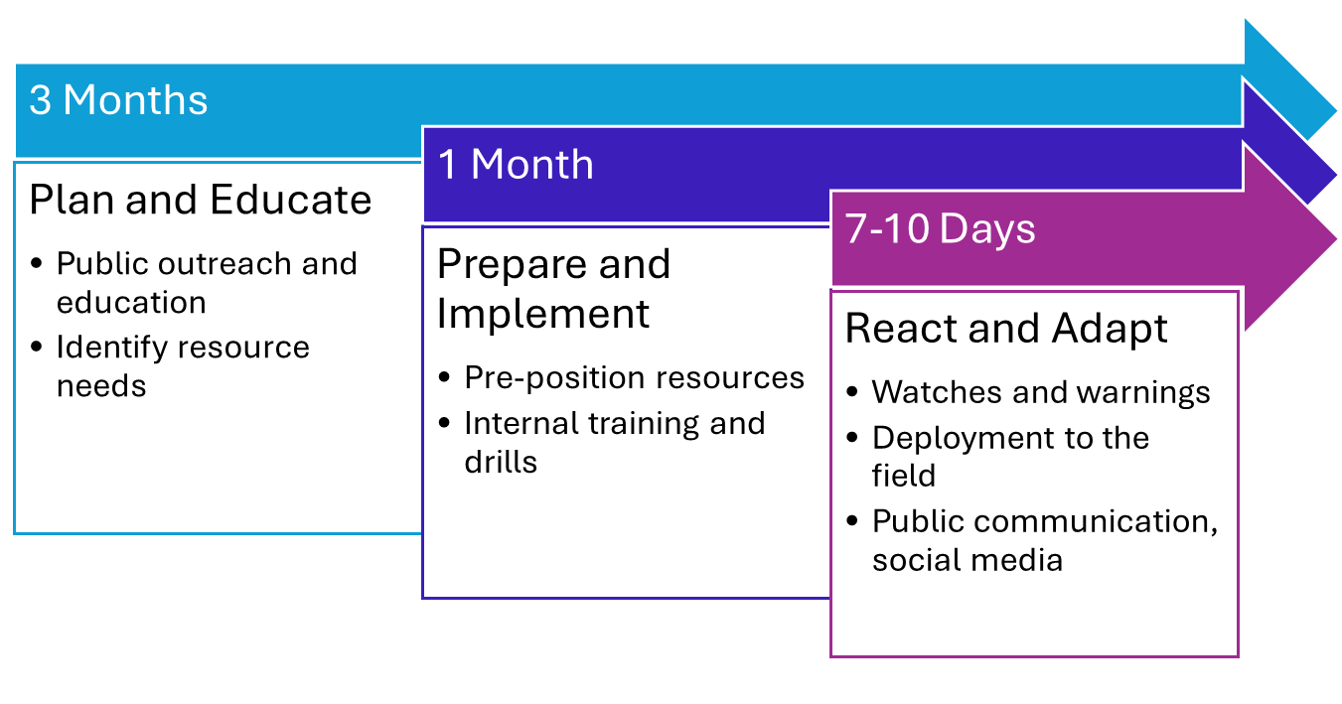
End-User Input
Increasing need for precision and confidence in weather information

Slide 4
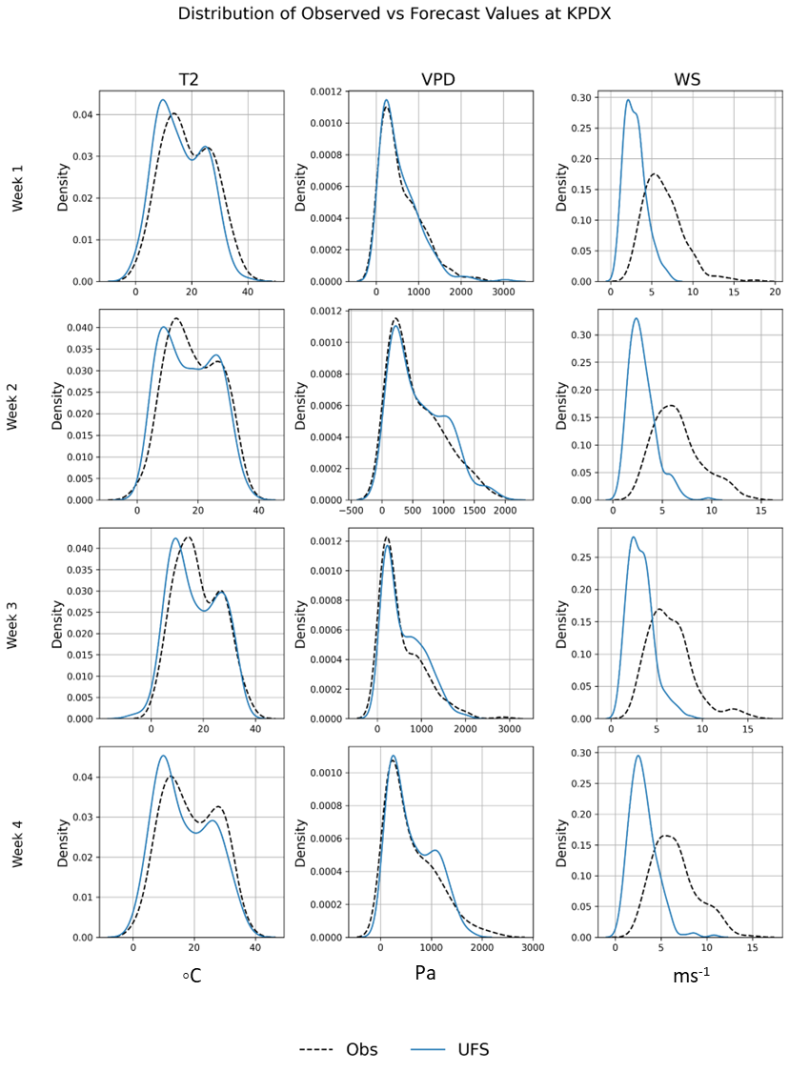
The Wind Problem
Across forecast models, wind speed variability and extremes are significantly underestimated
Example: ‘of 20,000 strong wind observations (>20 m/s²) in Wy and CO the HRRR model only accurately forecasted 294 instances correctly, resulting in a very low hit rate (0.01)’. – Collins et al., 2024
These issues are generally tied to topography
Collins, E., et al (2024). Forecasting high wind events in the HRRR model over Wyoming and Colorado. Part I: Evaluation of wind speeds and gusts. Weather and Forecasting, 39(5), 705–723. https://doi.org/10.1175/WAF-D-23-0036.1
Savazzi, A. C. M., et al: The representation of the trade winds in ECMWF forecasts and reanalyses during EUREC⁴A, Atmos. Chem. Phys., 22, 13049–13066, https://doi.org/10.5194/acp-22-13049-2022, 2022.
Nebila Lichiheb, et al., An evaluation of meteorological data prediction over Washington, D.C.: Comparison of DCNet observations and NAM model outputs, Urban Climate, Volume 48, 2023, 101410, ISSN 2212-0955, https://doi.org/10.1016/j.uclim.2023.101410.
Helbig, N., R. Mott, A. van Herwijnen, A. Winstral, and T. Jonas (2017), Parameterizing surface wind speed over complex topography, J. Geophys. Res. Atmos., 122, 651–667, doi:10.1002/2016JD025593.
Notes:
HRRR model …is one of the highest-resolution operation NWP models available… significantly underestimates strong wind speeds… of the almost 20,000 strong wind observations (>20 m/s²) the HRRR model only accurately forecasted 294 instances correctly, resulting in a very low hit rate (0.01).

Slide 5
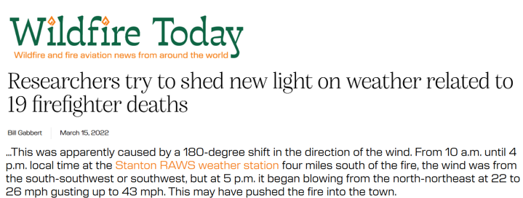
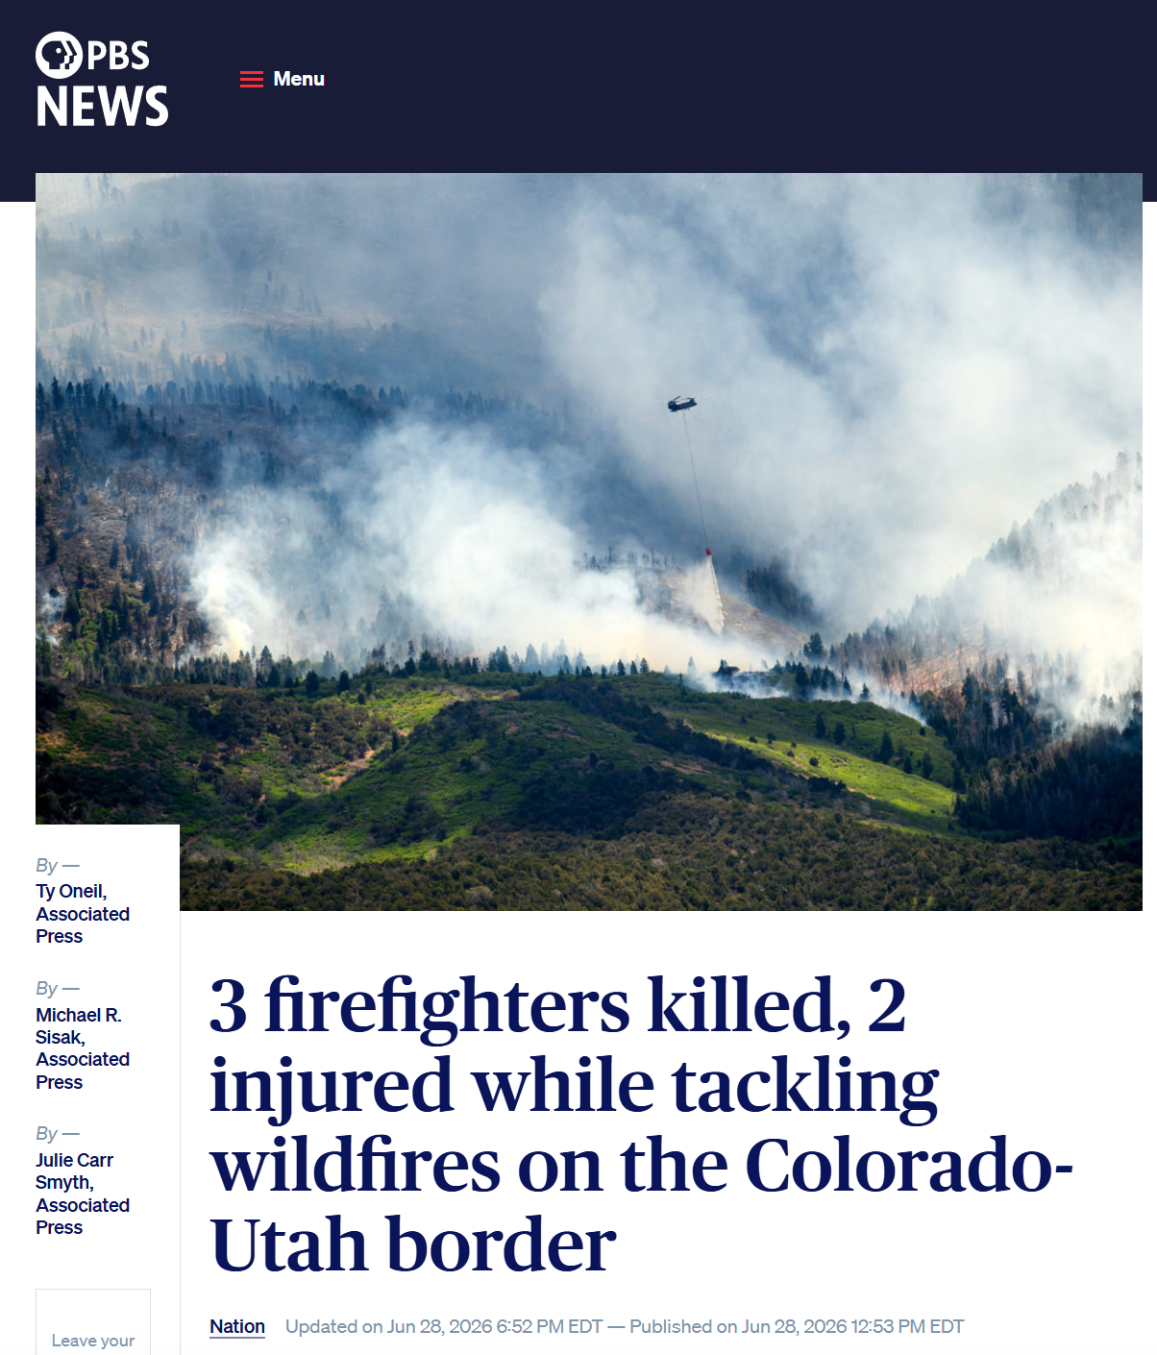
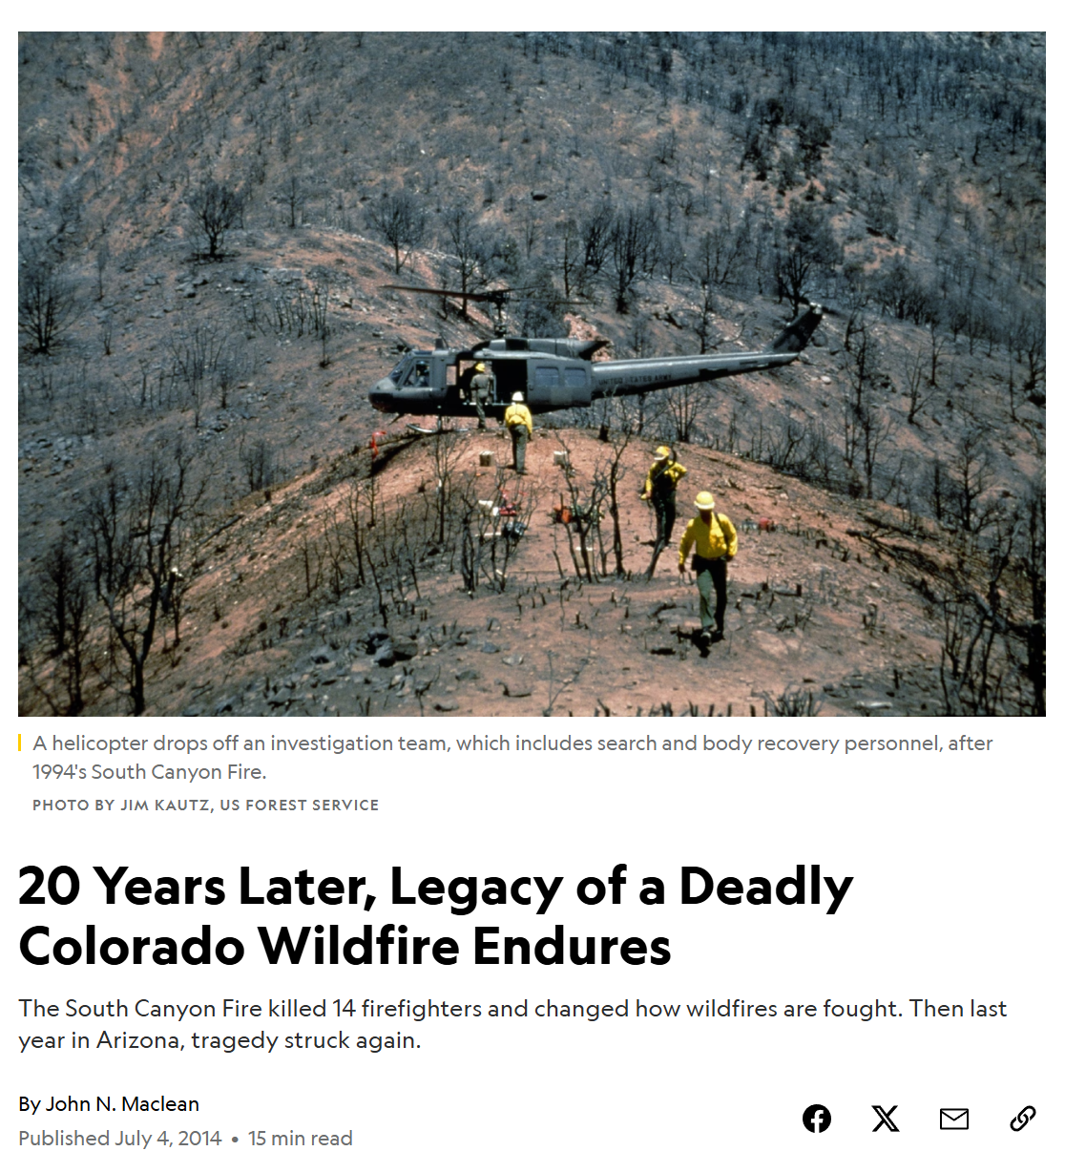
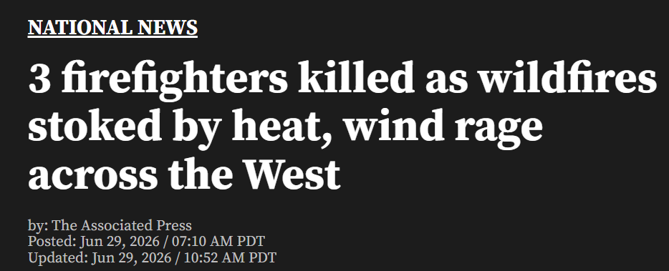
Wildland Firefighter Fatalities
Notes:
Wildfire firefighter fatalities 1910-2013 high marks https://www.nationalgeographic.com/science/article/140704-south-canyon-wildfire-colorado-wildlands-fire
CA 330
Idaho 136
Montana 44
Arizona 41
Colorado 40
https://wildfiretoday.com/researchers-try-to-shed-new-light-on-weather-related-to-19-firefighter-deaths/

Slide 6
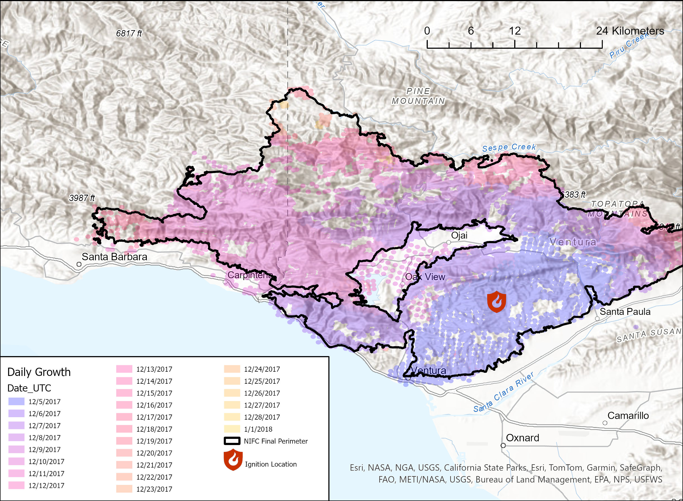
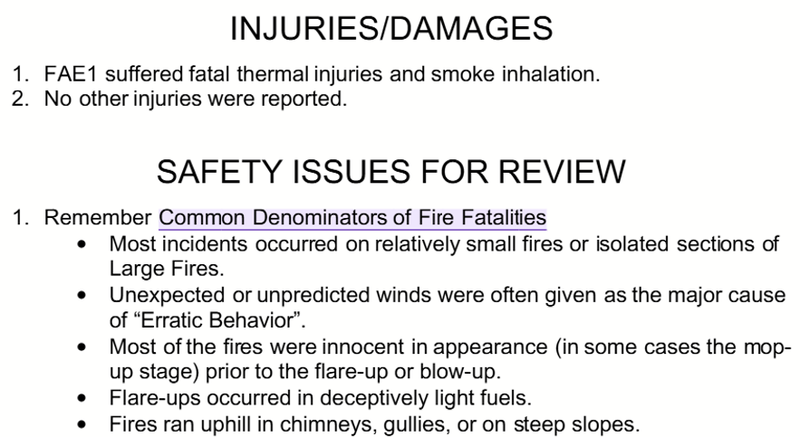
2017 Thomas Fire:
1,063 structures destroyed, Firefighter Fatality
California Department of Forestry and Fire Protection. (2017). Preliminary summary report of serious or near serious CAL FIRE injuries, illnesses and accidents: Fatality firefighter entrapment, Thomas Fire, 12/14/2017 (Green Sheet No. 17-CA-VNC-103156). California Southern Region.

Slide 7
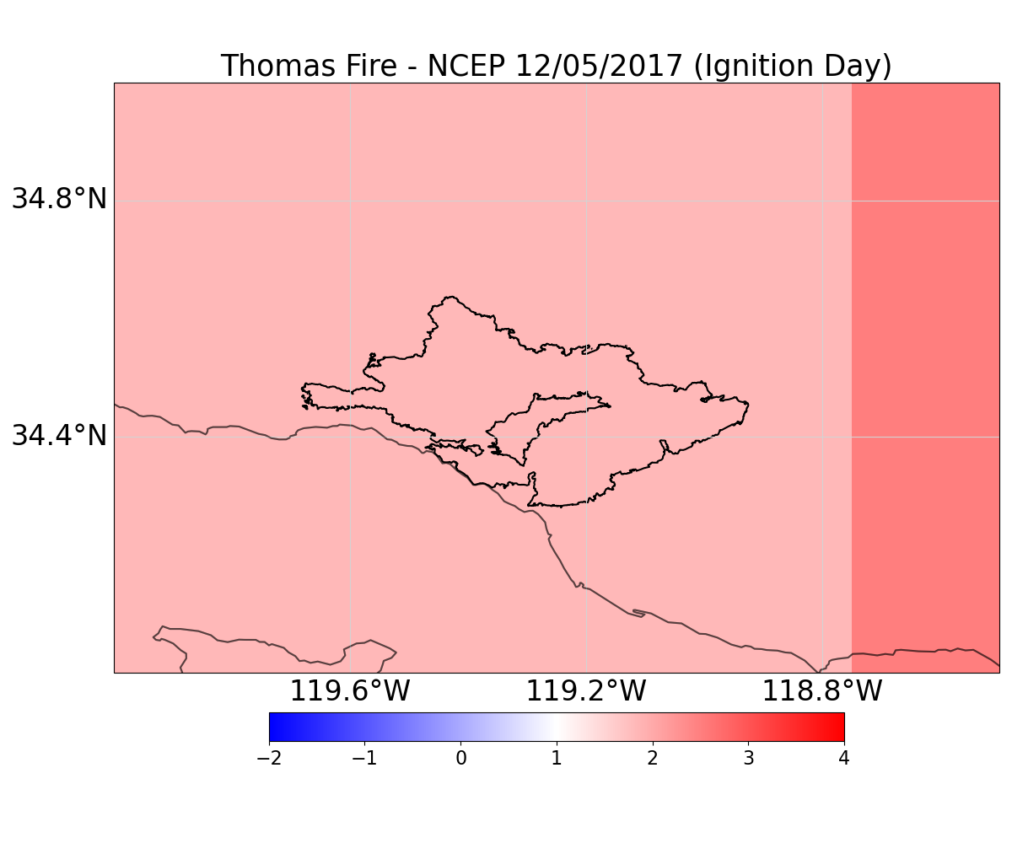
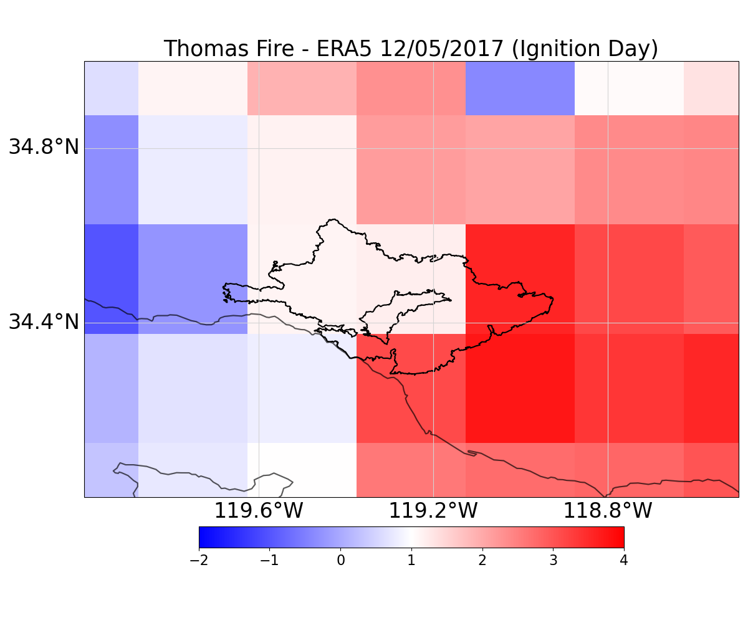
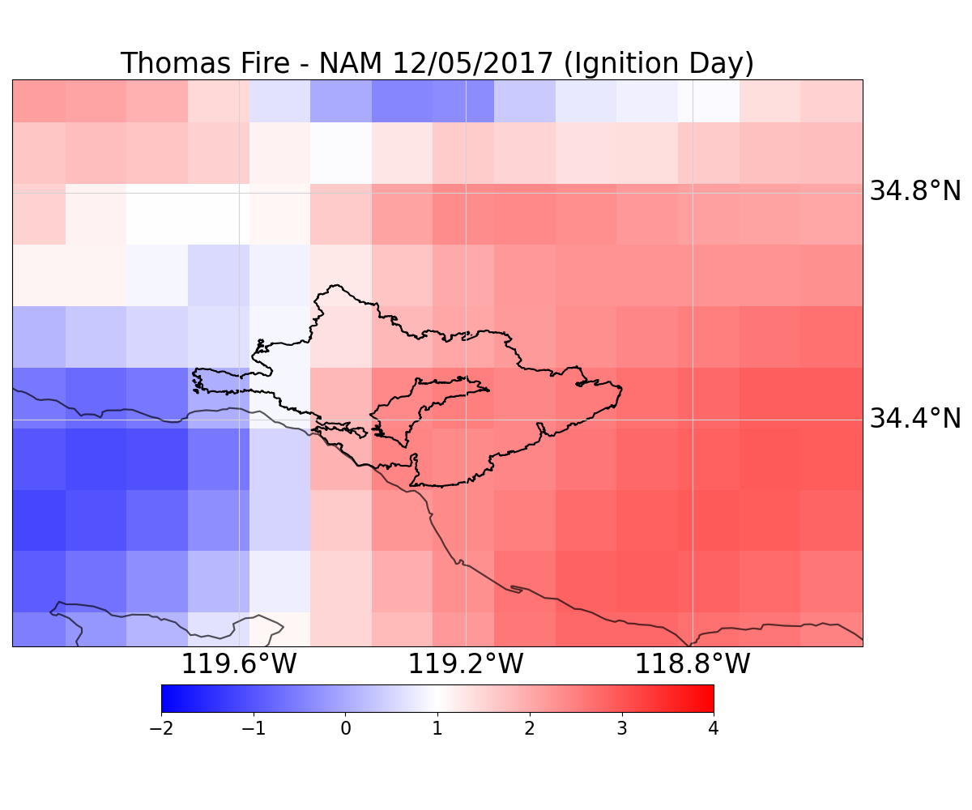
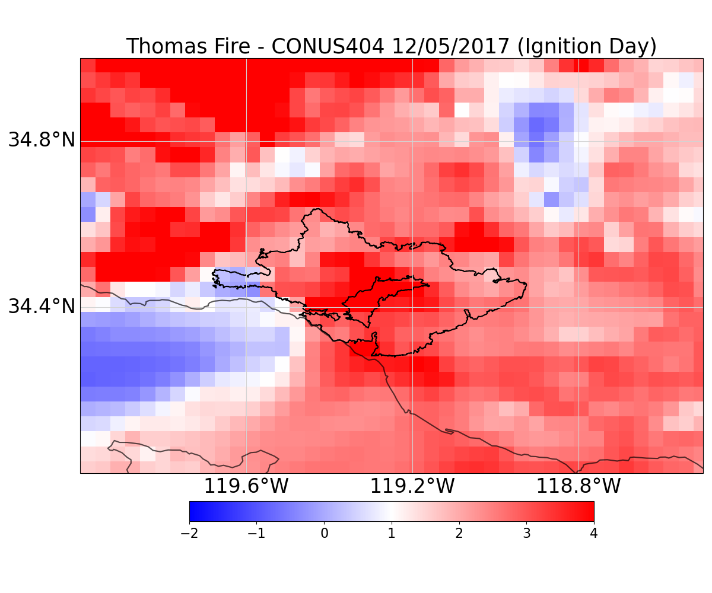
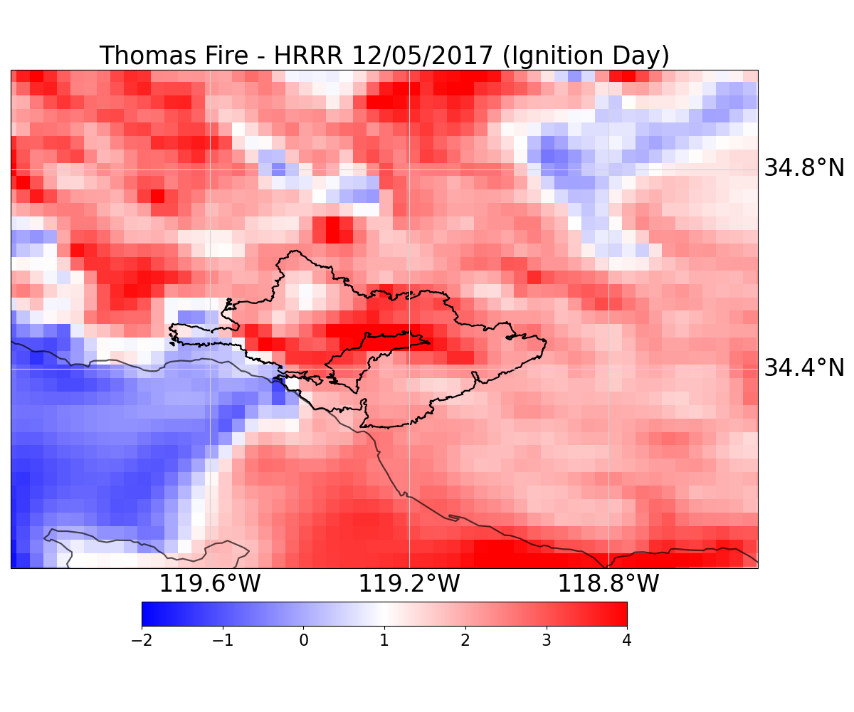
Thomas Fire Wind Anomalies: Ignition Day

Slide 8
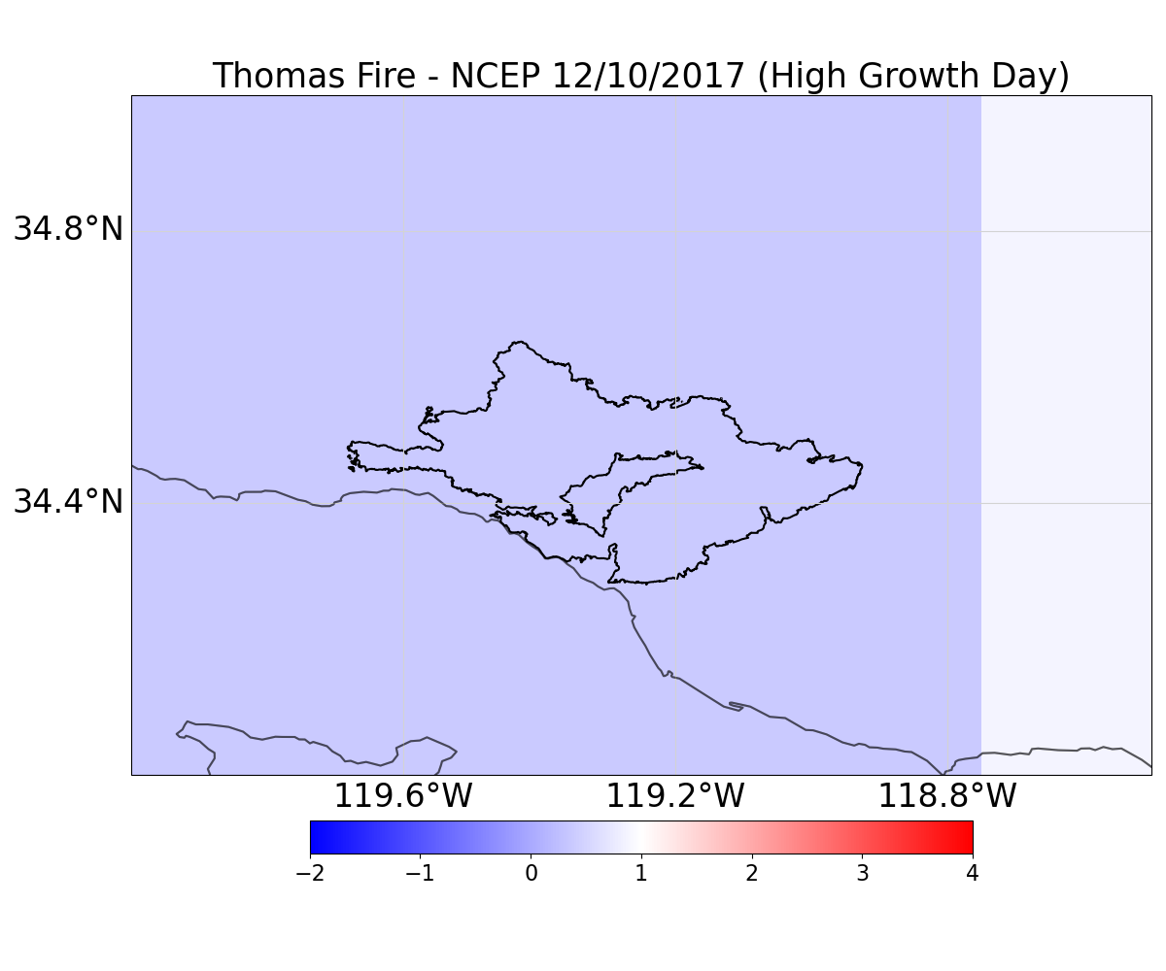
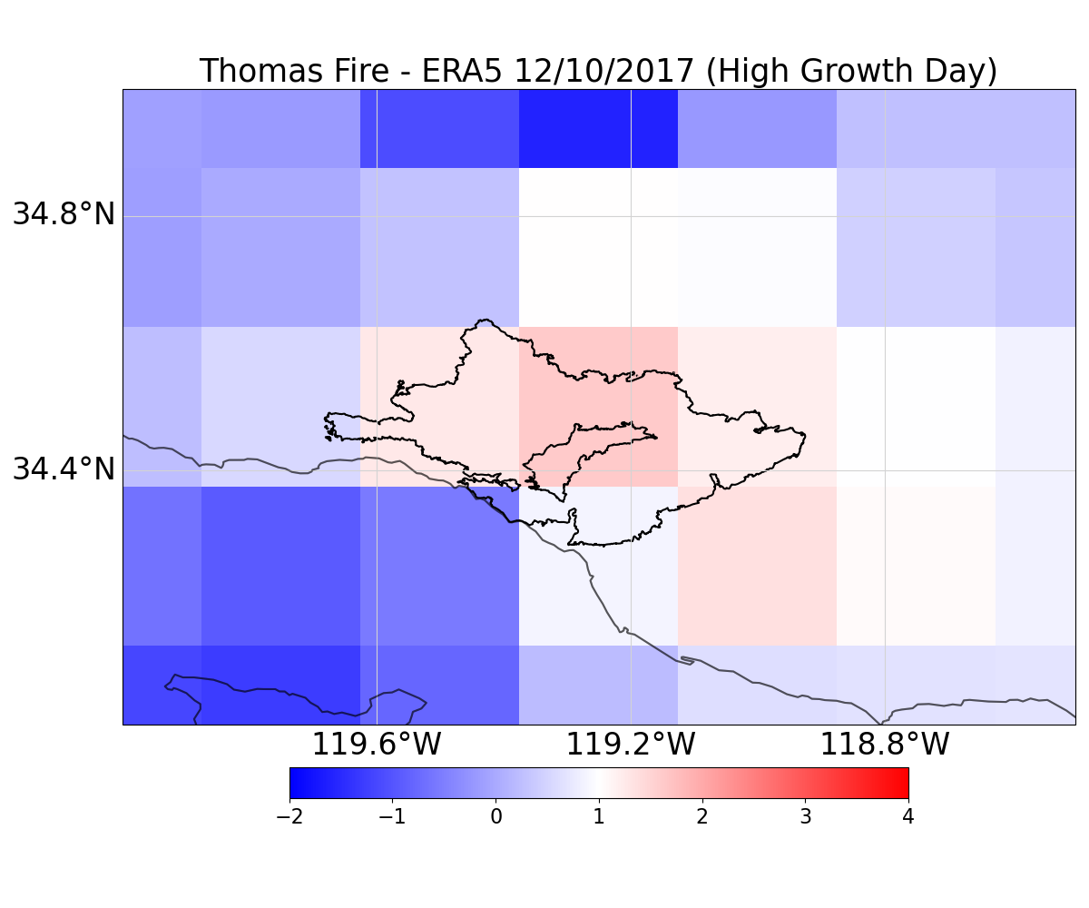
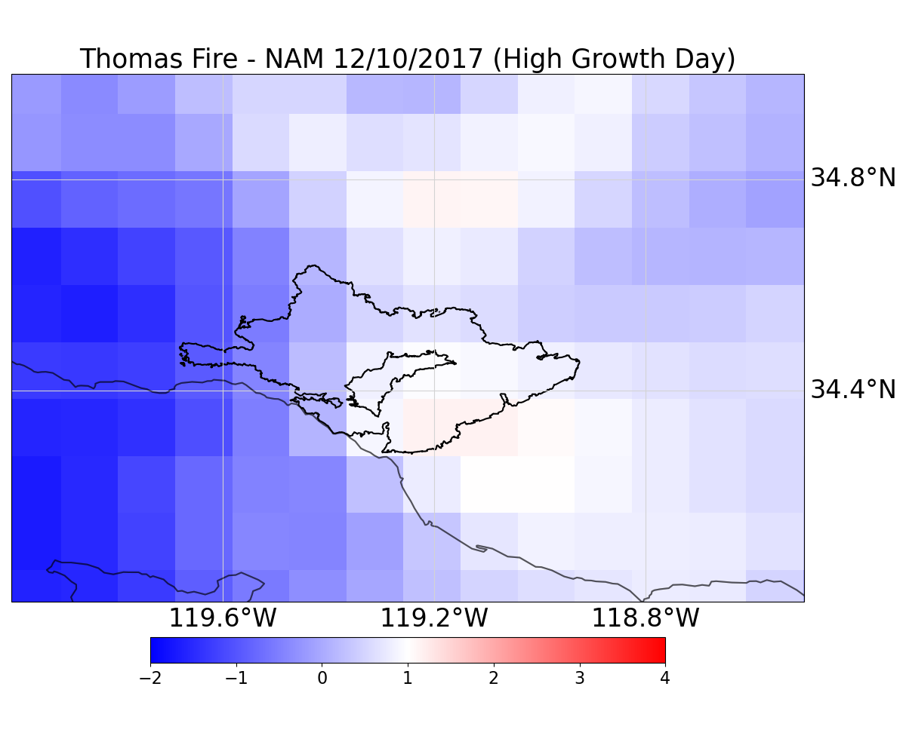
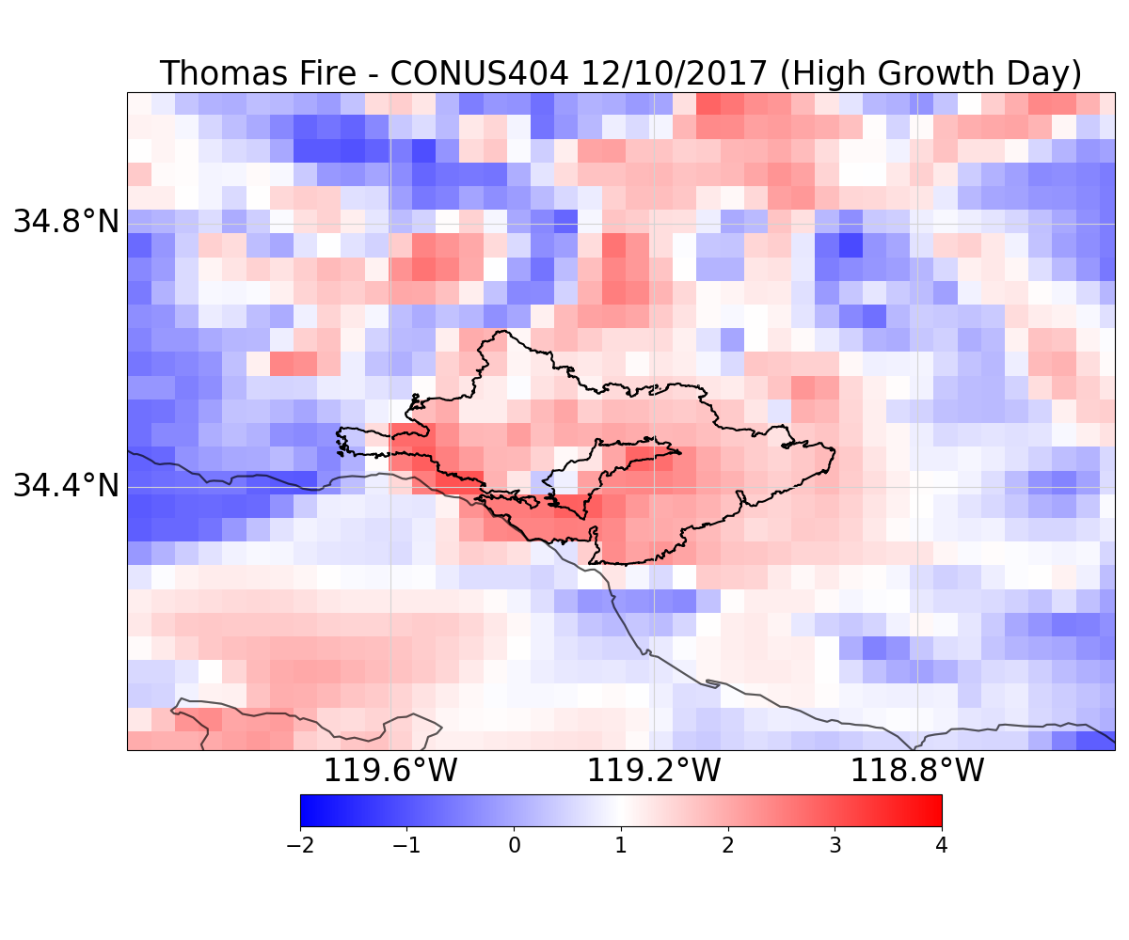
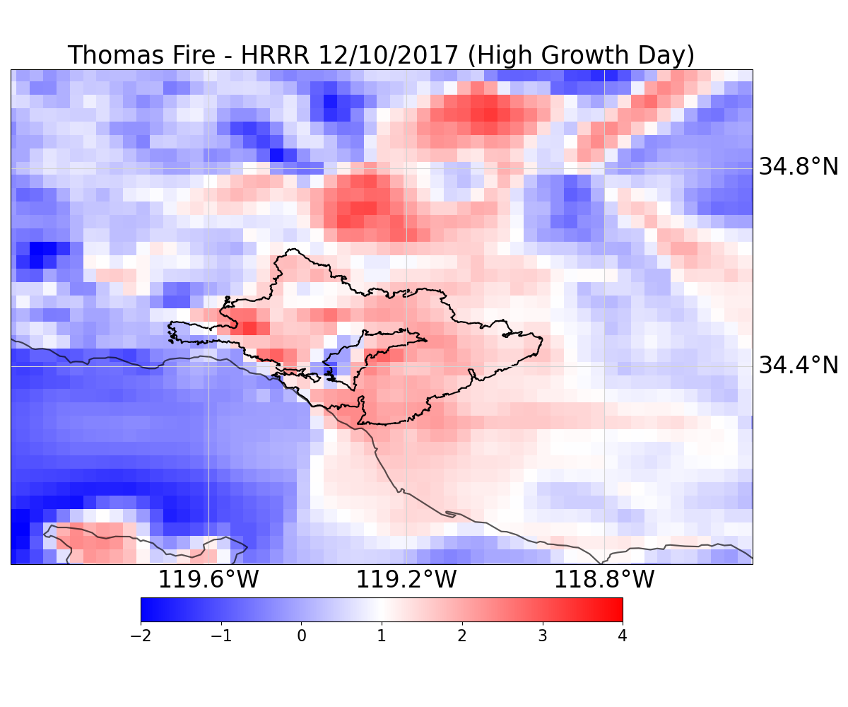
Thomas Fire Wind Anomalies: High-Growth Day

Slide 9
EPIC’s Short Range Weather (SRW) App
Simulation Approach :
Test SRW App dynamical downscaling in several wildfire case studies to improve wind representation in forecast models.
Mountain Fire / Ventura County, November 6, 2024: ~20k acres burned
Palisades Fire / Los Angeles County, January 7, 2025: ~20k acres burned
Thomas Fire / Santa Barbara, Ventura Counties, December 4, 2017, ~200k acres burned (highlighted here)
  Ignition: Dec. 4, 2017 ~6pm | Containment: Jan 12, 2018
  Area Burned: ~281,800 acres
  Cause: Power Lines
  Location: Southern California
  Conditions: predominately wind driven (Santa Ana Winds)
  Key Activity: Large fire growth upon ignition [12/4 18:00 - 12/5 12:00], second rapid-growth period on 12/10

Slide 10
EPIC’s Short Range Weather (SRW) App
Limited-area Atmospheric Model (LAM)
1-km horizontal grid resolution over a 3⁰ x 3⁰ domain
Full vertical atmosphere with 65 layers
High frequency time steps at 1
Common Community Physics Package v& (CCPP) parametrization suite
NOAA’s Warn-on-Forecast System (WoFS)
Primarily used for higher resolution applications
Does not parameterize deep convection
Initial and hourly lateral boundary conditions from NOAA Rapid Refresh Forecast System– RRFS Prototype (RRFSv1)
3-km horizontal forecast output for North America
Available through AWS S3
60-hr model simulation on 16 CPU ~13 hours to complete

Slide 11
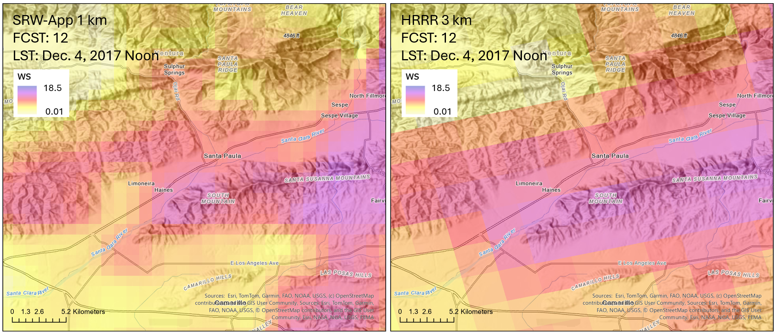
EPIC Dynamic Downscaling:
Notes:
SRW Modeling Initialization:
- Limited-area Atmospheric Model (LAM)
- 1-km horizontal grid resolution over a 3⁰ x 3⁰ domain
- Full vertical atmosphere with 65 layers
- High frequency time steps at 1
- Common Community Physics Package v& (CCPP) parametrization suite
- NOAA’s Warn-on-Forecast System (WoFS)
- Primarily used for higher resolution applications
- Does not parameterize deep convection
- Initial and hourly lateral boundary conditions from NOAA Rapid Refresh Forecast System– RRFS Prototype (RRFSv1)
- 3-km horizontal forecast output for North America
- Available through AWS S3
- 60-hr model simulation on 16 CPU ~13 hours to complete

Slide 12
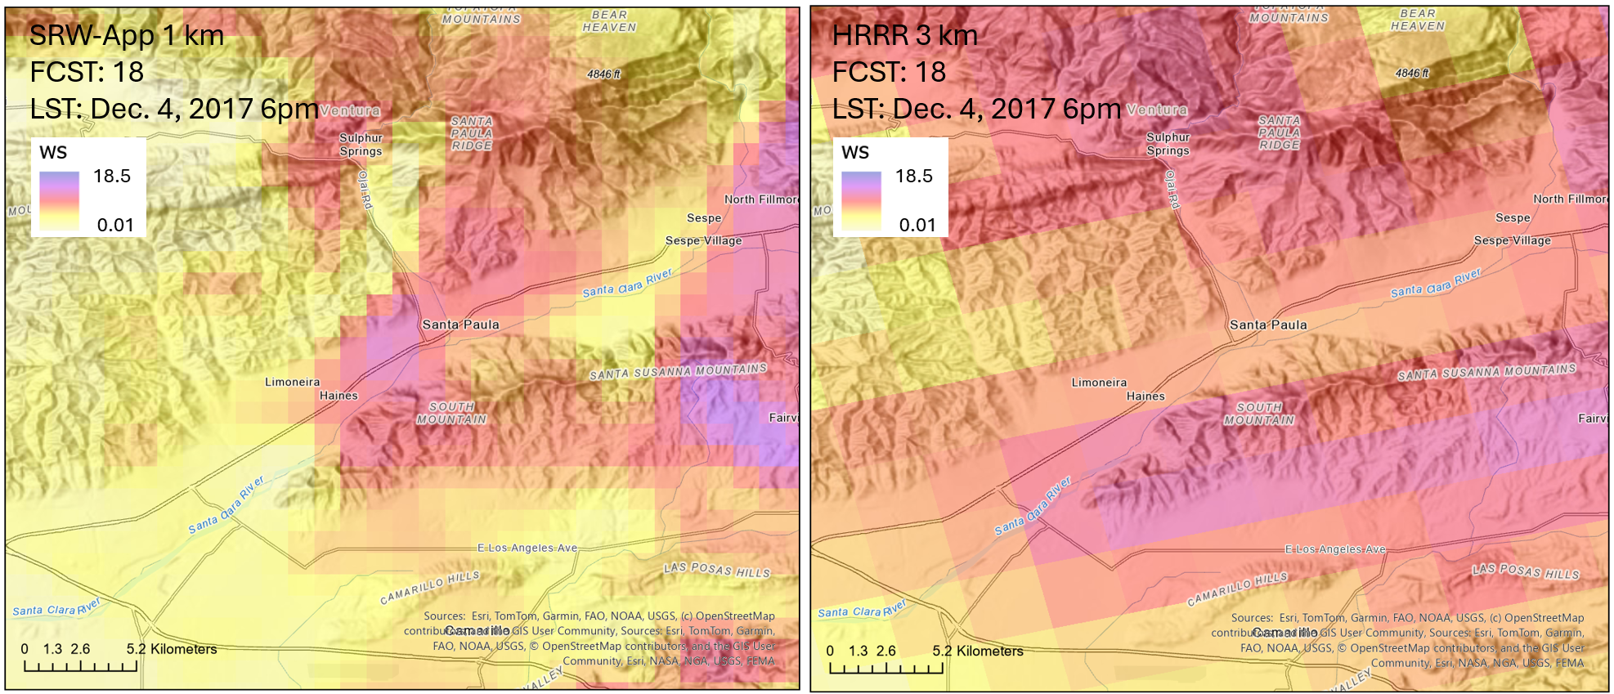
EPIC Dynamic Downscaling:

Slide 13
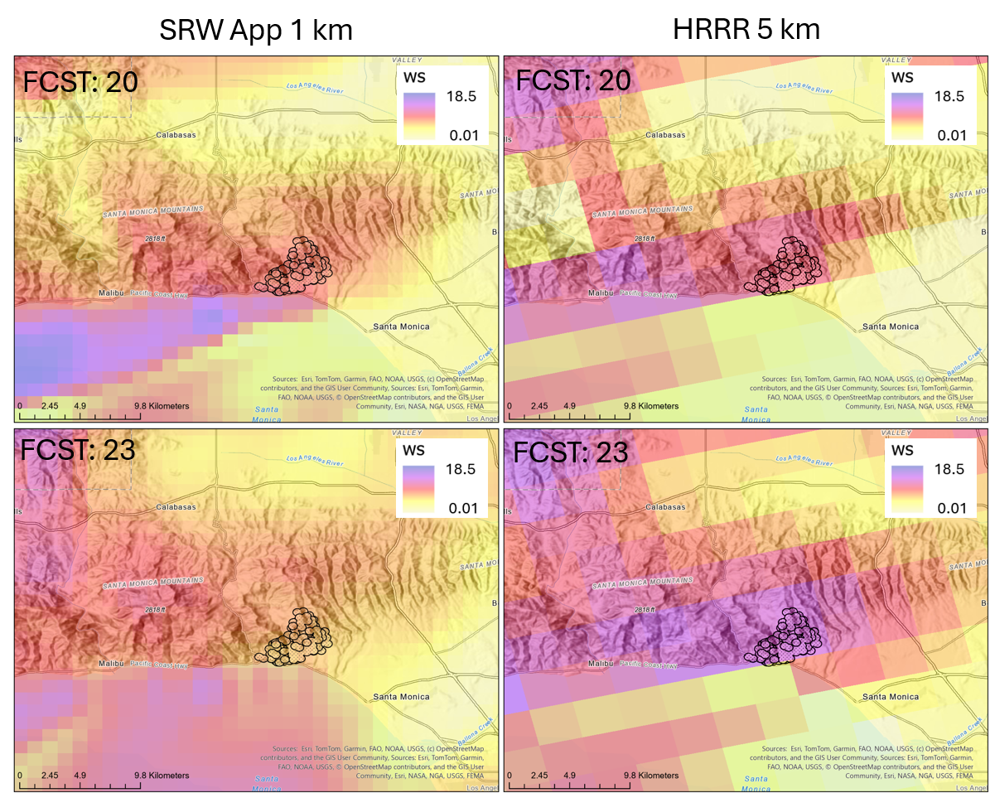
SRW App can Save Lives!
Dynamic downscaling of HRRR & RFFS with the SRW App improved representation of wind variability
Hour-to-hour specificity of wind speed extremes follow topographic influences and peak fire progression
Critical for fire operations and response at all scales
  “It’s this Operational yet!”
  “Can this be done live?”
  “I didn’t know this was possible”
Skill Level Limited not Cost Limited
Notes:
Not cost prohibited

Slide 14

Thank you!
Contact: Samantha Kramer
skramer@airiconsulting.com
Airiconsulting.com

Slide 15
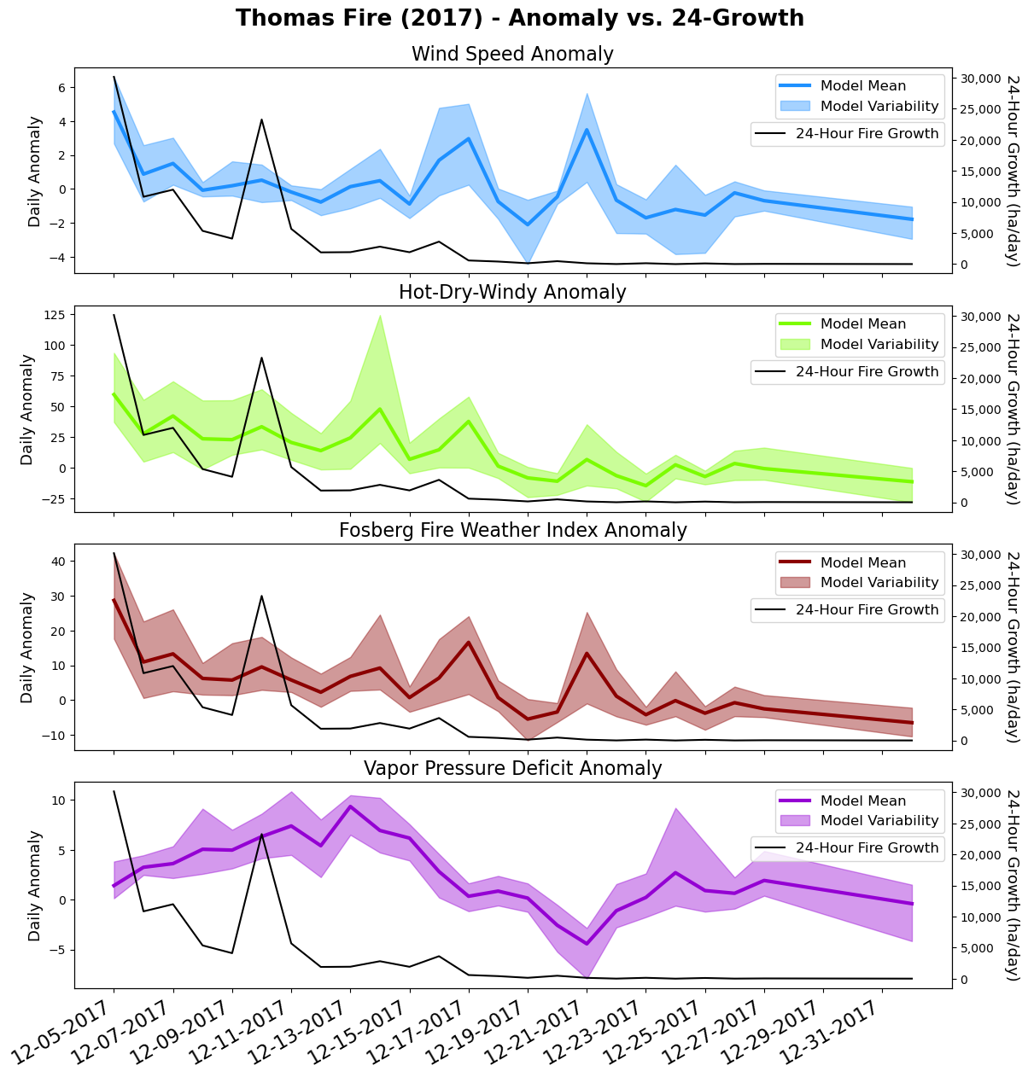
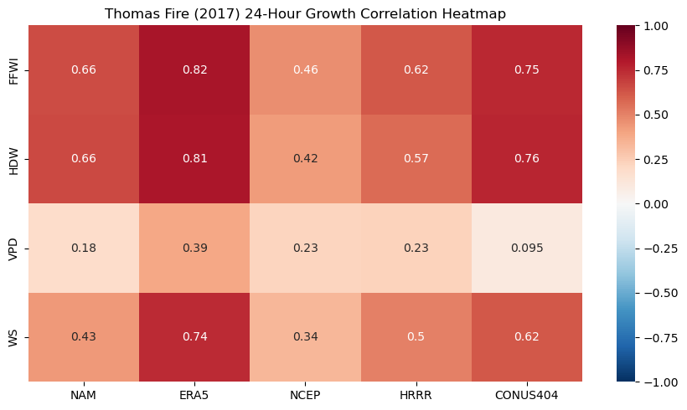

Slide 16
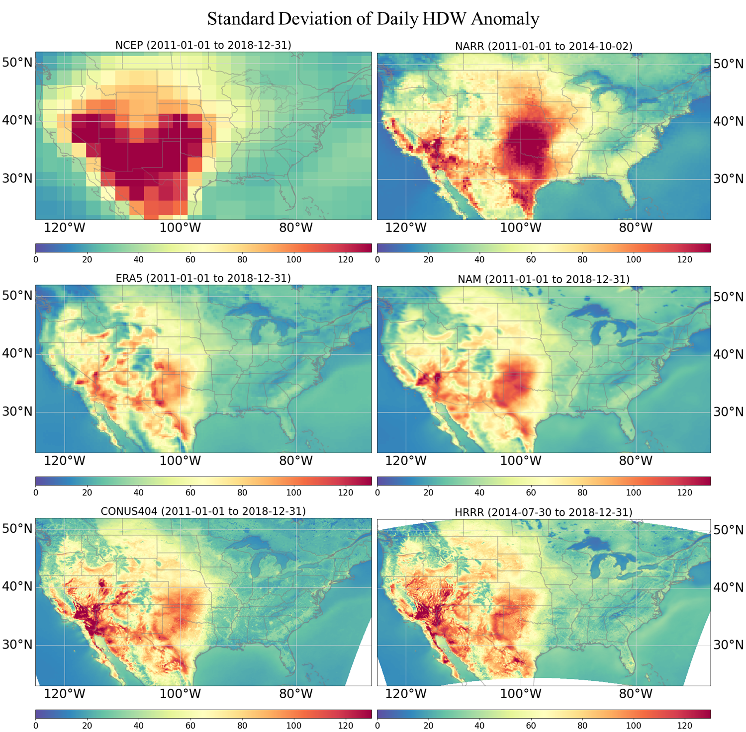
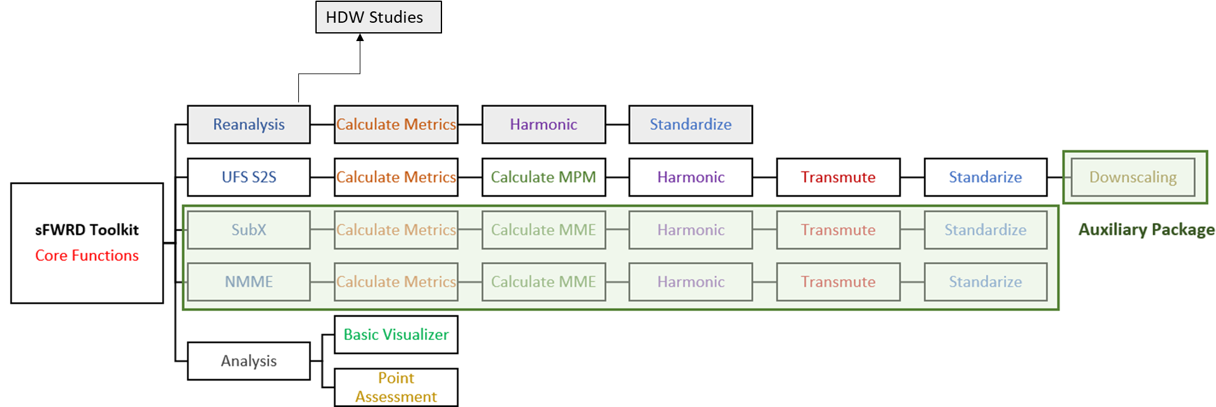
Open-Source Tools
Standardized Fire Weather Research Database (sFWRD)
Code Repository
Code Repo: https://github.com/s2sfire/sFWRD
Database: soon to be available at the (SJSU) Wildfire Interdisciplinary Research Center

Slide 17
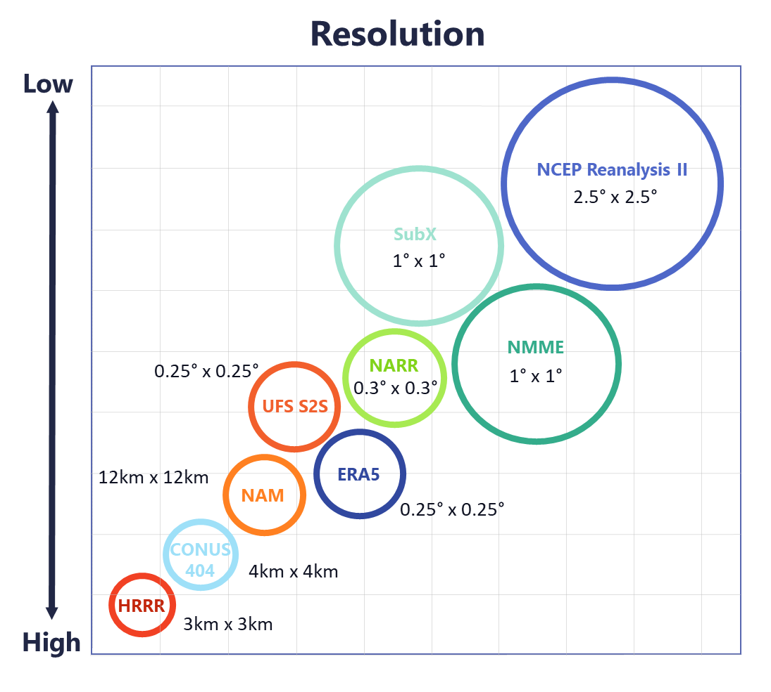
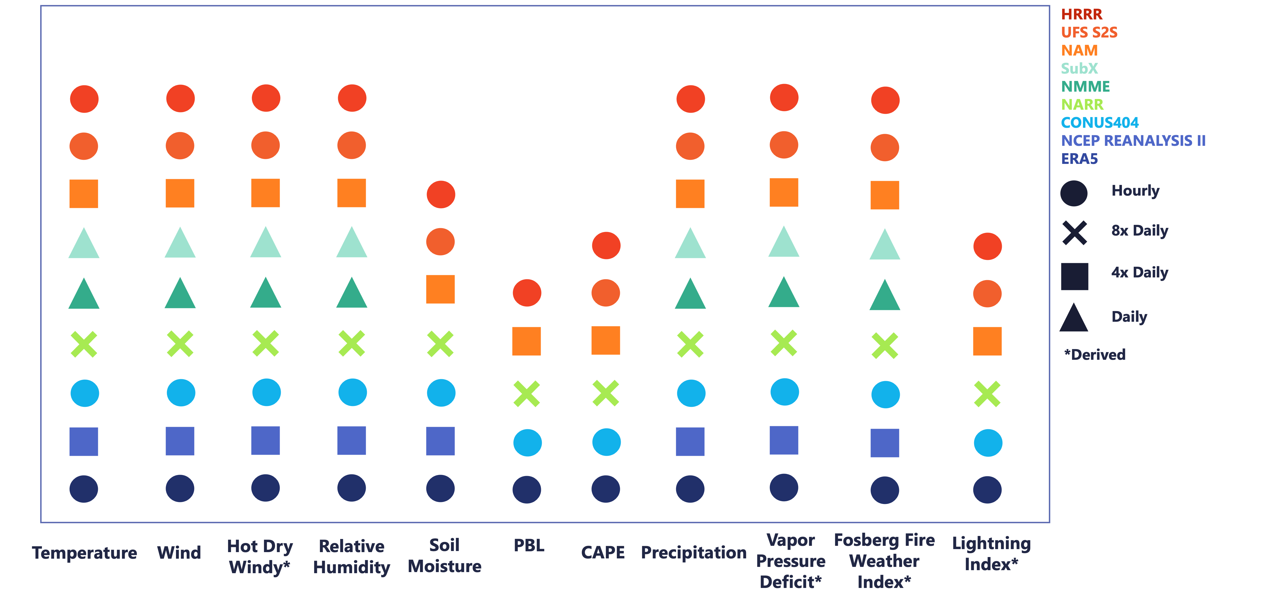
sFWRD: Data That is Ready-To-Use!
1
Files are netCDF with the same columns, naming convention, formats, structure throughout. All variables have the same names, abbreviations, units across all models. Sub-daily, as available, and daily aggregates (min, max, avg).
¹Malloy K., Tippett M.K., and Koshak W.J. (2023) ENSO and MJO modulation of U.S. cloud-to-ground lightning activity. Monthly Weather Review, 151(12), 3255-3274, December 1. Available at https://doi.org/10.1175/MWR-D-23-0157.1., coming soon

