Slide 1
Near-Real-Time AI Weather Forecasting with Nested-EAGLE
A Framework for Running EAGLE Models in Operations
Contributors: Mariah Pope*^{1,6}, D. Alex Burrows^{1,5}, Anil Kumar^{1,6}, Jacob Carley², Paul Madden³, Emily Carpenter³, Sergey Frolov⁴, Tim Smith⁴, Keven Blackman¹
*presenting author
1 Earth Prediction and Innovation Center
2 Environmental Modeling Center
3 Global Systems Laboratory
4 Physical Sciences Laboratory
5 RedLine Performance Solutions
6 Tomorrow.io

Slide 2
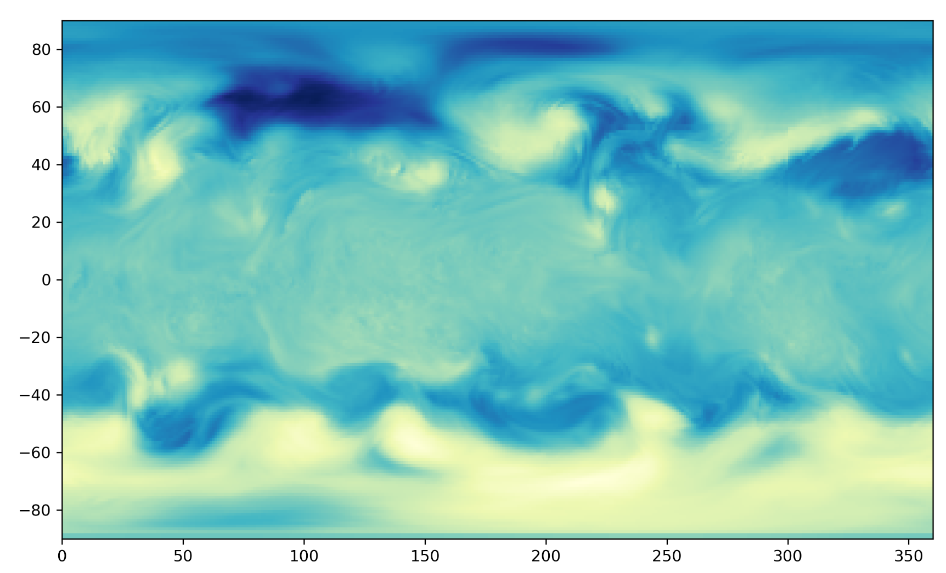
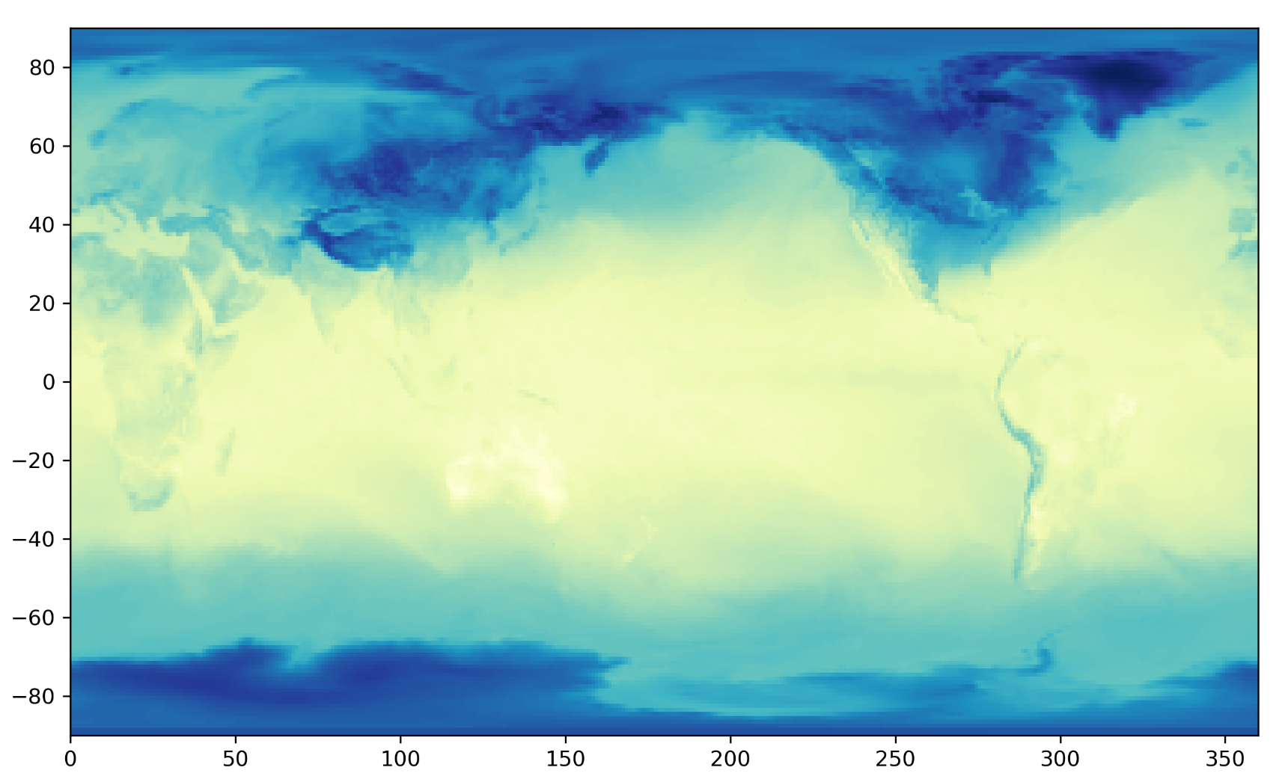
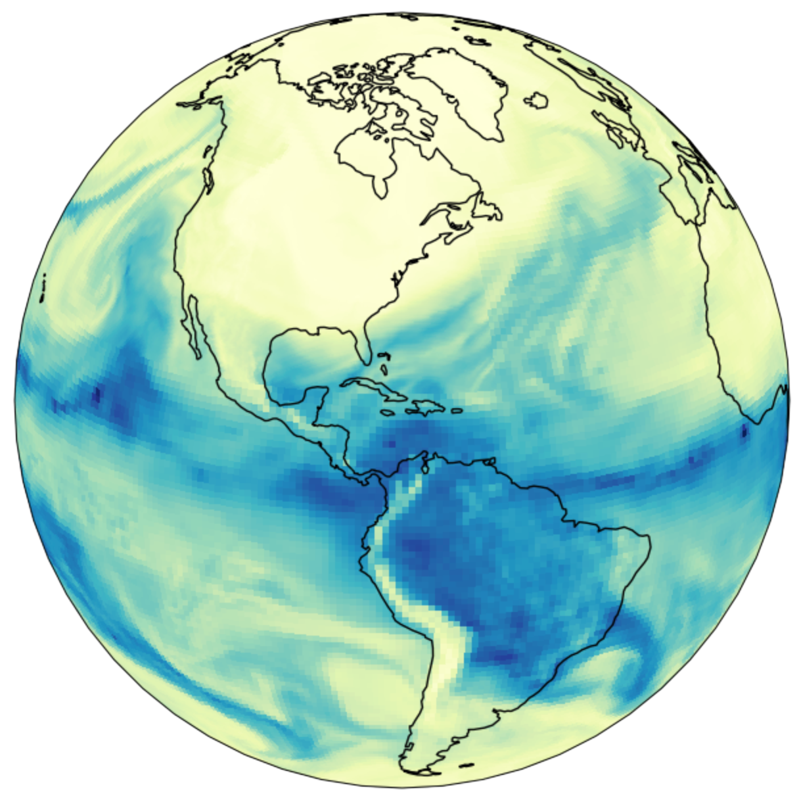
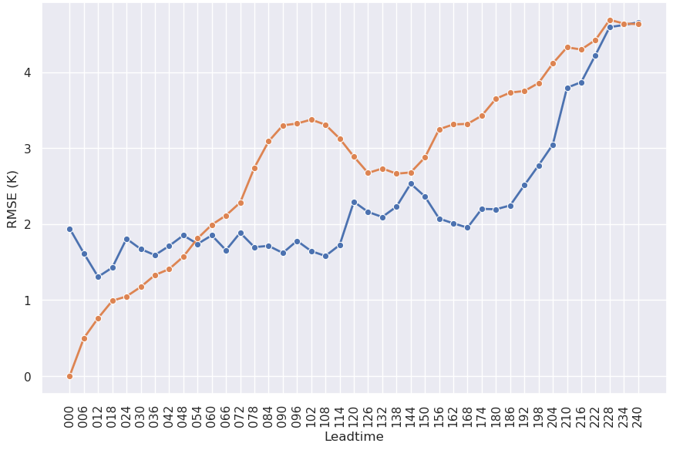

Project EAGLE
ufs2arco
Tool for making NOAA data more accessible for analysis and machine learning
Anemoi-inference
Package within the Anemoi framework for creating forecasts from a model checkpoint
wxvx
Tool for verifying forecasts against various models (GFS/HRRR) or observations
?
Model Training
Post-processing
Create Conda Environments
Data Preprocessing
Inference
Verification
Anemoi
Community framework for training graph-based ML weather models using anemoi-core.
eagle-tools
Python functions to make inference output more interpretable and user-friendly
What happens after someone has trained a skillful model?
Let’s to go operations!

Slide 3
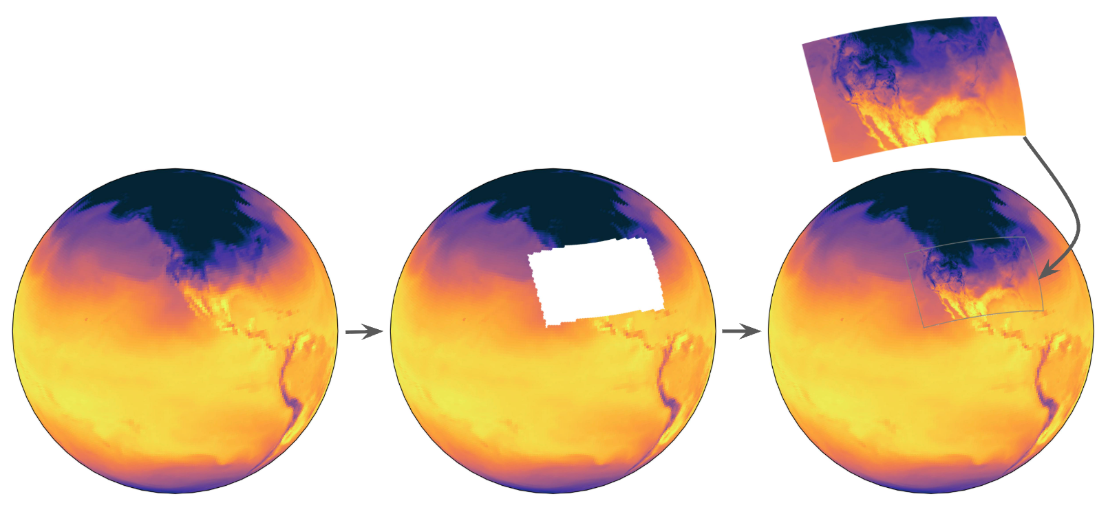
Nested-EAGLE in Near-Real-Time (NRT)
Our team has developed NRT capability within EAGLE
Currently running the Nested-EAGLE model in NRT on Ursa
  Every 6 hours (0, 6, 12, 18)
  10 day forecasts
  Verification of every forecast against observations
  Azure capability also provided

Slide 4

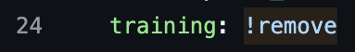
How Does it Work?
ufs2arco
Tool for making NOAA data more accessible for analysis and machine learning
Anemoi-inference
Package within the Anemoi framework for creating forecasts from a model checkpoint
wxvx
Tool for verifying forecasts against various models (GFS/HRRR) or observations
Model Training
Post-processing
Create Conda Environments
DISPLAY RESULTS!
Data Preprocessing
Inference
Verification
Anemoi
Community framework for training graph-based ML weather models using anemoi-core.
eagle-tools
Python functions to make inference output more interpretable and user-friendly

Slide 5




Config Generation
Set datetimes to most recent initialization
config management by uwtools, workflow (currently) by Jenkins
Verification
Load Initial Conditions
grid-to-obs
HRRR + GFS
wait ~12 days…
(240 hour forecast + 2 day prepbufr delay)
Create Forecast
10 day forecast

Slide 6
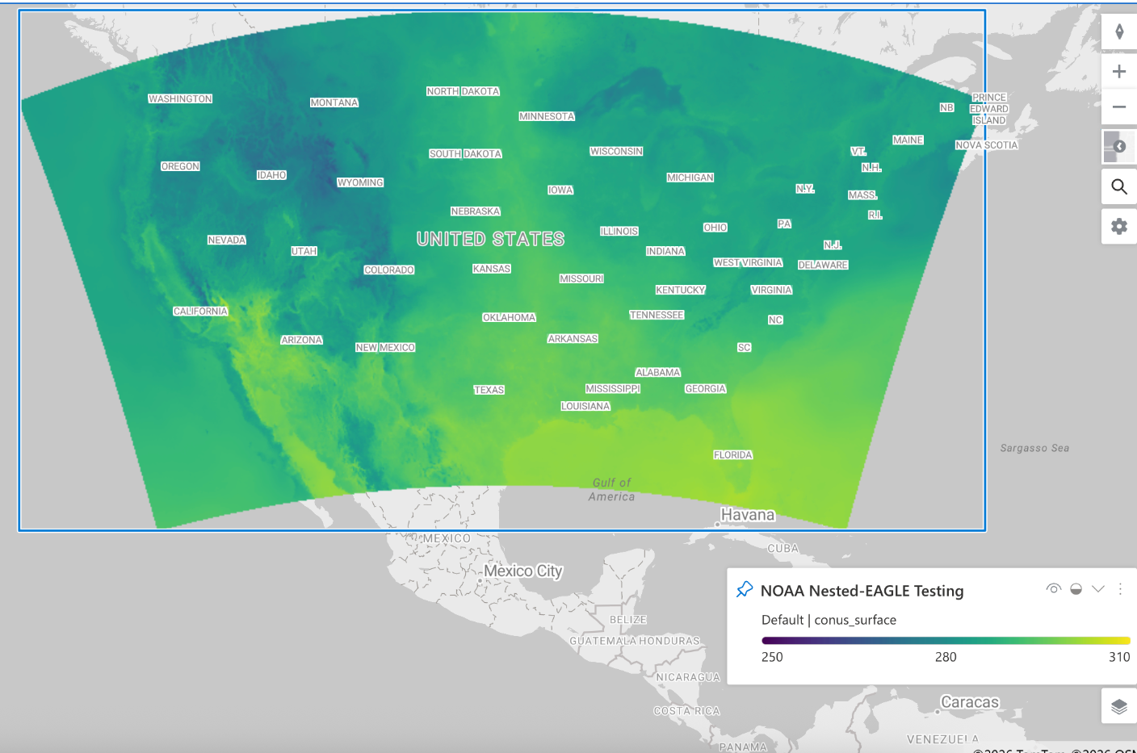
Forecast Display
Forecast (netcdf files) can be displayed in location of choice
Planned display locations
  DESI
    https://sites.gsl.noaa.gov/desi/
  Planetary Computer

Slide 7
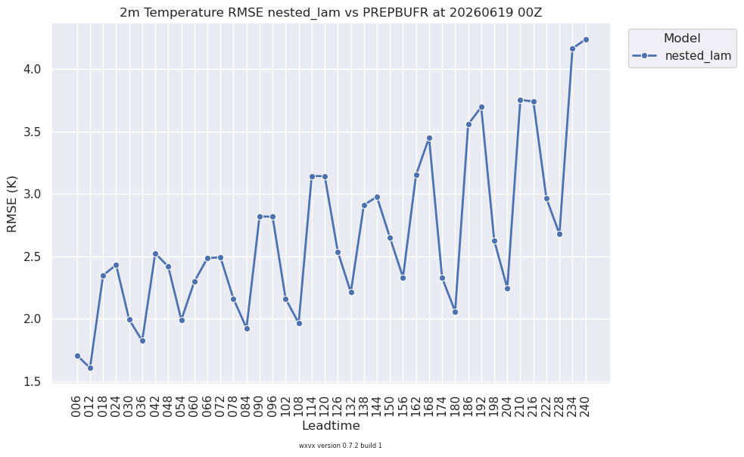
Verification Display
Verification runs after each forecast
Plan to host verification plots for selected core variables on the EPIC website
  temperature
  geopotential height
  winds
  specific humidity

Slide 8
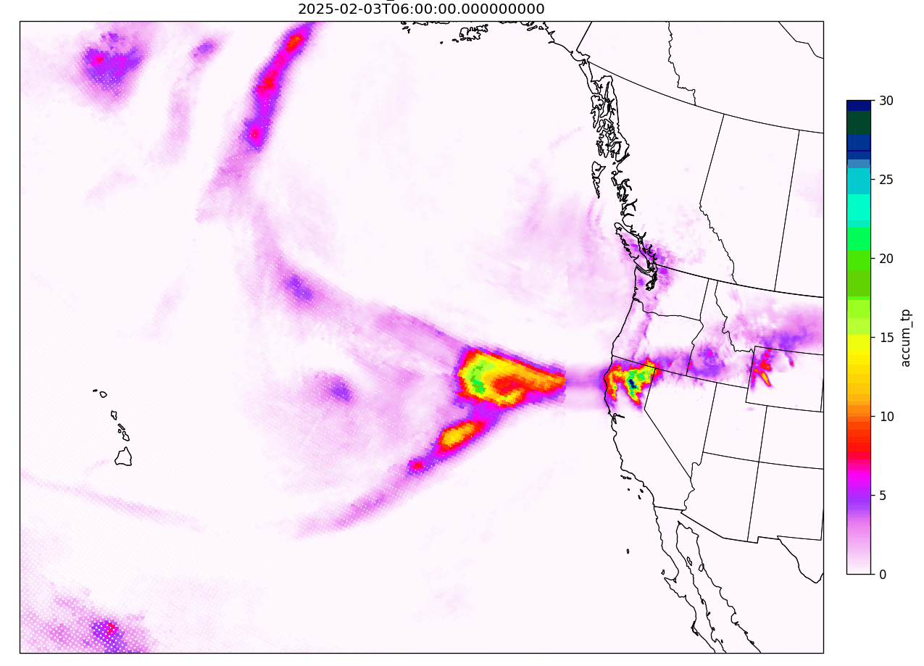
Future Work: This is just the beginning!
Nested-EAGLE Reforecast Example: 2025 Atmospheric River Event
Current status: proof of concept for taking an EAGLE model and running it in operations
We plan to keep refining and implementing feedback, with the goal of eventually creating a seamless process to quickly put new EAGLE models into operations.

Slide 9
Thank You!
Questions?

