Slide 1
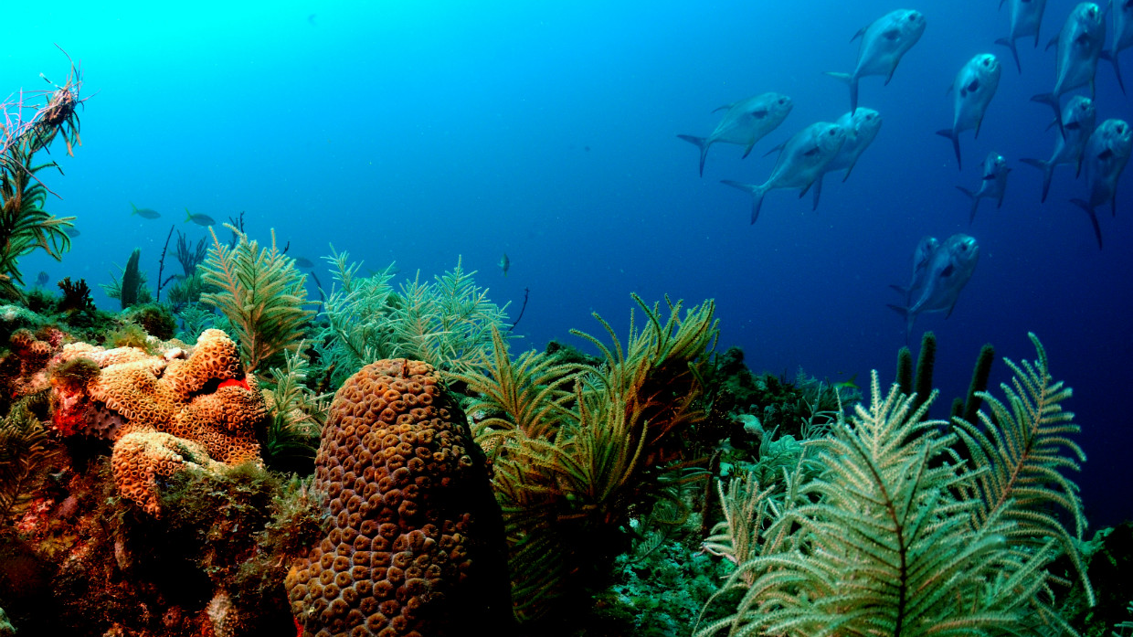
From Curiosity to
Contribution
A Place-Based Earth Science and Weather Forecasting Program for Grades 5-8
Tracy Fanara, PhD and Alison Gregory
Inspector Planet LLC, UCAR
Notes:
getting NOAA wide workflow
working with EPIC on agile training and work through NCAR- to enable all caps to be in place for NOS models to be used in the UFS
we need epic support- we have challenges that go beyond the initial cap; their expertise is what we need access to, and testing
DATM is a data atmosphere component: https://gsp-wm.readthedocs.io/en/develop/Glossary.html#term-DATM

Slide 2
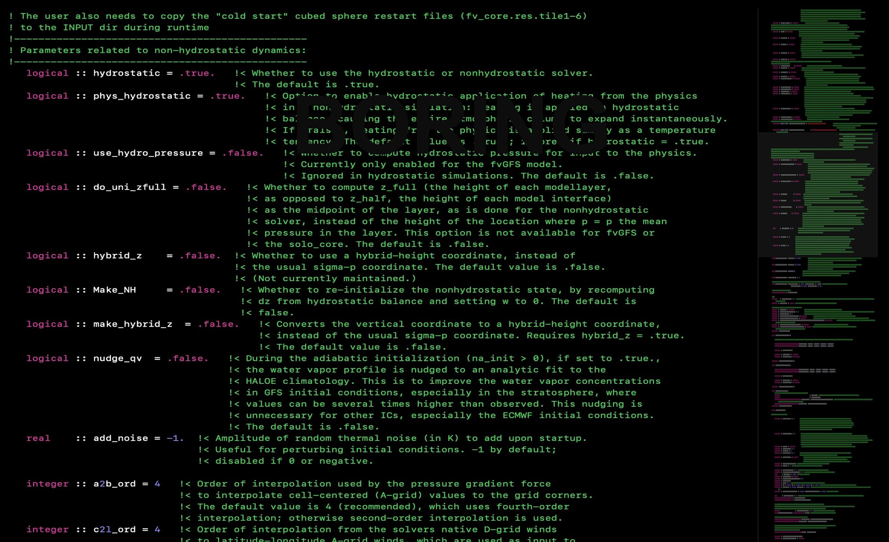
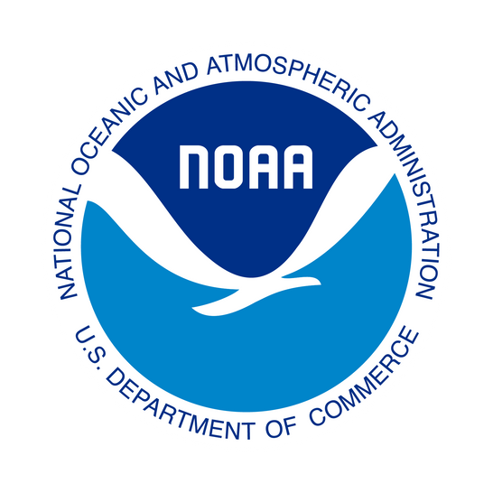
Recruitment after grad school isn’t cutting it, we need a pipeline.
Low visibility: Students don't know these careers exist.
High perceived barriers: Coding and modeling can look inaccessible.
Disconnected disciplines: Weather, water, oceans, ecosystems and computing are often taught separately.
Too few pathways: Curiosity rarely has a clear path toward continued participation.
BARRIER: WORKFORCE PIPELINE
Notes:
Our workforce challenge isn't simply that we don't have enough people. We also have a visibility and accessibility problem.
Students experience weather. They experience floods, drought, wildfire smoke, coastal hazards and changing ecosystems. But they often don't see the enormous scientific and technical infrastructure behind understanding and predicting those events.
And when we finally introduce modeling, it can look like this intimidating black box of code.
The opportunity is to change the entry point. Instead of starting with the model, we start with the world students already know.

Slide 3
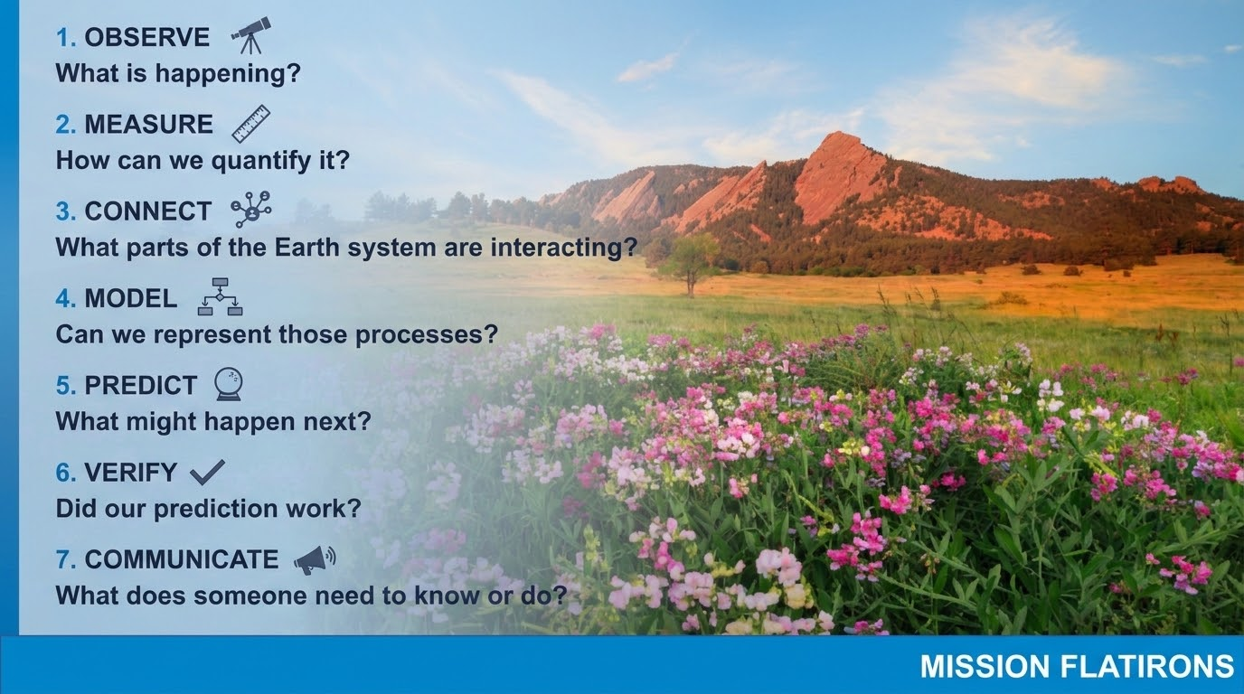
Notes:
Mission Flatirons is a proposed place-based Earth science and weather forecasting program for students in grades 5 through 8.
The concept is simple: instead of teaching Earth science, coding and forecasting as separate subjects, students experience them as parts of one scientific process.
They investigate the world around them, collect real observations, analyze data, use computational tools, and ultimately make and communicate a forecast.
The larger goal is to introduce students early to the skills and careers that support our future Earth-system forecasting workforce.

Slide 4
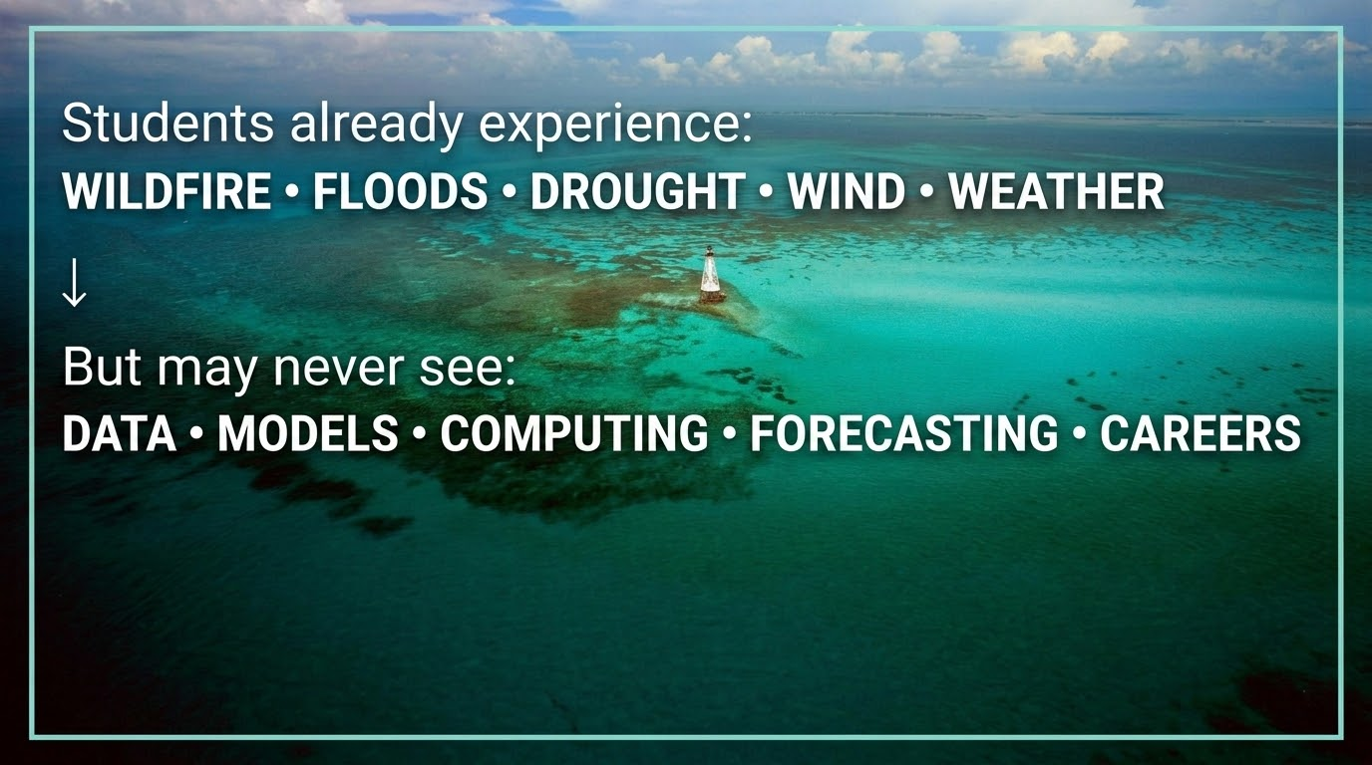
Notes:
Students already experience the phenomena our scientific workforce is trying to understand and predict. In Colorado, they see wildfire smoke, drought, high winds, snow and flooding.
But many never see the science and technology behind forecasting those events—or realize there are careers dedicated to solving these problems.
Mission Flatirons starts with phenomena students already know and uses those experiences as an entry point into Earth science, data, modeling and forecasting.

Slide 5
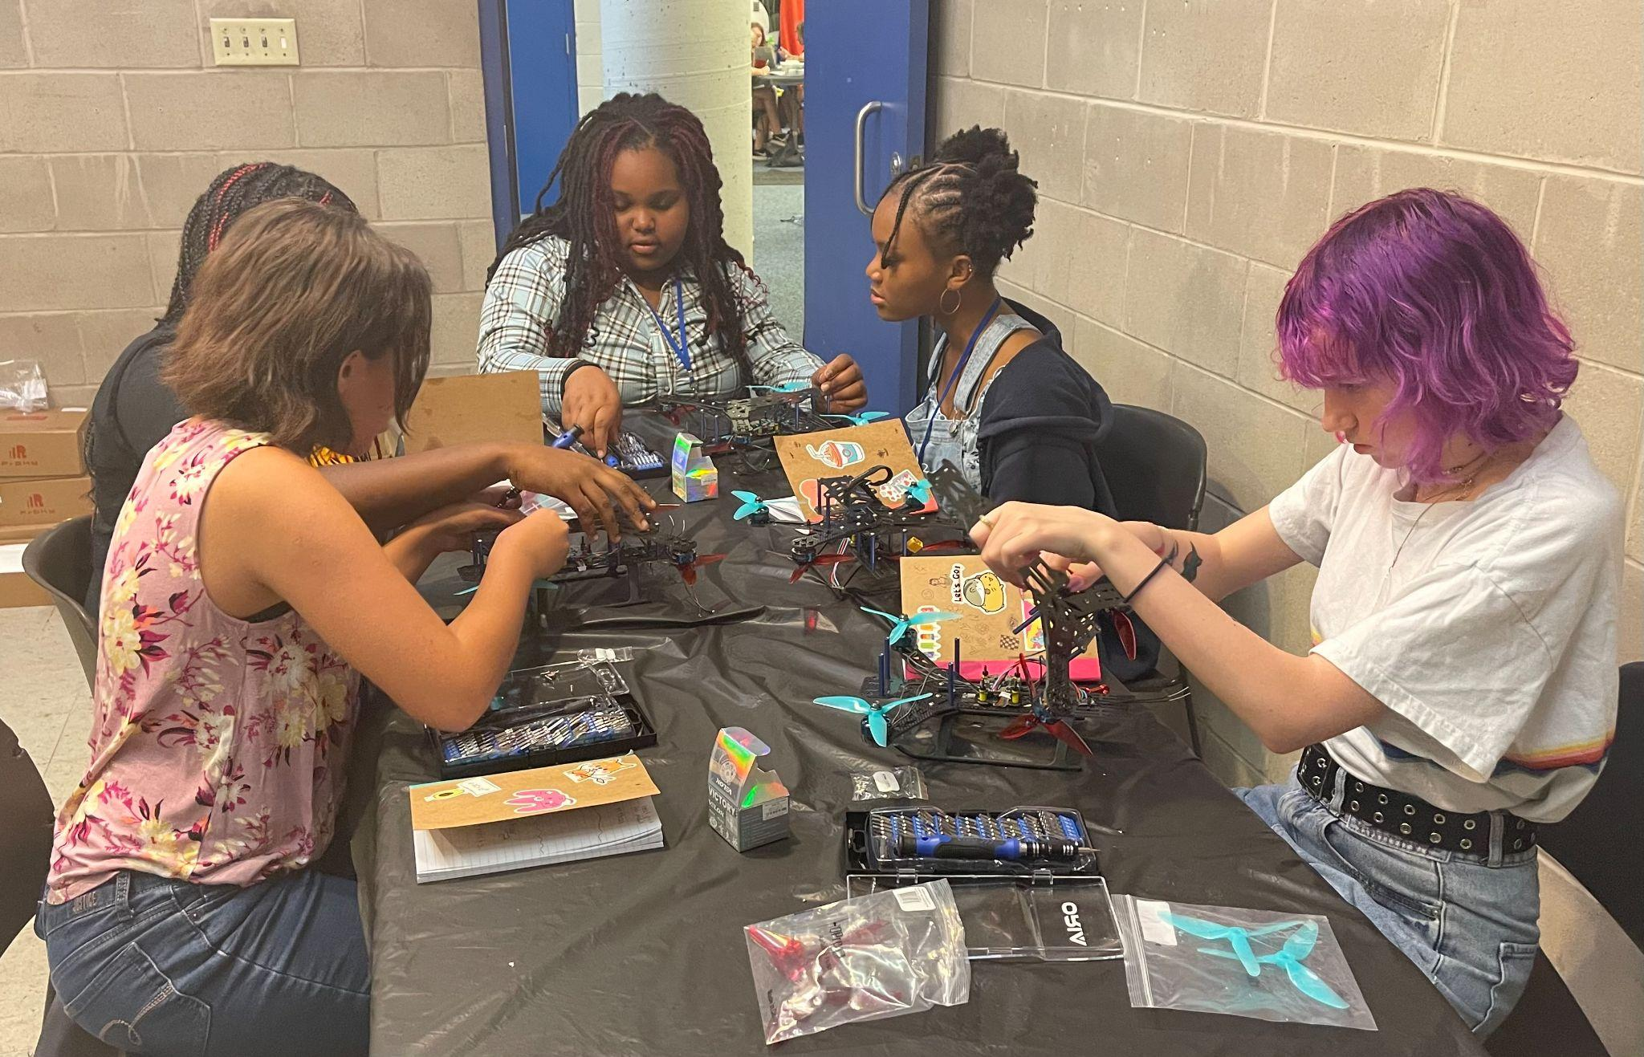
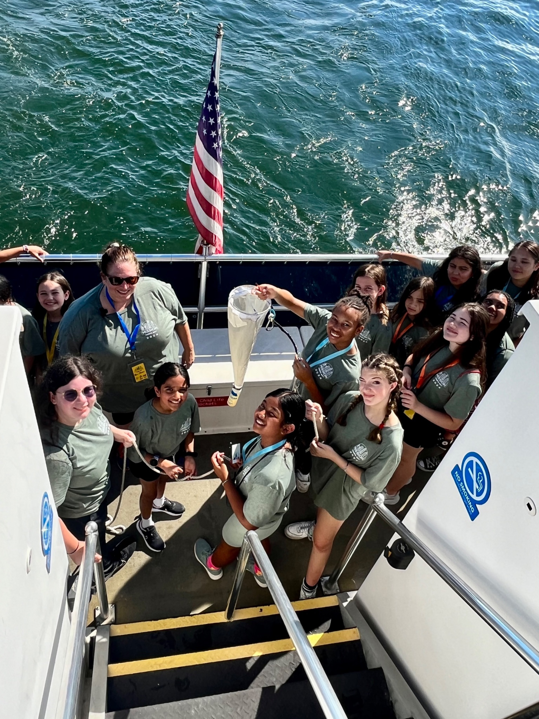
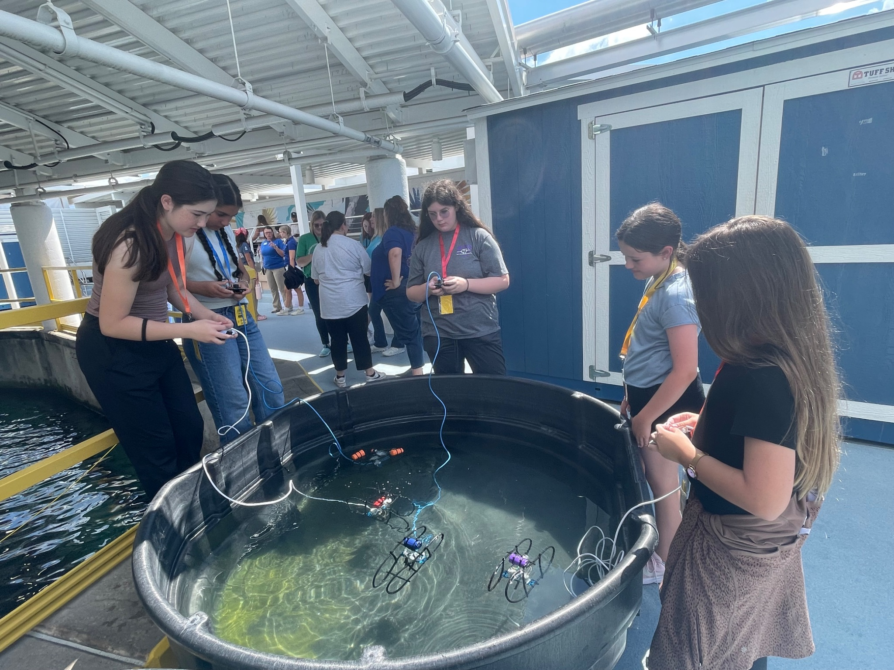
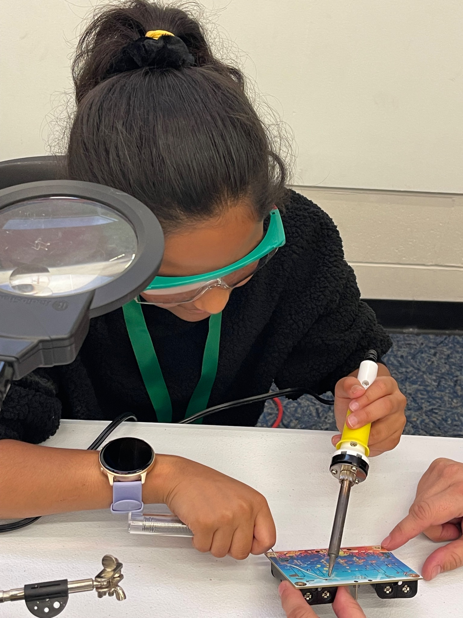
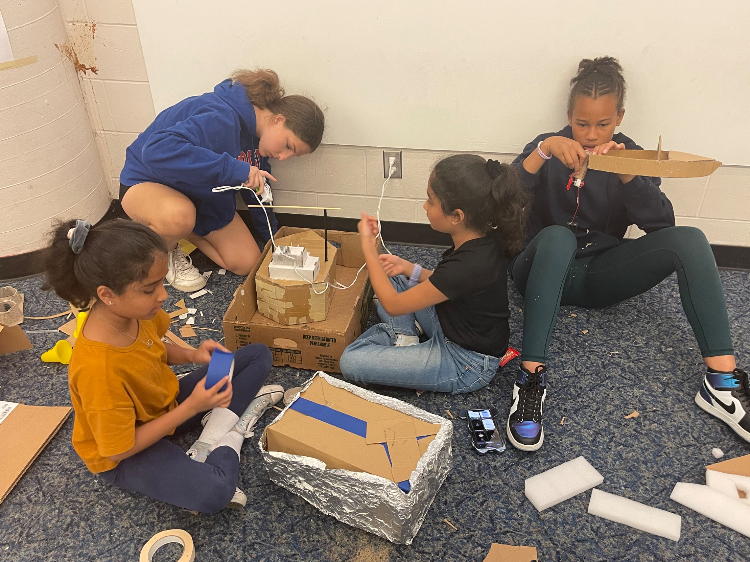
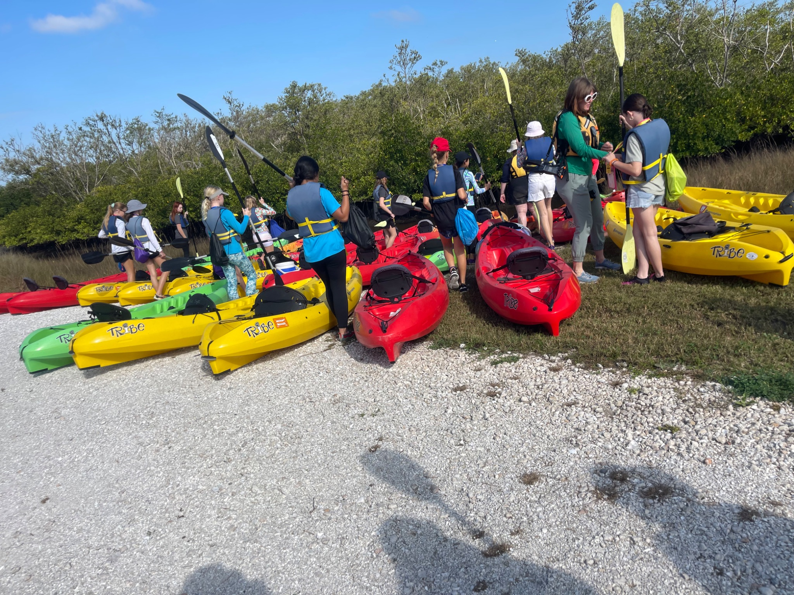
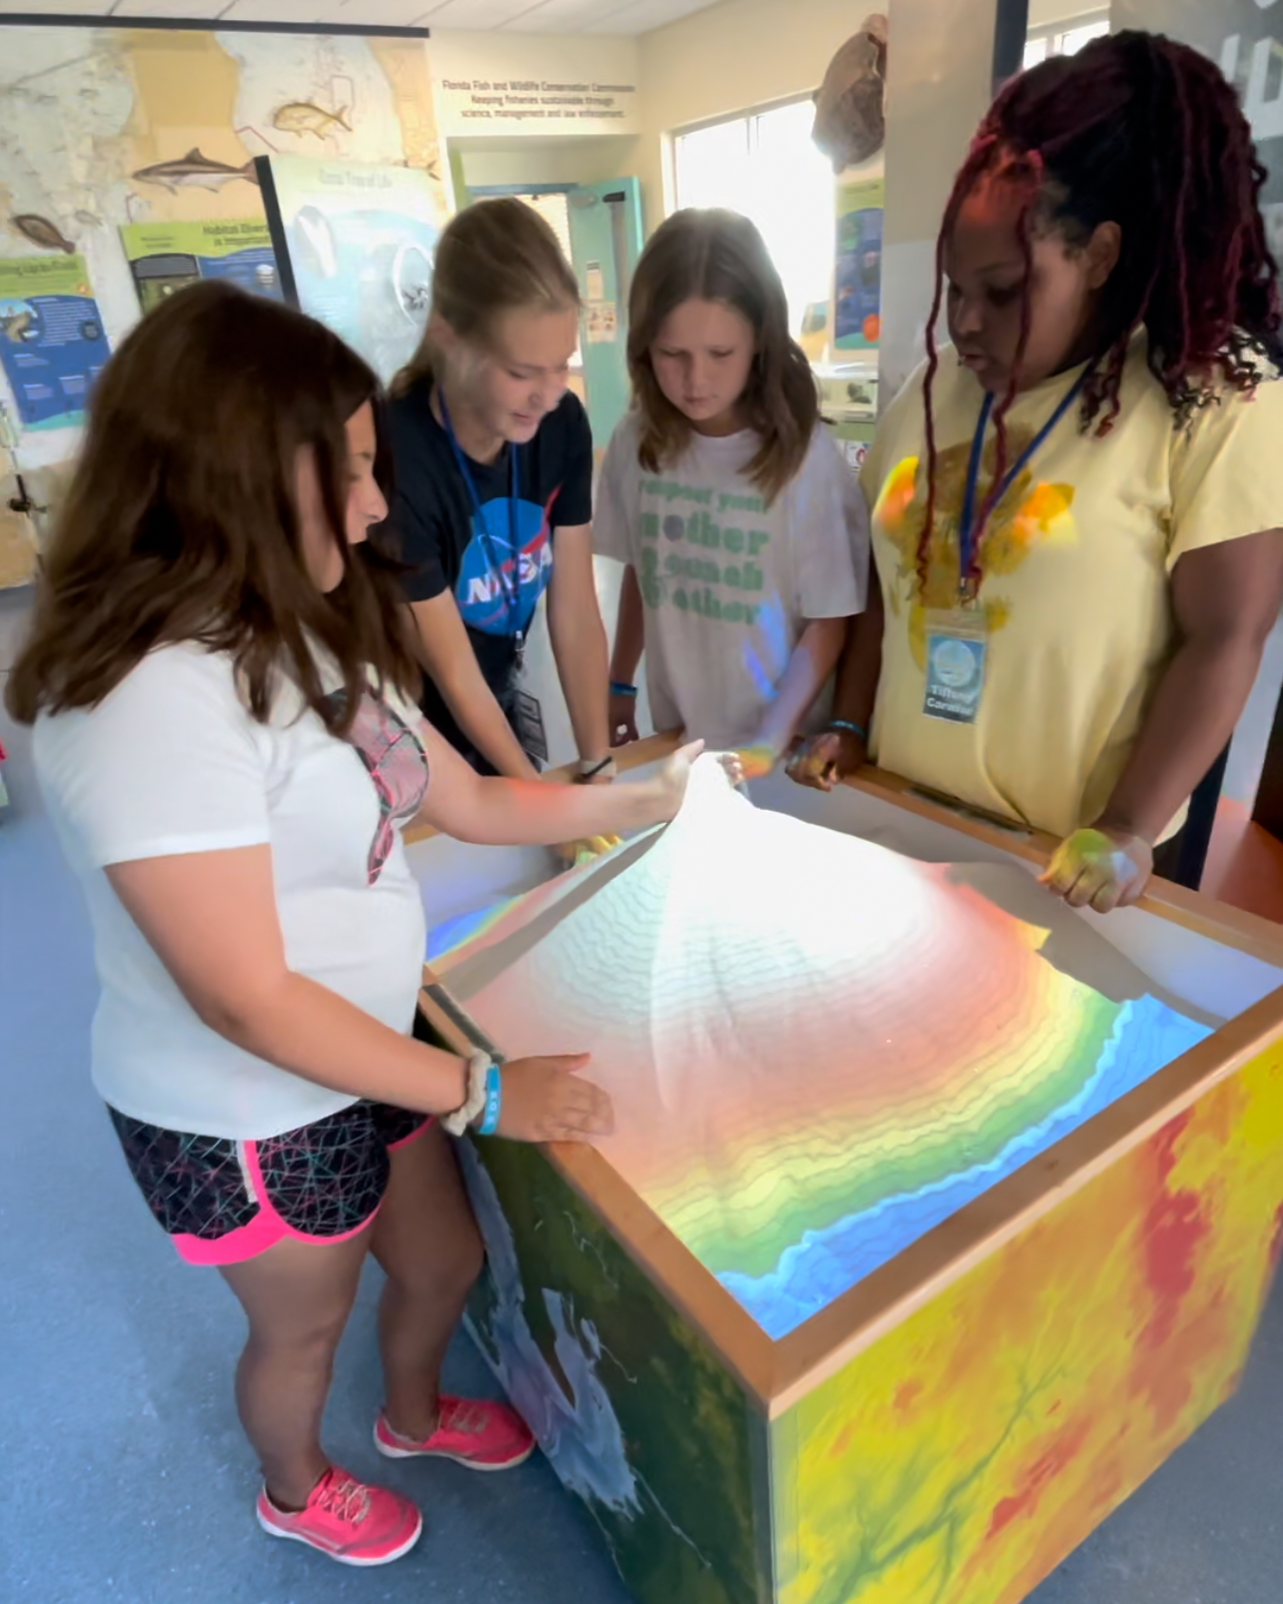
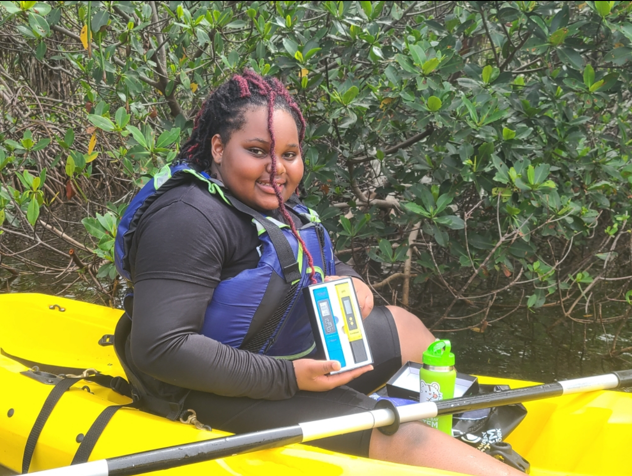
Mission Flatirons Launch 2027
Pilot Programs for 2026:
  Mission Tampa Bay: March and June
  Water World: July
Kids are given a Mission
  Research/Become a model user
  Develop tools for data collection- building
& coding
  In field data collection
  Model Development
  Comms
EVERY MISSION: Field Science + Sensors + Data + Coding + Models + Communication
Notes:
The Front Range becomes the classroom. Mountains interact with the atmosphere. Steep watersheds respond rapidly to rainfall. Drought influences water resources and wildfire risk. And communities are affected by all of these interacting systems.
Students can see earth phenomena, investigate them and measure them.
That connection to place gives students a reason to ask the question that drives the entire program: Why is this happening, and can we predict what happens next?

Slide 6
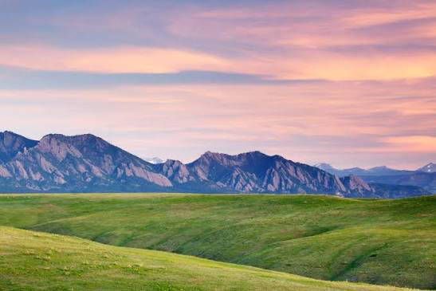
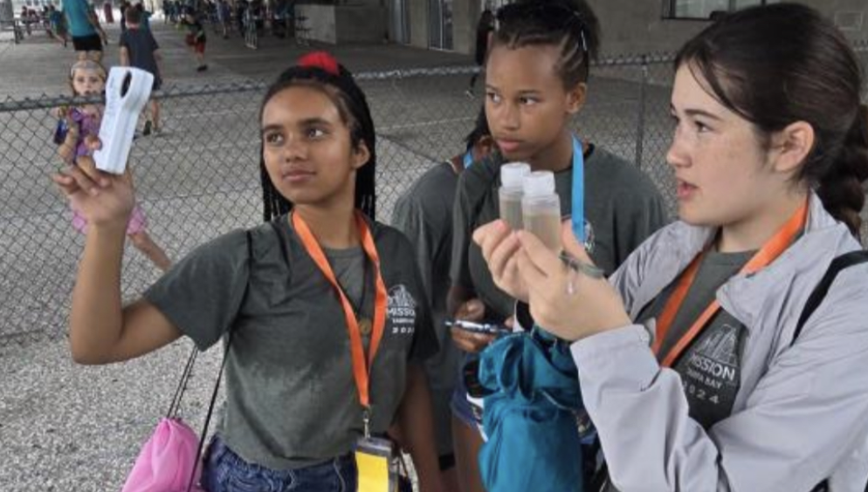
OBSERVE → MEASURE → INVESTIGATE → CODE → MODEL → FORECAST →COMMUNICATE
🏔️ MISSION 1
Wind & Mountain Waves
🌧️ MISSION 2
Flash Floods & Watersheds
🔥 MISSION 3
Wildfire Weather
💧 MISSION 4
Drought & Water Resources
🌦️ MISSION 5
The Forecast Challenge
Notes:
Students complete missions. Each mission begins with a real phenomenon and combines field science with computational thinking. Students investigate wind and mountain waves, flash floods and watersheds, wildfire weather, and drought and water resources. Across every mission, they follow the same scientific process: observe, measure, investigate, analyze, model and predict. Then, in the final mission, they bring everything together to produce a forecast.
One of the most important aspects of this approach is that students don't begin with code. They begin with the real world.
By the time students reach the computer, the variables mean something because they've observed or measured them themselves. Coding then becomes a tool for investigating patterns. Models become tools for testing what could happen next. The program culminates with student teams producing a 24-hour forecast and communicating it through a public weather briefing. Then they verify their predictions and ask what worked, what didn't and why.
We're not simply teaching students to code. We're teaching them how scientists solve problems.

Slide 7
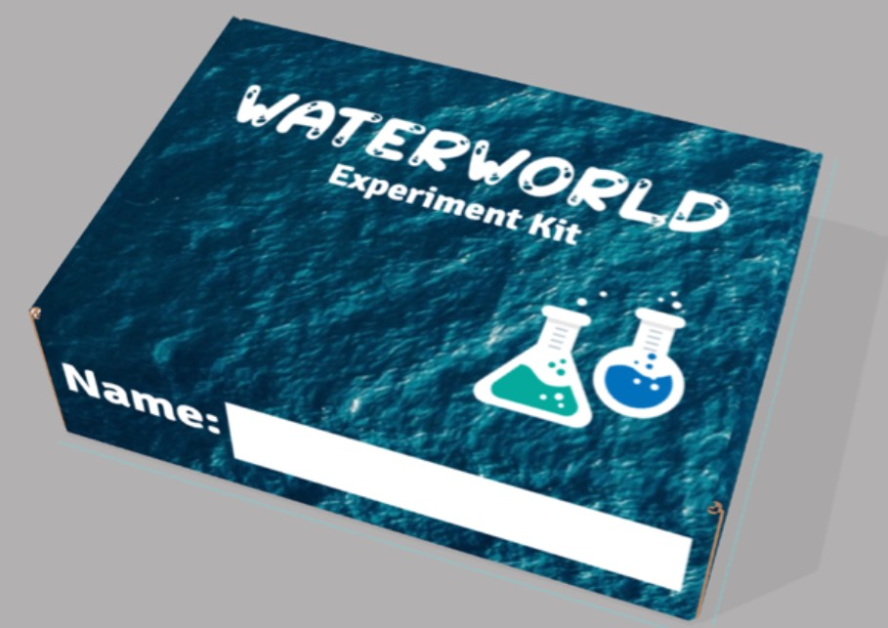
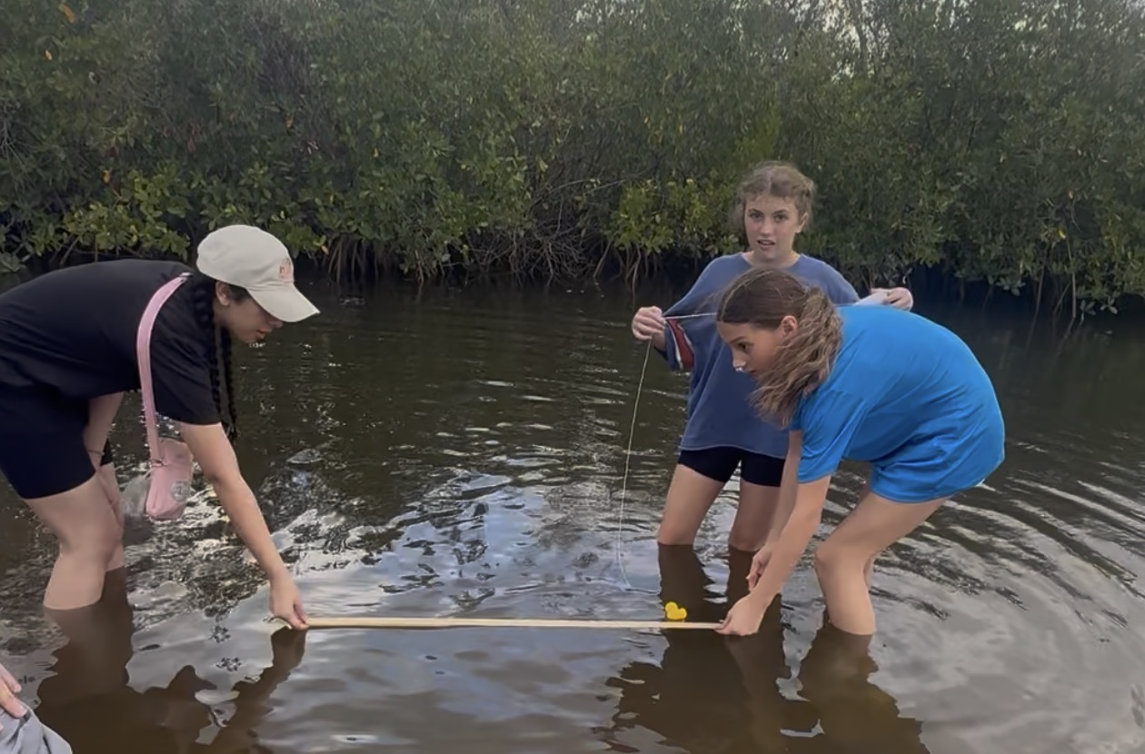
Portable Camp-In-A-Box
Weather happens everywhere - Run Model code from Anywhere!
Local community partner identifies regional issues (drought, flooding, extreme heat, tropical cyclones, tornados, severe storms, etc.)
Students run hands-on experiments in the field and learn from local experts
Code can be run on their own computer
Students build real world skills that are applied to real issues they see in their own backyard
Notes:
Mission Flatirons is intended to be the pilot, not the endpoint. The long-term vision is a Regional Earth Science Camp-in-a-Box that educators can adapt to the hazards and environmental phenomena of their own communities.
The science might change from mountain waves in Colorado to hurricanes on the Gulf Coast or severe weather in the Midwest. But the learning architecture remains the same: investigate local phenomena, collect observations, analyze data, use computational tools, make predictions and communicate results.
That creates a model that can scale without losing the power of place-based learning.

Slide 8
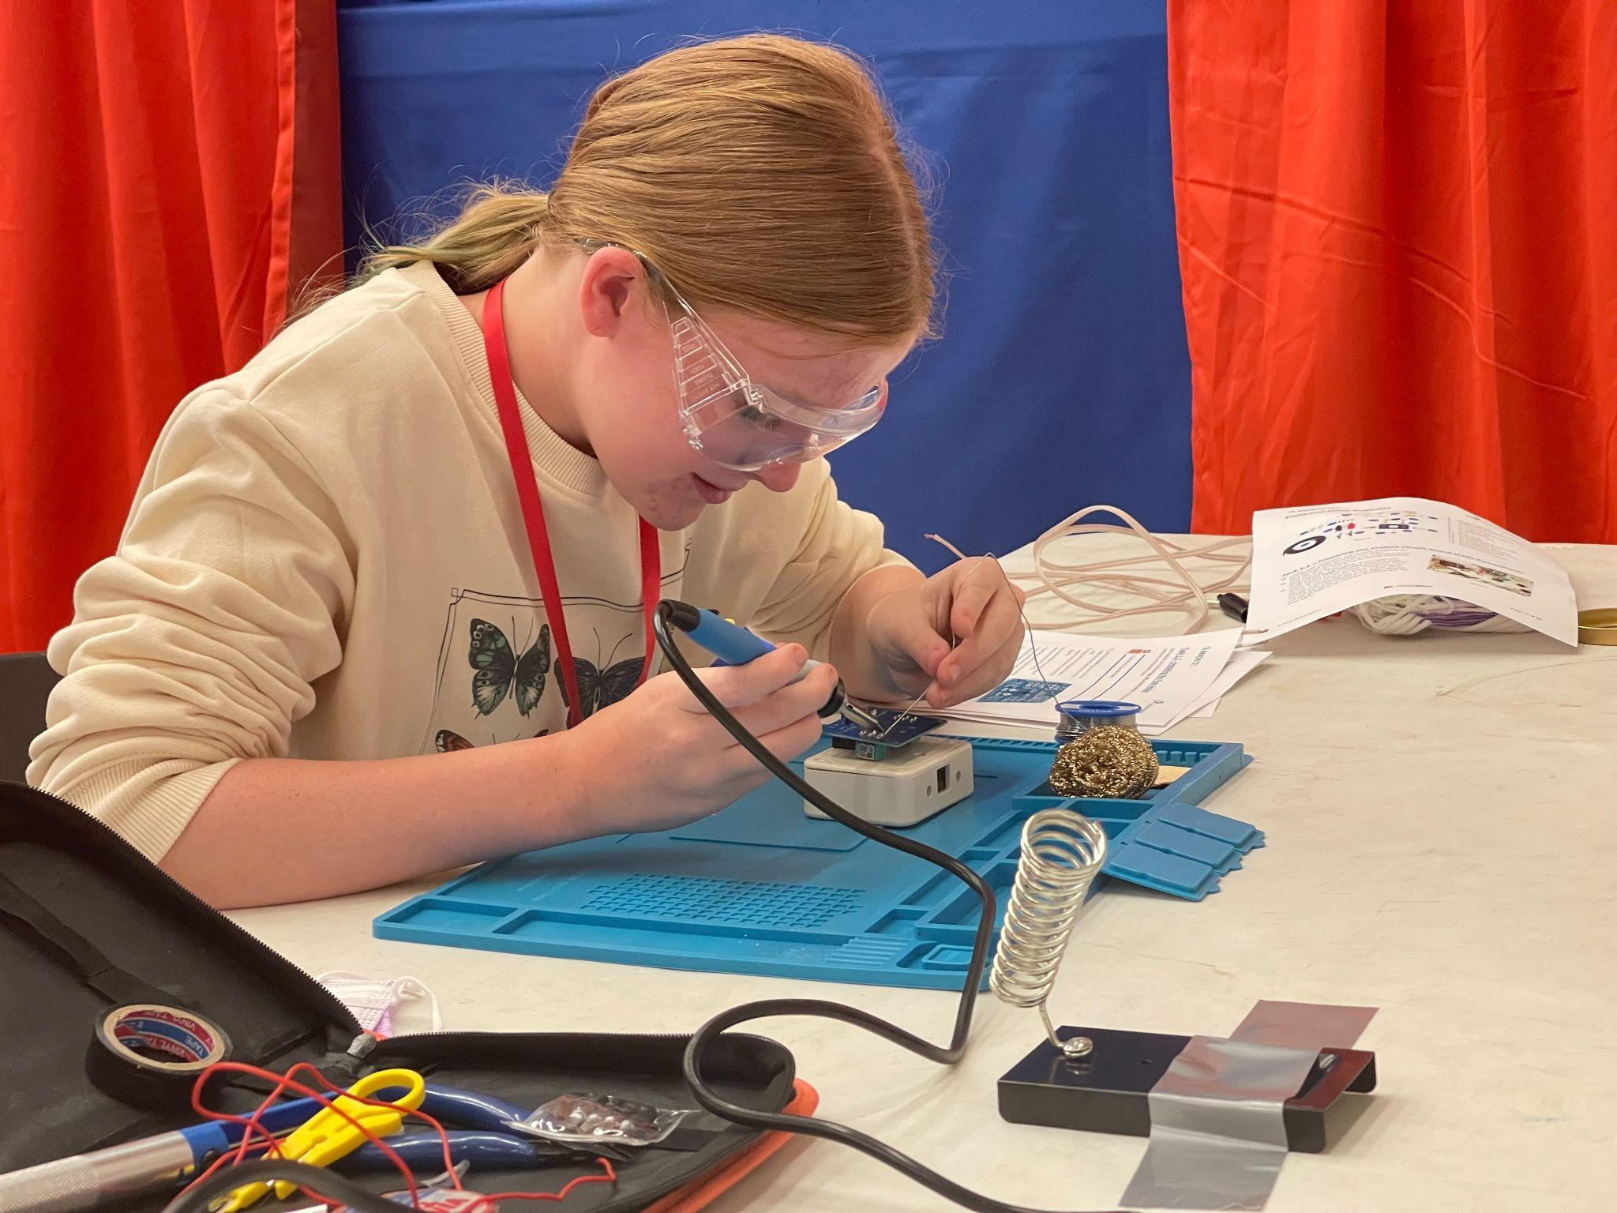
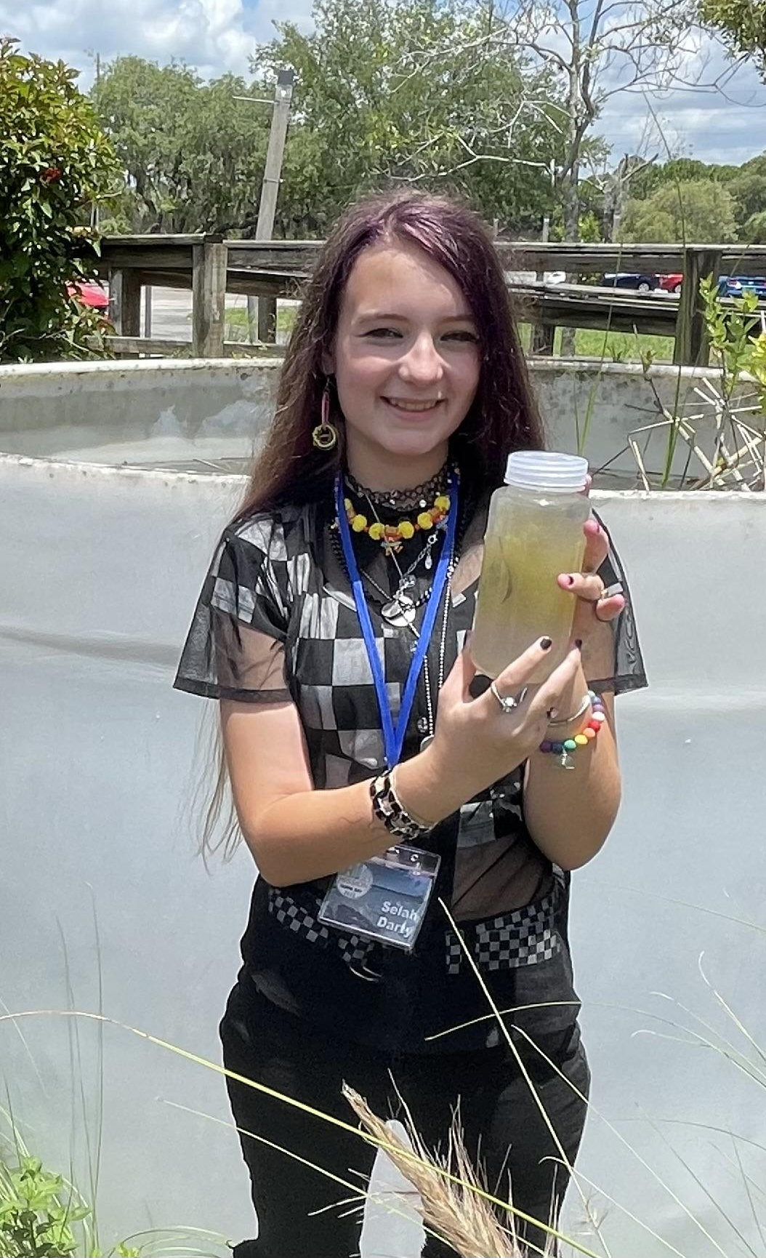
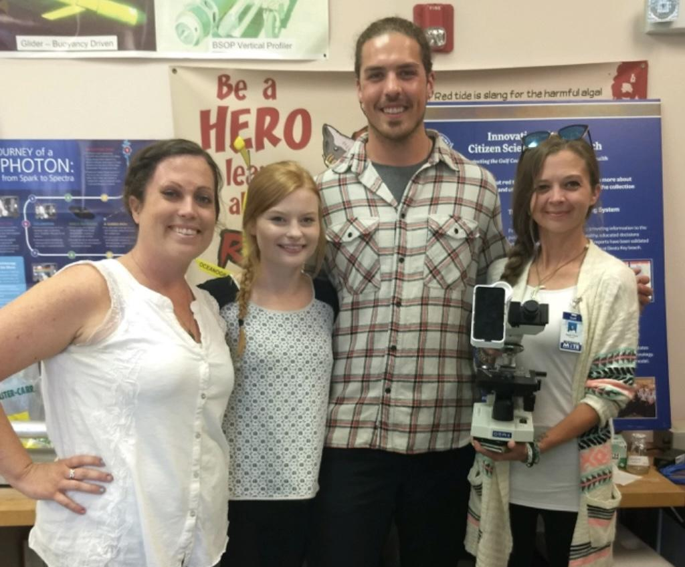
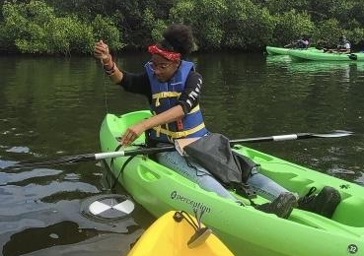
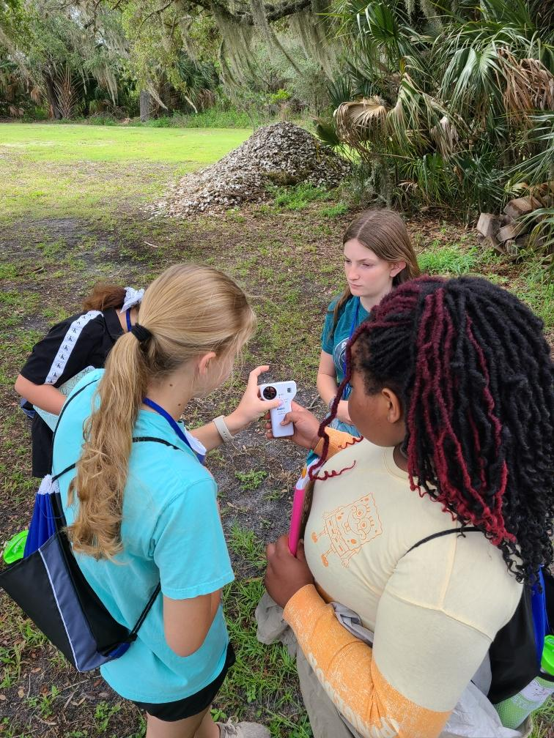
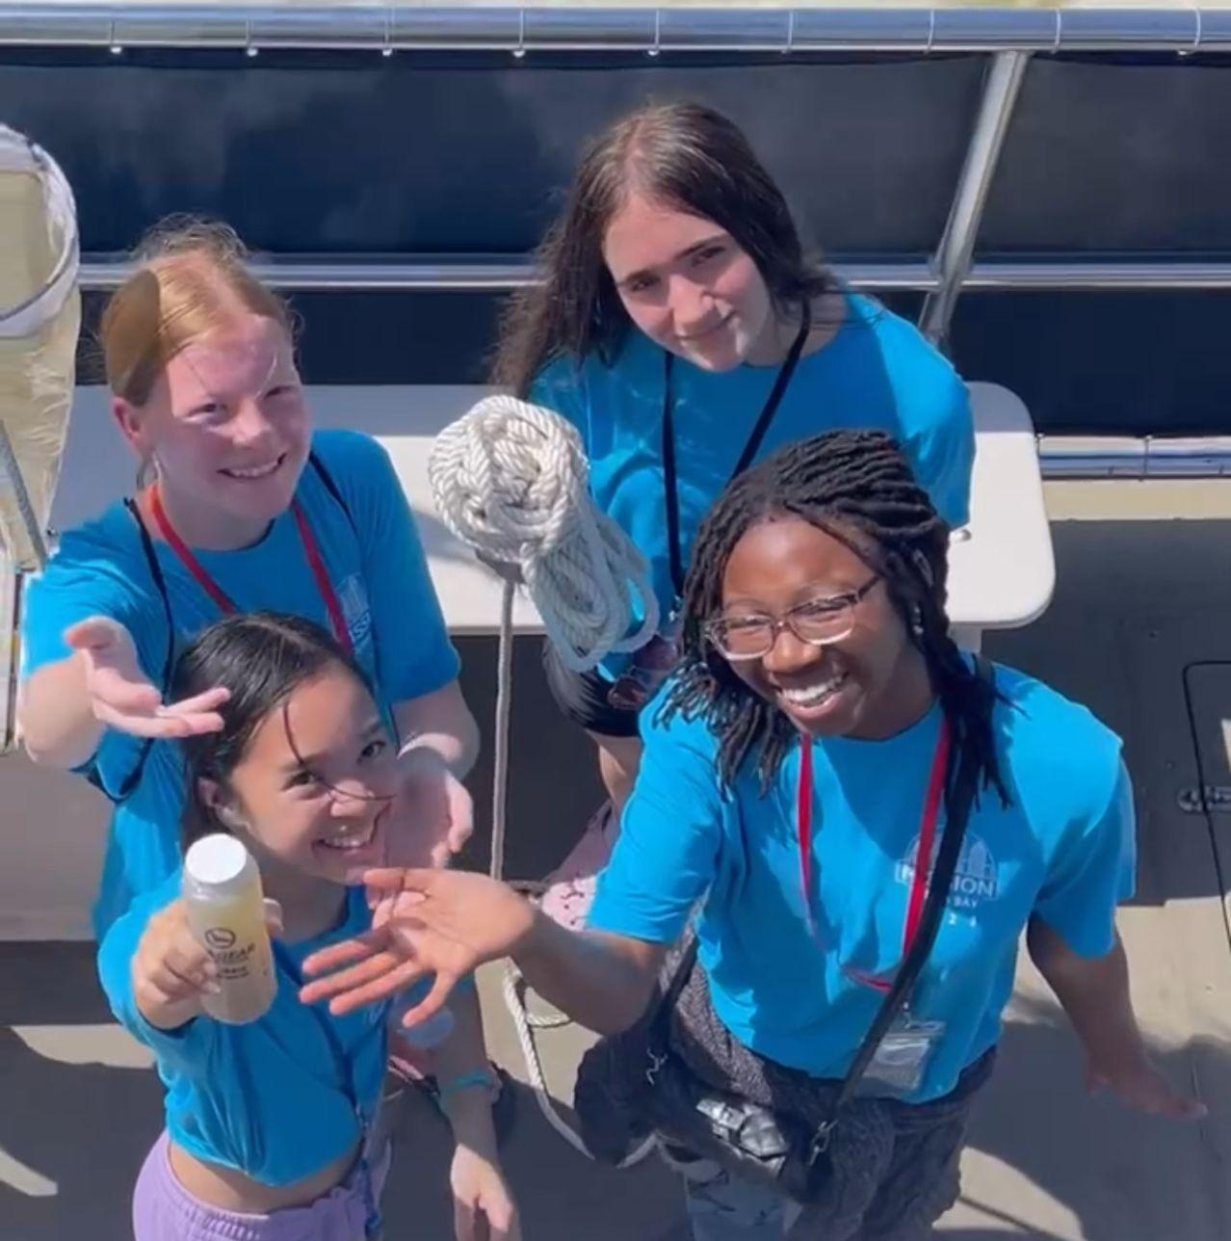
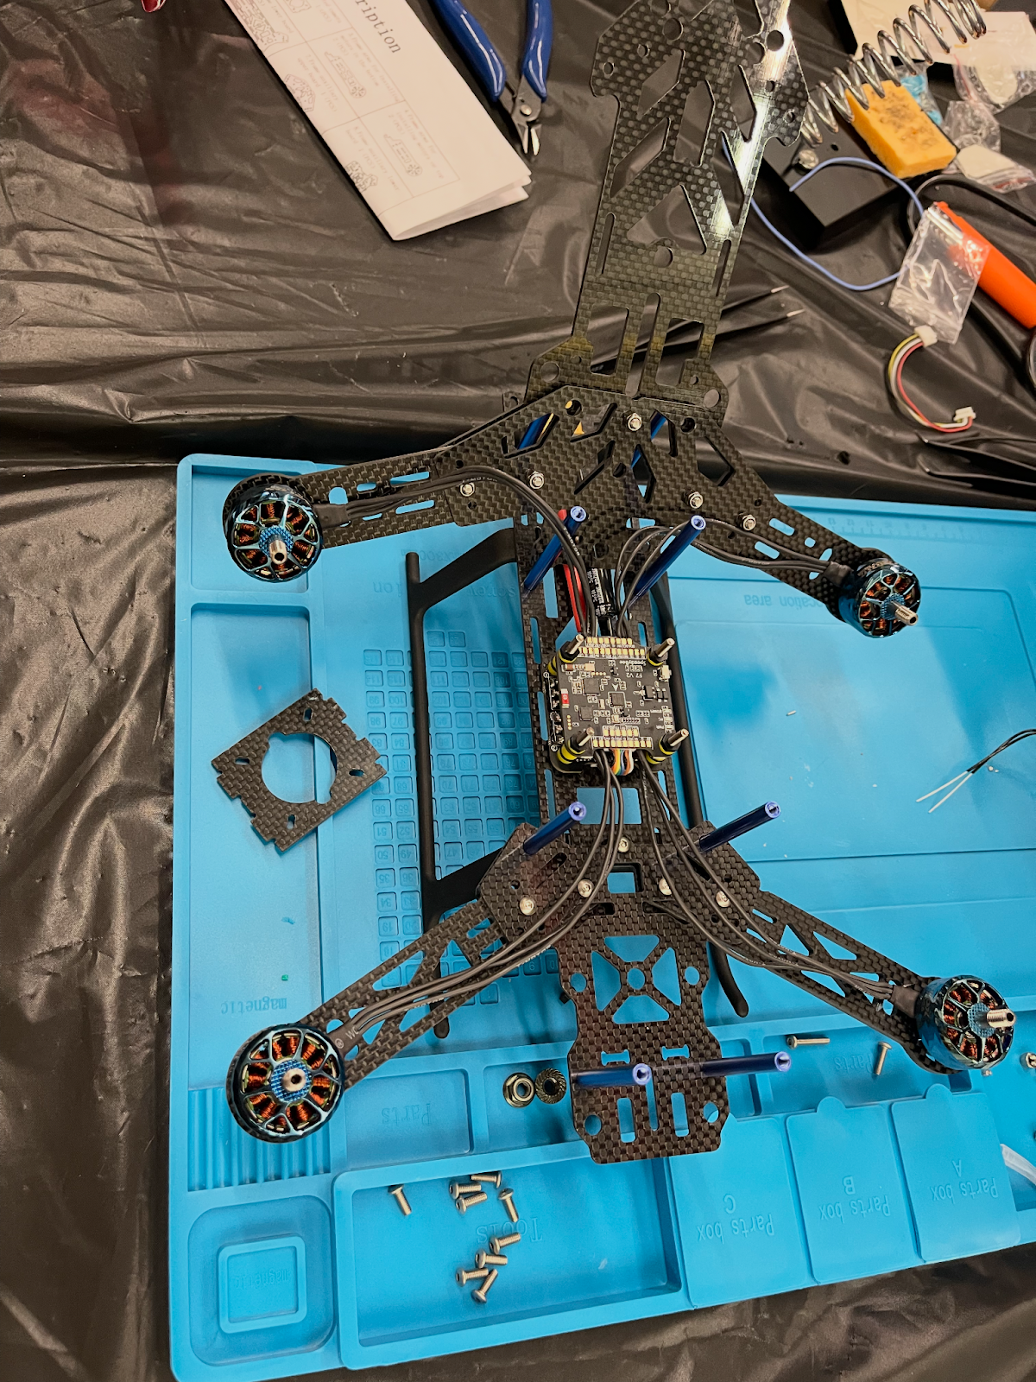
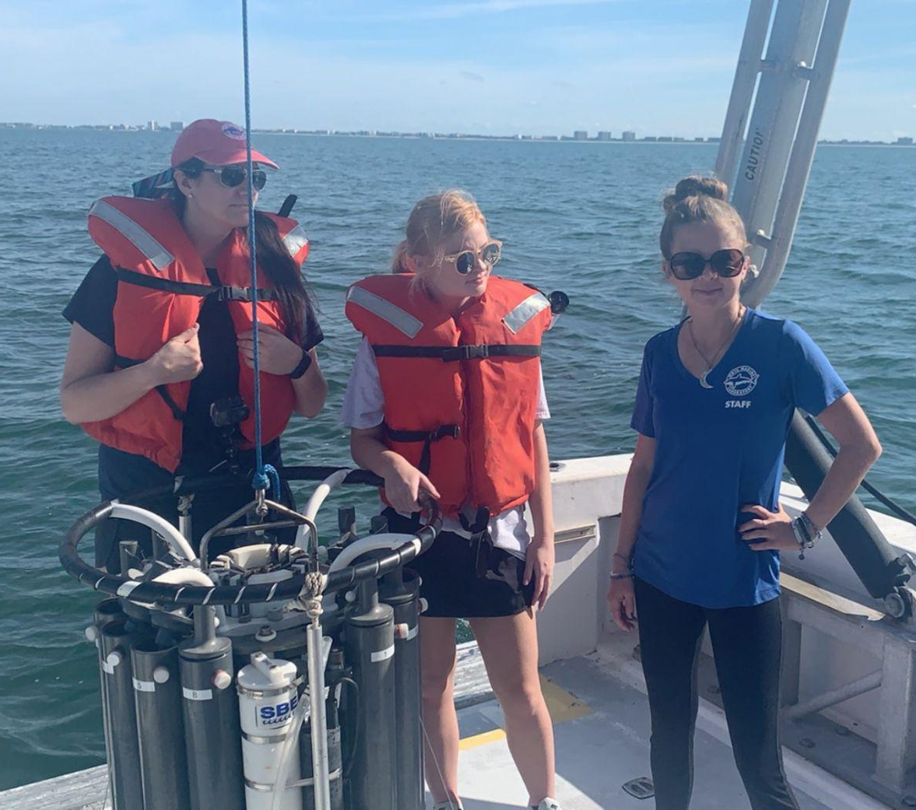
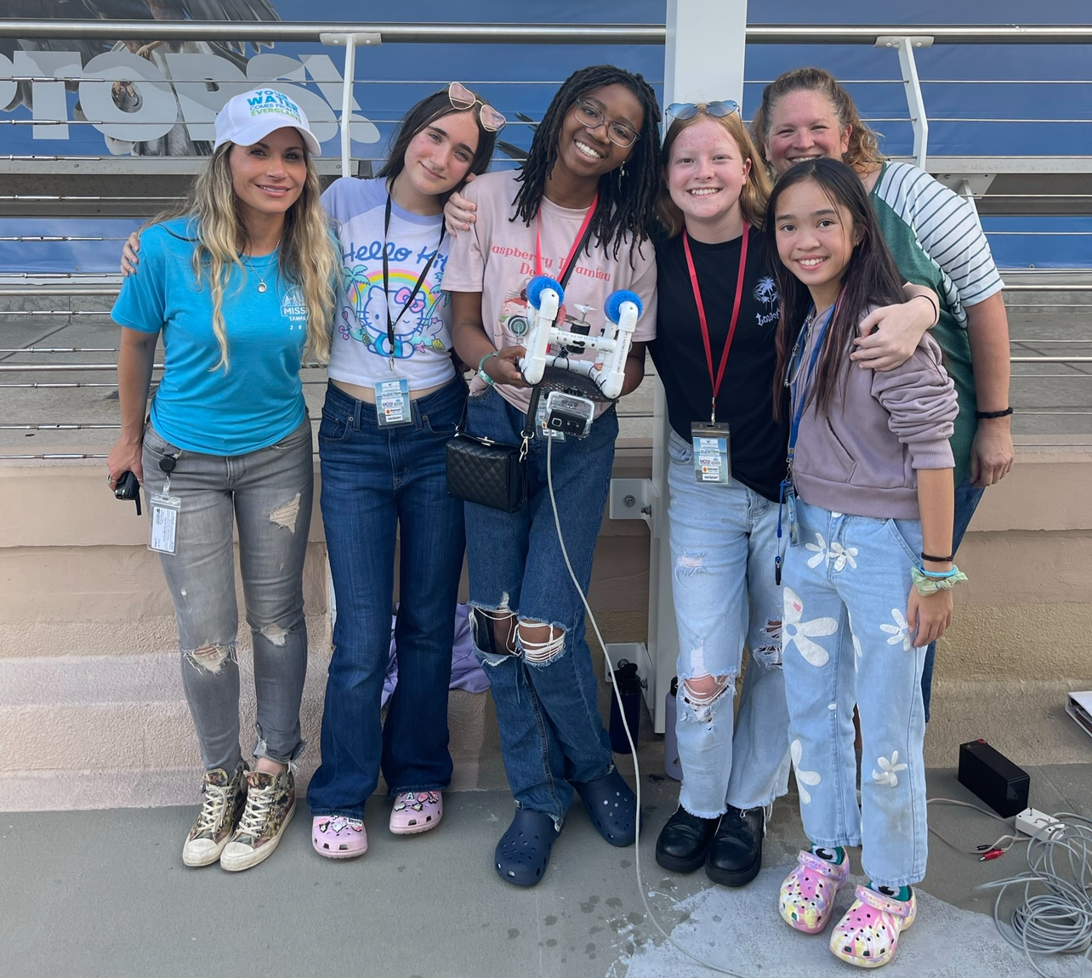
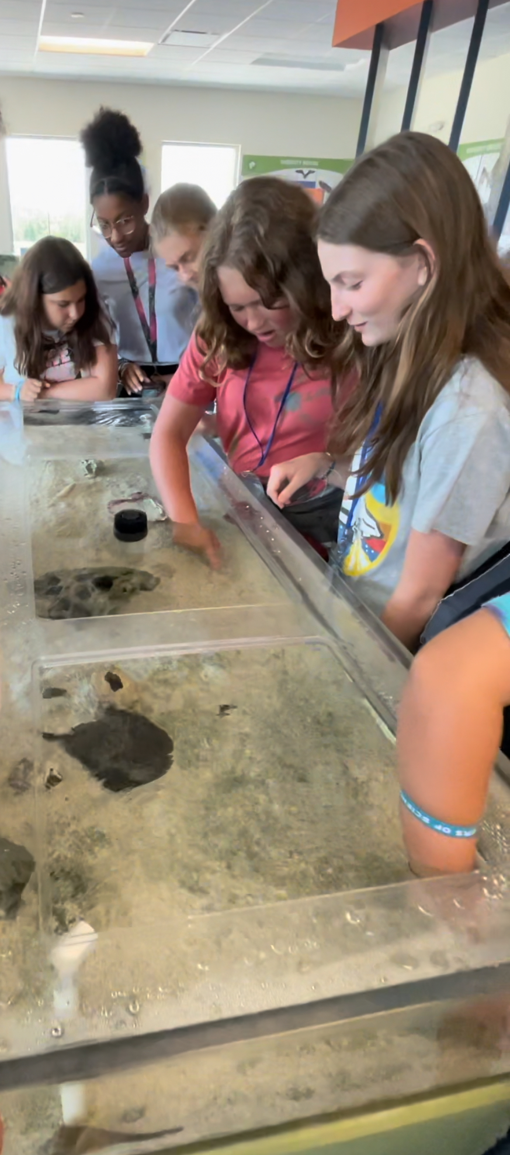
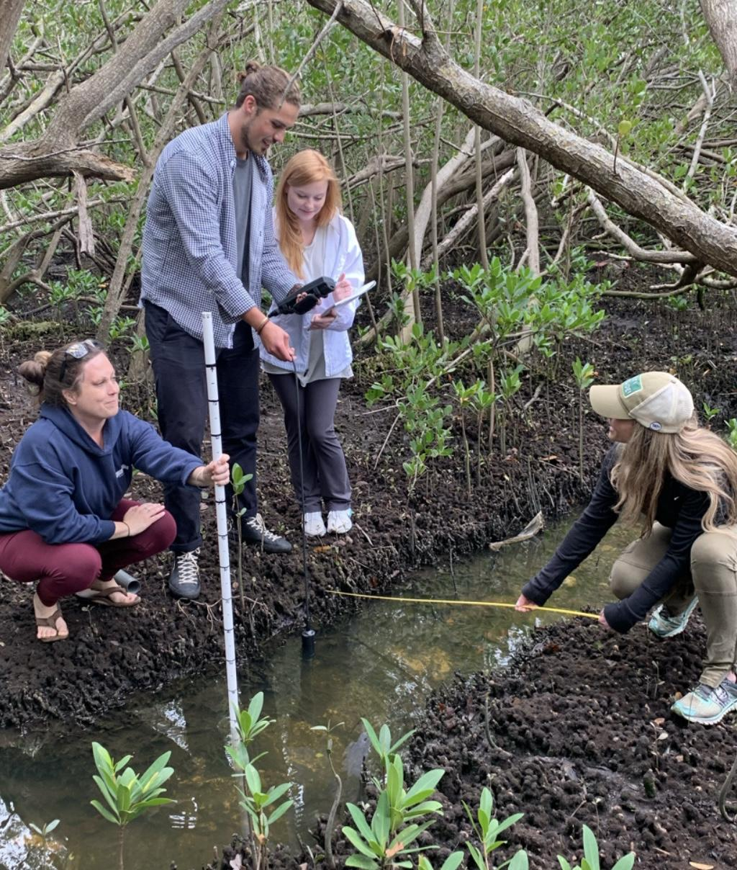
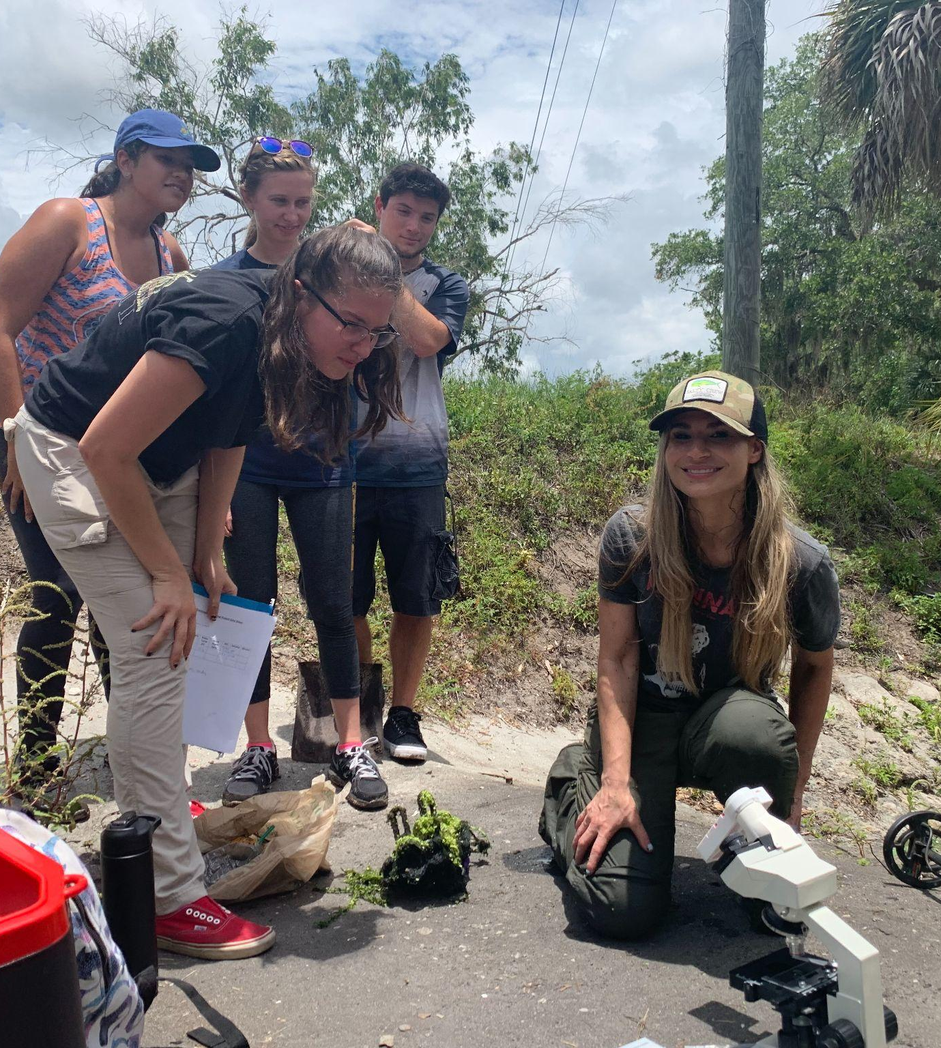
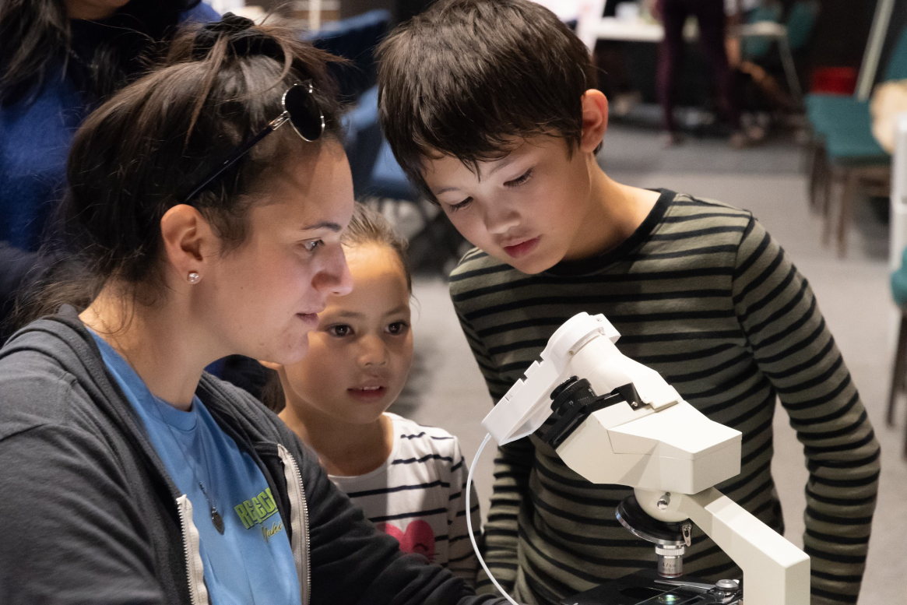
BUILDING THE FUTURE WORKFORCE
Notes:
Mission Flatirons is designed to make sure students have an opportunity to discover that they could become a meteorologist, hydrologist, model developer, data scientist, engineer, or another kind of Earth scientist.
The workforce we will need 10 or 20 years from now is sitting in middle school today. If we give students the opportunity to experience this science as something they can actually do, they become observers, data collectors, coders, modelers, forecasters and communicators. And somewhere along that pathway, a student may discover: I'm good at this. I belong here. This could be my future.
We talk a lot about workforce development as something that begins in college—with internships, fellowships, and recruitment. But by then, we have already lost an enormous opportunity.
What if workforce development started when students were 10, 11, or 12 years old?
Not by asking them to choose a career—but by letting them experience what scientists and forecasters actually do: observe the Earth, collect data, investigate patterns, use models, make predictions, communicate uncertainty, and solve problems that affect their own communities.
Our goal is to create a grades 5 through 8 curriculum and immersive camp experience that builds that pathway—from curiosity to contribution.

Slide 9
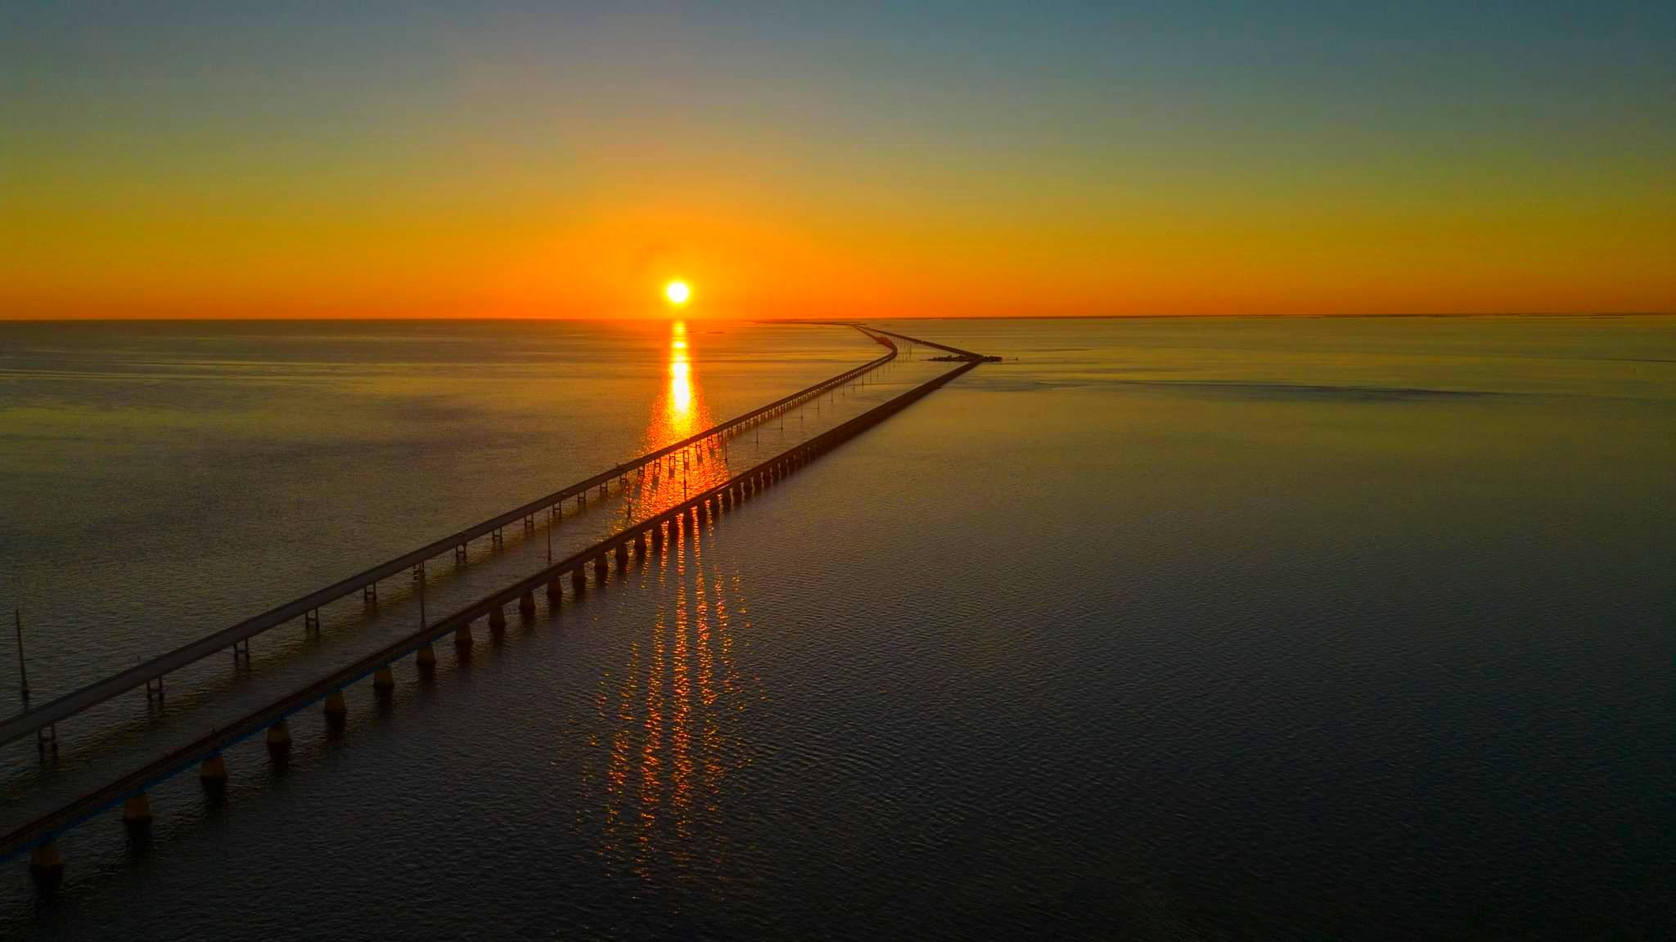
Thank You!
tracy@InspectorPlanet.com
Seven Mile Bridge, Florida Keys National Marine Sanctuary Photo: Bob Care

