Slide 1
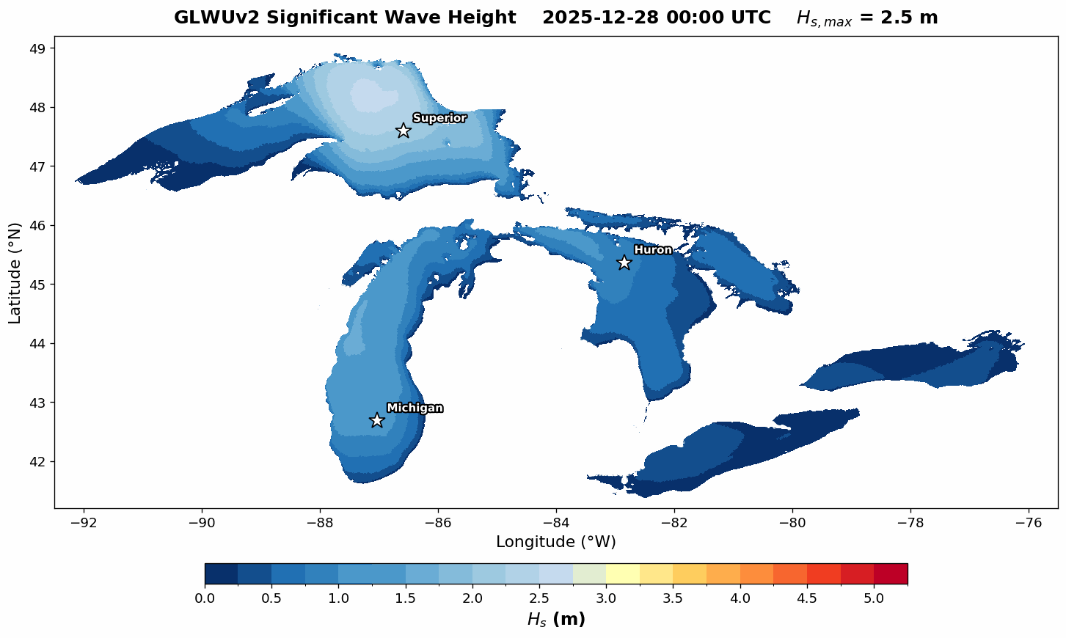
Bridging Academia and Operations:A WINGS Fellow's Experience
Winter waves, satellites, and surface roughness on the Great Lakes
Kaitlin Pereira
PhD Candidate, Civil & Environmental Engineering · Colorado School of Mines
CPAESS · WINGS Dissertation Fellowship · NOAA Weather Program Office
Notes:
0:00–0:20 — Good morning — I'm Kaitlin Pereira, a WINGS fellow. This talk is about bridging academia and operations: what the bridge looks like from inside, told through my dissertation on Great Lakes winter waves.

Slide 2
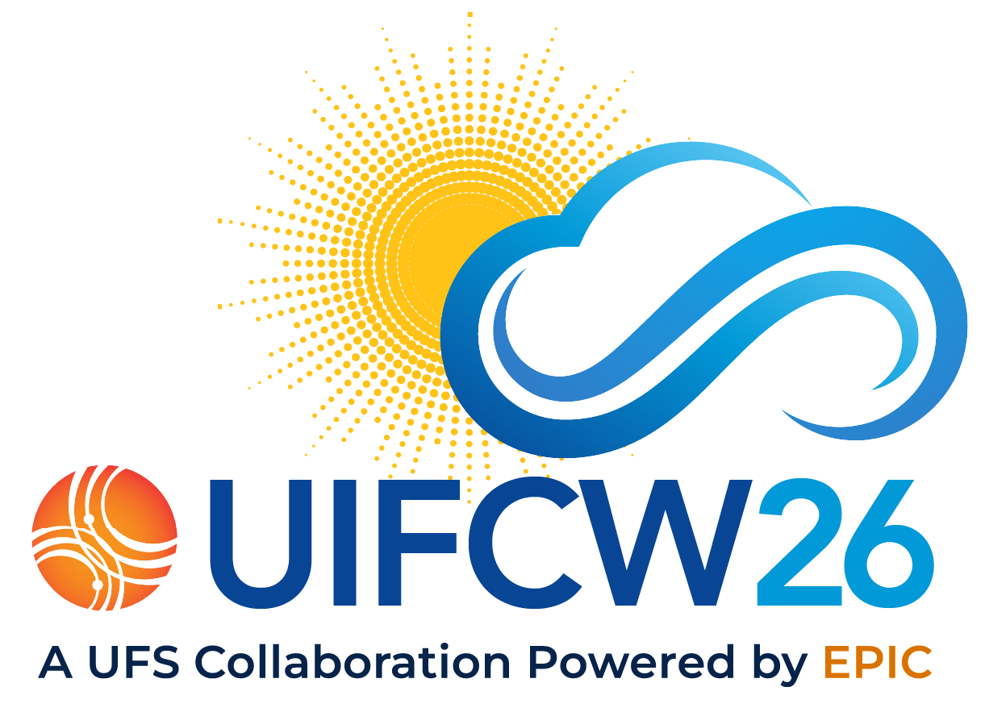
THE PROGRAM · A RARE CONVERGENCE
W.I.N.G.S. — the connective tissue
FELLOWSHIP PROPOSAL “Improvement of Lake Representation in Operational Weather Forecasting”
R2O · research improves the operational model
new observations · winter validation · physics insight
ACADEMIA
WINGS
fellowship
NOAA
Research
Operations
university · dissertation
new winter observations
WaveWatch III
daily forecasts
O2R · operational output reveals research needs
forecast gaps · error characteristics · priorities
WINGS is the connective tissue — direct access between an academic researcher and the developers who run the model operationally.
Colorado School of Mines (advisor) · NOAA NCEP + EMC (mentors) · GLOS / IOOS (winter buoys)
Notes:
1:00–2:00 — The problem this session cares about: the R2O pipeline depends on sustained connections between academic researchers and operational centers — hardest to build early-career. WINGS closes that gap. R2O: my research sends new observations, winter validation, and physics insight into the operational model. O2R: operational output flows back — forecast gaps and priorities that shape what I study next. Distributed mentorship makes it real: my advisor at Mines built NOAA's Great Lakes forecast systems; my NOAA mentors are at NCEP and EMC — WaveWatch III's original developer and the operational wave modelers; GLOS and IOOS fund the buoys. A rare convergence.

Slide 3
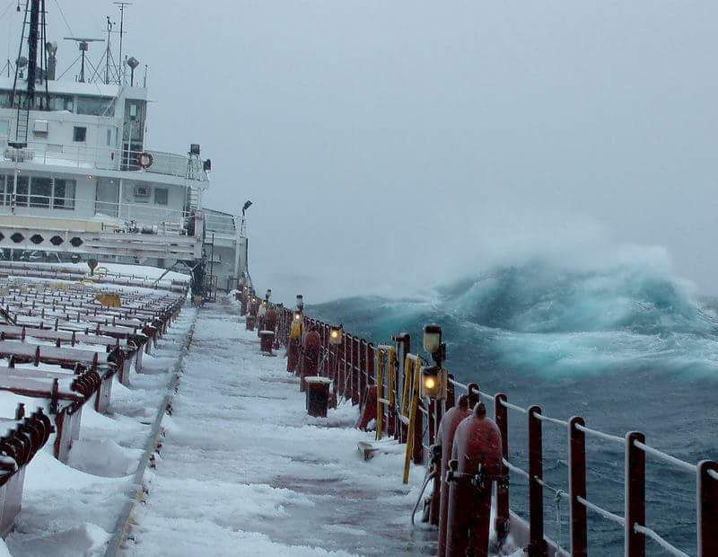
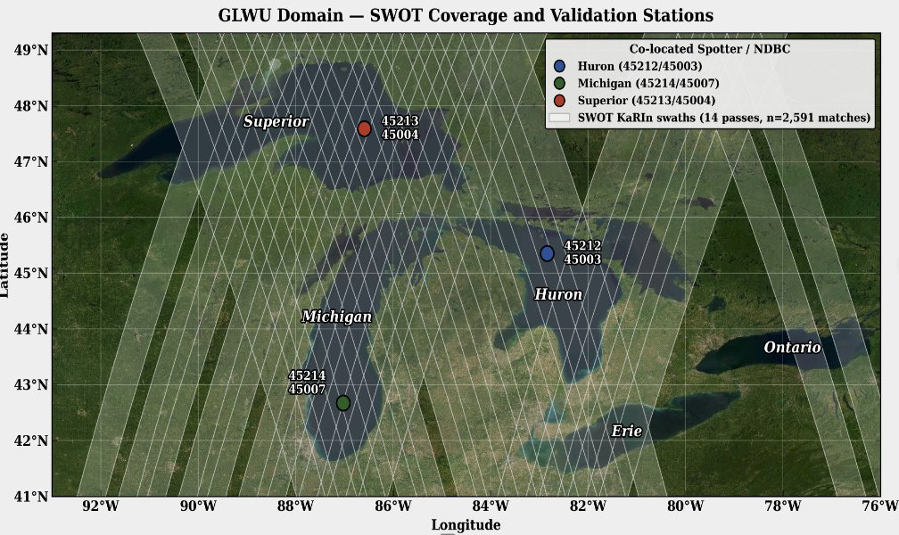
WHY IT MATTERS
Improving forecasts in the most dangerous time of year
Every winter, the Great Lakes go dark — buoys out before the ice, right when the biggest waves arrive.
SHIPS SINK IN WINTER WAVES
Historically ~6,000 wrecks and ~30,000 sailors lost — winter is the waviest, most dangerous season (the Edmund Fitzgerald; Hultquist et al. 2006, BAMS).
LAKE-EFFECT SNOW
Air travel and highway safety ride on lake–atmosphere fluxes — which depend on surface roughness.
THE GAP
A Great Lakes freighter in winter seas.
How big are Great Lakes waves in winter? No measurements until winter 2023.
Winter Spotters + NDBC, under SWOT coverage.
Notes:
2:00–3:00 — Why it matters: this is about improving forecasts in the most dangerous time of year. Every winter the lakes go dark — buoys out before the ice, right when the biggest waves arrive. Ships sink in winter waves: historically about six thousand wrecks and thirty thousand sailors lost — the Edmund Fitzgerald is the famous case, and there's a whole BAMS paper on its weather. And lake-effect snow — air travel, highway safety — rides on lake–atmosphere fluxes that depend on surface roughness. The gap: how big are Great Lakes waves in winter? Until winter 2023, no one had measurements.

Slide 4
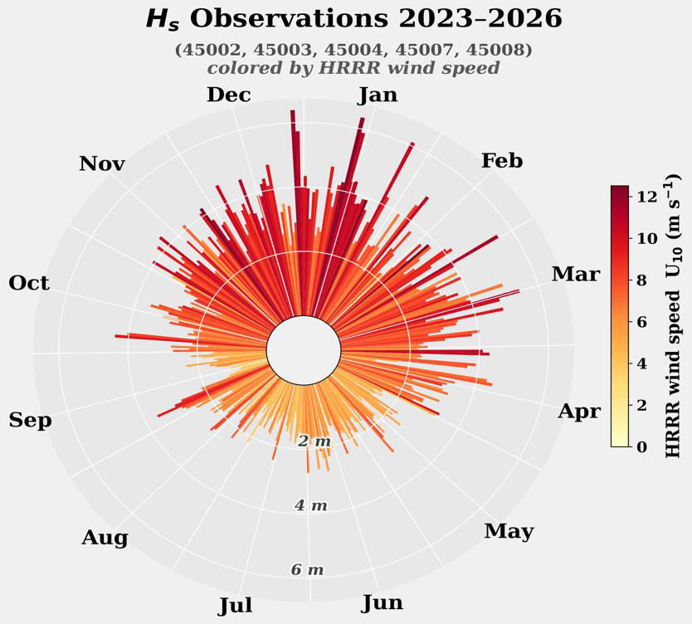
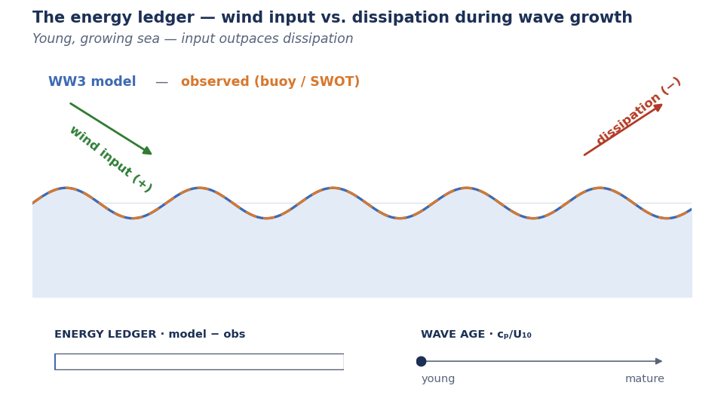
GOAL 1 · ASSESS
Filling the winter gap
First sustained winter skill assessment of the operational WAVEWATCH III (GLWU) system — in-situ (NDBC + Spotter) and SWOT altimetry, continuous and spatial, for the first time.
AS PREDICTED
The wave climate is winter-dominated — peak U10 and Hs concentrate Nov–Mar, now finally sampled.
THE FINGERPRINT
Hs biased +0.12–0.14 m (r ≈ 0.94); Tp high, Tm02 low — a spectral-shape error, not scatter.
THE MECHANISM
THE MECHANISM · animated — energy in vs. energy out
An input/dissipation imbalance in the growing wind-sea and its equilibrium-range tail — one imbalance, three symptoms, concentrated at young wave ages.
Notes:
3:00–4:15 — Goal one, assess: the first sustained winter skill assessment of the operational WAVEWATCH III system — in-situ and SWOT, continuous and spatial. As predicted, winter concentrates the energy — that's the wave rose. And here's the fingerprint, in the distributions: against sixteen thousand QC'd matchups the model is close — the height CDFs nearly overlap — but not the same: heights run slightly high, and peak periods run distinctly long. A spectral-shape fingerprint, not scatter. [If asked: input/dissipation imbalance in the growing wind-sea and its equilibrium-range tail, worst at young wave ages.]

Slide 5
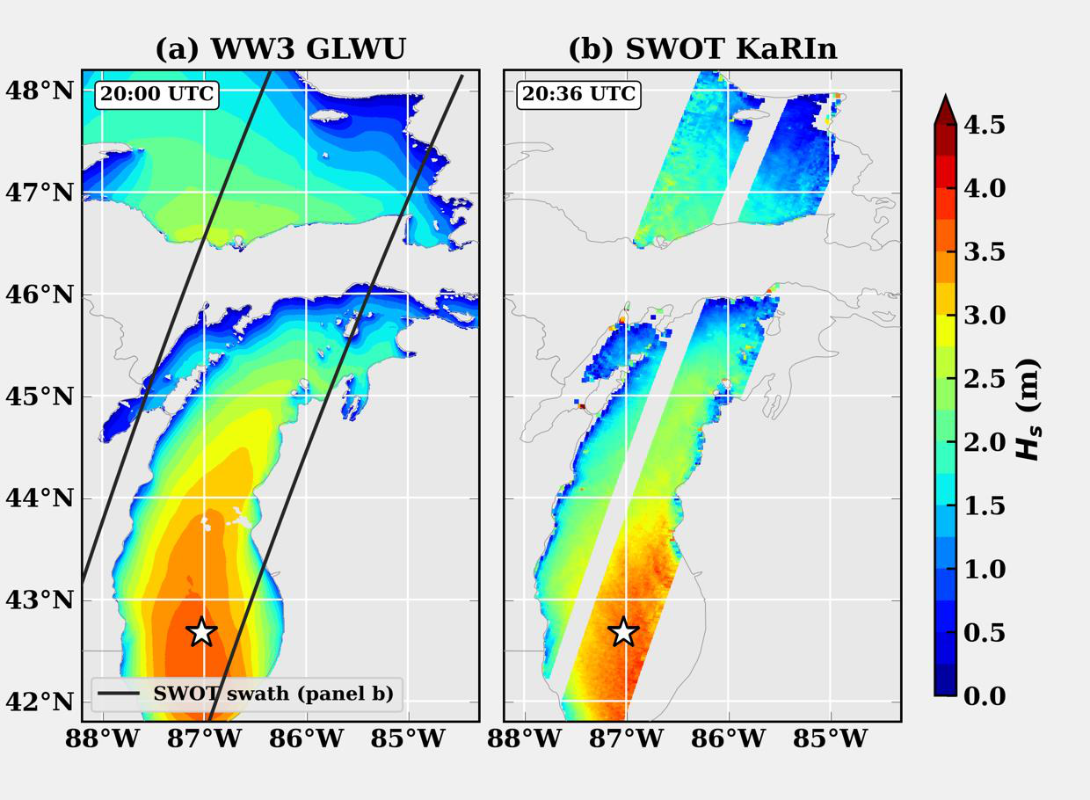
GOAL 2 · BRIDGE
Roughness characterization
Buoys: continuous point time series. SWOT KaRIn: km-scale σ0 swaths, ~3-day revisit. Together — the first basin-scale characterization of surface roughness in the Great Lakes.
CROSS-VALIDATION, FIRST
SWOT σ0 against buoy-derived wave state — 2,591 QC'd matchups establish trust in the retrievals.
THEN THE PHYSICS
Wind–wave–σ0 relationships in fetch-limited, young, steep seas — where ocean-derived relationships need not hold.
PUTTING THE MODEL TO THE TEST
Observed roughness confronts the model's Charnock closure, basin-wide.
Notes:
4:15–5:05 — Goal two, bridge — and here's the cool part: that was buoys, three points; with SWOT we get whole fields. Kilometer-scale swaths, every few days, over every lake. Cross-validation first: 2,591 QC'd matchups establish trust in the retrievals. Then the physics: wind–wave–sigma0 relationships in fetch-limited, young, steep seas — where ocean-derived relationships need not hold. Then observed roughness confronts the model's Charnock closure, basin-wide.

Slide 6
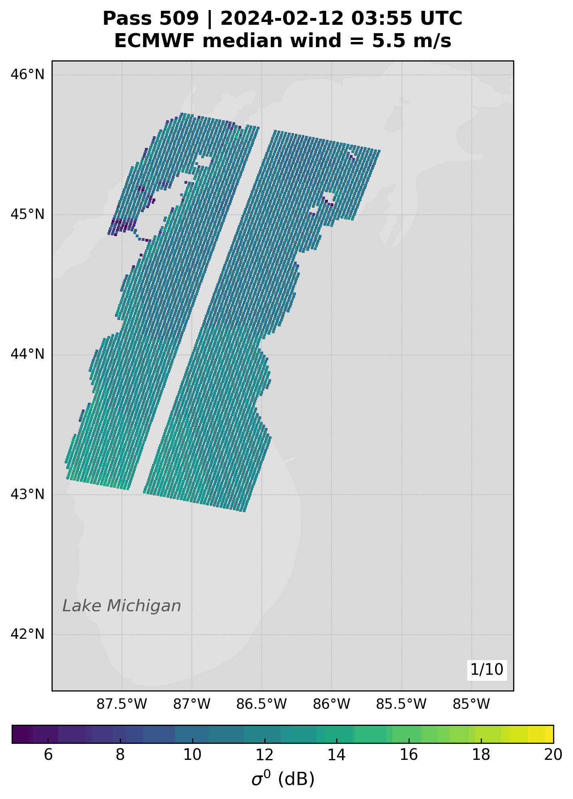
GOAL 3 · TUNE
Behind the veil of operations
THE HYPOTHESIS
Roughness parameterizations built on ocean conditions (COARE) systematically bias modeled air–lake momentum transfer.
COARE was tuned on ocean seas; Great Lakes waves are fetch-limited — shorter and steeper.
Deliverable: lake-tuned roughness — validated algorithms, an operational prototype, transition documentation — informing UFS-Wave development.
BUILT WITH THE PEOPLE BEHIND THE SYSTEM
Hendrik Tolman NOAA · WAVEWATCH III's original developer
Jessica Meixner NOAA EMC · operational wave modeling
Eric Anderson Colorado School of Mines (advisor) · former NOAA, Great Lakes systems
ONE LEVER, TWO FORECASTS
waves feel roughness as momentum flux · weather feels it as heat flux (lake-effect snow) · goal: lake-tuned roughness in WW3 + FVCOM
Notes:
5:05–6:15 — Goal three, tune. The hypothesis: roughness parameterizations built on ocean conditions — COARE — systematically bias modeled air–lake momentum transfer; Great Lakes waves are fetch-limited, shorter and steeper than the seas COARE was tuned on. The deliverable: lake-tuned roughness — validated algorithms, an operational prototype, transition documentation — informing UFS-Wave development. And one lever moves two forecasts: waves feel roughness as momentum flux — that's the fingerprint you just saw — and weather feels it as heat flux — that's lake-effect snow. The goal: lake-tuned roughness in WaveWatch III and FVCOM.

Slide 7
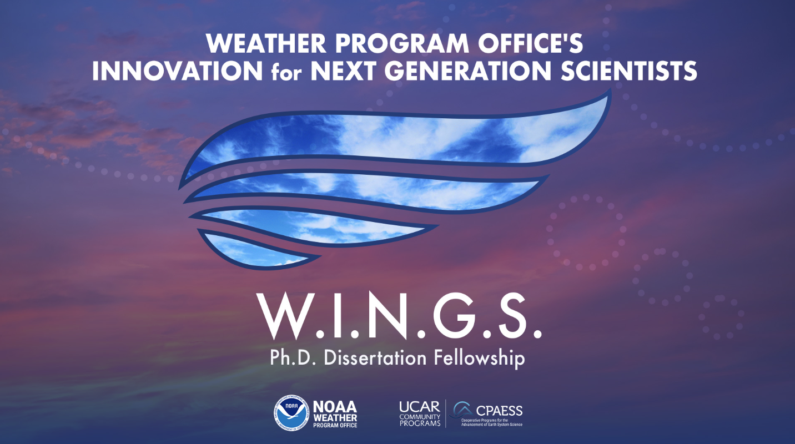
KNOWLEDGE SHARING
Distributed mentorship
Distributed mentorship isn't a formality — it rewired the science.
FRAMING
“Stratify by wave age, not season.” Mentor feedback reframed the winter analysis around wave physics — and the fingerprint emerged.
DISCIPLINE
Diagnose the error; don’t prescribe the tune. Operational practice shaped how findings are reported — so the community can act on them.
RELEVANCE
Validate the operational configuration, not a research setup. Results transfer directly to UFS-Wave.
BUILT WITH THE PEOPLE BEHIND THE SYSTEM
Hendrik Tolman NOAA · WAVEWATCH III’s original developer Jessica Meixner NOAA EMC · operational wave modeling Eric Anderson Mines (advisor) · former NOAA, Great Lakes systems
Notes:
6:15–7:15 — What did mentorship actually change? Three receipts. Framing: 'stratify by wave age, not season' — that reframing is why the fingerprint emerged. Discipline: diagnose the error, don't prescribe the tune — findings reported the way the community can act on them. Relevance: validate the operational configuration, not a research setup — so results transfer directly to UFS-Wave. That's bidirectional feedback in practice.

Slide 8
REFLECTION
A rare convergence
OPERATIONS
ACADEMIA
FELLOWSHIP
FUNDING
NOAA
Colorado School of Mines
WINGS
GLOS / IOOS
Mentored by WaveWatch III's lead developers
Advised by the builder of NOAA's Great Lakes systems
Links researchers directly with operational developers
Funds the winter buoys and the research
“One of a few times ever where all of this is lined up.”
— Eric J. Anderson, advisor
Research built to transition — validated, prototyped, and documented for NOAA's operational pipeline. That's the quiet superpower of UCP.
Kaitlin Pereira · Colorado School of Mines · CPAESS WINGS Fellow
Great Lakes, hydrodynamics, wave forecasting — come find me after.
Notes:
4:10–5:00 — Why does this work? It's a rare convergence: on the NOAA side, the lead developers of WaveWatch III; at Mines, the scientist who built NOAA's Great Lakes forecast systems; WINGS bridging them; GLOS and IOOS funding the buoys. My advisor calls it 'one of a few times ever where all of this is lined up.' And that's my reflection: WINGS placed a graduate student inside the research-to-operations loop — not adjacent to it — with steady feedback from brilliant scientists. And the work is built to transition — validated algorithms, an operational prototype, and the documentation to carry it into NOAA's pipeline. That's the quiet superpower of UCP. If you work on coastal problems, model transition, or observations — come find me after. Thank you.

