Slide 1
Measuring our Community
Social Science Metrics for
the Unified Forecast System
Alison Gregory
Community Engagement Specialist for the UFS
UCAR UCP, Cooperation Programs for the Advancement of Earth System Sciences
agregory@ucar.edu

Slide 2
My Role
Utilize social science methodologies to identify best practices, understand and measure progress with respect to the [UFS] community.

Slide 3
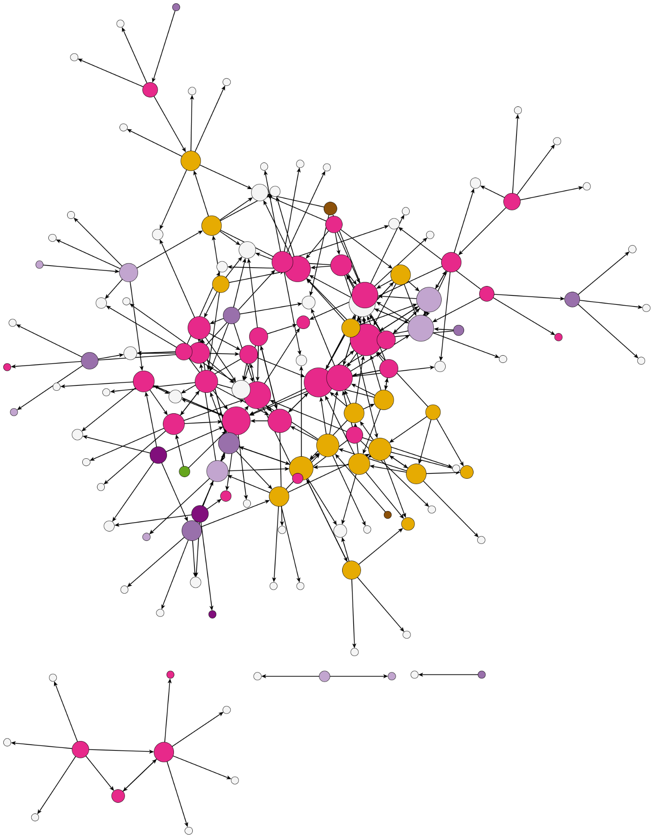
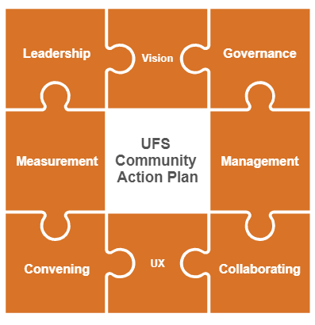
Background
A Community of Practice
“flexible group of professionals,
informally bound by
common interests,
who interact through interdependent tasks
guided by
a common purpose
thereby embodying a store of
common knowledge.”
2024
The UFS Community
EVERYONE
2025

Slide 4

UFS Community Metrics: N.E.S.T.
Engagement
Technical
Network
Strategic
Common Knowledge
Common Purpose
Common Interests
Interdependent Tasks
N | E | S | T | Total Community Health Score
Network | Engagement | Strategic | Technical
?? | ?? | ?? | ?? | ??
Overall Community Health Scorecard
Scale: 1.0 - Not Started, 2.0 - Emerging, 3.0 - Progressing, 4.0 - Strong, 5.0 - Exemplary

Slide 5
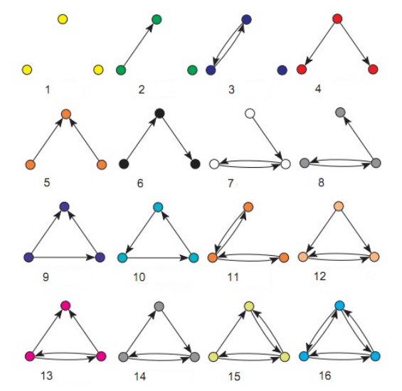
Network Metrics
Resiliency
Knowledge Flow
Collaboration
Tell Us About
Measures peer-to-peer connections and relationships
Metric | Description | Examples
Network Density | Defines paths for knowledge transfer | 0.0 (no one is connected) to 1.0 (everyone is connected)
Transitivity | Defines productive collaboration | 0.0 (all 1-way relationships) to 1.0 (all 2-way relationships)
Centrality - Average Degree | Defines average number of connections within the network | The average # of connections someone has in the network
Average Path Length | Defines speed of knowledge transfer | Information can spread through the network quicker (people can reach each other in few steps)

Slide 6
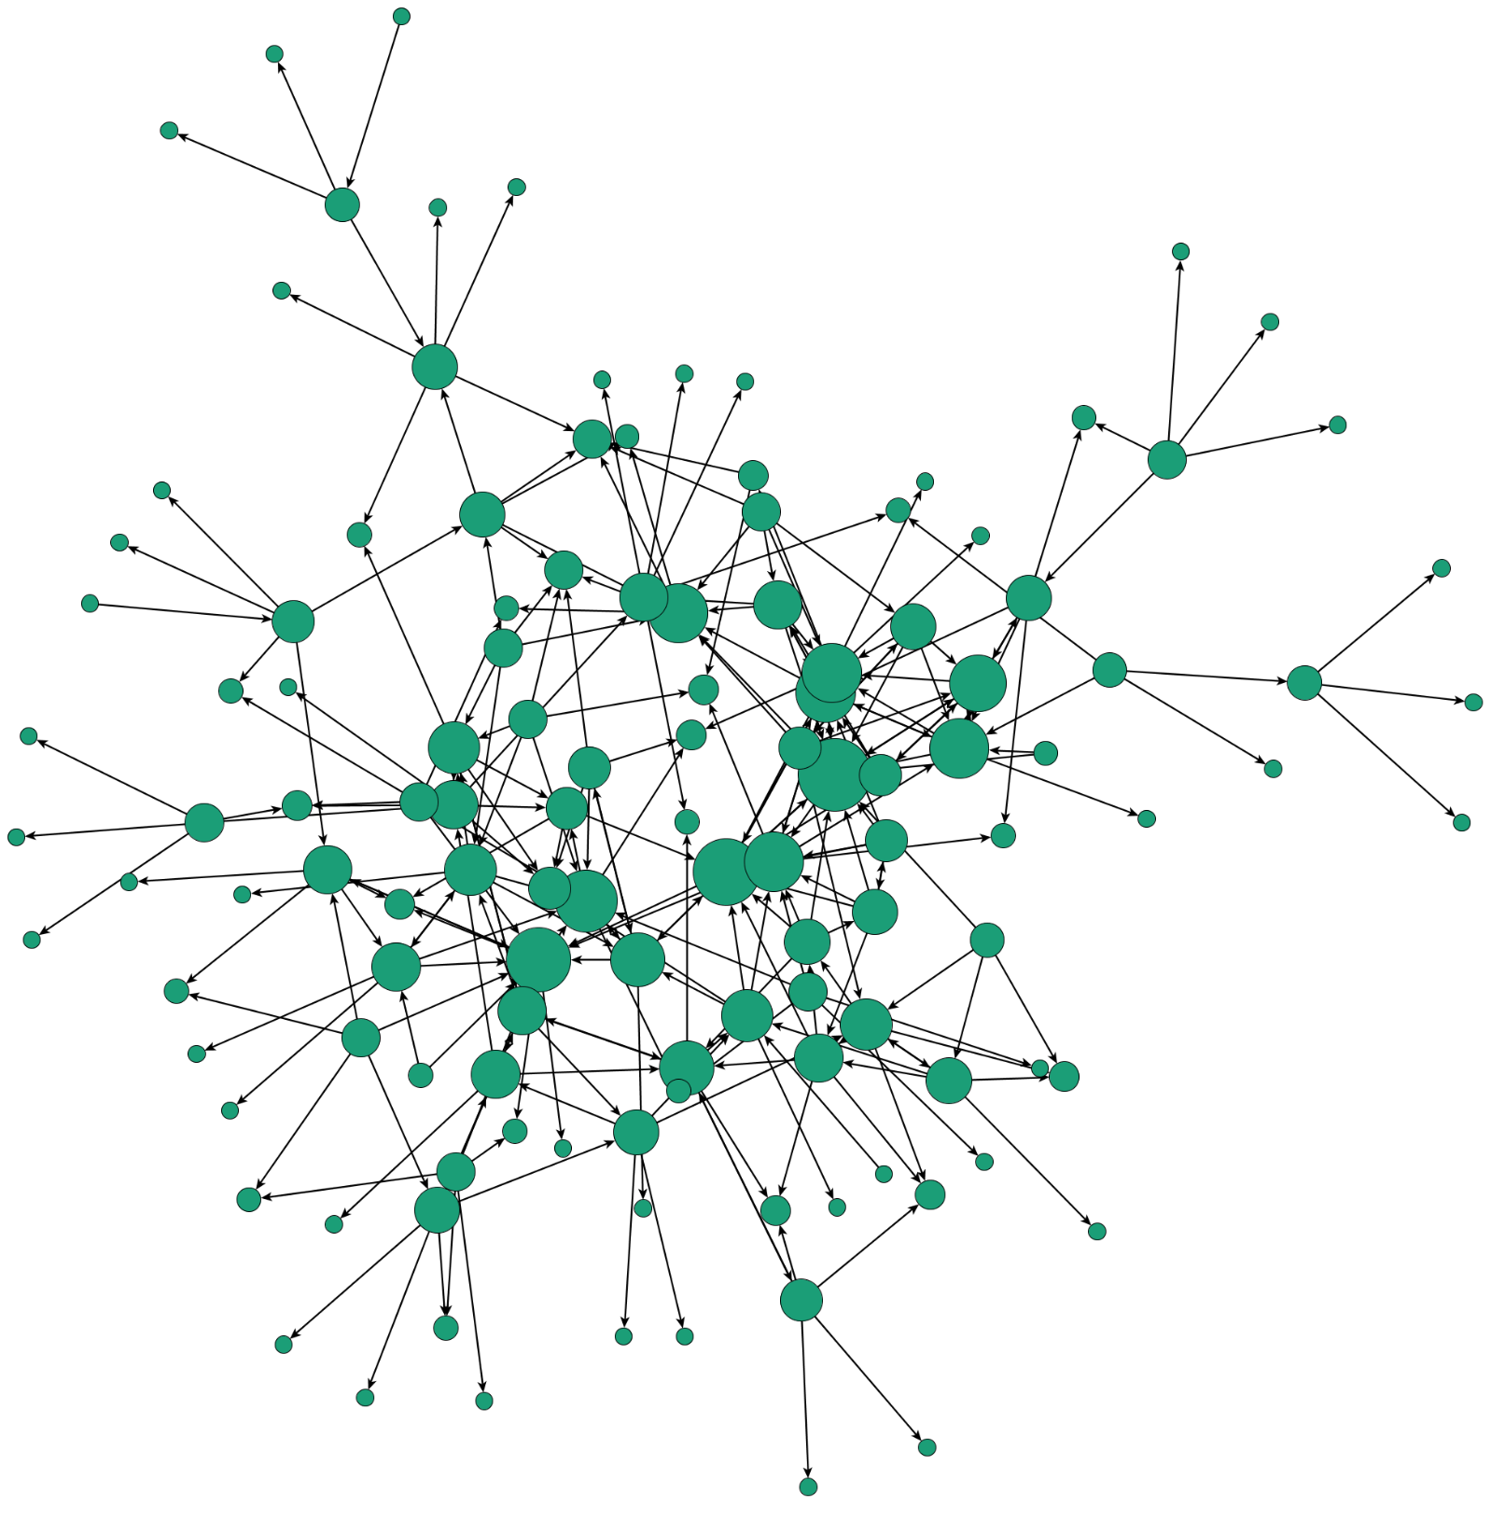
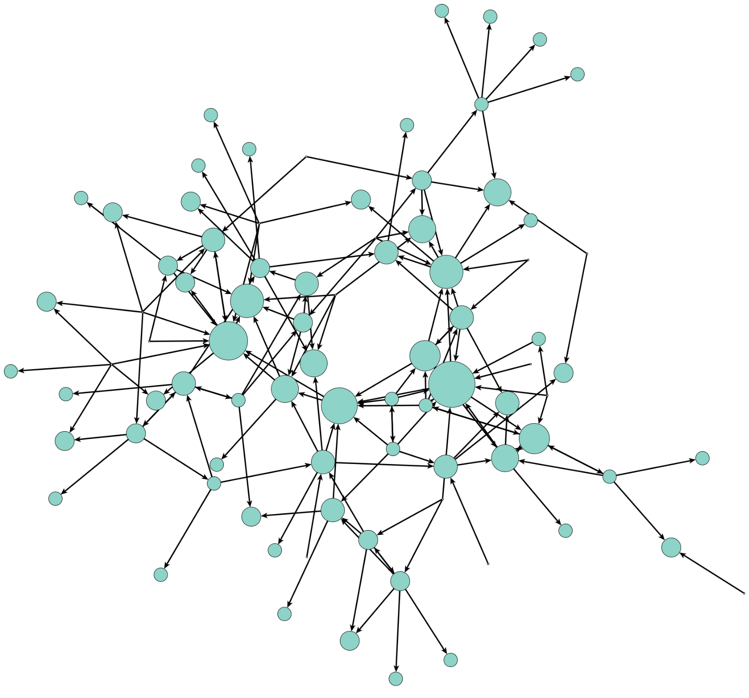
Work versus Advice Network
Density | 0.015
Transitivity | 0.237
Average Path Length | 8.68
Density | 0.011
Transitivity | 0.211
Average Path Length | 3.43
Notes:
This is the work network you recognize on your left, and the advice network on the right. This means that the person selected “I go to this person for advice
What do we notice?
Less individuals in this network
Weighted Avg. Path Length (doesn’t lean towards people who wrote in more connections)

Slide 7
Engagement Metrics
Overall Participation
Stakeholder Needs
Visibility
Tell Us About
Measures public-facing activity
Metric | Description | Examples
Digital Content | Defines credibility beyond working hours and provides avenues for outreach opportunities | # of social media followers (EPIC has LinkedIn, Instagram, X, Facebook, Youtube) # of web page visitors (epic.noaa.gov, ufs.epic.noaa.gov)
UFS Mailing List | Defines visibility within network of interested stakeholders | # of stakeholders on mailing list, # of correspondences
UIFCW Participation | Defines commitment | # of attendees, demographics of attendees, # of repeat attendees, presenters

Slide 8
Strategic Metrics
Goal Alignment
Representation
Tell Us About
Measures resource access and top-down support
Metric | Description | Examples
Active Working Group | Defines team dynamics | Cadence of meetings, team sizes, cross-knowledge sharing (S2S, R2O, Coastal, Land, DA)
Stakeholders | Defines representation across stakeholder groups with different resources and needs | Universities, federal offices, labs, private companies
Roles | Defines cross-functional participation. Participation from leadership, program managers, researchers, and code developers are all key. | Program managers, software developers, leadership
Notes:
Note: These can be evaluated in myriad ways (ie; what happens to these characteristics when all non-NOAA collaborators are removed from the network.)

Slide 9
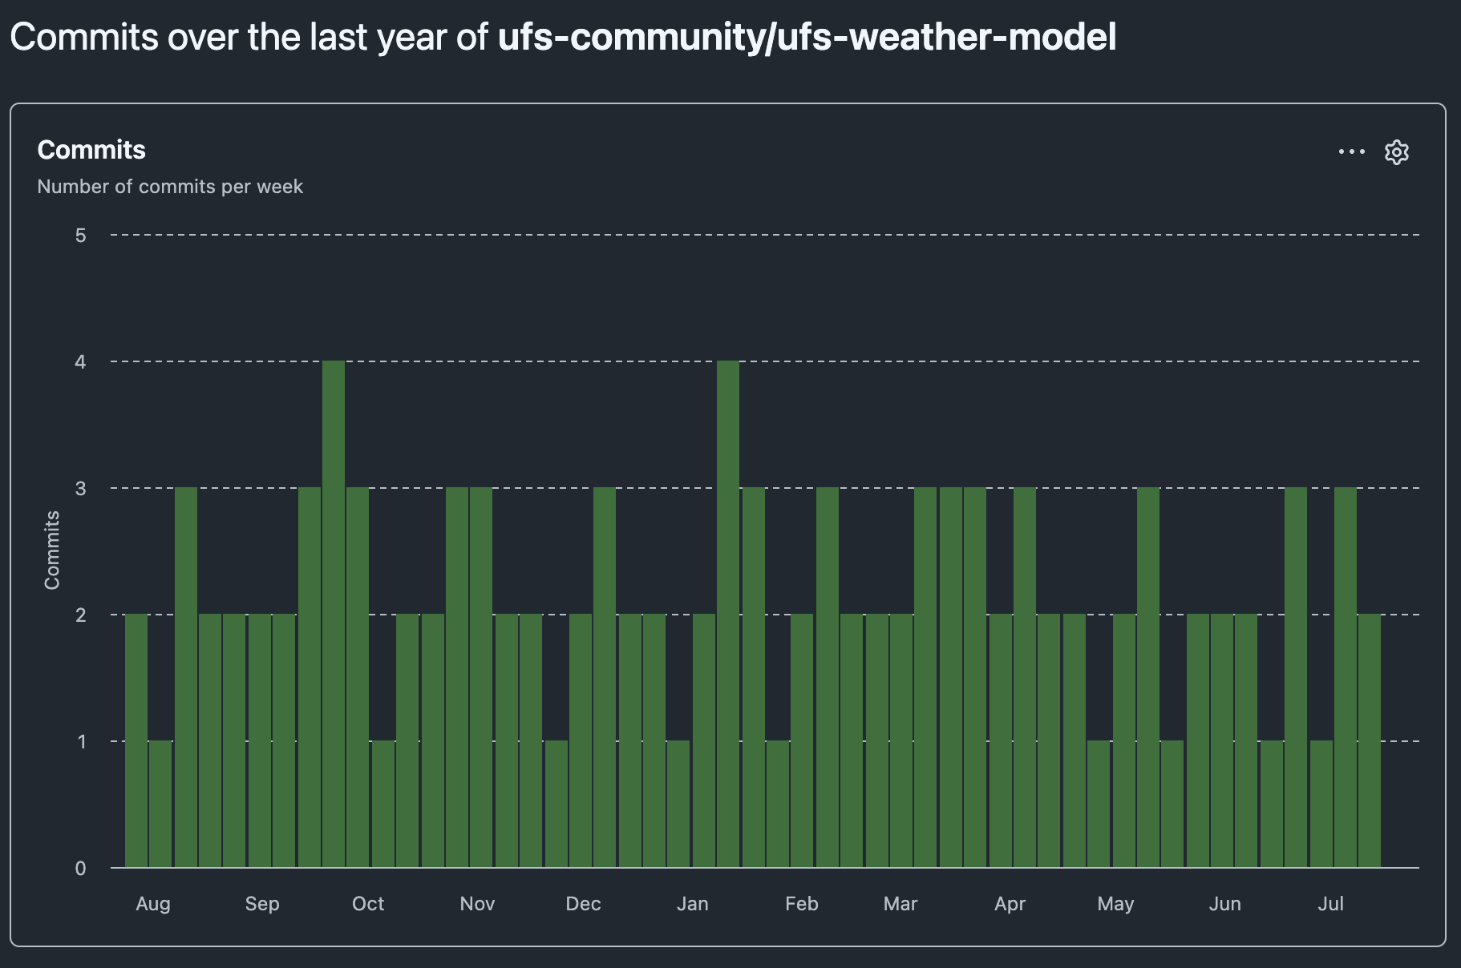
Technical Metrics
Code Workflow
Potential Roadblocks
Tell Us About
Measures code quality and user support
stars/forks understate total UFS activity
Metric | Description | Examples
Github | Defines codebase participation | Commits, contributors, pull requests, actions usage metrics, performance metrics
Abstracts | Defines active research and development | UIFCW, AMS, Peer-reviewed articles
Available Tutorials | Defines technical support resources | At conferences (UIFCW, AMS), virtual, etc.

Slide 10
What is “Success”?

Slide 11
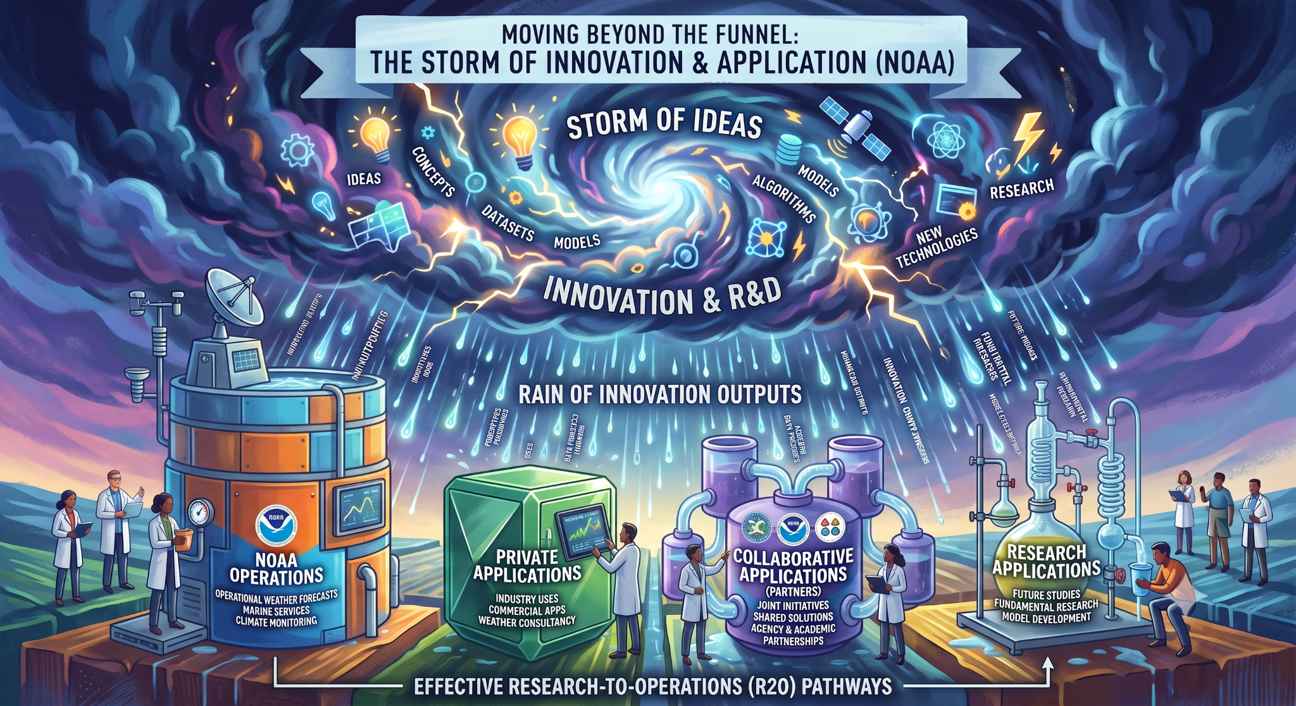

Slide 12
Future Recommendations
Engagement
Network
Technical
Strategic
Longitudinal Data is best: 2nd Network Survey (2027?)
Measuring Change: Determine metric scoring/ranking processes and evaluation cadence
Comparing Networks: How does MPAS network compare to UFS?
Receive input from YOU: Are we measuring the right processes? What are we missing? → Pair & Share Conclusion Activity Friday July 24th, 11:30am EDT
Alison Gregory, UFS Community Engagement Specialist
UCAR UCP CPAESS
agregory@ucar.edu

Slide 13
Other UFS Engagement Happenings…
UFS Ambassador Program
Lapenta Internships
K-12 Engagement: College lesson plans, tutorials, Weather Camp?
Community Modeling Committee - Information Gathering & Reporting (R2O2R + Usability)
EPIC + UIFCW Soc. Sci Assessment
Websites, social media, newsletter, UFS emailing list, UIFCW
Alison Gregory, UFS Community Engagement Specialist
UCAR UCP CPAESS
agregory@ucar.edu

Slide 14
Supplemental

Slide 15
Triads!
Tu, Kun & Li, Jian & Towsley, Don & Braines, Dave & Turner, Liam. (2018). gl2vec: Learning Feature Representation Using Graphlets for Directed Networks. 10.48550/arXiv.1812.05473.

Slide 16
This Network: Job Type
Job Type
Academia - Cooperative Institute
Academia - College or University
Research Institute
NOAA
Private Sector - NOAA Contractor
Fed - Non-NOAA
Private Sector - Non-NOAA
Notes:
Ask the audience: What do you notice? (4mins)
Core in the middle
Arms
Long paths for people on the outside
Cluster in lower left that is not connected
Academic partners are not connected to main cluster
There are bridge ties to isolated networks
heterogeneity refers to a significant variation in the structural properties or the attributes of nodes within a network, which goes beyond what is expected by chance
homophily refers to the principle that individuals with similar attributes are more likely to form connections and relationships within a network,

Slide 17
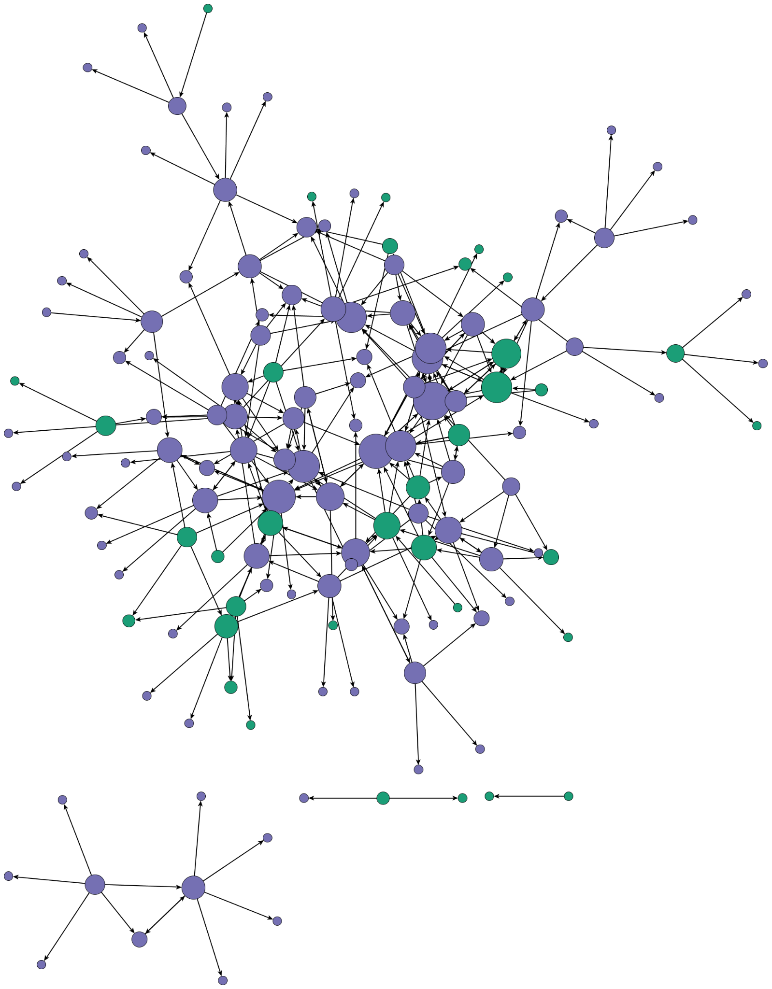
This Network: Opportunity
From the Literature
  Different kinds of direct contacts increase knowledge sharing
  Increasing network connectivity increases knowledge flow through the network
  An actors degree centrality increases the knowledge received
Knowledge, Networks, and Knowledge Networks: A Review and Research Agenda (Phelps et al. 2012)
Affiliation
NOAA
Non-NOAA
Notes:
Literature shows that there are benefits that are inclusive…Opportunity bring into core (one step away to bring them in) – suggestions?? Invite unique partners onto projects
https://business.uoregon.edu/sites/default/files/media/PhelpsHeidlWadhwa_2012_JoM.pdf

Slide 18
Future Analysis
Complete list of Attributes
Social Network Survey Questions
What is your age? Select one.
I contribute valuable ideas to the UFS community. Select one.
The UFS is important to my current work. Select one.
I feel responsible for the success of the UFS. Select one.
How often do you contribute code to the UFS (Github, etc.)? Select one.
What is your highest education level? Select one.
How familiar are you with the UFS code base and related applications? Select one.
What gender identity best describes you?
What is your race and/or ethnicity? Select all that apply.
What best characterizes your job type? Select one.
What employment/career level best describes you? Select one.
Are you a member of a UFS Working Group or Cross-Cutting Team? Select one.
How often do you run the UFS code or associated applications? Select one.
Do you attend UFS Steering Committee Meetings? Select one.
Completion
  Relationship
  I see this person as a leader.
  This person is a mentor to me.
  I learn from this person.
  I seek advice from this person.
  Work
  I attend the same meetings, conferences, or workshops as this person.
  I occasionally meet one-on-one with this person.
  I have collaborated on a shared research project, publication, or presentation with this person.
  Combined
  Psych Safety
  I feel comfortable sharing new ideas with this person.
  I feel this person has my best interests in mind.
  I feel this person is qualified to give me good advice in this field.
  I trust this person.
Notes:
10 seconds
Goal is let audience know that this was a BIG study and we are showing a fraction of it.

Slide 19
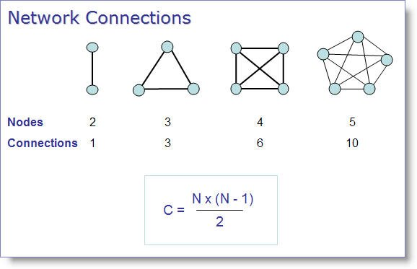
Notes:
https://sictransittecnicamundi.blogspot.com/2006/04/measuring-social-networks.html

