Slide 1
AI4NWP at NOAA:
Progress, Partnerships, and the Path Forward
Presenter: Isidora Jankov GSL
Collaborators from different NOAA Line Offices, AI4NWP Working Group, EPIC, Universities and Private Sector
UIFCW, July 23, 2026

Slide 2
Outline
Early starts of AI4NWP at NOAA and AI4NWP Working Group
Early Examples and Successes
Experimental AI Global and Limited-area Ensemble Forecast System (EAGLE)
Lessons learned
Going forward

Slide 3

AI4NWP Working Group and related Activities
AI4NWP Working Group - Established in November 2023
Mission
Facilitate and coordinate NOAA-wide collaboration in Artificial Intelligence for Numerical Weather Prediction (AI4NWP) to accelerate research, development, and demonstration of data-driven Earth prediction systems.
Participation : OMD, WPO, GSL, PSL, NSSL, AOML and GFDL
Areas of Focus
Accelerate AI-driven prediction systems
Foster NOAA-wide collaboration
Promote common data and workflows
Promote common verification
Strengthen external partnerships
EAGLE origins and evolution
https://doi.org/10.1175/BAMS-D-24-0062.1

Slide 4
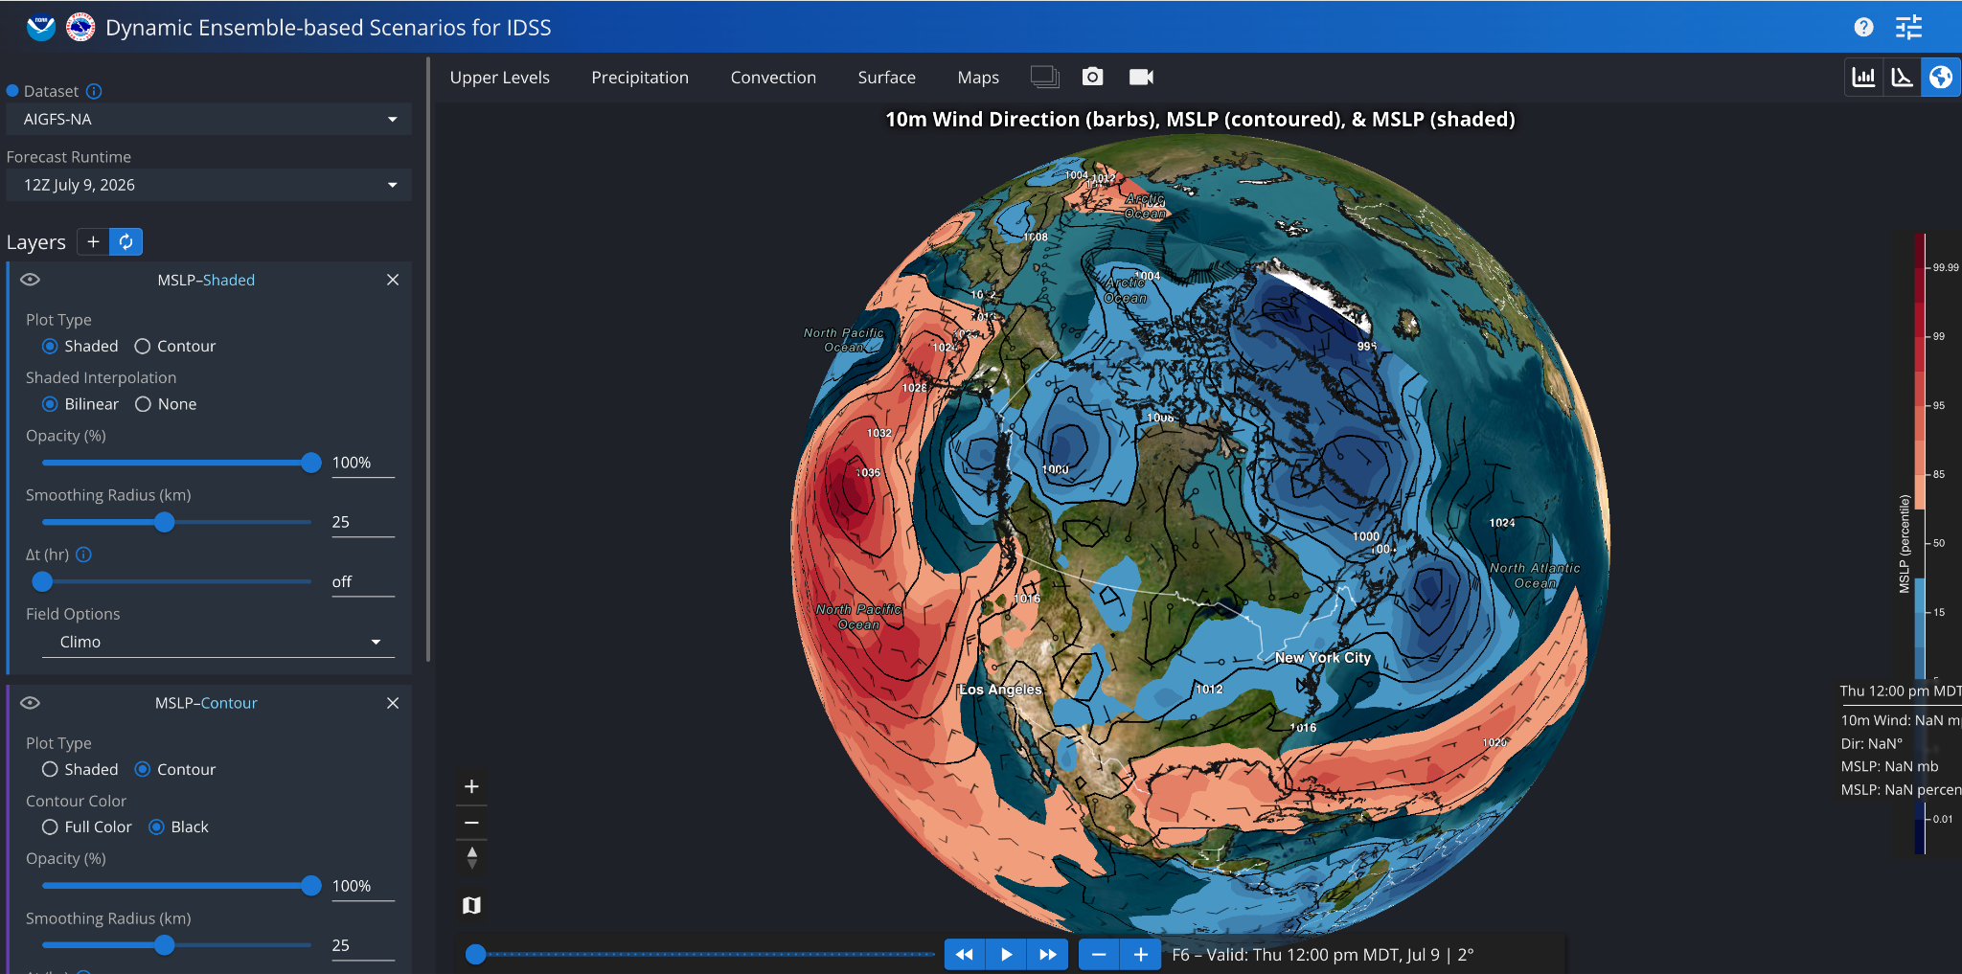
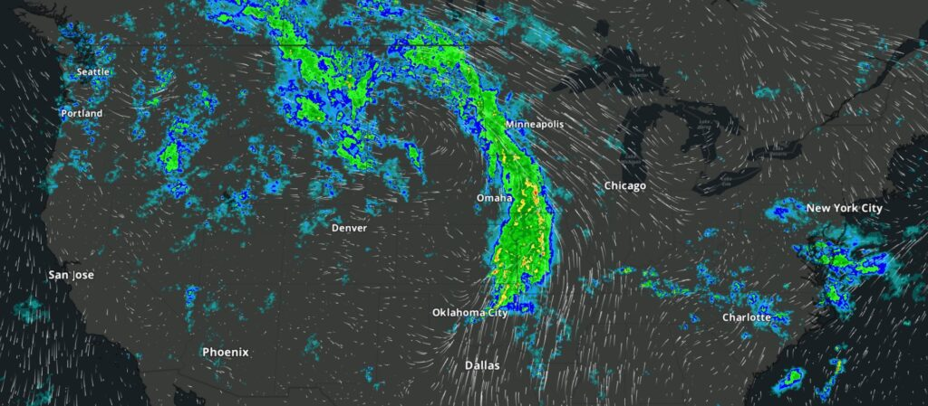
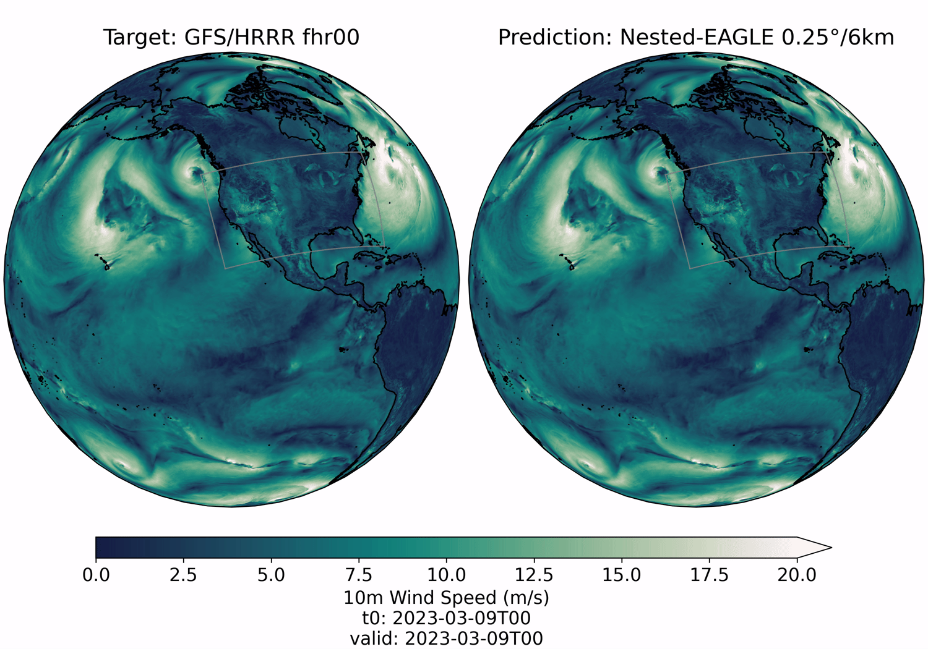
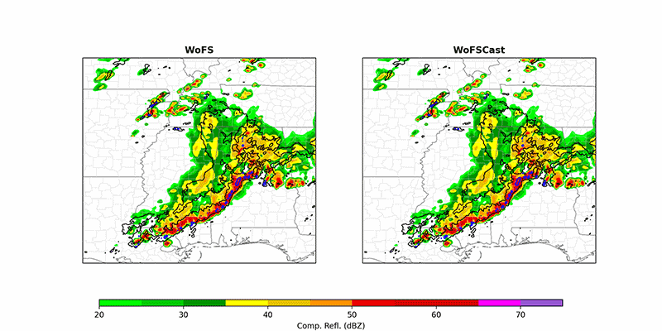
Coordinated Early Activities
AIGFS and AIGEFS - OMD
HRRRCast: CONUS-scale ensemble - GSL
Nested-Eagle: GFS and HRRR - PSL
WOFSCast: storm-scale model - NSSL

Slide 5
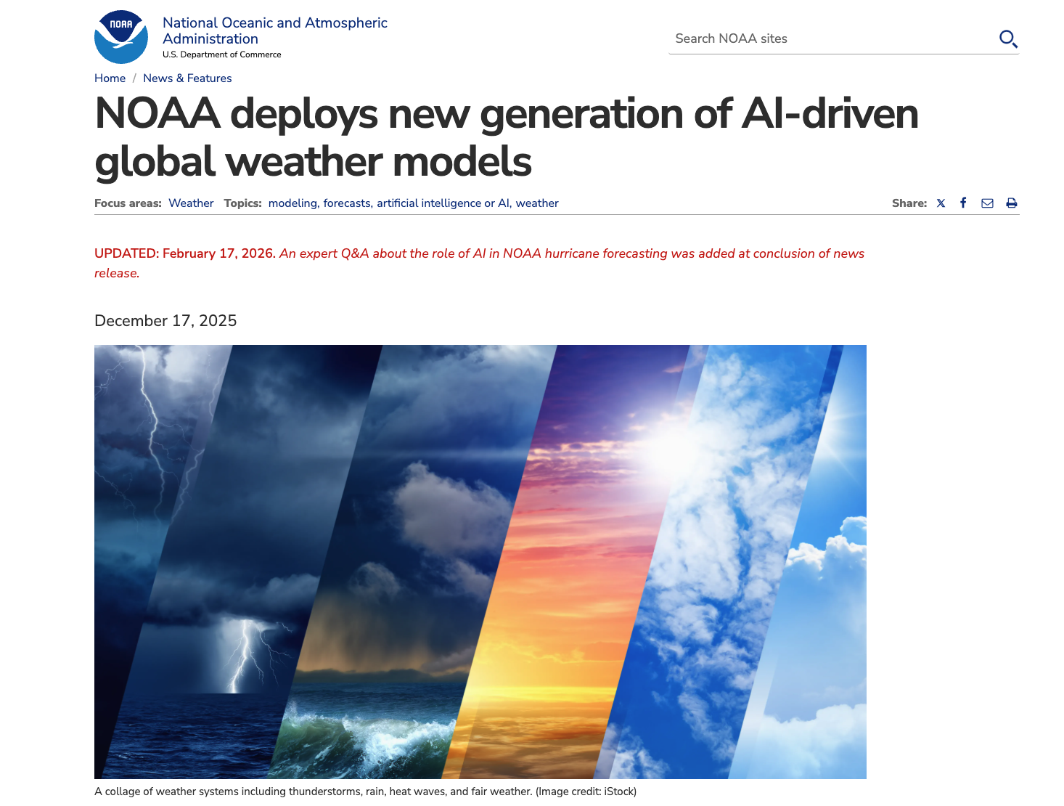
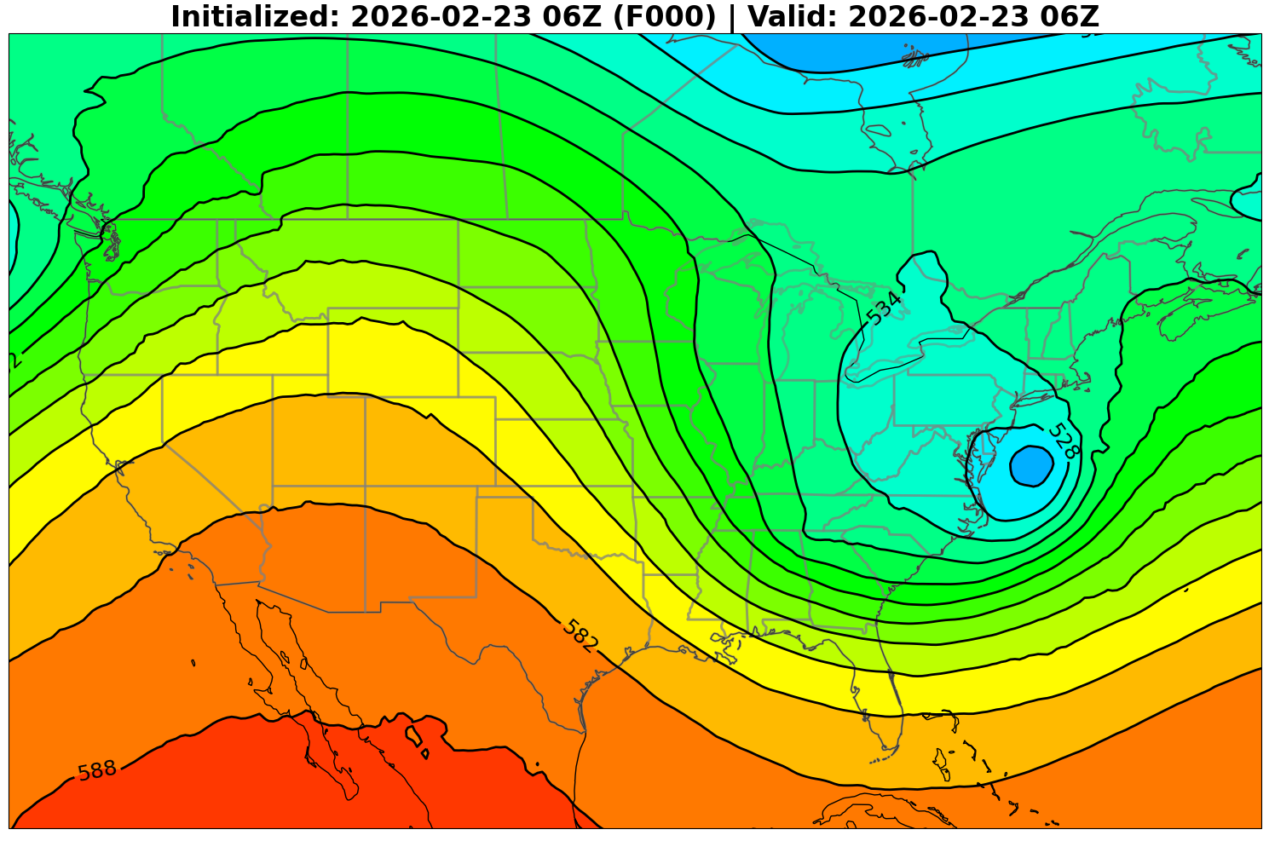
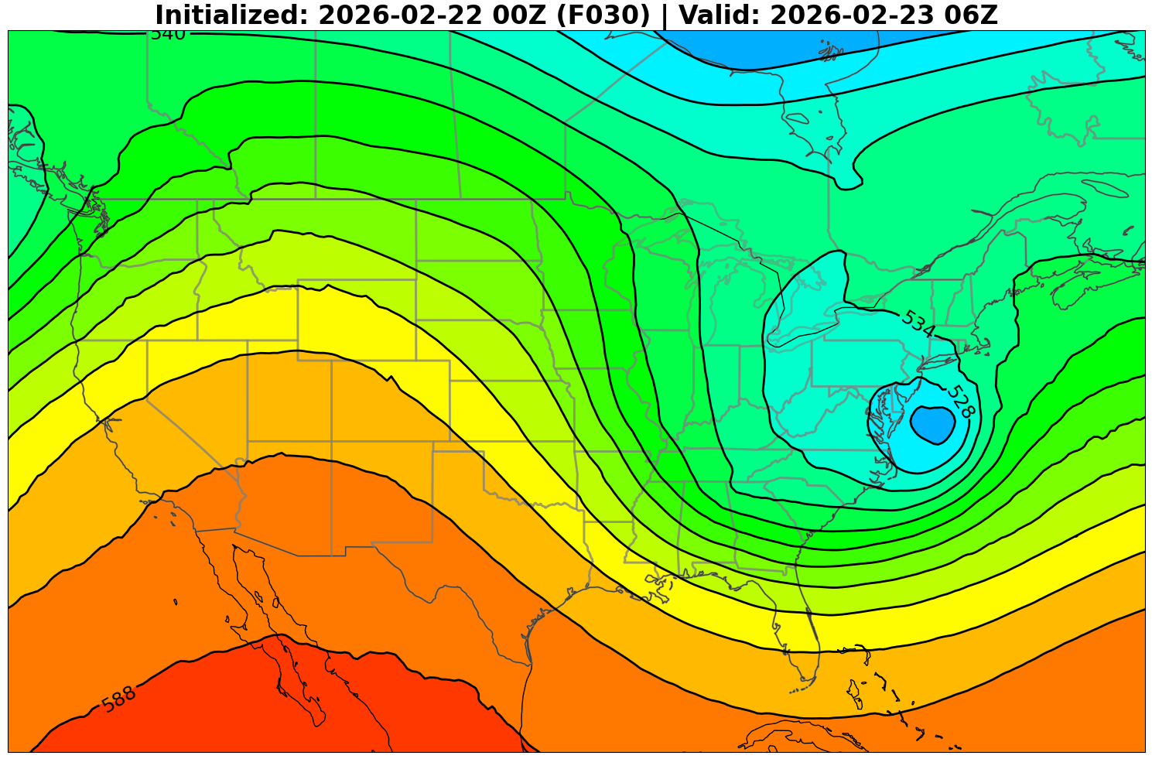
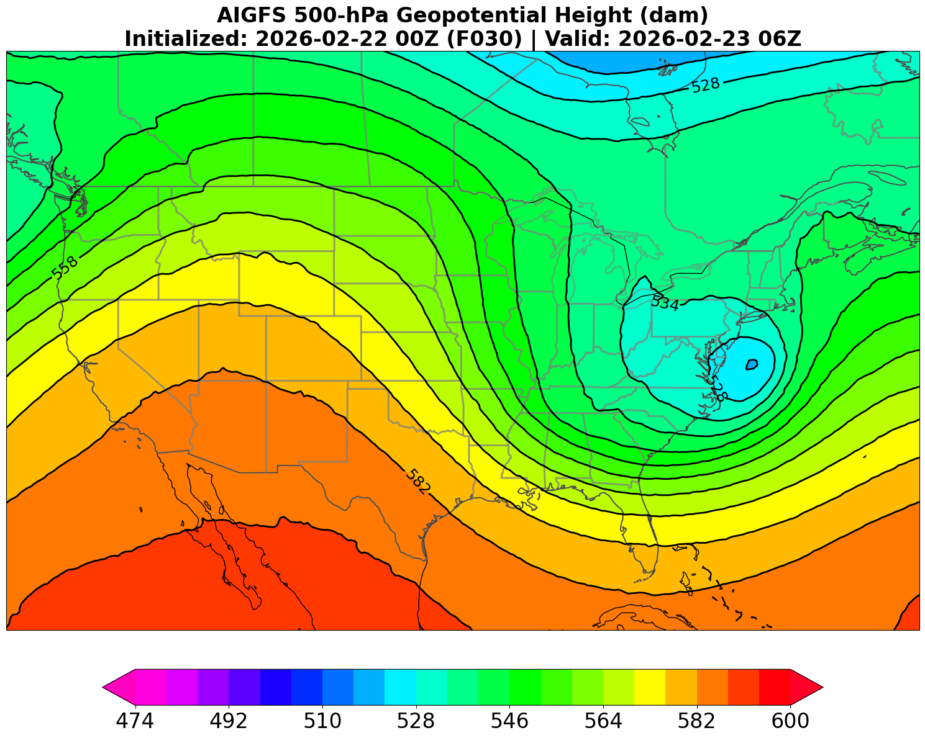
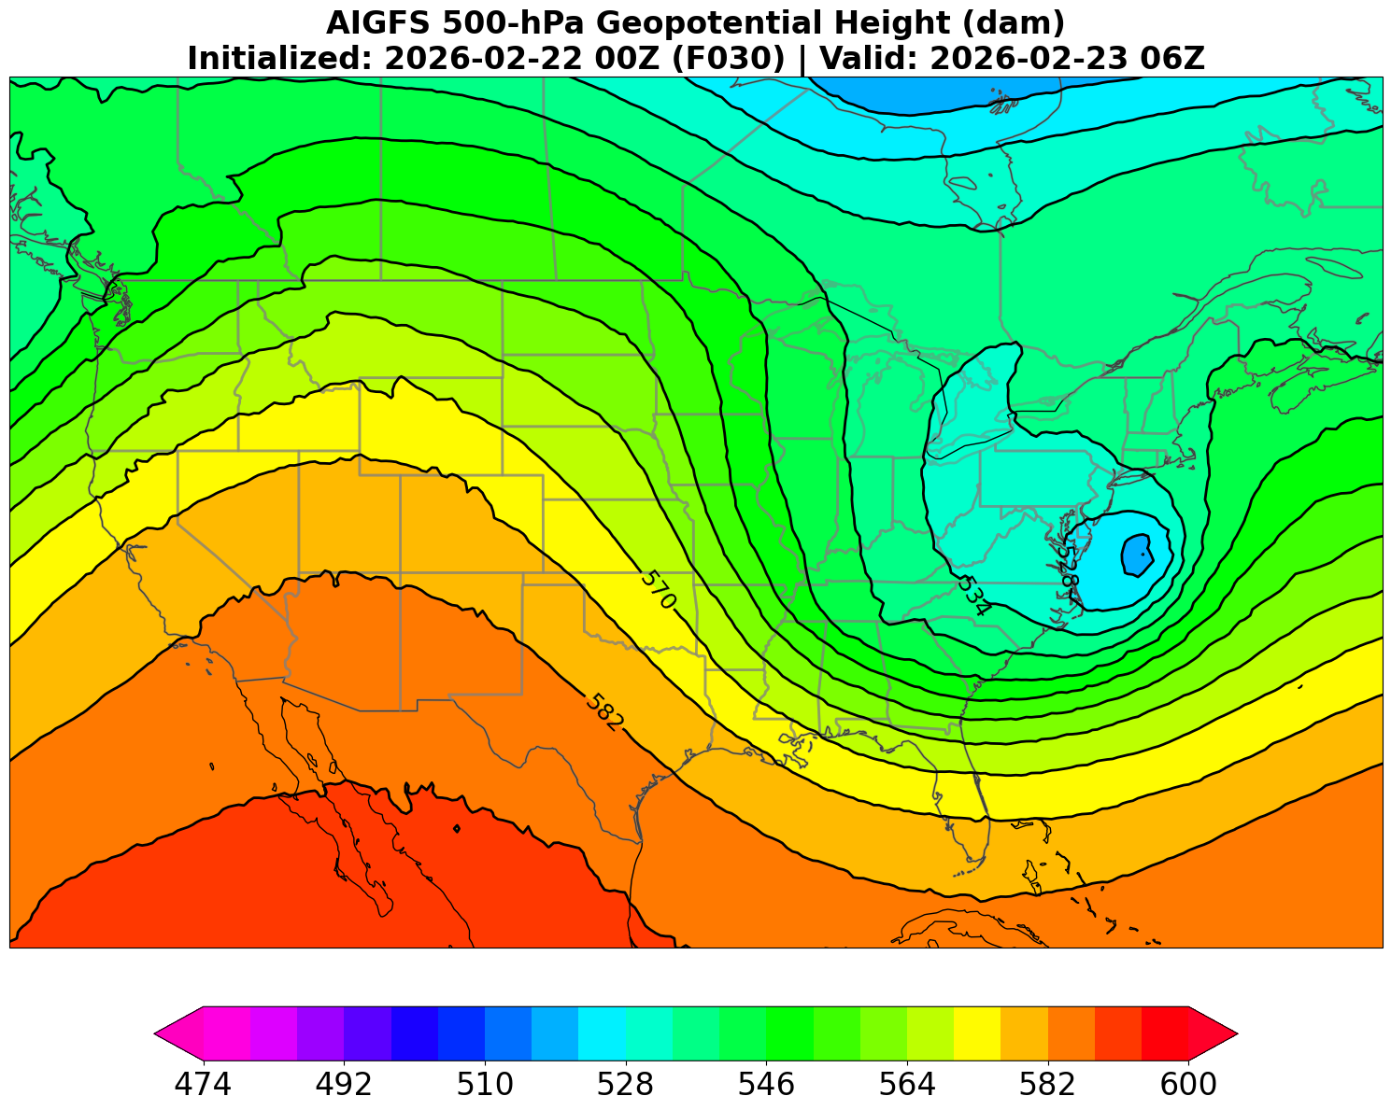
AIGFS, AIGEFS and HGEFS
GFS analysis
GFS
AIGFSv1.0
AIGFSdev
December 17, 2025 Operational Release of
AIGFS, AIGEFS and HGEFS
22-24 Feb 2026 East Coast Winter Storm
Courtesy of Jacob Carley

Slide 6
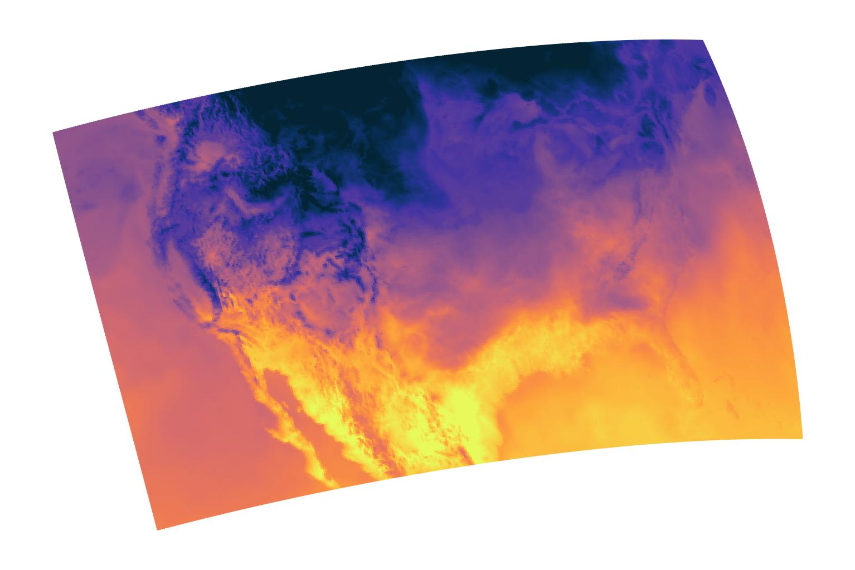
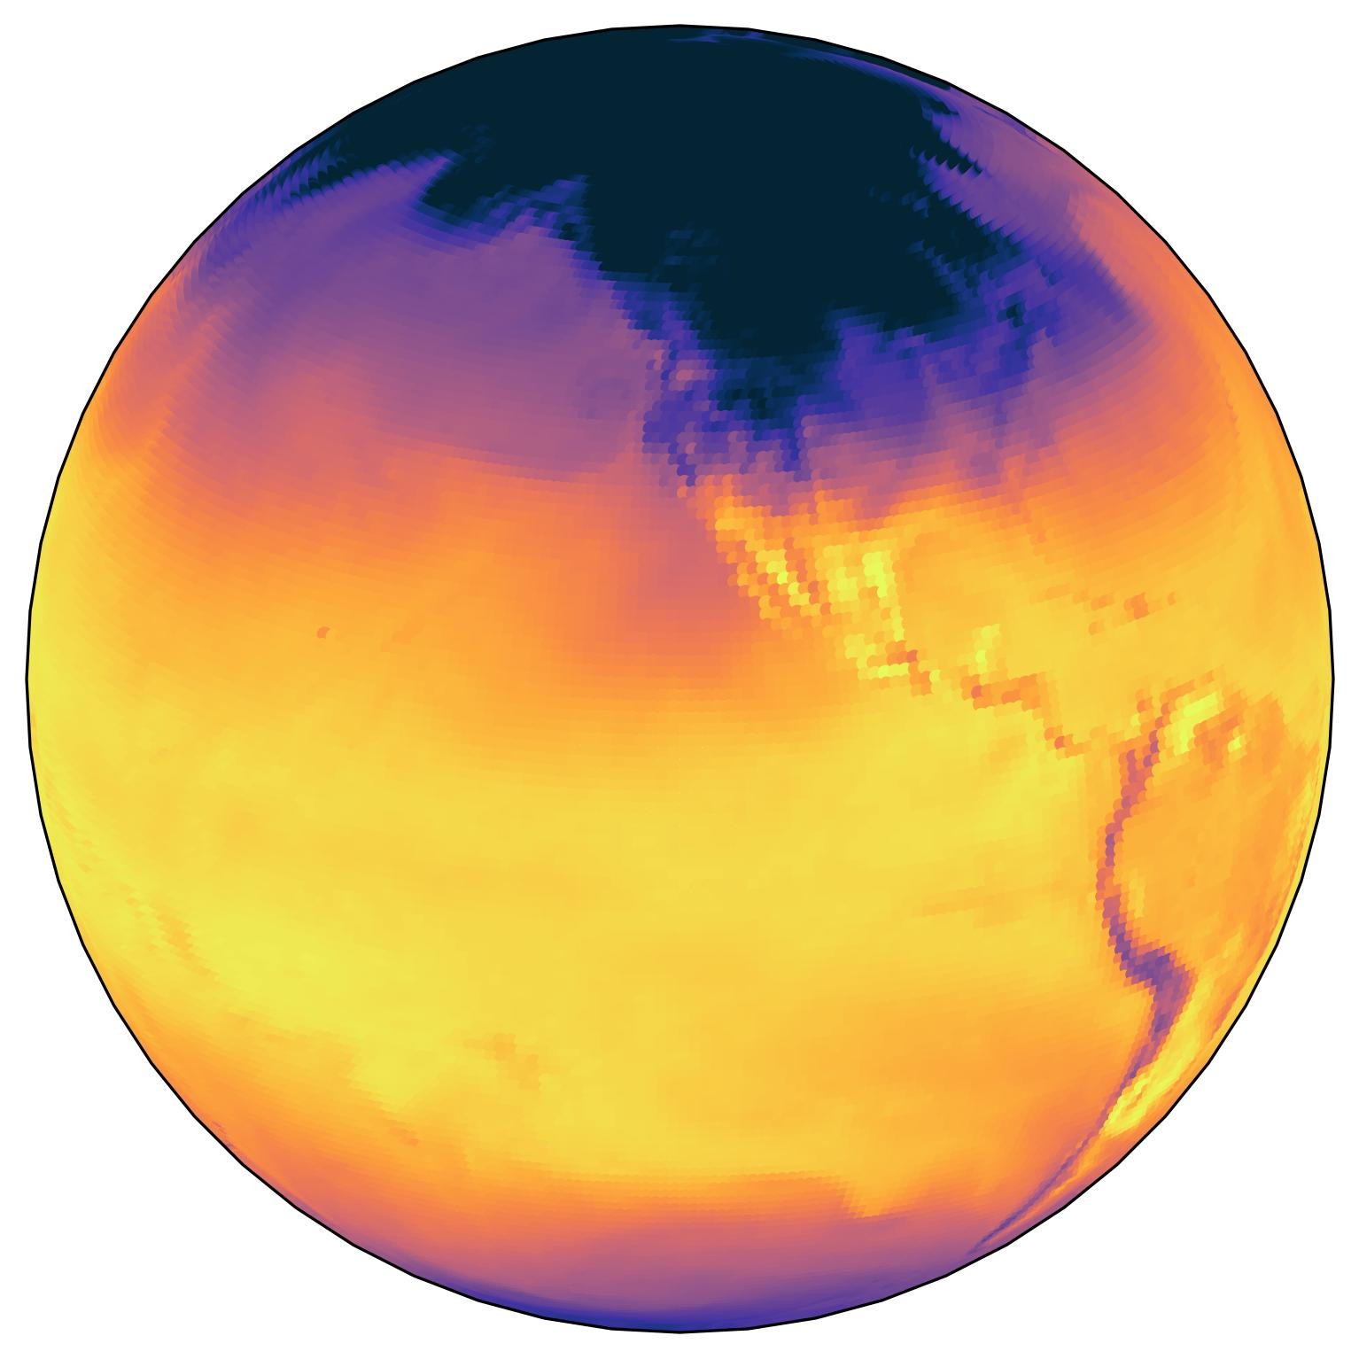
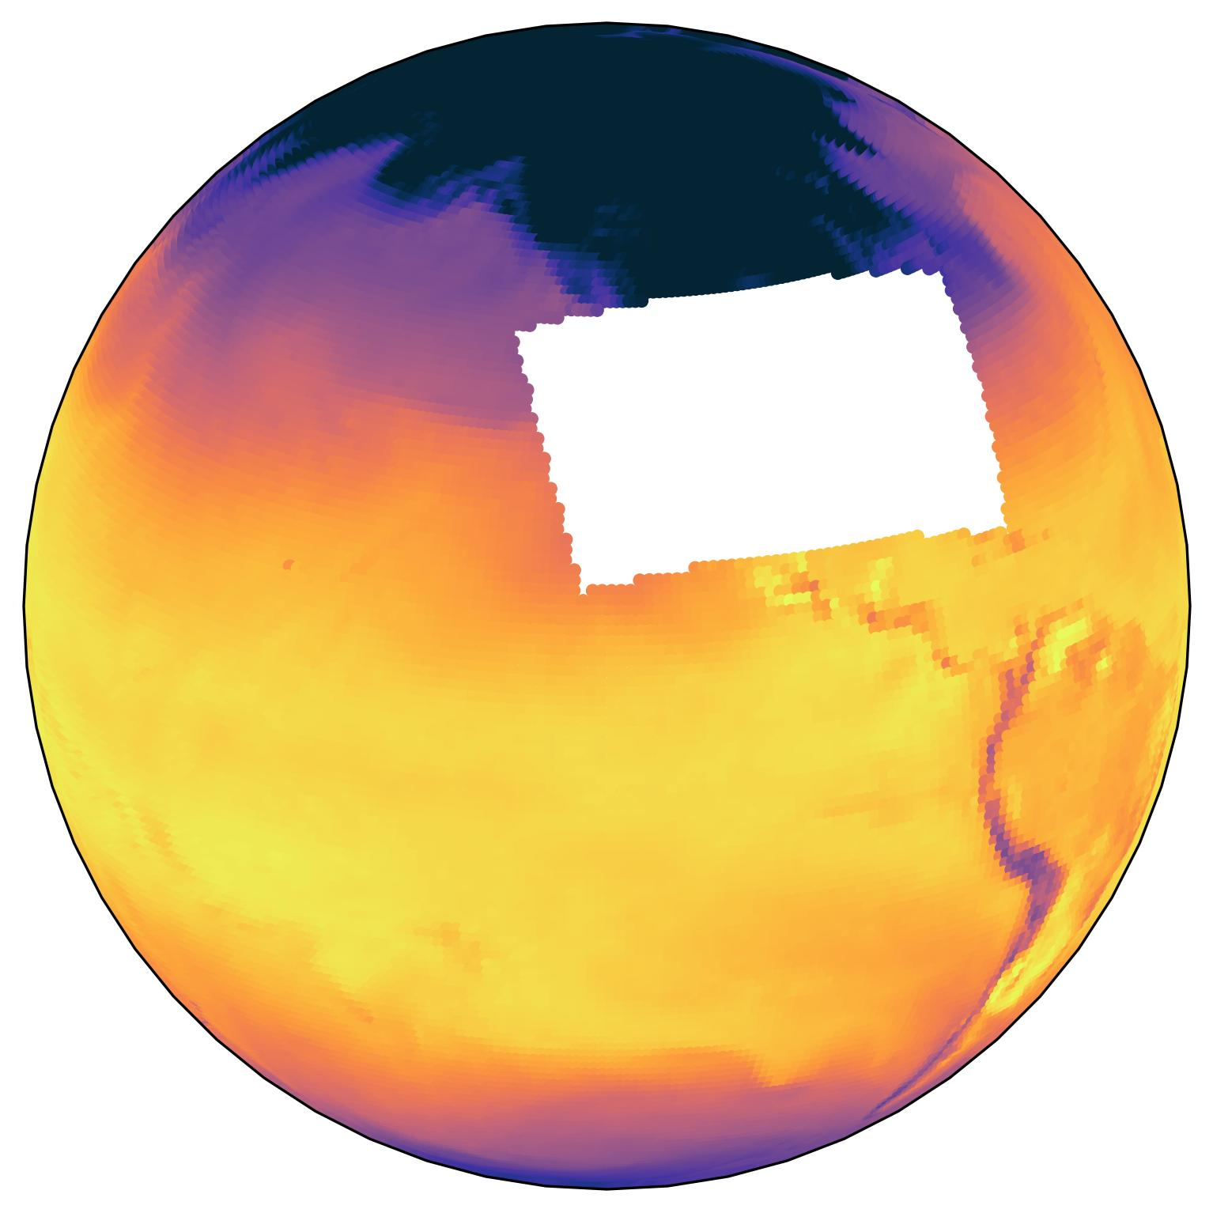

Global-Nest (Nested EAGLE)
Uses ECMWF Anemoi framework.
Follows approach pioneered by Nipen et al., (2024) at Met Norway, and directly benefits from open source contributions by their team.
Training data for Nested-EAGLE
8 years of GFS
8 years of HRRR
Courtesy of Sergey Frolov

Slide 7
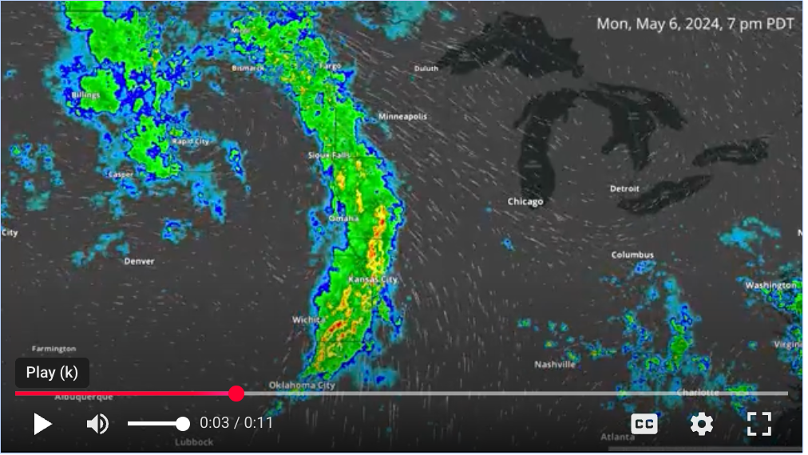
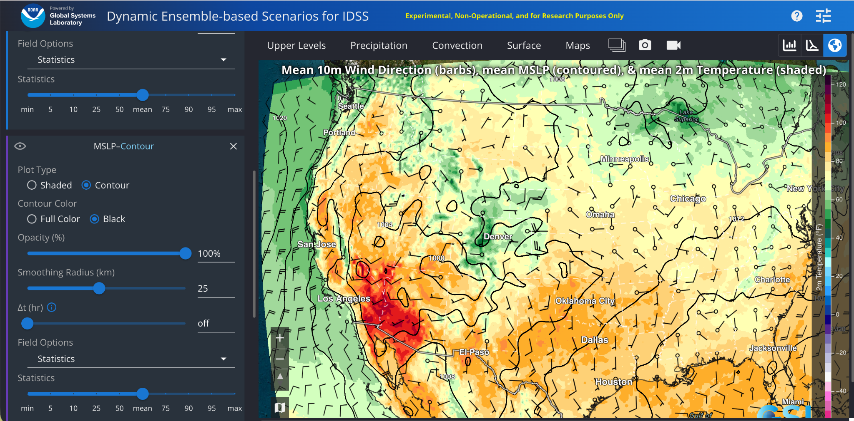
HRRRCast
In-house developed algorithm
3-km CONUS wide
Trained on HRRR analysis
18-member ensemble

Slide 8
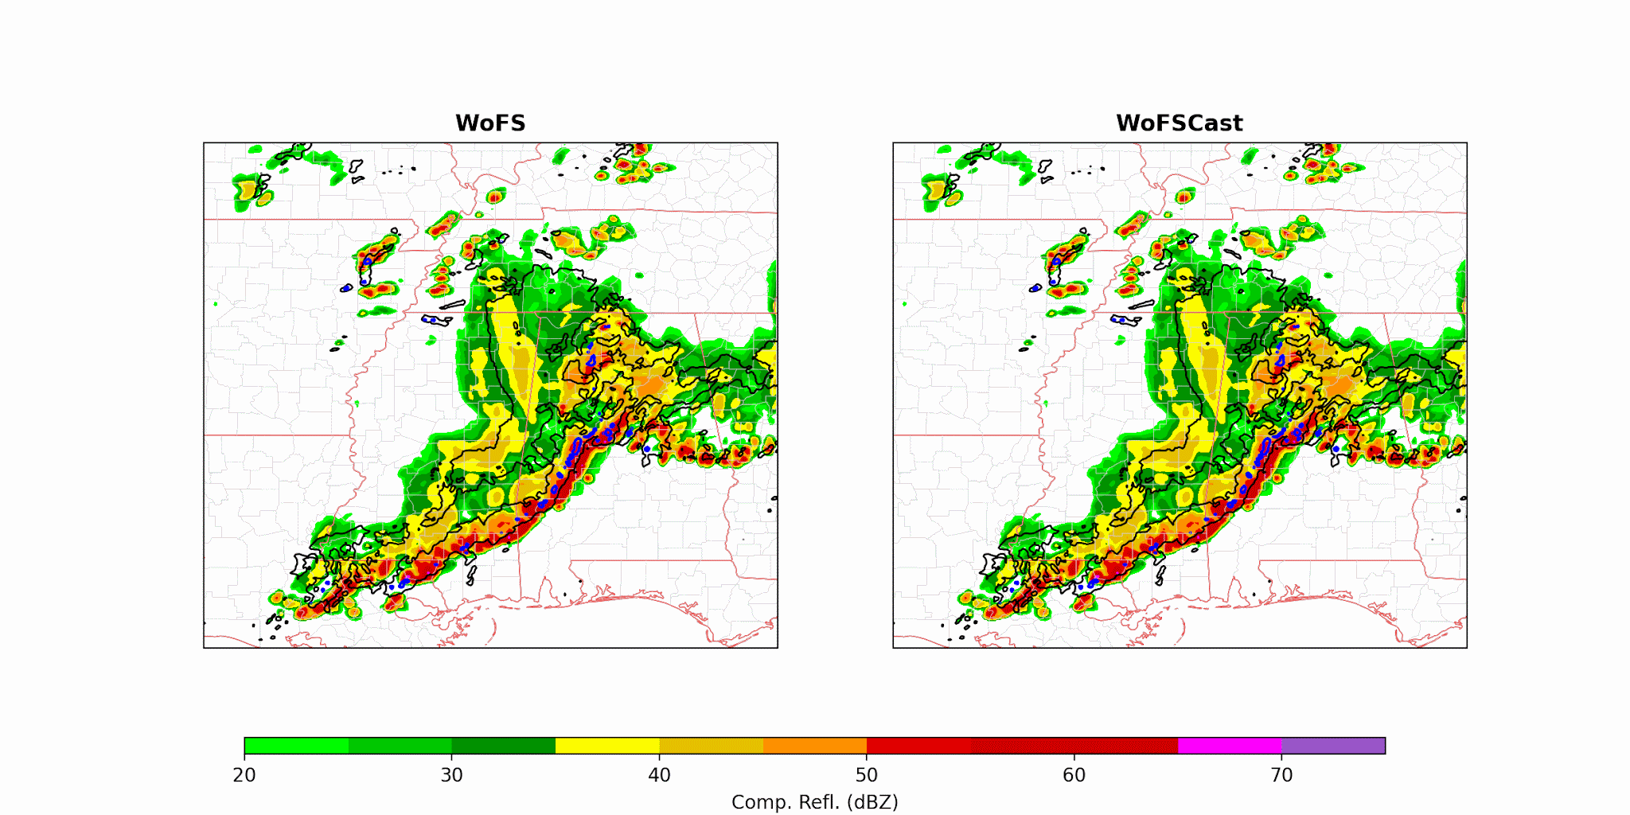
WoFSCast
Flora and Potvin (2025, GRL)
Blue/Black:
Observed storms
WoFS Emulator
GraphCast-Based
AI emulator for WoFS ensemble forecasts
3-km resolution, 0–6 h forecasts over a 900-km domain
Trained on 300 TB of WoFS data (Spring 2019–2021)
10-minute training data captures realistic storm evolution
Enables fast, low-cost ensemble guidance for severe weather
WoFSCast ensemble:
1 min with 1 GPU node
≤ $100/day
WoFS ensemble:
10 min with
>1000 CPUs
> $1000/day
Courtesy of Corey Potvin

Slide 9

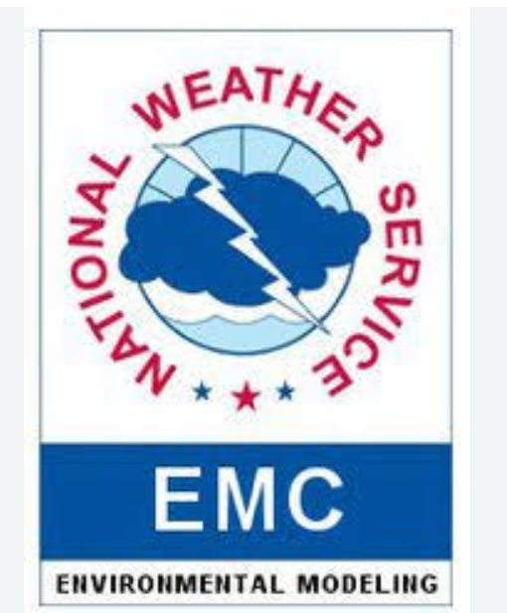

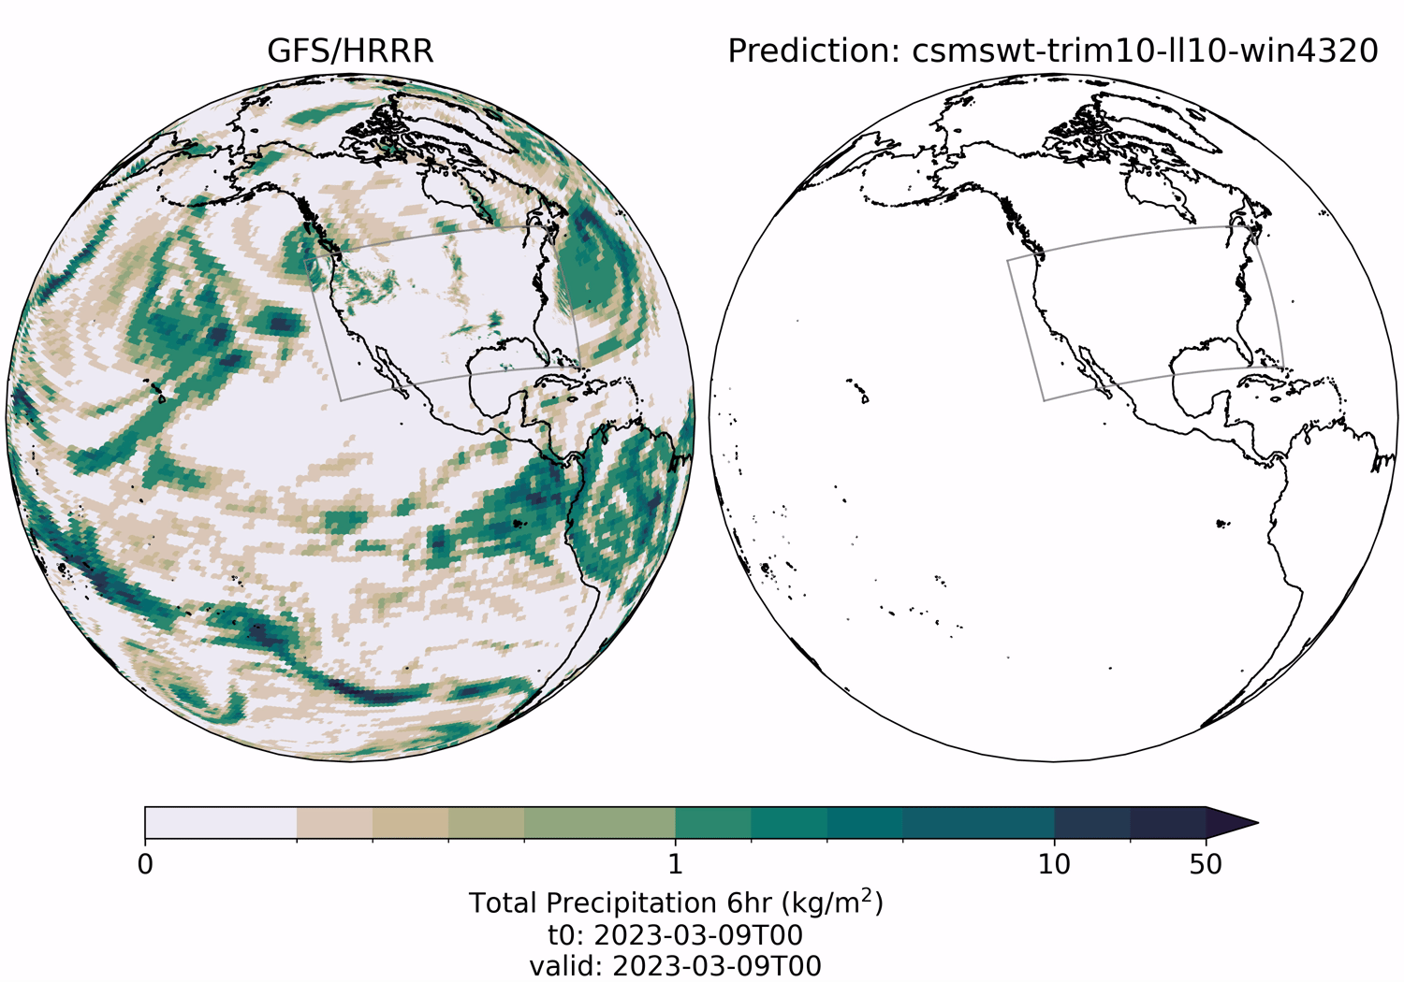







What is Project EAGLE?
PSL
GSL
EMC
DTC
CIRA
Microsoft
Department of Energy/NERSC
NOAA RDHPCS
OAR/ITMO
https://www.epic.noaa.gov/ai/eagle-overview/
Courtesy of John Ten Hoeve
Notes:
Project, not a specific model
Collaboration with all of these organizations, and is co-led by EPIC which is in WPO, EMC, and PSL
Project EAGLE stands for the Experimental AI Global and Limited-area Ensemble, which is a joint effort between NOAA Research Laboratories and the Earth Prediction Innovation Center (EPIC) in the Office of Oceanic and Atmospheric Research (OAR), and the National Weather Service (NWS). The Goal of Project EAGLE provides NOAA and the broader weather enterprise with the ability to rapidly test, develop, and demonstrate in the near real-time Artificial Intelligence (AI) models for global and limited area ensemble forecasting. Once fully-developed, the project will enable researchers within NOAA and across the weather enterprise to rapidly test their AI models against trusted forecast metrics or existing physics-based models. Project EAGLE will allow NOAA to identify the best performing AI innovations rapidly and advance them into near real-time demonstration that can deliver value to the Nation, save lives and property, and enhance the national economy.

Slide 10
Vision formulated by the AI4NWP group 18 months ago
Forecast Products
NOAA Dataset A
Project EAGLE Pipeline (Enabled by Anemoi & EPIC)
NOAA Dataset B
Datasets
Training
Models
Inference (Deployment)
External Dataset A
GEFS-AI Config
WOFS-AI Config
Co-Development with End Users (includes Testbed)
Automated Testing, Validation & Evaluation (using MET tools)
HRRR- Config
AR-AI Config
Courtesy of Sergey Frolov

Slide 11
Where are we today
Forecast Products
NOAA Dataset A
Near real time for 4 models
UFS-Replay
Project EAGLE Pipeline (Enabled by Anemoi & EPIC)
NOAA Dataset B
Datasets
Training
Models
Inference (Deployment)
GDAS
UFS2ARCO
Anemoi (from ECMWF)
Ursa
Azure
External Dataset A
ERA5
EAGLE-
Ensemble
Coupled-
EAGLE
GEFS-AI Config
WOFS-AI Config
Co-Development with End Users (includes Testbed)
Automated Testing, Validation & Evaluation (using MET tools)
Spring forecast experiment
wxvx (met-based)
eagle-tools
HRRRCast
AR-AI Config
HRRR- Config
Nested-
EAGLE
EAGLE repository publicly released by EPIC
  Contributions (in blue): PSL, GSL, EPIC, OMD
  Anemoi core model libraries from ECMWF (in green)
Courtesy of Sergey Frolov

Slide 12
What makes for an EAGLE product
To qualify:
Near real time execution
Model and weights available publicly
Output available publicly
Public visualization and monitoring (evaluation) pages
Advertised on the centralized EPIC eagle page
What is in EAGLE today:
AIGFS and AIGEFS
Global Nest
HRRRCast
Courtesy of Sergey Frolov

Slide 13
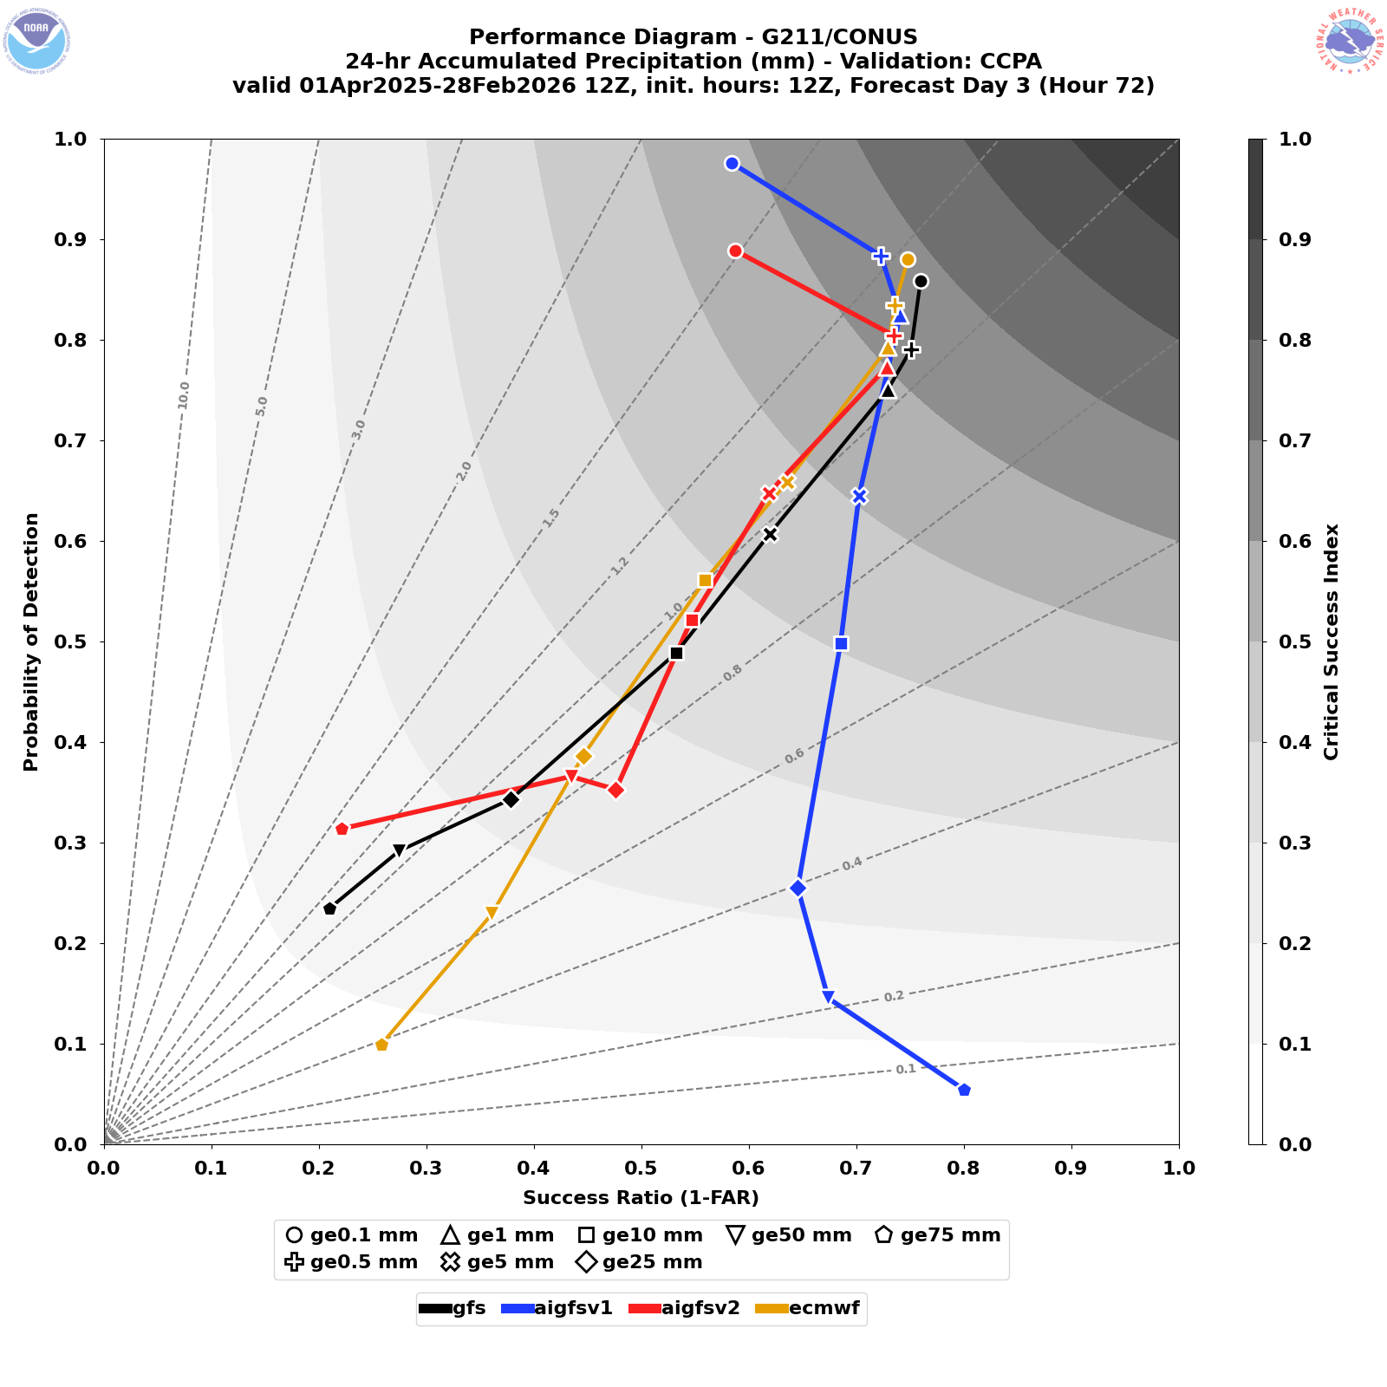
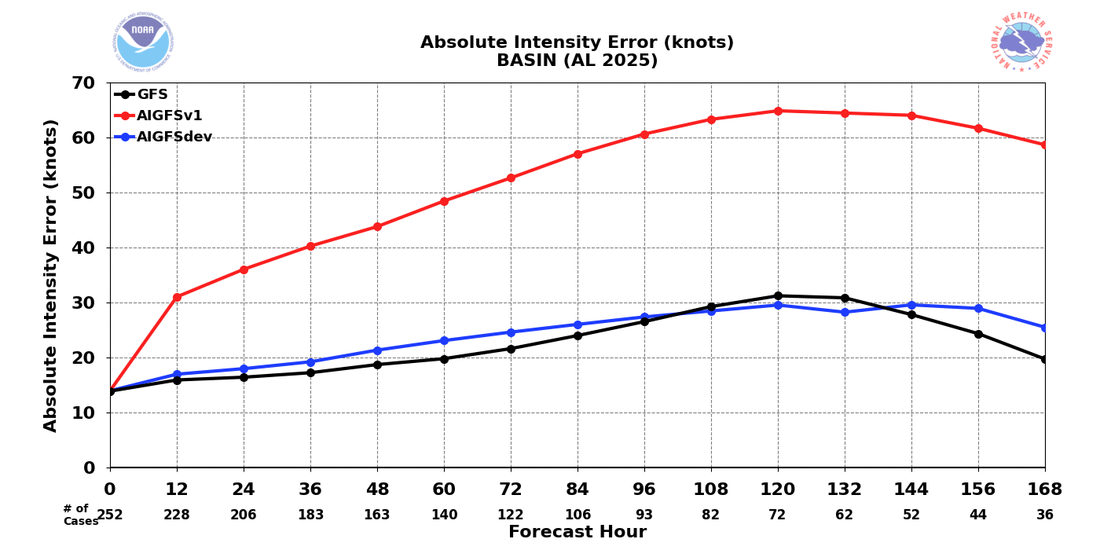

AIGFSv1.1 Implementation (transition from EAGLE to NCO)
AIGFS v1.1 updates:
  Updated to spectral harmonic Loss function with wind speed and direction presentation
  Expanded training dataset to March 2025
  Fine-tuning process updated to train the model with GDAS data for 1-12 AR steps
Apply modernized development lifecycle for operational implementation
Planed for operational implementation on July 20, 2026
DAY 3
CONUS
Atlantic

Slide 14
Some examples of related activities across NOAA
AOML - Graphcast for hurricane track and now Transformer for both track and intensity prediction
GFDL - AI/ML to create hurricane vortex ICs, ocean temperature bias reduction
PMEL - Tsunami prediction
GSL - RTMA emulator
…. Many other applications ….

Slide 15
Lessons Learned (So Far)
Full Understanding of the data-driven models capabilities
The algorithm – model architecture, strengths, and limitations
Training strategy – objectives, loss functions, and uncertainty representation
Training data – sources, quality, coverage, and potential biases
Clear Communication of Capabilities - Success depends on aligning expectations with model design
Purpose – What problem does it solve?
Optimization – What was it trained to predict?
Value – What information can users trust?
Limitations – When should it be used (or not used)?
Understanding capabilities is essential for meaningful evaluation and successful adoption!!!!!
Unification Around Problems, Not Models!

Slide 16
Lessons Learned (So Far)
Common Infrastructure: to facilitate development and transition to operations
Data management
Training and inference
  Deficiencies detected for limited area application
  Exploring CREDIT (Community Research Earth Digital Intelligence Twin, NCAR)
Verification and evaluation frameworks
Workflow orchestration
HPC, cloud, and GPU resources
Anemoi has been explored

Slide 17
Going Forward
AI4NWP Working group:
  Great progress early
  Connections with NOAA leadership
  Variety of developments - convergence around the problem?
Transition to operations:
Traditional NWP | Data-Driven Models
Code-centric | Data, weights, and workflows
Focus on forecast execution | Support training and inference
Periodic updates | Continuous retraining
Compute focused on forecasting | Compute for training and forecasting
HPC-based infrastructure | HPC, GPUs, cloud, and ML platforms

Slide 18
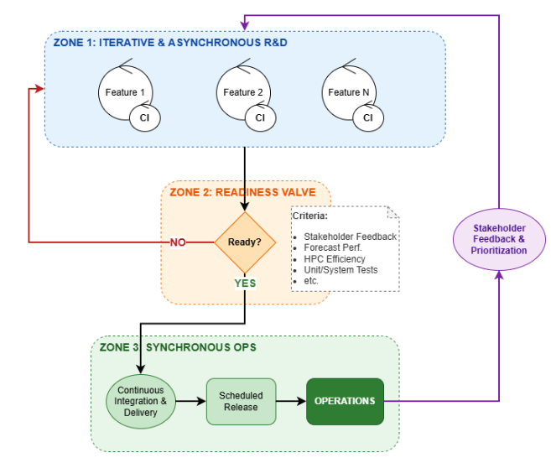
Modernized Development Lifecycle
Vision: transition from our current high-risk, multi-year release schedule to a predictable and sustainable rhythm of smaller, more frequent upgrades.
Bridging Development and Operations
Minimized environment differences
Streamlined handoffs
Improved feedback loops
Shared priorities
Transforming the Evaluation Process
Integrate evaluation into development
Engage stakeholders throughout the development cycle
Shift toward dynamic graphics
Use of consolidated evaluation metrics
Carley et al., 2026

Slide 19
THANK YOU!!!

