Slide 1
Assessing the Skill and Sensitivity of AIWP Models During the 2026 NOAA HWT Spring Forecasting Experiment
David Harrison,
Tim Supinie, Israel Jirak, Adam Clark

Slide 2
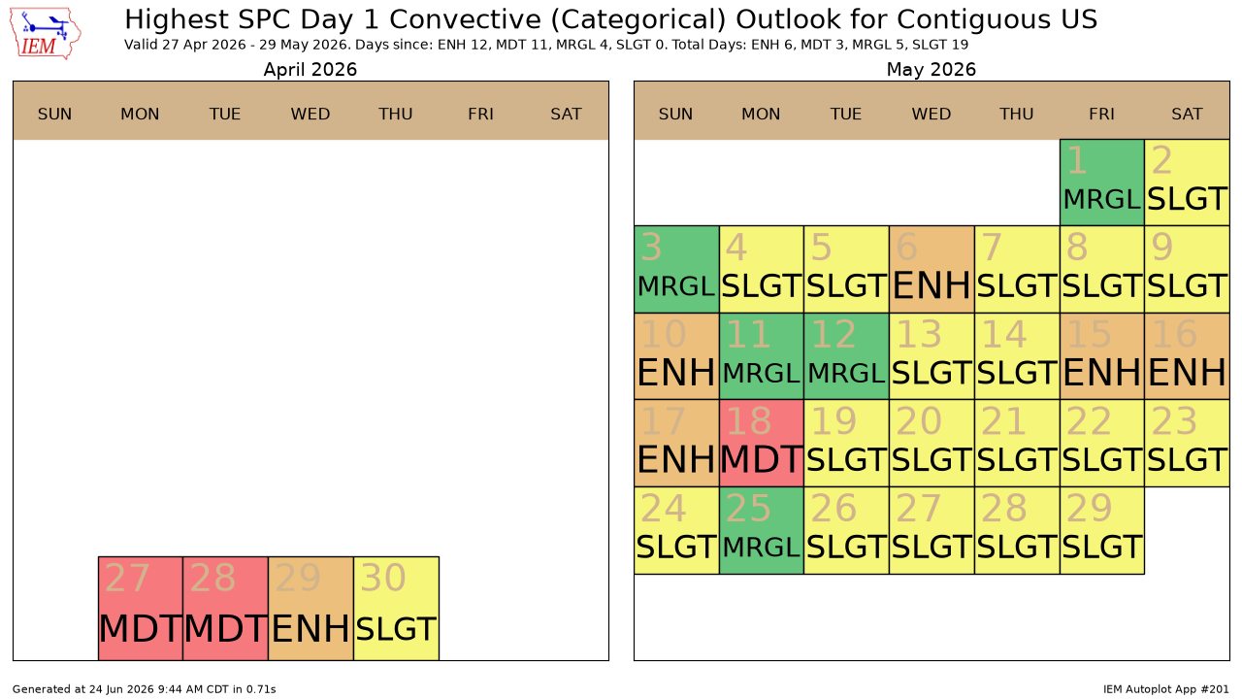

HWT Spring Forecasting Experiment
Five-week experiment jointly organized and facilitated by SPC and NSSL
Fourth hybrid SFE in 2026 with 58 remote and 75 in-person participants
Test and evaluate emerging technology for severe weather prediction
Accelerate R2O and develop, strengthen O2R pathways

Slide 3
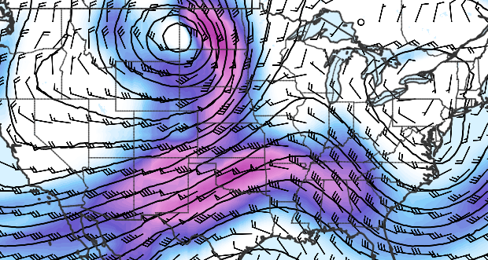
Global AIWP Emulators
Private-sector companies have explored and developed AI for global weather prediction (AIWP)
AIWP emulators have demonstrated similar or improved statistical skill to ECMWF’s Integrated Forecast System (IFS)
Can produce forecasts much faster than traditional NWP with fewer computational resources
Formal evaluation in real-time operational settings is limited
  How do these models compare to traditional NWP in an operational environment?
  How do different initial conditions impact model performance?

Slide 4
Experiment Design
Models were initialized using either GFS or EC initial conditions.
  Each group of models was compared independently
  Model names were hidden during evaluations
Participants evaluated the 500-mb forecasts and their usefulness for severe weather forecasting each day
Focused on the Day 7 forecast (F156 – F180) for the previous day
Participants could view the full North American domain, but were asked to consider how the forecast might impact areas of observed severe weather when evaluating
Subjective scores were provided on a 10-point Likert scale
GFS Initial Conditions | EC Initial Conditions
GFSv17 | GraphCast
AIGFS | Pangu-Weather
Pangu-Weather | Aurora
GraphCast | AIFS

Slide 5
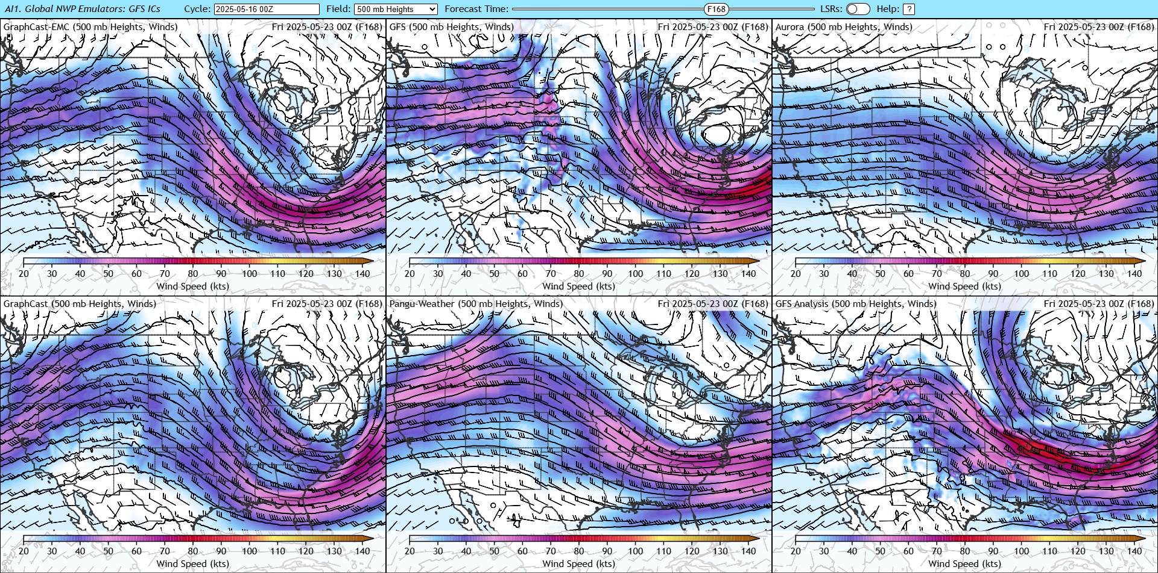
Experiment Design
Models with GFS ICs compared to operational GFS and GFS analysis
Models with EC ICs compared to operational ECMWF and EC analysis
Interactive webpage designed by Tim Supinie

Slide 6
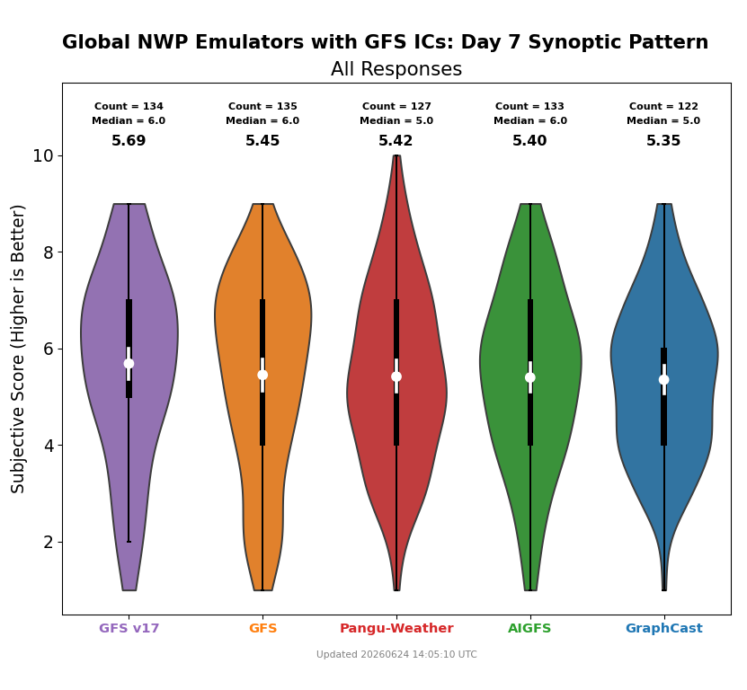
Preliminary Results - GFS ICs
For models initialized with GFS ICs compared to GFS Analysis:
  GFSv17 received the highest overall mean rating
  Differences between most AI ratings were small and not statistically significant
  In contrast to last year, the GFS and GFSv17 were generally favored over the AI models
  GFS and GFSv17 both saw a few large misses during the second half of the experiment

Slide 7
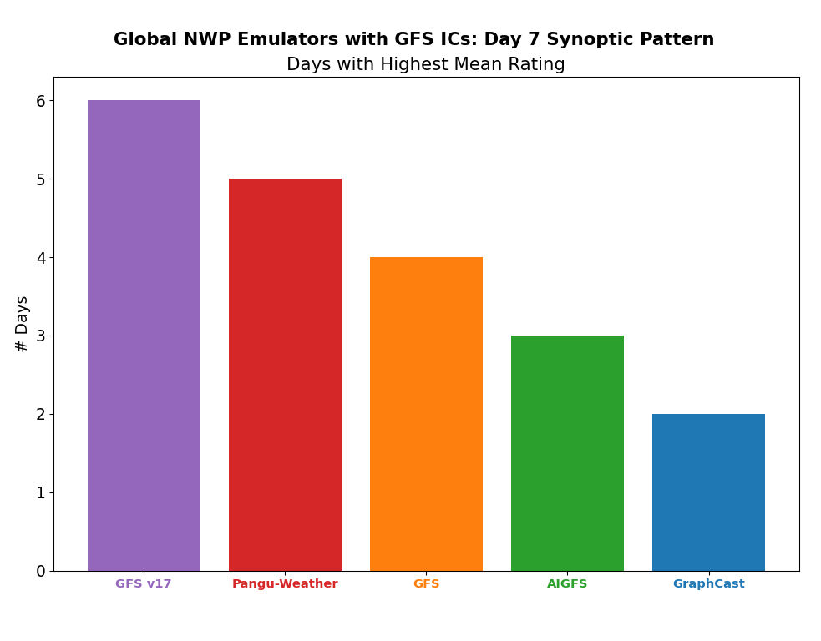
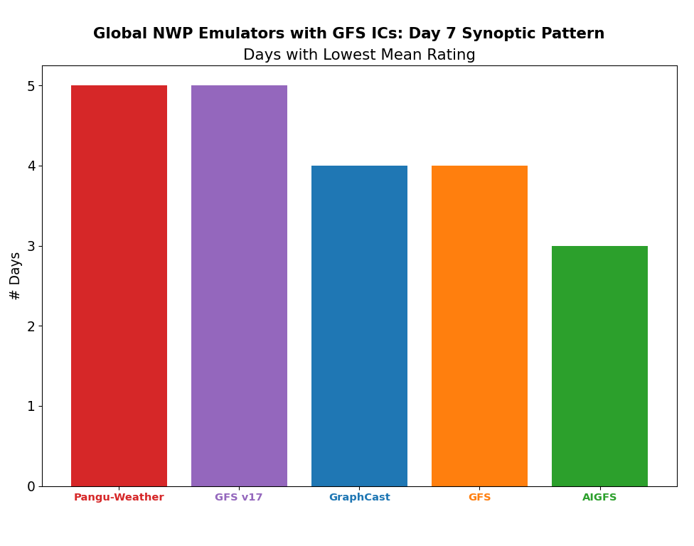
Preliminary Results - GFS ICs
# Best Days
# Worst Days

Slide 8
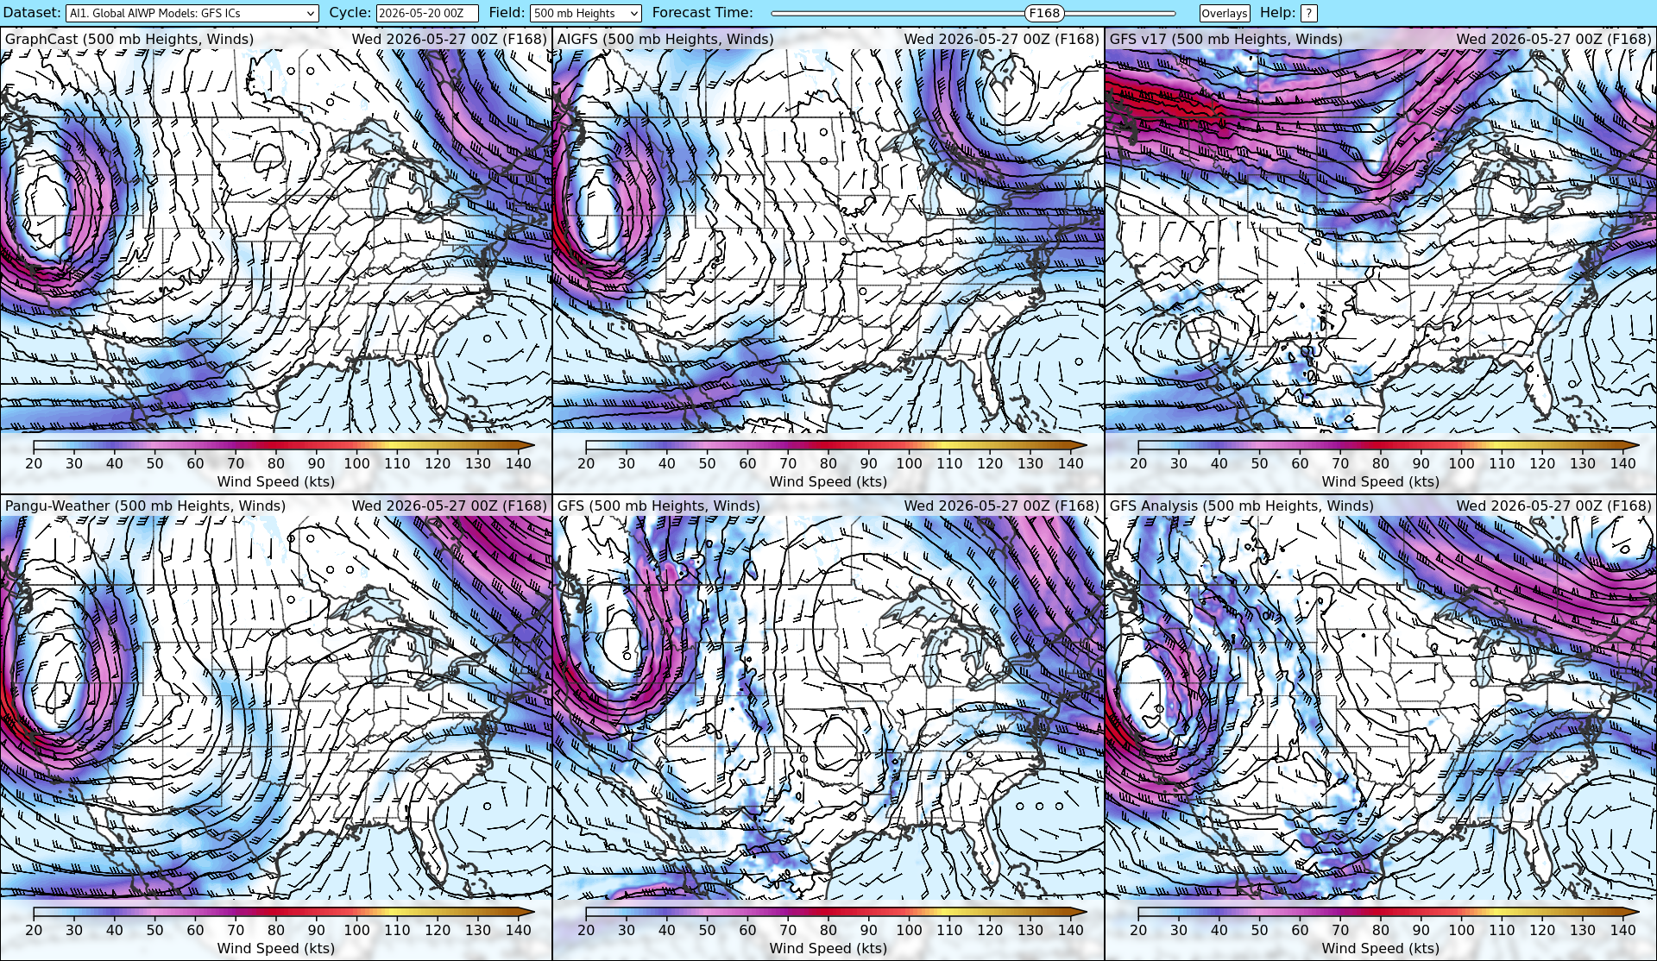
Preliminary Results - GFS ICs

Slide 9
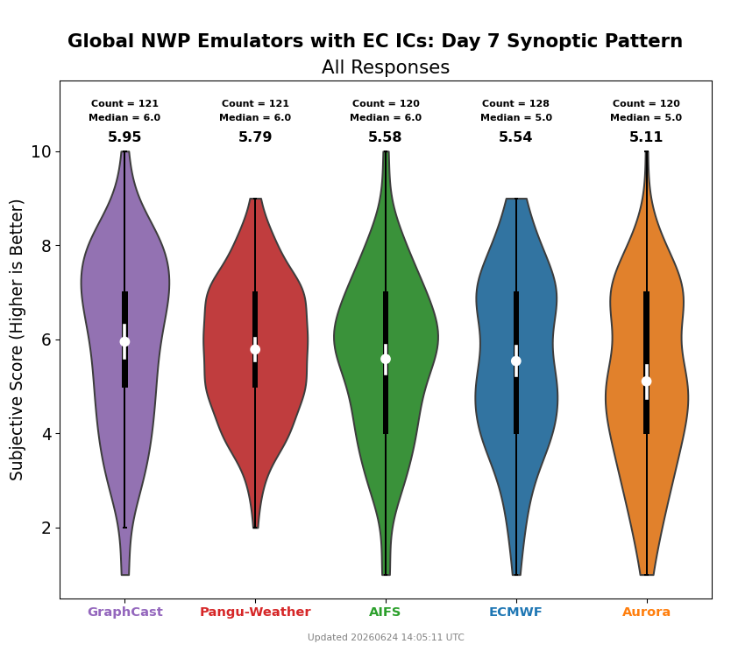
Preliminary Results - EC ICs
For models initialized with EC ICs compared to EC Analysis:
  GraphCast received the highest overall mean rating. Note that GraphCast had the lowest rating with GFS ICs.
  Most AI models were rated about the same or better than the ECMWF
  Microsoft’s Aurora continued to be rated lower than than other models but was anecdotally much better than last year
  ECMWF struggled this year, often with greater forecast error than the operational GFS and GFSv17

Slide 10
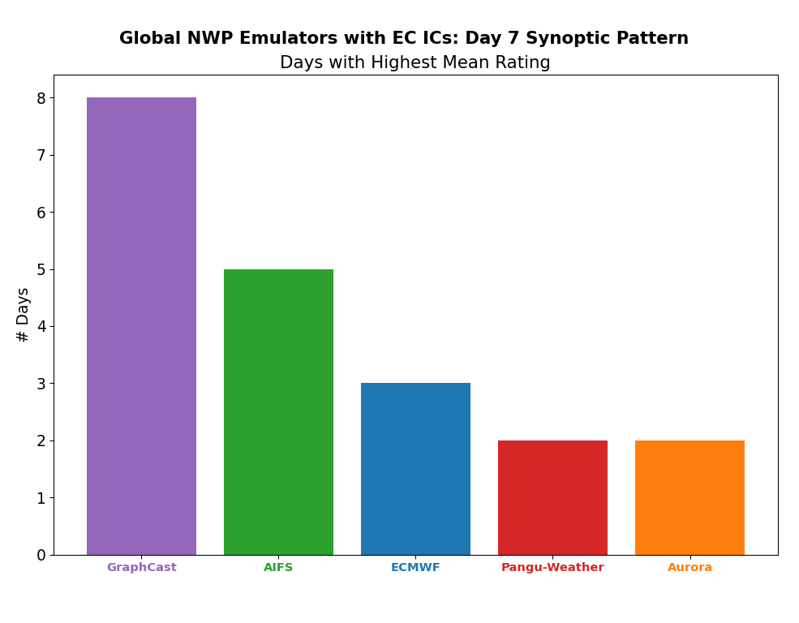
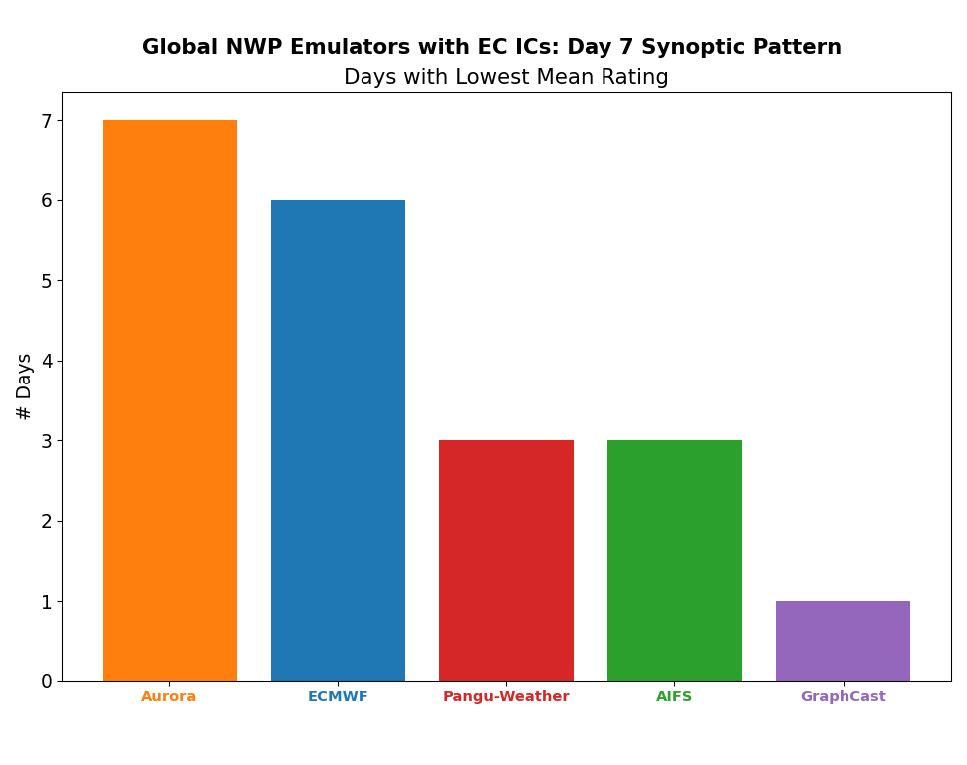
Preliminary Results - EC ICs
# Best Days
# Worst Days

Slide 11
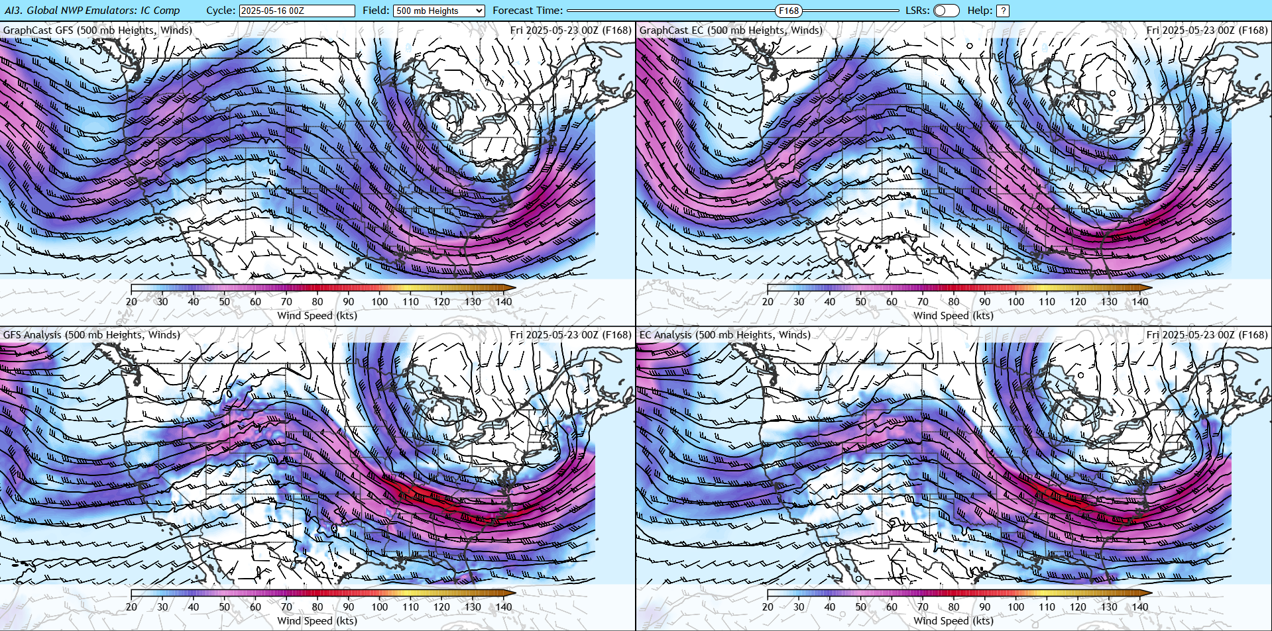
Preliminary Results - IC Comparison
One evaluation directly compared GraphCast with GFS and EC ICs
Participants compared to both GFS and EC Analyses
Forecasts were not blinded

Slide 12
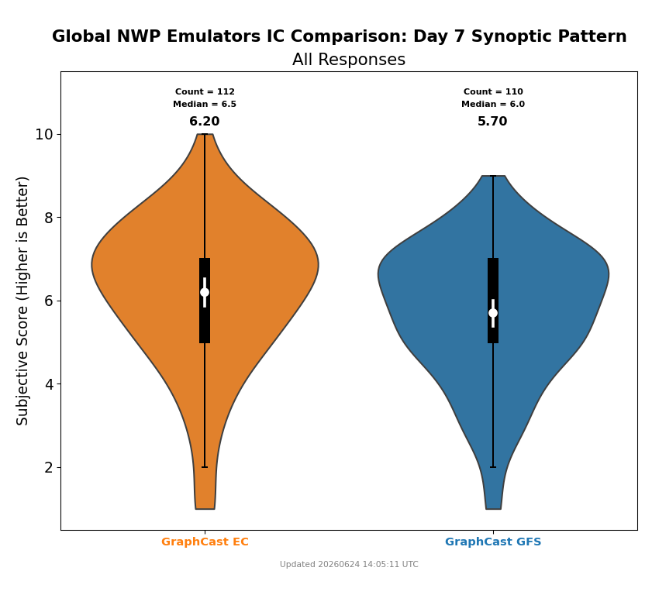
Preliminary Results - IC Comparison
  GraphCast with EC initial conditions was rated higher on average
  Differences between the two were usually subtle, with slight variation in the placement and strength of troughs, jets, etc.
  Mean ratings from previous slides:
  EC: 5.95
  GFS: 5.35

Slide 13
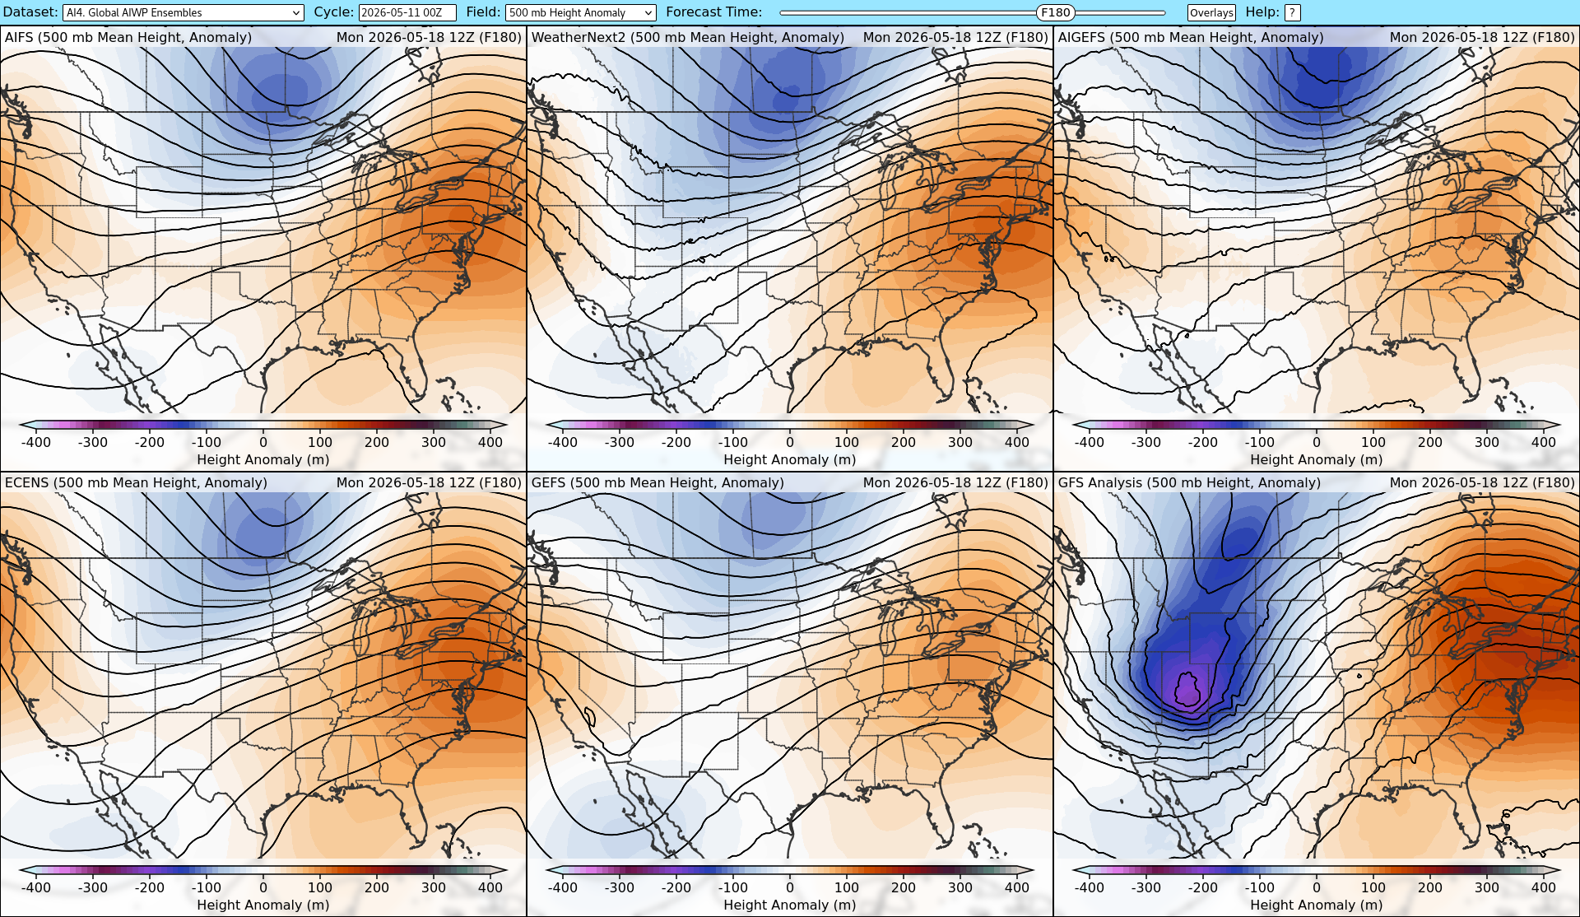
Preliminary Results - AI Ensembles
Participants evaluated the 500 mb height anomalies of WeatherNext2, AIGEFS, and AIFS and compared them to the GEFS and ECENS
The ensembles were blinded during evaluations

Slide 14
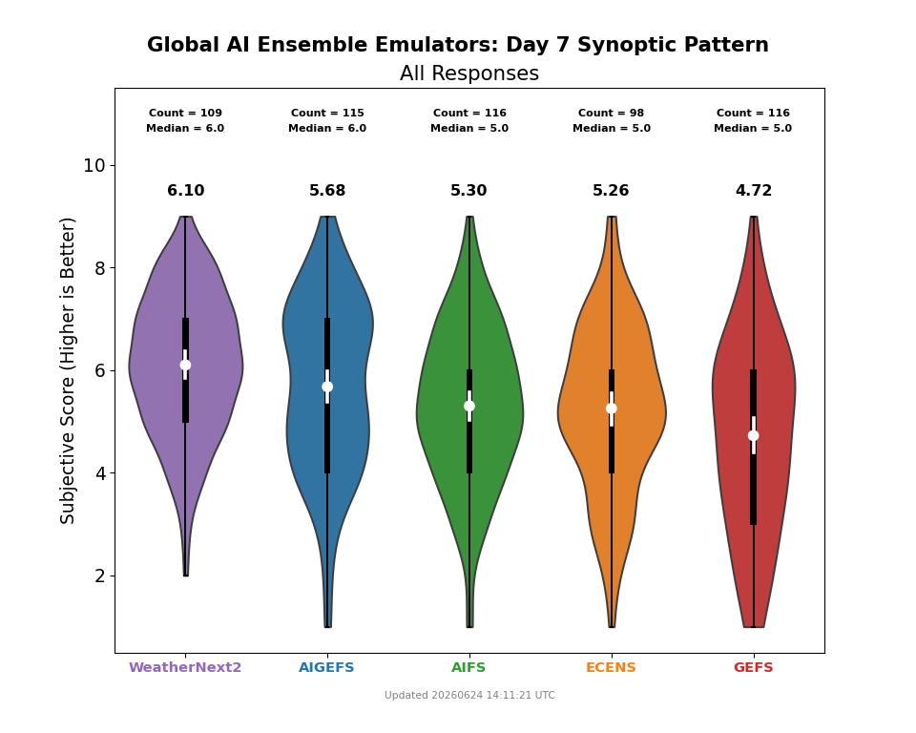
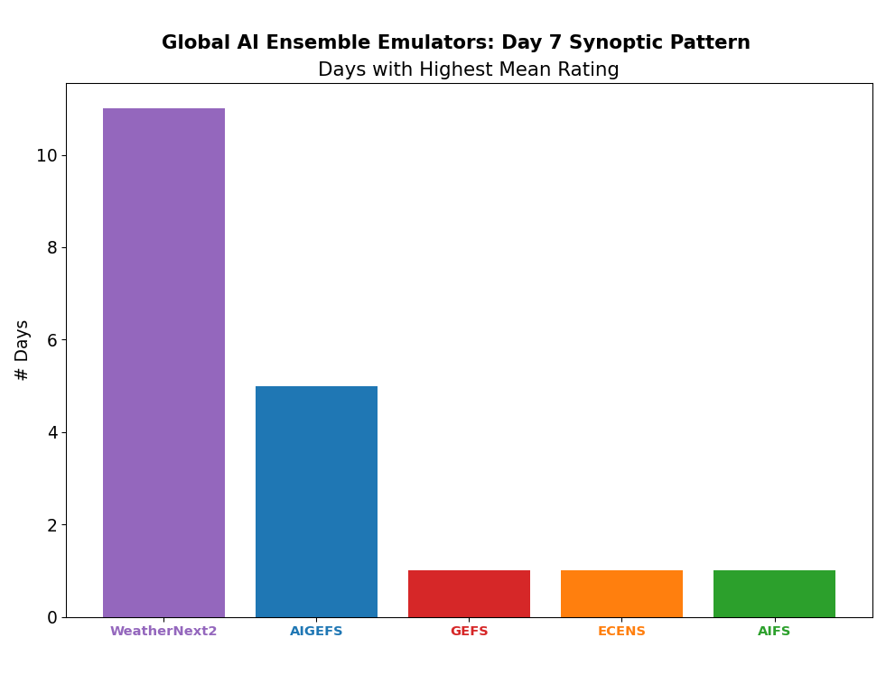
Preliminary Results - AI Ensembles

Slide 15
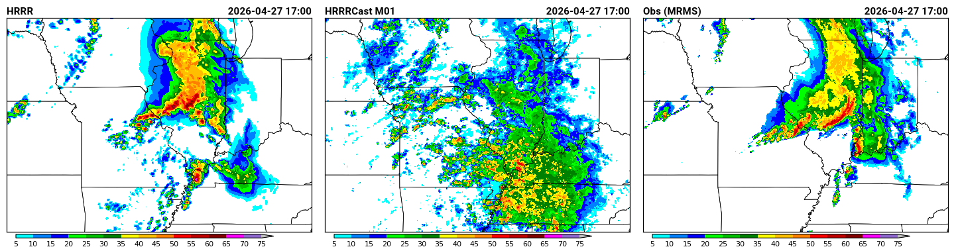
Preliminary Results - HRRRCast
Philosophy: Forecasters interrogate individual ensemble members to formulate possible scenarios, and their trust in the ensemble depends on realism in individual member solutions. Thus, the deterministic and ensemble evaluations compliment one another.
Disclaimer: HRRRCast is not directly comparable because it uses an hourly time step and the loss function rewards smoothed/spread out forecasts. Even though a scientifically “fair” comparison isn’t possible, we can assess potential value by comparing to operational guidance.

Slide 16
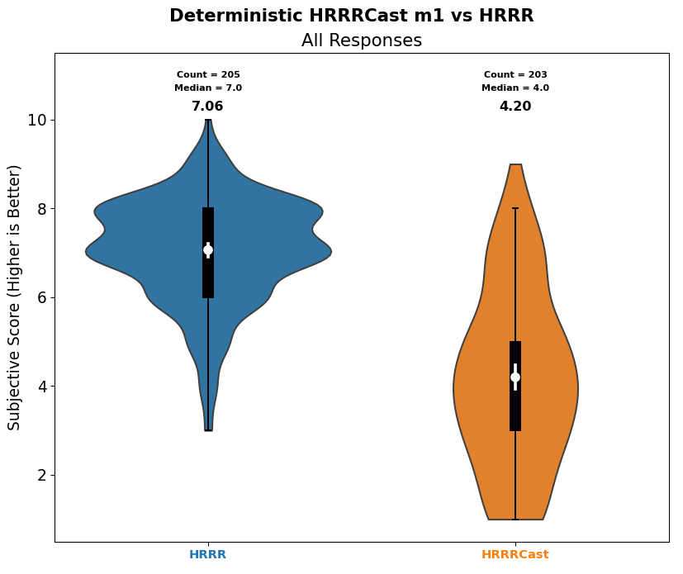
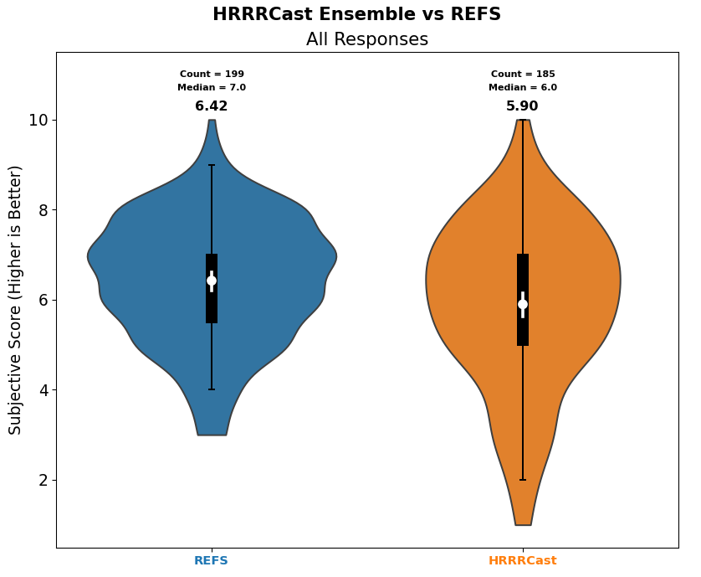
Preliminary Results - HRRRCast

Slide 17
Preliminary Results - HRRRCast
Deterministic HRRRCast forecasts do not provide realistic storm-scale forecasts like traditional NWP models at 3-km grid-spacing.
Ensemble forecasts demonstrated value, but tended to run hotter than other CAM ensembles during the experiment.
Storm-scale ensemble AIWP may be used to complement traditional storm-scale NWP.
  This is not how most forecasters currently use storm-scale guidance, so further testing is needed to assess this approach.

Slide 18
Questions?
More Info: https://hwt.nssl.noaa.gov/sfe/2026/
Email: david.harrison@noaa.gov
The statements, findings, conclusions, and recommendations are those of the authors and do not necessarily reflect the views of NOAA or the U.S. Department of Commerce.

Slide 19
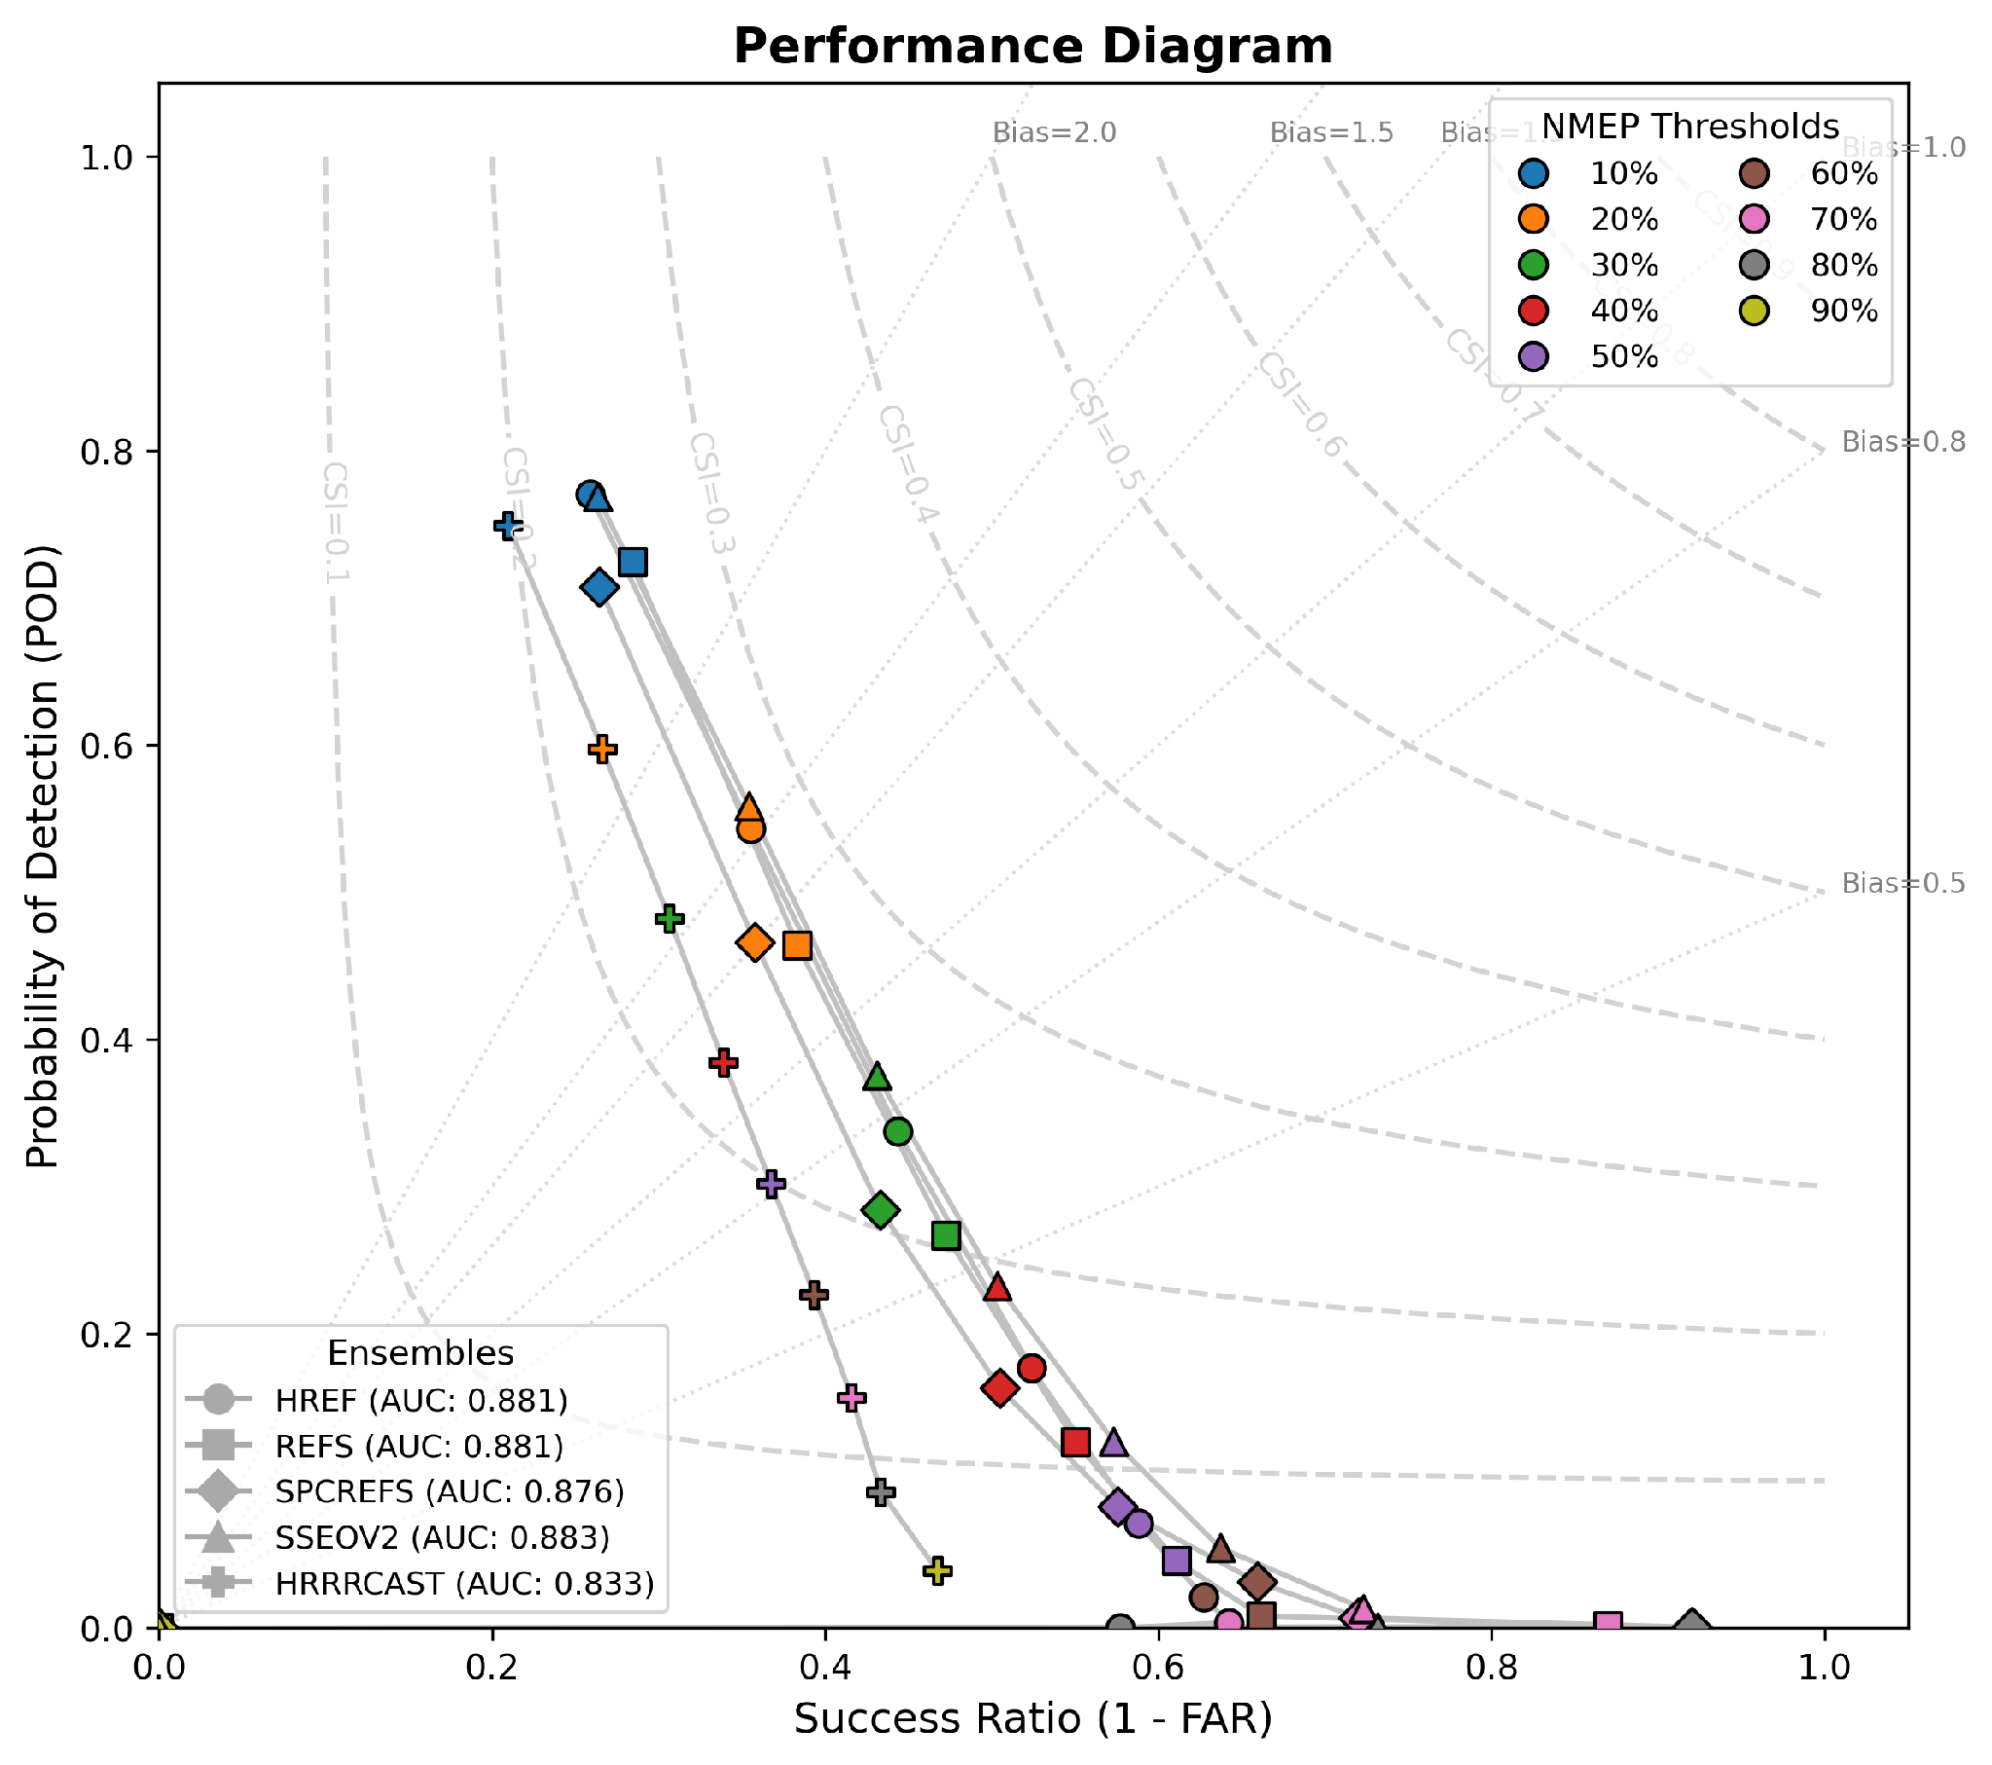
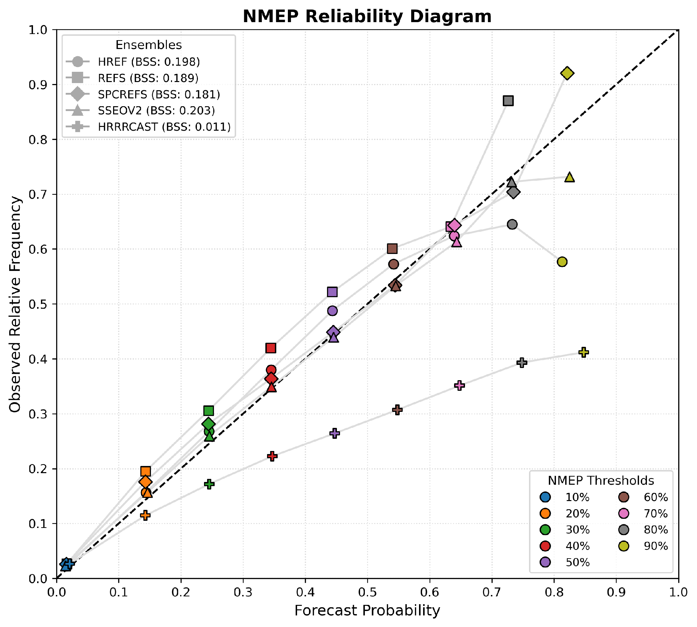
HRRRCast Ensemble Verification
NMEP REFC > 40 dBZ
NMEP REFC > 40 dBZ
HREF, REFS, etc
HREF, REFS, etc
HRRRCast
HRRRCast
Courtesy Jake Vancil

