Slide 1
Towards incorporating data assimilation in HRRRCast: a score-based approach
GSL: Daniel Abdi, Isidora Jankov, Vanderlei Vargas
MITRE: Conor Lewellyn, Nick Silverman, Nick Krall, Chris Miller
July 23, 2026

Slide 2
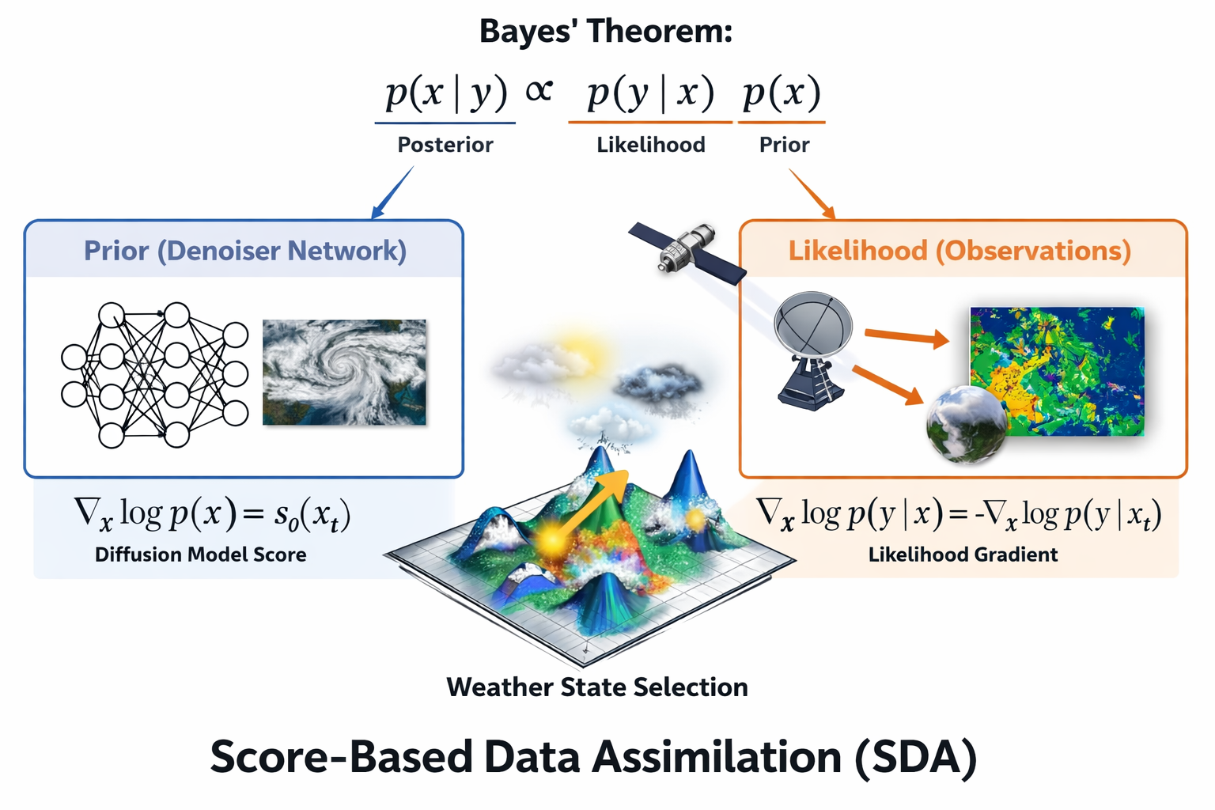
DA as a bayesian inference problem
Advantages:
Train once, use with any observations!
Generate ensembles by stochastic sampling of the posterior
Can be used with non-linear obs operators as long as 𝓗 and its Jacobian 𝜕𝓗/𝝏x can be extracted?

Slide 3



SDA algorithm
Posterior score: prior (learned background) + likelihood score (guidance)
Gaussian assumption for the likelihood, then take log of the exp function
Looks very much like 3D-Var cost function’s second term
Rozet et. al 2023 original algorithm
Manshausen 2024 SDA using HRRR dataset over Oklahoma for u10,v10,precip

Slide 4
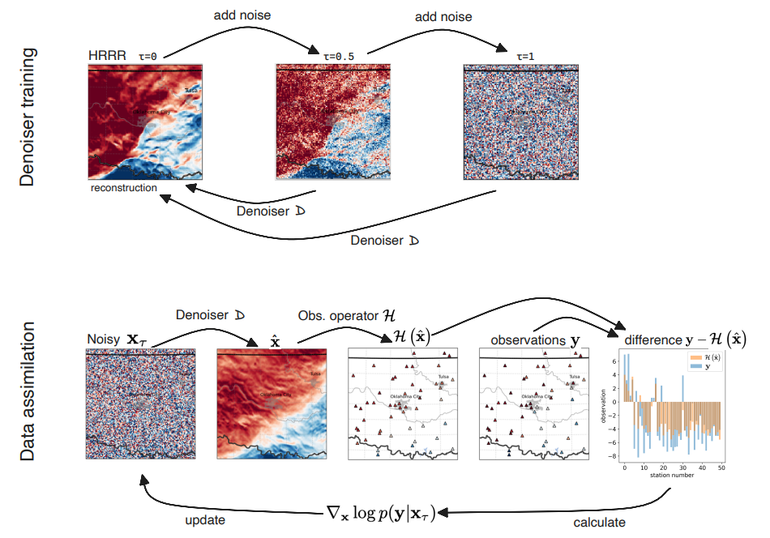
SDA workflow
Training:
  Learns weather distribution in the HRRR analysis dataset
Inference:
  Maximum likelihood optimization
  Likelihood score goes to 0 with more denoising steps

Slide 5
Our implementation
Denoiser training and network architecture
  Reuse entire HRRRCast infrastructure!
Observation operators are so far all analytic and linear
  𝓗(x) = 𝓗x
  Easy to compute Adjoint/Jacobian
Implemented observation operators
  Index-based operator: as used by the NVIDIA paper
  Interpolation operators: bilinear, bicubic
  Neighborhood operators: uniform and gaussian kernels with given radius of influence
SDA seems to be flexible enough for non-linear operators
  E.g CRTM or CRTM-emulator can provide 𝓗 and its adjoint
  Other complex obs operators: train a NN-emulator and use auto-diff to compute Jacobian?

Slide 6
Results with pseudo-observations

Slide 7
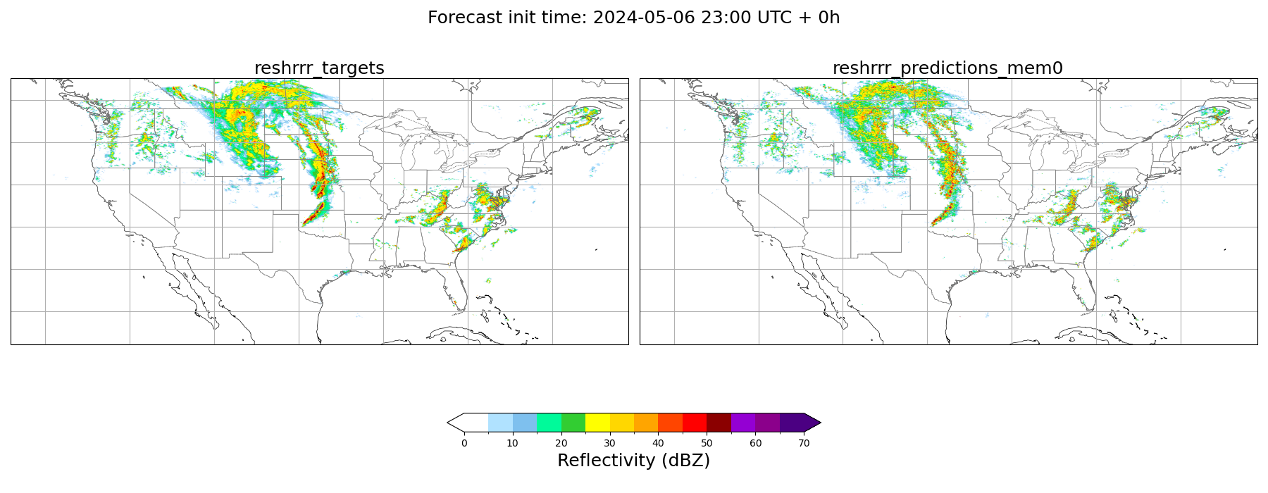
Station density 1:4 = 6.25%

Slide 8

Station density 1:8 = 1.56%

Slide 9

Station density 1:16 = 0.39%

Slide 10
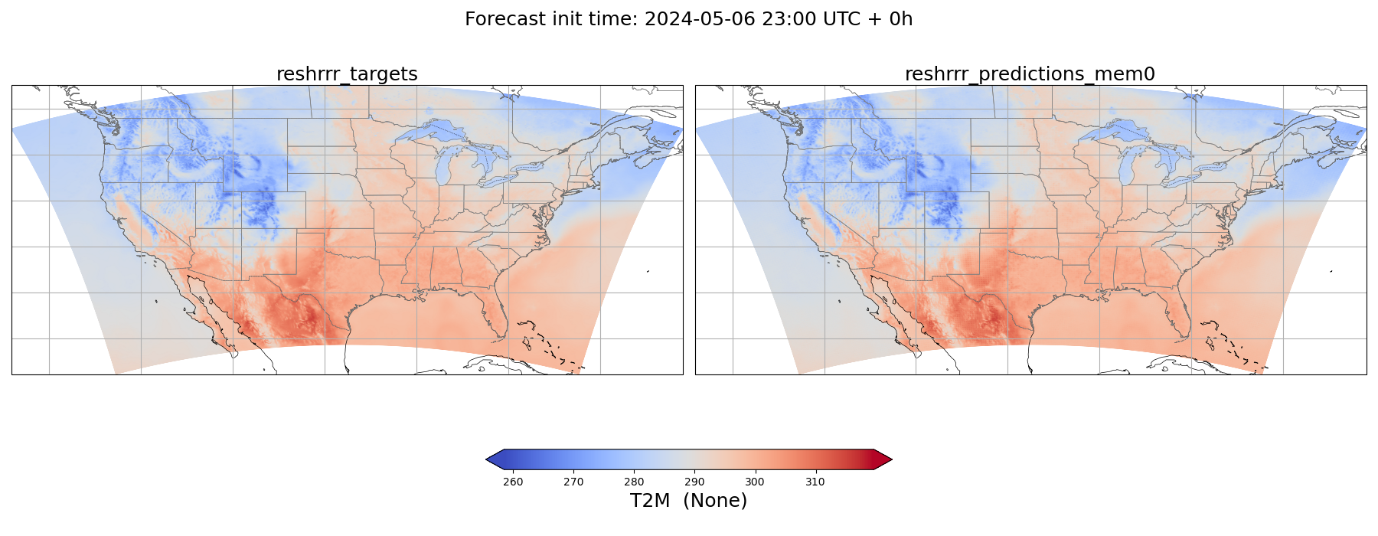
Station density 1:4 = 6.25%

Slide 11
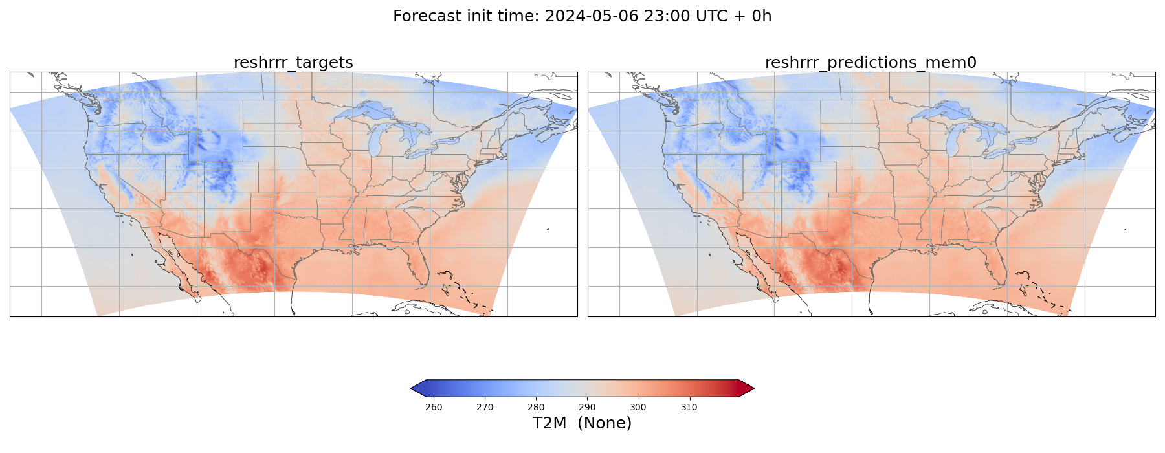
Station density 1:8 = 1.56%

Slide 12
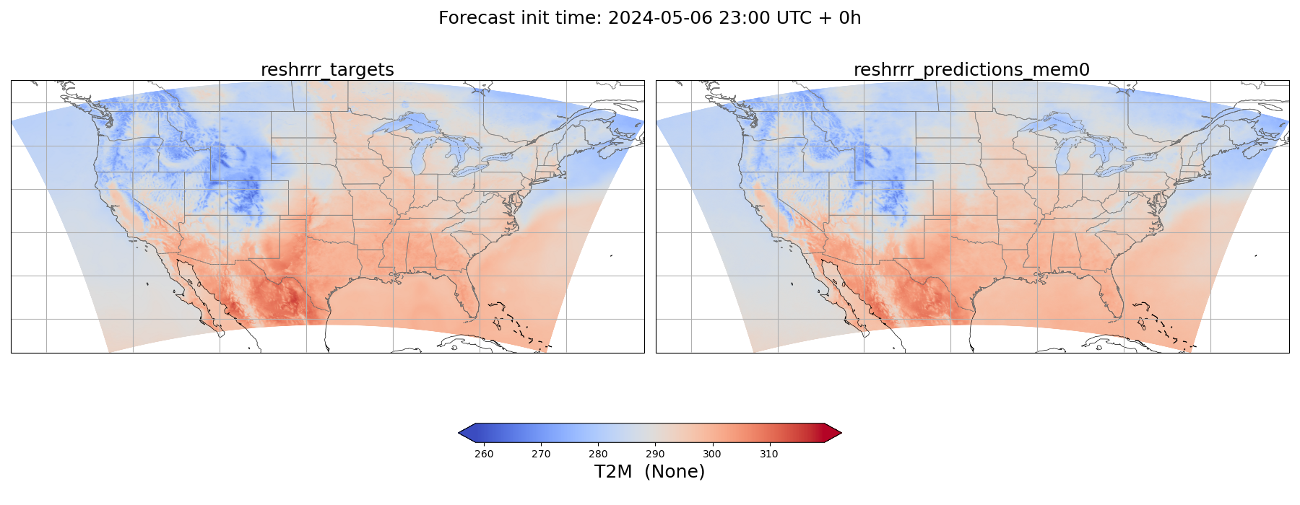
Station density 1:16 = 0.39%

Slide 13
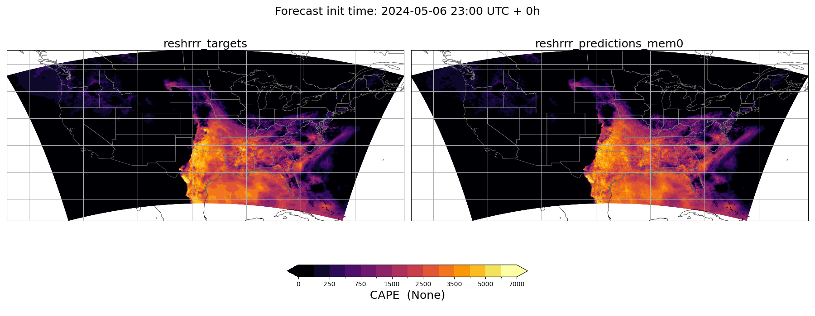
Station density 1:4 = 6.25%

Slide 14
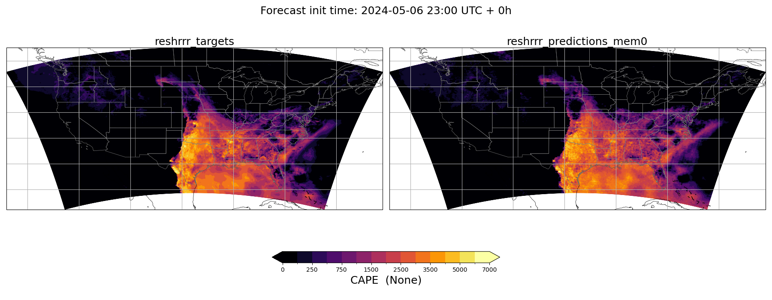
Station density 1:8 = 1.56%

Slide 15
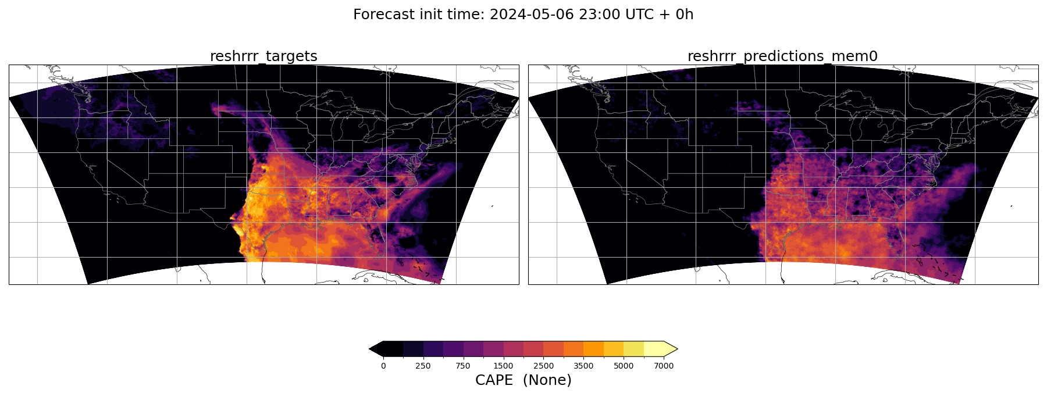
Station density 1:16 = 0.39%

Slide 16
Capturing multivariate relationships

Slide 17
Multivariate relationship: with REFC obs

Slide 18
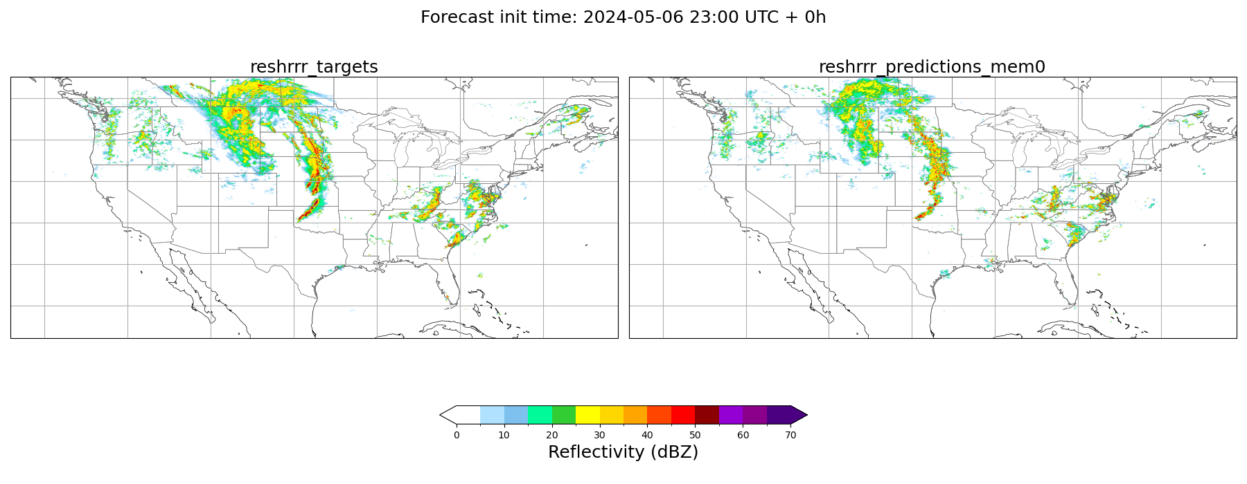
Multivariate relationship: without REFC obs

Slide 19
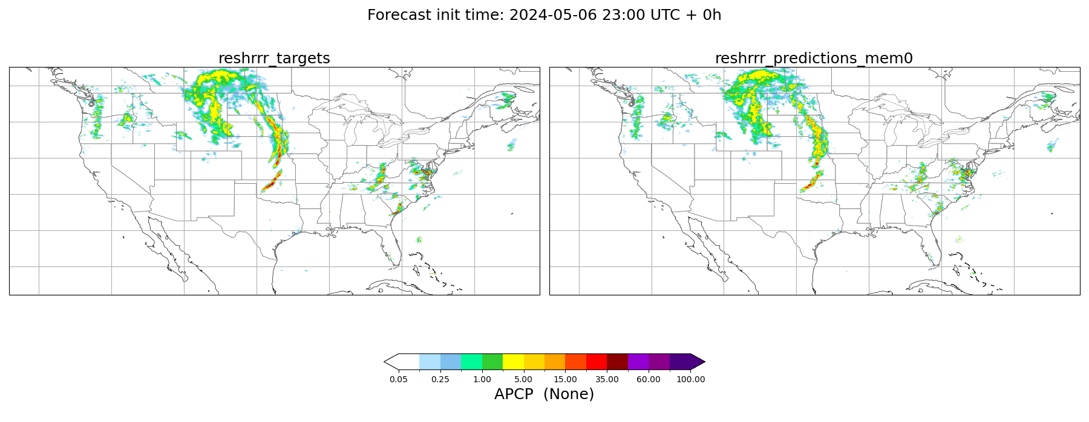
Multivariate relationship: learns REFC from APCP

Slide 20
Multivariate relationship: with T2M obs

Slide 21
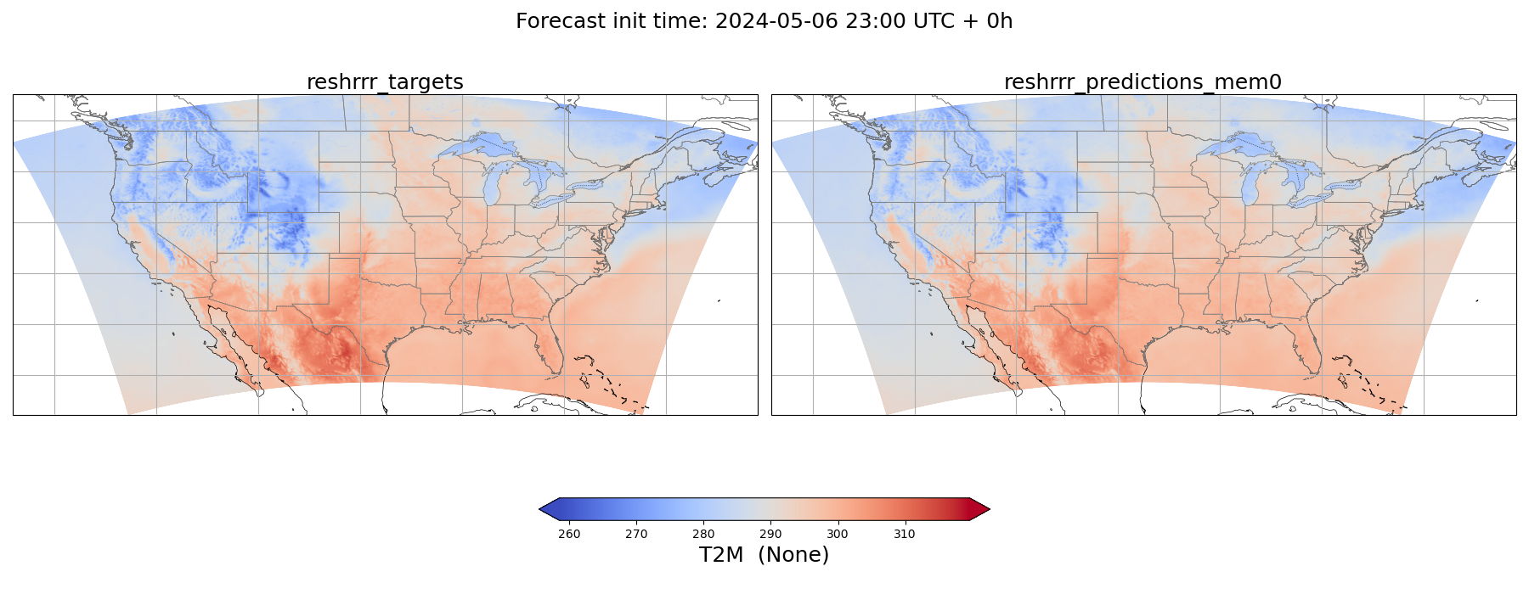
Multivariate relationship: without T2M obs

Slide 22
Multivariate relationship: with CAPE obs

Slide 23
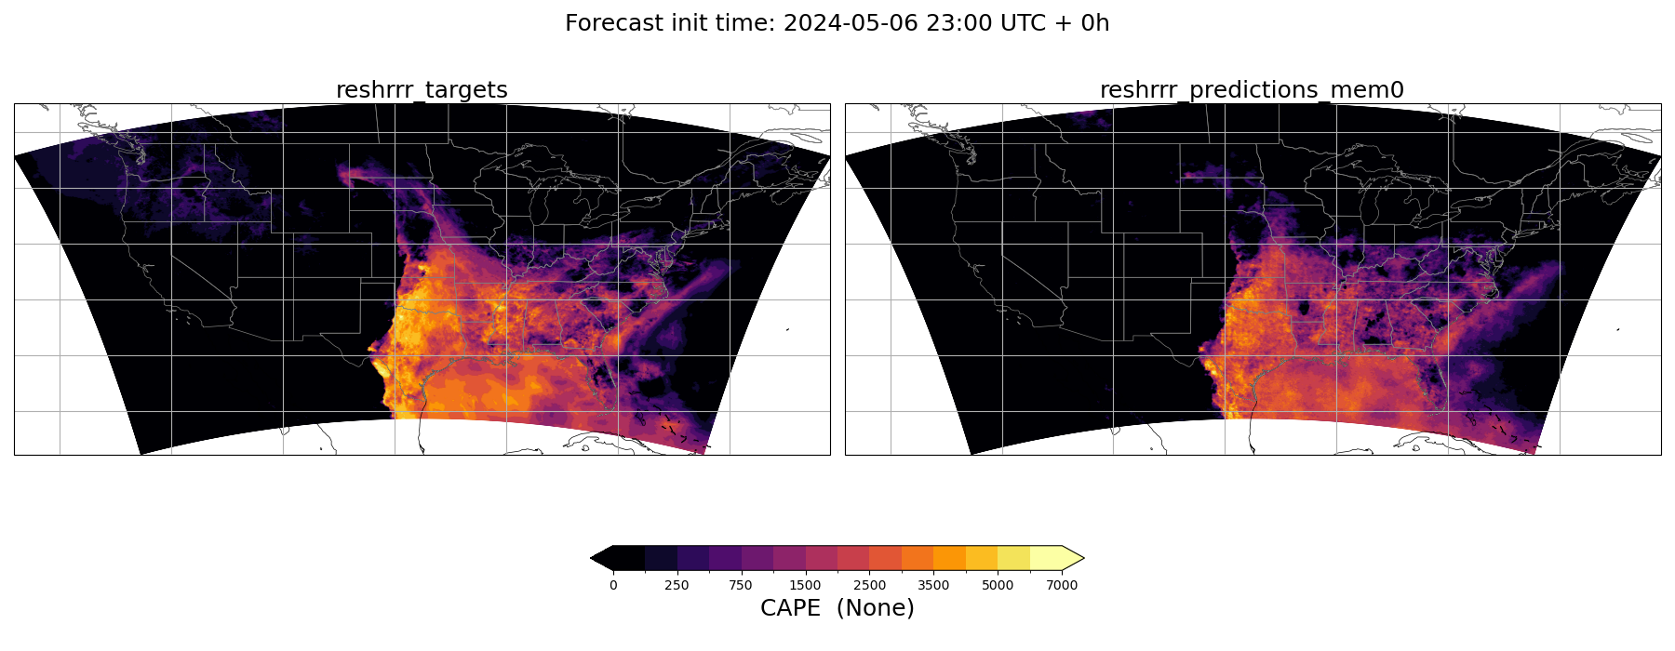
Multivariate relationship: without CAPE obs

Slide 24
MITRE experience

Slide 25
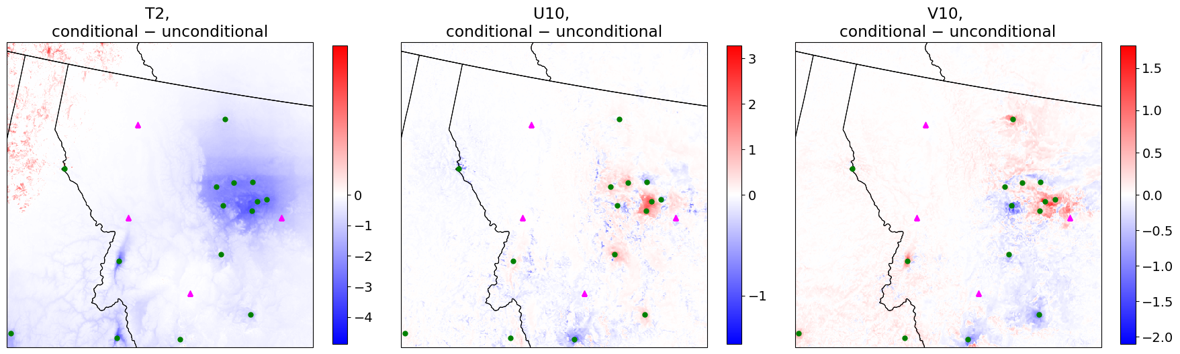
Cautionary tales
SDA does not use the model forecast as a background!
  Producing DA over sparse obs stations over complex terrain could be difficult
  Solution: Initialize SDA with background or construct pseudo-obs from background
SDA replace the covariance term with scalar inflation term
  Observation influence radius is much smaller
  High-frequency artefacts observed
Handling non-linear observation operators not straightforward

Slide 26
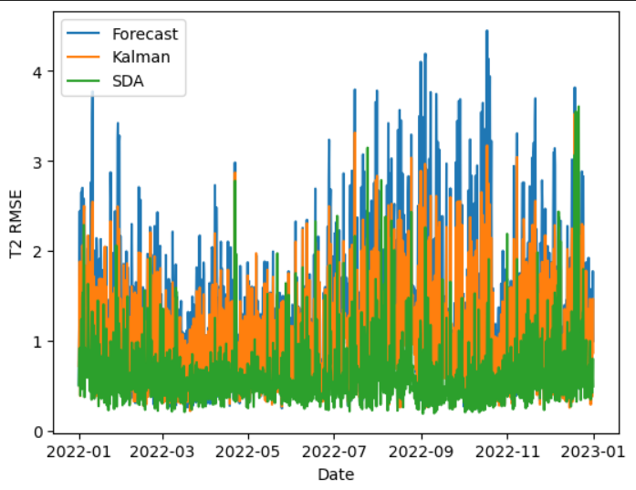
Forecast initialized SDA
Forecast initialized SDA consistently outperforms both the raw forecast and the Kalman filter

Slide 27
Next steps: real observations
Incorporate real observations
  Directly observed surface variables should be straight-forward
    METAR surface obs: T2M, D2M, U10M, V10M, MSLP
    Upper-air: Radiosonde temperature/wind profiles
  Satellite products are hard, require forward operators like CRTM
    A wrapper around CRTM or preferably an AI emulator of it
Incorporate background forecast to SDA
  As pseudo-observations during inference?
  Conditioning during training of the prior network?

Slide 28
Thank you
Notes:
Isidora

